Slide 1


Patient-Adaptive Beat Classification using Active Learning
Jenna Wiens*, John Guttag
Massachusetts Institute of Technology, Cambridge, MA USA

Slide 2
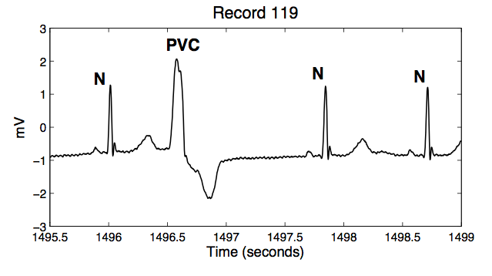
How can we use Machine Learning to to automatically interpret an ECG?
Supervised Learning
  Transform ECG recording into feature vectors and labels
?
+
+
+
+
-
?
?
?
-
+
+
-
-
-
-
-
-
?
  Given a set of labeled beats, learn a classifier
  Given a new example predict its labels using

Slide 3
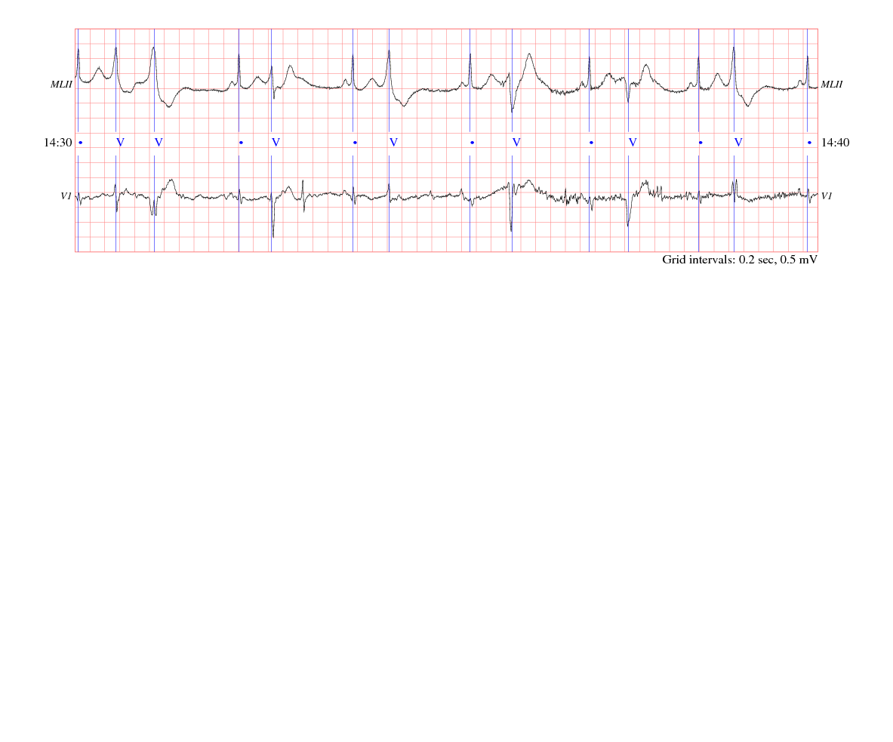
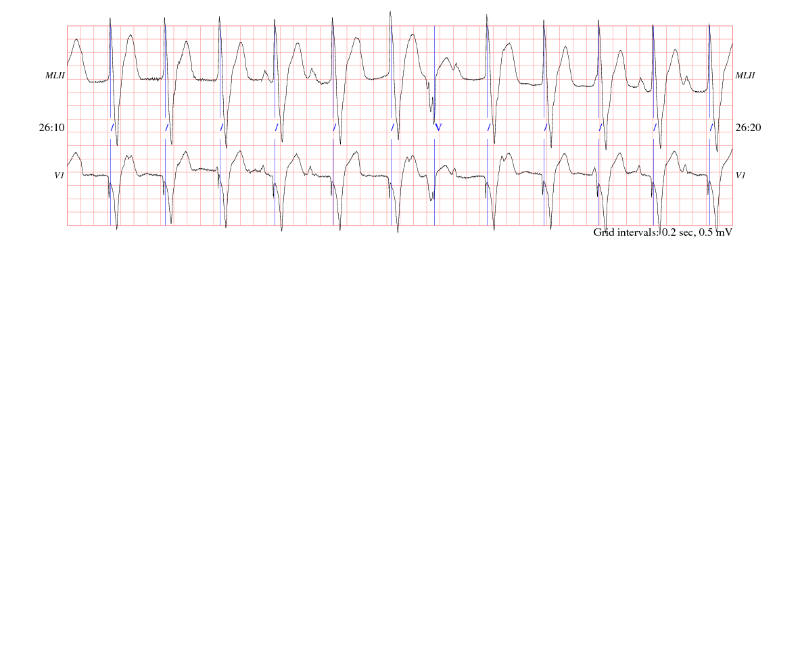
Challenges
Assumption: training data and test data come from the same underlying probability distribution
Inter-patient differences are common in ECG signals

Slide 4
Patient-Adaptive Classifiers
Solution:
  Train classifiers that adapt to the record in question
  Patient-Adaptive classifiers incorporate some labeled training data from the record of interest
  Passive selection of training data e.g., first 5 minutes, first 500 beats

Slide 5
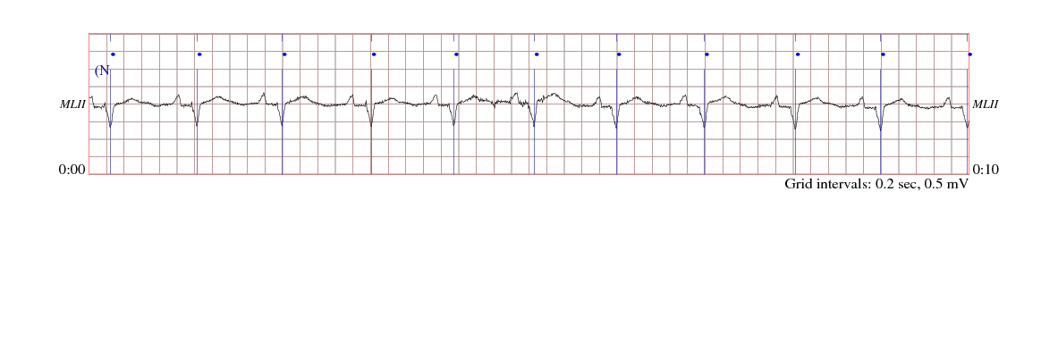
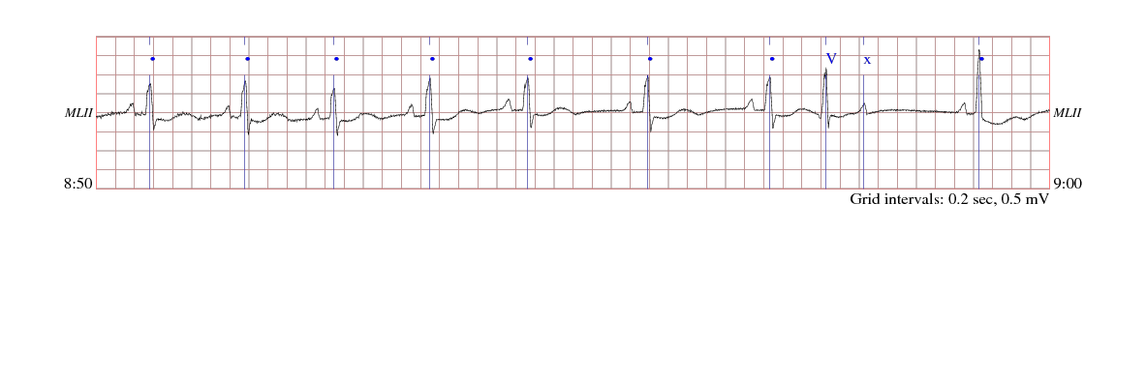
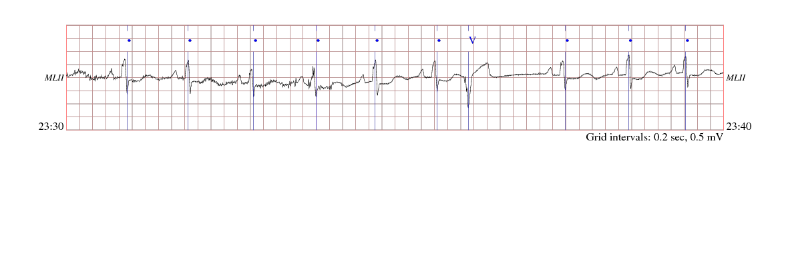
Patient-Adaptive Classifiers
Problem – redundancy & intra-patient differences

Slide 6
Active Learning
Goal: Actively choose the examples the expert should label and include in your training set.

Slide 7
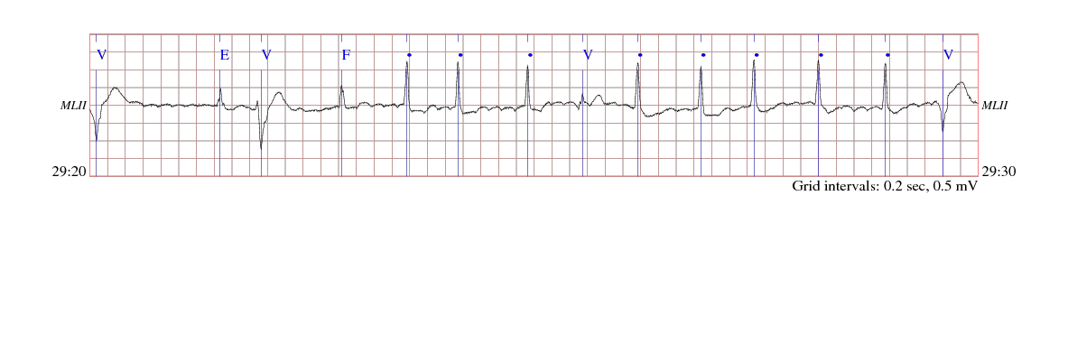
Experiments
Dataset 1:
  MIT-BIH Arrhythmia Database, 48 half-hour records
  Included ALL records in the testing, even patients with paced beats
Task 1:
  ventricular ectopic beats (VEBs) vs. non-VEBs.
+1
+1
+1
-1
-1
-1
-1
+1
-1
-1
-1
-1
-1
+1

Slide 8
Experiment 1 - Passive vs. Active
Passive Learning:
  1000 labeled beats per record to achieve a mean sensitivity > 90%
Active Learning:
  Mean sensitivity 96%
  On average < 37 beats per record
Fraction Queried | Mean Sensitivity
0.3 | 0.78 ± 0.34
0.6 | 0.92 ± 0.23
0.9 | 0.96 ± 0.17

Slide 9
Experiments
Data Set 2:
  4 half-hour records from another cohort of NSTEACS patients
Task 2:
  Premature ventricular contractions (PVCs) vs. non-PVCs

Slide 10
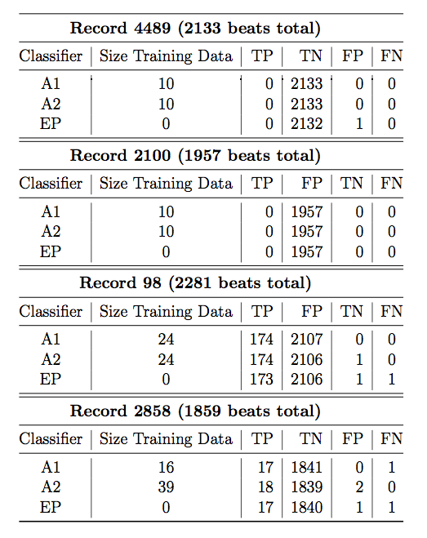
Experiment 2 – with Cardiologists
Two cardiologists supplied beat labels:
  1 = clearly non-PVC
  2 = ambiguous non-PVC
  3 = ambiguous PVC
  4 = clearly PVC
3 classifiers for each record:
  Expert #1
  Expert #2
  EP Ltd.
6 disagreements out of a possible 8230

Slide 11
Conclusions
Dramatically reduce the amount of effort required from a cardiologist to identify VEBs or PVCs in a record.
Active Learning can easily adapt to new tasks
Future Work: Active Leaning for multi-class classification

Slide 12
Acknowledgements
Collin Stultz
Benjamin Scirica
Zeeshan Syed

