Slide 1

A Case for Lease-Based, Utilitarian Resource Management on Mobile Devices
Yigong Hu, Suyi Liu, Peng Huang
Johns Hopkins University
ASPLOS 2019
Notes:
Hello everyone, I am Yigong Hu from Johns Hopkins University. Today, I will present a case for lease-based, utilitarian resource management on mobile devices. This work is done with my advisor, Ryan Huang.

Slide 2



Mobile Computing Requires Energy-Aware Apps
+
−
Design mechanisms to optimize system energy usage
Apps need to be
energy-aware too!
Energy-aware adaptation for mobile applications [SOSP’99]
ECOSystem: Managing Energy as a First Class Operating System Resource [ASPLOS ’02]
Energy Management in Mobile Devices with the Cinder Operating System [EuroSys ’11]
Drowsy Power Management [SOSP ’15]
CALOREE: Learning Control for Predictable Latency and Low Energy [ASPLOS ’18]
Notes:
I think everyone in this room would agree that mobile systems are constrained by energy. To address this challenge, there have been two decades of works that design new mechanisms to save system energy usage, typically with the assumption that the applications are cooperative. But today most applications running in the ecosystem are from many third-party developers. Now, all these developers share the burden of writing energy-efficient apps.

Slide 3



Energy-Aware Programming Is Challenging
Reasoning about code and testing app is hard
User Interaction | Environment Conditions | Runtime Changes
Click Bottom
Network
Disconnect
Orientation
Change
Notes:
However, energy-efficient programming is challenging for app developers. Unlike traditional programming, mobile apps need to handle frequent user interactions, environment condition changes and runtime changes. With diverse events occurring in the phone, reasoning about the code and testing the app is hard.

Slide 4

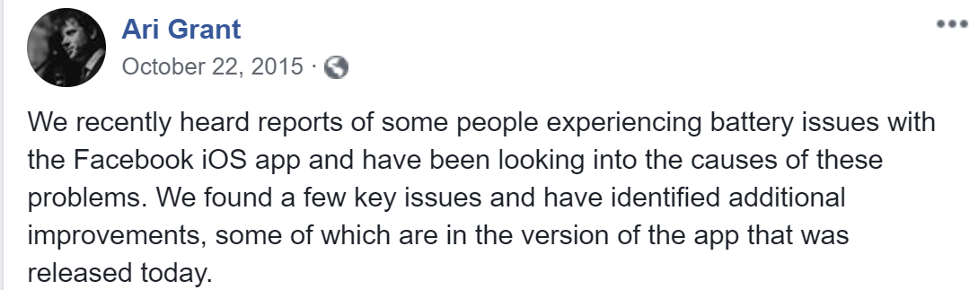

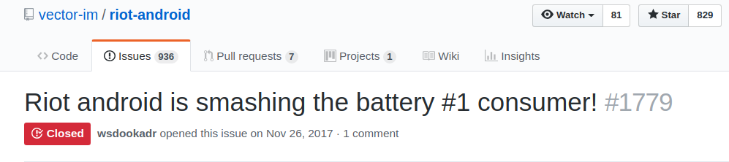

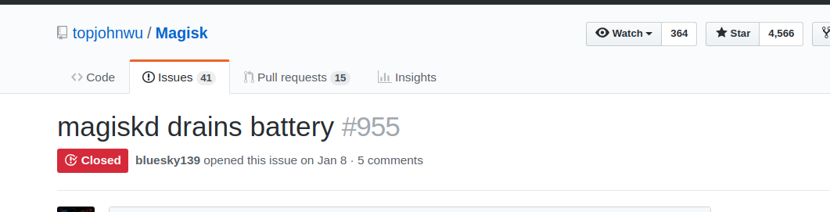

Apps with Energy Bugs Are Common
We need techniques to mitigate app energy bugs at runtime
Notes:
Indeed, while energy bug detection tools exist, some complex energy bugs can still escape from these tools and cause damage at the user side. Sometimes, even apps written by professional team like Facebook or Chrome can have energy bugs. Thus, the mobile system must mitigate app energy bugs at runtime.

Slide 5






Default Mobile Resource Management Is Libertarian
Here you are
I need to use GPS
Let me check whether you have the permission
Give app freedom
Allocate resource if permission and sanity checks pass Revoke resource only when the app releases it
App Usability
Energy Efficiency
Notes:
The current resource management uses a libertarian way to manage resource. It only performs an initial sanity check when the app requests a resource and only revokes the resource when the app explicitly releases it. While this mechanism gives apps enough freedom, it is prone to wasteful energy misbehavior because the system can not proactively stop app’s energy waste

Slide 6


Recent Authoritarian Approach via Throttling
Android Doze (since 6.0)
DefDroid
threshold
Screen off stationary on battery
Doze
network
CPU-intensive
App
Denied
time
Resource holding time
Energy Awareness
App Usability: legitimate app requests denied
Notes:
To reduce energy waste, Android system introduces the doze mode since its 6.0 version. The Doze mode conserves battery by restricting apps' access to network and CPU-intensive services. Recent works like DefDroid also propose to throttle app requests that exceed some threshold. These approaches achieve high energy efficiency but prohibit legitimate app requests and cause usability disruption.

Slide 7
Fix the Gap
Libertarian
App Usability
/ Feature Freedom
Android < 6.0
Our Goal
CinderOS,
JouleGuard
Android
6.0+
iOS
TAMER
Authoritarian
DefDroid
Reduction of Energy Waste
Notes:
If we put these existing solutions in a design space, we can see that they either trade app usability for high energy efficiency or sacrifice energy efficiency. There is a missing piece that ideally can prevent sloppy resource usage without causing usability disruption. And this is our goal.

Slide 8
Our Solution: LeaseOS
Design of Lease Abstraction for Mobile Systems
+
A Utilitarian Approach for Making Lease Decisions
+
A Lightweight System Runtime With Backward-Compatibility
Notes:
Toward this goal, we present LeaseOS. LeaseOS adapts the lease concept from distributed system. It manages resources in a utilitarian fashion. The LeaseOS is designed as a lightweight system runtime with backward compatibility.

Slide 9
Main Challenges of LeaseOS
How to use lease in mobile system to reduce energy waste?
How to reliably distinguish energy misbehavior from legitimate behavior?
Notes:
There are two main challenges in leaseOS: how to use lease in mobile system to reduce energy waste? And how to reliably distinguish energy misbehavior from legitimate behavior?

Slide 10
Outline
Motivation
Lease Abstraction
Making Lease Decision
Design of LeaseOS
Evaluation
Notes:
Now I will present the core abstraction in LeaseOS, lease.

Slide 11

Lease in Distributed System
Lease
Client
Data
Server
Access Request
Data
Access Request
Lease
Client
Data
Notes:
Lease is originally used in distributed systems for managing cache consistency. Before the client accesses the datum, it needs to require a valid lease first.

Slide 12


Lease in Distributed System
Expire Lease
Active Lease
Client
Data
Data
Right to Access
Server
Data
Client
Data
Notes:
As long as the client has a valid lease, it can directly access the datum. But each lease has a term. If the lease reaches a term without being renewed, it will be expired and the client can no longer access the data without requesting to renew the lease.

Slide 13
Lease Abstraction In Mobile System
Lease
App
Resource
Mobile
System
Access Request
Resource
Access Request
Lease
App
Resource
Notes:
We think the lease abstraction is useful in our problem domain. The lease can tolerate sloppy resource usage. Because by default, the lease will be expire at the end of lease term unless it is renewed. If we introduce the lease to the mobile system, now the app is client and the OS is sever. When the app accesses a resource, it needs to first request a valid lease from the OS. At a high level, this is straightforward. But in order to use lease for reducing energy waste, we need to make some changes.

Slide 14


Lease Deferred State
Expired Lease
Active Lease
Deferred Lease
Misbehavior in the last term
Revoke for Delay interval
App
Resource
Mobile
System
Resource
App
Resource
Notes:
Specifically, we introduce a deferred state that slows down inefficient app executions. If a lease expires and the app misbehaves in the past lease term, the lease will transit into deferred state. In the deferred state, the resource associated with the lease is temporarily revoked. The deferred state has a delay interval. After the delay interval, the resource is restored and the lease transits to active states again.

Slide 15


An Example – Buggy K-9 Mail
Code Snippet
Code Snippet
Code Snippet
Code Snippet
Lease
Probe
Time
wakeLock.acquire();
while (!stop){
resp=connect();
...
}
wakeLock.release();
Active state
Term expiration
Deferred state
WakeLock: a feature to allow apps to control CPU power state
Notes:
Here, I will use a real world example, K-9 mail to show how lease reduces app energy waste. K-9 mail acquires a wakelock before building a connectioN to its server. By holding a wakelock, the app ensures that it won’t be interrupted when connecting with the server.
When the app requires a wakelock, a new lease is created in the background. In the normal scenario, k-9 mail works well and the lease will be transparently renewed in the background. However, if there is some network issue, K-9 mail will be stuck in a loop of exceptions and prevent the wakelock from being released. As a result, the app consumes lots of energy with little contribution to the app functionality since the users can’t send or receive any email. The lease can slow down this inefficient app execution by introducing a new deferred state. Since the K-9 mail misbehaves when the network is disconnected, the lease will transit to the deferred state. The deferred state temporarily revokes the wakelock and thus allows the device enter a lower power state. In the low power state, the execution of K-9 mail is automatically slowed down by the system and thus saves the energy. Each deferred state is followed by a short active state to probe whether the app returns to normal behavior or not. If the short active state captures a good app behavior, it will grant a longer active lease term. Then, the app can keep working.
Wakelock is a system resource to allow apps to control the CPU power state.

Slide 16


Lease Decision Rules
Make a lease decision at the end of lease term
Making Decision
Active state
Expire state
Deferred state
Inactive state
Notes:
Now with the new lease abstraction, the most important thing is how to make lease decision at the end of each term

Slide 17
Outline
Motivation
Lease Abstraction
Making Lease Decision
Design of LeaseOS
Evaluation
Notes:
In the following section, I will show some observations about the energy misbehavior that motivate our lease decision policy.

Slide 18
Experiment Setup
How buggy apps behave at runtime?
  Measure resource related metrics
  Identify reliable indicators
Test Devices
Moto G Samsung Galaxy Nexus 4 Pixel XL
Low-end
High-end
Heavily used
Lightly used
Notes:
In order to correctly identify app energy misbehavior, it is useful to first understand how buggy apps behave at runtime. We test several buggy apps on a set of different mobile devices, which represent low-end to high-end smartphones. The software ecosystems are also different. The lowest end phone is heavily used while the highest end phone is lightly used.

Slide 19

Example 1 - BetterWeather
Weather widget app
Keeps asking for GPS when the app can’t get GPS
Test result on Pixel XL
Failure rate = 100%
High GPS request time
Notes:
The first buggy app is an weather app called BetterWeather. In one version of the BetterWeather, it keeps searching for GPS in an environment with poor GPS signals. We find that the app has a very high GPS request time. But since the device is in an poor GPS environment, all the requests actually failed.

Slide 20
Resource Request Time Varies Among Devices
Implication : absolute resource request time is not a good indicator for energy misbehavior
O1: For the same energy misbehavior, the request time might vary a lot on different devices
Notes:
We then reproduce the same buggy app on different devices. Interestingly, we found that for the same energy misbehavior, the request time actually varies a lot. This observation implies that absolute resource request time is not a good metric for energy misbehavior. But if the absolute value is not reliable, what metrics should we use?

Slide 21

Example 2 - Kontalk
Messaging app
Releases the wakelock only when the service is destroyed
Test result on Samsung S4
Utilization < 10%
High Wakelock holding time
Notes:
We answer this question in the second example, Kontalk. In one version of the kontalk, it forces CPU to stay active for a long time and causes battery drain. We find that the Kontalk have a very high wakelock holding time during its execution but since the app doesn’t do anything, resource utilization is very low .

Slide 22
The Low Utilization Ratio Is Consistent
SAMSUNG S4
The utilization ratio is always low among different device
Nexus 4
Notes:
We measure Kontalk on different phones and this low resource utilization is consistent among all the devices. From this observations, it suggests that low utilization ratio can be an potential indicator for misbehavior. But that’s not always reliable.

Slide 23

Utility Is Also a Good Indicator
Email app
Gets stuck in a loop when the network is disconnected
> 100%
Test result on Pixel XL
Low utility
High Wakelock holding time
High utilization ratio
Notes:
Here is the previous K-9 mail example. It in fact has a very high resource utilization ratio. But the utilized resource contributes little to the app functionality. This observation suggests that besides the utilization, the utility is also important.

Slide 24
Four Classes of Energy Misbehavior
Ask
Use
Release
Assumptions
In Practice
Success in short time
Do useful work
Release in time
Unavailable for a long time
Do useless work
Release very late
Frequent-Ask-Behavior (FAB)
Long-Holding-Behavior (LHB)
Low-Utility-Behavior (LUB)
Excessive-Use-Behavior (EUB)
Notes:
We then break down energy misbehavior into four classes based on the current resource usage model, ask-use-release. This model makes three assumptions: first, the app can get the resource in a short time. Second, the app uses the resource to do useful work. Third, the resource is released in time. However, in practice, all of these three assumptions can be error-prone that lead to different energy misbehavior. First, the request might not be available for a long time, which causes the frequent-ask-behavior. Second, the app might use the resource to do some work that is not desired by the user, which causes the low-utility-behavior or the app might not do any work, which causes long-holding-behavior. Third, the app might keep using the resource for a very long time, which causes the excessive-use-behavior.

Slide 25
Prevalence of Each Misbehavior Type
109 real-world misbehavior cases
FAB: Frequent-Ask-Behavior
LHB: Long-Holding-Behavior
LUB: Low-Utility-Behavior
EUB: Excessive-Use-Behavior
LeaseOS targets FAB, LHB, and LUB
Most EUB cases are ambiguous
58% cases of the total cases
EUB
Bug | 23%
Configuration | 53%
Enhancement | 15%
N/A | 9%
FAB,LUB,LHB
Bug | 81%
Configuration | 16%
Enhancement | 3%
Notes:
We then study 109 real world misbehavior cases and find that although 31% cases are EUB, most of them are caused by software settings, which are highly related to user preference. This makes it hard to distinguish the EUB with the normal behavior. On the other hand, FAB,LHB and LUB are most caused by clearly defect and occupy 58% of the total cases. Thus, we decide to target these three types.

Slide 26
Metrics for All Type of Misbehavior
Frequent-Ask-Behavior
success ratio : $\frac{unsuccessful request time}{ total request time}$
success ratio : (𝑢𝑛𝑠𝑢𝑐𝑐𝑒𝑠𝑠𝑓𝑢𝑙 𝑟𝑒𝑞𝑢𝑒𝑠𝑡 𝑡𝑖𝑚𝑒)/(" " 𝑡𝑜𝑡𝑎𝑙 𝑟𝑒𝑞𝑢𝑒𝑠𝑡 𝑡𝑖𝑚𝑒)
Long-Holding-Behavior
utilization ratio : $\frac{resource usage time}{ holding time}$
utilization ratio : (𝑟𝑒𝑠𝑜𝑢𝑟𝑐𝑒 𝑢𝑠𝑎𝑔𝑒 𝑡𝑖𝑚𝑒)/(" " ℎ𝑜𝑙𝑑𝑖𝑛𝑔 𝑡𝑖𝑚𝑒)
Low-Utility-Behavior
utility rate : $utility score ∈[0,100]$
utility rate : 𝑢𝑡𝑖𝑙𝑖𝑡𝑦 𝑠𝑐𝑜𝑟𝑒 ∈[0,100]
Notes:
Based on the previous study, we identify a set of indicators for each misbehavior types. For example, for the FAB, this success ratio is the unique indicator. Then we just need to collect corresponding metrics for each mobile resource such as GPS, wakelock at runtime. For the LUB, we use a normalized utility score from 0 – 100 to represent low to high utility.
Similarly, we need to collect corresponding metrics for LHB.

Slide 27
Generic Utility Metrics
Positive Event
UI updates
User interaction
Negative Event
Exception
Stationary time
Request Frequency
Standby time
Moving distance
Notes:
To calculate the utility score, LeaseOS measures a set of positive and negative events during an app’s execution. The positive events include the number of UI update and user interaction. The negative events include the number of exceptions throwing by the app during its execution or the moving distance for GPS.
provide both generic and customizable interface. The generic utility metric is calculated based on

Slide 28

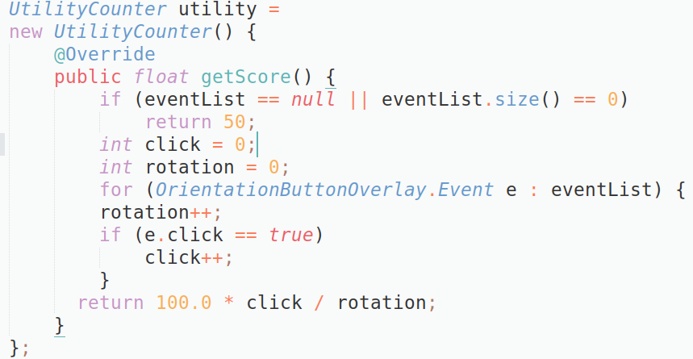
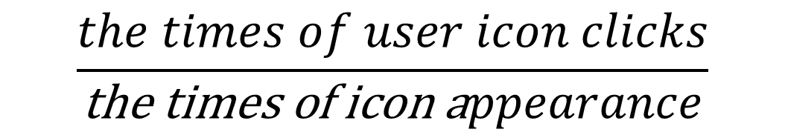
An Example of Customizable Utility Metric
TapAndTurn
Provide an icon to let user control screen rotation
Customizable Metric formula for orientation:
$$\frac{the times of user icon clicks}{\text{the} \text{times} \text{of} \text{icon} \text{a}ppearance}$$
Notes:
However, utility is often app specific and thus the generic metric might not be accurate for some cases. So LeaseOS also provides an optional customizable interface for developers to write their own formula for calculating utility metric. For example, for an app that requires orientation to provide an icon for the users to control screen rotation, developer can write the formula as the times of user icon clicks divided by the time of icon appearance. And implement the getScore method in a utility counter interface to tell the LeaseOS how to calculate the utility for this app.

Slide 29
Outline
Motivation
Lease Abstraction
Making Lease Decision
Design of LeaseOS
Evaluation
Notes:
Now let’s talk about our system design

Slide 30
App-Oblivious Lease Management
Requirements:
Low Latency Overhead
No App Code Changes
App 1
Resource descriptors
Lease
Manager
Lease Table
Kernel objects
Kernel objects
Lease Stat
Location Service
Hide from the app
Power
Service
Lease Proxy
Lease Proxy
Notes:
We have two main requirements when designing LeaseOS. First, LeaseOS shouldn’t incur high latency overhead to apps. Second, we shouldn’t require the developers to re-write their app. To meet the two requirements, we design a few light-weight lease proxies. Each lease proxy manages one type of mobile resource, and is placed in side the OS subsystem managing that type of resource. When an app requests a resource, the lease proxy transparently makes lease requests on behalf of the app to the lease manager and gives the resource descriptor to the app. Since lease decisions are made separately by the lease manager, the lease proxies can quickly respond to app requests. For more details about our system design, please read our paper.
because the mobile apps are latency sensitive, the
, and thus hides from the applications

Slide 31
LeaseOS Implementation
Build on Android 7.1.2
  with 9,100 lines of code
  Android framework
Implement on 7 types of resource
  Wakelock, GPS, Sensor, WI-FI and etc.
Notes:
We implement the LeaseOS on top of the Android 7.1.2. It supports 7 types of resource including wakelock, GPS, Sensor and etc.

Slide 32
Outline
Motivation
Lease Abstraction
Making Lease Decision
Design of LeaseOS
Evaluation

Slide 33
Evaluation
How effective can LeaseOS mitigate energy misbehavior?
What is the overhead of LeaseOS?
What is the impact to app usability?
Notes:
For evaluation, we would like to answer three main questions.

Slide 34
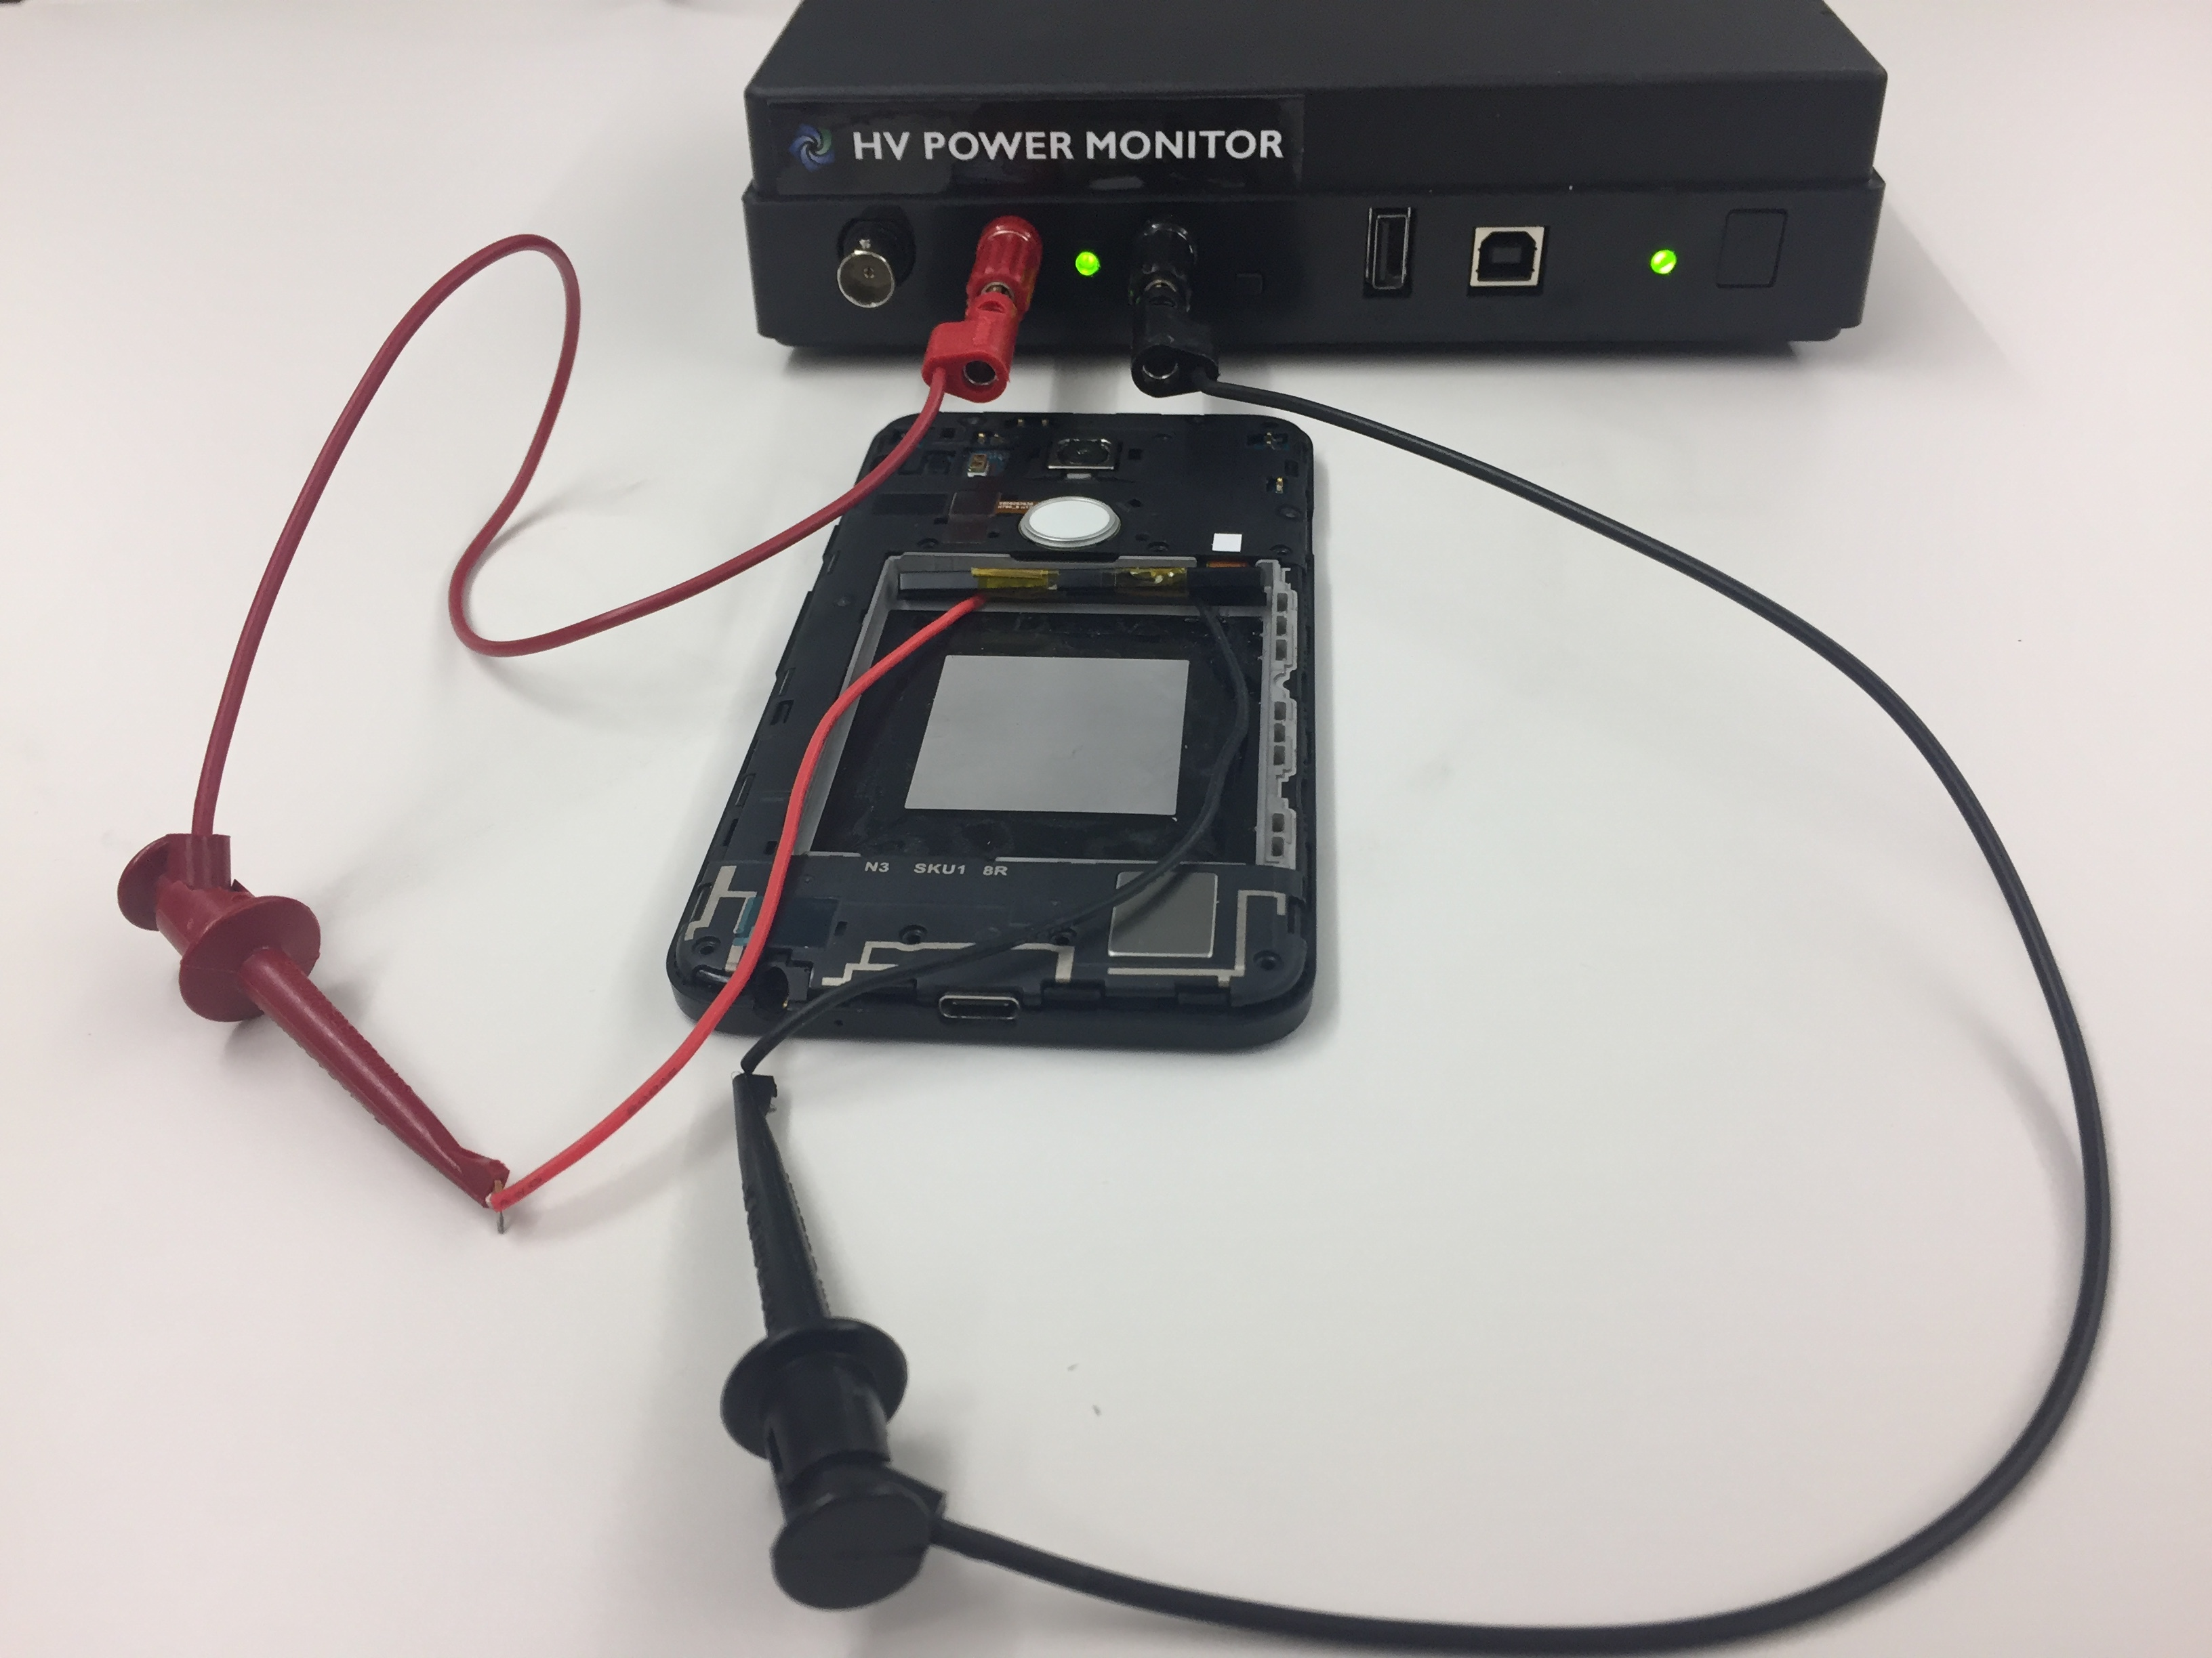
Experiment Setup
Devices
  Google Pixel XL, Nexus 5X
Data collector
  Android build-in tool, Trepn, Monsoon Power Monitor
Dataset
  Reproduce 20 real-world energy misbehavior cases
Notes:
For the experiment set-up, we use google pixel XL phone as the main test device. We use the android build-in profiler and Trepn profiler to track the energy waste and latency. For measuring system wide energy consumption, we use Monsoon power monitor and a Nexus 5X phone as a substitute. We reproduce 20 real-world misbehavior cases as our test set.

Slide 35
Energy Waste Reduction
LeaseOS: 92%
Doze: 70%
Defdroid:62%
…
* : Entering doze mode after 5 mins of each experiment
Notes:
We first measure the energy waste reduction of LeaseOS on 20 apps. We compare leaseOS with Android Doze mode and Defdroid. But since the default Doze is very conservative and hard to trigger, we relax the triggering condition by forcing it to take effect after 5 mins of each experiment. Overall, LeaseOS can achieve 92% energy reduction on average while the doze mode and Dedroid save 70% and 62%.
In general, leaseOS performs better than Doze mode and Defdroid. But here is one case that leaseOS performs worse. This is because the utilization of this app is close to our low utilization threshold, which causes suboptimal lease decision.

Slide 36
System Energy Overhead
  1.02%
Notes:
We then measure the overhead of LeaseOS. We test leaseOS on five scenarios: idle mode, no user interaction, watching youtube, using 10 popular apps such as chrome, facebook, twitter and using 30 apps. The result shows that the highest overhead introduced by LeaseOS is 1.02%.

Slide 37
Resource Request Latency Overhead
  0.8%
Notes:
We also measure the impact of leaseOS to the resource request latency. We trace the resource request latency of three representative apps and the result shows that the LeaseOS introduce up to 0.8% latency overhead.

Slide 38
Usability Impact Experiment
App | Usability Impact
 | DefDroid | LeaseOS
Spotify (Music) | Stop playing music | Keep playing in the back ground
RunKeeper (fitness tracker) | Stop tracking location and movement | Keep tracking in the background
Haven (intruder monitoring) | Stop monitoring | Keep monitoring
Notes:
The last experiment we will show is to test the usability impact of LeaseOS. We test LeaseOS on three apps: Spotify, RunKeeper and Haven. For all three apps, LeaseOS will continuously renew leases because all three apps have high utilization and utility. In comparison, the pure throttling scheme causes the three apps experience some kinds of disruptions.

Slide 39
Related Works
OS Support
  ECOSystem [ASPLOS’02], Ghost Hints [Mobisys’04], CinderOS [EuroSys’11], JouleGuard [SOSP’15]
Energy-Aware Adaption
  Odyseey [SOSP’99], GraceOS [SOSP’03], SPECTR [ASPLOS’18], CALOREE [ASPLOS’18]
Runtime Mitigation
  DefDroid [Mobisys’16]
Energy Bug Detection
  No-sleep energy bug [MobiSys’12], eDoctor [NSDI’13], AppDoctor [EuroSys’14], Nchecker [EuroSys’16]
LeaseOS’s main difference: a new abstraction to reduce energy waste caused by non-cooperative misbehaving apps
Notes:
Our work builds on the advance of related works in OS support for energy efficient, energy-aware adaption, runtime mitigation and energy bug detection. The contribution of LeaseOS is that we introduce a new abstraction to reduce energy waste caused by non-cooperative misbehaving apps.
This work is especially inspired by the ECOSystem and JouleGurad.

Slide 40

Conclusion
1. Lease is a well-suited abstraction for managing resource in mobile system
2. Explore utilitarian approach for making lease decisions
LeaseOS
3. Design of LeaseOS – a lightweight runtime resource management
4. Reduce 92% energy waste on 20 apps
App Usability
Libertarian
Android < 6.0
CinderOS,
JouleGuard
Utilitarian
IOS
Authoritarian
Android 6.0+
TAMER
DefDroid
https://orderlab.io/LeaseOS/
Reduction of Energy Waste
Notes:
In summary, We argue that lease is a well suited abstraction for managing resource in mobile system and we should use an utilitarian approach for determining misbehavior and making lease decision. We design LeaseOS a lightweight runtime resource management on top of android system and leaseos can reduce 92% energy waste on 20 apps without introducing much overhead or causing usability impact. With that, thank you for your attention and I’m happy to take questions.

Slide 41
Questions
How hard is it for developers to implement the customizable utility interface?
What if the developer abuse the customizable interface?
What is the sensitivity to the threshold settings?
How do we handle DVFS?
Notes:
Read the limitation and reviewers questions

Slide 42
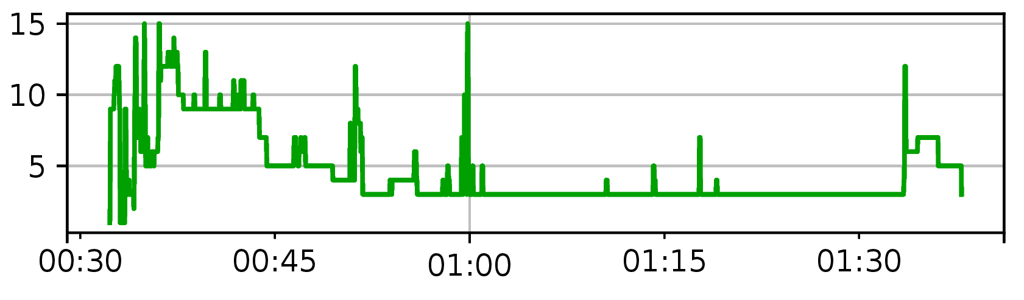
Number of Active Lease

Slide 43
Average Latency of Major Lease Operation
Create | Check (Acc) | Check (Rej) | Update
0.357 | 0.498 | 0.388 | 4.79

Slide 44
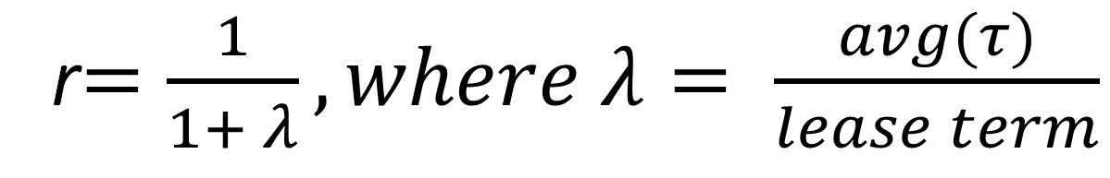
Lease Policy
Impact of lease term and delay interval:
r$=\frac{1}{1+ λ}, where λ= \frac{avg(τ)}{lease term}$
Notes:
We also analyze how does the parameters of leaseos impact the effectiveness of mitigating energy misbehavior. Due to the time limit, I can not talk about the detail here. For more information, please read our paper.

