Slide 1
ENERGY HARVESTING & storage
Comparison of Energy Harvesting Systems for Wireless Sensor Networks
A Quantitative Investigation of Inertial Power Harvesting for Human-powered Devices
Hyeon Joo
Notes:
The reason I choose these two paper:
First paper shows that the general idea of how the energy harvesting systems for wireless sensor networks are working by comparing the different methods.
It is good paper to read and get an idea about how we can scavenge the energy from the environment.
The second paper shows an application of human powered devices using vibration inertial energy generator system which also shown in the first paper.
It tried to approach the experiments in real life and presented how much the energy can be generated to operate the mobile devices.

Slide 2
OUTLINE
Power requirement
Suitable scavenging energy source
Energy conversion device
Vibration

Slide 3
Power requirement

Slide 4
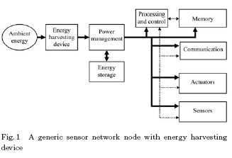
Power requirement
Notes:
It is difficult to generalize about which parts of the node consume the most power.
It is commonly the case that actuators and communication functions consume a large part of total power.

Slide 5
Power requirement
Actuator and Communication consumes a large proportion of total power

Slide 6
Suitable scavenging energy source
Notes:
When scavenging energy,

Slide 7
Mechanical energy source
Steady state mechanical source
Steady state: wind, flow, current..
Intermittent mechanical source
Human activity(walking, typing.. 5.88J/2steps )
Vehicles passing
Vibration
Energy depends on the amplitude and its freq.
Mass of harvesting device relative to the vibrating mass

Slide 8
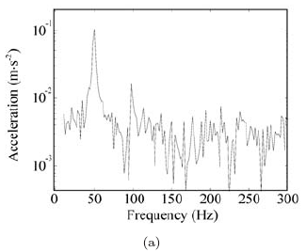
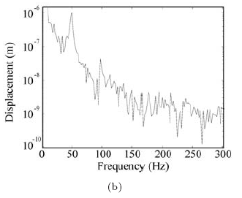
Mechanical energy source
Typically vibration is made up of a number of fundamental freq. and their harmonic
Notes:
Fundamental frequency in the range 60-200Hz. This is taken from a domestic freeze. It indicates a fundamental frequency of 50Hz with an acceleration amplitude of 0.1m/s2 with the 2nd and higher harmonic present at lower amplitudes
It is hard to establish a strong relationship b/w the amplitude and fundamental frequency

Slide 9
Energy conversion devices

Slide 10
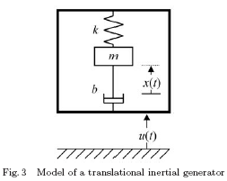
Vibration
m: seismic mass
k: spring of stiffness
u(t): Position of case
x(t): Position of the seismic
b: Damping coefficient
Notes:
There is short description about Electromagnetic radiation and thermal. Skip
Talk about Vibration in detail.

Slide 11
Vibration
m: seismic mass
k: spring of stiffness
u(t): Position of case
x(t): Position of the seismic
b: Damping coefficient
Mx’’(t) + Bx’(t) + Kx(t) = - Mu’’(t)

Slide 12
Vibration
m: seismic mass
k: spring of stiffness
u(t): Position of case
x(t): Position of the seismic
b: Damping coefficient

Slide 13
Vibration
mx’’(t) + bx’(t) + kx(t) = - mu’’(t)
Notes:
X(t) is the position of the seismic mass relative to its equilibrium position in the case

Slide 14
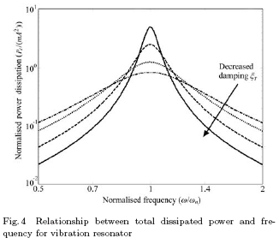
Vibration
ω : vibration freq
ωn : natural freq
: damping factor
ω =ωn => peak power
(resonant)
Notes:
Y=A/w^2

Slide 15
Vibration
ω : vibration freq
ωn : natural freq
: damping factor
Increase the damping factor
Reducing the peak power,
but increase bw
Notes:
Y=A/w^2

Slide 16
Vibration
ω : vibration freq
ωn : natural freq
: damping factor
Thus,
fixed freq => low d.f.
Various freq => high d.f.
Notes:
Y=A/w^2

Slide 17
Vibration
Harvested energy is proportional to the m
Notes:
Total Damping is split b/w electrical energy and parasitic element

Slide 18
Vibration
Piezoelectric conversion (pressure)
Commonly used material: PZT, BaTiO3, PVDF
Electrostatic conversion
The formation of a parallel plate capacitor
Electromagnetic conversion
Magnetic and coil
Notes:
PZT is 80% of pressure can transform into the energy
PVDF is a polymeic material available as flexible sheet and is more robust than PZT.
정기장

Slide 19
Intermittent mechanical conv.
Piezoelectric conversion
Electro-active polymers(EAP) conversion
Electromagnetic conversion

Slide 20
Any Questions?

Slide 21
OUTLINE
Motivation
Mobile device
Energy harvesting model
Data Analysis
Power Estimation

Slide 22
Motivation
Human motion energy harvesting
Electronic devices
Realistic experiment
6 different parts of body
Notes:
This paper shows that generating power using human motion by attaching the 6 sensors on 8 people's body.
The data is collected simultaneously logs 3 axis at 80Hz from the 6 places.
Because the previous experiments were short time experiment in the laboratory, the author wants to have an experiment in real situation.
It is studied all day continuously of eight human subjects in ordinary lives and sees whether the garnered power can supply the mobile devices such as MP3 decoder chip, RF receiver chip, and so on.
The movement of the body is different so that the total amount of generating energy is different from the sensor location.

Slide 23
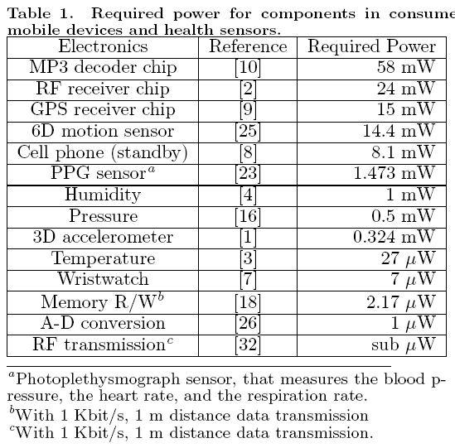
Mobile devices
Wearable device
Wearable device

Slide 24
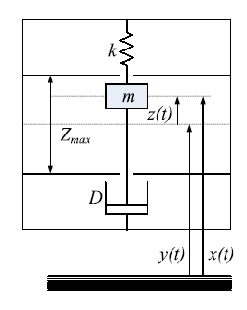
Energy harvesting model
k: spring constant
m:proof mass
d: damping coefficient
y(t): generator displacement
z(t): generator’s motion
Zmax: interval travel limit

Slide 25
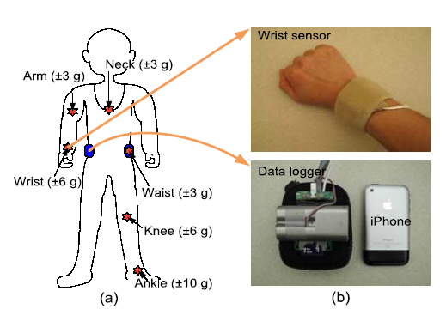
Energy harvesting model
Loggers: 1GB SD
80HZ
Notes:
Logger: (cell phone holster)
Neck accelerometer: worn around the neck on a lanyard, like pedant
Medical bondage; ankle
Elastic band: body

Slide 26
Data Analysis
3-aixs accelerometers (X,Y,Z)
Harvest energy from daily human activities using free motion
Only kinetic energy from human body
Zero-gravity for accuracy
High-passed filtered with 0.05Hz cuffoff
Notes:
Free motion: VDRG does not experience forces beyond those due to its relative displacement and the inertial of its proof mass
(Ex. Accelerometer do not measure and VDRG would not harvest energy from torque generated while steering wheel to drive a car or pedaling a bicycle.
zero-gravity: calibration were performed for all accelerometers to obtain accurate voltage output.
Record position by +g, -g.

Slide 27
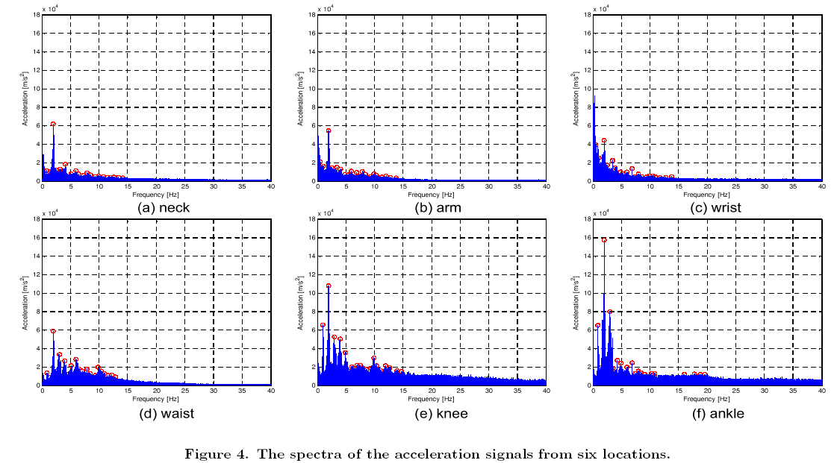
Data Analysis
Notes:
The data showed the FFT after harvesting the acceleration data. And 20 reds dot from 0.5Hz to 40Hz are plotted to show the dominant frequency.
So when we look at the data the top 3, neck, arm, wrist are mostly low frequency.
On the other hand the bottom 3, waist, knee and ankle are higher than top 3 frequency.
This means that generate more power than upper body.

Slide 28
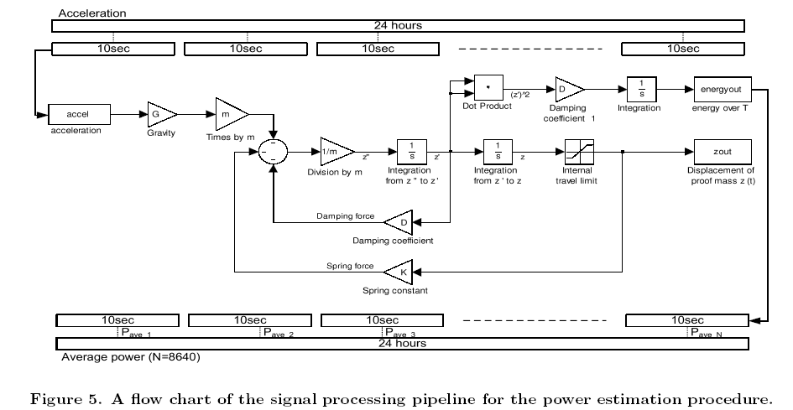
Data Analysis

Slide 29
Data Analysis

Slide 30
Any questions?

