Slide 1
How to Give a Bad Talk How to Give a Good Talk
Barzan Mozafari

Slide 2
How to Start?
With
details,
apologies,
unnecessary background
anything that’s boring!

Slide 3
Background I
Here I am going to bore you with all sort of details before I tell you why
But guess what? I promise you they will be all useful later in the talk
Well, even if they’re not useful, I still want to talk about these for the sake of completeness
Nontheless, I am sure you are all following me very carefully
Here, I am running out of space, but I am not going to give up! I have more stuff to tell you. So I am now going to keep doing the same thing but in the next slide

Slide 4
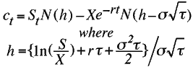
Background (II)
Hello! So here’s more background and I am sure you’re all very interested in this stuff and are paying a lot of attenion
Definition: Non-usefulness-of-a-talk metric:
Sorry, I am not going to explain this to you because I don’t have time, so I am just going to put it here. You will figure it out. Or maybe not.
Also, don’t worry about why I am telling you all this stuff. It will become all clear later towards the end of this talk (hopefully)

Slide 5
Background (III)
Every time you lick a stamp, you consume 1/10 of a calorie.
The average person falls asleep in seven minutes.
Studies show that if a cat falls off the seventh floor of a building it has about thirty percent less chance of surviving than a cat that falls off the twentieth floor. It supposedly takes about eight floors for the cat to realize what is occurring, relax and correct itself.
Your stomach has to produce a new layer of protection every 2 weeks otherwise it will digest itself.
The citrus soda 7-UP was created in 1929; '7' was selected after the original 7-ounce containers and 'UP' for the direction of the bubbles.
101 Dalmatians, Peter Pan, Lady and the Tramp, and Mulan are the only Disney cartoons where both parents are present and don't die throughout the movie. .
Source: http://brainofbrian.com

Slide 6
How to Start?
With a
conconise,
convincing, and
exciting
motivation!

Slide 7
Why should you care?
Most talks:
Are boring!
99.9% of them!
Fail to convery their message

Slide 8
Be Verbose, Wordy, and Use a lot of Synonyms
Use as many words as possible!
Colors are for the weak!
A Good Presentation = The Process of Converting PDF into Powerpoint
Follow the same flow used in the paper!
Put everything you want to say on the slide, otherwise you may forget it!
Pack as much info in each slide to cut down the number of slides

Slide 9
Problem Statement
Problem Statement: we can formally state the problem as follows:
The problem’s input is
Data
The problem’s output is
Solution
Goal:
Our goal in this paper is to find a subset of tricks that work across different settings whether it is a lecture or a classroom, basically anything that puts people to sleep

Slide 10
Treat Words like Cholesterol
Cut them down!
Use animations
Use figures
Use colors
Don’t Use Full Sentences
OK to be Concise
If still too much
Split into 2 slides!
Animate to appear one at a time!

Slide 11
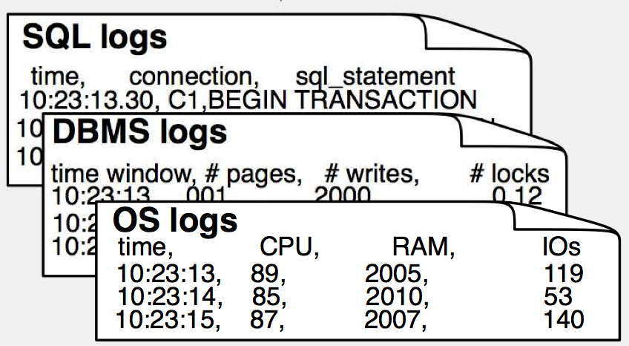
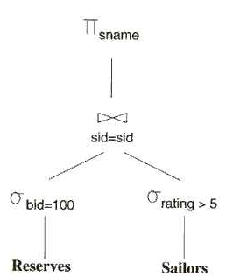
Problem Statement
Input:
(OS + DBMS + SQL) logs
Output:
A query plan
Goal:
Minimize Avg Latency!

Slide 12
Redundant Arrays of Inexpensive Disks (RAID)
Physical Disks
Logical Disk

Slide 13
Be Linear!
Just tell them one thing at a time
People will figure out the connection themselves
They’ll thank you later

Slide 14
Use a Roadmap!
Be Organized:
Say what you will tell them
Tell them
Tell them what you told them
Use a Big Picture/Architecture/Flow
Keep going back to it!

Slide 15
Outline
1960’s/1970’s: Hierarchical (IMS)
1970’s: Network/Graph (CODASYL)
1970’s/1980’s: Relational
1970’s: Entity-Relationship
1980’s: Extended Relational
1970’s/1980’s: Semantic (SDM)
1980’s/1990’s: Object Oriented
1980’s/1990’s: Object Relational
Late 1990’s – 2000’s: Semi-structured & XML

Slide 16
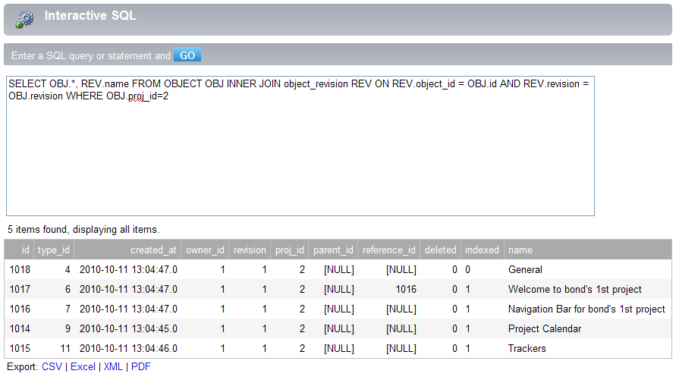
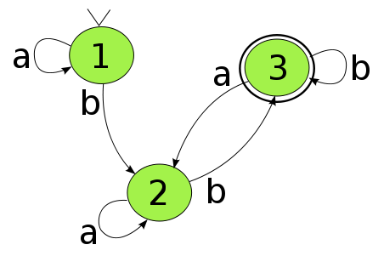
K*SQL Architecture
Data Source
Query
Event Stream
.. .…. ...
.. .…. ...
Output
Execution Engine
Stream Mill Engine
✔
✔
Optimization

Slide 17
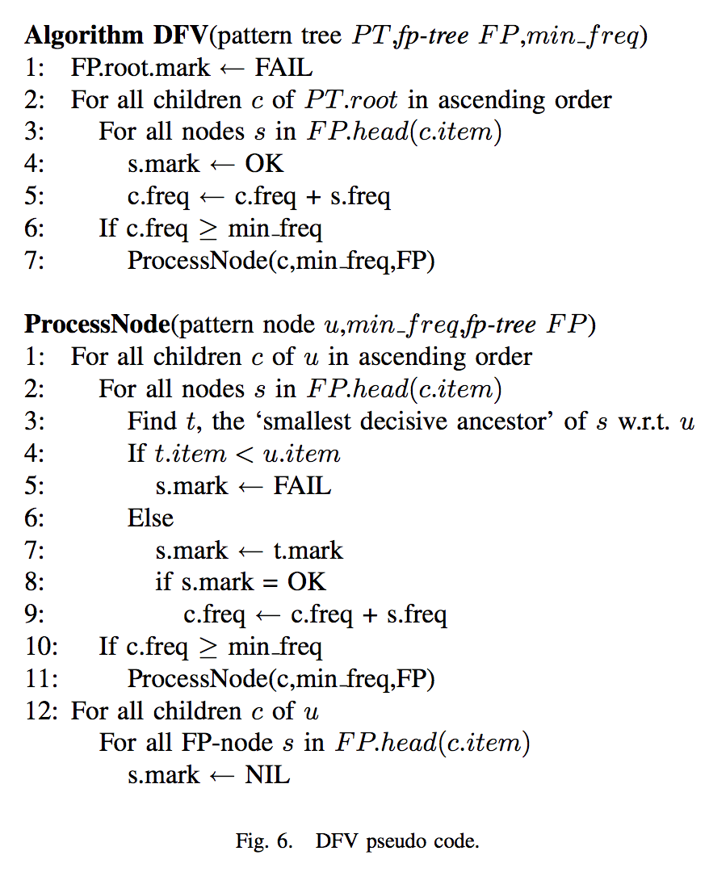
Audience Love to See Pseudo Codes

Slide 18
Algorithms = Simplification + Examples
Simplify greatly!
Use animation
Use small examples!
Remember: People are not expected to implement an algorithm based on your slides!

Slide 19
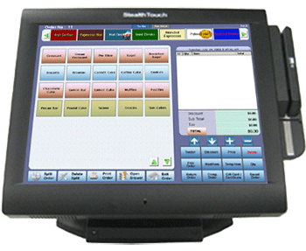
minsupp = 2
DATABASE
POS
TID | ITEMS
100 | 1 3 4
200 | 2 3 5
300 | 1 2 3 5
400 | 1 5
500 | 1 3 5
Record Txns

Slide 20
DATABASE
ITEM SETS | SUPP
{1} | 4
{2} | 2
{3} | 4
{4} | 1
{5} | 4
TID | ITEMS
100 | 1 3 4
200 | 2 3 5
300 | 1 2 3 5
400 | 1 5
500 | 1 3 5
Count Support
ITEM SETS | SUPP
{1} | 4
{2} | 2
{3} | 4
{5} | 4
L₁

Slide 21
ITEM SETS | SUPP
{1,2} | 1
{1,3} | 3
{1,5} | 3
{2,3} | 2
{2,5} | 3
{3,5} | 3
ITEM SETS | SUPP
{1} | 4
{2} | 2
{3} | 4
{5} | 4
Candidate Generation (size = 2)
L₁
C₂

Slide 22
ITEM SETS | SUPP
{1,2} | 1
{1,3} | 3
{1,5} | 3
{2,3} | 2
{2,5} | 3
{3,5} | 3
ITEM SETS | SUPP
{1,3} | 2
{1,5} | 3
{2,3} | 2
{2,5} | 3
{3,5} | 2
Prune Infrequent Item sets
C₂
L₂

Slide 23
ITEM SETS | SUPP
{1,3} | 2
{1,5} | 3
{2,3} | 2
{2,5} | 3
{3,5} | 2
C₃
Candidate Set Generation
ITEM SETS | SUPP
{1,3,5} | 2
{2,3,5} | 2
ITEM SETS | SUPP
{1,3,5} | 2
{2,3,5} | 2
L₂
L₃

Slide 24
ALGORITHM
Use as seeds, generate Candidate Item Sets of size k+1 (C_{k+1})
Count support of item sets in C_{k+1}
Find large item sets of size k (L_{k})
Use as seeds, generate Candidate Item Sets of size k+1 (C_{k+1})
Find large item sets of size k (L_{k})
Repeat until no new large item sets found.
Discard sets for which support < minsupp
Count support of item sets in C_{k+1}
Use as seeds, generate Candidate Item Sets of size k+1 (C_{k+1})
Find large item sets of size k (L_{k})
Use as seeds, generate Candidate Item Sets of size k+1 (C_{k+1})
Count support of item sets in C_{k+1}
Discard sets for which support < minsupp
Find large item sets of size k (L_{k})
Find large item sets of size k (L_{k})

