Slide 1
UCSD Media Computation in Java CS1 for majors* (N >130, 2x a year)
Increase retention
Losing 32% by end of first year
Increase recruitment (more students == more power)
Recruit more, keep the best ☺
Best peer-reviewed results
Assessment: Will we keep using it?
Do students “learn” less?
Is retention/recruitment higher?
Student attitudes (measured and anecdotally) better?
*See at ITiCSE 2010:
Experience Report: CS1 for Majors with Media Computation

Slide 2
3-way chromakey (&& and ||)
Write a program that uses at least 3 images to create a new image.
You will take a picture with at least one person wearing a colored T-shirt in front of a green screen.
You will then find two pictures. One will be the background (to replace the green screen) and one will replace the T-shirt. You could put the person in the picture in Hawaii by using the Hawaii background and give them a fractal colored T-shirt.
There is room for creativity. You can have multiple people in the image, or you could use a blue and a green sheet to provide two different backgrounds. The minimum required is replacing one background and one T-shirt.

Slide 7
Scaffolded Collage (or what to do on midterm week)
Week 5: Simple 3 images, each with different filter, horizontally glued
Week 6 (midterm): Write a program that uses at least 3 images to create a collage. The three images can each be duplicated in the collage. Every image should appear at least one with a filter on it. You can apply more than one filter to an image if you like. Really, just be creative.

Slide 8
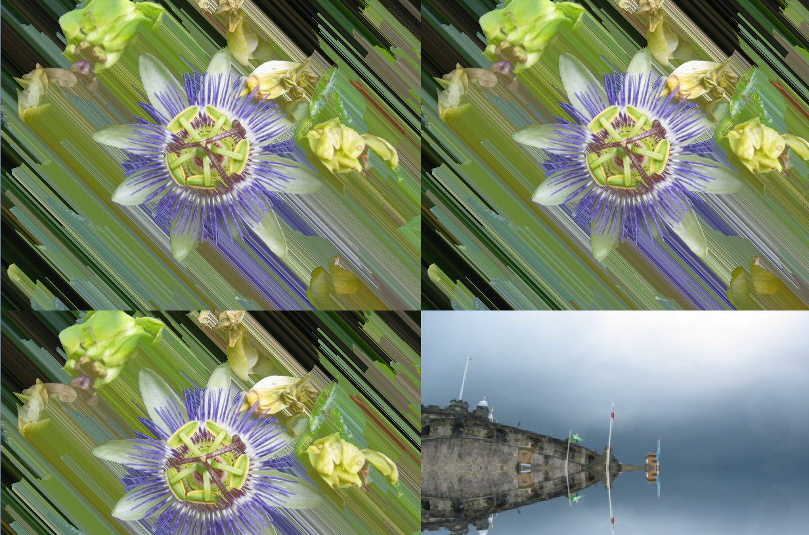

Slide 9
Art Show
Choose your favorite:
Chromakey
Collage
Change it however you like!
Prize (very important)
Certificate
Dept chair handshake in class
SUPER important
Show them “inspiration” from last year

