Slide 1
Computing with Digital Media: A Study of Humans and Technology
Mark Guzdial, School of Interactive Computing

Slide 2
Overview and Story
The Importance of Computing as Medium
History: Computing-as-Medium led to the Personal Computer (and OOP)
How Media are Digitized
Media are Digitized for People, not Technology
Professional Media Choices
A Balance between People and Technology Concerns
Media touches on most Technologies

Slide 3
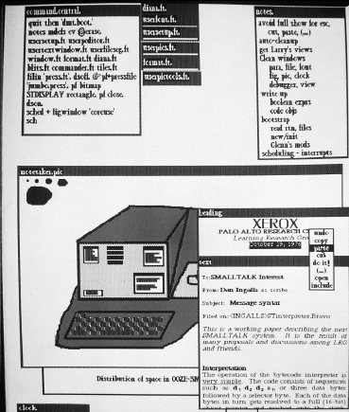
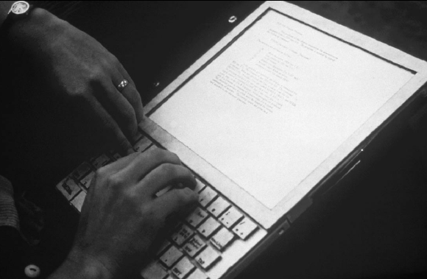
Computer as Medium (circa 1972)

Slide 4
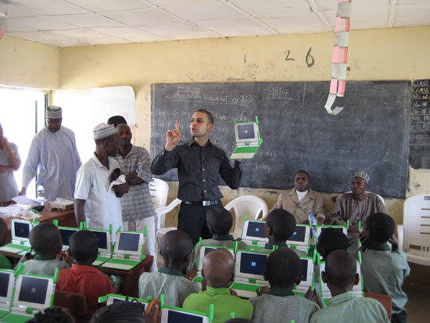
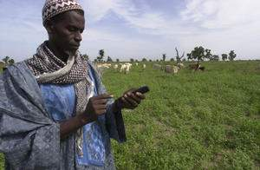
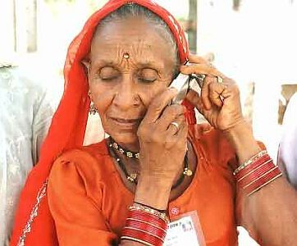
Computational Media for Good

Slide 5
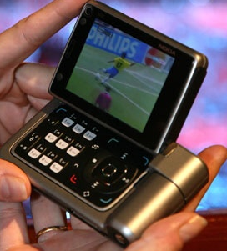
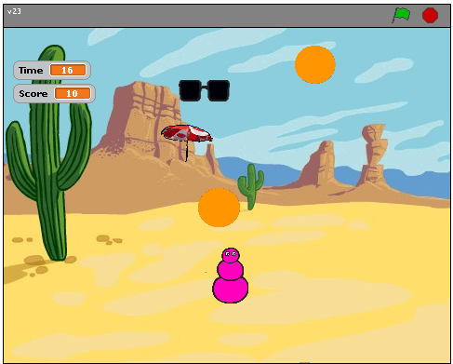
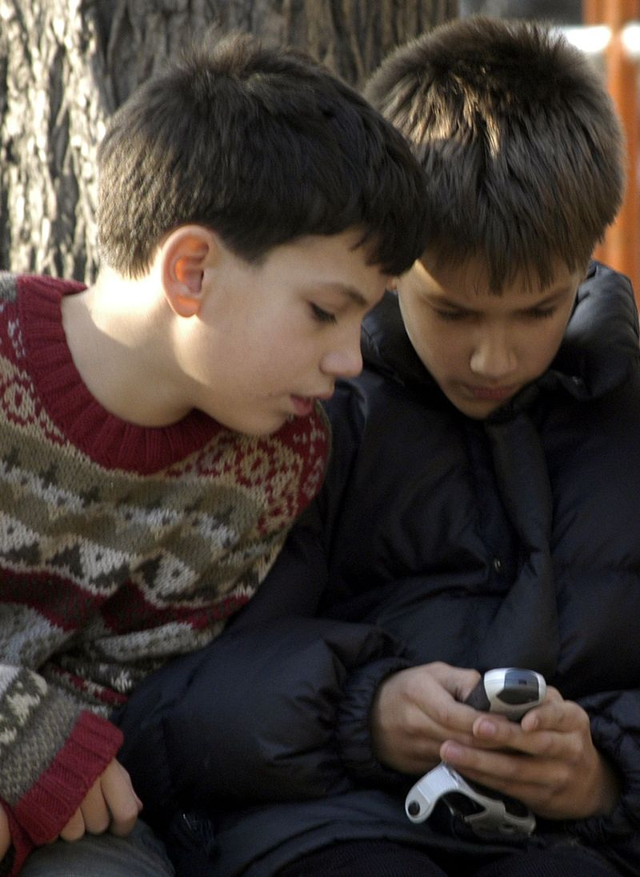
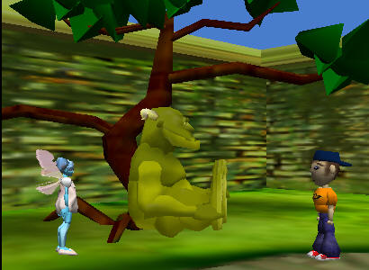
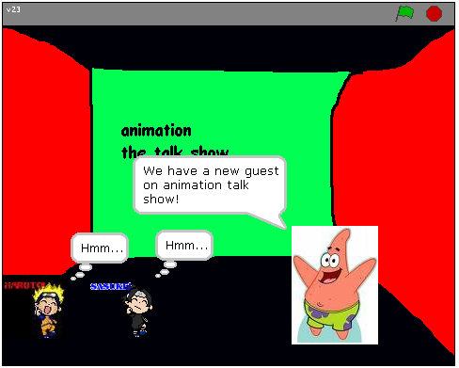
Computational Media Supporting Human-ness
Storytelling is part of what separates humans from other primates.

Slide 6
The challenge of digital media
What’s needed to represent:
Text?
Images?
Animation?
Video?
Sound?
It’s not just about data, it’s about considering that people will receive the data…

Slide 7
How sound works: Acoustics, the physics of sound
Sounds are waves of air pressure
Sound comes in cycles
The frequency of a wave is the number of cycles per second (cps), or Hertz
(Complex sounds have more than one frequency in them.)
The amplitude is the maximum height of the wave
Notes:
Do sound visualization work tool here.

Slide 8
Volume and pitch: Psychoacoustics, the psychology of sound
Our perception of pitch is related (logarithmically) to changes in frequency
Higher frequencies are perceived as higher pitches
We can hear between 5 Hz and 20,000 Hz (20 kHz)
A above middle C is 440 Hz
Our perception of volume is related (logarithmically) to changes in amplitude
If the amplitude doubles, it’s about a 3 decibel (dB) change

Slide 9
Digitizing Sound: How do we get that into bytes?
Remember in calculus, estimating the curve by creating rectangles?
We can do the same to estimate the sound curve
Analog-to-digital conversion (ADC) will give us the amplitude at an instant as a number: a sample
How many samples do we need?

Slide 10
Nyquist Theorem
We need twice as many samples as the maximum frequency in order to represent (and recreate, later) the original sound.
The number of samples recorded per second is the sampling rate
If we capture 8000 samples per second, the highest frequency we can capture is 4000 Hz
That’s how phones work
If we capture more than 44,000 samples per second, we capture everything that we can hear (max 22,000 Hz)
CD quality is 44,100 samples per second

Slide 11
Digitizing sound in the computer
Each sample is stored as a number (two bytes)
What’s the range of available combinations?
16 bits, 2¹⁶ = 65,536
But we want both positive and negative values
To indicate compressions and rarefactions.
What if we use one bit to indicate positive (0) or negative (1)?
That leaves us with 15 bits
15 bits, 2¹⁵ = 32,768
One of those combinations will stand for zero
We’ll use a “positive” one, so that’s one less pattern for positives

Slide 12
+/- 32K
Each sample can be between -32,768 and 32,767
Why such a bizarre number?
Because 32,768 + 32,767 + 1 = 2¹⁶
< 0
> 0
i.e. 16 bits, or 2 bytes
0

Slide 13
How does MP3 work?
A 2.5 minute song is 13,230,000 samples
16 megabytes
How do we get all that audio data into a 3 megabyte MP3?
It’s not just compressed data.
It’s compressed sounds for people
You can never hear low violin over a tuba.
You can’t hear something soft right after something loud.
If a human can’t hear it, throw it away.

Slide 14
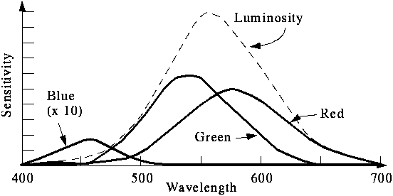
We perceive light different from how it actually is
Color is continuous
Visible light is wavelengths between 370 and 730 nm
That’s 0.00000037 and 0.00000073 meters
But we perceive light with color sensors that peak around 425 nm (blue), 550 nm (green), and 560 nm (red).
Our brain figures out which color is which by figuring out how much of each kind of sensor is responding
Dogs and other simpler animals have only two kinds of sensors
They do see color. Just less color.

Slide 15
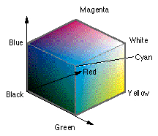
RGB: Three dimensions of color
In RGB, each color has three component colors:
Amount of red
Amount of green
Amount of blue
Each does appear as a separate dot on most devices, but our eye blends them.
Each color channel is encoded in a single byte.
A value between 0 and 255

Slide 16
A visualization of a sound is a mapping from sample to pixel

Slide 17
Why care about media transformations?
Transformed digital media can be more easily transmitted
For example, transfer of binary files over email is usually accomplished by converting to text.
We can encode additional information to check for and even correct errors in transmission.
It may allow us to use the media in new contexts, like storing it in databases.
Some transformations of media are made easier when the media are in new formats.

Slide 18
A Mapping
From sound to color:
If sample < -1000, red.
If sample > 1000, blue
Else, green.
From color to sound:
Colors aren’t exact in JPEG
If close to red, -1000
If close to blue, 1000
If close to green, 0

Slide 19
Any visualization of any kind is merely an encoding
A line chart? A pie chart? A scatterplot?
These are just lines and pixels set to correspond to some mapping of the data
Sometimes data is lost
Sometimes data is not lost, even if it looks like a dramatic change.
Creating a negative of an image, then taking the negative of a negative to get back to the original.

Slide 20
All we’re doing is changing encodings
The basic information isn’t changing at all here.
What’s changing is our encoding.
Different encodings afford us different capabilities.
If we go to numbers, we can use Excel.
If we go to lists, we can represent structure more easily.

Slide 21
Kurt Gödel
One of Time magazine’s 100 greatest thinkers of the 20th century
Proved the “Incompleteness Theorem”
By mapping mathematical statements to numbers, he was able to show that there are true statements (numbers) that cannot be proven by any mathematical system.
Gödel numbers
In this way, he showed that no system of logic can prove all true statements.

Slide 22
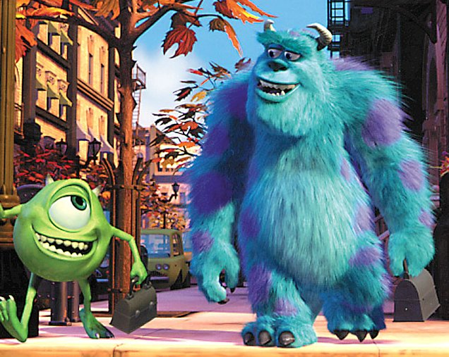
Media Computing for Expression

Slide 23
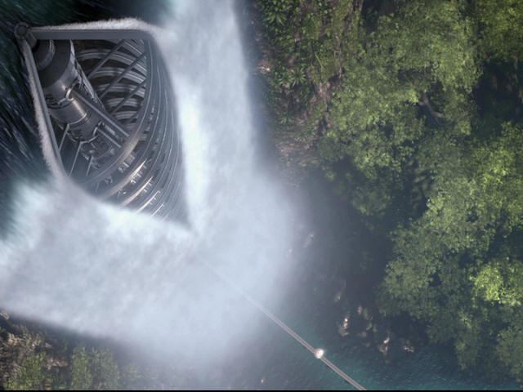
Platform implications

Slide 24
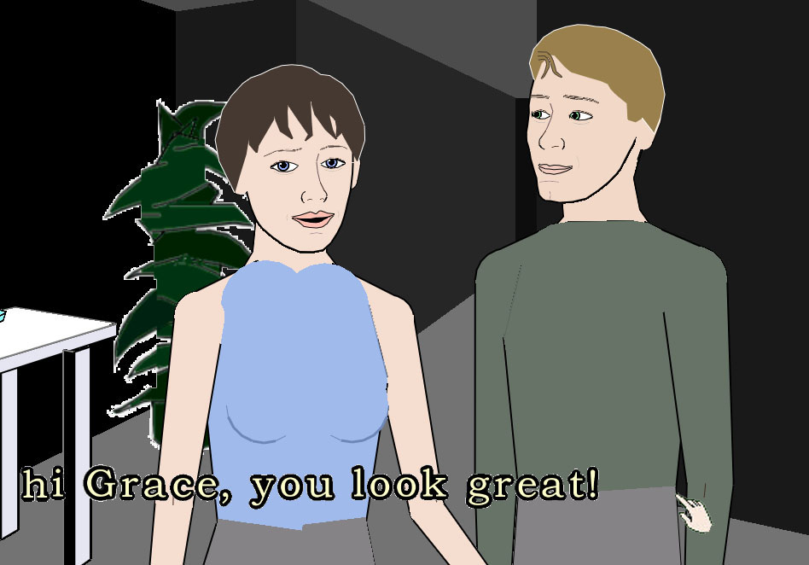
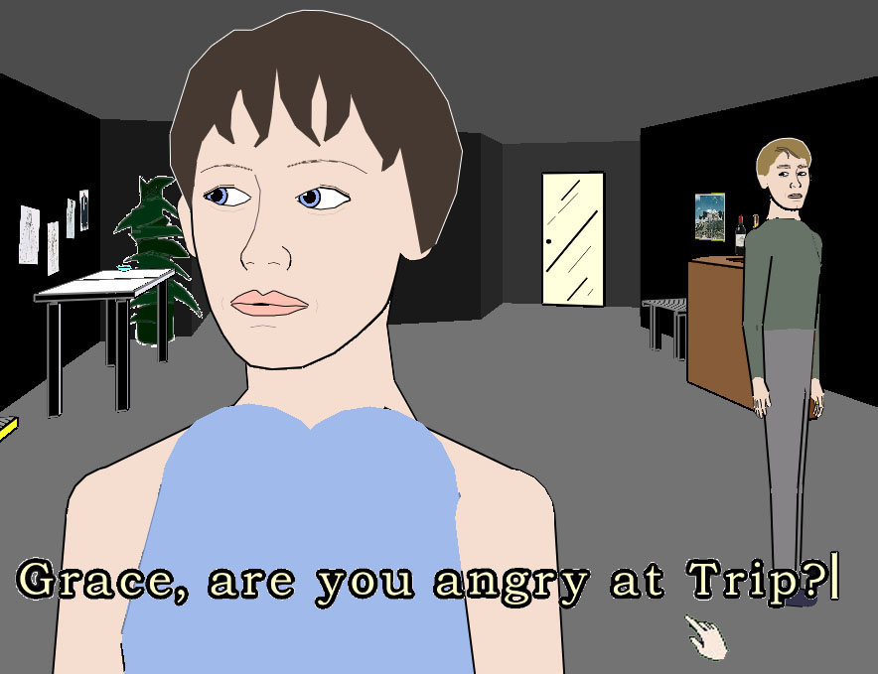
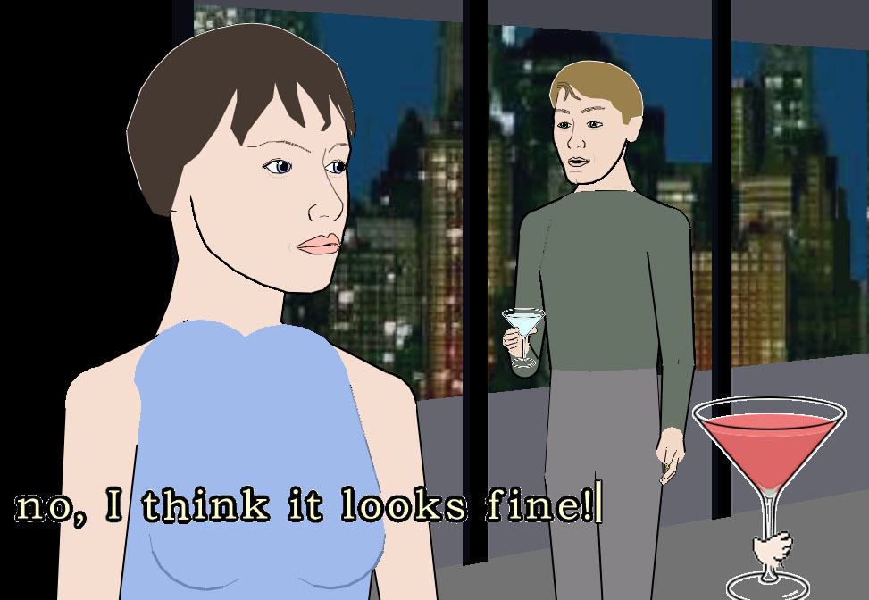
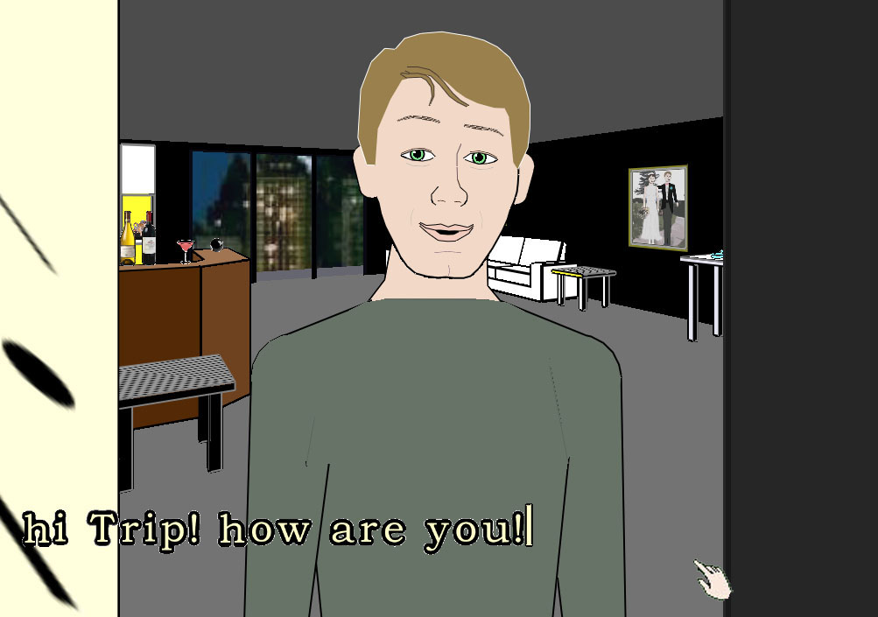
AI implications

Slide 25
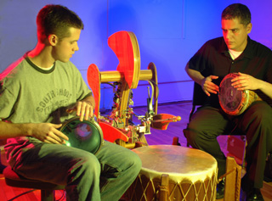
Device implications

Slide 26
Summary
Computing as a tool for manipulating digital media is an important application area.
It has driven advances in computing technology, platforms, devices, and intelligent.
It enables storytelling, part of what makes us human.
Media are digitized on a computer the way they are because the media are to be consumed by humans.

Slide 27
End
Questions?

