Slide 1
Introducing computing with media, with a pedagogical side tour
Mark Guzdial
School of Interactive Computing

Slide 2
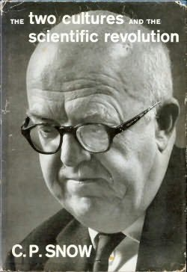

The Two Cultures
Notes:
Why is this a problem? We may not be talking to them right. There is more than one audience for what we have to offer.
Most of them don’t look like us. Some people reject science: Denialists. Global warming? Vaccines? There are no learning styles. Psychological Science in the Public Interest

Slide 3
Who wants what CS has to offer?
Computing is at the core of the modern society and modern economy.
Computing is key to innovation in many disciplines.
Computer Science has a much larger potential audience beyond software developers.
  Estimates:
  ~13 million non-professional programmer/end-user programmers in US by 2012,
  vs.
  ~3 million professional software developers (Scaffidi, Shaw, & Myers, 2005)
Notes:
There are jobs out there. The classes are good. But students just don’t want to do this.

Slide 4
Overview
Demonstrating a Media Computation lecture
  The Importance of Computing as Medium
    History: Computing for Expression led to the Personal Computer
  How Media are Digitized
    Media are Digitized for People, not Technology
  Media touches on much of Computer Science
Side trip into Pedagogy:
  Peer Instruction
  Demonstrations
Research results on Media Computation

Slide 5
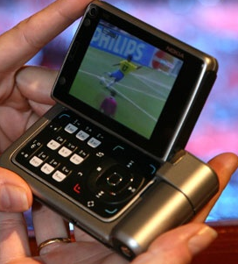
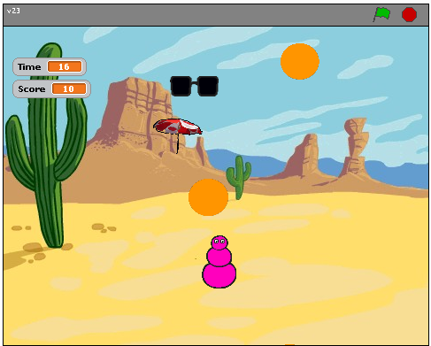
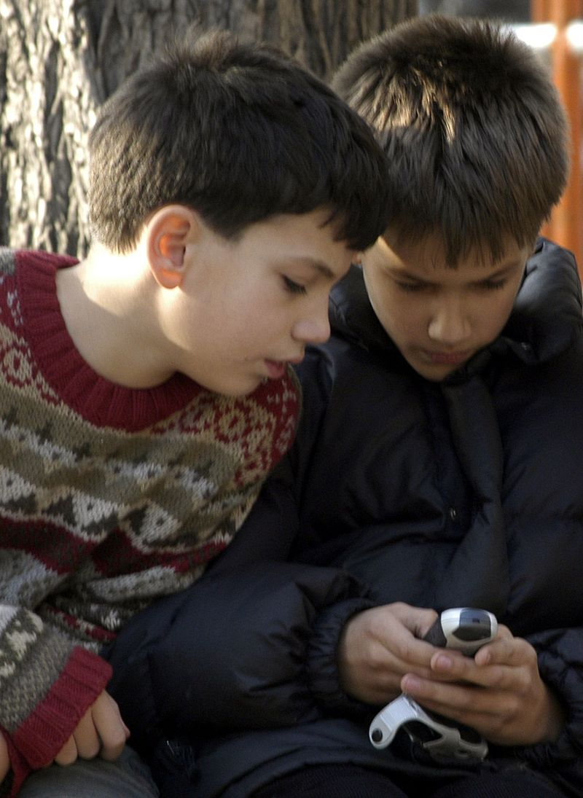
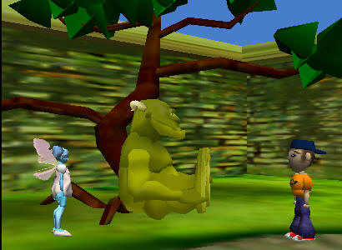
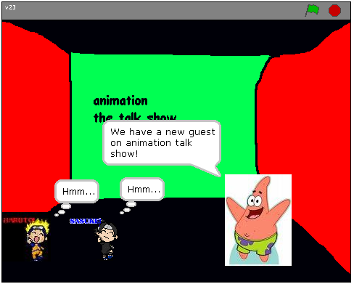
Our students live in a world of digital media
Storytelling is part of what separates humans from other primates.

Slide 6
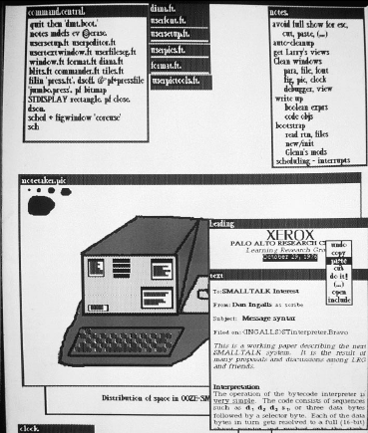
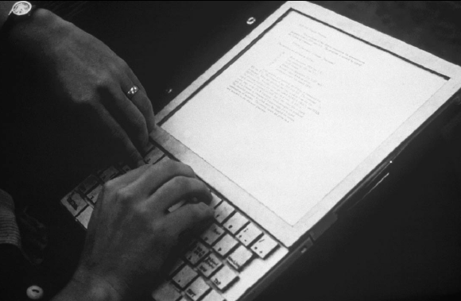
Computer as Medium (circa 1972)

Slide 7
The challenge of digital media
What’s needed to represent:
  Text?
  Images?
  Animation?
  Video?
  Sound?
It’s not just about data,
it’s about considering that people will receive the data…

Slide 8
How sound works:
Acoustics, the physics of sound
Sounds are waves of air pressure
  Sound comes in cycles
  The frequency of a wave is the number of cycles per second (cps), or Hertz
    (Complex sounds have more than one frequency in them.)
  The amplitude is the maximum height of the wave
Notes:
Do sound visualization work tool here.

Slide 9
Volume and pitch:
Psychoacoustics, the psychology of sound
Our perception of pitch is related (logarithmically) to changes in frequency
  Higher frequencies are perceived as higher pitches
  We can hear between 5 Hz and 20,000 Hz (20 kHz)
    Musical note A above middle C is 440 Hz
Our perception of volume is related (logarithmically) to changes in amplitude
  If the amplitude doubles, it’s about a 3 decibel (dB) change
  Let’s try it!

Slide 10
Digitizing Sound: How do we get that into bytes?
Remember in calculus, estimating the curve by creating rectangles?
We can do the same to estimate the sound curve
  Analog-to-digital conversion (ADC) will give us the amplitude at an instant as a number: a sample
Each sample is a two-byte number (16 bits).
  It’s signed: Positive and negative
  So, +/- 15 bits, 2¹⁵ = 32,768 (32K)
What if values were only +/- 32K?

Slide 11
Maximizing sound
def maximize(sound):
for sample in getSamples(sound):
value = getSampleValue(sample)
if value >= 0:
setSampleValue(sample,32767)
if value < 0:
setSampleValue(sample,-32768)

Slide 12
Vote: Will we hear the words?

Slide 13
Re-vote: Will we hear the words?

Slide 14
Side notes on Pedagogy:
Value of Peer Instruction
The Problem with Demonstrations
Value of Live Coding

Slide 15
Peer Instruction (clickers)
Individual Vote
Group Discussion (fixed 3 person)
Tutors actively engage groups in justifying/talking
Group Vote (consensus required)
Class-wide Discussion
Led by Students First – Explain WRONG answers
Final Cognitive Modeling by Instructor
Simon, et. al. Experience Report: Peer Instruction in Introductory Computing, SIGCSE 2010

Slide 16
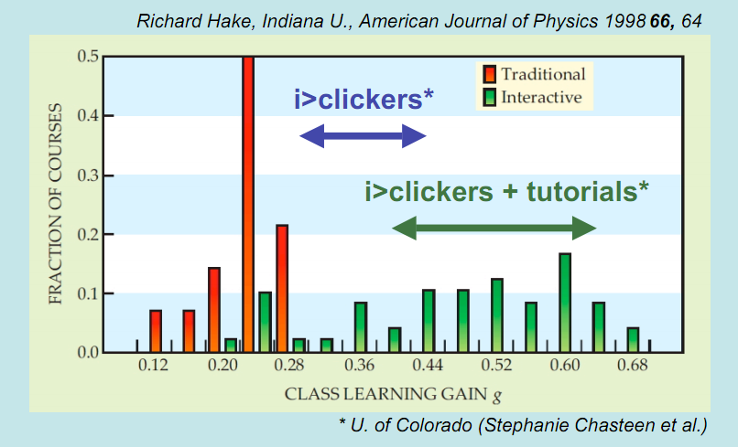
Dramatic Impacts on Learning
N = 62 courses
Notes:
Is it simply that “better professors” use clickers?

Slide 17
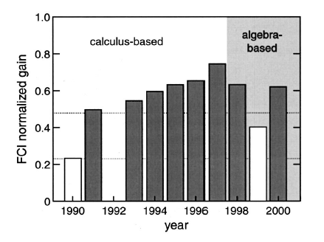
It’s not the instructor effect
Crouch, C., Mazur, E. Peer Instruction: Ten years of experience and results
Traditional Instruction
Peer Instruction

Slide 18
Why does PI work?
Activates prior knowledge.
Failure-based learning (Roger Schank)
  “What?!? How could I have been wrong?”
Uses social learning, not just lecture.
  “You thought that, too?”

Slide 19
Do demonstrations help?
On several topics, counter-balanced:
  No Demonstration
  Observe a demonstration
  Make a prediction before the demonstration: “What do you think you will see?”
  After the demonstration, discuss your predictions
Two weeks later, take a test on those topics.
  (Mazur, 2011, ICER keynote)

Slide 20
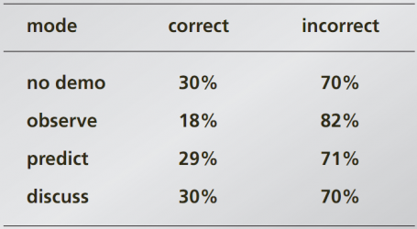
People remember models, not facts
On the test, people who got it wrong and saw a demo actually said, “As seen in the lecture demonstration…”

Slide 21
Value of live coding
Best practice for engaging women (Lecia Barker & NCWIT)
  Shows the details of coding that are often unspoken.
  Shows that even the teacher makes errors.
  Shows how the teacher figures out errors.
Reduces fear of programming

Slide 22
Shifting back to lecture

Slide 23
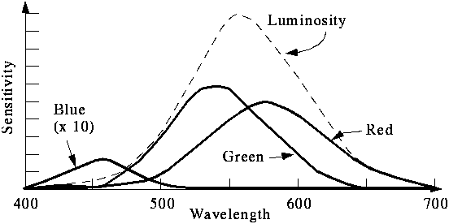
We perceive light different from how it actually is
Color is continuous
  Visible light is wavelengths
  between 370 and 730 nm
    That’s 0.00000037 and 0.00000073
    meters
But we perceive light with color sensors that peak around 425 nm (blue), 550 nm (green), and 560 nm (red).
    Our brain figures out which color is which by figuring out how much of each kind of sensor is responding
    Dogs and other simpler animals have only two kinds of sensors
      They do see color. Just less color.

Slide 24
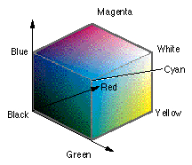
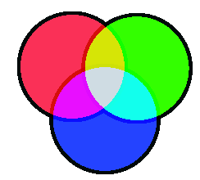
RGB: Three dimensions of color
In RGB, each color has three component colors:
  Amount of red
  Amount of green
  Amount of blue
Each does appear as a separate dot on most devices, but our eye blends them.
Each color channel is encoded in a single byte.
  A value between 0 and 255
Let’s try it!
Notes:
Explore picture, clear red, explore picture, re-open, negate.

Slide 25
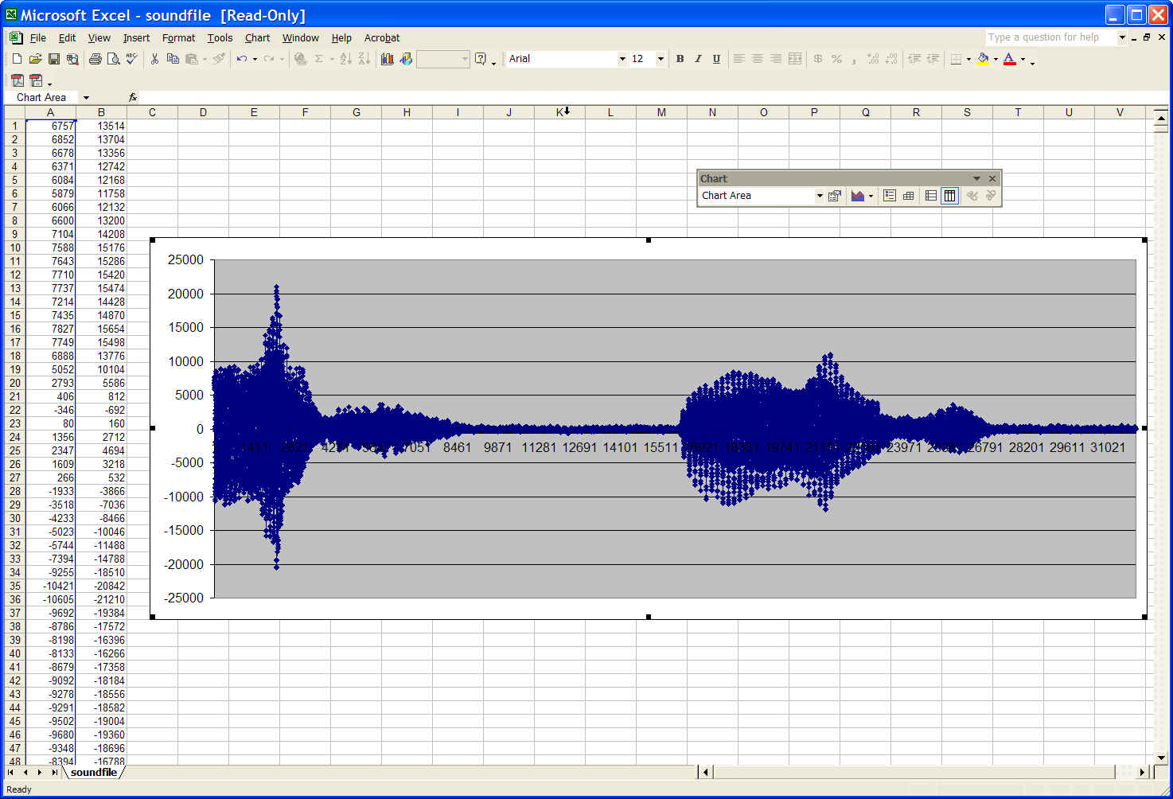
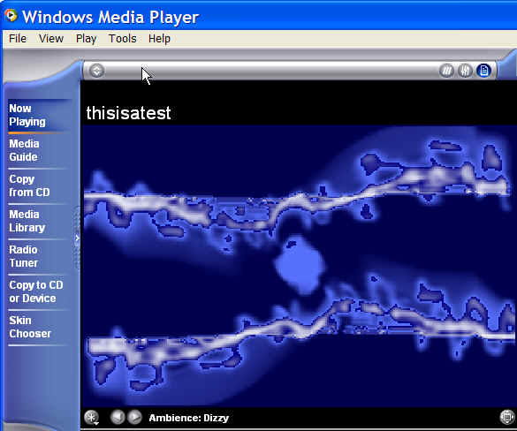
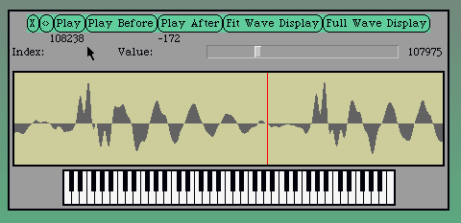
A visualization of a sound is a mapping from sample to pixel

Slide 26
A Mapping
From sound to color:
  If sample < -1000, red.
  If sample > 1000, blue
  Else, green.
From color to sound:
  Colors aren’t exact in JPEG
  If close to red, -1000
  If close to blue, 1000
  If close to green, 0
Let’s try it!

Slide 27
Any visualization of any kind is merely an encoding
A line chart? A pie chart? A scatterplot?
  These are just lines and pixels set to correspond to some mapping of the data
Sometimes data is lost
Sometimes data is not lost, even if it looks like a dramatic change.
  Creating a negative of an image, then taking the negative of a negative to get back to the original.
Information in a general, Shannon-sense is a powerful idea.

Slide 28
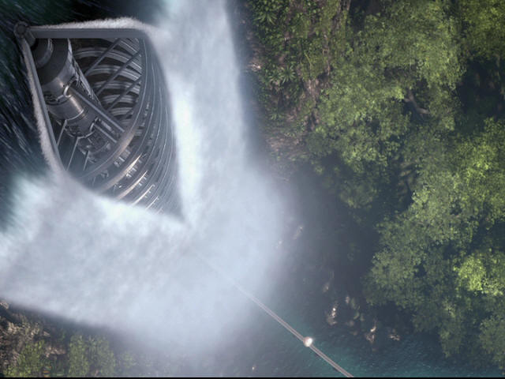
Media impacting Computing Platforms

Slide 29
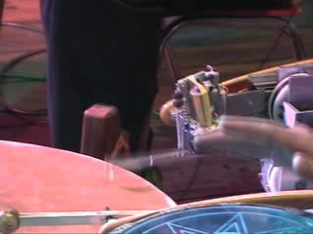
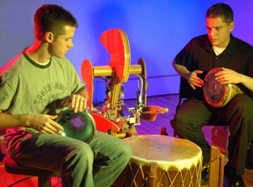

Device implications

Slide 30
“What is this media stuff that you’re teaching?
Does it work?”

Slide 31
Research results:
How we used to teach CS
Fall 1999:
All students at Georgia Tech must take a course in computer science.
  Considered part of General Education, like mathematics, social science, humanities…
1999-2003: Only one course met the requirement.
  Tried Pascal-like language and Scheme

Slide 32
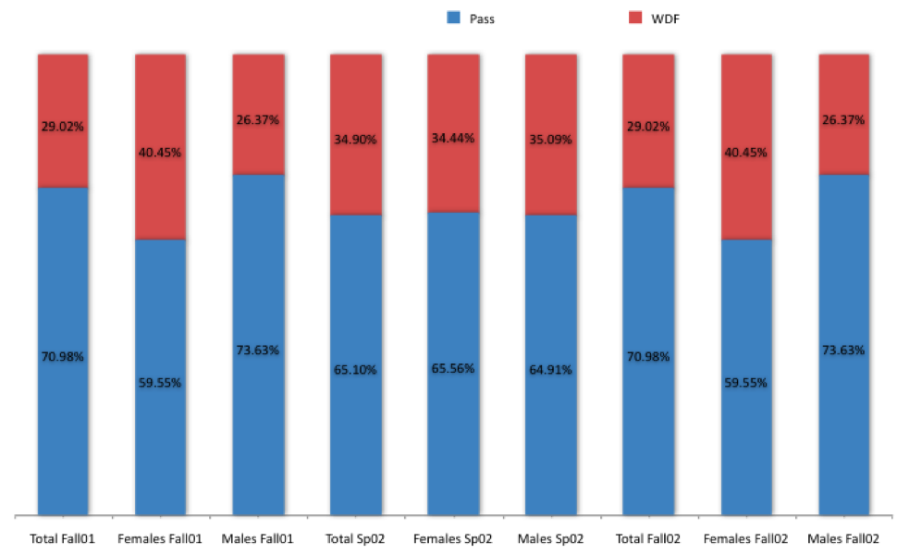
One-class: Pass (A, B, or C) vs.
WDF (Withdrawal, D or F)
Success Rates in CS1 from Fall 1999 to Spring 2002 (Overall: 78%)
Architecture | 46.7%
Biology | 64.4%
Economics | 53.5%
History | 46.5%
Management | 48.5%
Public Policy | 47.9%
Notes:
Actually, quite good pass rates, compared to many others in CS.
Across campus, these are the pits.
And the women are failing or withdrawing. in greater numbers than the men.
This looks like C.P. Snow’s “Two Cultures”

Slide 33
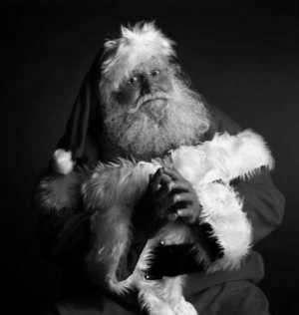
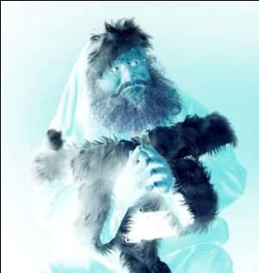
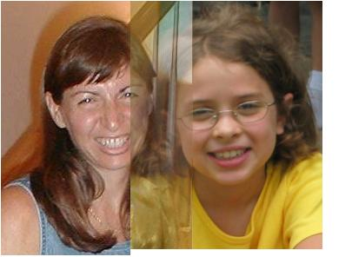

Media Computation:
Teaching in a Relevant Context
Presenting CS topics with media projects and examples
  Iteration as creating negative and grayscale images
  Indexing in a range as removing redeye
  Algorithms for blending both images and sounds
  Linked lists as song fragments woven to make music
  Information encodings as sound visualizations
33

Slide 34
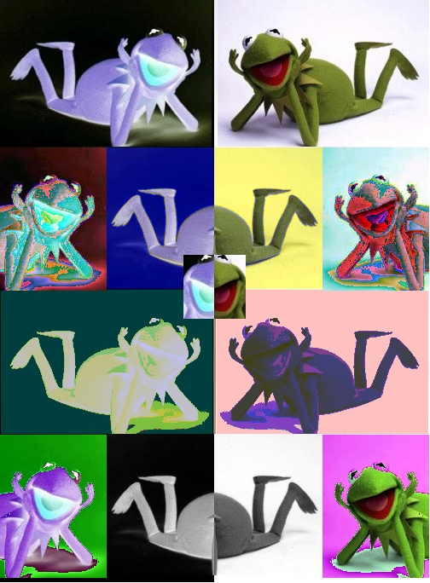
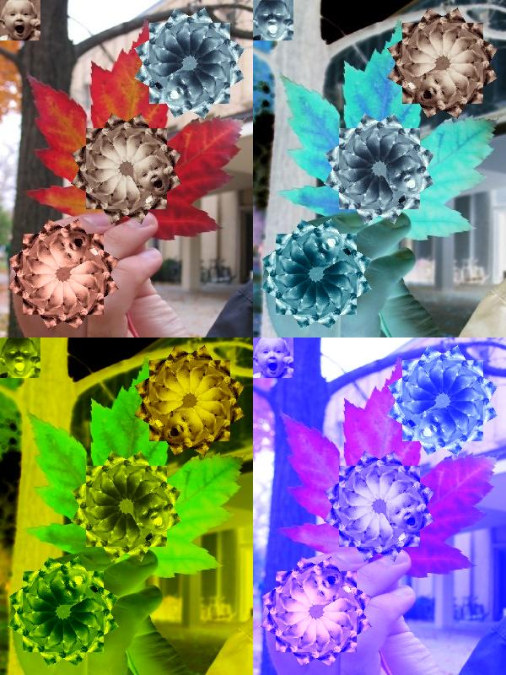
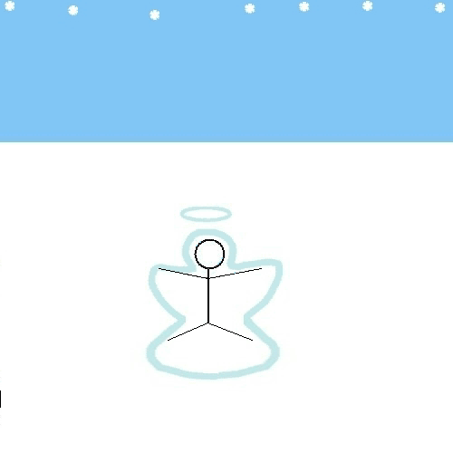
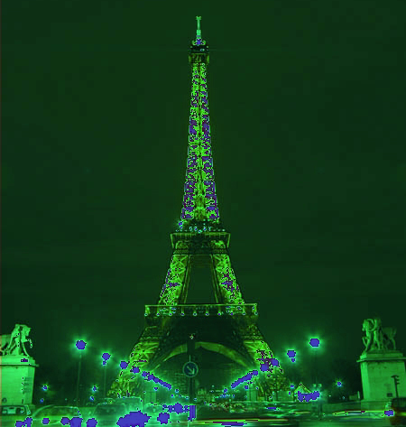


Open-ended, contextualized homework in Media Computation
Sound collage
Linked list canon
Notes:
34

Slide 35
Results With “Media Computation”
Change in Success rates in CS1 “Media Computation” from Spring 2003 to Fall 2005 (Overall 85%)
Architecture | 46.7% | 85.7%
Biology | 64.4% | 90.4%
Economics | 54.5% | 92.0%
History | 46.5% | 67.6%
Management | 48.5% | 87.8%
Public Policy | 47.9% | 85.4%
Notes:
Be sure to wonder, “But are they learning the same?”

Slide 36
Was the class successful?
Interviewed Intl Affairs student (female): “I just wish I had more time to play around with that and make neat effects. But JES [IDE for class] will be on my computer forever, so… that’s the nice thing about this class is that you could go as deep into the homework as you wanted. So, I’d turn it in and then me and my roommate would do more after to see what we could do with it.”
Survey one year later:
  19% of respondents had programmed since class ended
"Did the class change how you interact with computers?”
  “Definitely makes me think of what is going on behind the scenes of such programs like Photoshop and Illustrator.”
Notes:
FIX HAVE->HAD

Slide 37
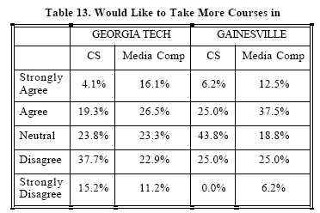
Results at Other Schools
Similar results at 2 year public Gainesville College (Tew, Fowler, Guzdial, SIGCSE 2005) and at ( much more diverse) U. Illinois-Chicago’s CS0.5 (Sloan & Troy, SIGCSE 2008)
Would you like more CS?
  GT 15.2% “Strongly Disagree.” <25% agree.
  More MediaComp? GT and Gainesville over 40% agree.
(Tew, Fowler, Guzdial, SIGCSE 2005)

Slide 39
Recent Results at
University of California, San Diego
Simon, Kinnunen, Porter, Zaskis, ACM ITICSE 2010
Using Java Media Computation as normal CS1 for CS majors at a research university.
Did extensive data collection last semester before switching to Media Computation.
Been following two cohorts of CS1 students for comparison.
Findings:
MediaComp has more focus on problem-solving, less on language.
MediaComp students have higher pass rates and retention rates one year later

Slide 40
Summary
Computing as a tool for manipulating digital media is an important application area.
  It has driven advances in computing technology, platforms, devices, and intelligent.
  It enables storytelling, part of what makes us human.
Media are digitized on a computer the way they are
because the media are to be consumed by humans.
We can improve learning by changing pedagogy.
  Peer instruction engages students, activates prior knowledge.
  Live coding reduces student fear of programming.
Media Computation improves student motivation to complete.

Slide 41
With thanks to our funding supporters
US National Science Foundation
  Statewide BPC Alliance: Project “Georgia Computes!” http://www.gacomputes.org
  CCLI for Media Computation and CPATH for Teacher Professional Development Grants
  Computing Education in the 21st Century (CE21) for new media for teachers
Microsoft Research
Georgia Tech's College of Computing
Georgia’s Department of Education
GVU Center

Slide 42
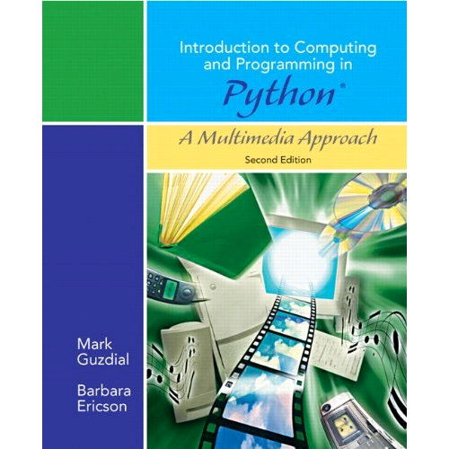
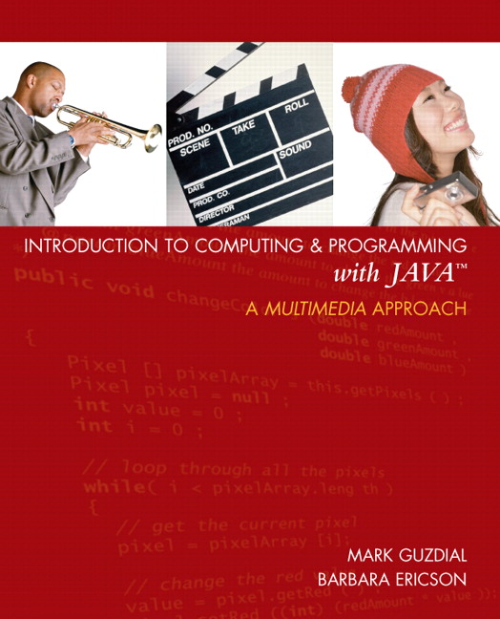
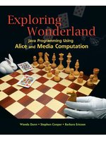

Thank you! Questions?
http://www.cc.gatech.edu/~mark.guzdial
http://home.cc.gatech.edu/csl
http://www.georgiacomputes.org
For more on MediaComp approach:
http://www.mediacomputation.org

Slide 43
Extra slides

Slide 44
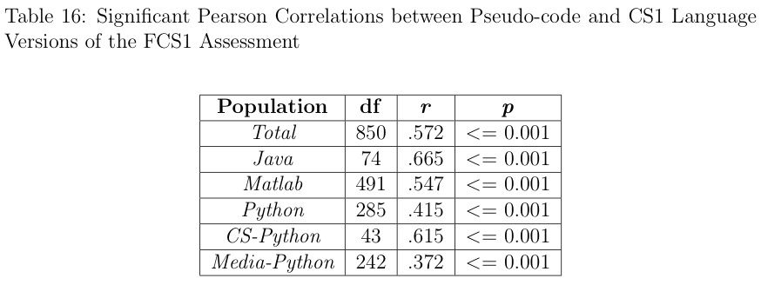
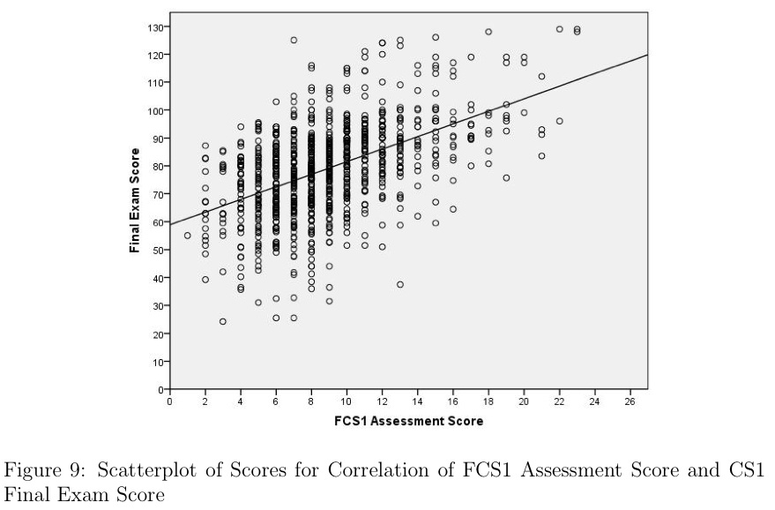
Are they learning the same?
We don’t know,
but now we can know.
Allison Elliott Tew has just completed the first language-independent validated test of CS1 knowledge.

Slide 45
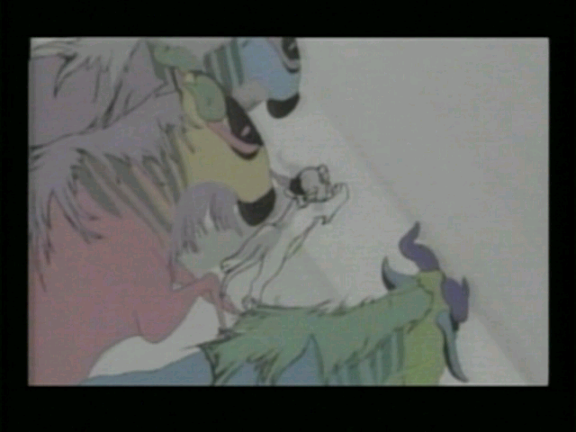
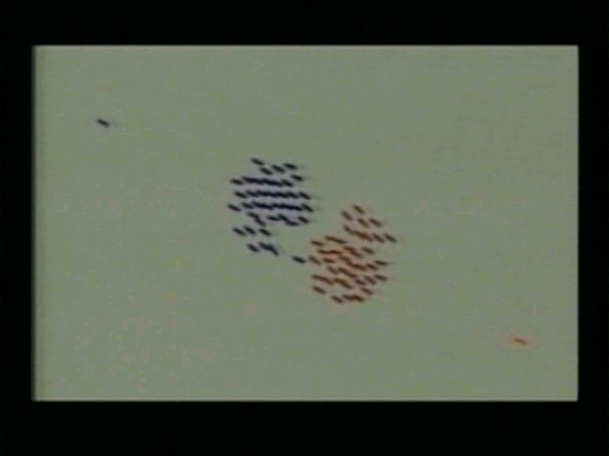
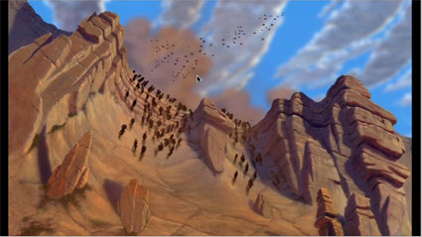
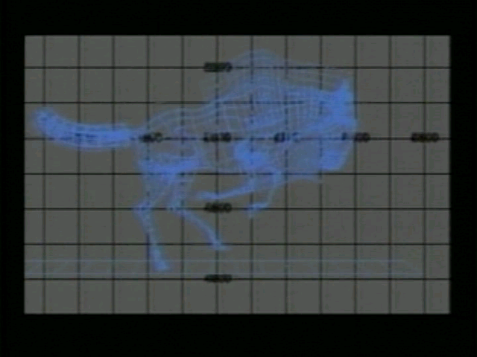
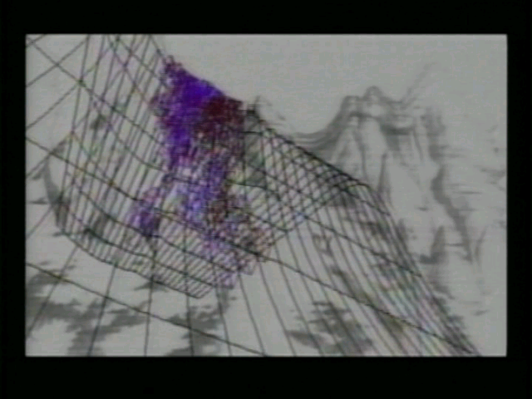
A Contextualized CS2:
MediaComp Data Structures
How did the Wildebeests charge over the
ridge in Disney's "The Lion King"?
Notes:
How is it different? The first “tree” that students use is an n-ary tree, a scene graph. Why not start with a binary tree? Because binary trees are irrelevant to media developers.
Java course, all non-majors, 90% success rate

Slide 46
Research Question:
Is context still useful in a second course?
Mixed model research design
  Interviews informing whole-class survey
11% agreed with “Working with media is a waste of time that could be used to learn the material in greater depth.”
  “I didn’t take this class to learn how to make pretty pictures.”
A majority of the class (70%) agreed or strongly agreed that working with media makes the class more interesting.
67% of the students agreed or strongly agreed that they were really excited by at least one class project
66% reported doing extra work on projects to make the outcome look “cool.”
(Yarosh and Guzdial, JERIC, Jan 2008)

Slide 47

High School Participation in
AP STEM Disciplines
— Chris Stephenson, CSTA, 2010
Notes:
Graph shows # of students taking the various STEM AP tests since 1997. CS is the sad red line at the bottom. Note that even the relatively new AP courses – statistics and environmental sciences – are doing much better than us.

Slide 48
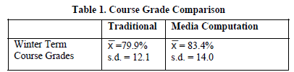
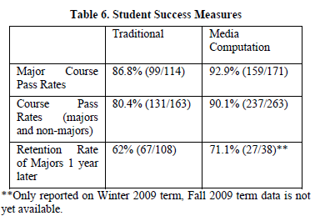
Simon et al. Key Findings Summarized
Notes:
It’s about changing definitions of computer science.

Slide 49
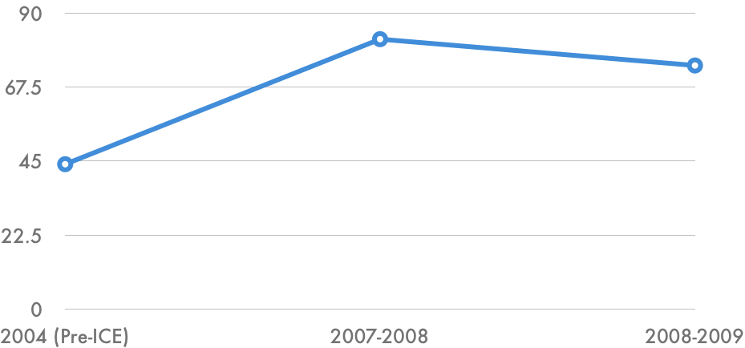
Schools in Georgia Teaching AP CS
2006
GaComputes starts

Slide 50
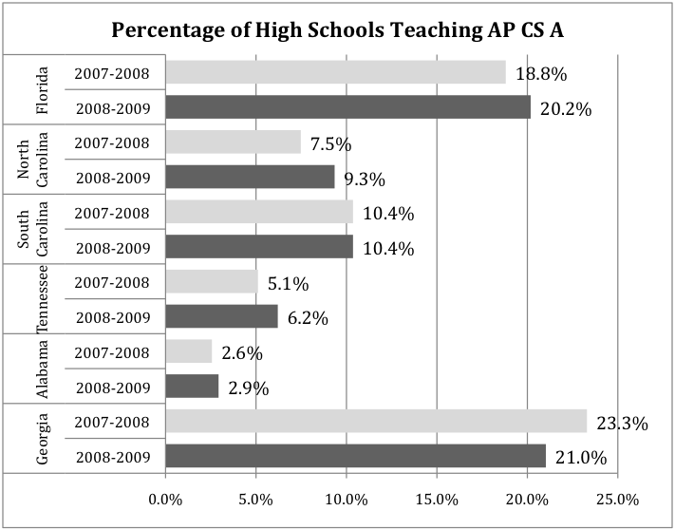
As percent of schools, best in Southeast

Slide 51
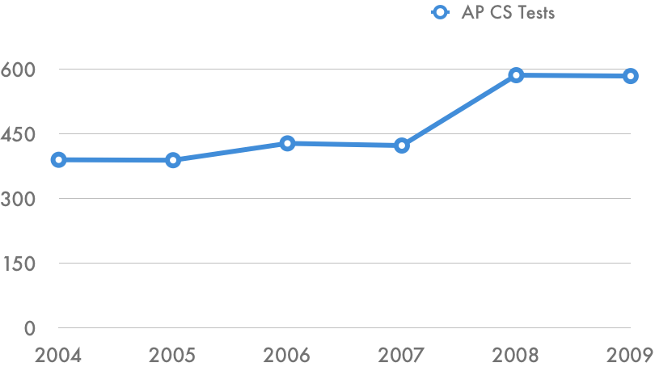
AP CS Test Taking in Georgia
2006
GaComputes starts

Slide 52
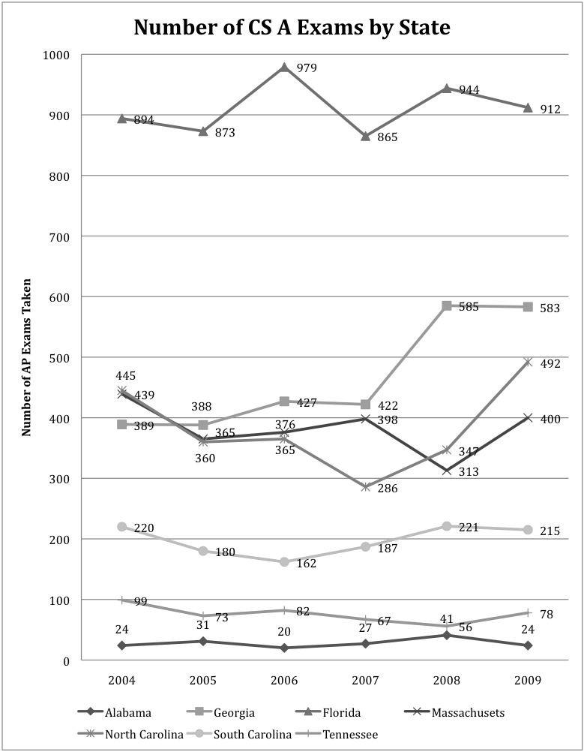
Number of AP CS Tests

Slide 53
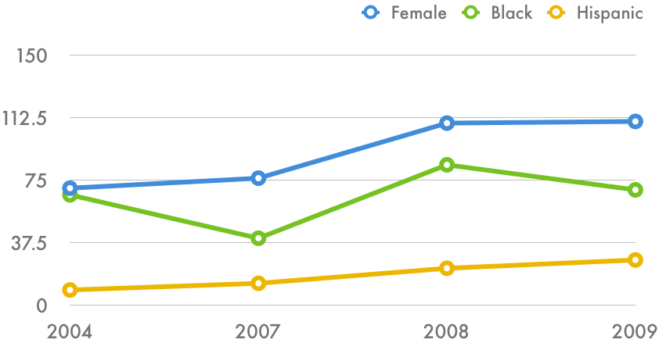
Who’s taking those tests?
2006
GaComputes starts

Slide 54
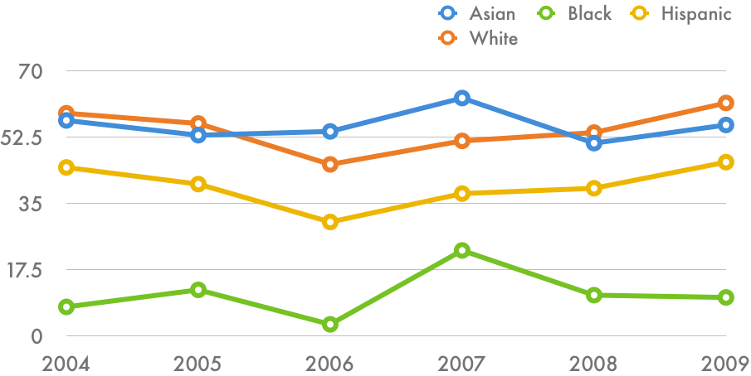
And how are they doing?
Percentage of students earning a 3 or higher.
2006
GaComputes starts

