Slide 1
Systems Software Verification Summer School
Chapter 2
Specification
Manos Kapritsos, University of Michigan
Jon Howell, VMWare Research
Rob Johnson, VMWare Research

Slide 2
Specification
Specification
Karma is a word. Another way of saying “What I am here to do”

Slide 3
Specification
A way to define formally what your program should do
Before you start writing a proof, make sure you know what you are proving
lemma Double(x:int) returns (y:int)
ensures y == 2*x
{
y := 2*x;
}

Slide 4
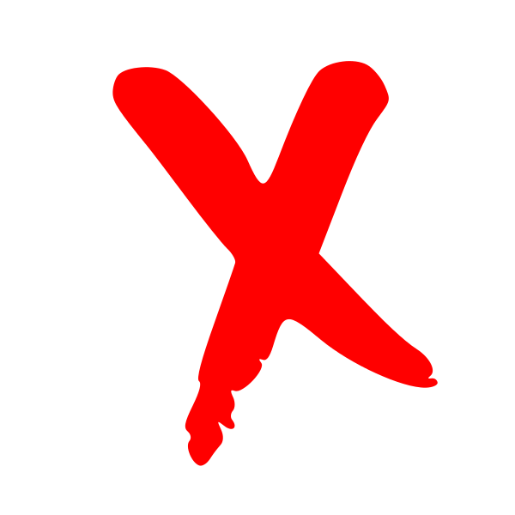
Specification
A specification defines which executions are allowable
lemma Double(x:int) returns (y:int)
ensures y == 2*x
{
y := 2*x;
}
(x=1, y=2)
(x=2, y=4)
(x=2, y=2)
(x=-3, y=-6)
(x=-2, y=4)

Slide 5
Ways to specify what the program should do
C-style assertions
Postconditions
Properties/invariants
Refinement
y = 2*x; assert(y==2*x)
lemma Double(x:int) returns (y:int)
ensures y == 2*x
{
y := 2*x;
}
“At most one node holds the lock at any time”
Linearizability
Equivalence to logically centralized service

Slide 6
Specification is trusted
Formal verification: proving that your protocol or implementation meets the spec
You cannot prove that the spec is correct
You have to trust your spec
Your proof is as good as your spec
A wrong spec is one of the few ways to introduce bugs into formally verified code

Slide 7
Check your spec
Check your spec!
Check your spec!
Check your spec!
Check your spec!
Check your spec!
Now that should be your 1st, 2nd, 3rd, 4th and 5th concern!

Slide 8
The benefit of specification
The spec should be much smaller than the code
So we have to inspect a few lines of code only
Dijkstra’s algorithm spec
IsShortestPath(g, p) { && IsPath(g, p) && forall p2 :: IsPath(g, p2) ==> |p| <= |p2|
}

Slide 9
a good spec
A good spec is correct/complete
It precludes all undesirable behaviors
Example: find minimum element of sequence
predicate IsMin (a:seq<int>, x:int) {
forall i :: 0 <= i < |a| ==> a[i] >= x
}

Slide 10
a good spec (cont.)
A good spec is concise
It elides every irrelevant concept
Is simple and easy to read
predicate IsIndexOfMin (a:seq<int>, index:int) {
forall i :: 0 <= i < |a| ==> a[i] >= a[index]
}

Slide 11
a good spec (cont.)
A good spec is abstract
It doesn’t constrain the implementation
Dijkstra’s algorithm spec
IsShortestPath(g, p) { && IsPath(g, p) && forall p2 :: IsPath(g, p2) ==> |p| <= |p2|
}

Slide 12
Verification and the ”eradication” of bugs
Frequent quote from verification papers
“We prove that there are no bugs at all…”
Frequent quote from verification skeptics
“Nonsense! You can still have bugs in your spec”
The truth is somewhere in the middle
Yes, your spec may have bugs
But do you prefer inspecting 30 lines for bugs or 30000?

Slide 13
Lab session exercises
In the next lab session solve exercises in chapters 1 and 2
Do them in order
Ask us for help if you get stuck

