Slide 1
Compiler-Assisted Detection of Transient Memory Errors
Presented by Mia Kelly, Jeffrey Brill, and Alex Janosi

Slide 2
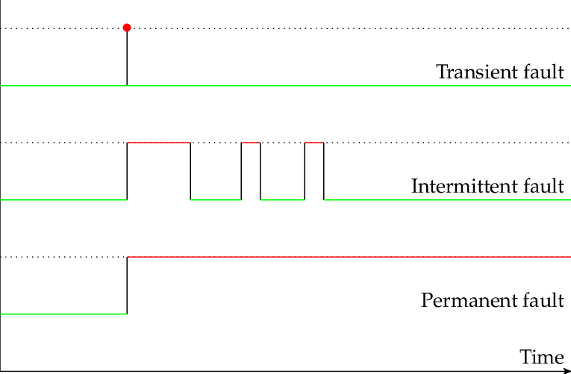
Motivation
Hardware reliability versus scaling technology
Reduction of power consumption
Lower voltage levels and smaller noise margins
Transient faults result in undetected bit flips
Silent data corruption
Incorrect address generation
Need reliable systems to detect and fix bit flips
Liu, Baisi. (2014). An Efficient Approach for Diagnosability and Diagnosis of DES Based on Labeled Petri Nets: Untimed and Timed Contexts.

Slide 3
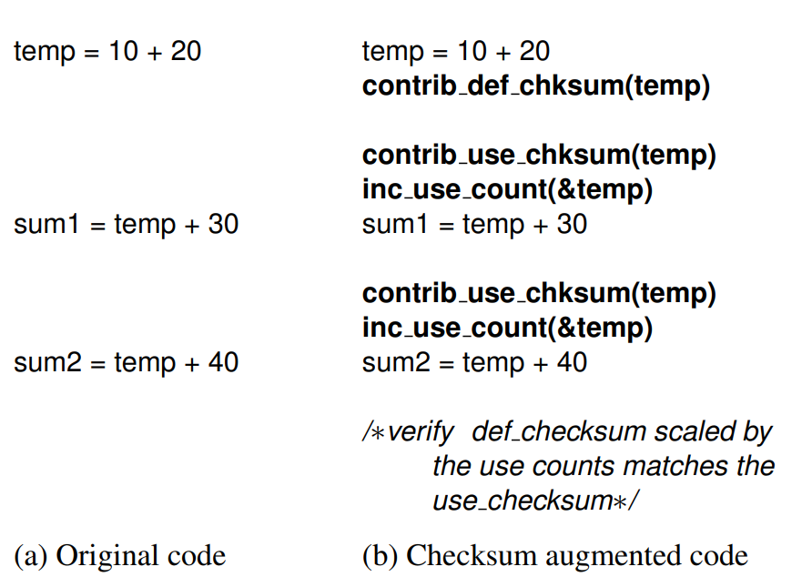
Previous Attempts
Software-level approaches
Redundant execution of memory operations
Duplicate variables and operations
Significantly increase memory space and bandwidth requirements
Limit to definition and uses of variables using checksums to detect memory errors

Slide 4
How the Technique Works
Main idea:
Keep track of use count of variables
Every time a variable is used, “record” what value was used
At the end of the program, ensure that every time the value is used, it was the correct value
Make it efficient! Re-checking the value every time is far too costly
Instead, use additive checksums
Two cases:
Total use count for a definition is known at compile time
Total use count cannot be determined at compile time

Slide 5
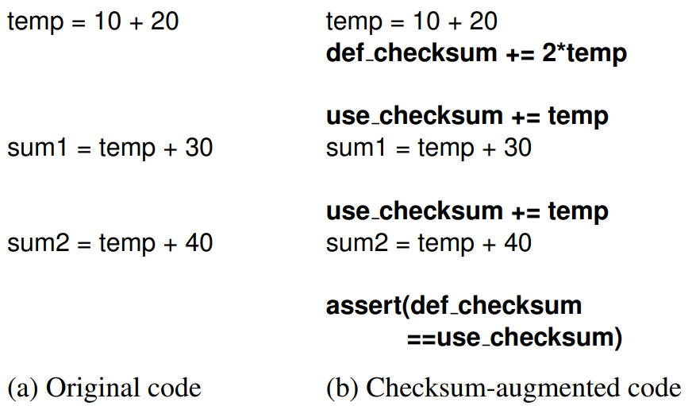
When Use-Counts Are Known at Compile Time
On definition, value is multiplied by use number and stored in def_checksum
Every use, the current value of temp is added the use_checksum
If the two checksums are different, temp suffered data corruption during the execution
30
60
30
30
Fault occurs!
15
45
60
45
Fault detected!

Slide 6
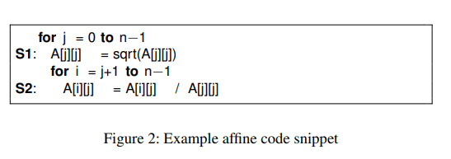
Determining Use Counts at Compile-Time
Of course, use counts are not always determinable
However, sometimes they are
We focus on affine loops
Affine loops are loops where bounds and array references are affine functions of the loop iterators and program parameters
Affine functions are essentially generalized linear functions
e.g. y = Ax + By + Cz + D

Slide 7
Determining Use Counts at Compile-Time
For each statement
Get the iteration space of that statement
Parameterize the iteration space
Get the targets of the statement
Set use count equal to cardinality of targets
Example for statement S1
I = {S1[j]: 0 ≤ j ≤ n-1}
I^{param} = {S1[j]: jp}
Targets = {S2[jp, i]: 0 ≤ jp ≤ n-1, jp+1 ≤ i ≤ n-1}
Uses = |Targets| = {n - 1 - jp: 0 ≤ jp ≤ n - 2}

Slide 8
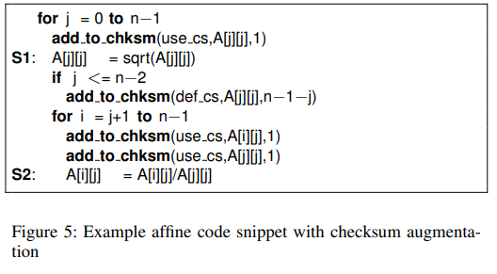
Determining Use Counts at Compile-Time

Slide 9
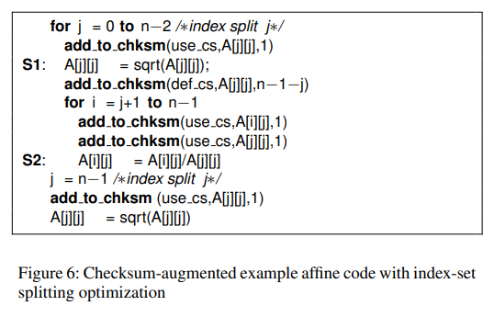
Optimization: Index-Set Splitting
If-statement within S1 is inefficient
Observation: we can split loop into two loops
First for j = 0 … n-2
Second for j = n-1
Like unrolling specific iterations to avoid adding conditions

Slide 10
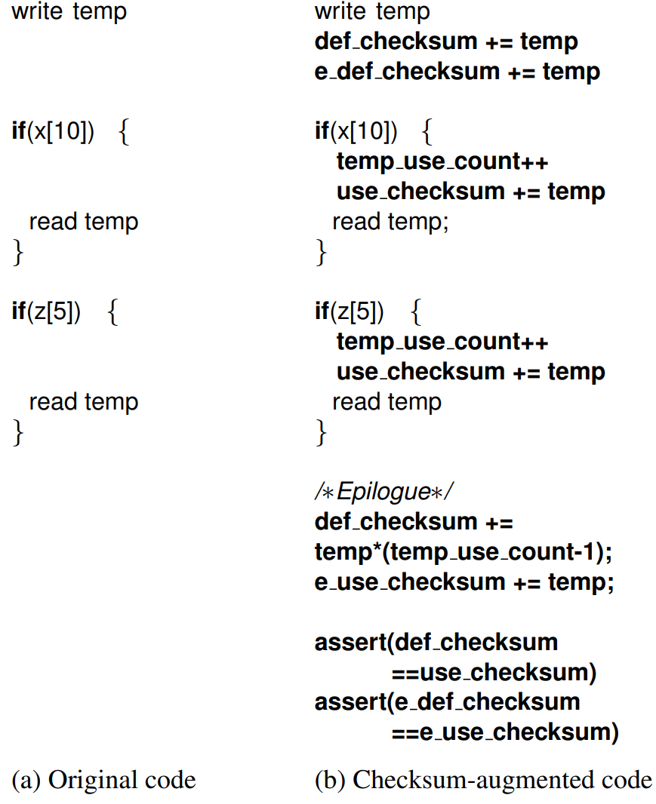
When Use-Counts Aren’t Known at Compile-Time
30
30
Use counts dependent on memory accesses
Count total uses
But this is still susceptible to memory errors!
Corrupted value in both def- and use-checksum
Use auxiliary def- and use-checksums to compare final and original values
30
30
30
30
Fault occurs!
45
15
45
15*(1)
15
15
Fault detected!

Slide 11
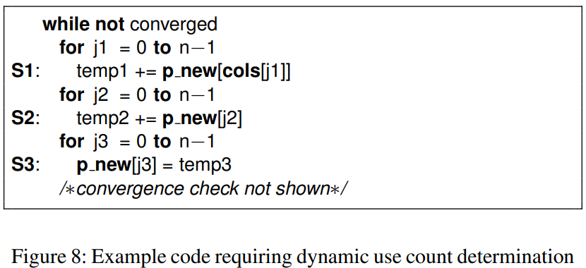
Observations About Iterative Code
S1: Reads depend on cols, but will not change as cols is not written to
S2: Reads are based on index expression from loop bounds that are affine
S3: Definitions of p_new only used a fixed number of times…
But this number isn’t known at compile-time
Notes:
S1: these reads are loop invariant because cols is never written to during the loop

Slide 12
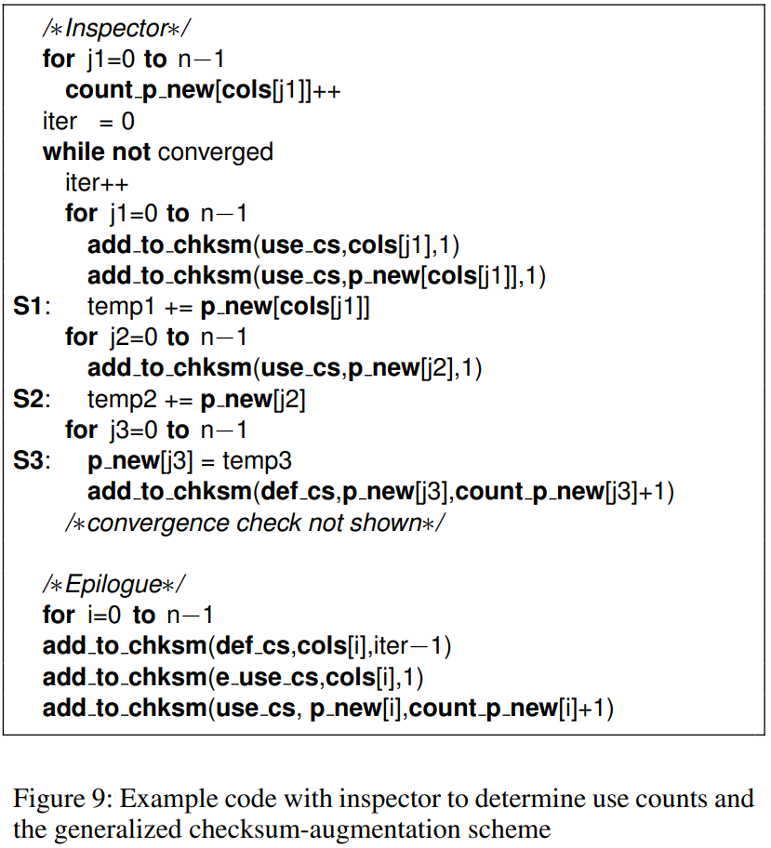
Optimizations for Iterative Code
Inspector is added to examine which elements of p_new will be read.
These accesses are loop invariant, so inspector can be hoisted
Accesses to cols are affine, but total number of loop iterations not known beforehand
Instead of adding each individually during the loop, we can add value ⨯ iters after the loop finishes

Slide 13
Combining the Two Approaches
Use global def_checksum and use_checksum for all variables
When counts are known at compile time
At defs: add value ⨯ uses to def_checksum
At uses: add value to use_checksum
When counts aren’t known at compile time
At defs: Add value to def_checksum and auxiliary e_def_checksum
At use:
For data-dependent accesses - generate inspector to determine use counts, else:
Add value to use_checksum
Increment dynamic_use_count by 1
At end:
Add (dynamic_use_count - 1) ⨯ value to def_checksum
Add value to auxiliary e_use_checksum
Check for errors
Compare def_checksum and use_checksum
Compare auxiliary e_def_checksum and e_use_checksum

Slide 14
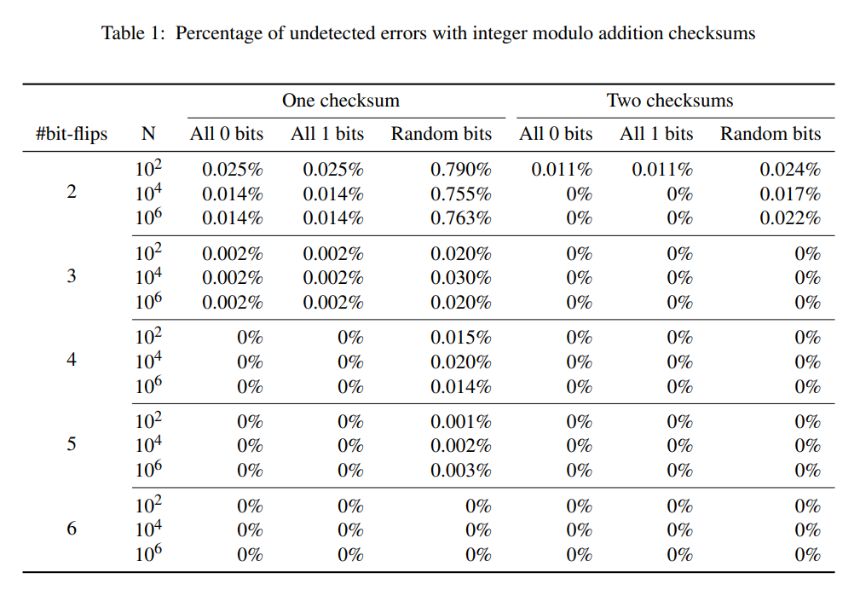
Results: Effectiveness
Metric to quantify detection
Tested on arrays of 64-bit integers
Initialized to all 0, 1, or random bits
First checksum has holes
Second checksums where we add permutations of values encountered
Rotate bits for robustness

Slide 15
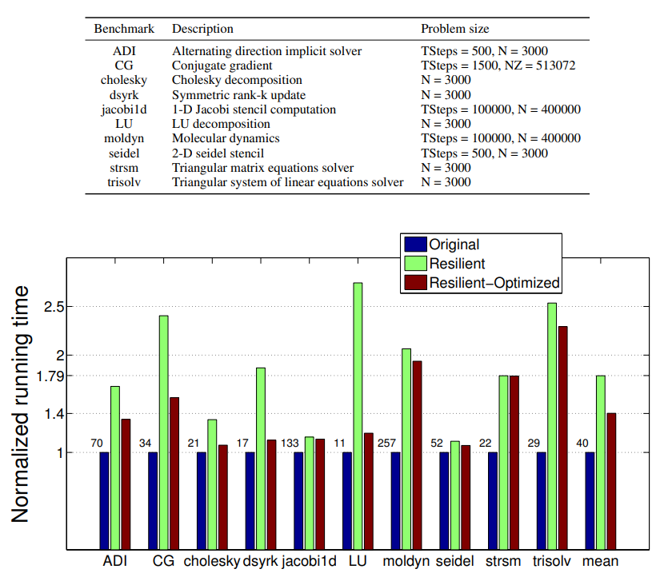
Results: Software Overhead
Performance overheads is 78.8%
Index-set splitting and inspector-hoisting optimization decrease overhead to 40.2%
Partitioned loops has same use count per statement
Moldyn fails due to no inspector loop-invariant properties

Slide 16
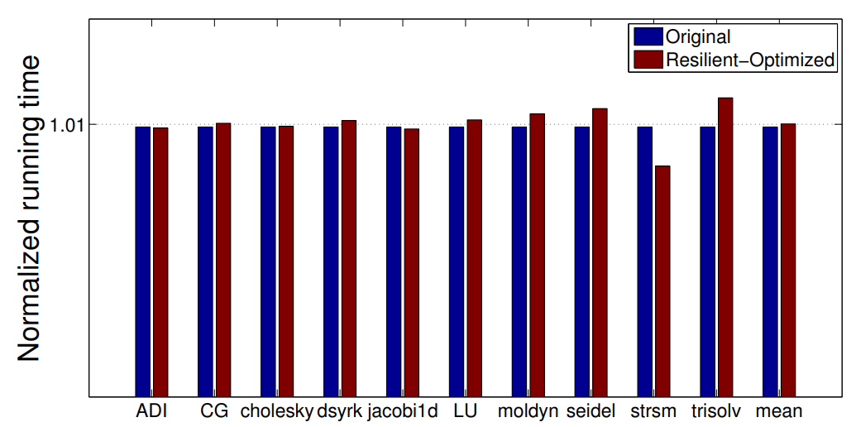
Results: Hardware Overhead
Proposed checksum functional units
Perform in parallel with main execution
Perform integer modulo arithmetic operations on inputs and outputs of functional units - one ALU unit needed
Intermediate checksum values are stored in internal registers
Replace software with checksum instructions during “nop” instructions
Average overhead of 3%

Slide 17
Strengths
Limitations
Main idea is intuitive and explained well
Relatively easy to implement at the software layer
Can be easily enabled or disabled depending on use case
No requirements for specialized hardware
Applicable to essentially any language/IR
No false positives are possible
The approach assumes fault resilience in the processor's ALU and registers, focusing on detecting errors exclusively in memory
Strong trade-off between error detection coverage and execution efficiency - could fail during real-time applications
Direct hardware approach increases the complexity of the compiler
Might not be possible for situations with no hardware support
False negatives still are not perfect
Variability of software results (Modlyn case)

Slide 18
Thank you!
Question?

