Slide 1
Superblock Formation Using Static Program Analysis
Group 20: Haitong Chen, Wenfan Jiang, Jane Luo, Jeremy Styma, and Yifan Zhu

Slide 2
The Challenge of Profile-Guided Transformations
Time and Resource Intensive
Compile → Profile → Recompile
Limited Applicability
May not be feasible for Embedded Systems
Branch Prediction Accuracy ≠ Optimal ILP
Input data may not expose important execution paths
Most likely branch may contain hazards!

Slide 3
Introducing Static Program Analysis
Efficiency and Speed
Does not rely on runtime behavior.
Universal Applicability
Suitable for any system.
Especially beneficial for Embedded Systems.
Comprehensive Optimization
Analyzes all code paths
Enhances optimization potential by avoiding known hazards

Slide 4
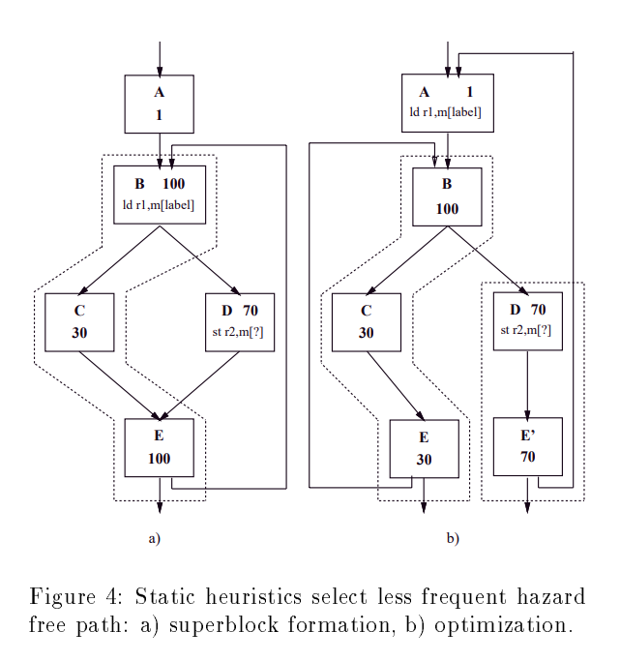
Superblock Formation using Static Program Analysis
Load hoisted successfully
Path selected based on hazard avoidance, rather than branch frequency

Slide 5
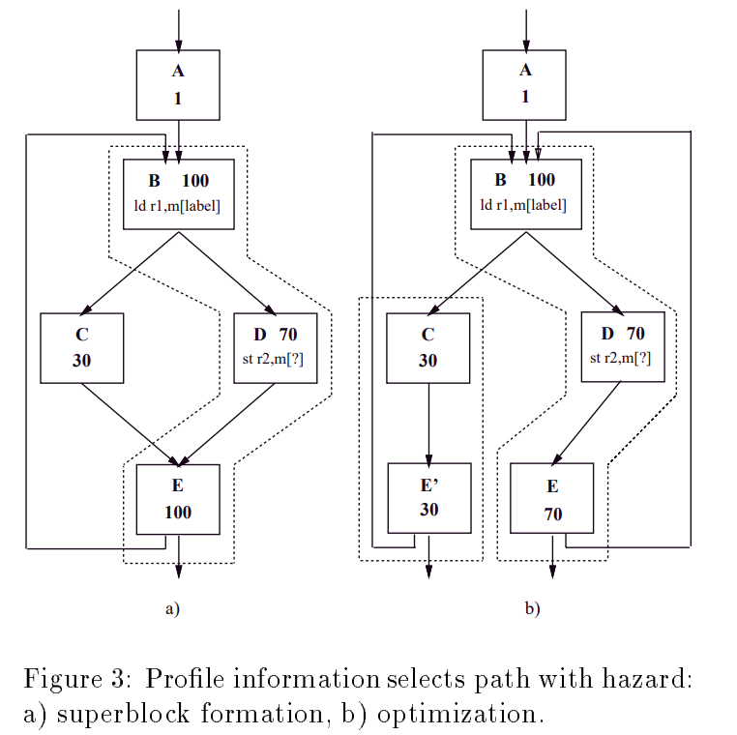
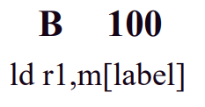
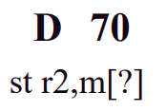
Superblock Formation using Profile Information
Load cannot be hoisted
Most frequent path contains hazard

Slide 6
Static Heuristics
Select branch directions to avoid hazards (hazard avoidance heuristic)
Predict the most likely direction of the remaining branches (path selection heuristic)
Notes:
Wenfan
We can use Static Branch Analyzer to measure heuristics

Slide 7
Hazard Avoidance
Hazard is an instruction with unclear side effects at compile time:
Modification to part of the program state that may not be precisely determined.
Hardly identified succeeding instructions.
Notes:
Wenfan
As we’ve learned, we form superblock because we want to further optimize the instructions, like moving them around inside the superblock, so we want to carefully select which basic blocks should be included in the superblock.

Slide 8
Undetermined Modification
Modification here
1. I/O instructions
2. Subroutine calls
3. Synchronization instructions
4. Ambiguous stores
int data = 10;
void foo() {
data = 20;
}
foo(); // Subroutine call
int value = data; // Memory access
Notes:
Wenfan:
1: Such as Read and Write - Results won’t be determined until runtime
2: Function calls - Can’t safely move the memory access instruction without checking the function!
3: Instructions to manage concurrency, such as lock - They will produce constraints, i.e. ordering, memory access
4. A store to an unknown address, or an address that won’t be determined until runtime - Unclear dependencies
These hazards typically act as a barrier when included in a superblock since few instructions may be optimized or scheduled across them.

Slide 9
Unidentified Succeeding Instructions
1. Subroutine returns
2. Jumps with indirect target address
int foo() {
return 0;
}
a = foo(); // Subroutine call 1
…
a = foo(); // Subroutine call 2
Unclear call sites
Notes:
Wenfan:
We may also have instructions that can be hardly predicted:
We can call a function at multiple places. And when a function completes its execution and returns a value, the point it returns to can be any of these call sites, and the compiler won’t know which exact place it is.
An indirect jump is a type of jump instruction where the destination address is not directly specified but is determined at runtime based on the value stored in a register or memory location, so the compiler won’t know where it will jump to.

Slide 10
Hazard Avoidance Heuristic
Potential hazard?
Post-dominator?
Yes
Yes
Must select
No
No
Good to select !
Select another path
Notes:
Wenfan:
If {a successor block contains a hazard or unconditionally goes to a block that contains a hazard} and {the successor block does not post-dominate the branch}, select the other path.

Slide 11
Path Selection
Predict the remaining branches after the hazard avoidance heuristic
5 ways ranked from high to low priority:
Pointer Heuristic
Loop Heuristic
Opcode Heuristic
Guard Heuristic
Branch Direction Heuristic

Slide 12
Pointer Heuristic
A pointer is not likely to be NULL
Two pointers are not likely to be equal
if (ptr == NULL) {
return;
} else {
a++; // select this
}

Slide 13
Loop Heuristic
Predicts the branch that enters the loop
Entry
preferred
Loop
Non loop
Exit

Slide 14
Opcode Heuristic
Analysis of a set of benchmark programs
Performance may vary across benchmarks
Example: given some benchmarks, a is unlikely negative
if (a < 0) {
return;
} else {
num++; // select this
}

Slide 15
Guard Heuristic
If a branch guards the use of a variable, it predicts in the direction where the variable is used
if (num < 0) {
return;
} else {
num++; // select this
}

Slide 16
Branch Direction Heuristic
Backward branches are preferred over forward
Entry
BB1
preferred
BB2

Slide 17
Experiments
Benchmark: 14 non-numeric programs
Compiler: IMPACT-I C compiler
Issue rate of the processor varies from 1 to 8

Slide 18
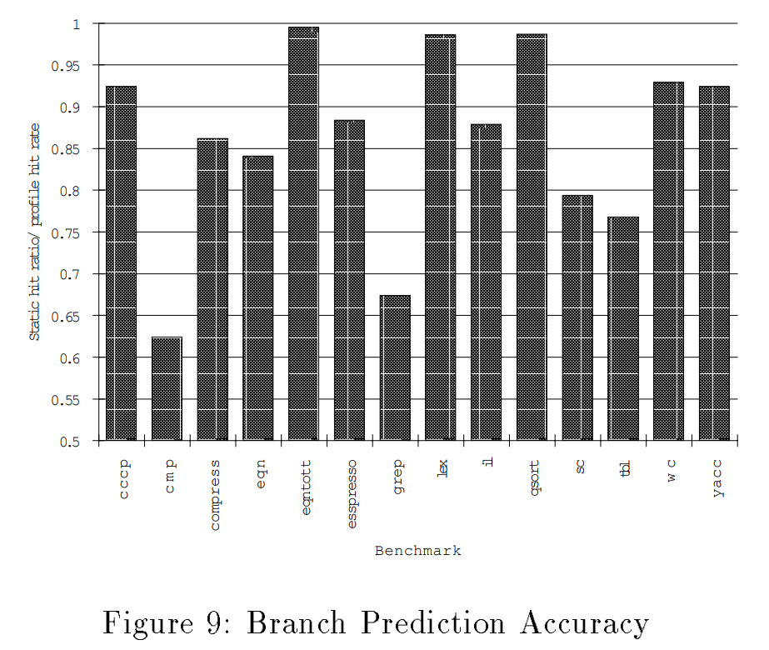
Results
Compare accurate analyzer predictions to profile info predictions
These predictions match ∼86% of the time
Notes:
Jane
Each bar in this graph represents the ratio of correct branch predictions made by the analyzer to those made by profile information. This means that a ratio closer to 1 represents more similarity between the predictions made by the analyzer and profile information (not necessarily higher prediction accuracy). The average ratio across all these benchmarks was about 86%, so the hazard free paths that are selected by the branch analyzer do tend to match the paths selected through profile information.

Slide 19
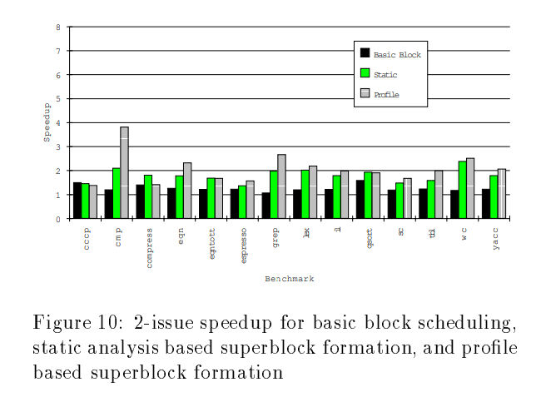
Results
Static analyzer performs better in some benchmarks
Profile-based method dominates in higher issue machines
Notes:
Jane
When it comes to superblock formation, the static analyzer has comparable performance to that of profile-based method. The analyzer even does better in some benchmarks (compress, eqntott, qsort). This can be attributed to the effectiveness of path selection heuristics in choosing hazard free paths. However, you can also see that in the cmp benchmark, mispredicted branches can cause the analyzer performance to be largely overshadowed by profile information.
In higher issue machines, profile information starts to dominate analyzer performance. This could be due to better use of available resources by the profiler or a need for better heuristics on the analyzer side.

Slide 20
Commentary
Static program analysis heuristics
No profile information needed
ILP without runtime data
Optimization and scheduling comparable to profiling
Broaden the scope of compiler optimization techniques
Limitation
Accurately predict actual runtime behavior
Tradeoff! Comprehensiveness vs. efficiency
What we plan to work on: 1) llvm; 2) path selection; 3) different heuristics
Notes:
Haitong
Good: Make use of static program analysis and the heuristics for superblock formation, so we are provided benefits like analyzing without the need for profile information, instruction-level parallelism without the need for runtime data, which saves us time and resources. It’s also notable that the static program analysis enables optimization and scheduling that are comparable to dynamic analysis using profiling. Overall, this finding broaden the scope of compiler optimization and techniques, so there can be more options in scenarios when runtime data and profiling information are not available.
Limitation: The limitation of this approach lies in the potential inaccuracy resulted from static analysis, which might not be able to capture some nuances in the actual program runtime. Therefore, there can be a tradeoff between targeting the comprehensiveness from dynamic analysis, and the efficiency that comes from static analysis.

Slide 21
Thank you!
Q&A Time

