Slide 1
Indirect Memory Software Prefetching
Presenters: Ari Singer, Peter He, Jack Holland, Harsh Sinha, Weiyuan Lyu
Authors: Sam Ainsworth, Timothy M. Jones (University of Cambridge)
Indirect Memory Software Prefetching (click me)

Slide 2
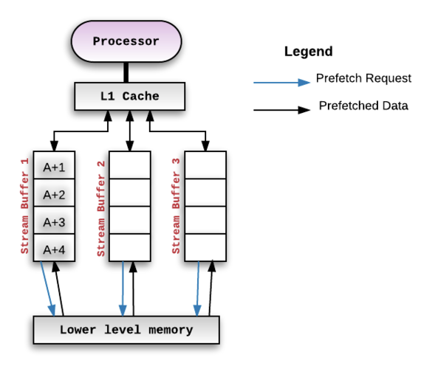
Introduction
Prefetching: Preloading data into cache before it's needed.
Hardware Prefetching
Regular Memory access patterns:
Sequential
Strided
Stream Buffers – a hardware prefetching technique for sequential access patterns (PC += 1)

Slide 3
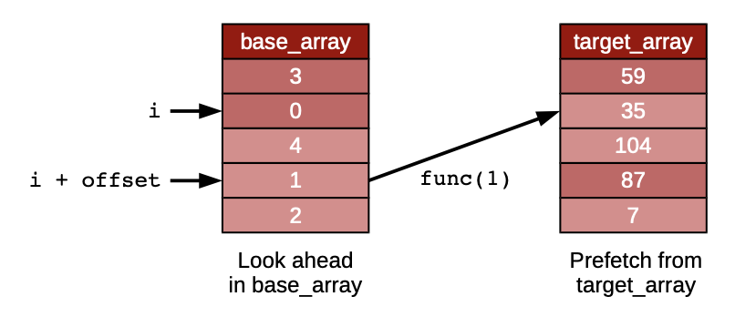
Motivation
Challenge of Irregular Access Patterns
Software Prefetching
High Performance Workloads → Indirect Memory Accesses
Idea: Identify indirect accesses and insert prefetch instructions during compilation.
Code containing stride-indirect accesses
Goal: prefetch future values from the target array.

Slide 4
Algorithm: Software Prefetch Generation
Analysis: Preloading data into cache before it's needed.
Fault Avoidance
Prefetch Generation
Scheduling
Notes:
The algorithm present a pass which finds loads that can be prefetched based on look-ahead within an array, and generates software prefetches for those that will not be identified by a stride prefetcher. I will first describe the analysis required, then the actual code generated.

Slide 5
Algorithm: Analysis Pass
Aim: identify loads that can be profitably prefetched and determine the code required to generate prefetch instructions for them.
Target loads: where it is possible to generate a prefetch with lookahead.
Notes:
The overall aim of our analysis pass is to identify loads that can be profitably prefetched and to determine the code required to generate prefetch instructions for them. The target loads are those where it is possible to generate a prefetch with lookahead.

Slide 6
Algorithm: Analysis Pass
For every load in loop
walk the data dependence graph backwards using DFS to find an induction variable.
record all instructions that reference this induction variable along each path to the load.
Constrain the recorded set of instructions , such that no function calls or non-induction-variable phi nodes appear within it.
Notes:
We start with loads that are part of a loop. We walk the data dependence graph backwards using a depth-first search from each load to find an induction variable within the transitive closure of the input operands. We stop searching along a particular path when we reach an instruction that is not inside any loop. When we find an induction variable, we record all instructions that reference this induction variable (directly or indirectly) along each path to the load.
Our recorded set of instructions will become the code to generate the prefetch address in a later stage of our algorithm. However, we must constrain this set further, such that no function calls or non-induction-variable phi nodes appear within it,

Slide 7
Algorithm: Fault Avoidance
Reason: need to ensure that any look-ahead values will be valid addresses
Strategies
1. add address bounds checks to limit the range of induction variables to known valid values
2. analyse the loop containing the load, and only proceed with prefetching if we do not find stores to data structures that are used to generated load addresses
Notes:
Intermediate loads used to calculate addresses can cause faults, so we need to ensure that any look-ahead values will be valid addresses. We follow two strategies to address this challenge: First, we add address bounds checks into our software prefetch code, to limit the range of induction variables to known valid values. Second, we analyse the loop containing the load, and only proceed with prefetching if we do not find stores to data structures that are used to generated load addresses within the software prefetch code.

Slide 8
Algorithm: Prefetch Generation
Insert an add instruction to increase the induction variable by an offset.
Generate an instruction ( select or conditional branch) to take the minimum value of the size of the data structure and the offset induction variable.
Create new copies of the software prefetch code instructions, but with any induction-variable affected operands replaced by the instruction copies.
Notes:
Now the next task is to actually insert new instructions into the code. We insert an add instruction to increase the induction variable by a value, which is the offset for prefetch. We then generate an instruction (either a select or conditional branch) to take the minimum value of the size of the data structure and the offset induction variable. We create new copies of the software prefetch code instructions, but with any induction-variable affected operands replaced by the instruction copies. Finally, we generate a software prefetch instruction instead of the final load.

Slide 9
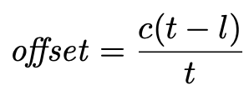
Algorithm: Scheduling
Goal: schedule prefetches by finding a look-ahead distance that is generous enough to prevent data being fetched too late, yet avoids polluting the cache.
Formula: t: total number of loads in a prefetch sequence
l: the position of a given load in its sequence
c: a microarchitecture-specific constant,
Notes:
Our goal is to schedule prefetches by finding a look-ahead distance that is generous enough to prevent data being fetched too late, yet avoids polluting the cache and extracts sufficient memory parallelism to gain performance. We generate look-ahead distances using the following formula where t is the total number of loads in a prefetch sequence, l is the position of a given load in its sequence, and c is a microarchitecture-specific constant.

Slide 10
Algorithm Example
Data dependency graph for loads

Slide 11
Algorithm Example
Prefetching code for 7 ld
Prefetching code for 5 ld

Slide 12
Results
Experimental Setup
Benchmark: Integer Sort(IS), Conjugate Gradient(CG), RandomAccess(RA), Hash Join 2EPB (HJ-2), Hash Join 8EPB (HJ-8), Graph500 Seq-CSR (G500)
System: HasWell(out of order), Xeon Phi(out of order), A57(in order), A53(in order)
Benchmark: different scenario for testing indirect access pattern
System: Xeon Phi (ICC), Others(Clang)

Slide 13
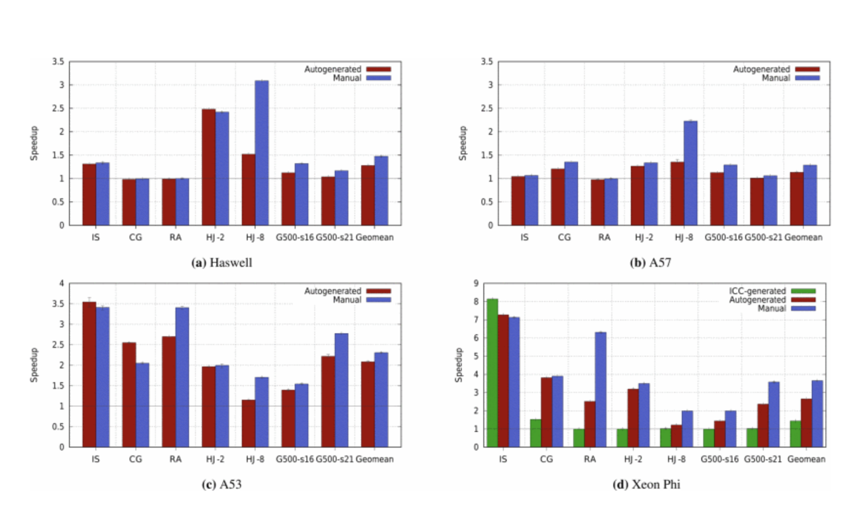
Result: Autogenerated vs Manual
Out-of-order gain performance, But not much as in-order
Jump out of the original track of execution
Some notification: Hash Join 8 Performance
the stride-hash-indirect pattern
Not recognize the linked-list element in one loop

Slide 14
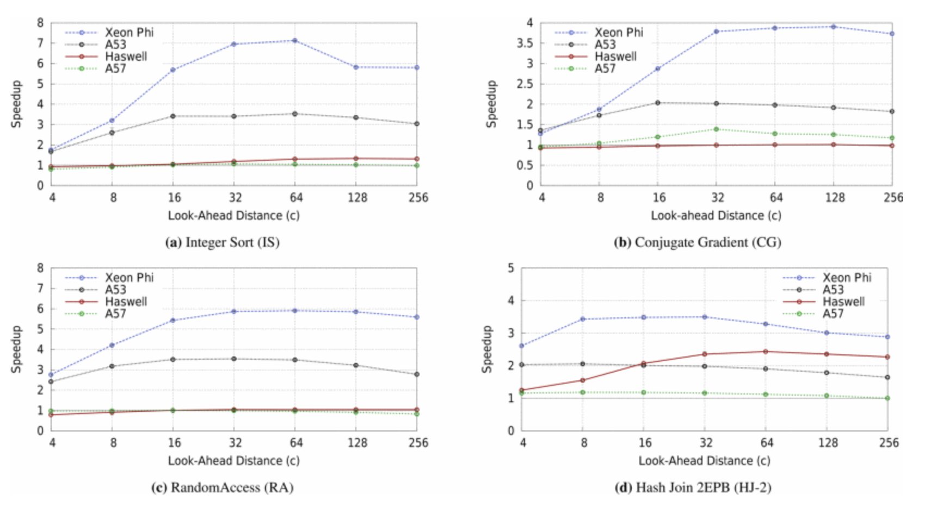
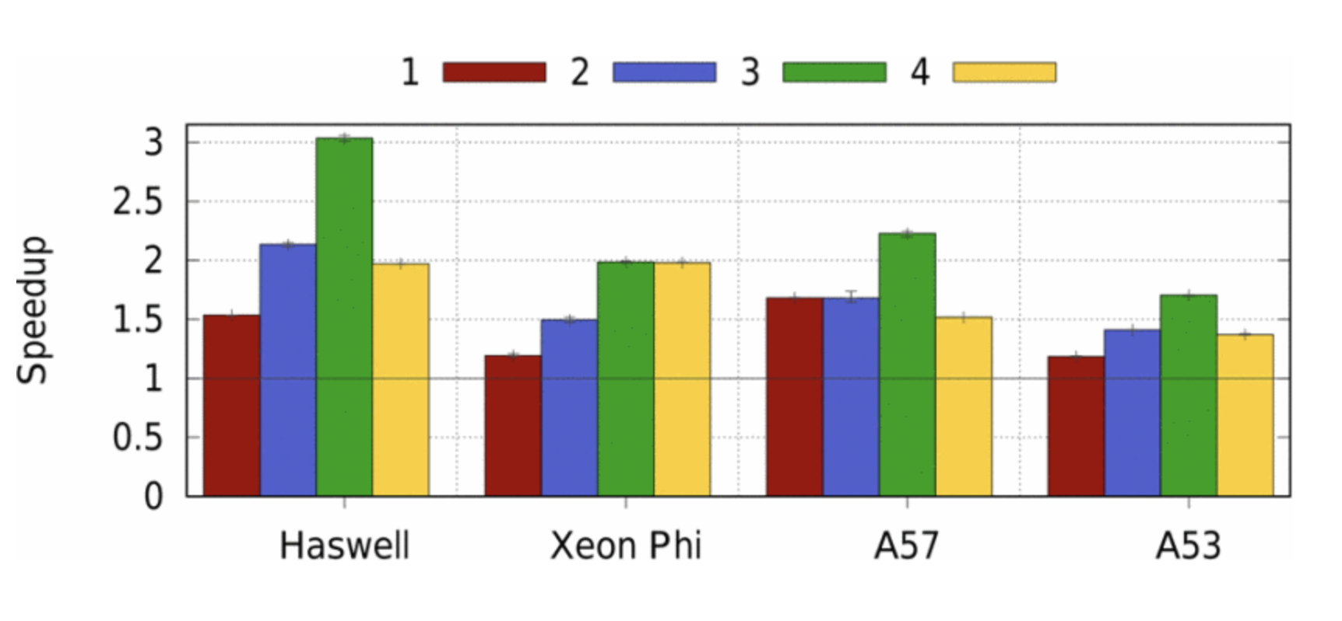
Result
Microarchitectural Impact
Look-Ahead Distance：
microarchitecture-specific constant c,
best = 64
Prefetch Stagger Depth:
how much nested loads to preload, best = 3
Bandwidth(DRAM):
shared memory system is a bottleneck
TLB support(Page table): varies result from benmarks

Slide 15
Thoughts
Relevant in a Cloud Computing Environment
Consumer
Sped up workloads
Provider
Higher throughput and utilization
Potential Downside: Scalability of resource requirements (DRAM bandwidth)

Slide 16
Project
Implement in LLVM 17.0
Constant “c” curiously the same across multiple architectures
Modify “c” derivation
Use page table size
Use DRAM bandwidth
Use CPU instruction-per-cycle
c: microarchitecture-specific constant
t: # of loads in prefetch sequence
l: position of load in a prefetch in a sequence
Notes:
C is based on memory bandwidth of system

Slide 17
Questions?

