Slide 1
Sculptor: Flexible Approximation with Selective Dynamic Loop Perforation
Shikai Li, Sunghyun Park, Scott Mahlke
Presented by Group 25
Yuhang Ning, Chen Huang, Yuanzhe Zheng, Houming Chen, Yucheng Huo
04/08/2024
Notes:
Hello everyone! We are group 25, and today we are going to present the paper “Sculptor: Flexible Approximation with Selective Dynamic Loop Perforation”

Slide 2
Background - Approximate computing
Approximate computing
Sacrifice some accuracy to get better performance
Task Skipping - skip some codes
Loop Perforation
Approximate Computing
Task Skipping
Loop Perforation

Slide 3
Background - Loop Perforation
Traditional Loop Perforation
Skip some iterations of a loop periodically.
int sum_to_n(int n) {
int sum = 0;
for (int i = 1; i <= n; i++)
sum += i;
return sum;
}
n=10000
No Perforation: 1+2+3+....+10000 = 50005000
Perforation (execute 1 iter, skip 1 iter) : 1+3+5+....+9999 = 25000000
Perforation (execute 1 iter, skip 4 iter) : 1+6+11+....+9996 = 9997000
What if we only cares about the order of magnitude (log-scale) of the resulting sum?

Slide 4
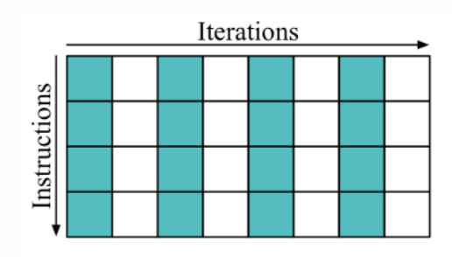
Problems of the Traditional Loop Perforation
Traditional loop perforation is “limited to skip iterations entirely with all internal instructions and periodically with a constant rate during runtime”.
Maybe we could only skip some instructions in a loop?
Maybe we can intelligently chose some iterations to skip, rather than skipping all the iterations?

Slide 5
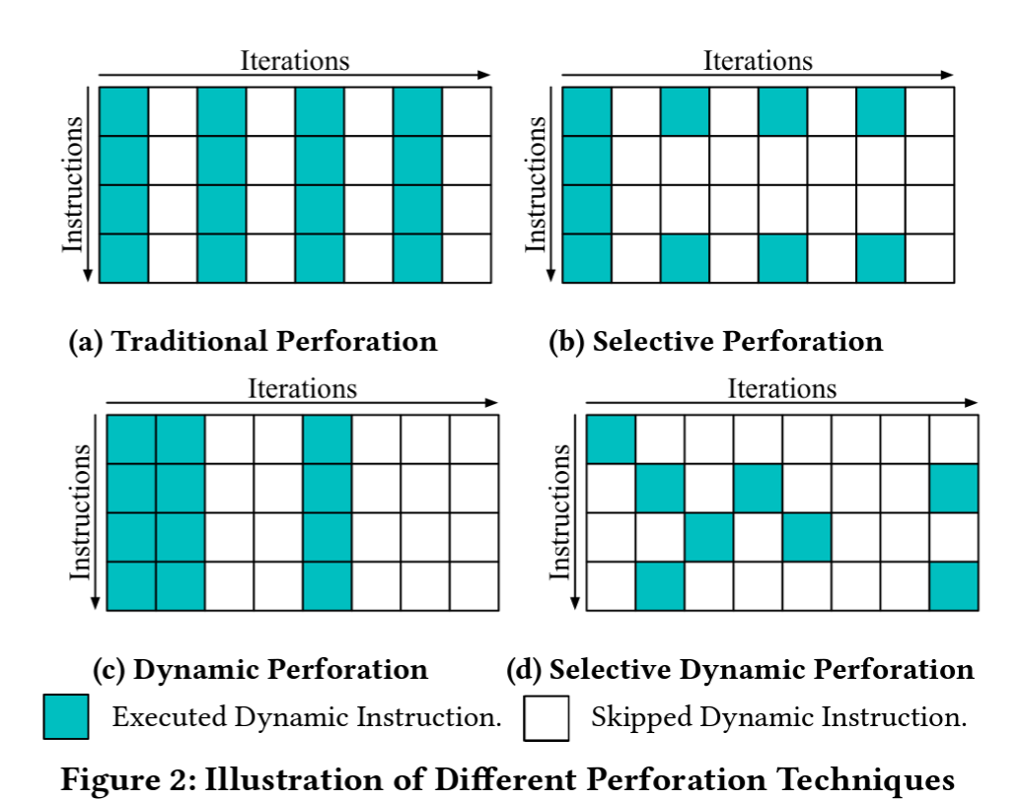
Selective/Dynamic Perforation
Selective Perforation:
loops skip a flexible subset of their instructions.
Dynamic Perforation:
loops skip a flexible subset of their iterations.
Selective Dynamic Perforation:
Loops skip a dynamic subset of their instructions in a dynamic subset of their iterations.

Slide 6
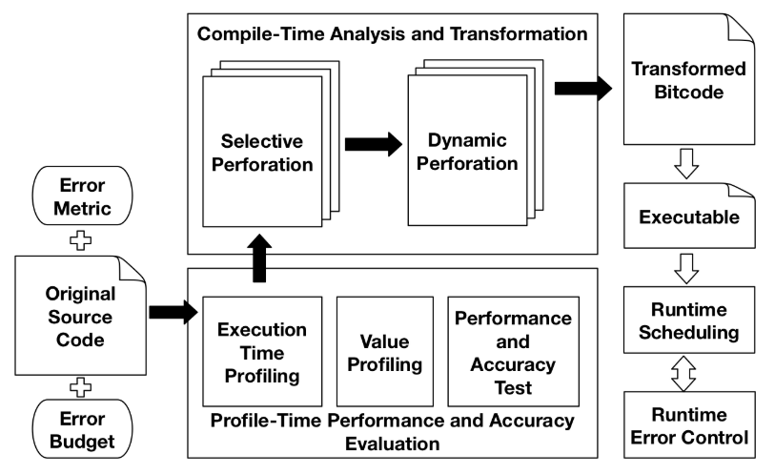
Overview of Sculptor

Slide 7
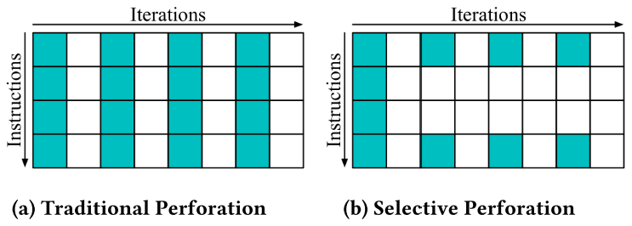
Selective Perforation
Idea:
Need a finer-grained perforation strategy
Some instructions hurt output quality significantly, while other instructions hurt output quality negligibly
→
Skip instructions that have a large impact on performance and a small impact on accuracy.
Instruction Level
Load based
Store based
Instructions executed
Instructions skipped

Slide 8
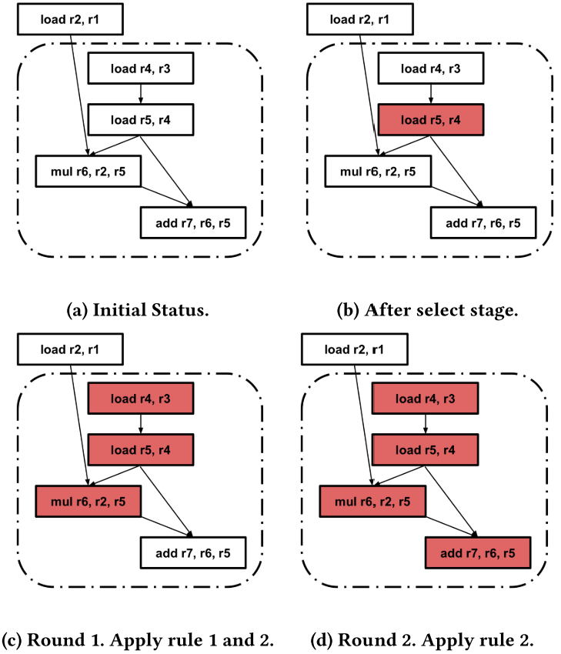
Instruction Level Selective Perforation
If function calls exist, select them. Otherwise, target all instructions.
Based on static analysis, exclude instructions that may cause program corruption or catastrophic errors.
Based on profiling, exclude instructions that may cause the output error to exceed the error budget based on profiling
Split the basic block and inserting a branch instruction before each consecutive target instruction chain.
Unswitching Optimization: Create two copies, one original and one perforated. Run the wanted one with a single branch.
Unrolling Optimization: Unroll small loops
Selection Stage
Expansion Stage
Transformation Stage
Notes:
Expansion stage
1) All instructions which only use results of target instructions or loop invariant values.
2) All instructions whose results are only used by the target instructions
Transformation stage 1:
it brings too much control divergence overhead and may cause performance downgrade at sometimes. Compiler optimizations could be performed to reduce this overhead, including instruction reordering, loop unswitching, loop unrolling, etc

Slide 9
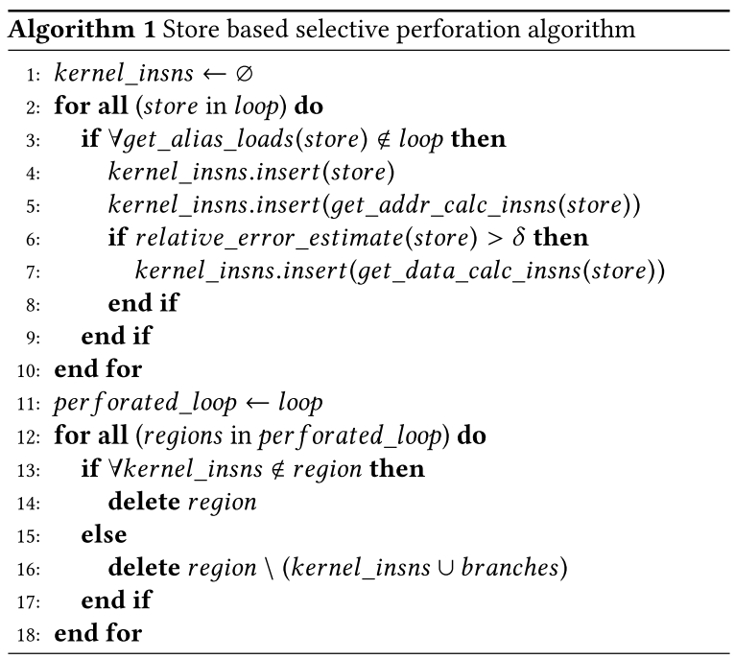
Load/Store Based Selective Perforation
Load Based
The same as instruction level, but only target load instructions in the selection stage.
→ Reduces the profiling overhead in the selection stage.
Store Based
Find all stores that
Have alias loads outside the loop or across iterations
Have large impact on the error
Those stores are important and should not be perforated
Perforate all instructions that are not related to those stores
Notes:
Load based: reduce the profiling overhead in the selection stage
Store based: avoids the complexity of analyzing every instruction and the runtime overhead to go through the unnecessary control flow divergences

Slide 10
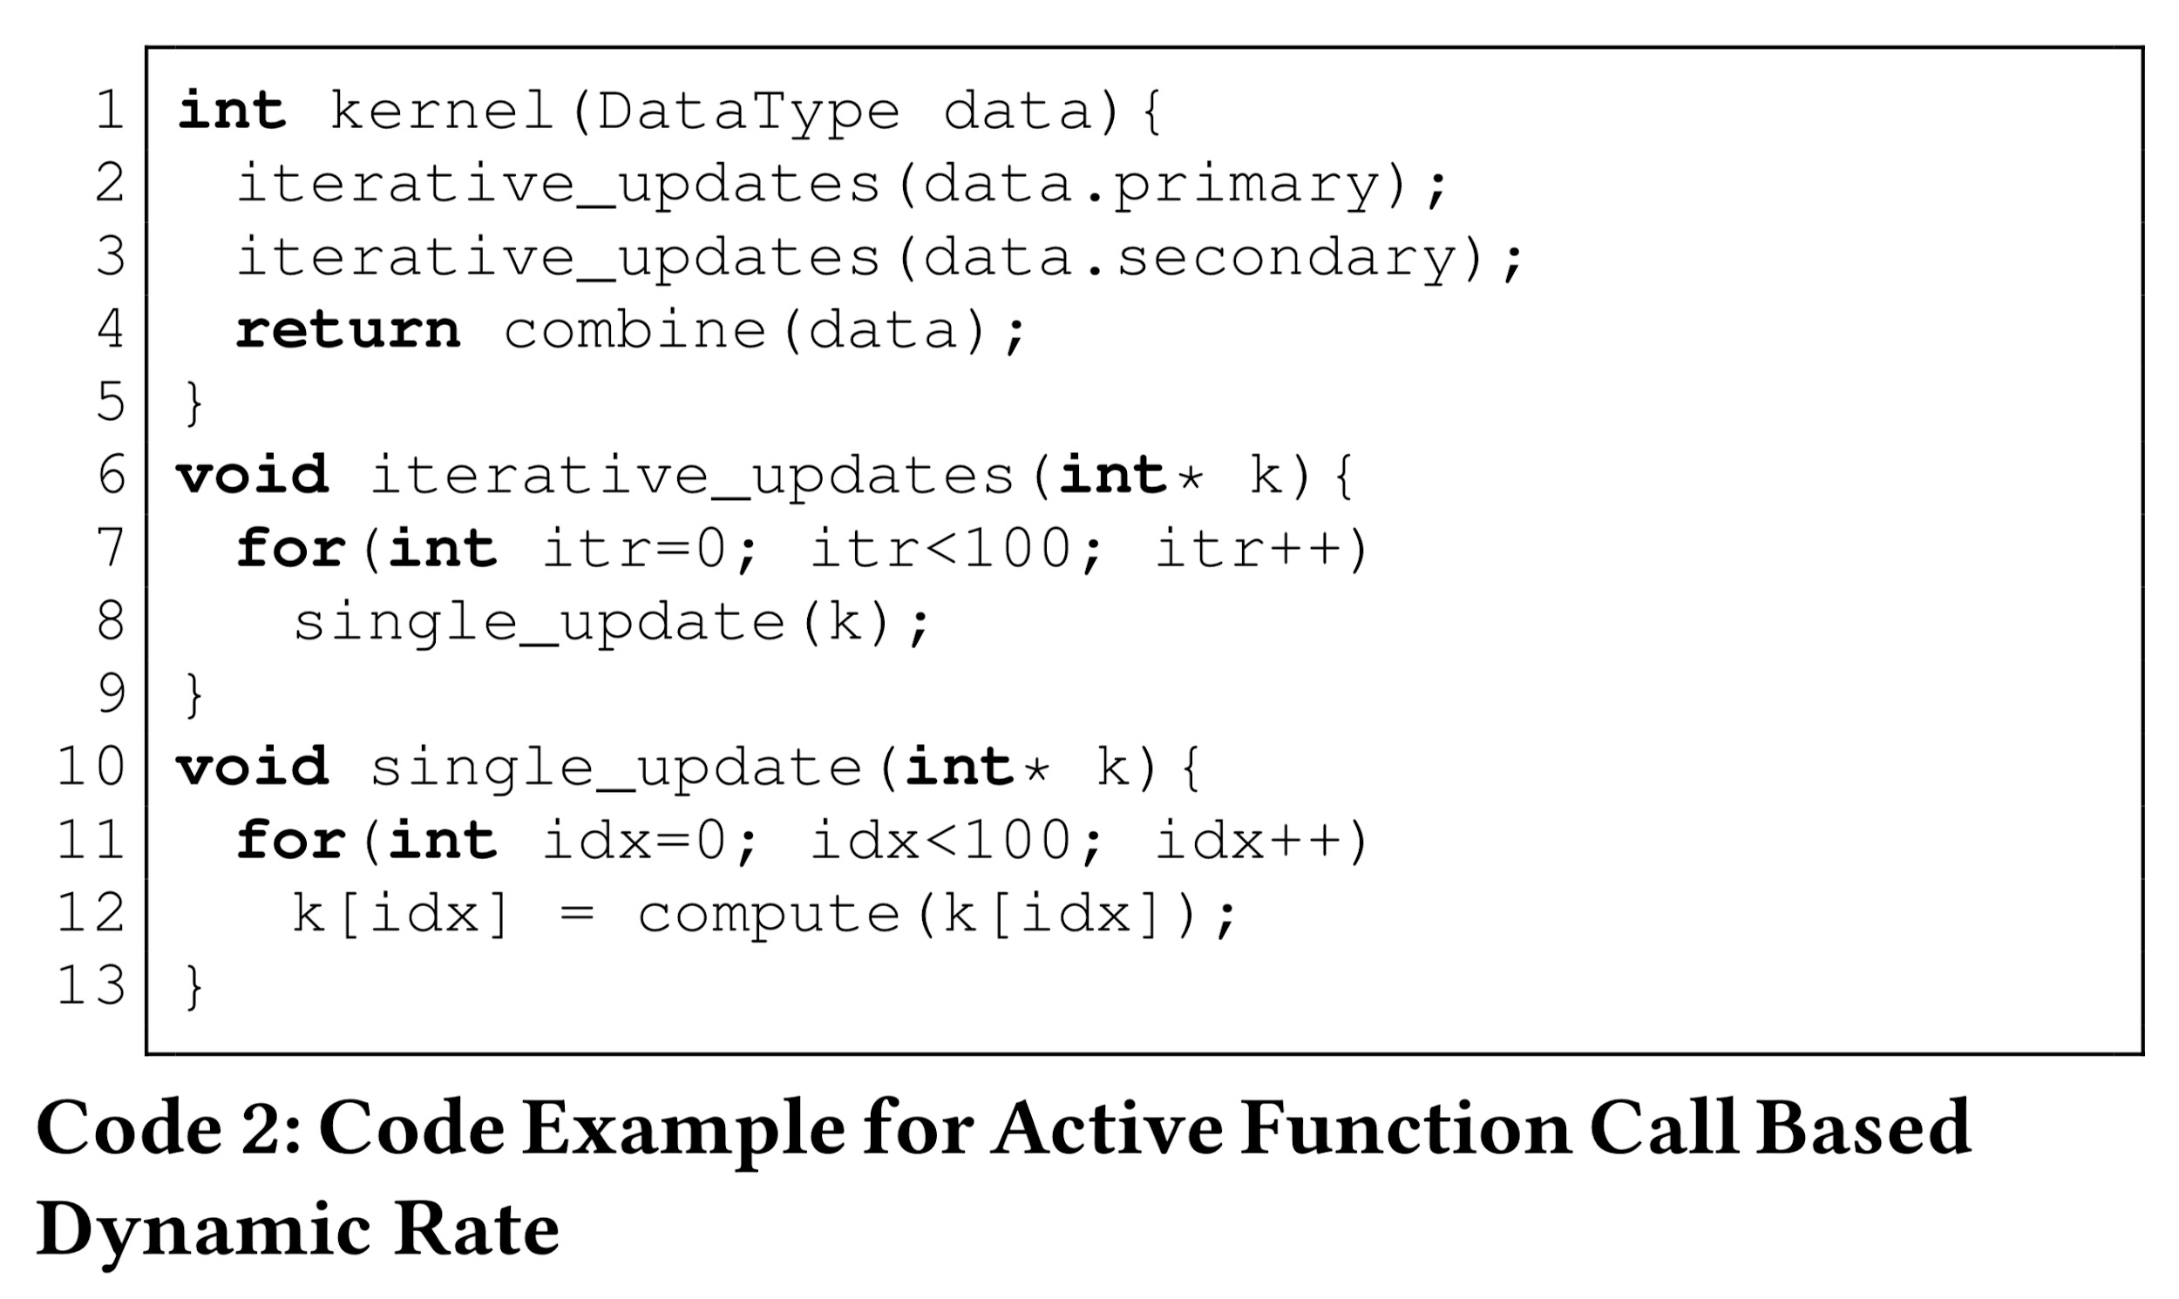
Dynamic Perforation Overview
Dynamic Perforation
Adaptive optimization for approximate computing based on runtime information and program execution context
Flexibility
Adjusts to runtime changes for optimal performance-accuracy balance
Methods
Active Function Call Based Dynamic Rates
Active Loop Iteration Based Dynamic Rates
Benefit
Enhanced performance with controlled accuracy trade-offs
Notes:
Dynamic Perforation as a leap forward in approximate computing. It’s not just about skipping iterations; it's about smartly adapting to what the program is doing at runtime. This adaptability allows us to fine-tune the balance between how fast we want the program to run and how accurate we want our results to be. The methods we discuss, namely Active Function Call and Active Loop Iteration Based Dynamic Rates, are our tools for achieving this balance. Highlight the main benefit: achieving significant performance improvements without compromising much on accuracy, which is crucial for compute-intensive applications in domains where some degree of approximation is acceptable.
In Code 2, it is clear that, at each program execu- tion, compute function will be executed 20000 times. However, the first 10000 executions and the second 10000 executions of com- pute are operated on different parts of data. Through profiling, if data.secondary is observed to be highly tolerant of errors but data.primary is observed to be less tolerant to errors, it is better to approximate the first 10000 executions of compute more aggres- sively but approximate the second 10000 executions of compute less aggressively at runtime. Active - function call based dynamic rate.

Slide 11
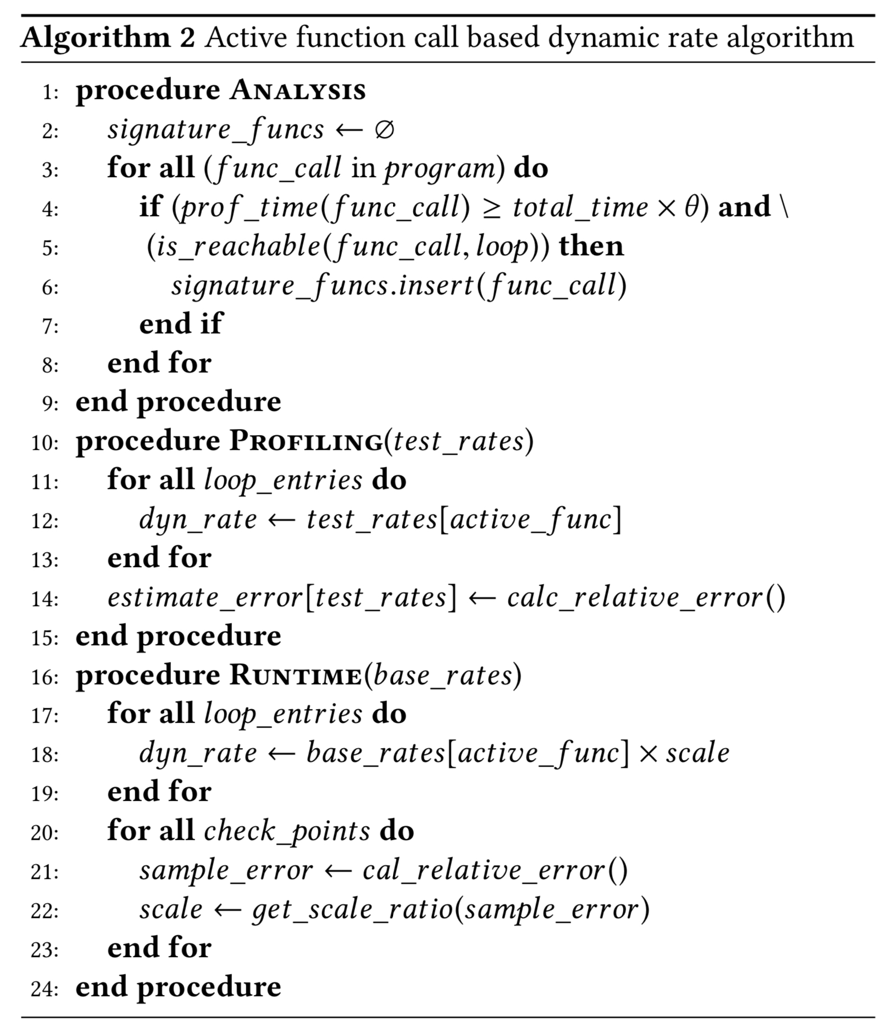
Implementing Dynamic Perforation
Active Function Call Based
Modifies perforation rates by monitoring active function calls.
Active Loop Iteration Based
Alters perforation according to the count of loop iterations.
Notes:
Active Function Call Based Dynamic Rate: perforation rate is adjusted based on the active function calls observed at each loop entry. The core idea is that different function calls, when active, can have varying impacts on the accuracy of loop executions. Through profiling, it's possible to determine which parts of the data are more tolerant to errors. The system then uses this information to adjust the perforation rates more aggressively for data that can handle more approximation and less aggressively for more sensitive data.
Active Loop Iteration Based Dynamic Rate: The method is predicated on the observation that the impact on accuracy varies significantly across different iterations of loops, especially in loops nested within other loops. By profiling and analyzing the program's behavior, the system identifies key iterations (or phases within those iterations) where approximation can be more aggressively applied without significantly affecting overall accuracy.

Slide 12
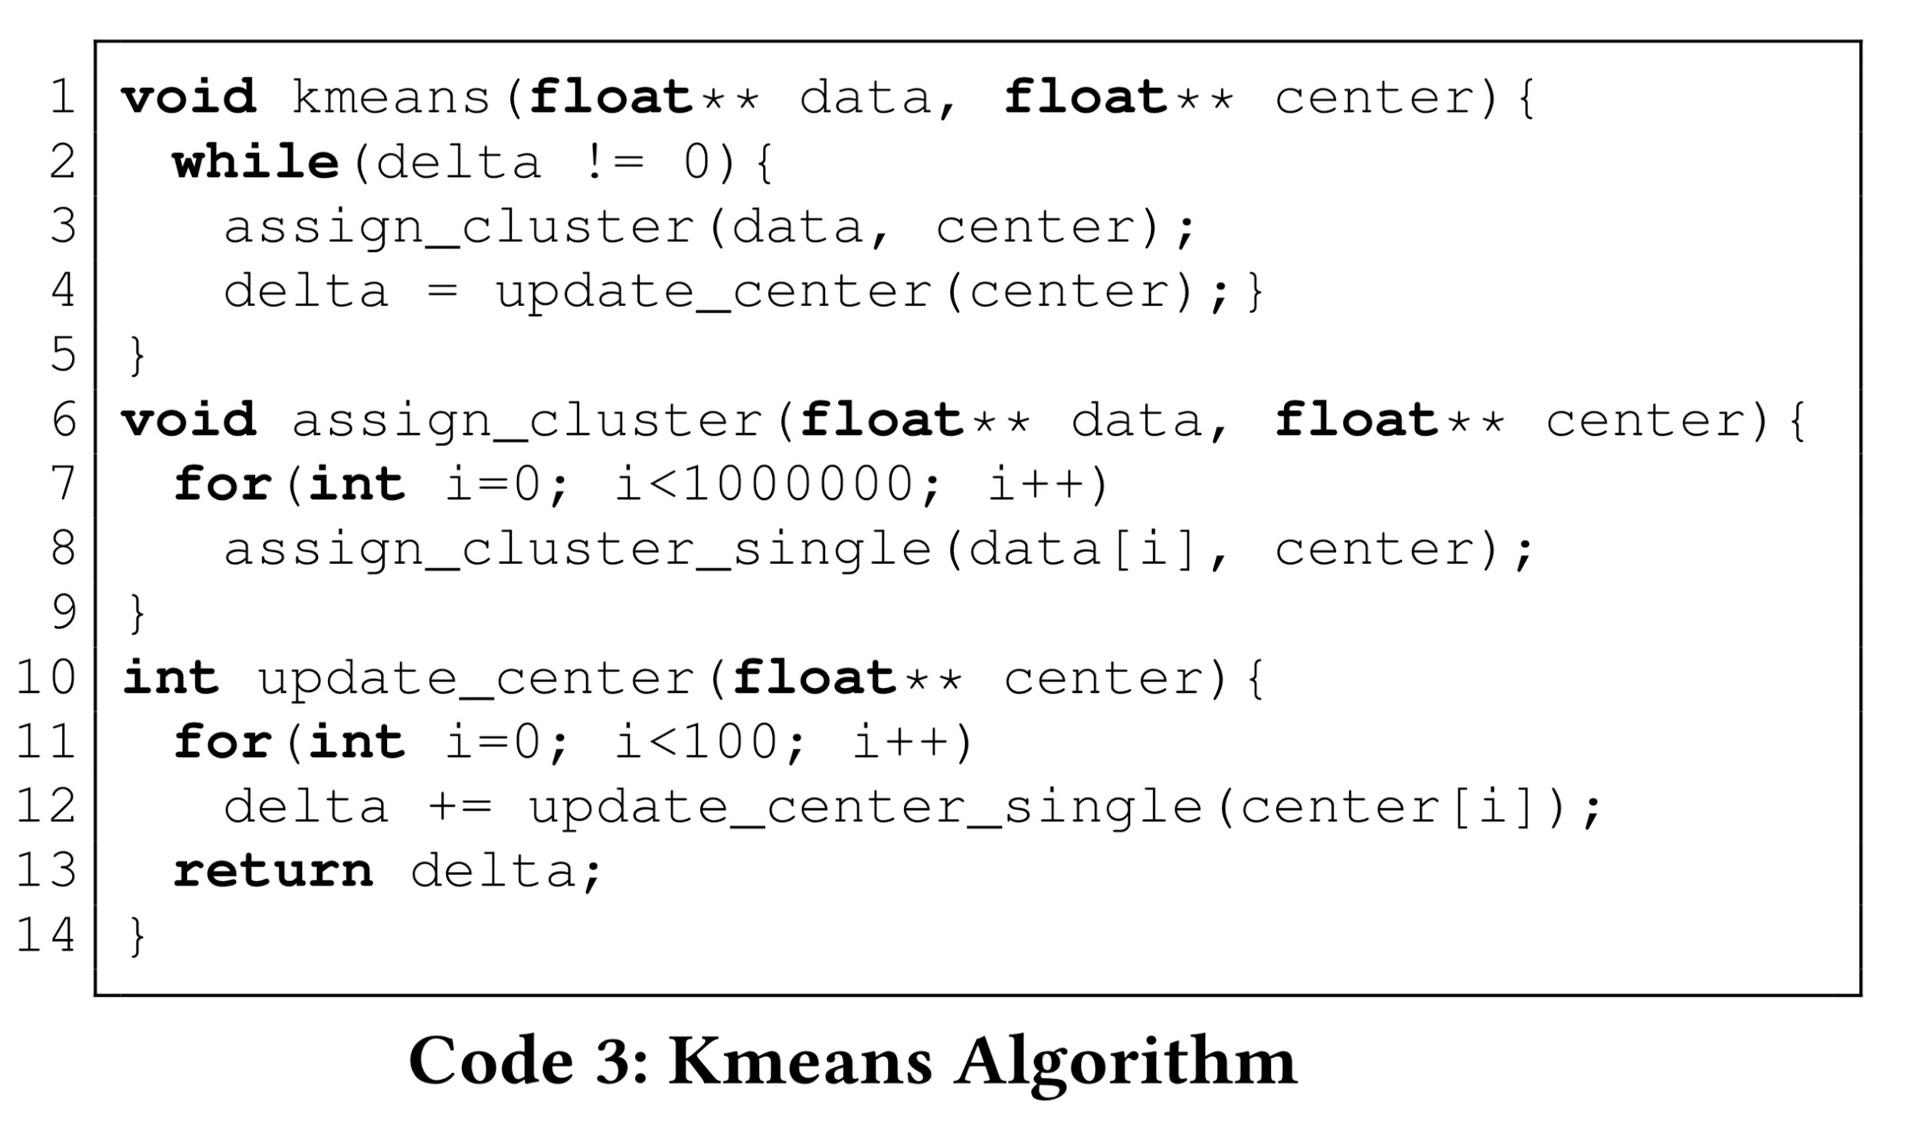
Dynamic Start
Traditional loop perforation may incur accuracy loss due to non-uniform iteration execution.
Improving the accuracy of loop perforation by varying the iteration start points during runtime.
Example: k-means algorithm
Notes:
Begin with the challenge posed by traditional loop perforation techniques, which often lead to accuracy loss due to the static nature of iteration start points. This static approach can neglect parts of the data set, leading to significant errors in computations, especially in algorithms that rely on comprehensive data coverage like kmeans.
Introduce Dynamic Start as a novel solution that addresses this challenge by dynamically adjusting iteration start points during runtime. This ensures that all parts of the data set have an equal chance of being processed, thus mitigating the issue of non-uniform execution and its impact on accuracy.
Highlight the key benefits of implementing Dynamic Start, emphasizing its role in promoting fairness in how data is accessed and processed within loops. This not only improves the accuracy of the results but also retains the efficiency benefits of loop perforation by selectively skipping iterations.
Use the kmeans clustering algorithm as a concrete example of Dynamic Start's application. k-means requires processing all data points to assign them to the nearest cluster center and then recalculating the centers based on the assignments. Traditional loop perforation techniques, which skip iterations in a fixed pattern, can lead to a biased or incomplete view of the dataset because the same data points might consistently be skipped. This dynamic adjustment means that over multiple iterations, the algorithm effectively considers the entire dataset, leading to more accurate calculation of cluster centers, even if some data points are skipped in any single iteration.

Slide 13
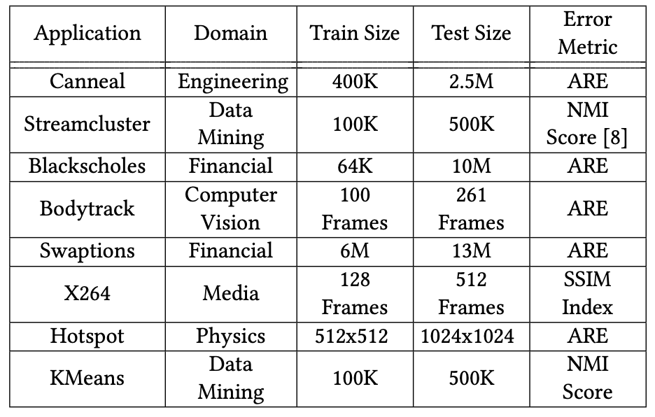
Evaluation – benchmarks + metrics
KMeans:
Assign points to the nearest cluster based on the distance to cluster means. Randomly initialize data clusters and update until converge.
Bodytrack
Track 3D human movement
Image processing, creating image hull from cameras
Swaptions
Monte Carlo Simulation on random path of interest rates.
X264
Encode video streams to MPEG-4 AVC formats.
NMI = 1 -> perfect matches the true cluster
SSIM = 1 -> same image
calculates the image similarity based on luminance + info
Northeastern University. (2015). Normalized Mutual Information (NMI). Retrieved from https://course.ccs.neu.edu/cs6140sp15/7_locality_cluster/Assignment-6/NMI.pdf

Slide 14
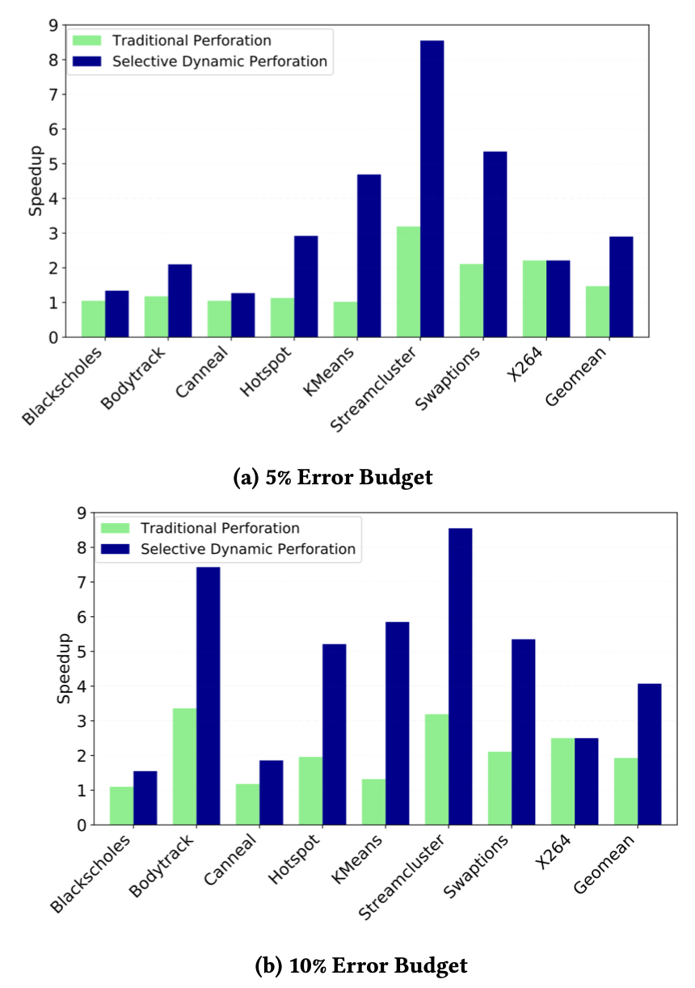
Evaluation - Results
Overall Improvement
bodytrack, streamclusters, Hotspots Kmeans shows the best improvement.
X264 has a nice performance on traditional perforation already.

Slide 15
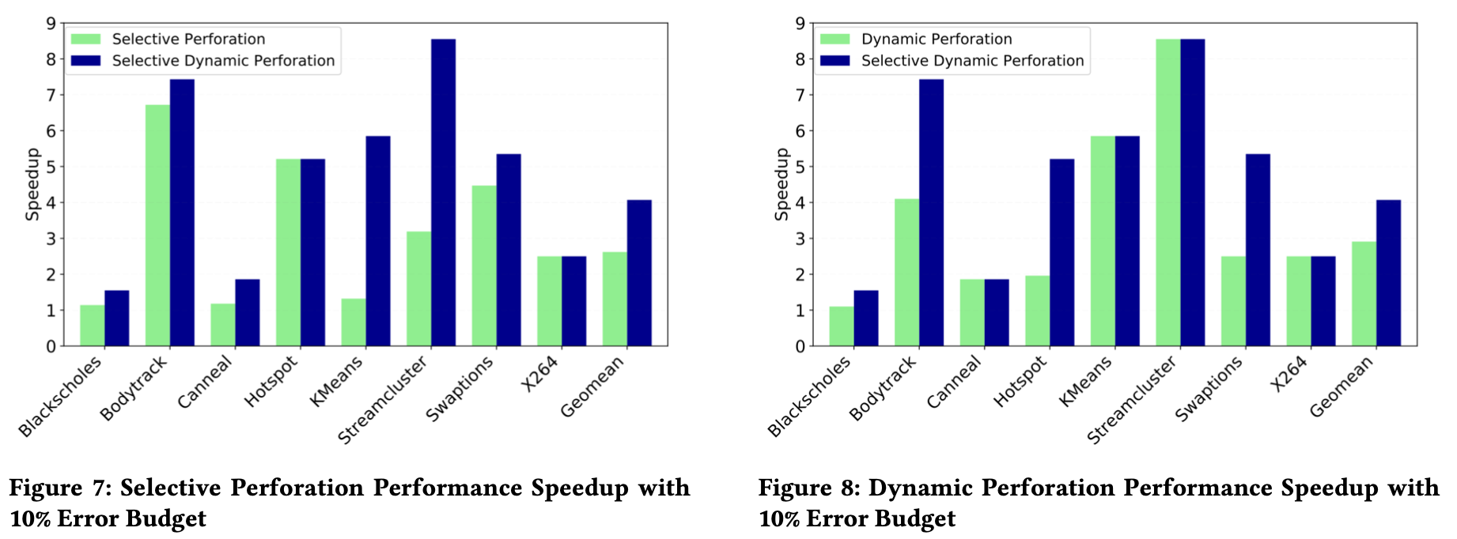
Evaluation - Results
BodyTrack
Selectively skips weight calculation but keeps the updating instruction. Consecutive elements tend to have similar weights.
Hotspots
Selectively skips the current phase temperature calculation and uses the previous phases inside a loop. Nearby location has small variance.
Kmeans
Traditional perforation: skips iteration is unfair for certain data clusters and data. Huge error.
Dynamic perforation rate: terminate loop earlier after most points are assigned pretty nicely to a cluster. Keeps the initially updating iteration the same.

Slide 16
Commentary
Strengths
Innovative Technique: Introduces selective dynamic loop perforation for finer control over computation approximation.
Potential for Performance Improvement: Offers significant performance gains in computation-intensive domains under same error budgets.
Evaluation of Methodology: Validates technique across various applications, showcasing broad applicability.

Slide 17
Commentary
Weaknesses
Complexity of Implementation: Requires complex compiler modifications and sophisticated runtime management.
Dependence on Profiling Accuracy: Effectiveness relies on accurate profiling for optimal strategy identification.
Potential Overhead: Dynamic adjustments might introduce overhead, affecting tight energy budgets.
Scope of Applicability: Precision-critical applications may find the approximation approach less favorable.

Slide 18
Thanks!

Slide 19
Q&A

