Slide 1
Formal Verification of SSA-Based Optimizations for LLVM
Jianzhou Zhao, Santosh Nagarakatte, Milo M. K. Martin, Steve Zdancewic
Presented by “group” 23: Yu Wang

Slide 2
Background & Motivation
Test case(simulation)-based testing – not convincing.
- There is always one more edge case.
- Serious bugs have been found in GCC and LLVM.
- Are there no more?
Formal verification provides a proof if a program is correct (or a counterexample if not).

Slide 3
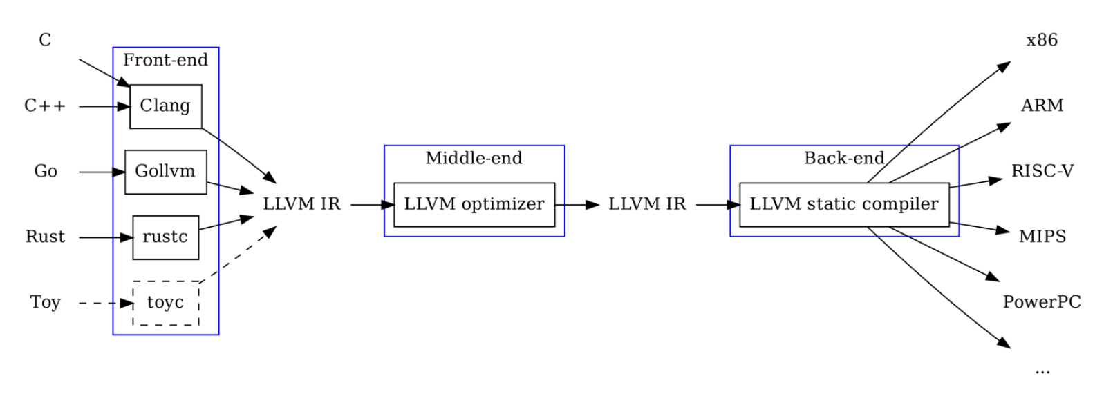
Background & Motivation
conservative => usually safe
aggressive => dangerous
Image source: https://www.alibabacloud.com/blog/compilation-optimization-llvm-code-generation-technology-details-and-its-application-in-databases_598408
Notes:
Few bugs have been found in the frontend

Slide 4
Source of Bugs
LLVM IR
LLVM Code
……
LLVM Code
LLVM Code
(Hopefully) LLVM IR
safe
safe
not safe
not safe
safe?
LLVM was not designed with verification in mind!
Notes:
Allowed to break SSA during optimization. HW2.

Slide 5
Verifying an Optimization Pass
Safety property:
The optimized code is well-formed SSA.
The transformed program refines the original program. The original behaviors include all the transformed behaviors.
Tools:
Coq proof assistant.
Vminus – a formal/mathematical/logical encoding of LLVM that coq can reason with.
Idea: rewrite the pass in Vminus and verify it with coq.

Slide 6
Verifying an Optimization Pass
Operational semantics: a set of rules that describe the behavior of a programming language.
Main theorem:
$$If⊢f and f, P⊢σ and f⊢σ→σ^{′}, then f, P⊢σ′$$
$(A⊢B⟹B is “good” in the context of A)$
If function f is well-formed, program states in function f satisfy the property P, and the transformation is in operational semantics, then the transformed states satisfy the property as well.

Slide 7
Source of Bugs
LLVM IR
LLVM Code
……
LLVM Code
LLVM Code
(Hopefully) LLVM IR
safe
safe
not safe
not safe
safe?
LLVM was not designed with verification in mind!
Middle steps could break SSA form $⇒$
not every move is in operational semantics

Slide 8
Example: Variable Substitution
$$r1=r2$$
$$…$$
$$pc: r4=r1+1→r4=r2+1$$
Goal: replace $r2$ with $r1$
$r ≔rhs\{r1/r2\}$
$f$ is well-formed. $r1$ used at $pc$ $⟹$ $def(r1)$ dominates $pc$
$r1∈sdom(pc)$
$f$ is well-formed. $r2$ used at $def(r1)$ $⟹$ $def(r2)$ dominates $pc$ (transitive)
$r2∈sdom(pc)$
$r2$’s value is defined by some instruction
$∃{rhs}_{2} δ\left[r2\right]= {[\left[{rhs}_{2}\right]]}_{δ}$
$r1$’s value is defined by some instruction
$∃{rhs}_{1} δ\left[r1\right]= {[\left[{rhs}_{1}\right]]}_{δ}$
$r2$ is redundant with $r1$ ($r1=r2$)
${rhs}_{2}= {rhs}_{1}$
Every definition still dominates all its uses
Every variable is still assigned exactly once
$⇒$ The transformed code is well-formed!
$S$: the set of existing encodings (safe)
$S′$: the set of encodings for the transformation (the above 6 lines)
$coq\left(S+S^{′}\right)⟹OK!$

Slide 9
Verifying (Rewriting) mem2reg
Converts trivial SSA into minimal, pruned SSA.
$l1: r0=alloca int$
$store int 0 r0$
$l2: r1=load \left(int ∗\right) r0$ $l2: r1=phi \left[0, l1\right] […, …]$
Captures 88% of the benefit of the $−O1$ level optimizations.
Verifying mem2reg is non-trivial:
- Significant, non-local changes to memory and temporary variables (no alloca)
- Intermediate stages break SSA

Slide 10
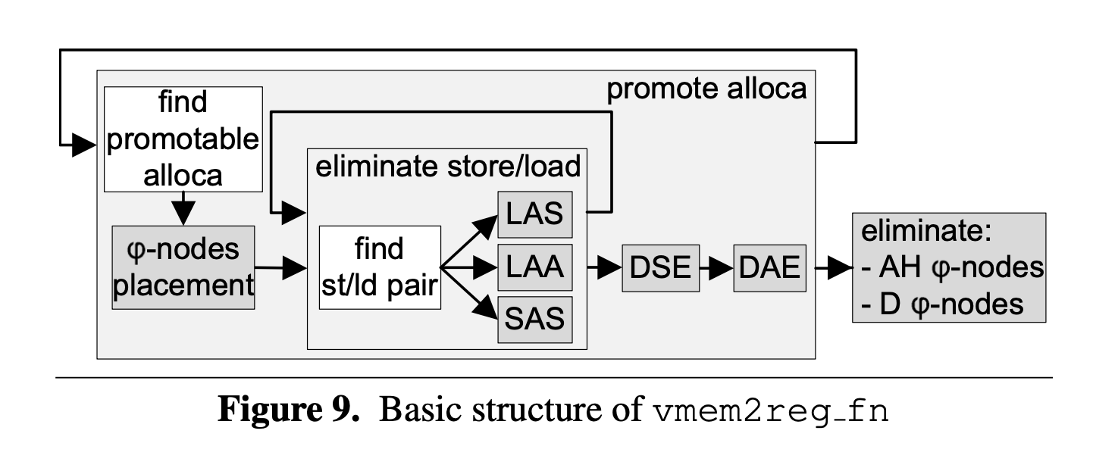
Verifying (Rewriting) mem2reg

Slide 11
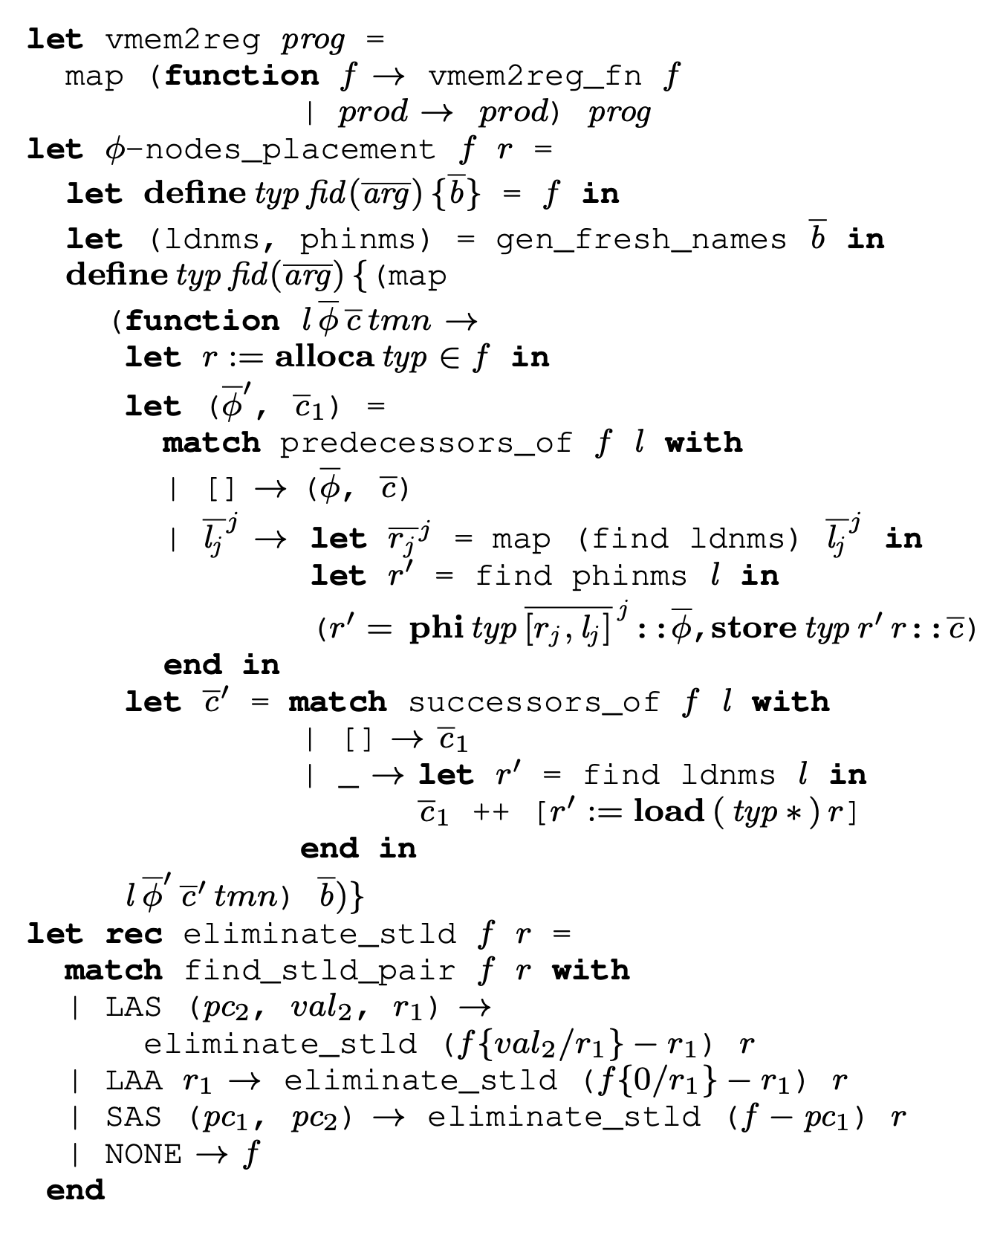
Verifying (Rewriting) mem2reg
Each micro-transformation is verifiable
Semantics are always preserved
(Main theorem:
$If⊢f and f, P⊢σ and f⊢σ→σ^{′},$
$then f, P⊢σ′$)
The entire transformation preserves
semantics
Coq says OK!

Slide 12
Results and Impact
Verified (rewritten) code is correct and just as efficient
Same approach can be used on other optimization passes
Possible improvement: a more readable logical language than Vminus?

Slide 13
Questions

