Slide 1
Augmenting Loop Tiling with Data Alignment for Improved Cache Performance
Group 16
Atharva Bhamburkar, Abhinav Nakarmi, Shmeelok Chakraborty, Matthew Keenan, Inderjeet Nair

Slide 3
Caches
What: Super-fast but expensive memory
Why: Main memory is very slow = More execution time
How:
Temporal locality: If you use something now, it is likely that you will use it again in the future
Spatial locality: If you use something now, it is likely that you will use something close-by in the future

Slide 4
Cache Misses
What: You don’t find something in the cache
Compulsory: Initial empty cache
Capacity: Cache size is insufficient
Conflict:
Multiple locations in memory are mapped to a particular cache line
Only one of these can be present in the cache at once
Access a competing memory location = Kick out the current one

Slide 5
Loop Tiling
Working Set: Data that the loop needs to execute
Too large = Cache misses = More execution time
Idea: Break the loop into smaller tiles
Reduces the size of the Working Set
Tries to eliminate capacity misses

Slide 6
Working Set
Cache

Slide 7
Cache
Smaller Working Set

Slide 8
Previous Techniques
Tile selection algorithms: LRW, ESS, TSS, etc
Limitations:
1D tiling
Tile size highly sensitive to array size - sometimes leads to inefficient cache utilization

Slide 9
Motivating example
n x n

Slide 10
Motivating example
X
n x n
n x n

Slide 11
Motivating example
X
n x n
n x n

Slide 12
Motivating example
X
n x n
n x n

Slide 13
Motivating example
X
n x n
n x n

Slide 14
Motivating example
X
n x n
n x n

Slide 15
Motivating example
X
n x n
n x n

Slide 16
Motivating example
X
n x n
n x n

Slide 17
Motivating example
X
n x n
n x n

Slide 18
Need to fetch the same row again!!
X
n x n
n x n

Slide 19
Cache of block size 2
Matrix
Cache

Slide 20
Matrix
Cache

Slide 21
Cache

Slide 22
Cache
0 | 1
2 | 3
4 | 5
6 | 6
8 | 9
10 | 11
12 | 13
14 | 15
0 | 1 | 2 | 3 | 4 | 5 | 6 | 7
8 | 9 | 10 | 11 | 12 | 13 | 14 | 15
16 | 17 | 18 | 19 | 20 | 21 | 22 | 23
24 | 25 | 26 | 27 | 28 | 29 | 30 | 31
memory address maps to exactly one cache block

Slide 23
Cache
0 | 1
2 | 3
4 | 5
6 | 6
8 | 9
10 | 11
12 | 13
14 | 15
0 | 1 | 2 | 3 | 4 | 5 | 6 | 7
8 | 9 | 10 | 11 | 12 | 13 | 14 | 15
16 | 17 | 18 | 19 | 20 | 21 | 22 | 23
24 | 25 | 26 | 27 | 28 | 29 | 30 | 31

Slide 24
Cache
0 | 1
2 | 3
4 | 5
6 | 6
8 | 9
10 | 11
12 | 13
14 | 15
0 | 1 | 2 | 3 | 4 | 5 | 6 | 7
8 | 9 | 10 | 11 | 12 | 13 | 14 | 15
16 | 17 | 18 | 19 | 20 | 21 | 22 | 23
24 | 25 | 26 | 27 | 28 | 29 | 30 | 31

Slide 25
Cache
0 / 16 | 1 / 17
2 / 18 | 3 / 19
4 / 20 | 5 / 21
6 / 22 | 6 / 23
8 / 24 | 9 / 25
10 / 26 | 11 / 27
12 / 28 | 13 / 29
14 / 30 | 15 / 31
0 | 1 | 2 | 3 | 4 | 5 | 6 | 7
8 | 9 | 10 | 11 | 12 | 13 | 14 | 15
16 | 17 | 18 | 19 | 20 | 21 | 22 | 23
24 | 25 | 26 | 27 | 28 | 29 | 30 | 31
Multiple addresses mapped to same block!
CONFLICTS!

Slide 26
Naive Approach to Tile Selection
Too small tile size:
Advantage: Everything fits into cache.
Disadvantage: Too many accesses to main memory as working set size is small.

Slide 27
Cache
Matrix

Slide 28
Naive Approach to Tile Selection
Too large tile size:
Disadvantage: Might not fit into cache and we have a large working set size.

Slide 29
Cache
Matrix

Slide 30
Solution
Need of an optimal tile selection algorithm
- Cache size
- Data access patterns

Slide 31
Solution
Idea: Choose the largest tile for which the working set size fits into the cache.

Slide 32
Solution
Idea: Choose the largest tile for which the working set size fits into the cache.
Allow user to specify tile size with additional information about the application.

Slide 33
Tile Selection Cases
Common case where user does not specify anything

Slide 34
Tile Selection Cases
ShapeX = 2 [Constant] ShapeY is a Variable

Slide 35
Tile Selection Cases
ShapeY = 2 [Constant] ShapeX is a Variable

Slide 36
Tile Selection Cases
ShapeY = 3 [Constant] ShapeX = 3 [Constant]

Slide 37
Tile Selection Cases
User defines aspect ratio: ShapeX / ShapeY e.g. 1:1

Slide 38
Memory
Cache
A | B
C | D
E | F
G | H

Slide 39
Memory
Cache
A | B
C | D
E | F
G | H
A,

Slide 40
Memory
Cache
A | B
C | D
E | F
G | H
A,
B

Slide 41
Memory
Cache
A | B
C | D
E | F
G | H
A,
B
C

Slide 42
Memory
Cache
A | B
C | D
E | F
G | H
A,
B
C
D

Slide 43
Conflict will lead to a cache miss!
Memory
Cache
A | B
C | D
E | F
G | H
A, E
B
C
D

Slide 44
Conflict will lead to a cache miss!
Memory
Cache
A | B
C | D
E | F
G | H
A, E
B, F
C
D

Slide 45
Conflict will lead to a cache miss!
Memory
Cache
A | B
C | D
E | F
G | H
A, E
B, F
C, G
D

Slide 46
Conflict will lead to a cache miss!
Memory
Cache
A | B
C | D
E | F
G | H
A, E
B, F
C, G
D, H

Slide 47
A | B
C | D
E | F
G | H
A

Slide 48
A | B
C | D
E | F
G | H
A
B

Slide 49
A | B
C | D
E | F
G | H
A
B
C

Slide 50
A | B
C | D
E | F
G | H
A
B
C
D

Slide 51
A | B
C | D
E | F
G | H
A
B
E
C
D

Slide 52
A | B
C | D
E | F
G | H
A
B
E
F
C
D

Slide 53
A | B
C | D
E | F
G | H
A
B
E
F
C
D
G

Slide 54
Still Has a Conflict!
A | B
C | D
E | F
G | H
A, H
B
E
F
C
D
G

Slide 55
A | B
C | D
E | F
G | H

Slide 56
A | B
C | D
E | F
G | H
A

Slide 57
A | B
C | D
E | F
G | H
A
B

Slide 58
A | B
C | D
E | F
G | H
A
B
C

Slide 59
A | B
C | D
E | F
G | H
A
B
C
D

Slide 60
A | B
C | D
E | F
G | H
A
B
E
C
D

Slide 61
A | B
C | D
E | F
G | H
A
B
E
F
C
D

Slide 62
A | B
C | D
E | F
G | H
A
B
G
E
F
C
D

Slide 63
Padding with 2 cache lines works
A | B
C | D
E | F
G | H
A
B
G
H
E
F
C
D

Slide 64
Experiments
Workstation Information:
SUNSparc5 (SS5)
8 KB data cache equivalent to 1024 double precision elements
16 byte cache line (2 elements per line)
SUNSparc10 (SS10)
4-way associative 16 KB data cache equivalent to 2048 elements
32 byte cache line (4 elements per line)
Example Problems
Matrix Multiplication (MM)
Successive Order Relaxation (SOR)
LU decomposition (LUD)
Laplace

Slide 65
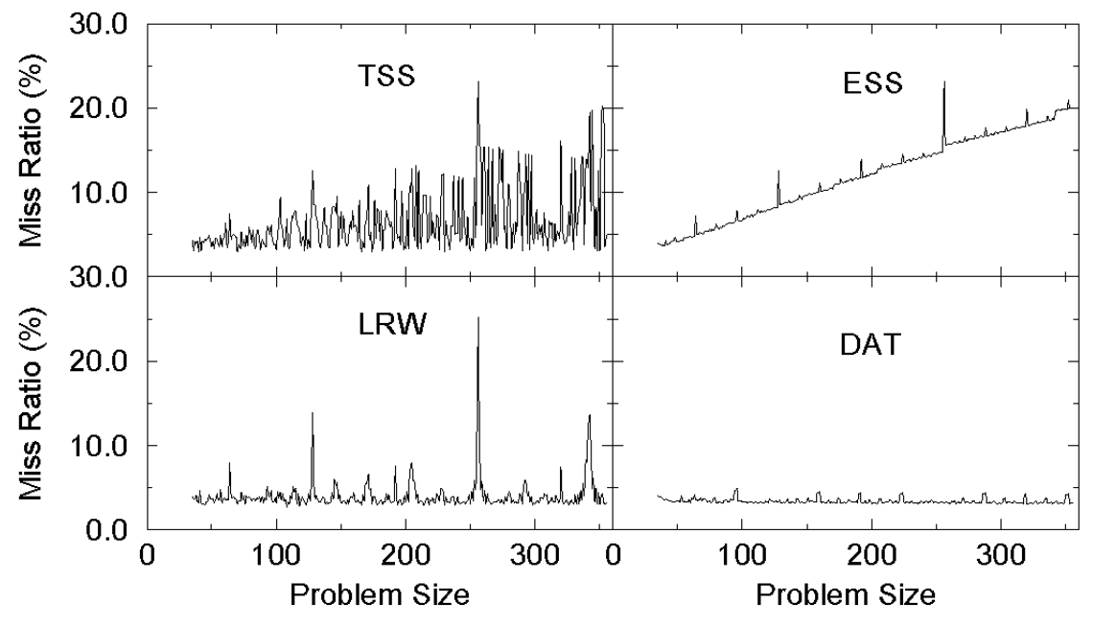
Results for Matrix Multiplication

Slide 66
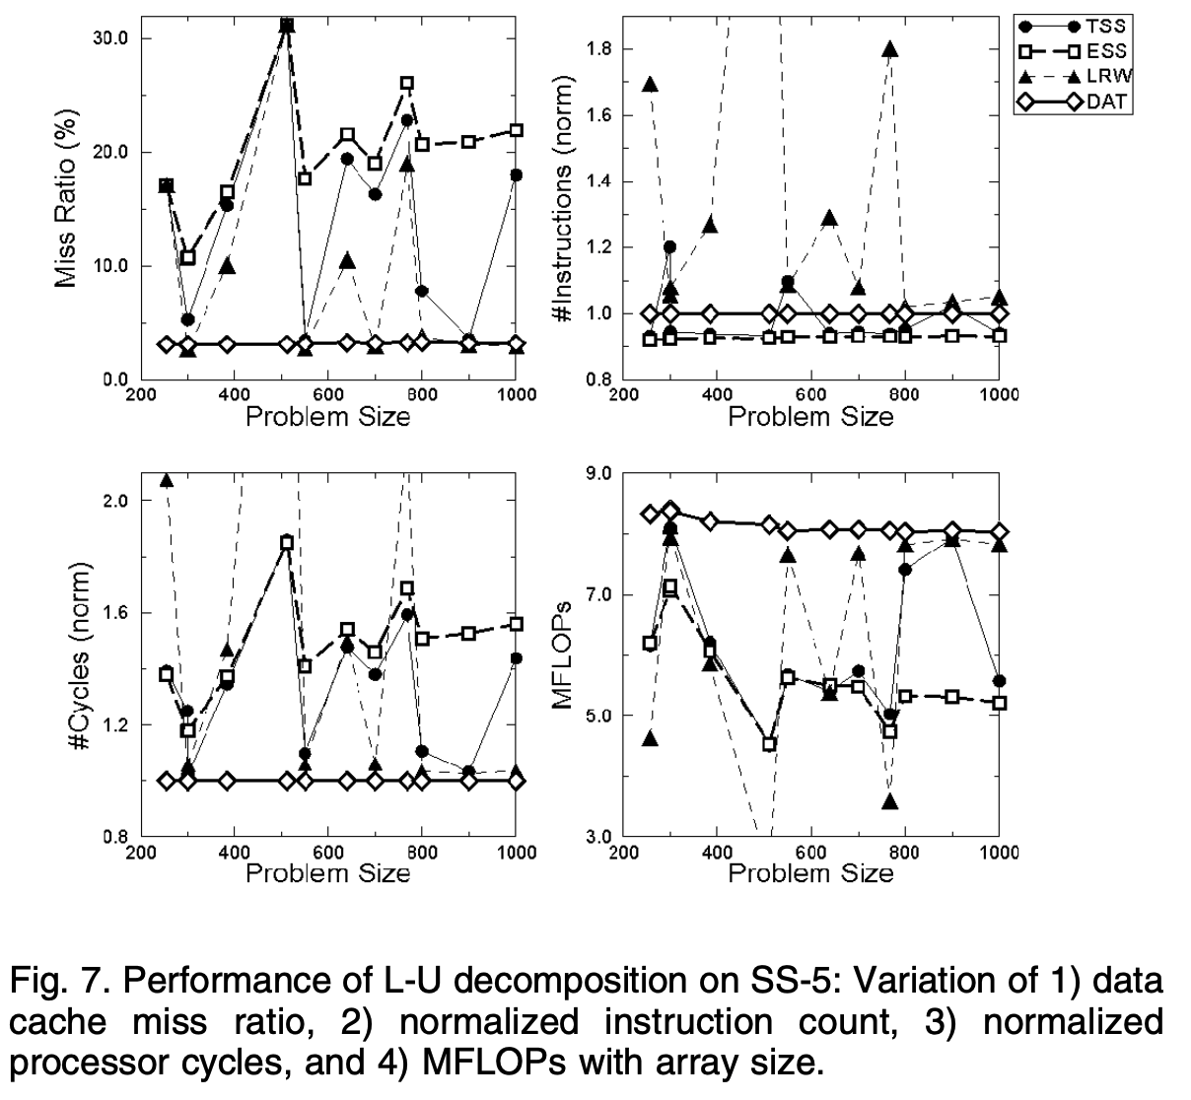
Results for LU Decomposition

Slide 67
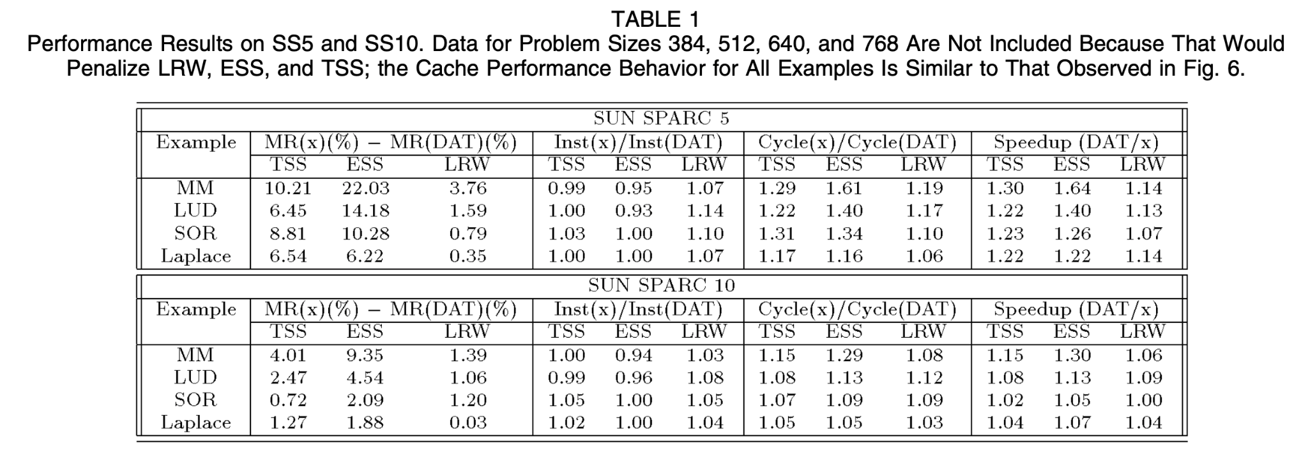
Comparative analysis for different tasks

Slide 68
Criticism of the paper
Structure of the data arrays has changed and the code has to reflect the new structure
1 | 5
2 | 6
3 | 7
4 | 8
1 | 7
2 | 8
3 | 9
4 | 10
5 | 11
6 | 12
The indices have changed
After Padding

Slide 69
Thank you!

