Slide 1
LLVM Based Parallelization of C Programs for GPU
Team 6: Heyang Zhang, Yuxin Xue, Ziyi Zhou, Jifeng Wang, Haoran Cheng

Slide 2
Motivation
Parallel Programming Model
Ex: CUDA, OpenCL
Pragma Based Model
Ex: OpenMP, OpenACC, DVMH
Automatic Parallelizing Compilers
Implicit Parallel Programming

Slide 3
SAPFOR
System FOR Automated Parallelization
includes an automatic parallelizing compiler
Produce a parallel version of a program based on DVMH model

Slide 4
DVMH Model Requirements
parallel loops identification
compute region specification
high-level data transfer directives
Notes:
The DVMH model is all about making our code ready for parallel computing, which means we're telling the program how to run on multiple processors to speed things up. Think of it as adding to code a set of special instructions. These instructions fall into three main categories: figuring out which loops in the code can run in parallel, telling specific parts of the code to run on special hardware like GPUs to make things faster, and managing how data moves around efficiently in this parallel setup. It's all about adding these annotations to our code so that it can run in parallel on multiple processors.

Slide 5
Properties for Parallelization
program variables and corresponding memory locations
control flow
Source-level alias tree
Notes:
To make sure the insertion of these directives is permissible, the automatic parallelizing compiler must investigate the properties of the code section to be parallelized. We investigate into two kinds of properties: the properties of program variables and corresponding memory locations, and the properties of the control flow. We will use SAPFOR for the static analysis. At the core of SAPFOR’s analysis process is the source-level alias tree, which analyze the accessed memory in the program. We will talk about this later. And the analysis for control flow is meant to identify situations like function calls have side effect or program may terminate inside a function call, which makes the code not available for parallelization.

Slide 6
Processing of Original Code
Applies depth-first ordering traversal in call graph
Evaluates constraints of loops for parallelization
Transforms analysis into parallelization directives.
Notes:
After the properties of the program have been explored, SAPFOR looks up for sections of code that can be executed in parallel. By applying depth-first ordering traverse, we traverse the call graph to identify potential loops for parallelization. Then for each loop we examine the following constraints: Safety of control flow, Safety of memory accesses, Direction of data usage, The ability to express properties of memory locations with DVMH directives and The ability to collapse iteration spaces of nested loops into one larger iteration
space. If all constraints are satisfied, the current loop will be parallelized and corresponding DVMH directives will be created.

Slide 7
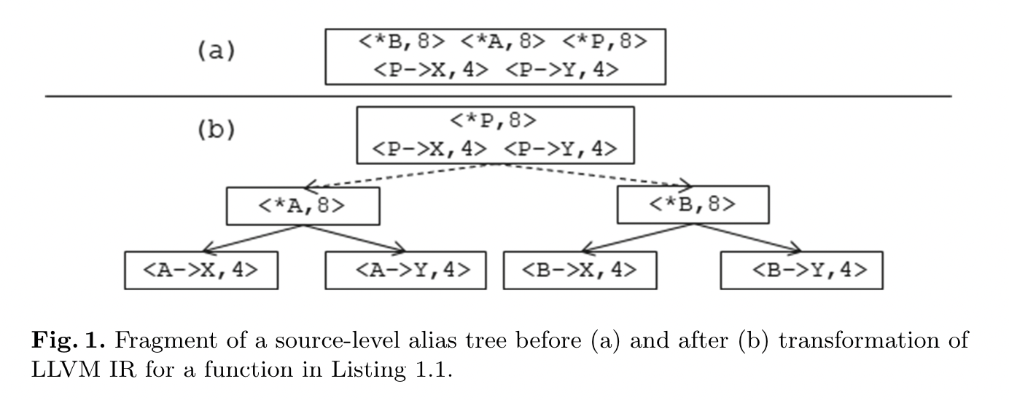

Slide 9
Implementation Details
Client Thread:
Responsible for program parallelization
Request necessary information from the analysis server
Analysis Server:
Separate thread started inside the automatic compiler
Clones the original LLVM IR for analysis and transform passes

Slide 11
Evaluation
The analysis time(s) of the NAS Parallel Benchmarks (NPB)
Notes:
The applicability of the implemented approach was examined on the C versions of the NAS Parallel Benchmarks.
We consider the semi-automatic parallelization of three benchmarks: EP (Embarrassingly Parallel), BT (Block Tri-diagonal solver) and CG (Conjugate Gradient).
For the Semi-automatic transformation, we made some simple preliminary transformations of benchmarks manually to deal with the limitations of the current version of SAPFOR. The reason for that is current version of SAPFOR cannot establish a correspondence between the original higher level source and a single LLVM IR, which prevents source-to-source transformations and it implies us to merge all sources except header files manually.
As shown in the table, the original versions comprise source files with preliminary transformations mentioned above. The transformed versions were obtained after manual and user-guided automatic transformations. And finally, the parallel C-DVMH versions were obtained after automatic parallelization.
The increase in code size of the transformed versions is primarily due to the inline expansion, which allows SAPFOR to perform pairwise comparison of array accesses ‘ to determine whether dependencies exist between two subscripted references to this array in the loop nest. In case of inline expansion the loop nest may grow notably causing
significant rise of analysis time (up to 37 min for BT).
As for CG, call to a function with arguments of pointer type is another reason for inline expansion because invocation context should be analyzed to investigate whether or not two pointers can point to the same object. The usage of restrict keyword in a source code is another way to overcome this Issue.
Although SAPFOR is not able to reveal privatisable arrays in a static way, it uses dynamic analysis which is helpful in case of EP and BT programs.

Slide 12
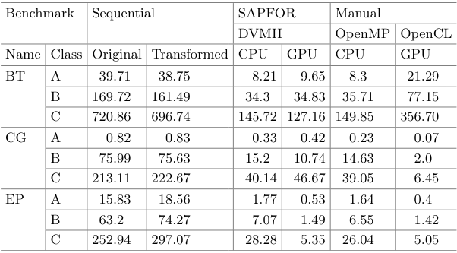
Evaluation
The execution
time(s) of the
NAS
Parallel
Benchmarks
(NPB)
Notes:
This shows the execution times of parallel versions obtained after automatic parallelization of the transformed benchmarks. It can be noted that the sequential transformed version of the BT benchmark is better optimized than the original one. It is the result of inline expansion which provides the compiler with more optimization opportunities.
A significant advantage of the OpenCL version of the CG benchmark compared to the DVMH version is caused by the use of shared memory on GPU. In addition, in the OpenCL version, the developers performed the vectorization of some inner loops. At the same time, DVMH and OpenCL versions of EP benchmark have similar performance, and on the BT benchmark, the DVMH program significantly outperforms OpenCL version.
As to the maintainability, the OpenCL program is dramatically inferior to DVMH program because it is very different from the original sequential program.

Slide 13
Conclusion
SAPFOR: automatic parallelizing compiler
Property sensitive transformations
Suffering from insufficient inter-procedural analysis
Notes:
The paper proposes an approach to the automation of parallel programming which follows an implicit parallel programming methodology. This approach was implemented in SAPFOR which includes an automatic parallelizing compiler. It provides source-to-source transformation techniques that allow the user to bring the sequential program to a well-formed version. The paper shows that automatically generated parallel versions have the similar performance to the manually parallelized ones.
This paper advocates the use of low-level program transformations which enables property sensitive transformations to increase the quality of the analysis of the original program.
The evaluation results show that SAPFOR is still suffering from an insufficient level of inter-procedural analysis. Future work will focus on this issue.

Slide 14
Q&A

