Slide 1
Modulo Graph Embedding: Mapping Applications onto Coarse-Grained Reconfigurable Architectures
Hyunchul Park, Kevin Fan, Manjunath Kudlur, Scott Mahlke
Presented by Minsik Kim, Jonah Parkes (Group 21)

Slide 2
High-Level Questions
Modulo Scheduling on CGRA
What should be the order of the scheduling?
Which operations should be placed adjacent to each other?
How do we ensure that the scheduling can make forward progress?

Slide 3
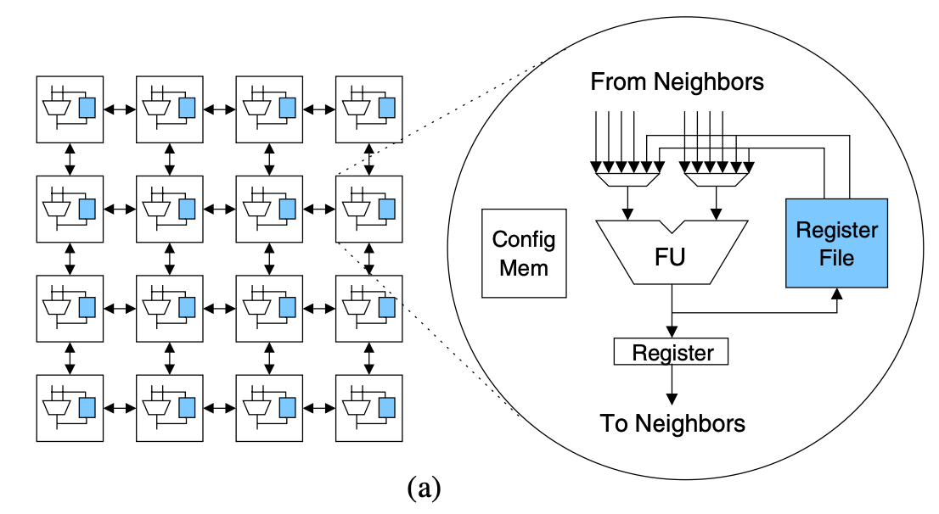
What is CGRA?
Coarse-Grained Reconfigurable Array
A large number of interconnected functional units (FUs), typically in a mesh-style interconnect
FUs used for both computation and data routing

Slide 4
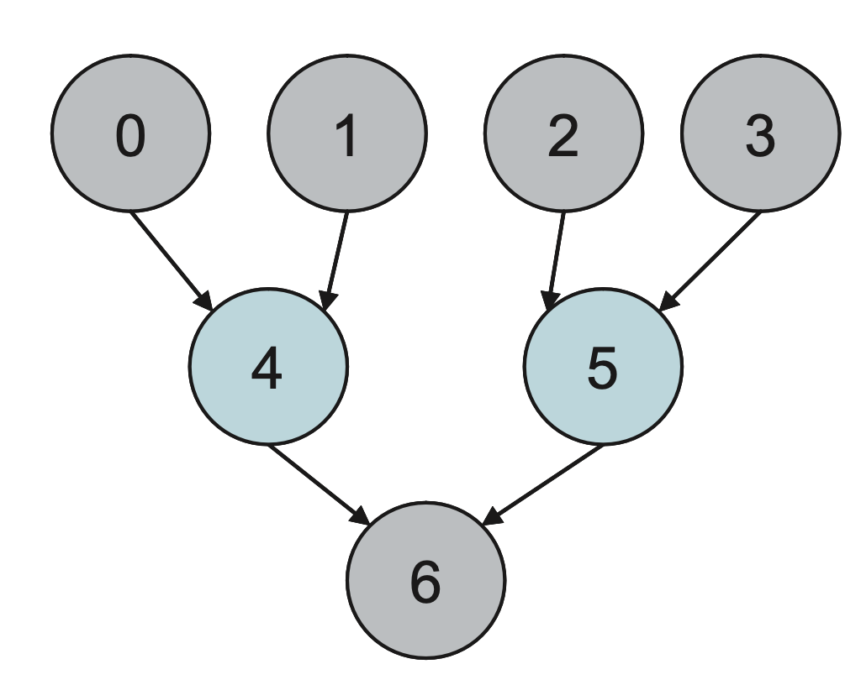
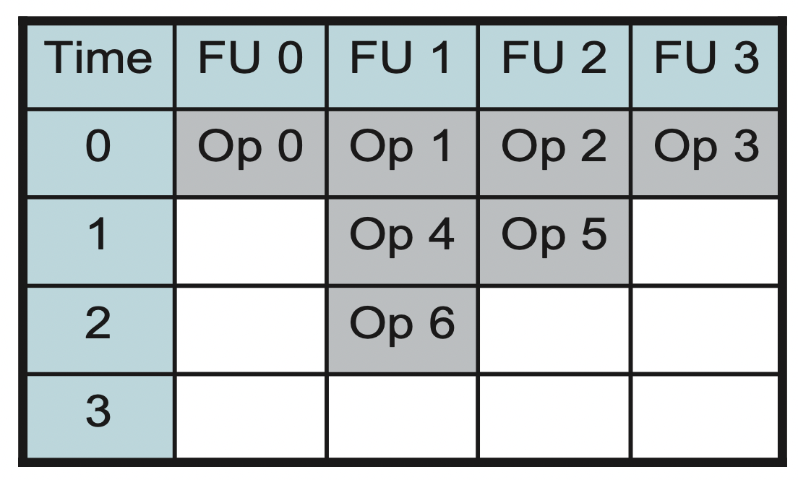
What we want to do
DFG
Schedule
CGRA (sparse interconnect)

Slide 5
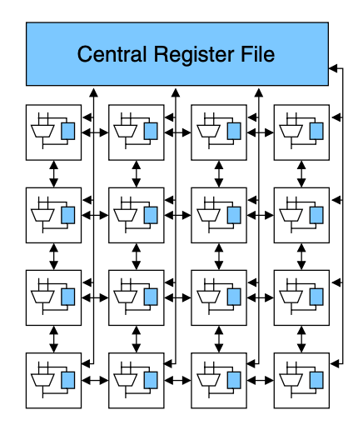
CGRA Scheduling
Central Register File vs Dedicated Register File
A
B
(1,0)
(1,0)
C

Slide 6
CGRA Scheduling
Central Register File vs Dedicated Register File
A
B
t=0
A
B
(1,0)
(1,0)
C

Slide 7
CGRA Scheduling
Central Register File vs Dedicated Register File
A
B
t=1
A
C
B
(1,0)
(1,0)
C

Slide 8
CGRA Scheduling
Central Register File vs Dedicated Register File
A
B
t=1
A
B
(1,0)
(1,0)
C
C

Slide 9
CGRA Scheduling
Central Register File vs Dedicated Register File
t=0
A
B
A
B
(1,0)
(1,0)
C

Slide 10
CGRA Scheduling
Central Register File vs Dedicated Register File
t=1
A
C
B
A
B
(1,0)
(1,0)
C

Slide 11
CGRA Scheduling
Central Register File vs Dedicated Register File
t=0
A
A
B
(1,0)
(1,0)
C
B

Slide 12
CGRA Scheduling
Central Register File vs Dedicated Register File
t=3
A
A
B
C
(1,0)
(1,0)
C
B

Slide 13
CGRA Scheduling
Central Register File vs Dedicated Register File
t=3
A
A
B
C
(1,0)
(1,0)
C
B

Slide 14
Routing Cost
Routing cost = number of FUs being used for routing
<Low routing cost (0)>
<High routing cost (4)>
A
C
B
A
C
B

Slide 15
Height-based Scheduling
Operations with the greater dependence height are scheduled first
Operations with the same height are considered together
Smaller search space
Consumers can be placed close to producers
Scheduled first
A
B
C
D
E
F
G
H
Scheduled last

Slide 16
That’s not enough
Height-based scheduling tells you to place E close to A and B
But it doesn’t tell you to place A and B adjacent to each other!
A
D
C
B
A
B
C
D
E
F
G
H

Slide 17
That’s not enough
Height-based scheduling tells you to place E close to A and B
But it doesn’t tell you to place A and B adjacent to each other!
A
D
C
B
A
B
C
D
E
E
F
G
H

Slide 18
Affinity Graph
Intuition: place operations that have close common consumers close to each other
A
B
C
D
E
F
G
H

Slide 19
Affinity Graph
Intuition: place operations that have close common consumers close to each other
High affinity
A
B
C
D
Common consumer
E
F
G
H

Slide 20
Affinity Graph
Intuition: place operations that have close common consumers close to each other
Medium affinity
A
B
C
D
E
F
G
Common consumer
H

Slide 21
Affinity Graph
Intuition: place operations that have close common consumers close to each other
Zero affinity
A
B
C
D
E
F
G
H
No common consumer

Slide 22
Affinity Graph
<DFG>
<Affinity Table>
<Affinity Graph>
A
B
C
D
 | A | B | C | D
A | 0 | 2 | 1 | 0
B | 2 | 0 | 1 | 0
C | 1 | 1 | 0 | 0
D | 0 | 0 | 0 | 0
A
B
E
F
G
D
C
H

Slide 23
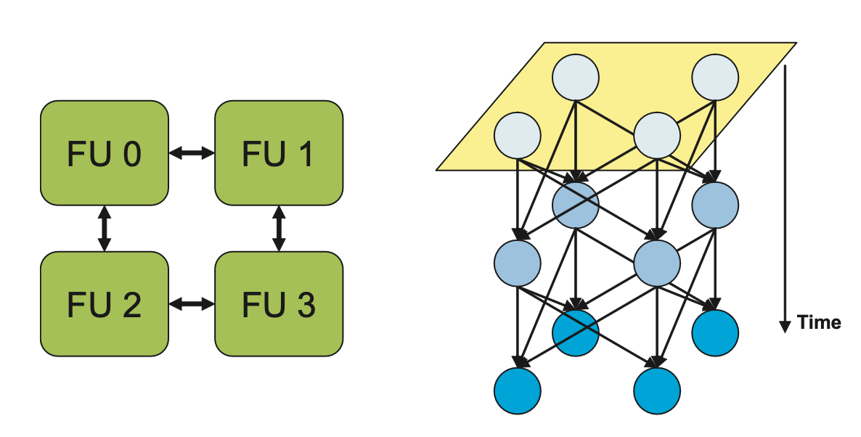
Graph Embedding
Assigning each operation a slot in the Modulo Reservation Table
Grid Layout: Simulated Annealing
<Affinity Graph>
<CGRA>
<Target Space>
A
B
D
C

Slide 24
Graph Embedding
Assigning each operation a slot in the Modulo Reservation Table
Grid Layout: Simulated Annealing
<Affinity Graph>
<CGRA>
<Target Space>
A
B
B
D
A
C
D
C

Slide 25
Skewed Scheduling Space
How do we ensure that all necessary routing can take place?
Routing is easy when the CGRA is empty
Still easy under II cycles
Need to prevent gridlock as scheduling continues

Slide 26
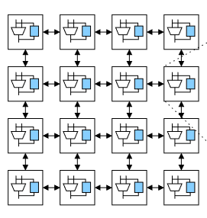
Skewed Scheduling Space
Observations:
Can avoid routing failure to a consumer if resources are free in time slots after a producer’s time slot.
Most applications aren’t very parallel – can’t use all CGRA FUs at once
Idea: Prevent routing failure in advance by clustering the CGRA

Slide 27
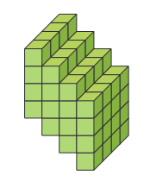
Skewed Scheduling Space
Form clusters left-to-right, prioritize leftmost FUs (position cost)
Route values to FUs on the right
Forms a skewed scheduling space
Last schedule slot always available for output of the last schedule slot to the left
Good for forward dependence – what about recurrences?
Reserve slots in advance when placing the consumer

Slide 28
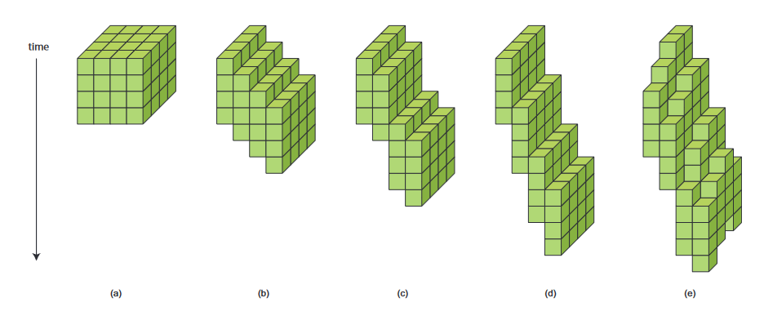
Skewed Scheduling Space
Normal (a) vs. Skewed (b, c, d, e) Scheduling Spaces

Slide 29
Implementation
Preprocessing
Scheduling Process

Slide 30
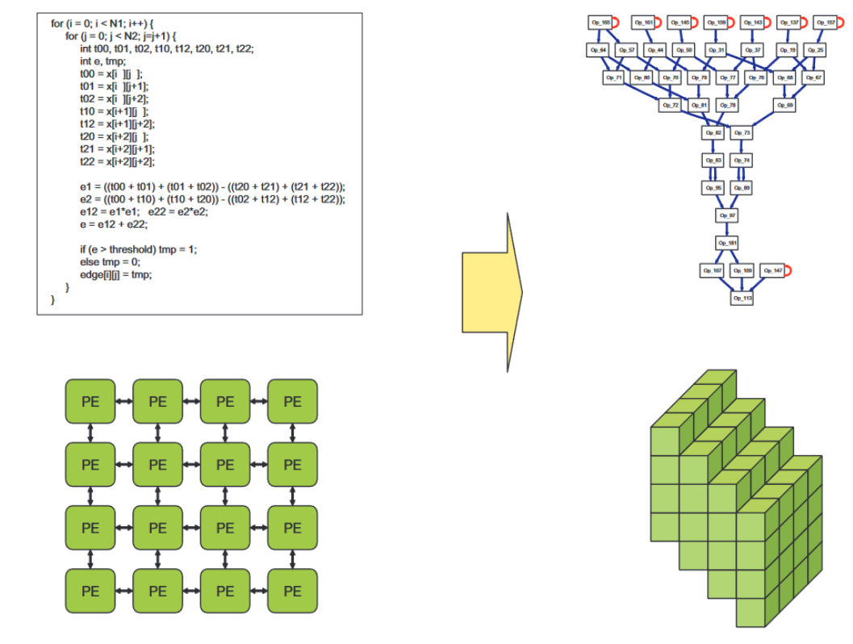
Preprocessing
Input: Assembly program, CGRA description
Calculate heights for all ops (DFG)
Create a skewed scheduling space

Slide 31
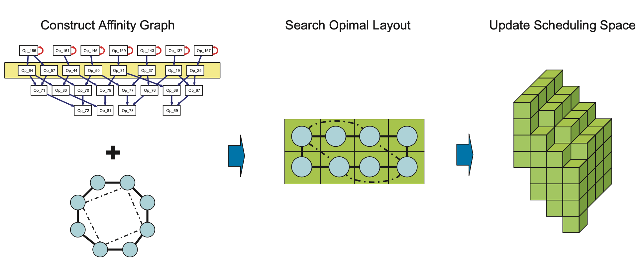
Height Scheduling
Enter a loop. For each height level in the DFG:

Slide 32
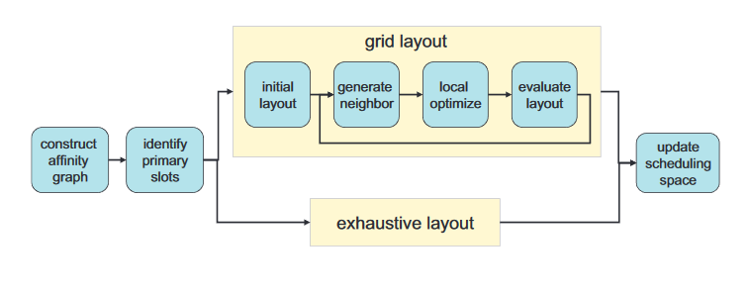
Height Scheduling
Detailed scheduling process for each height level

Slide 33
Grid Layout
Used to form a layout when #ops is large (cannot do exhaustively)
Simulated annealing approach
Find an optimal layout of ops at each level by minimizing layout cost

Slide 34
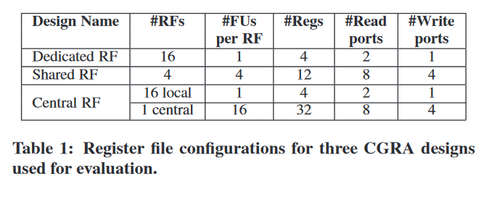
Experimental Results

Slide 35
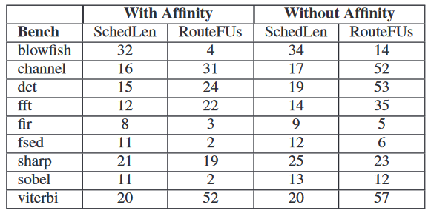
Results: Affinity Heuristic
The use of the affinity graph heuristic was shown to
Reduce the schedule length
Reduce the number of FUs used for routing
Across nine benchmarks (acyclic code)

Slide 36
Results: Modulo Scheduler
Average utilization: 56%

Slide 37
Results: Summary
The affinity graph heuristic is effective at reducing schedule length and routing FUs
Modulo graph embedding achieves avg. 56% utilization on benchmark programs for a CGRA with distributed reg. files
Similar utilization previously achieved only on CGRAs with highly ported central reg. files and dense connectivity.
The scheduler is faster than existing implementations
Height-based search space, systematic placement of operations
CGRAs with increased reg. file sharing achieved lower II and higher utilization metrics

Slide 38
Remarks and Discussion
Our project: Scheduling on CGRA-style Domain-Specific Accelerator
Applicable Concepts: Height-based Scheduling, Affinity
Discover our own heuristic!
Other relevant papers
Park, Hyunchul, Kevin Fan, Scott A. Mahlke, Taewook Oh, Heeseok Kim, and Hong-seok Kim. "Edge-centric modulo scheduling for coarse-grained reconfigurable architectures." In Proceedings of the 17th international conference on Parallel architectures and compilation techniques, pp. 166-176. 2008.
Ansaloni, Giovanni, Kazuyuki Tanimura, Laura Pozzi, and Nikil Dutt. "Integrated kernel partitioning and scheduling for coarse-grained reconfigurable arrays." IEEE Transactions on Computer-Aided Design of Integrated Circuits and Systems31, no. 12 (2012): 1803-1816

Slide 39
Questions?

