Slide 1
Towards a Transpiler for C/C++ to Safer Rust
Ravi Bhatt, Daniel Calco, Arjav Patel
Daniel Tian, Yusei Uehara
EECS 583 - Group 7

Slide 2
Authors
Notes:
Borrow checking for safety and performance
Briefly: why each of these is illegal

Slide 3
The Rust Language
Compiler-enforced memory validity
These are illegal in Rust
void foo(char* c, int size){
for(int i = 0; i < size; i++){
c[i] = 'h';
}
}
int x = 5;
auto fn = [&x](){
x++;
};
std::thread t1{fn}, t2{fn};
Notes:
Borrow checking for safety and performance
Briefly: why each of these is illegal

Slide 4
Transpilation
struct debug_vsh_out
{
float4 outColor [[user(locn0)]];
float4 gl_Position [[position]];
float gl_PointSize [[point_size]];
};
struct debug_vsh_in
{
float4 inPosition [[attribute(0)]];
uint inColor [[attribute(1)]];
};
struct UniformBufferObject{ float4x4 viewProj; };
vertex debug_vsh_out debug_vsh(debug_vsh_in in [[stage_in]], constant UniformBufferObject& ubo [[buffer(4)]])
{
debug_vsh_out out = {};
out.gl_Position = ubo.viewProj * float4(in.inPosition.xyz, 1.0);
out.outColor = unpack_unorm4x8_to_float(in.inColor);
out.gl_PointSize = in.inPosition.w;
return out;
}
Convert one high-level language into another
layout(location = 0) in vec4 inPosition;
layout(location = 1) in uint inColor;
layout(location = 0) out vec4 outColor;
layout(push_constant) uniform UniformBufferObject{
mat4 viewProj;
} ubo;
void main()
{
gl_Position = ubo.viewProj * vec4(inPosition.xyz, 1.0);
outColor = unpackUnorm4x8(inColor);
gl_PointSize = inPosition.w;
}
Notes:
Borrow checking for safety and performance
Briefly: why each of these is illegal

Slide 5
Related Work
Rust's Rising Popularity: Named "most loved programming language" for seven consecutive years since 2015 according to Stack Overflow Developer Surveys.
Transpilation Tools: Various tools (C2Rust, CRust, bindgen) available for converting C/C++ code to Rust.
Enhancing Code Safety and Performance:
Ling et al.'s transpiler reduces "unsafe" keyword usage, transforming C code into safer Rust code.
Lunnikivi et al. explored transpiling Python code to Rust for performance gains while maintaining readability, using tools like pyrs and involving manual refactoring.
Notes:
Borrow checking for safety and performance
Briefly: why each of these is illegal

Slide 6
Related Work - Transpilation Tools Explored
C2Rust:
Open-source tool for C to Rust conversion.
Limitations include issues with complex C code, dependencies, performance, and unsafe code generation.
Rust bindgen:
Generates FFI bindings, not suitable for full transpilation.
CRust:
Shows promise in converting basic C/C++ code.
Limitations include header file conversion, unknown function handling, class support, and preprocessors.
Notes:
Borrow checking for safety and performance
Briefly: why each of these is illegal

Slide 7
Related Work - Case Study: gperf Module Transpilation Using CRust
Results showed partial success in automatic transpilation, with conversion percentages ranging from 5% to 45%.
Significant manual effort required to complete the conversion process.
Demonstrates limitations of current tools in handling complex or extensive C/C++ codebases.
Notes:
Borrow checking for safety and performance
Briefly: why each of these is illegal

Slide 8
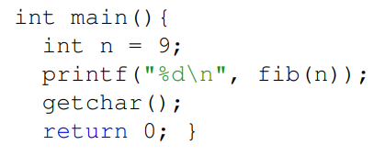
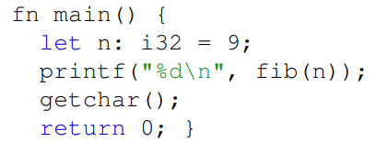
Methodology
A lot of C/C++ to Rust transpilation is simply replacing syntax…
We will look further into cases where transpilation is not as straightforward.

Slide 9
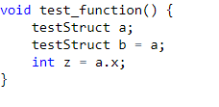
Methodology
Current transpilation tools struggle with enforcing borrow checking. As a result, unsafe Rust is used for sections that cannot easily be translated to safe rust.

Slide 10
Methodology
Global Variables can be implemented a few ways:
Const and Static work for immutable variables
Static mut for mutable global variables, but are unsafe!

Slide 11
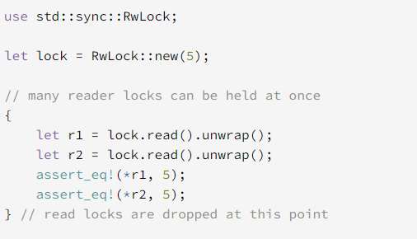
Methodology
Use std:sync module for thread-safe mutable global variables.

Slide 12
Methodology
Translate structs to Rust counterparts

Slide 13
Methodology
Reimplement unsupported features
Do-While Loops
Ternary Operators

Slide 14
Methodology - Non-trivial Constructs
//Declaration
int foo(bool p1);
//Implementation
int foo(bool p1){
return 1;
}
Functions
Things start getting messy…
No separated decls & impls
No function overloading
// Overloaded Fn 1
int ovr(bool p1);
// Overloaded Fn 2
int ovr(int p1);

Slide 15
Methodology - Non-trivial Constructs
//Declaration
int foo(bool p1);
//Implementation
int foo(bool p1){
return 1;
}
//No Separations!
fn foo(p1: bool)->i32{
1
}
Easy!
// Overloaded Fn 1
int ovr(bool p1);
// Overloaded Fn 2
int ovr(int p1);
// Overloaded Fn 1
fn ovr1(p1: bool) {2}
// Overloaded Fn 2
fn ovr2(p1: i32) {1}
Tedious…
but easy!

Slide 16
Methodology - Non-trivial Constructs
// Inline C++
inline void foo(bool p1){...}
Inline Functions?
Just a compile-time request
Easy!
//inline Rust
#[inline]
fn foo(p1: bool)->i32{...}

Slide 17
Methodology - Non-trivial Constructs
Class C{
int a; int b; int c;
public:
C(int x, int y, int z){
A = x; b = y; c = z; }
void method1 (int x,
int y) {a=x;, b=y;}
C obj(x,y,z);
pub struct C{
a:i32 , b:i32, c:i32 }
impl C{
pub fn method1(&mut self, x:i32, y:i32, z:i32)
{ self.a = x; self.b = y; }
}
let obj = C {a:x, b:y, c:z};

Slide 18
Methodology - Non-trivial Constructs
What about inheritance?
2 Solutions
struct St1
{ int a; int b; }
struct St2 : St1
{ int c; }
Recursive Solution
Composition
struct St1
{a:i32, b:i32}
struct St2
{a:i32, b:i32, c:i32}
struct St1
{a:i32, b:i32 }
struct St2
{ parent:St1, c:i32 }

Slide 19
Methodology - Non-trivial Constructs
Pointers - dangerous with a memory safe language.
Not recommended.
let a:u32 = 27;
let a_ptr:*const u32 = &mut total
int a = 27;
int a_ptr = &a;
let mut a_m:u32 = 27;
let a_m_ptr:*mut u32 = &mut total

Slide 20
Methodology - Non-trivial Constructs
Heap References? Meet the Box
float *ptr = new float(10.25)
let ptr:Box<f32> = Box::new(10.25)

Slide 21
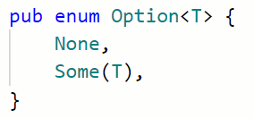
Methodology - Non-trivial Constructs
Null pointer is also unsafe to use.
→ Meet option!
let c:Option<&str> = None;
assert!(c.is_none());
Basically, a wrapper
If there’s something inside, it’s of enum Some!

Slide 22
Results
Existing transpilers produce unsafe Rust code
CRust is the most promising → 40% of work for basic code
Many challenges throughout the transpilation process
Transpiled Rust program generally has best performance*
Potential drawbacks with liberal use of optimization flags*
Minimum Runtime Difference (ms)
4.3
-0.9
0.3
0.6
4.1
0
Notes:
Arjav

Slide 23
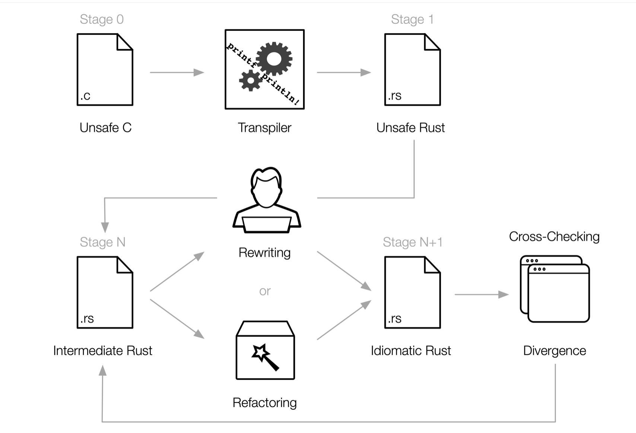
Current State of Auto-Transpilation
Limitations
Advanced language features
External Dependencies
Best Practices
Manual Intervention
https://c2rust.com/manual/
Notes:
Arjav

Slide 24
Future Work
Use transpilation table to continue work on an automatic transpiler
Create / Improve guidelines + processes when there’s no direct translation for language-specific construct (ex. friend classes)
Support transpilation between more languages
C++ Code → LLVM IR → Minecraft Command Language (Our project)
Front-End
Back-End
Notes:
Arjav

Slide 25
Thank You!
Questions?
rnbhatt@umich.edu
dcalco@umich.edu
arjav@umich.edu
dqanxy@umich.edu yuehara@umich.edu
Notes:
Arjav

