Slide 1
Ultimate SLH: Taking Speculative
Load Hardening to the Next Level
Zhiyuan Zhang , Gilles Barthe , Chitchanok Chuengsatiansup ,
Peter Schwabe , Yuval Yarom
Presented by: Haider Baloch, Justin Liu, David Zhong

Slide 2
Agenda
Background
Motivation
Design
Evaluation

Slide 3
Background
In 2018, researchers demonstrated multiple microarchitectural side-channel attacks due to performance optimizations within microprocessors (mostly due to speculation)
Branch Speculation
If the prediction was wrong, then the processor will roll-back the execution and throw away the instructions corresponding to the mispredicted instruction stream.
Such design leaves microarchitectural footprints from the mispredicted instruction stream, allowing adversaries to figure out confidential information.
These attacks are classified as Spectre attacks
Notes:
Talk about how these types of attacks are characterized as Spectre vulnerabilities, and are mainly broken down into 4 different variants described below at the end

Slide 4
Background: Spectre v1
Before the correct outcome of the bounds check is known, the branch predictor continues with the most likely branch target
However, if the bounds check is incorrectly predicted as true, an attacker can leak secret information in certain scenarios
Cache will not be flushed on misprediction: attacker probes cache to determine secret value
Attacker will train the branch predictor to be always taken
Attacker flushes cache, calls function with index >= arrayLen
Attacker probes every element of array2
Fast access index corresponds with array [index]
Notes:
Are these steps

Slide 5
Background: Other Types of Spectre Attacks
Many other of Spectre variants exists:
V2: Branch poisoning
V3: Exception handling
V4: Store-Load forwarding
Other timing variants of Spectre v1
Conditional
Variable timing
Discussed later in the presentation

Slide 6
Background: Mitigations Against Spectre Attacks
Have no speculation
No branch prediction, no speculation
But, performance degradation (basic blocks are serialized)
Hardware
Difficult to ensure
Requires new hardware for all users
Compiler
Have the compiler mitigate these attacks
LLVM: Speculative Load-Hardening (SLH)
Instructions are added to mask critical data on speculation

Slide 7
Background: LLVM SLH Example
uintptr_t all_ones_mask = INT_MAX;
uintptr_t all_zeros_mask = 0;
void leak(int data);
void example(int* pointer1, int* pointer2) {
uintptr_t predicate_state = all_ones_mask;
if (condition) {
predicate_state = !condition ? all_zeros_mask : predicate_state;
pointer1 &= predicate_state;
leak(*pointer1);
} else {
predicate_state = condition ? all_zeros_mask : predicate_state;
int value2 = *pointer2 & predicate_state;
leak(value2);
}
}
void leak(int data);
void example(int* pointer1, int* pointer2) {
if (condition) {
// ... lots of code ...
leak(*pointer1);
} else {
// ... more code ...
leak(*pointer2);
}
}
a) Victim function without SLH
b) Victim function with SLH

Slide 8
Motivation
LLVM’s Speculative Load hardening is not rigorous enough for all variants of Spectre v1
Leaks value use in stores
Leaks value used in conditional statements
Leaks value used in variable-time instructions

Slide 9
SSLH
Patrignani and Guarnieri introduce Strong SLH
SSLH hardens fixed load addresses, SLH doesn’t
SSLH hardens store addresses, SLH doesn’t
Protects during transmission to attacker
SSLH hardens conditional predicate

Slide 10
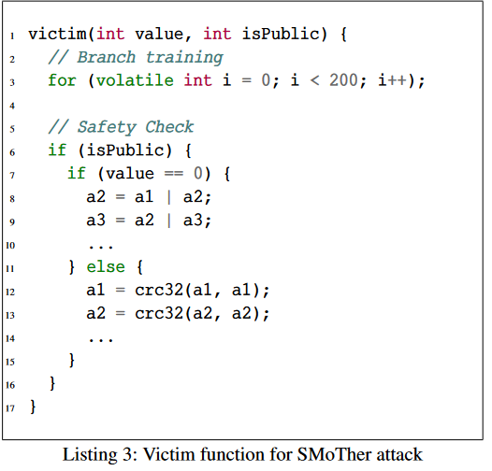
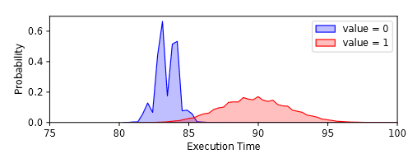
SLH Security: Exploiting Secret-Dependent Control Flow
Here they ran an attack to try and determine what value is
Tested with no security, LLVM-aSLH and SSLH
Showed that SSLH is necessary
Port Contention
or uses ports 0, 1, 5, 6, whereas crc32 uses port 1
Success rate of differentiating the two paths:
No mitigation: 98.57%
LLVM-aSLH: 95.23%
SSLH: 50.03%

Slide 11
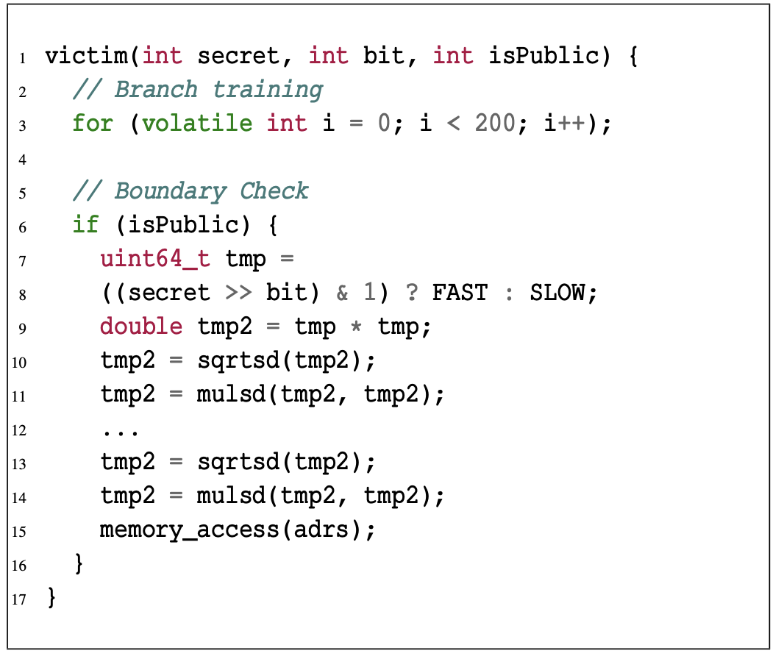
SLH Security: Variable Timing Attacks
Instructions themselves use a variable-amount of time depending on its value
Example: Hardware for Floating Point Square Root can be implemented similar to binary search
FSQRT(65536) is much faster than FSQRT(2.34*10⁻³⁰⁸)
This can be exploited to leak possible data
Idea: Memory access on address will occur only when the value is fast (such as 65536)
Probe time it takes to access adrs
However, memory access can go ahead of sqrt if no dependencies (OoO execution)

Slide 12
SLH Security: Variable Timing Attack Gadgets
Hardening repeat instructions
As executing repeat instructions may leak the number of times they execute, we poison %rcx
Hardening floating-point instructions
We harden SSE2, vector and X87 floating-point instructions
For vector and SSE2, all arguments are hardened, for X87, an lfence speculation barrier inserted in every argument

Slide 13
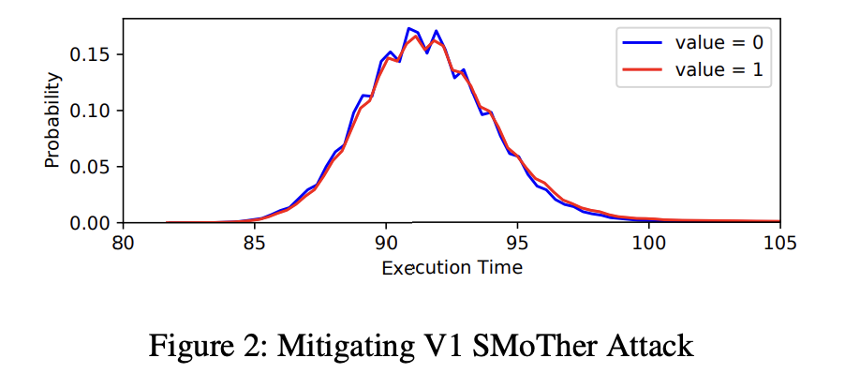
Testing USLH (timing security)
Take the average of 100 samples, and run this for 20,000 averages
Result: Indistinguishable

Slide 14
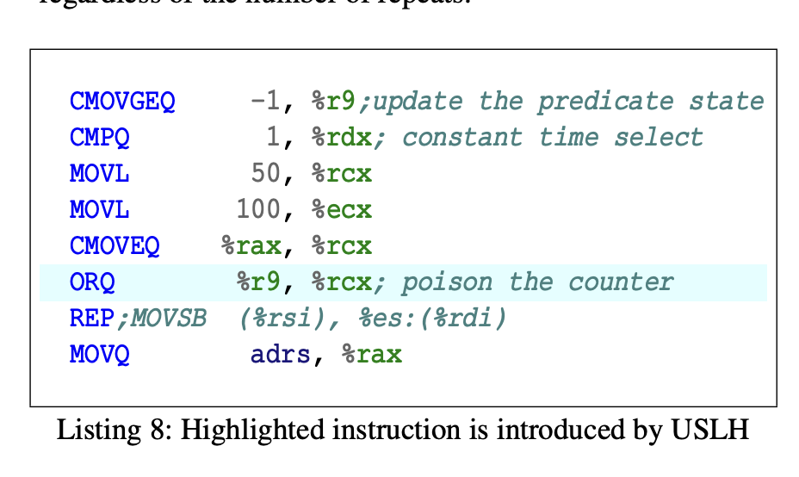
Testing USLH (repeat instruction security)
Tests ran 100,000 times, same result: adrs is never accessed

Slide 15
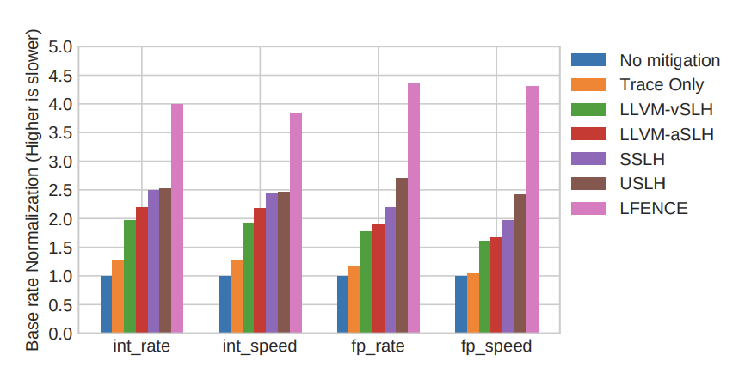
Performance Metrics
SSLH and USLH have slightly extra costs. Very close to basic LLVM SLH

Slide 16
Questions

