Slide 1
Register File Partitioning and Compiler Support for
Reducing Embedded Processor Power Consumption
Author: Xuan Guan and Yunsi Fei
Group 18
Notes:
Presenter: Eshan Jain, Benjamin Miller, Reinardus Joseph, Max Tennant, Haoran Jin

Slide 2
Introduction/Motivation
Register file (RF) in modern embedded processors contributes a substantial budget in the energy consumption due to its large switching capacitance and long working time
For embedded processors, on average 25% of registers count for 83% of RF accessing time (80/20 rule)
Want to partition the RF into hot and cold regions, with the most frequently used registers placed in the hot region, and the rarely accessed ones in the cold region.

Slide 3
Introduction/Motivation
Divide RF into two regions that share same address space, where one has smaller number of registers but used more frequently and the other larger region but used less
Employ bit-line splitting and drowsy register cell to reduce overall accessing power of RF
Formulate the RF partitioning process into a graph partitioning problem
apply effective algorithm to obtain optimal result
Not as simple as picking most used registers, need to consider other factors such as instructions using registers from different regions and switching time overhead

Slide 4
Register File Energy Consumption
Four main dynamic energy types:
Word-line, bit-line, sense amplifier, and for driving control signals
Bit-line is 70% of the dynamic energy consumption

Slide 5
Register File Energy Reduction
How to reduce the power consumption?
Bit-line Splitting
Smaller groupings, memory access is quicker
Drowsy Technique
Enter “sleep” mode when memory is not being used

Slide 6
Register File Energy Equation
P =
P1-P4 represents working modes power (region 1 or 2 accessed, both, none)
Coefficients represent each modes instruction count

Slide 7
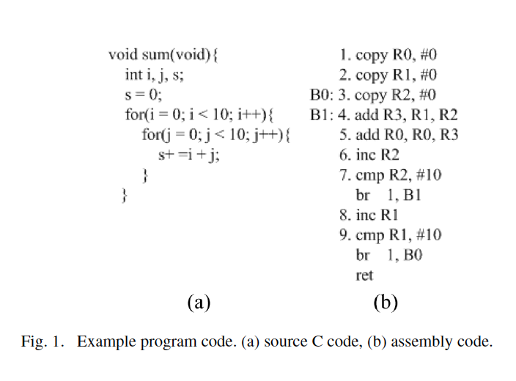
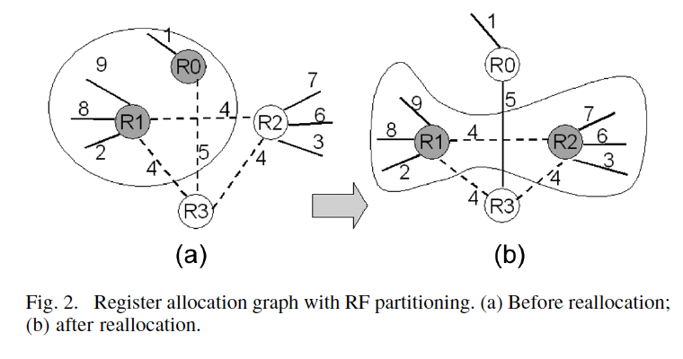
Register File Partitioning Problem Formulation

Slide 8
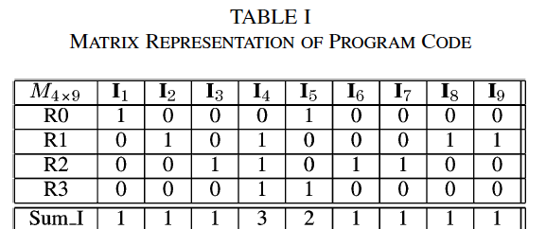
Register File Partitioning Problem Formulation

Slide 9
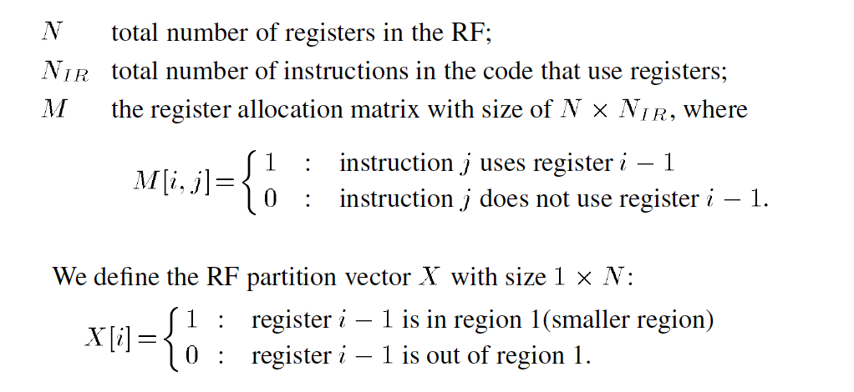
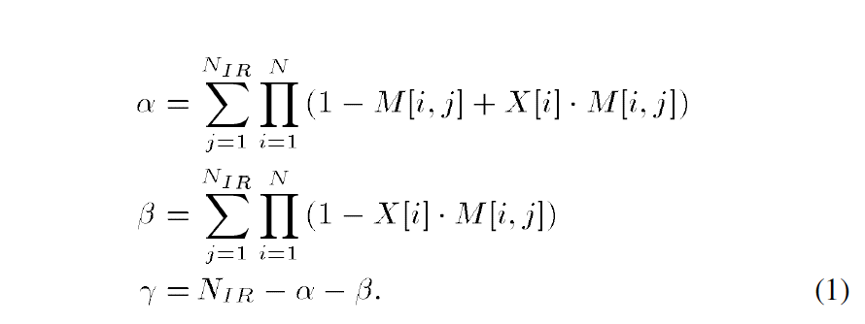
Register File Partitioning Problem Formulation

Slide 10
Graph Partitioning Algorithm
𝞪, 𝞫, and 𝞬 are distributed in a way that the average power consumption is minimized; value of 𝞭 is determined by the program itself → will not be affected by the partitioning algorithm

Slide 11
Graph Partitioning Algorithm: Kernighan-Lin Algorithm
Why
Widely used
Much lower computation complexity
Reasonable optimization result
What
Improve an initial partition by iteratively swapping registers between regions to maximize power reduction.

Slide 12
Graph Partitioning Algorithm: Optimization
● Applying our partitioning algorithm to the whole program may be very time-consuming, so we choose most important blocks to optimise.
Steps:
Rank all basic blocks in decreasing execution frequency and size.
RF partitioning starts with highest ranked block.
Incremental consideration of subsequent blocks with K-L algorithm.
Termination after power saving value plateaus for five steps.

Slide 13
Experimental Setup
Different benchmarks: SPEC2000 and MiBench
3 operating systems:
PISA (RISC, 32 registers), only OS running SPEC2000
Alpha (RISC, 32 registers)
x86 (CISC, 16 registers)
Examining power saving and performance degradation
https://vhosts.eecs.umich.edu/mibench/
http://www.spec.org/

Slide 14
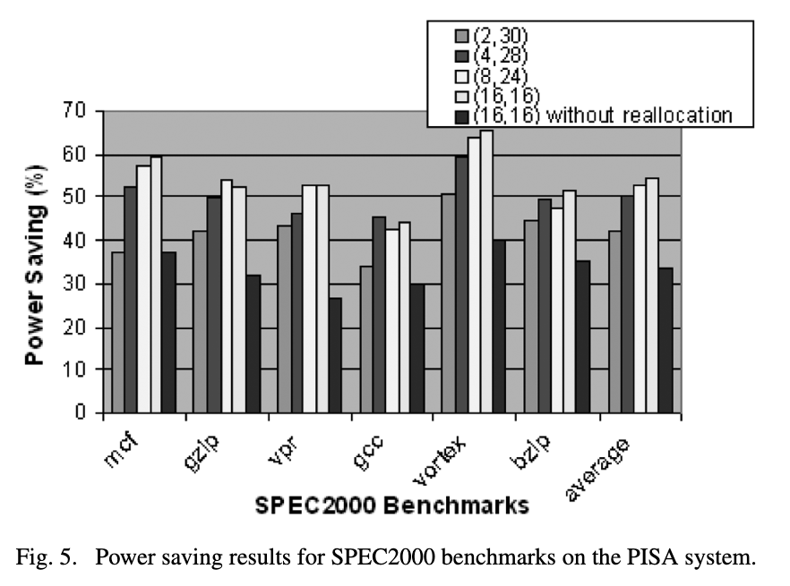
Power Saving –
Spec2000 on PISA
(16, 16) typically best with some variation
All configurations better than original register allocation
Additional 20% power reduction on average

Slide 15
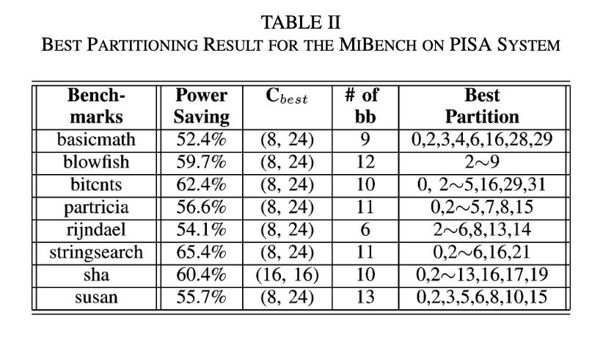
Power Saving –
MiBench on PISA
(8, 24) typically best, less variation
Also recorded 20% average power reduction increase
Difference between general-purpose and embedded applications

Slide 16
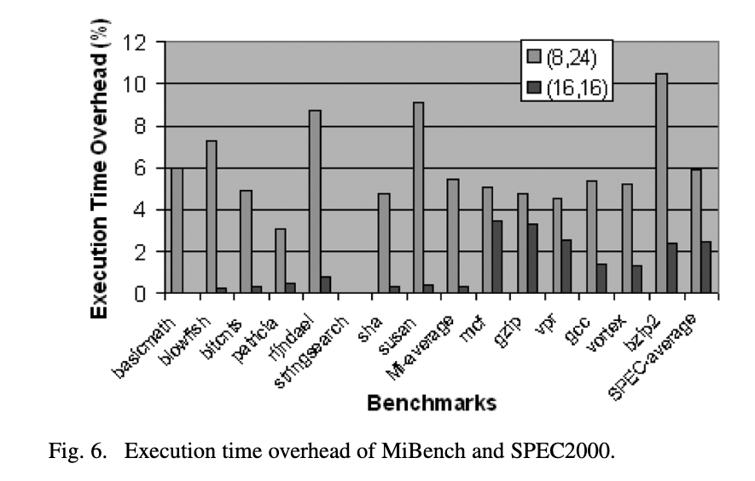
Performance
Degradation
Relatively small, more severe for (8, 24) configuration
(16, 16) clear choice for SPEC2000
MiBench has tradeoff between power saving and performance degradation

Slide 17
Alpha and x86 Results
Solely MiBench analysis
(8, 24) and (4, 12) partitions best for Alpha and x86, respectively
Both systems produce ~55% average power savings
Verified 80/20 rule on MiBench for all three operating systems

Slide 18
Conclusions
MiBench and SPEC2000 applications:
Power
Average saving of 58.3% and 54.4% over the non-partitioned RF accessing power
The area overhead is negligible
Less than 3%
The execution time overhead is acceptable.
Average 2.4% and 5.5%
Notes:
Haoran With the novel rf partitioning technique, power can be reduced by Area
Execution time

Slide 19
Related works
Content-aware register file
Share common patterns in the higher bits
Cache based register file
Replacement strategy
Register value is mostly used only once
Notes:
In the early stage of CMOS, 20 years ago. Many exploration of CMOS RF.
Content: upper bits 0 and 1 2s’ complement
Cache: different from memory

Slide 20
Our work
Single-cycle RF is taken for grant in CMOS nowadays
Not the case for Superconducting electronics
CPU frequency can run up to 10-100 GHz for Superconducting electronics
Existing NDRO(DFF) based RF design
read/write latency takes up to 200-250ps (2-20 CPU cycles)
Occupies a large percentage of area/power
We propose to use Delay line memory to build RF
Area efficient
Apply strategy in CMOS RF to reduce average read/write latency

Slide 21
Paper link
https://ieeexplore.ieee.org/stamp/stamp.jsp?tp=&arnumber=5238570

