Slide 1
Vectorizing programs with IF‑statements for processors with SIMD extensions
Jiezhong Yang, Yi Liang, Yiming Xiang, Yue Huang
Group 9

Slide 2
Motivation (high-level overview)
Vectorization is crucial for performance
IF-statements are bad for vectorization
IF-conversion is used for CPUs that support masked instructions
What about CPUs without masked instructions?
Notes:
– _area + problem + why is it important to solve this problem_

Slide 3
SIMD
SIMD: Single Instruction, Multiple Data
Data-level parallel
Each unit performs the same instruction with different data
Efficient
Loads several data at once
Values are processed in parallel even on a non-superscalar processor
Instruction Pool
Data Pool
Processor
Processor
Processor
Processor
Notes:
(approaches to vectorization
(1) loop vectorization
(2) basic block or superword-level parallelism (SLP) vectorization

Slide 4
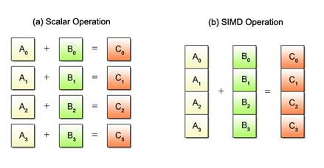
for (int i = 0; i < 1024; i++) {
c[i] = a[i] + b[i];
}
v_a, v_b, v_c, etc. are pre-defined vectors by SIMD
Load 4 double elements into vector v_a from contiguous memory starting from a[i]
SIMD Illustration
for (int i = 0; i < 1024; i += 4) {
simd_load(v_a, &a[i]);
simd_load(v_b, &b[i]);
v_c = simd_vaddd(v_a, v_b);
simd_store(v_c, &c[i]);
}
Add 4 elements of va with 4 elements of v_b element-wise, return the result
Store 4 elements of vector v_a into contiguous memory starting from c[i]

Slide 5
With IF-Statement?
for (int i = 0; i < 1024; i++) {
if (m[i] < 0)
c[i] = a[i] + b[i];
else
c[i] = 0;
}
Notes:
_IF-statements are bad for vectorization_
_程序中的IF语句引入了控制流分歧，这妨碍了向量化。_

Slide 6
for (int i = 0; i < 1024; i++) {
if (m[i] < 0)
c[i] = a[i] + b[i];
else
c[i] = 0;
}
IF-Conversion: Example
p is also a vector
What if a[i] shouldn’t be accessed?
Exception!!
for (int i = 0; i < 1024; i += 4) {
p = m[i] < 0
v_a = load &a[i] if p
v_b = load &b[i] if p
v_add = v_a + v_b
store v_add to &c[i] if p
store 0 to &c[i] if !p
}
for (int i = 0; i < 1024; i += 4) {
p = m[i] < 0
v_a = load &a[i] if p
v_b = load &b[i] if p
v_add = v_a + v_b
v_c = select(p, v_add, 0)
store v_c to &c[i]
}
maskload
maskstore
blendv
Using Masked Instruction
Exception can be masked
Using Select Instruction
Exception cannot be masked
Notes:
select(p, a, b) means (if p then a else b)
If exception might happen (compiler cannot decide), compiler will then check masked instruction, finally fail back to generate scalar code

Slide 7
IF-Conversion: Comparison
This is because when using select, both branches are executed in an unmasked manner; thus, it does not mask exceptions, which may occur on the unmasked data.
Masked instructions
Conditionally operate instructions depending on the mask bit
Select instructions
Both branches are executed in an unmasked manner
Select by the mask bit before store to memory
According to the Intel manual, select is faster than masked
Why don’t we just always use select instructions?
Select is not safe: it does not mask exceptions occurring on the unselected data
Comparison
Select is faster but…
Not safe: does not mask exceptions occurring on the unselected data
Notes:
intro to select and mask, compare
_大多数SIMD指令集通过提供掩码指令和/或选择指令来支持谓词执行。
掩码指令使IF语句的每个分支依次执行，根据相应的掩码位条件地操作元素。
而当使用选择（也称为“混合”，但我们在本文中使用“选择”）指令时，两个分支以未掩码的方式执行，并且选择指令在存储到内存之前使用掩码来混合来自两个分支的变量。
根据Intel手册 [11]，选择指令比掩码指令更快，但当IF语句中的操作具有异常时，不能总是安全地使用选择指令。这是因为当使用选择时，两个分支以未掩码的方式执行；因此，它不会屏蔽异常，这可能发生在未屏蔽的数据上。

Slide 8
IF-Conversion: Process
This is because when using select, both branches are executed in an unmasked manner; thus, it does not mask exceptions, which may occur on the unmasked data.
for (int i = 0; i < 1024; i++) {
p = m[i] < 0
c[i] = a[i] + b[i] if p
c[i] = 0 if !p
}
Begin
Check for exceptions
when the confirms that there are no exceptions. If there might be exceptions, the compilers generate masked instructions if the target permits them, otherwise, the compilers generate scalar code guarded by IF-cascade for targets without masked instructions. There are two main reasons why the compilers do not generate select instructions, which results in IF-cascades for targets without masked instructions. First, the program analysis for proving the absence of exception is too pessimistic and may provide false negative results. Second, the capability of transforming IF-statements into select instructions is limited for complex nested IF-statements.
Comparison
Select is faster but…
Not safe: does not mask exceptions occurring on the unselected data
Exceptions confirmed
No exceptions confirmed
Otherwise
Exceptions unconfirmable
Employ
select instructions
Employ
masked instructions
What if masked instructions are not supported?
Notes:
Subject: modern compilers
Program analysis: check for exceptions

Slide 9
IF-Conversion: Process
by a compare on the particular lane’s mask value
Not all SIMD instruction sets support masked instructions
Intel AVX512, ARM SVE, and RISC-V: support both
ARM NEON and IBM VSX: only support select
What will modern compilers do in this case?
Current approach: out of luck!
Scalar code guarded by IF-cascades: memory operation is guarded by a branch
for (int i = 0; i < 1024; i++) {
if (m[i] < 0)
c[i] = a[i] + b[i];
else
c[i] = 0;
}
Notes:
yjz
_the target processor relies on some SIMD instruction sets_
_As a result: no SIMD!_

Slide 10
Our goal
Two reasons why compilers don’t generate select instructions when no masked instructions
Exception
Our solution: optimized LLVM code generation for vectorizing IFs
The current capability of transforming IF-statements into select instructions is limited for nested IFs
Our solution: IF-select based on statement matching on the IR level
As a result, scalar code guarded by IF-cascades
Two reasons why compilers don’t generate select instructions when no masked instructions
Exception
The current capability of transforming IF-statements into select instructions is limited for nested IFs
As a result, scalar code guarded by IF-cascades
for (i = 0; i < 1024; i++) {
if (a[i] < b[i]) {
if (a[i] < 10)
c[i] = a[i] + b[i];
else
c[i] = a[i] - b[i];
}
}

Slide 11
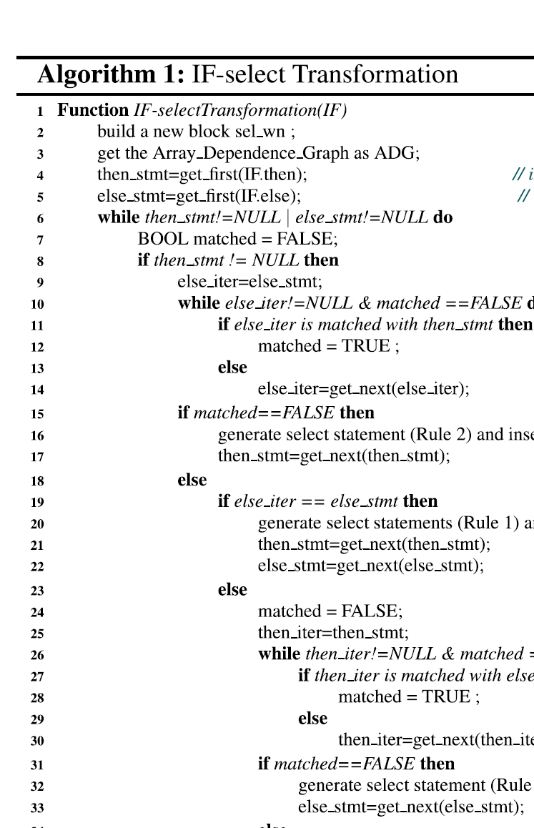
IF-select Transformation: Algorithm
if (cond)
dest = val1;
else
dest = val2;
dest = select(cond, val1, val2)
if (cond)
dest = val1;
dest = select(cond, val1, dest)
Notes:
hy
How the technique works, examples are super helpful

Slide 12
case1: dest = select(cond, val1, val2)
case2: dest = select(cond, val1, dest)
condition
IF_then
IF_else
dest1 = val1
dest2 = val2
IF_then
IF_else
IF_then
IF_else
dest1 = val1
dest2 = val2
dest1 = val1
nothing
match!
match!
Check
dependency!
match!
dest2 = val4
dest1 = val3
no dependency
in at least one block
dest1 = select(cond, val1, val3)
dest2 = select(cond, val2, val4)
case2
dest1 = select(cond, val1, dest1)
then_stmt = get_next(then_stmt)
similar if dest2 have nothing match
dependency
in both block
can’t transformation, the corresponding order can’t be changed
Notes:
hy
How the technique works, examples are super helpful

Slide 13
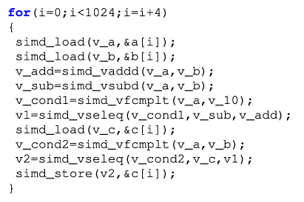
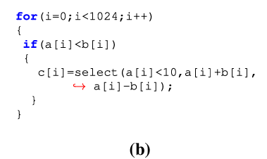
If-select Transformation: Example
for (i = 0; i < 1024; i += 4) {
simd_load(v_a, &a[i]);
simd_load(v_b, &b[i]);
v_add = simd_vaddd(v_a, v_b);
v_sub = simd_vsubd(v_a, v_b);
v_cond1 = simd_vfcmplt(v_a, v_10);
v1 = simd_vselect(v_cond1, v_sub, v_add);
simd_load(v_c, &c[i]);
v_cond2 = simd_vfcmplt(v_a, v_b);
v2 = simd_vselect(v_cond2, v_c, v1);
simd_store(v2, &c[i]);
}
for (i = 0; i < 1024; i++) {
if (a[i] < b[i]) {
if (a[i] < 10) {
c[i] = a[i] + b[i];
} else {
c[i] = a[i] - b[i];
}
}
}
for (i = 0; i < 1024; i++) {
if (a[i] < b[i]) {
c[i] = select(a[i] < 10,
a[i] + b[i], a[i] - b[i]);
}
}
for (i = 0; i < 1024; i++) {
c[i] = select(a[i]<b[i], select(a[i] < 10,
a[i] + b[i], a[i] - b[i]), c[i]);
}
Notes:
ly

Slide 14
The optimized LLVM code generation
The given text is discussing an approach for handling conditional memory operations in LLVM, a compiler infrastructure that optimizes code before it's executed on a processor. Let's translate this technical text into Chinese and then explain it:
翻译成中文：
在LLVM中处理IF语句时，编译器会以一种悲观的方式分析是否可能出现异常。当证明没有异常时，编译器会在评估IF语句的条件之前提升（hoist）加载（load）操作，并在IF语句之后下沉（sink）存储（store）操作。通过将加载和存储操作从IF语句中提升/下沉，内存访问操作就不再是基于条件的，编译器发出选择指令来混合IF语句两个分支的值。
否则，内存访问操作将是基于条件的，且在IR级别为其生成掩码指令。在后端，LLVM的Scalarize Masked Mem Intrin（SMMI）通道会查询Target Transform Information（TTI）分析结果，以评估掩码指令是否适用于选定的目标。如果结果是负面的，该通道会将掩码指令转换为在IF级联保护下的标量加载和存储操作。因此，这种方法显著降低了整体性能。
为了解决这个问题，我们利用选择指令减少没有掩码指令目标的掩码内存访问LLVM-IR指令。为了防止异常，我们通过填充来避免越界内存访问。每个内存分配都填充到硬件的向量化因数的下一个倍数，例如，在一个具有256位SIMD扩展的处理器上，分配会被填充到下一个32字节。这种填充对内存分配的效率影响可以忽略不计。在我们防止了越界内存访问之后，我们可以在后端优化掩码内存访问IR为选择指令。我们的优化执行以下步骤：(1) 基于掩码加载创建一个未掩码的向量化加载。(2) 将原始掩码转换为整数类型并与0比较。使用分支来保护向量化加载，确保掩码不等于0。当掩码为0时，访问可能导致访问违规。(3) 创建一个选择指令，根据原始掩码在加载的值和原始值之间进行选择。(4) 移除掩码加载指令。对于掩码存储指令，优化执行类似的步骤。(1) 在将要执行存储的内存区域创建一个向量化加载。(2) 创建一个选择指令，在原本打算存储的原始值和先前加载的值之间根据掩码进行选择。(3) 用选定值的未掩码向量化存储替换掩码存储指令。(4) 与掩码加载一样，通过检查掩码是否不等于0来确保操作安全。这种优化比现有的SMMI通道生成的IF级联具有更高的性能。
解释：
文本描述了LLVM编译器如何处理可能抛出异常的条件性代码，特别是涉及内存访问操作。编译器会尝试通过移动代码块的位置（提升和下沉）来优化这些操作，并在可能的情况下使用`select`指令代替掩码指令，以提高性能。当处理器不支持掩码指令时，它会通过IF语句的级联结构来保护这些操作，这种做法可能会降低程序的运行
When the compiler cannot confirm exception & processor does not support masked instructions, it will use scalar code.
Can we do better?
Transform some masked instructions to select instructions!
addr might be invalid when simdload?
Vector comparison
if (v_p != 0) {
v_1 = load addr
}
v_a = select(v_p, v_1, v_a)
v_a = load addr if v_p
Solution
Add padding when allocation.
Padded to the next multiple of the hardware’s vectorization factor. (In our example with 256-bit SIMD instructions, it is padded to the next 32 bytes)
Notes:
ly

Slide 15
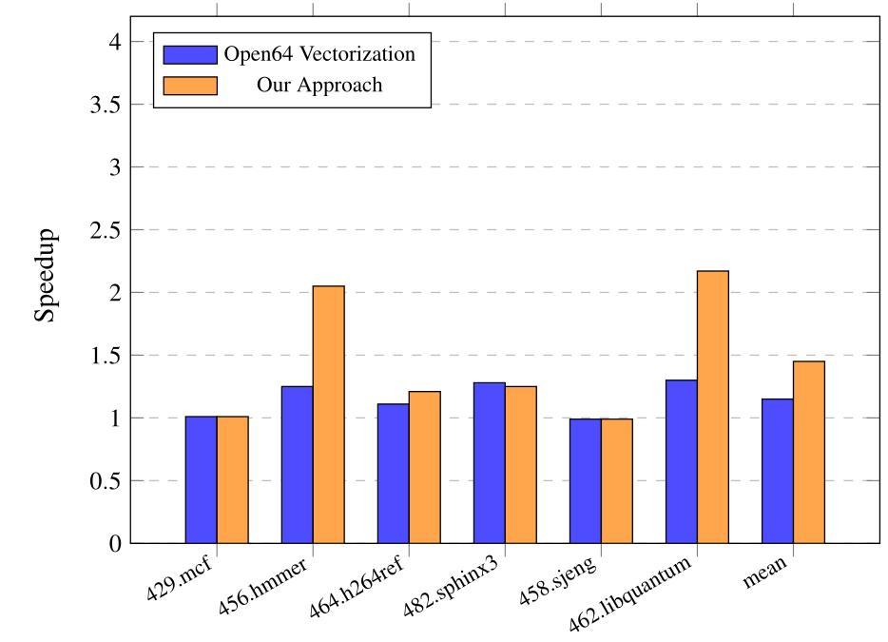
Experimental Evaluation
Tested on SW26010 processor used in Sunway TaihuLight supercomputer which does not support masked instructions
Using Open64 Compiler
The baseline is Open64 vectorization
Not nested
Innermost loop-dependent IF-statement
Not vectorized
Two-level nested IF-statement
Loop excluded from vectorization
Notes:
xym

Slide 16
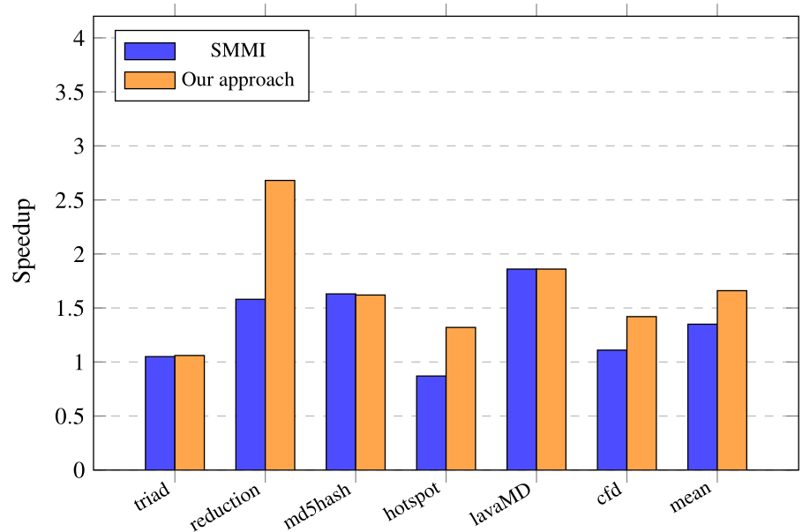
LLVM Optimization Evaluation
Tested on IBM power processor with IBM AltiVec vector instructions
Using LLVM
The baseline is the unvectorized kernel optimized only with the
standard LLVM optimization pipeline (-O3).
Notes:
xym

Slide 17
Group’s Commentary
Advantage:
Easy to apply for nested loop
Evaluation: test for both overtime as well as kernel time
Limitations:
Application scope: Only helpful for CPUs without masked instructions
Weaknesses:
Only description about the LLVM optimization, which is not clear
Notes:
What is best about the paper? Why is the idea so awesome? Don’t focus on results What are limitations/weaknesses of the approach (be critical!)

Slide 18
Thank you for listening!
Any Questions?
References
Sun, H., Gorlatch, S. & Zhao, R. Vectorizing programs with IF-statements for processors with SIMD extensions. J Supercomput 76, 4731–4746 (2020).

