Slide 1
EECS 583
Loop Rolling for Code Size Reduction
Group 11- Saloni Koshe, Mihir Sri Parankusam, Karthik Sunil

Slide 3
Contents of the Presentation
Introduction
Existing Solution for Compressing Code Size
Existing Loop Rerolling Strategy
Motivation
Proposed Solution
Methodology
Evaluation
Drawbacks
Related Work
Conclusion

Slide 4
Introduction
Code size optimization is vital for resource-constrained systems, impacting memory usage and download sizes, thus influencing costs and revenues.
Compilers currently provide specialized optimizations including common subexpression elimination and dead code elimination to address code size concerns.
Modern size optimizations focus on merging equivalent code to eliminate duplicates, using function merging and function outlining streamlining code structures.

Slide 5
Existing Solution for Compressing Code Size
Loop re-rolling transforms equivalent instructions from a block into a loop.
Existing methods are limited to partially unrolled loops and cannot handle straight-line code.
The ineffectiveness of current loop rerolling implementations stems from rigid algorithms that fail to identify code duplicates adequately.

Slide 6
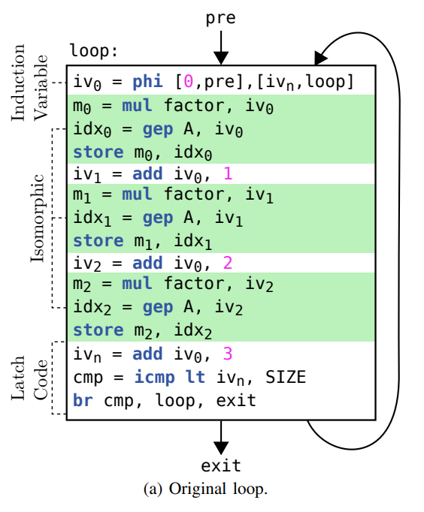
Existing Loop Rerolling Strategy
Identify single-block loops within the code.
For each identified single-block loop, LLVM searches for a basic induction variable of integer type.
The recursive aspect of a basic induction variable is denoted using a phi-node.

Slide 7
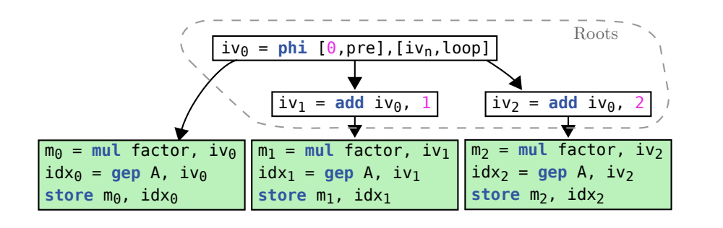
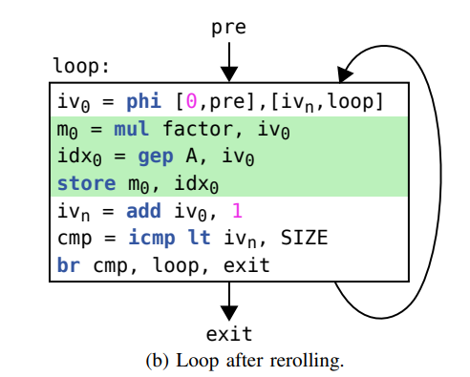
Existing Loop Rerolling Strategy
These induction variables mark the starting points for LLVM's loop rerolling approach.
By following definition-use chains, LLVM identifies instructions representing the incremental changes of the unrolled induction variable.
Instructions in the graph following these root instructions are collected, excluding those in the latch code.
Collected instruction sets must contain equivalent instructions representing each unrolled iteration, ensuring uniformity in opcode, data types, and operands. If all criteria are met, the loop is rerolled.

Slide 8
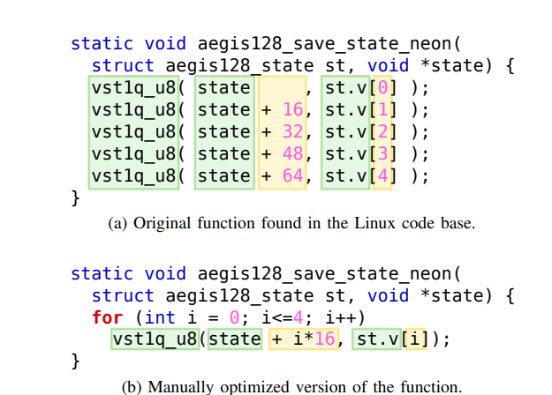
Motivation
Operands are not completely identical:

Slide 9
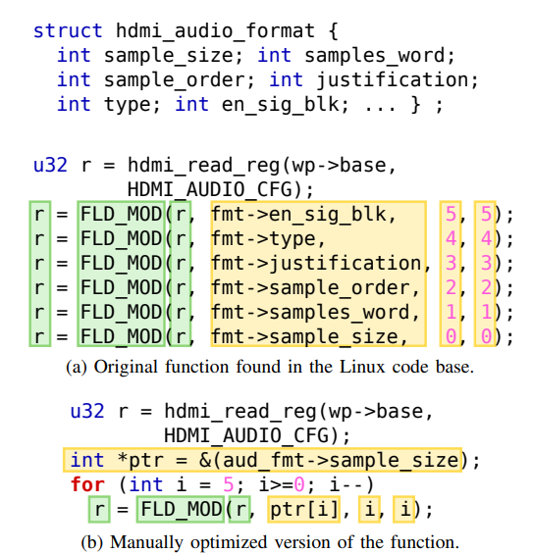
Motivation
Function calls where each value returned from one call is passed as argument to the next one :

Slide 10
Proposed Solution
The paper introduces RoLAG, a new loop rolling method that operates on straight-line code and utilizes graph alignment.
RoLAG functions through five key stages:
A. Seed collection
B. Graph alignment
C. Scheduling analysis
D. Code generation
E. Profitability analysis
The process operates in a bottom-up manner, where each basic block undergoes a specific procedure.

Slide 11
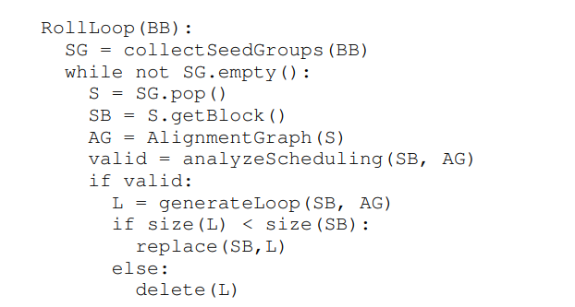
Proposed Solution
RoLAG scans instructions in a basic block, identifying seed groups.
These seed groups are analyzed for similarities in their SSA graphs, constructing an alignment graph that distinguishes between matching and mismatching nodes.
After verifying the feasibility of rearranging instructions as loop iterations, RoLAG generates the rolled loop.

Slide 12
Seed Collection
RoLAG examines each basic block, gathering seed instructions, primarily comprising store instructions, function calls, and potentially leading to reduction trees.
These seed instructions are grouped based on certain similarities, such as store instructions by data type and base address, and function calls by callee.
These grouped seed instructions form the initial stage of RoLAG's graph alignment strategy.

Slide 13
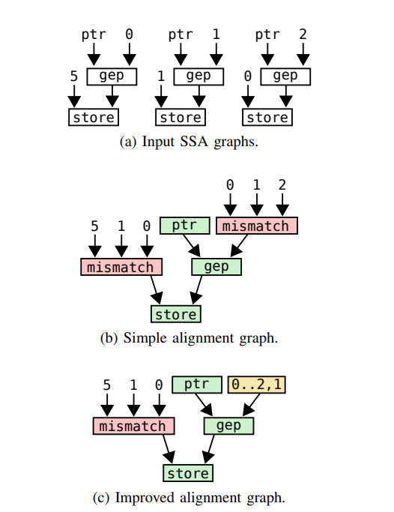
Aligning Isomorphic Code
RoLAG creates an alignment graph corresponding to each set of seed instructions.
Nodes - matching or mismatching.
The alignment graph is constructed by traversing the SSA graph from bottom to top, beginning with the seed instructions and expanding towards their operands.

Slide 14
Abstracting Special Code Patterns
Monotonic Integer Sequences
Neutral Pointer Operations
Algebraic Properties of Binary Operations
Chained Dependencies
Reduction Trees
Joining Alignment Graphs

Slide 15
Abstracting Special Code Patterns
Monotonic Integer Sequences

Slide 16
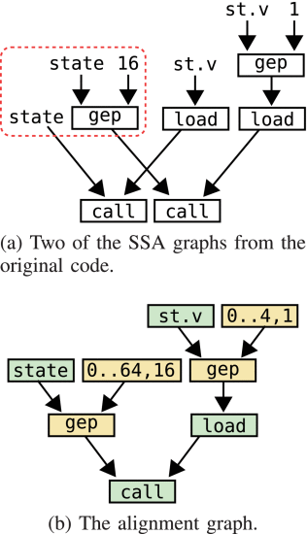
Abstracting Special Code Patterns
2. Neutral Pointer Operations

Slide 17
Abstracting Special Code Patterns
3. Algebraic Properties of Binary Operations
Utilizes algebraic properties like addition with 0 or multiplication with 0
This improves the mismatching nodes to be matched
It also uses commutativity property to increase similarity
a+0 = a
0*a = 0
a+b = b+a

Slide 18
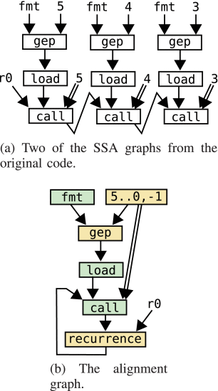
Abstracting Special Code Patterns
4. Chained Dependencies

Slide 19
Abstracting Special Code Patterns
5. Reduction trees

Slide 20
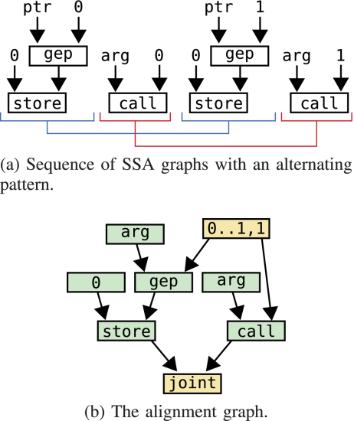
Abstracting Special Code Patterns
6. Joining Alignment Graphs

Slide 21
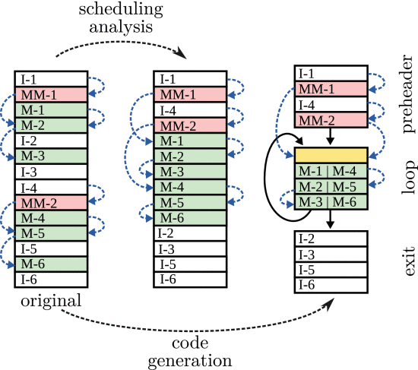
Scheduling Analysis
Check to ensure correctness
Merge all matching nodes
Allows circular dependencies

Slide 22
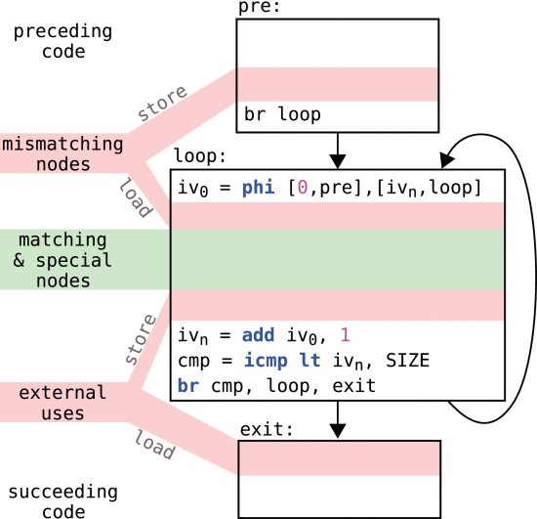
Code Generation
Initially generates Basic Block and control flow
Generates
Pre-header
Body
Exit
Matched nodes are directly added
Mismatched nodes are stored in global array
Constructs DU chains, finds external use and adds store to support this use

Slide 23
Profitability Analysis
Costs for handling the mismatching nodes
Target specific analysis
Target-Transformation Interface (TTI) - built-in cost model
Notes:
Add some detail on benchmarks

Slide 24
Evaluation
RoLAG is compared against LLVM’s standard loop re-roller:
Evaluated on 4 different benchmark suites:
AnghaBench
MiBench
SPEC 2017
TSVC
Benchmark suites all built with Clang/LLVM targeting x86 using -Os, with loop unrolling disabled
All experiments performed on a quad-core Intel Xeon CPU E5-2650

Slide 25
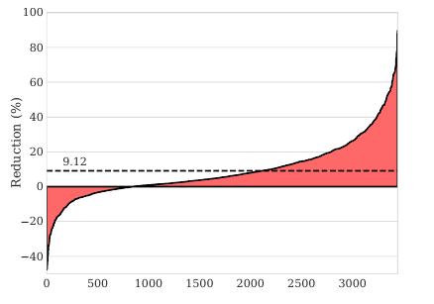
Results on AnghaBench
Benchmark provides 1 million compatible functions from popular repositories such as PostgreSQL, numpy and Linux
RoLAG achieves average code size reduction of 9.12% over the LLVM reroller
Best case: 90% code size reduction achieved in a memory copy function in the Linux kernel
Index of benchmark (top 3500)

Slide 26
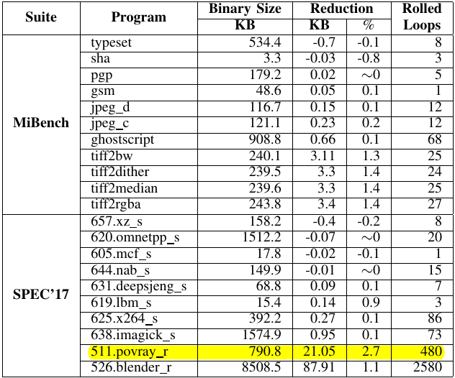
Results on MiBench and SPEC 2017
Benchmark suites comprising whole programs
LLVM Loop Re-roller never triggered on these programs
RoLAG finds several optimizations that LLVM does not, but impact is most noticeable when several loops are rolled in the same program
Highest reduction of 2.7% achieved, 480 loop rolling ops were performed

Slide 27
Results on TSVC
Benchmark consists of programs with partially unrolled loops that can be perfectly rolled
RoLAG achieves 23.4% code size reduction on average across kernels, compared to LLVM’s 13.69%
RoLAG works for every basic block, but LLVM only works for partially unrolled loops
Average slow-down of 20% reported across the TSVC benchmark when using RoLAG

Slide 28
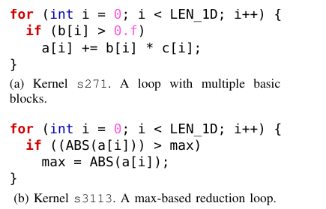
Limitations
Some limitations in the RoLAG loop roller:
Code size increase compared to LLVM observed in some cases due to false positives in profitability analysis:
Loop Rolling may prevent future optimizations like CSE and dead-code elimination
Cost models estimate code size at IR level when lowered to target arch, but may not account for other optimizations and register allocation
Unable to roll loops across multiple basic blocks
Min/Max reduction trees remain unsupported
Notes:
Maybe add these in drawbacks of the paper:
Despite SIMD hardware, performance gain is underwhelming because of two reasons:
Overhead of executing both the then and the else path
In the case of irregular memory accesses there is additional cost in packing them into vectors in comparison to continuous memory accesses

Slide 29
Related and Future Work
Some related areas of work include:
Superword Level Parallelism Vectorization: Uses the same principle and collects seed instructions that may lead to vectorization. Unlike loop rolling, this is limited to targets with vector units.
Future work:
Currently, the RoLAG loop re-roller (say that 5 times quickly :P) is only able to roll loops within a single basic block, the authors propose to extend this to multiple blocks in the same function.
Integrate optimizations for SLP vectorization into loop roller
Evaluate impact of loop rolling on other optimizations, register allocation and the instruction cache
Notes:
Add references later

