Slide 1
TVM: An Automated End-to-End Optimizing Compiler for Deep Learning
Tianqi Chen, Thierry Moreau, Ziheng Jiang , Lianmin Zheng, Eddie Yan, Meghan Cowan, Haichen Shen, Leyuan Wang, Yuwei Hu, Luis Ceze, Carlos Guestrin, Arvind Krishnamurthy
Paul G. Allen School of Computer Science & Engineering, University of Washington
AWS, Shanghai Jiao Tong University, UC Davis, Cornell
Team 10: Shaurya Gunderia, Marissa Bhavsar, Rushil Talla, Raghav Ramesh, Ankith Palakodati

Slide 2
Roadmap
Native Machine Learning
Tensor Virtual Machine (TVM)
Compiler stack

Slide 3
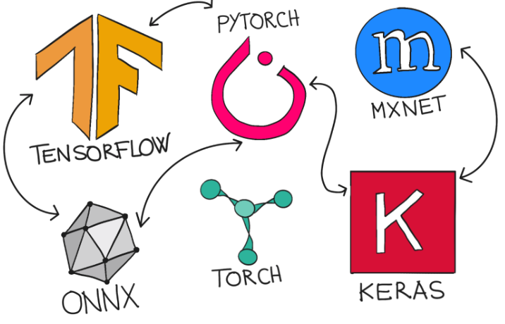
Expansion of ML
Increasing need to bring ML to diverse hardware
Different back-ends (GPUs, ASICs, etc.)
Different platforms (Phones, cars, etc.)
Current framework relies on vendor-specific operator libraries and optimize for very specific hardware
Deploying to new platforms requires significant manual effort
Can it be optimized?
Notes:
So machine learning has become increasingly popular over the past few years as models have become more powerful (CV, GPT). With this popularity comes an increase need to support ML on diverse hardware - different backends like GPUs and CPUs and different target platforms like phones and cars. There is a challenge w The current framework relies on vendor-specific operator libraries and optimize for specific hardware meaning deploying workloads to new platforms like accelerators requires significant manual effort. But is it possible to optimize this process?

Slide 4
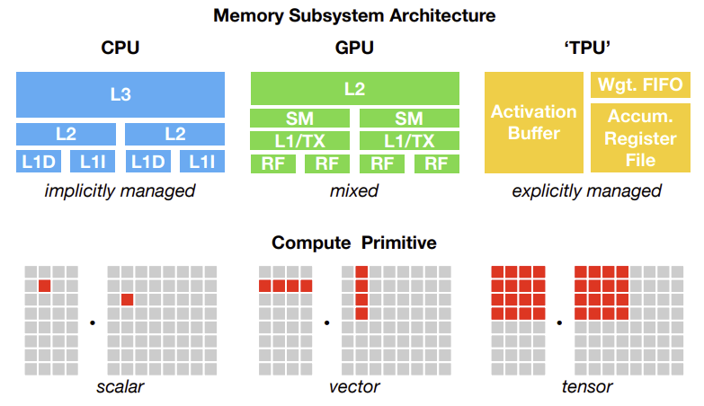
Different Hardware
Notes:
Here is a quick diagram showing how different accelerators have different architectures. Compute primitives are the basic unit of computation and as seen here the different architectures have really different ways of running calculations. These differences need to be addressed when generating optimized code that works universally

Slide 5
Current Deep Learning Frameworks
Optimize with computational graphs
High-level and device-agnostic, may not effectively address back-end specific capabilities
Provide tailored optimization for server-class GPU but require significant manual tuning
With supported back-ends, still must make a choice
Avoid graph optimizations that introduce new, unsupported operators.
Use unoptimized implementations for these new operators.
Optimize Performance, Maintain Compatibility, Address Hardware Needs
Notes:
The current Deep Learning networks rely on a computational graph intermediate representation (nodes are operators/variables, links are data flow; intermediate step in executing computation) to implement optimizations. However, the optimizations are fairly high-level and designed to be device-agnostic. While providing performance gains overall, these optimizations dont always fully exploit the specific optimizations that can be applied to each backend like memory or special instruction scheduling.
There are a small set of backends that these frameworks provide extra optimization for but they are mostly server-class GPUs and require significant manual tuning
Since we want to be able to run our model on any target.
Propose idea of having 3 separate transitions for last row - shaurya

Slide 6
Roadmap
Native Machine Learning
Tensor Virtual Machine (TVM)
Compiler Stack

Slide 7
Tensor Virtual Machine (TVM)
High level specification of a deep learning program from existing frameworks
Low level optimized code for a diverse set of hardware back-ends

Slide 8
Challenges TVM Aims to Address
Leveraging Specific Hardware Features and Abstractions
Multi-dimensional inputs, different data layouts, special memory hierarchy requirements
Challenge in generating optimized code for a given operator description across different hardware platforms
Large Search Space For Optimization
Combinatorial choices of memory access, threading pattern, and hardware primitives
Challenge in producing efficient code without manually tuning operators
Difficulties with predefined cost models
Notes:
DL accelerators introduce optimized compute primitives while GPUs/CPUs continuously improve processing units

Slide 9
Three Key Modules
Graph rewriter
Computational graph -> optimized graph
Takes full advantage of high-level and operator-level optimizations
Tensor expression language
Supports automatic code generation for each operator
Extends Halide’s compute/schedule separation concept
Automated program optimization framework
Guided by an ML-based cost model
Finds optimized tensor operators given schedule primitives
Notes:
Provide program transformation primitives that generate different versions of the program with various optimizations
Separating target hardware intrinsics from transformation primitives
Incrementally computing schedules
Schedules:
Rich space of valid programs for a given operator declaration

Slide 10
Roadmap
Native Machine Learning
Tensor Virtual Machine (TVM)
Compiler Stack

Slide 11
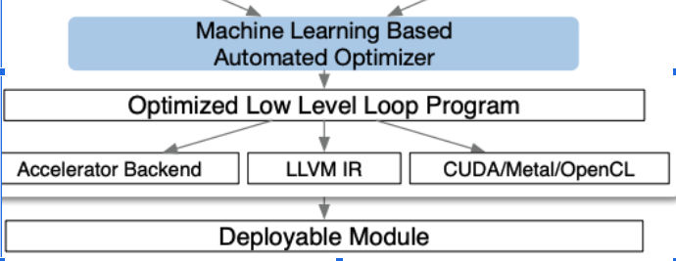
The TVM Compiler Stack
Notes:
Takes input of model from existing framework
Transforms into computational graph representation
Performs high-level dataflow rewriting to generate an optimized graph
Operator-level optimization module generates efficient for each fused model

Slide 12
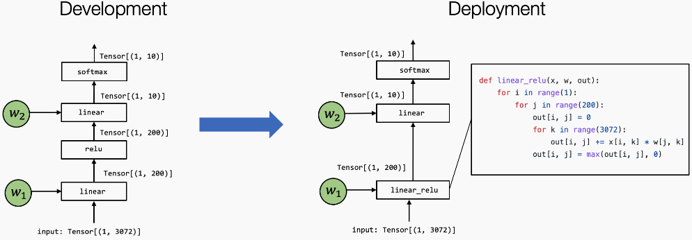
Optimizing Computational Graphs
Notes:
LABEL THIS??

Slide 13
Generating Tensor Operations
Dimensions
Tensors
Reduction operation axis

Slide 14
Automating Optimization
Gradient Tree Boosting
Prioritize speed for rapid optim
Predict Relative order of performance
Features are extracted from loop structures
Self improving!
Notes:
Bullets are taken straight from “machine learning model design choices” section

Slide 15
Evaluation
Evaluation of TVM on various hardware backends
Comparison with other deep learning compiling frameworks
Evaluation of TVM on real-world workloads

Slide 16
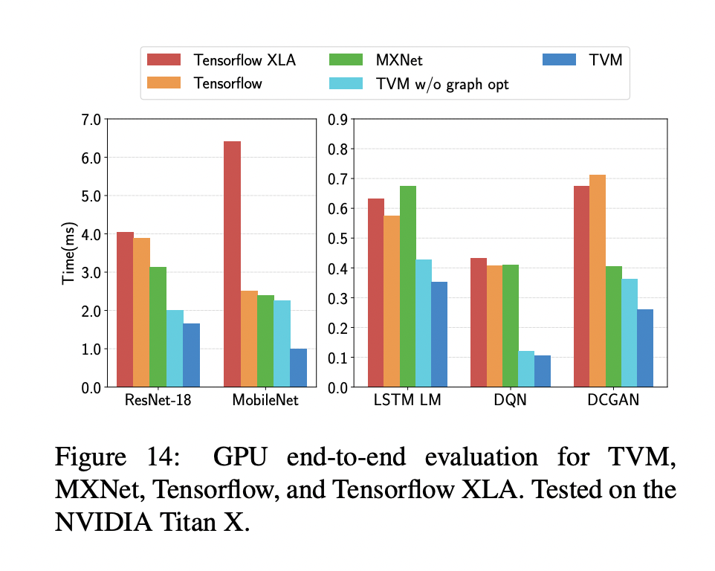
TVM vs DL Compilers
Notes:
This graph displays how TVM performs vs other existing DL compilers tested on a GPU. As you can see in the visual, TVM, even without graph optimizations has significant improvements in time, and even more of an improvement with graph optimizations.

Slide 17
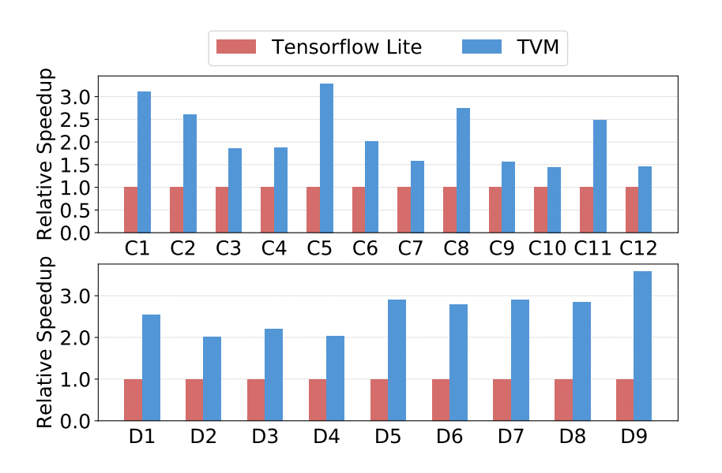
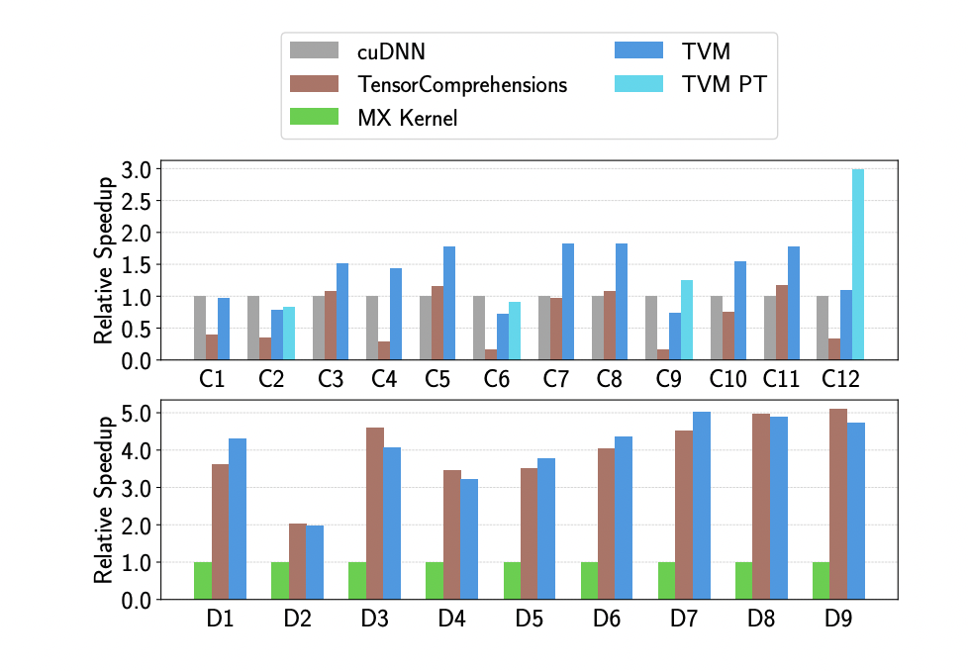
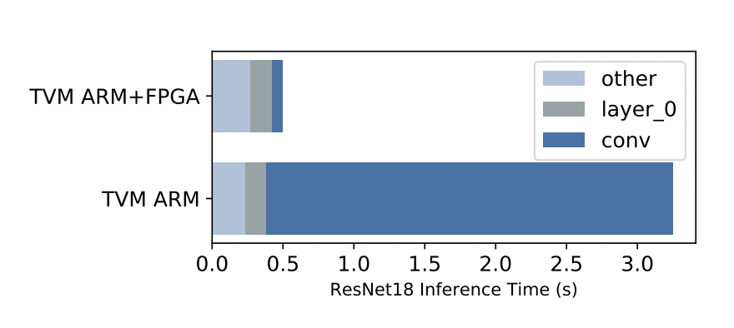
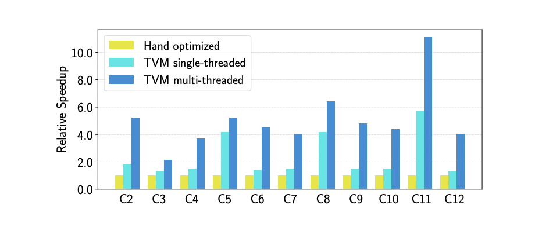
Operator Level Optimizations Results
CPU:
GPU:
FPGA(Hardware Accelerator)
Notes:
For operator level optimizations, the paper tested how TVM performed on various hardware devices on several convolutional and depthwise convolutional layers
On a CPU, compared to Tensorflow, TVM has significant speedups, especially on the later depthwise convolutional layers. It also gains significant speed advantages if you can incorporate multi-threading
On a GPU, although CUDA deep neural network library seems to be faster on some convolutional layers, TVM is faster on overall. As for the depthwise convolutional layers, TensorComprehensions and TVM seem to be on par with each other.
Finally, when TVM was tested using a hardware accelerator on a CPU, the convolutional layers had a significant decrease in overall time(roughly 40 times acceleration). The greyed out regions indicate that the layers couldn’t be run on the FPGA.

Slide 18
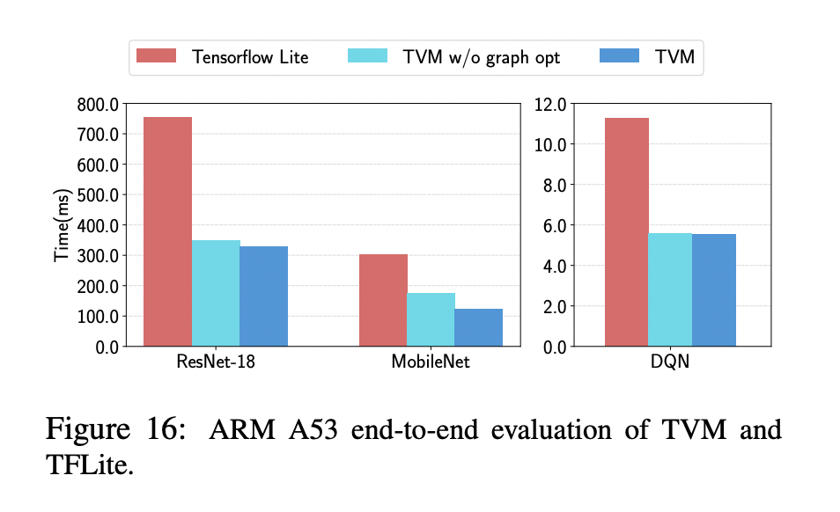
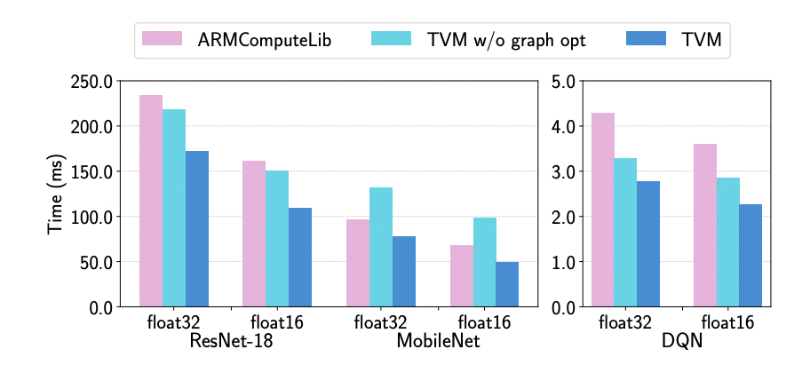
Graph Level Optimizations Results
CPU:
FPGA(Hardware Accelerator)
Notes:
The paper also compared how the graph level optimizations performed.
On the CPU, the graph level optimizations reduced time slightly more than without the graph level optimizations, while both significantly outperformed TF Lite.
Using the FPGA, they were able to see higher reductions in time due to the graph level optimizations, while both outperformed ARMComputeLib

Slide 19
Key Takeaways
End to end optimization across different hardware backends and DL frameworks
Graph + Operator level optimizations
Automated exploration of optimized schedules
Schedule primitives for memory management and latency hiding

Slide 20
Limitations
Future Work
Possible performance trade-offs (prioritizing efficiency over accuracy)
Limited support for specialized hardware
Lacks evaluation for large scale deployments
Expanding operator coverage
Handling dynamic shape and control flow
Easier integration with DL frameworks

