Slide 1
Large Language Models for Compiler Optimization
Group #1: Clark Kaminsky, Joshua Symonds, Christopher Kok Paper: https://arxiv.org/pdf/2309.07062.pdf

Slide 2
Introduction ~ Code Optimization
-fauto-inc-dec
-fbranch-count-reg
-fcombine-stack-adjustments
-fcompare-elim
-fcprop-registers
-fdce
-fdefer-pop
-fdelayed-branch
-fdse
-fforward-propagate
-fguess-branch-probability
-fif-conversion
-fif-conversion2
-finline-functions-called-once
-fipa-modref
-fipa-profile
-fipa-pure-const
-fipa-reference
-fipa-reference-addressable
-fmerge-constants
-fmove-loop-invariants
-fmove-loop-stores
-fomit-frame-pointer
-freorder-blocks
-fshrink-wrap
-fshrink-wrap-separate
-fsplit-wide-types
-fssa-backprop
-fssa-phiopt
-ftree-bit-ccp
-ftree-ccp
-ftree-ch
-ftree-coalesce-vars
-ftree-copy-prop
-ftree-dce
-ftree-dominator-opts
-ftree-dse
-ftree-forwprop
-ftree-fre
-ftree-phiprop
-ftree-pta
-ftree-scev-cprop
-ftree-sink
-ftree-slsr
-ftree-sra
-ftree-ter
-funit-at-a-time
*Some* example compilation flags from GCC - https://gcc.gnu.org/onlinedocs/gcc/Optimize-Options.html
Notes:
Throughout this class we’ve learned about tons of different optimizations, what they do, and how they change the code size and runtime. A code pass for this paper is a optimization transformation done to the IR code, like constant propagation or if conversion. Pass ordering is the task of finding and ordering a list of passes which result in the best or optimized code we can find for a given program.
Most people don’t worry about pass ordering and just use the defaults baked into the -o compilation flags. However, if you really want to find the optimal ordering of passes, your search space is about 10^18 likely combinations with infinite being theoretically possible. It’s not worth it for a human to explore this search space to optimize a single program, but with machine learning rapidly improving it's also been able to help find better pass ordering quickly.

Slide 3
Introduction ~ Large Language Models
Machine learning models can make intelligent decisions automatically for code optimization
Traditional machine learning methods require lossy code representation
Why Might Large Language Models Help?
Code optimization might just be too complicated for LLMs
What can current LLMs accomplish?
From Two Sigma Ventures
Notes:
However, many machine learning methods require code to be represented in a way that loses information, forgetting information like control flow or specific variable values which lead to a model with incomplete understanding of the code. As a result, most machine learning techniques struggle to effectively optimize code at the IR level which requires deeper understanding of the code.
Large Language Models, or LLMs can receive code as raw text which retains all of the information so they have the potential to perfectly understand code unlike other ML methods. LLMs have also demonstrated a decent understanding of optimizing code at the source code level, so it is natural that they might be able to optimize at the IR level. Further, LLMs specifically have had an explosive rise in popularity and development recently so leveraging rapidly improving LLMs to optimize code has great potential.
However, using preexisting LLMs doesn’t work since IR code optimization requires deep understanding which must be explicitly trained for; existing models work fine for making minor tweaks but easily confuse themselves with more substantial optimizations.
This paper began with the researchers posing that LLMs *could* be useful for code optimization, but they planned to show and explain the limitations of LLMs and why they would fail. Specifically, LLMs struggle with multi-tiered reasoning, arithmetic, and utilization of complex data structures and algorithms; all of which are crucial for code optimization. After training a model to outline their expected shortcomings, the researchers found their model to be remarkably accurate at both identifying and executing optimizations.
Most simply, the singular contribution this paper makes is that it is the first application of LLMs to compiler optimization and found it to be surprisingly accurate, far surpassing their expectations, and worth further exploration.

Slide 4
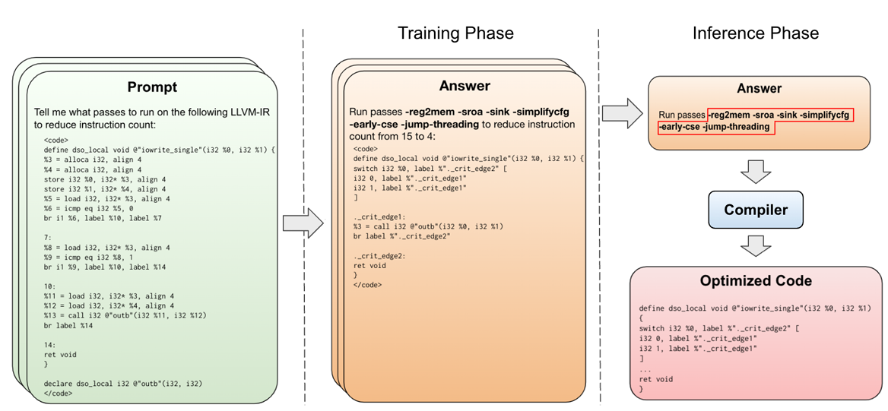
Pass Ordering ~ What’s the model actually doing?
We need generalizable understanding of how to optimize code
Optimizing for # of IR instructions
Improve performance with Chain-Of-Thought Reasoning [1] during training time
[1] Chain-of-Thought Prompting Elicits Reasoning in Large Language Models, https://arxiv.org/abs/2201.11903
Notes:
Previous machine learning approaches have struggled to generalize across different programs, but a complex LLM with deep reasoning might be enough to generalize reliably. In fact, previous work with ML code optimization is impractical for real-world use since they need to recompile new programs tens or even hundreds of times to explore different configurations of passes to effectively optimize.
The model focuses on IR optimization instead of source code since IR code is more generalizable and requires a deeper understanding than single source languages like Python and it aims to optimize the minimum number of IR instructions as proxy for file size, taking in unoptimized IR code as raw text as its input.
It then outputs the pass ordering ~ what the compiler should do and in what order.
In addition to the pass ordering, the model also predicts the resulting optimized code and the instruction counts before and after running the optimization passes it generates.
By requiring the model to output these auxiliary steps for figuring the necessary passes, the model is forced to have a deeper understanding of code optimization and its impact on the source code. This method of having LLMs “showing their work” to improve performance on tasks is called Chain-Of-Thought Prompting and it is used to improve performance of LLMs across many tasks.
This model is able to optimize for code size 3% more effectively than the compiler defaults, and the auxiliary code generation is compilable over 90% of the time and perfectly emulates the compilers output 70% of the time. This means that 70% of the time, we can optimize IR code correctly using an LLM without referencing the slower compiler at all. Admittedly, no one wants an LLM pretending to be their compiler if it breaks their code 30% of the time but this paper shows the potential that LLMs have and encourages more research into improving their ability to optimize code.
Since the auxiliary code generation is imperfect, they only use the output of the auxiliary tasks to help with training and a compiler is used to execute the passes for testing.

Slide 5
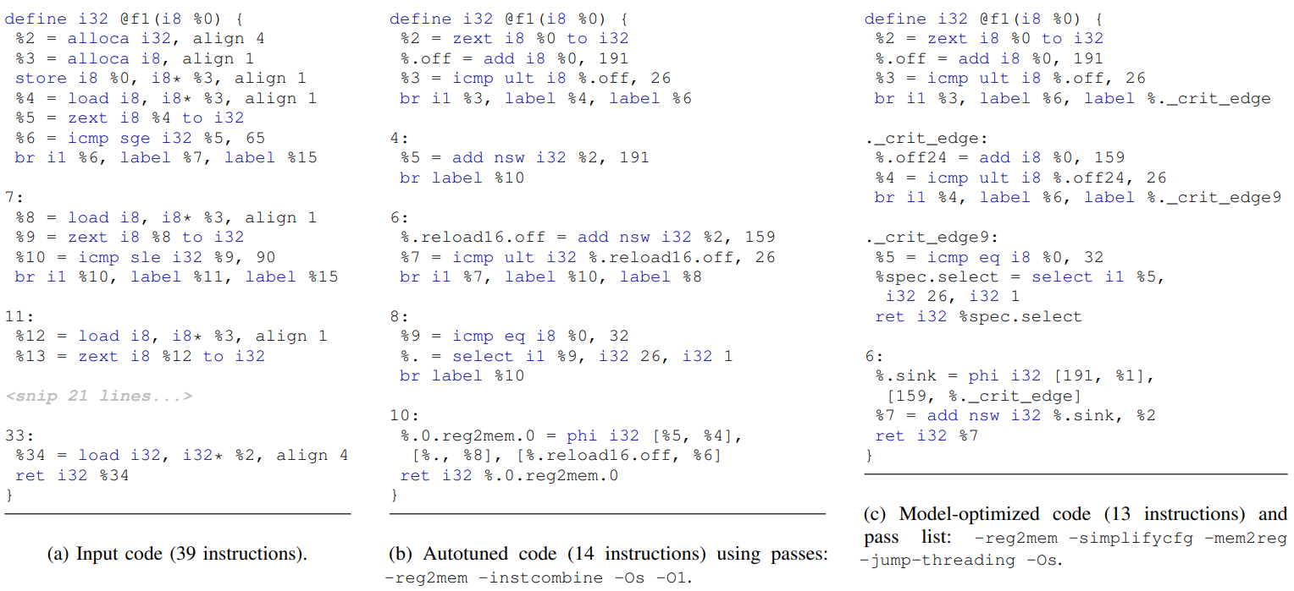
The Model
Transformer Architecture
Self attention: capture contextual relationships between tokens to encourage the model to understand and process the semantic structure
Trained-from-scratch version of Llama 2 (7B parameters)
During training, the model was evaluated on a holdout validation set of 1,000 unseen IRs that were processed in the same manner as the training set every 250 steps.

Slide 6
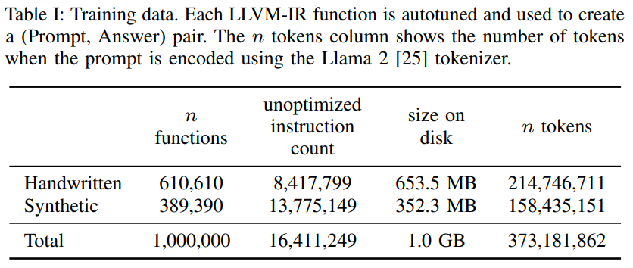
Training Data
Combined publicly available handwritten C/C++ code and synthetic code generated by C/C++ compiler test generators for a training corpus of 1,000,000 IR functions (373M training tokens)
Using individual IR functions rather than entire modules to maximize the amount of training and testing data
Used autotuning to find the list of optimization passes that will produce the smallest instruction count
Autotuner combines random search and all-to-all results broadcasting between functions
Huge computational cost: 9,016 CPU days
Goal: Achieve some fraction of the performance of the autotuner using a predictive model without compiling thousands of times

Slide 7
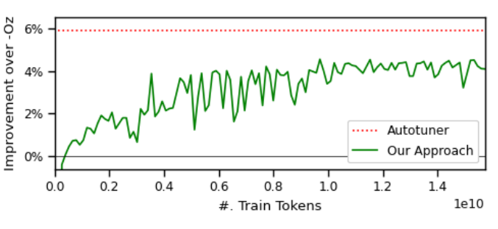
Evaluation
4.4% fewer instructions than when optimized using the compiler’s built-in pass ordering (-Oz)
No compiler invocations needed!
The autotuner achieves a greater instruction count reduction of 5.6%, but this required 27 million compilations of the validation set.

Slide 8
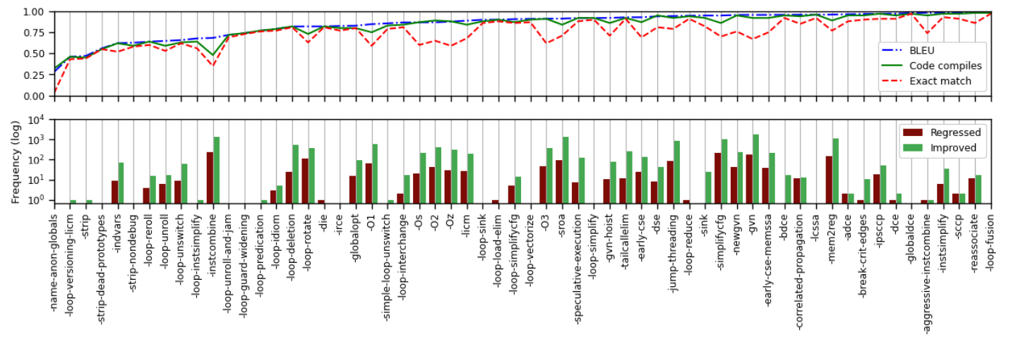
Quality of Code
Top plot: quality the of generated code for the corresponding pass (ordered by BLEU score)
Bottom plot: frequency that the corresponding pass contributed to an improvement or regression of instruction count over -Oz.
Peak performance: 90.5% of the time, model generates code that compiles without errors
BLEU score of 0.952: model code closely approximates that of the compiler – 70% exact match

Slide 9
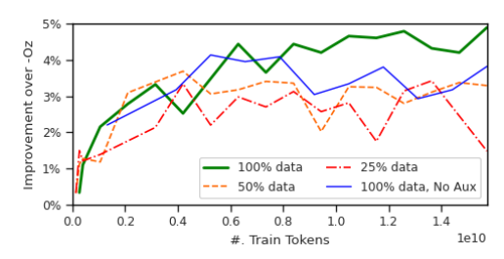
Additional Experiments
Dataset Size Ablation (with 25% or 50% of the dataset) → performance falls ~23%
Optimization Task Ablation (without code generation) → performance falls by 16%
Notes:
Dataset Size Ablation: The authors explored how varying the size of the training dataset affects model performance. By reducing the dataset to 50% and 25%, they observed a decline in the model's optimization capabilities, indicating the importance of a large, diverse dataset for training effective optimization models.
Falls by 21 and 24 % respectively
Optimization Task Ablation: In an interesting twist, the authors found that training the model not just to predict optimization strategies but also to generate optimized code itself actually improved the model's performance. This counterintuitive result suggests that engaging the model in the deeper task of code generation forces it to develop a more nuanced understanding of code optimization.
Falls by 16%
Single Pass Translation Evaluation: The authors assessed the model's ability to emulate individual optimization passes. This experiment provided insights into the model's capability to understand and apply specific compiler optimizations, revealing strengths in certain optimizations and challenges in others, such as complex arithmetic reasoning.
“The model has learned to perform these optimizations entirely from examples, without access to the compiler implementation.”

Slide 10
Additional Experiments
Single Pass Translation (generating optimized code for an individual pass)
Notes:
Dataset Size Ablation: The authors explored how varying the size of the training dataset affects model performance. By reducing the dataset to 50% and 25%, they observed a decline in the model's optimization capabilities, indicating the importance of a large, diverse dataset for training effective optimization models.
Falls by 21 and 24 % respectively
Optimization Task Ablation: In an interesting twist, the authors found that training the model not just to predict optimization strategies but also to generate optimized code itself actually improved the model's performance. This counterintuitive result suggests that engaging the model in the deeper task of code generation forces it to develop a more nuanced understanding of code optimization.
Falls by 16%
Single Pass Translation Evaluation: The authors assessed the model's ability to emulate individual optimization passes. This experiment provided insights into the model's capability to understand and apply specific compiler optimizations, revealing strengths in certain optimizations and challenges in others, such as complex arithmetic reasoning.
“The model has learned to perform these optimizations entirely from examples, without access to the compiler implementation.”

Slide 11
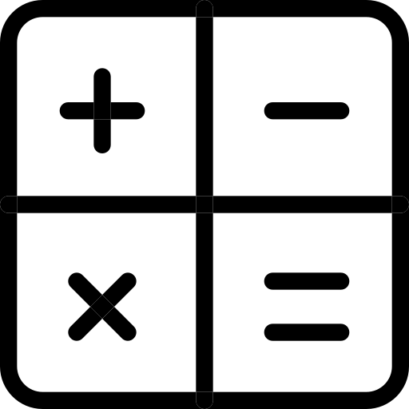
Discussion
Context Window Challenges
But the field is growing! (e.g. Code Llama)
Arithmetic Reasoning Limitations
Trying a curriculum of arithmetic and logic
Inference Speed Considerations
GPUs, batching, specializing the vocabulary
Where we come in!
Notes:
Context Window Challenges: The authors highlight the challenge posed by the limited context window size of Large Language Models (LLMs), which restricts the amount of code that can be processed at once. This limitation hinders the model's ability to perform optimizations that require broader program context or to optimize larger programs effectively.
Arithmetic Reasoning Limitations: A significant limitation identified by the authors is the model's struggle with arithmetic reasoning and logic. This shortcoming affects the model's ability to predict the outcomes of certain optimizations, particularly those involving compile-time computations. The authors suggest that future research might explore techniques like chain-of-thought prompting to improve the model's reasoning capabilities.
Where we come in: Using SOTA models like GPT4 that include longer context lengths and arithmetic reasoning but providing context-specific material that should help (RAG).
Inference Speed Considerations: The authors discuss the computational overhead of using LLMs for code optimization, noting that generating optimization strategies with an LLM is significantly slower than executing compiler optimizations directly. They propose that future work could investigate methods to increase inference efficiency, such as model quantization or vocabulary specialization, to make LLM-based optimization more practical for real-world applications.

Slide 12
Related Work
Compiler Pass Ordering History
Several using Machine Learning
E.g. Ogilvie et al. → “Minimizing the Cost of Iterative Compilation with Active Learning”
But none with LLMs!
Language Models in Code Generation
Code-based LLMs for tasks like code completion, translation, and repair
E.g. Gallagher et al. → RoBERTA architecture on LLVM-IR for code weakness
But none specifically for compiler pass ordering!
Notes:
Compiler Optimization History: The authors provide an overview of the longstanding efforts in compiler optimization, noting that the manipulation of compiler pass orderings has been a focus for improving runtime performance and code size for decades. This historical context sets the stage for understanding the novelty of applying LLMs to this domain.
Machine Learning in Compiler Optimization: Prior to the authors' work, various machine learning techniques, including reinforcement learning and iterative compilation, have been applied to optimize compiler pass orderings. However, these approaches generally required extensive compilations to find optimal configurations, contrasting with the authors' method of using a predictive model to bypass repeated compilations.
Language Models in Code Generation: The authors acknowledge the broader landscape of LLMs trained on source code for tasks such as code completion, translation, and repair. While these models have demonstrated proficiency in code-related tasks, the authors' work is pioneering in its focus on leveraging LLMs specifically for the task of compiler optimization.

Slide 13
Thank you!

