Slide 1
Characterizing and Enhancing Global Memory Data Coalescing on GPUs
Group 13
N. Fauzia, L. -N. Pouchet and P. Sadayappan, "Characterizing and enhancing global memory data coalescing on GPUs," 2015 IEEE/ACM International Symposium on Code Generation and Optimization (CGO), San Francisco, CA, USA, 2015, pp. 12-22, doi: 10.1109/CGO.2015.7054183.

Slide 2
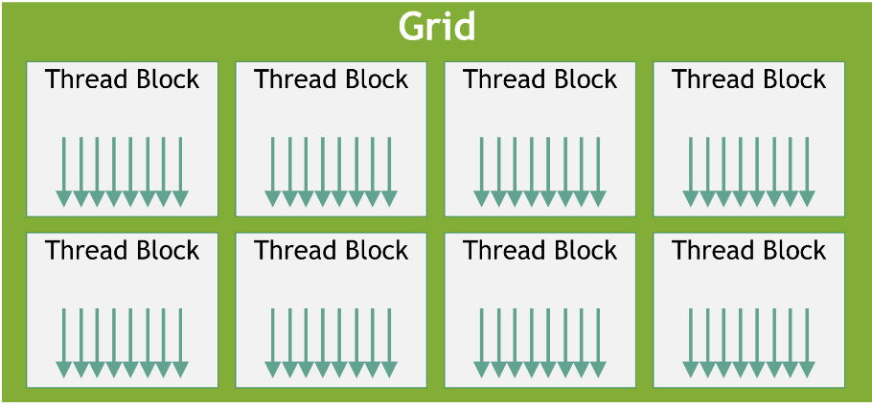
Intro to GPU architecture and CUDA framework
SM (Streaming Multiprocessors consist of hundreds of cores arranged in tightly coupled groups of 8-32 scalar processors.
Blocks - Groups of threads that are scheduled on a SM and can not migrate.
Threads are spawned in 1-, 2-, 3-dimensional rectangular group of cooperative groups.
Grids - 1-, 2-, 3-dimensional group of thread blocks.
Used to schedule thread blocks.
Geometry of the thread space:
G = (bdimx, bdimy, bdimz, tdimx, tdimy, tdimz).

Slide 3
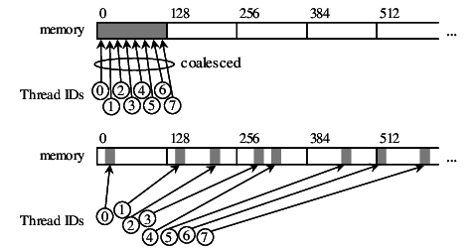
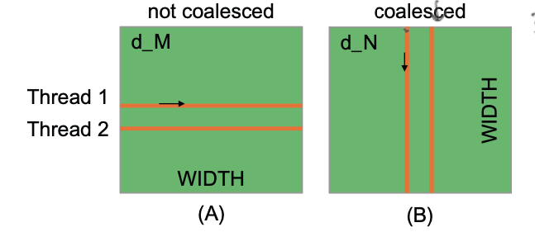
Memory Data Coalescing
When Parallel threads running the same instruction access consecutive locations in the global memory.
Optimal usage of global memory bandwidth.
Reduces number of transactions to the global memory.
GPU threads do not access contiguous memory in consecutive iterations:
Translating parallel programs for CPU to CUDA programs may not exhibit coalesced memory accesses.
“Row major”
adj elts in row are in consecutive locations in memory space.

Slide 4
Contributions
Dynamic analysis tool for characterizing memory accesses of PTX code and providing suggestions for improvement
Transformation framework that remaps work to threads to improve global memory access coalescing (based on results from dynamic analysis)
Smaller set of transformations that can be applied to all programs
Aggressive, geometry-based approach limited to some CUDA programs
Previous work:
Relied on input from programmer (not automatic).
Notes:
Mention PTX is machine-agnostic ISA (like LLVM IR)
Helps work with kernel parameters/thread geometry
Today focus on smaller set of transformations

Slide 5
Overview
Original CUDA
Kernel
Memory Trace
Instrument
Instrumented PTX
Execute
Analyze
Transformed Kernel
Suggested Optimization
Transform
Notes:
Like in HWs

Slide 6
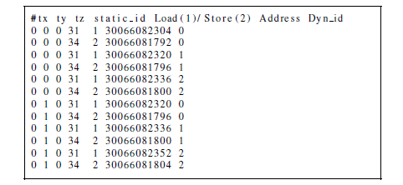
Dynamic Analysis of Uncoalesced Accesses
Input to the dynamic analysis is PTX code of kernel.
Fig: Example of memory trace of PTX code

Slide 7
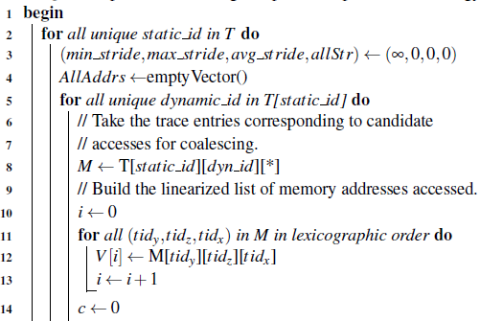
Memory Trace Analysis Algorithm
Simplified Pseudocode:
Iterate over each instance of a memory access and store it as a list
Notes:
Access strides -> differences in memory addresses between consecutive accesses

Slide 8
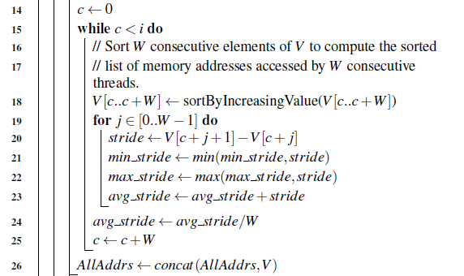
Memory Trace Analysis Algorithm (contd)
Process accesses in chunks to analyze access stride
(Access Stride - Differences in memory addresses between consecutive accesses)

Slide 9
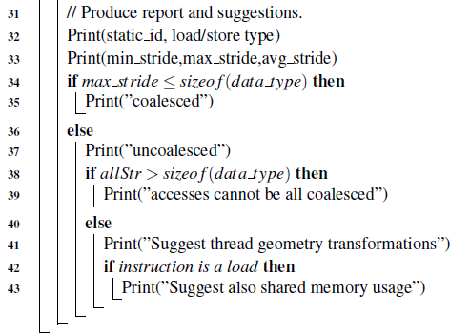
Memory Trace Analysis Algorithm (contd)
Check if set of all memory accesses for this instruction is contiguous in memory
Suggest optimization strategies based on the analysis
Notes:
This is the key part of the algorithm and a key insight of the paper!
Note:
allStr is the largest gap between memory accesses over entire space.
If max_stride <= sizeof(data_type) is saying: if all of our strides are less than the data type, we know that there are no gaps that will make the memory uncoalesced.
If allStr > sizeof(data_type) is saying: If there's a gap larger than the size of the data within ALL of the memory space, there's absolutely no way to line things up and get it coalesced. Otherwise we might be able to switch up the y and z axis for instance to get coalescing.

Slide 10
Transformation of the Thread Geometry
Goal: reschedule the threads by permuting the dimensions of the geometry
ie. update G = (bdimy, bdimx, bdimz, tdimy, tdimx, tdimz) and swap uses of threadIdx.x and threadIdx.y in the code
Consecutive memory accesses along the t_x dimension
(i) Input: Original geometry & AST
(ii) Compute all 3 permutations and run previous dynamic analysis
(iii) Choose configuration with lowest number of uncoalesced accesses

Slide 11
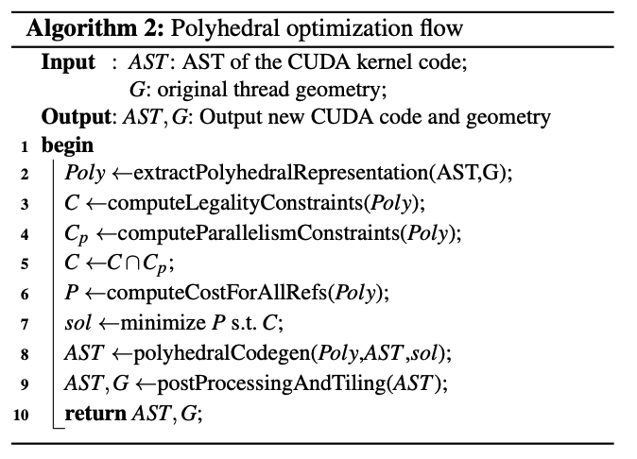
Polyhedral Optimization
Lift parallel loops
Body of loop is source of parallel threads
1D -> 2D geometry
Need control and data-flows to be characterized at compile time
AST -> Polyhedron
View thread block geometry as a 3- nested loop
Construct an ILP for scheduling the threads
Legality constraints => program semantics
Parallelism constraints => dependencies
Notes:
Polyhedron: Subset S of R^n where for some P in R^mxn and q in R, S = { x: Px <= q }

Slide 12
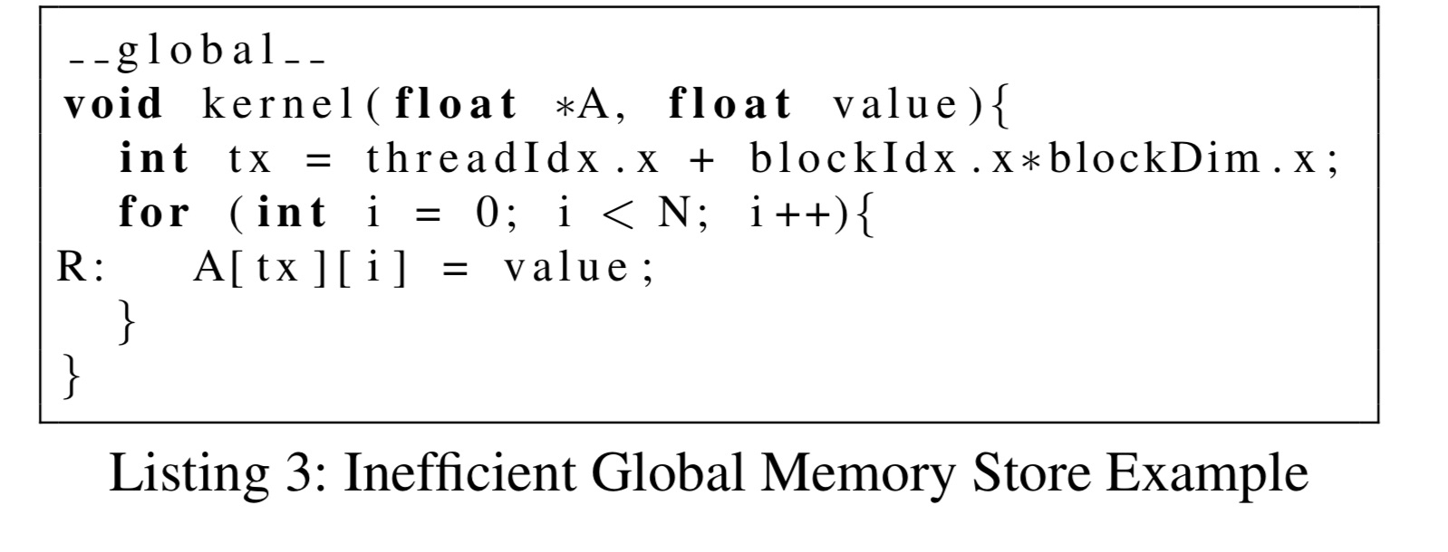
Convert to A[ty][tx], launch with N threads in ty dim, removes need for loop
Notes:
Polyhedron: Subset S of R^n where for some P in R^mxn and q in R, S = { x: Px <= q }

Slide 13
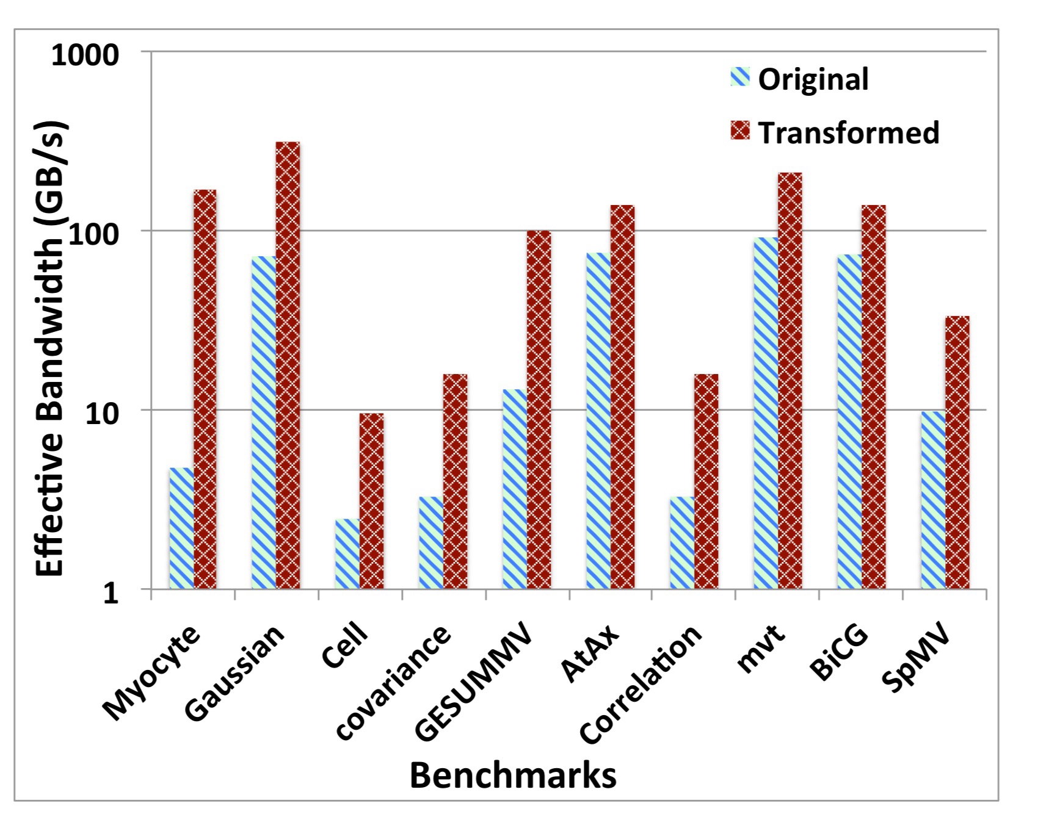
Benchmarks/Results
Use PolyBench and Rodinia (suite of scientific computing algorithms).
Profile code with dynamic analysis algorithm, apply static transformations.
2-8x speedup from coalescing memory accesses, depending on kernel.
(Benchmarked on single Tesla K20, Y axis is log scale)
Notes:
For Gaussian elimination (row reduction of matrix) and 3D Stencilr( cellular automata), previously called ce4lll, simply switching the thread geometry was enough to get about a 4x speedup.
Some Use 1D thread geometry.

Slide 14
Discussion
Shortcomings
Many ML developers use higher-level abstractions (PyTorch, Tensorflow) with efficient CUDA implementations instead of CUDA kernels.
Written for general CUDA kernels, more focused papers can apply targeted optimizations.
Many other CUDA optimizations
Utilize tiling for memory coalescing in more complicated scenarios.
Prevent thread divergence.
Take advantage of hardware (tensor cores, caches).
Related ideas in ML Compilers:
Compiling CUDA kernels into execution graphs optimally (Alpa).
Data movement-aware scheduling policy (FireIron).
Automated kernel fusion (DeepCuts).
Notes:
PolyDL: Polyhedral optimizations

