Slide 1
Reducing False Sharing on Shared Memory Multiprocessors through Compile Time Transformations Tor E. Jeremiassen and Susan J. Eggers
Group 12
Adarsh Ponaka, Aryan Joshi, Ayush Rautwar, Mitchell Chang, and Ronit Pattanayak

Slide 2
What is False Sharing?
A cache-line is the smallest unit of cache memory
True sharing is when different threads access/modify same variable
False sharing is when different threads access different variables on the same cache-line

Slide 3
Processor 1 cache
Processor 2 cache
use_count (4 bytes), pointer (8 bytes), etc (52 bytes)
-
-
-
use_count (4 bytes), pointer (8 bytes), etc (52 bytes)
-
-
-

Slide 4
Processor 1 cache
Processor 2 cache
use_count++
use_count (4 bytes), pointer (8 bytes), etc (52 bytes)
-
-
-
use_count (4 bytes), pointer (8 bytes), etc (52 bytes)
-
-
-

Slide 5
Processor 1 cache
Processor 2 cache
use_count++
invalidated
use_count (4 bytes), pointer (8 bytes), etc (52 bytes)
-
-
-
use_count (4 bytes), pointer (8 bytes), etc (52 bytes)
-
-
-

Slide 6
Processor 1 cache
Processor 2 cache
use_count++
invalidated
use_count (4 bytes), pointer (8 bytes), etc (52 bytes)
-
-
-
use_count (4 bytes), pointer (8 bytes), etc (52 bytes)
-
-
-
Cost: updates from other caches or memory

Slide 7
Motivation
Repeated cache invalidation is expensive, causes stalls and uses bandwidth
Invalidations hinder ideal scaling of processors
Manual techniques are cumbersome and can be outperformed by compiler
Paper found 70% of cache misses are due to false sharing
These transformations eliminate 80% of misses caused by false sharing
Notes:
Reduced Scalability: False sharing can limit the scalability of parallel programs, as contention for shared cache lines increases with the number of processors.

Slide 8
Outline
Compile-time Analysis
Data Transformations
Transformation Heuristics
Results

Slide 9
Compile-time Analysis
Three distinct static passes (stages)
Interprocedural Control Flow Analysis
Non-concurrency Analysis
Interprocedural Flow-sensitive Summary Side-effect Analysis

Slide 10
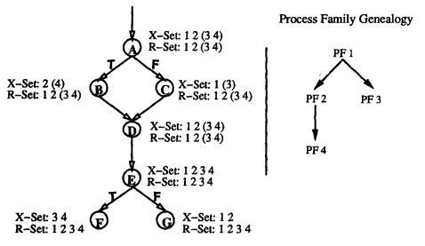
Interprocedural Control Flow Analysis
Tags the control flow graph with executing process by detecting control flow divergence using process differentiated variables

Slide 11
Non-concurrency Analysis
Splits the control flow graphs by barrier synchronization to identify where concurrency is not possible
fork()
<code segment 1>
barrier_sync()
<code segment 2>
Code segment 1 and 2 can never run concurrently

Slide 12
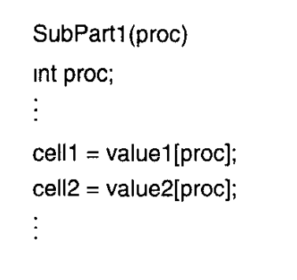
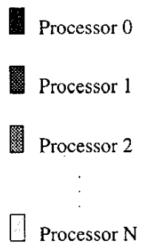
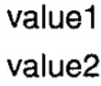
Interprocedural Flow-sensitive Summary Side-effect Analysis
Determines when same-code array index operations create cache invalidations

Slide 13
Data Transformations
Padding
Group/Transpose
Indirection

Slide 14
Padding
Single cache line
32 byte variable | 32 byte variable
Two cache lines, each variable in unique cache line
32 byte variable | 32 byte padding | 32 byte variable | 32 byte padding

Slide 15
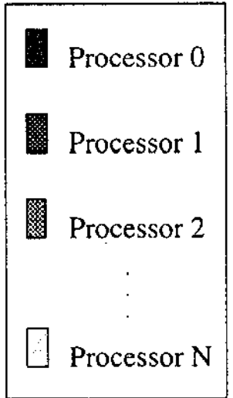
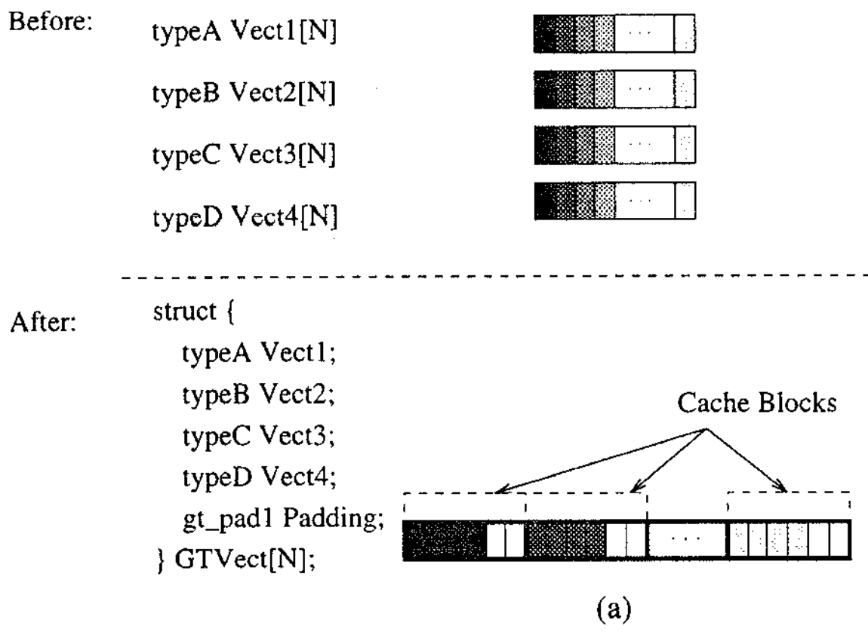
Group and Transpose
Group per-process data
Transpose data for processor locality, and pad it to prevent cache line sharing
Struct of arrays → array of structs
Static sized arrays

Slide 16
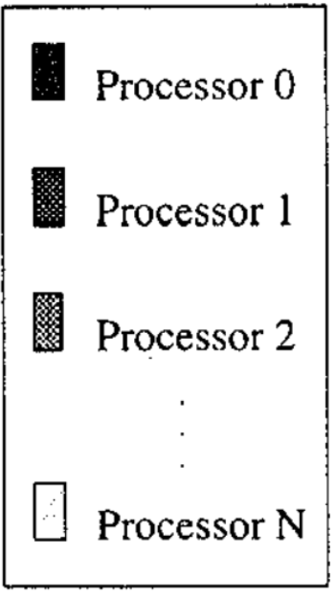
Indirection
For heap allocated data structures that can't be transposed so indirection is used
Overhead: memory for pointer, and one additional memory access

Slide 17
Use Case: Padding Locks
Locks often share cache lines with shared data
Many cases for invalidations can occur if the shared data and lock is accessed for read or write.
Solution is to always pad locks to their own cache line

Slide 18
Transformation Heuristics
Developed by per-process analysis and false sharing profiling
Data access patterns (factors):
Type of access (read/write/shared)
Stride (known/unknown)
Frequency of accesses
Notes:
we can’t just automatically do these trasnfoarmtions because each trasnformation will inherently have memory overhead

Slide 19
Data Transformation Considerations
Locks are always padded
Data structure read w/strong locality → only transform if writes are more frequent than reads
Data structure reads and writes w/o strong locality → padded and aligned
Data structure with minimal read-write conflicts & read w/o processor locality → group/transpose or indirection
Notes:
because reads won’t cause false sharing, so there’s no need to fix/transform anything unless we actually cause more cache invalidations (through writes)

Slide 20
Transformation Considerations
Data structure with minimal read-write conflicts & reads w/o strong locality → group/transpose or indirection
Notes:
w/o strong processor locality
(if it already has spatial locality, then doing thi smay ruin it)

Slide 21
Methodology and Workload
Impact of static algorithms and transformations on program performance was assessed
3 program versions: unoptimized, compiler-transformed, and hand-optimized.
Hand-optimized for locality to varying degrees

Slide 22
Results
Applied optimizations on numerous unoptimized programs
Maxflow: Maximum flow in a directed graph
PVerify: Logical Verification
Topopt: Topological Optimization
Fmm: Fast multipole method (n-body)
Radiosity: Equilibrium Distribution of light
Others: Raytrace, LocusRoute, Mp3d, Pthor, Water

Slide 23
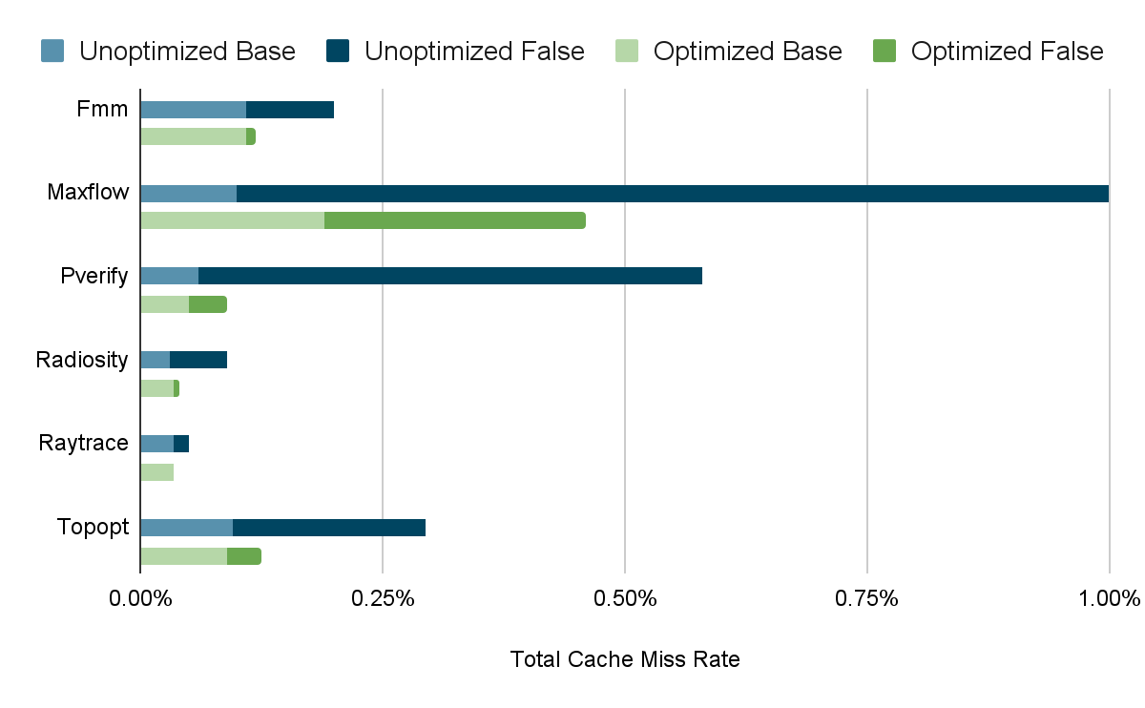
Results

Slide 24
Results
Program | False Sharing Reduction Total | Fraction of Reduction by Transformation
 |  | Group & Transpose | Indirection | Pad & Align | Locks
Maxflow | 56.5% |  |  | 49.2% | 7.3%
Pverify | 91.2% | 6.4% | 81.6% |  | 3.1%
Topopt | 79.9% | 61.3% | 18.6%
Fmm | 90.8% | 84.8% |  |  | 6.0%
Radiosity | 93.5% | 85.6% |  | 1.0% | 6.8%
Raytrace | 78.3% | 70.4% |  | 3.3% | 4.6%

Slide 25
Conclusion
False sharing quietly destroys performance
Static analysis allows for identification of places for improvement with false sharing
Group & Transpose, Indirection, and Pad & Align are all effective methods of reducing false sharing
Performance is noticeably better with vs. without these optimizations

Slide 26
Our Project
Dynamic analysis tool to detect false-sharing during execution
LLVM implementation of data transformations

Slide 27
Related Works
J. Torrellas, MS. Lam, and J.L. Hennessy. False sharing and spatial locality in multiprocessor caches. IEEE Transactions on Computers, 43(6):651–663, June 1994.
M. Dubois, J. Skeppstedt, L. Ricciulli, K. Ramamurthy, and P. Stenstrom. The detection and elimination of useless misses in multiprocessors. In 20th Annual International Symposium on Computer Architecture, pages 88–97, June 1993.

Slide 28
Paper Reference
Tor E. Jeremiassen and Susan J. Eggers. 1995. Reducing false sharing on shared memory multiprocessors through compile time data transformations. In Proceedings of the fifth ACM SIGPLAN symposium on Principles and practice of parallel programming (PPOPP '95). Association for Computing Machinery, New York, NY, USA, 179–188. https://doi.org/10.1145/209936.209955

