Slide 1

EECS 583 – Class 7
Static Single Assignment Form
University of Michigan
February 5, 2024

Slide 2

Announcements & Reading Material
HW1 grades posted on canvas – Let us know if there is a problem
HW2 – Get started early
  Spec and starting code are available on course webpage
  Also check out piazza – See detailed post by Aditya
  Talk to the GSIs if you are stuck
Today’s class
  “Practical Improvements to the Construction and Destruction of Static Single Assignment Form,” P. Briggs, K. Cooper, T. Harvey, and L. Simpson, Software--Practice and Experience, 28(8), July 1998, pp. 859-891.
Next class – Optimization
  Compilers: Principles, Techniques, and Tools,
  A. Aho, R. Sethi, and J. Ullman, Addison-Wesley, 1988,
  9.9, 10.2, 10.3, 10.7 Edition 1; 8.5, 8.7, 9.1, 9.4, 9.5 Edition 2

Slide 3
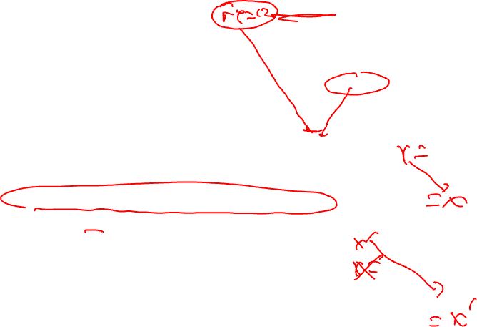
Static Single Assignment (SSA) Form
Difficulty with optimization
  Multiple definitions of the
  same register
  Which definition reaches
  Is expression available?
Static single assignment
  Each assignment to a variable is given a unique name
  All of the uses reached by that assignment are renamed
  DU chains become obvious based on the register name!
r1 = r2 + r3
r6 = r4 – r5
r4 = r6
r6 = 8
r7 = r4 – r5
r8 = r2 + r3

Slide 4
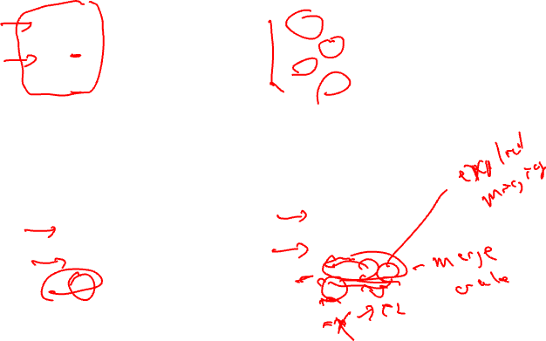
Converting to SSA Form
Trivial for straight line code
More complex with control flow – Must use Phi nodes
x = -1
y = x
x = 5
z = x
x0 = -1
y = x0
x1 = 5
z = x1
if ( ... )
x = -1
else
x = 5
y = x
if ( ... )
x0 = -1
else
x1 = 5
x2 = Phi(x0,x1)
y = x2

Slide 5

Converting to SSA Form (2)
What about loops?
  No problem!, use Phi nodes again
i = 0
do {
i = i + 1
}
while (i < 50)
i0 = 0
do {
i1 = Phi(i0, i2)
i2 = i1 + 1
}
while (i2 < 50)

Slide 6
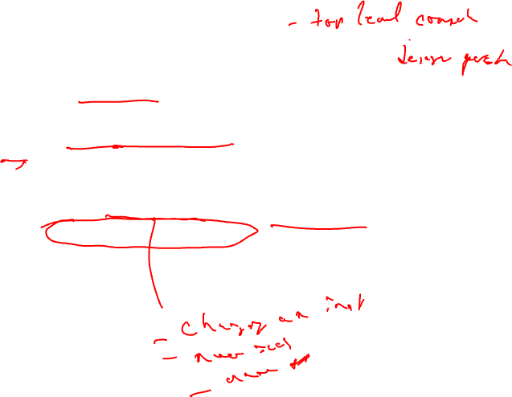
SSA Plusses and Minuses
Advantages of SSA
  Explicit DU chains – Trivial to figure out what defs reach a use
    Each use has exactly 1 definition!!!
  Explicit merging of values
  Makes optimizations easier
Disadvantages
  When transform the code, must either recompute (slow) or incrementally update (tedious)

Slide 7
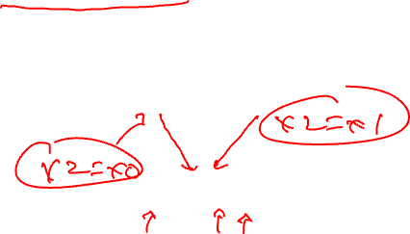
Phi Nodes (aka Phi Functions)
Special kind of copy that selects one of its inputs
Choice of input is governed by the CFG edge along which control flow reached the Phi node
Phi nodes are required when 2 non-null paths X→Z and Y→Z converge at node Z, and nodes X and Y contain assignments to V
x0 =
x1 =
x2 = Phi(x0,x1)

Slide 8
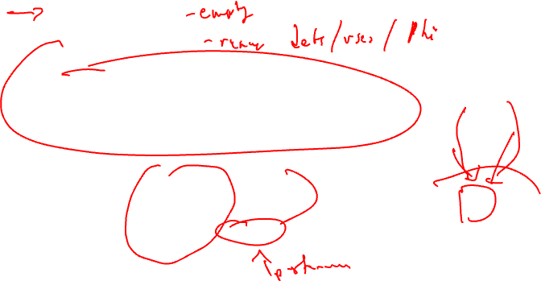
SSA Construction
High-level algorithm
  Insert Phi nodes
  Rename variables
A dumb algorithm
  Insert Phi functions at every join for every variable
  Solve reaching definitions
  Rename each use to the def that reaches it (will be unique)
Problems with the dumb algorithm
  Too many Phi functions (precision)
  Too many Phi functions (space)
  Too many Phi functions (time)

Slide 9
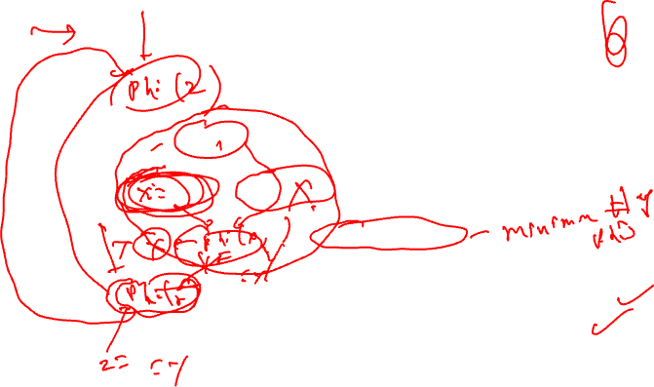
Need Better Phi Node Insertion Algorithm
A definition at n forces a Phi node at m iff n not in DOM(m), but n in DOM(p) for some predecessors p of m
BB0
def in BB4 forces Phi in BB6
def in BB6 forces Phi in BB7
def in BB7 forces Phi in BB1
BB1
BB2
BB3
Phi is placed in the block that
is just outside the dominated region
of the definition BB
BB4
BB5
BB6
Dominance frontier
The dominance frontier of node X is the
set of nodes Y such that
* X dominates a predecessor of Y, but
* X does not strictly dominate Y
BB7

Slide 10

Recall: Dominator Tree
First BB is the root node, each node
dominates all of its descendants
BB DOM
0 0
1 0,1
2 0,1,2
3 0,1,3
BB DOM
4 0,1,3,4
5 0,1,3,5
6 0,1,3,6
7 0,1,7
BB0
BB1
BB0
BB2
BB3
BB1
BB2
BB3
BB4
BB5
BB4
BB5
BB6
BB6
BB7
BB7
Dom tree

Slide 11
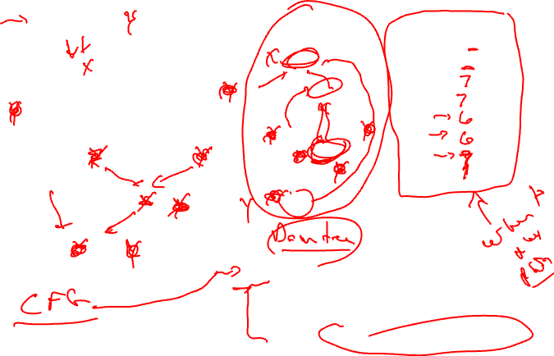
Computing Dominance Frontiers
BB0
BB0
BB DF
0
1
2
3
4
5
6
7
BB1
BB1
BB2
BB3
BB2
BB3
BB4
BB5
BB4
BB5
BB6
BB6
BB7
BB7
For each join point X in the CFG
For each predecessor, Y, of X in the CFG
Run up to the IDOM(X) in the dominator tree,
adding X to DF(N) for each N between Y and
IDOM(X) (or X, whichever is encountered first)

Slide 12
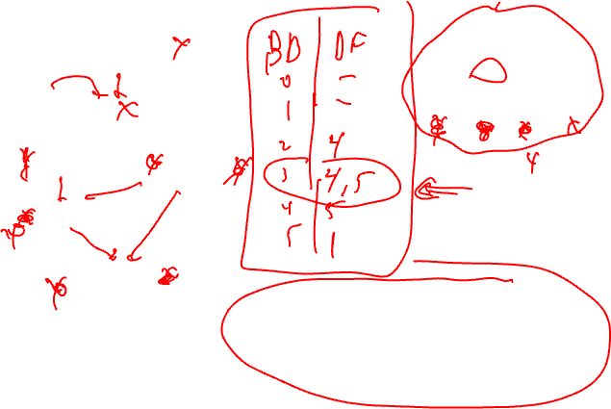
Class Problem – Compute DF for each BB
Dominator Tree
BB0
BB0
a =
b =
c =
BB1
BB1
BB2
BB3
BB4
BB5
BB2
c = b + a
BB3
b = a + 1
a = b * c
BB4
b = c - a
BB5
a = a - c
c = b * c
For each join point X in the CFG
For each predecessor, Y, of X in the CFG
Run up to the IDOM(X) in the dominator tree,
adding X to DF(N) for each N between Y and
IDOM(X) (or X, whichever is encountered first)

Slide 13
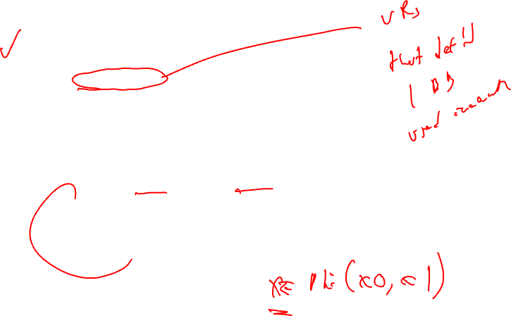
SSA Step 1 - Phi Node Insertion
Compute dominance frontiers
Find global names (aka virtual registers)
  Global if name live on entry to some block
  For each name, build a list of blocks that define it
Insert Phi nodes
  For each global name n
    For each BB b in which n is defined
      For each BB d in b’s dominance frontier
        Insert a Phi node for n in d
        Add d to n’s list of defining BBs

Slide 14
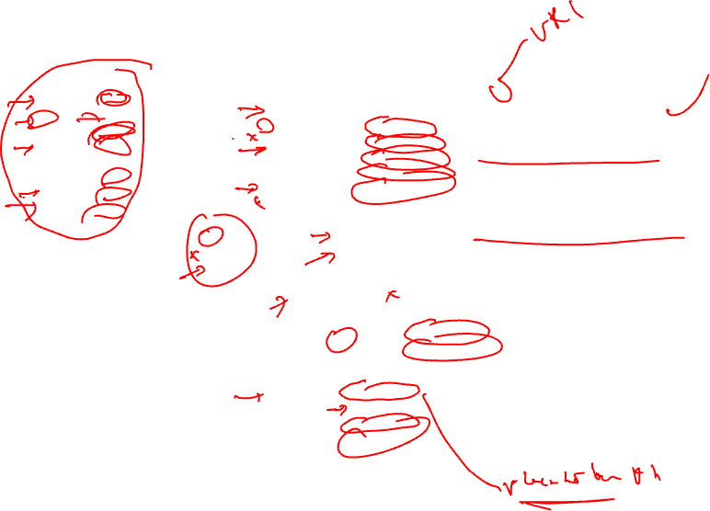
Phi Node Insertion - Example
BB DF
0 -
1 -
2 7
3 7
4 6
5 6
6 7
7 1
a is defined in 0,1,3
need Phi in 7
then a is defined in 7
need Phi in 1
b is defined in 0, 2, 6
need Phi in 7
then b is defined in 7
need Phi in 1
c is defined in 0,1,2,5
need Phi in 6,7
then c is defined in 7
need Phi in 1
d is defined in 2,3,4
need Phi in 6,7
then d is defined in 7
need Phi in 1
i is defined in BB7
need Phi in BB1
a =
b =
c =
i =
BB0
a = Phi(a,a)
b = Phi(b,b)
c = Phi(c,c)
d = Phi(d,d)
i = Phi(i,i)
BB1
a =
c =
BB2
b =
c =
d =
BB3
a =
d =
BB4
d =
BB5
c =
BB6
b =
c = Phi(c,c)
d = Phi(d,d)
BB7
i =
a = Phi(a,a)
b = Phi(b,b)
c = Phi(c,c)
d = Phi(d,d)

Slide 15
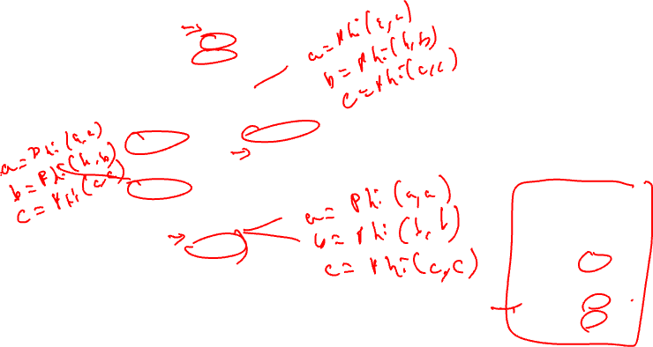
Class Problem – Insert the Phi Nodes
Dominator tree
BB0
a =
b =
c =
BB0
BB1
BB1
BB2
BB3
BB4
BB5
BB2
c = b + a
BB3
b = a + 1
a = b * c
Dominance frontier
BB4
b = c - a
BB DF
0 -
1 -
2 4
3 4, 5
4 5
5 1
BB5
a = a - c
c = b * c

Slide 16

SSA Step 2 – Renaming Variables
Use an array of stacks, one stack per global variable (VR)
Algorithm sketch
  For each BB b in a preorder traversal of the dominator tree
    Generate unique names for each Phi node
    Rewrite each operation in the BB
      Uses of global name: current name from stack
      Defs of global name: create and push new name
    Fill in Phi node parameters of successor blocks
    Recurse on b’s children in the dominator tree
    <on exit from b> pop names generated in b from stacks

Slide 17
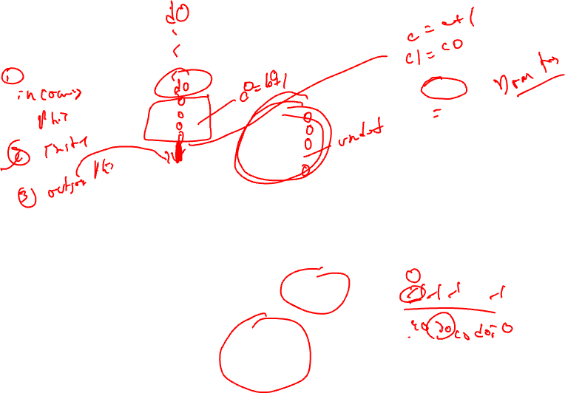
Renaming – Example (Initial State)
BB0
a =
b =
c =
i =
a = Phi(a,a)
b = Phi(b,b)
c = Phi(c,c)
d = Phi(d,d)
i = Phi(i,i)
BB1
BB0
BB2
BB3
BB1
a =
c =
BB4
BB5
BB6
BB2
b =
c =
d =
BB3
a =
d =
BB4
d =
BB5
c =
BB7
c = Phi(c,c)
d = Phi(d,d)
var: a b c d i
ctr: 0 0 0 0 0
stk: a0 b0 c0 d0 i0
BB6
b =
BB7
i =
a = Phi(a,a)
b = Phi(b,b)
c = Phi(c,c)
d = Phi(d,d)

Slide 18
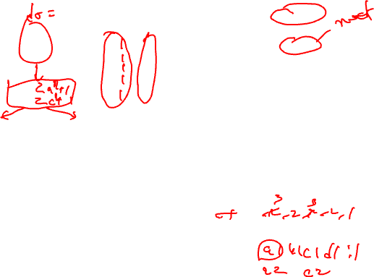
Renaming – Example (After BB0)
BB0
a0 =
b0 =
c0 =
i0 =
BB0
a = Phi(a0,a)
b = Phi(b0,b)
c = Phi(c0,c)
d = Phi(d0,d)
i = Phi(i0,i)
BB1
BB2
BB3
BB1
a =
c =
BB4
BB5
BB2
b =
c =
d =
BB3
a =
d =
BB6
BB4
d =
BB5
c =
BB7
c = Phi(c,c)
d = Phi(d,d)
var: a b c d i
ctr: 1 1 1 1 1
stk: a0 b0 c0 d0 i0
BB6
b =
BB7
i =
a = Phi(a,a)
b = Phi(b,b)
c = Phi(c,c)
d = Phi(d,d)

Slide 19
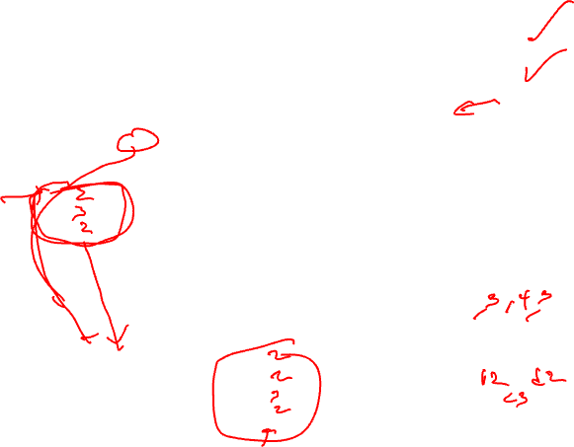
Renaming – Example (After BB1)
BB0
a0 =
b0 =
c0 =
i0 =
BB0
a1 = Phi(a0,a)
b1 = Phi(b0,b)
c1 = Phi(c0,c)
d1 = Phi(d0,d)
i1 = Phi(i0,i)
BB1
BB2
BB3
BB1
a2 =
c2 =
BB4
BB5
BB2
b =
c =
d =
BB3
a =
d =
BB6
BB4
d =
BB5
c =
BB7
c = Phi(c,c)
d = Phi(d,d)
var: a b c d i
ctr: 3 2 3 2 2
stk: a0 b0 c0 d0 i0
a1 b1 c1 d1 i1
a2 c2
BB6
b =
BB7
i =
a = Phi(a,a)
b = Phi(b,b)
c = Phi(c,c)
d = Phi(d,d)

Slide 20

Renaming – Example (After BB2)
BB0
a0 =
b0 =
c0 =
i0 =
BB0
a1 = Phi(a0,a)
b1 = Phi(b0,b)
c1 = Phi(c0,c)
d1 = Phi(d0,d)
i1 = Phi(i0,i)
BB1
BB2
BB3
BB1
a2 =
c2 =
BB4
BB5
BB2
b2 =
c3 =
d2 =
BB3
a =
d =
BB6
BB4
d =
BB5
c =
BB7
c = Phi(c,c)
d = Phi(d,d)
var: a b c d i
ctr: 3 3 4 3 2
stk: a0 b0 c0 d0 i0
a1 b1 c1 d1 i1
a2 b2 c2 d2
c3
BB6
b =
BB7
i =
a = Phi(a2,a)
b = Phi(b2,b)
c = Phi(c3,c)
d = Phi(d2,d)

Slide 21
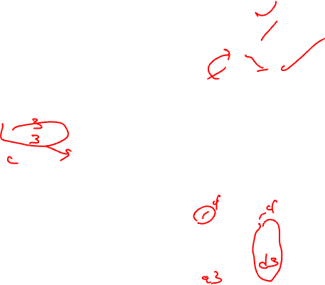
Renaming – Example (Before BB3)
This just updates
the stack to remove the
stuff from the left path
out of BB1
BB0
a0 =
b0 =
c0 =
i0 =
BB0
a1 = Phi(a0,a)
b1 = Phi(b0,b)
c1 = Phi(c0,c)
d1 = Phi(d0,d)
i1 = Phi(i0,i)
BB1
BB2
BB3
BB1
a2 =
c2 =
BB4
BB5
BB2
b2 =
c3 =
d2 =
BB3
a =
d =
BB6
BB4
d =
BB5
c =
BB7
c = Phi(c,c)
d = Phi(d,d)
var: a b c d i
ctr: 3 3 4 3 2
stk: a0 b0 c0 d0 i0
a1 b1 c1 d1 i1
a2 c2
BB6
b =
BB7
i =
a = Phi(a2,a)
b = Phi(b2,b)
c = Phi(c3,c)
d = Phi(d2,d)

Slide 22

Renaming – Example (After BB3)
BB0
a0 =
b0 =
c0 =
i0 =
BB0
a1 = Phi(a0,a)
b1 = Phi(b0,b)
c1 = Phi(c0,c)
d1 = Phi(d0,d)
i1 = Phi(i0,i)
BB1
BB2
BB3
BB1
a2 =
c2 =
BB4
BB5
BB2
b2 =
c3 =
d2 =
BB3
a3 =
d3 =
BB6
BB4
d =
BB5
c =
BB7
c = Phi(c,c)
d = Phi(d,d)
var: a b c d i
ctr: 4 3 4 4 2
stk: a0 b0 c0 d0 i0
a1 b1 c1 d1 i1
a2 c2 d3
a3
BB6
b =
BB7
i =
a = Phi(a2,a)
b = Phi(b2,b)
c = Phi(c3,c)
d = Phi(d2,d)

Slide 23
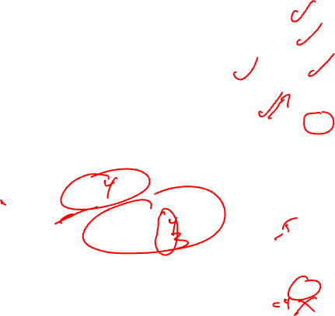
Renaming – Example (After BB4)
BB0
a0 =
b0 =
c0 =
i0 =
BB0
a1 = Phi(a0,a)
b1 = Phi(b0,b)
c1 = Phi(c0,c)
d1 = Phi(d0,d)
i1 = Phi(i0,i)
BB1
BB2
BB3
BB1
a2 =
c2 =
BB4
BB5
BB2
b2 =
c3 =
d2 =
BB3
a3 =
d3 =
BB6
BB4
d4 =
BB5
c =
BB7
c = Phi(c2,c)
d = Phi(d4,d)
var: a b c d i
ctr: 4 3 4 5 2
stk: a0 b0 c0 d0 i0
a1 b1 c1 d1 i1
a2 c2 d3
a3 d4
BB6
b =
BB7
i =
a = Phi(a2,a)
b = Phi(b2,b)
c = Phi(c3,c)
d = Phi(d2,d)

Slide 24
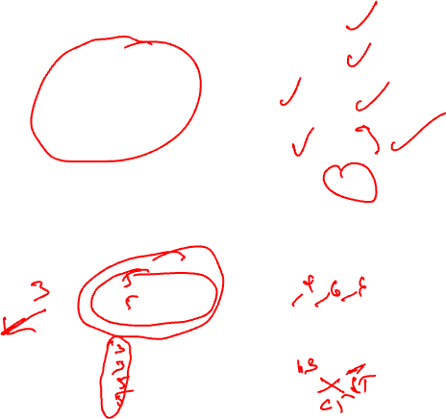
Renaming – Example (After BB5)
BB0
a0 =
b0 =
c0 =
i0 =
BB0
a1 = Phi(a0,a)
b1 = Phi(b0,b)
c1 = Phi(c0,c)
d1 = Phi(d0,d)
i1 = Phi(i0,i)
BB1
BB2
BB3
BB1
a2 =
c2 =
BB4
BB5
BB2
b2 =
c3 =
d2 =
BB3
a3 =
d3 =
BB6
BB4
d4 =
BB5
c4 =
BB7
c = Phi(c2,c4)
d = Phi(d4,d3)
var: a b c d i
ctr: 4 3 5 5 2
stk: a0 b0 c0 d0 i0
a1 b1 c1 d1 i1
a2 c2 d3
a3 c4
BB6
b =
BB7
i =
a = Phi(a2,a)
b = Phi(b2,b)
c = Phi(c3,c)
d = Phi(d2,d)

Slide 25
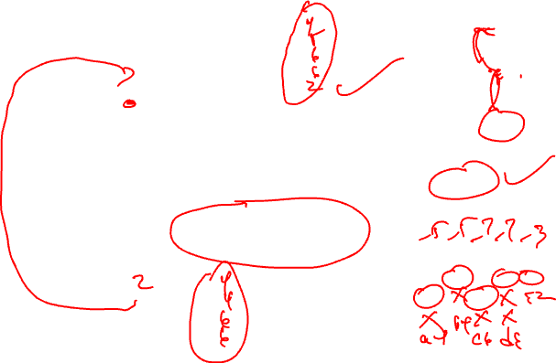
Renaming – Example (After BB6)
BB0
a0 =
b0 =
c0 =
i0 =
BB0
a1 = Phi(a0,a)
b1 = Phi(b0,b)
c1 = Phi(c0,c)
d1 = Phi(d0,d)
i1 = Phi(i0,i)
BB1
BB2
BB3
BB1
a2 =
c2 =
BB4
BB5
BB2
b2 =
c3 =
d2 =
BB3
a3 =
d3 =
BB6
BB4
d4 =
BB5
c4 =
BB7
c5 = Phi(c2,c4)
d5 = Phi(d4,d3)
var: a b c d i
ctr: 4 4 6 6 2
stk: a0 b0 c0 d0 i0
a1 b1 c1 d1 i1
a2 b3 c2 d3
a3 c5 d5
BB6
b3 =
BB7
i =
a = Phi(a2,a3)
b = Phi(b2,b3)
c = Phi(c3,c5)
d = Phi(d2,d5)

Slide 26

Renaming – Example (After BB7)
BB0
a0 =
b0 =
c0 =
i0 =
BB0
a1 = Phi(a0,a4)
b1 = Phi(b0,b4)
c1 = Phi(c0,c6)
d1 = Phi(d0,d6)
i1 = Phi(i0,i2)
BB1
BB2
BB3
BB1
a2 =
c2 =
BB4
BB5
BB2
b2 =
c3 =
d2 =
BB3
a3 =
d3 =
BB6
BB4
d4 =
BB5
c4 =
BB7
c5 = Phi(c2,c4)
d5 = Phi(d4,d3)
var: a b c d i
ctr: 5 5 7 7 3
stk: a0 b0 c0 d0 i0
a1 b1 c1 d1 i1
a2 b4 c2 d6 i2
a4 c6
BB6
b3 =
BB7
i2 =
a4 = Phi(a2,a3)
b4 = Phi(b2,b3)
c6 = Phi(c3,c5)
d6 = Phi(d2,d5)
Fin!

Slide 27

Homework Problem – Rename the Variables
Dominator tree
BB0
BB0
a =
b =
c =
a = Phi(a,a)
b = Phi(b,b)
c = Phi(c,c)
BB1
BB2
BB3
BB4
BB5
BB1
a = Phi(a,a)
b = Phi(b,b)
c = Phi(c,c)
BB2
c = b + a
BB3
b = a + 1
a = b * c
BB4
b = c - a
a = Phi(a,a)
b = Phi(b,b)
c = Phi(c,c)
BB5
a = a - c
c = b * c

Slide 28
Homework Problem –Answer
Rename the variables
Dominator tree
Dominance frontier
BB0
BB DF
0 -
1 -
2 4
3 4, 5
4 5
5 1
BB0
a0 =
b0 =
c0 =
a1 = Phi(a0,a5)
b1 = Phi(b0,b5)
c1 = Phi(c0,c5)
BB1
BB2
BB3
BB4
BB5
BB1
a3 = Phi(a1,a2)
b3 = Phi(b1,b2)
c3= Phi(c2,c1)
BB2
c2 = b1 + a1
BB3
b2 = a1 + 1
a2 = b2 * c1
BB4
b4 = c3 – a3
a4 = Phi(a2,a3)
b5 = Phi(b2,b4)
c4 = Phi(c1,c3)
BB5
a5 = a4 – c4
c5 = b5 * c4

