Slide 1

EECS 583 – Class 6
Dataflow Analysis II
University of Michigan
January 31, 2024

Slide 2

Announcements & Reading Material
HW 2 is available
  See: https://web.eecs.umich.edu/~mahlke/courses/583w24/homeworks.html
  Due: Wed Feb 21
  HW2 is significantly harder than HW1 so get started early!
  Aditya will go over the HW2 spec and template code at the end of today’s class (continued in discussion section)
    Slides posted on the course website if you cannot attend discussion
Today’s class
  Compilers: Principles, Techniques, and Tools,
  A. Aho, R. Sethi, and J. Ullman, Addison-Wesley, 1988.
  (Sections: 10.5, 10.6, 10.9, 10.10 Edition 1; 9.2, 9.3 Edition 2)
Next class
  “Practical Improvements to the Construction and Destruction of Static Single Assignment Form,” P. Briggs, K. Cooper, T. Harvey, and L. Simpson, Software--Practice and Experience, 28(8), July 1998, pp. 859-891.

Slide 3
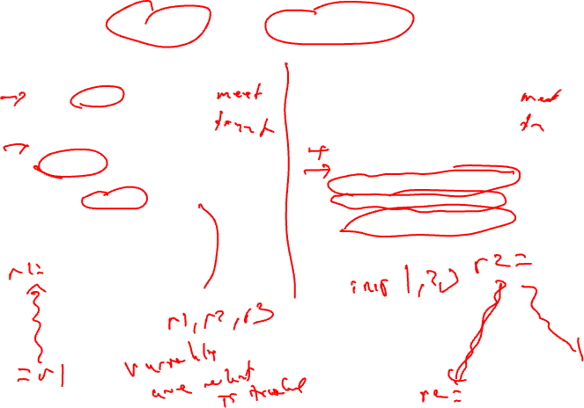
Recap: Liveness vs Reaching Defs
Liveness
Reaching Definitions/DU/UD
OUT = Union(IN(succs))
IN = GEN + (OUT – KILL)
IN = Union(OUT(preds))
OUT = GEN + (IN – KILL)
Bottom-up dataflow
Any path
Keep track of variables/registers
Uses of variables → GEN
Defs of variables → KILL
Top-down dataflow
Any path
Keep track of instruction IDs
Defs of variables → GEN
Defs of variables → KILL

Slide 4

Generalizing Dataflow Analysis
Transfer function
  How information is changed by “something” (BB)
  OUT = GEN + (IN – KILL) /* forward analysis, e.g., rdefs */
  IN = GEN + (OUT – KILL) /* backward analysis, e.g., liveness */
Meet function
  How information from multiple paths is combined
  IN = Union(OUT(predecessors)) /* forward analysis */
  OUT = Union(IN(successors)) /* backward analysis */
Generalized dataflow algorithm
  while (change)
    change = false
    for each BB
      apply meet function
      apply transfer functions
      if any changes → change = true

Slide 5
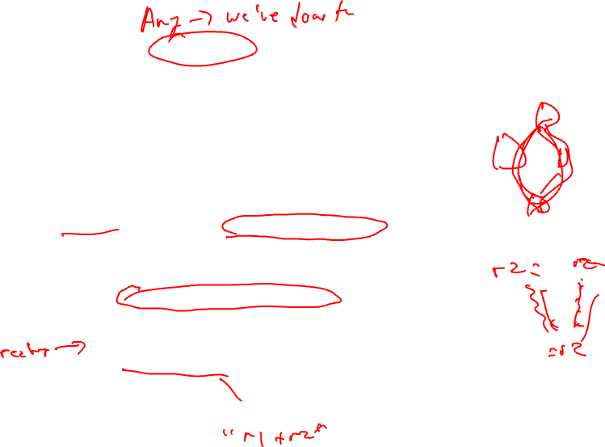
What About All Path Problems?
Up to this point
  Any path problems (maybe relations)
    Definition reaches along some path
    Some sequence of branches in which def reaches
    Lots of defs of the same variable may reach a point
  Use of Union operator in meet function
All-path: Definition guaranteed to reach
  Regardless of sequence of branches taken, def reaches
  Can always count on this
  Only 1 def can be guaranteed to reach
  Availability (as opposed to reaching)
    Available definitions
    Available expressions (could also have reaching expressions, but not that useful)

Slide 6
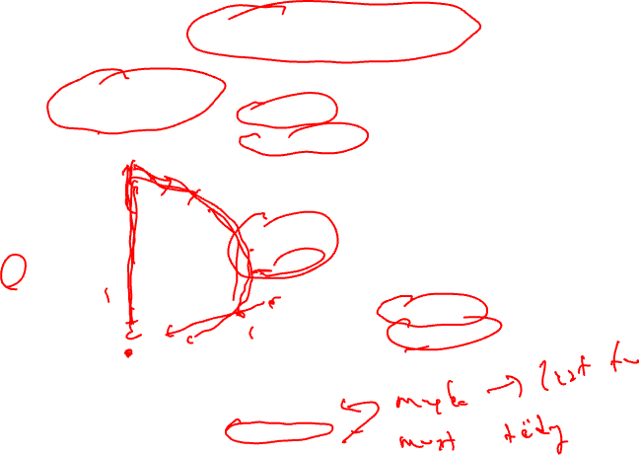
Reaching vs Available Definitions
1:r1 = r2 + r3
2:r6 = r4 – r5
1,2 reach
1,2 available
3:r4 = 4
4:r6 = 8
1,2 reach
1,2 available
1,3,4 reach
1,3,4 available
5:r6 = r2 + r3
6:r7 = r4 – r5
1,2,3,4 reach
1 available

Slide 7
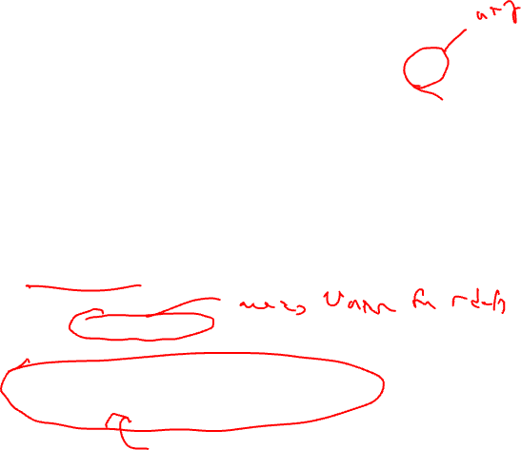
Available Definition Analysis (Adefs)
A definition d is available at a point p if along all paths from d to p, d is not killed
Remember, a definition of a variable is killed between 2 points when there is another definition of that variable along the path
  r1 = r2 + r3 kills previous definitions of r1
Algorithm
  Forward dataflow analysis as propagation occurs from defs downwards
  Use the Intersect function as the meet operator to guarantee the all-path requirement
  GEN/KILL/IN/OUT similar to reaching defs
    Initialization of IN/OUT is the tricky part

Slide 8
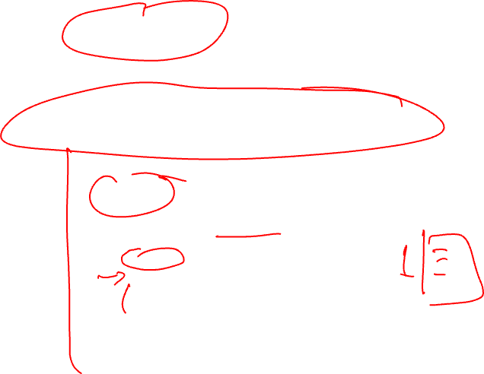
Compute GEN/KILL Sets for each BB (Adefs)
Exactly the same as reaching defs !!!
for each basic block in the procedure, X, do
GEN(X) = 0
KILL(X) = 0
for each operation in sequential order in X, op, do
for each destination operand of op, dest, do
G = op
K = {all ops which define dest – op}
GEN(X) = G + (GEN(X) – K)
KILL(X) = K + (KILL(X) – G)
endfor
endfor
endwhile

Slide 9
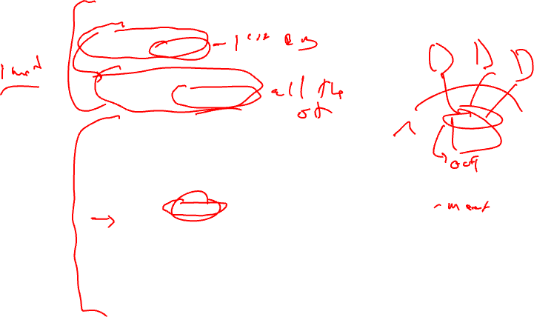
Compute IN/OUT Sets for all BBs (Adefs)
U = universal set of all operations in the Procedure
IN(0) = 0
OUT(0) = GEN(0)
for each basic block in procedure, W, (W != 0), do
IN(W) = 0
OUT(W) = U – KILL(W)
change = 1
while (change) do
change = 0
for each basic block in procedure, X, do
old_OUT = OUT(X)
IN(X) = Intersect(OUT(Y)) for all predecessors Y of X
OUT(X) = GEN(X) + (IN(X) – KILL(X))
if (old_OUT != OUT(X)) then
change = 1
endif
endfor
endwhile

Slide 10
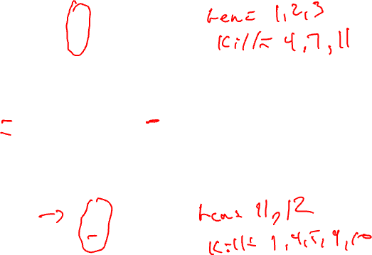
Example Adef Calculation
G = op
K = {all ops which define dest – op}
GEN(X) = G + (GEN(X) – K)
KILL(X) = K + (KILL(X) – G)
BB1
1. r1 = MEM[r2+0]
2. r2 = MEM[r1 + 1]
3. r8 = r1 * r2
BB2
4. r1 = r1 + 5
5. r3 = r5 – r1
6. r7 = r3 * 2
BB3
7. r2 = 0
8. r7 = r1 + r2
9. r3 = 4
BB4
10. r3 = r3 + r7
11. r1 = r2 – r8
12. r3 = r1 * 2

Slide 11
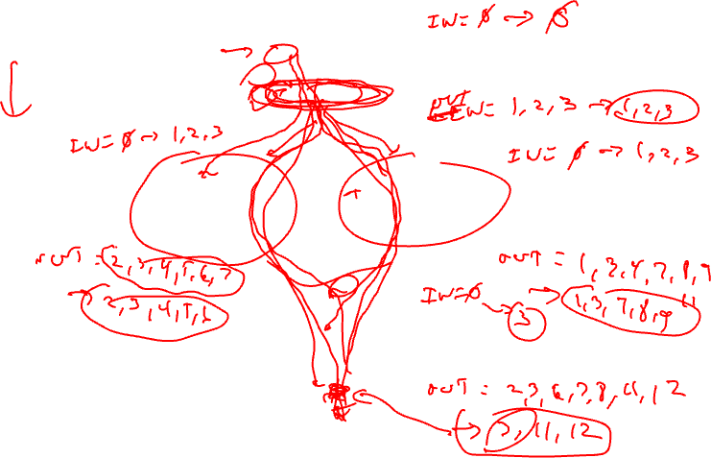
Example Adef Calculation - Continued
IN = Intersect(OUT(preds))
OUT = GEN + (IN – KILL)
BB1
1. r1 = MEM[r2+0]
2. r2 = MEM[r1 + 1]
3. r8 = r1 * r2
GEN = 1, 2, 3
KILL = 4, 7, 11
BB2
4. r1 = r1 + 5
5. r3 = r5 – r1
6. r7 = r3 * 2
BB3
7. r2 = 0
8. r7 = r1 + r2
9. r3 = 4
GEN = 4, 5, 6
KILL = 1, 8, 9, 10, 11, 12
GEN = 7, 8, 9
KILL = 2, 5, 6, 10, 12
BB4
10. r3 = r3 + r7
11. r1 = r2 – r8
12. r3 = r1 * 2
GEN = 11, 12
KILL = 1,4,5,9,10

Slide 12
Example Adef Calculation - Answer
IN = Intersect(OUT(preds))
OUT = GEN + (IN – KILL)
BB1
1. r1 = MEM[r2+0]
2. r2 = MEM[r1 + 1]
3. r8 = r1 * r2
IN = 0 → 0
GEN = 1, 2, 3
KILL = 4, 7, 11
OUT = 1,2,3 → 1,2,3
IN = 0 → 1,2,3
BB2
4. r1 = r1 + 5
5. r3 = r5 – r1
6. r7 = r3 * 2
BB3
7. r2 = 0
8. r7 = r1 + r2
9. r3 = 4
IN = 0 → 1,2,3
GEN = 4, 5, 6
KILL = 1, 8, 9, 10, 11, 12
GEN = 7, 8, 9
KILL = 2, 5, 6, 10, 12
OUT = 2,3,4,5,6,7 → 2,3,4,5,6
OUT = 1,3,4,7,8,9,11 → 1,3,7,8,9
BB4
10. r3 = r3 + r7
11. r1 = r2 – r8
12. r3 = r1 * 2
IN = 0 → 3
GEN = 11, 12
KILL = 1,4,5,9,10
OUT = 2,3,6,7,8,11,12 → 3,11,12

Slide 13
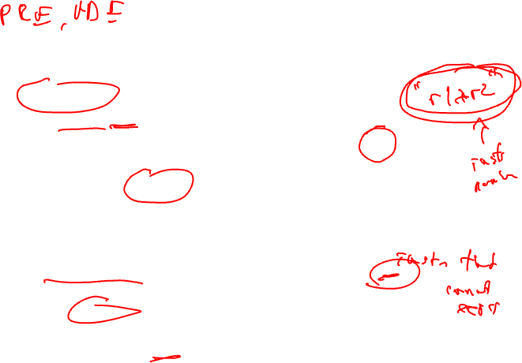
Available Expression Analysis (Aexprs)
An expression is a RHS of an operation
  r2 = r3 + r4, r3+r4 is an expression
An expression e is available at a point p if along all paths from e to p, e is not killed
An expression is killed between 2 points when one of its source operands are redefined
  r1 = r2 + r3 kills all expressions involving r1
Algorithm
  Forward dataflow analysis as propagation occurs from defs downwards
  Use the Intersect function as the meet operator to guarantee the all-path requirement
  Looks exactly like adefs, except GEN/KILL/IN/OUT are the RHS’s of operations rather than the LHS’s

Slide 14
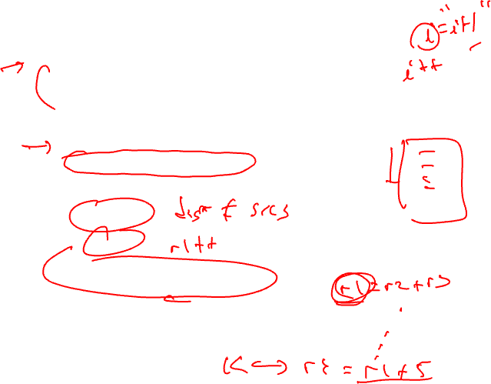
Computation of Aexpr GEN/KILL Sets
We can also formulate the GEN/KILL slightly differently so you do not
need to break up instructions like “r2 = r2 + 1”.
for each basic block in the procedure, X, do
GEN(X) = 0
KILL(X) = 0
for each operation in sequential order in X, op, do
K = 0
for each destination operand of op, dest, do
K += {all ops which use dest}
endfor
if (op not in K)
G = op
else
G = 0
GEN(X) = G + (GEN(X) – K)
KILL(X) = K + (KILL(X) – G)
endfor
endfor

Slide 15
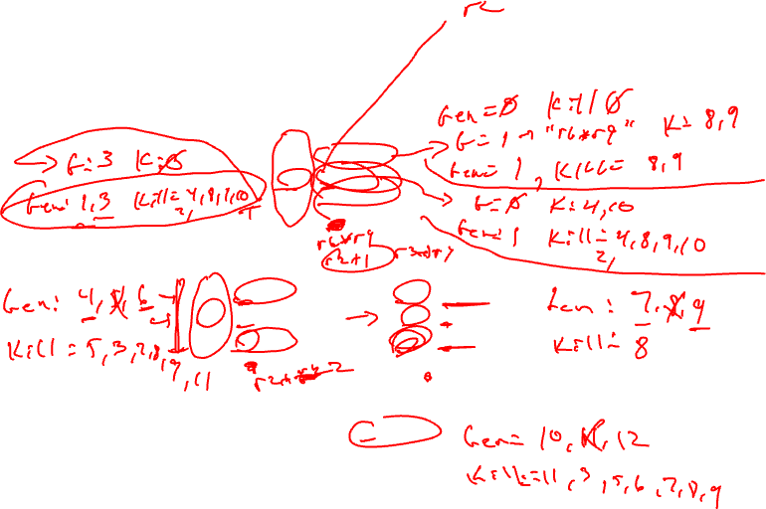
Example Aexpr Calculation
1: r1 = r6 * r9
2: r2 = r2 + 1
3: r5 = r3 * r4
4: r1 = r2 + 1
5: r3 = r3 * r4
6: r8 = r3 * 2
7: r7 = r3 * r4
8: r1 = r1 + 5
9: r7 = r1 - 6
10: r8 = r2 + 1
11: r1 = r3 * r4
12: r3 = r6 * r9

Slide 16
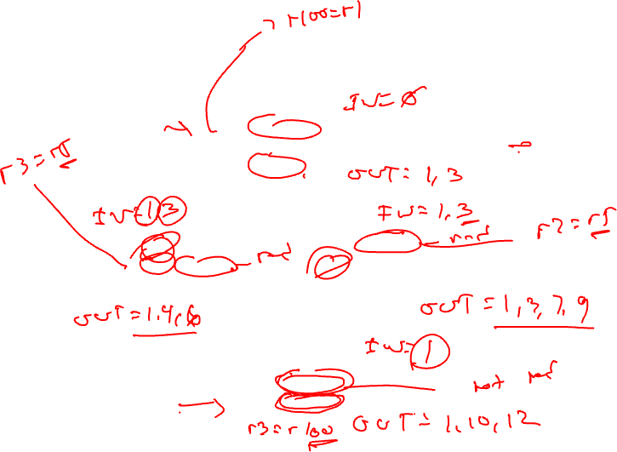
Example Aexpr Calculation - Continued
1: r1 = r6 * r9
2: r2 = r2 + 1
3: r5 = r3 * r4
GEN = 1,3 (remember {1, 3} means {“r6*r9”, “r3*r4”})
KILL = 2, 4, 8, 9, 10
4: r1 = r2 + 1
5: r3 = r3 * r4
6: r8 = r3 * 2
7: r7 = r3 * r4
8: r1 = r1 + 5
9: r7 = r1 - 6
GEN = 4, 6
KILL = 3, 5, 7, 8, 9, 11
GEN = 7, 9
KILL = 8
10: r8 = r2 + 1
11: r1 = r3 * r4
12: r3 = r6 * r9
GEN = 10, 12
KILL = 3, 5, 6, 7, 8, 9, 11

Slide 17
Example Aexpr Calculation - Answer
IN/OUT sets
A → B
A = initial state
B = after first iteration
IN = - → -
1: r1 = r6 * r9
2: r2 = r2 + 1
3: r5 = r3 * r4
GEN = 1,3 (remember {1, 3} means {“r6*r9”, “r3*r4”})
KILL = 2, 4, 8, 9, 10
OUT = 1,3,5,6,7,11,12 → 1,3
IN = - → 1,3
4: r1 = r2 + 1
5: r3 = r3 * r4
6: r8 = r3 * 2
7: r7 = r3 * r4
8: r1 = r1 + 5
9: r7 = r1 - 6
IN = - → 1,3
GEN = 4, 6
KILL = 3, 5, 7, 8, 9, 11
GEN = 7, 9
KILL = 8
OUT = 1,2,4,6,10,12 → 1,4,6
OUT = 1,2,3,4,5,6,7,9,10,11,12 → 1,3,7,9
10: r8 = r2 + 1
11: r1 = r3 * r4
12: r3 = r6 * r9
IN = - → 1
GEN = 10, 12
KILL = 3, 5, 6, 7, 8, 9, 11
OUT = 1,2,4,10,12 → 1,10,12

Slide 18
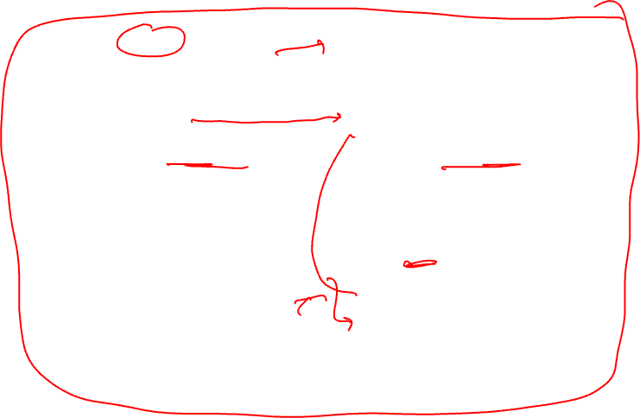
Dataflow Summary
Liveness
Reaching Definitions/DU/UD
OUT = Union(IN(succs))
IN = GEN + (OUT – KILL)
IN = Union(OUT(preds))
OUT = GEN + (IN – KILL)
Bottom-up dataflow
Any path
Keep track of variables/registers
Uses of variables → GEN
Defs of variables → KILL
Top-down dataflow
Any path
Keep track of instruction IDs
Defs of variables → GEN
Defs of variables → KILL
Available Expressions
Available Definitions
IN = Intersect(OUT(preds))
OUT = GEN + (IN – KILL)
IN = Intersect(OUT(preds))
OUT = GEN + (IN – KILL)
Top-down dataflow
All path
Keep track of instruction IDs
Expressions of variables → GEN
Defs of variables → KILL
Top-down dataflow
All path
Keep track of instruction IDs
Defs of variables → GEN
Defs of variables → KILL

