Slide 1

EECS 583 – Class 5
Dataflow Analysis
University of Michigan
January 29, 2024

Slide 2

Reading Material + Announcements
HW 1 due tonight, midnight
  Submit uniquename_hw1.tgz file to:
    eecs583a.eecs.umich.edu:/hw1_submissions
  Before asking questions: 1) Read all threads on piazza, 2) Think a bit
    Then, post question or talk to Aditya/Yunjie if you are stuck
  If you don’t finish – Check late policy, submit whatever you have
Today’s class
  Compilers: Principles, Techniques, and Tools,
  A. Aho, R. Sethi, and J. Ullman, Addison-Wesley, 1988.
  (Chapters: 10.5, 10.6 Edition 1; Chapters 9.2 Edition 2)
Material for next Monday
  Compilers: Principles, Techniques, and Tools,
  A. Aho, R. Sethi, and J. Ullman, Addison-Wesley, 1988.
  (Chapters: 10.5, 10.6, 10.9, 10.10 Edition 1; Chapters 9.2, 9.3 Edition 2)

Slide 3
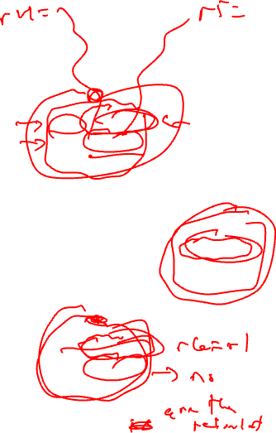
Looking Inside the Basic Blocks:
Dataflow Analysis + Optimization
r1 = r2 + r3
r6 = r4 – r5
Control flow analysis
  Treat BB as black box
  Just care about branches
Now
  Start looking at ops in BBs
  What’s computed and where
Classical optimizations
  Want to make the computation more efficient
Ex: Common Subexpression Elimination (CSE)
  Is r2 + r3 redundant?
  Is r4 – r5 redundant?
  What if there were 1000 BB’s
  Dataflow analysis !!
r4 = 4
r6 = 8
r6 = r2 + r3
r7 = r4 – r5

Slide 4
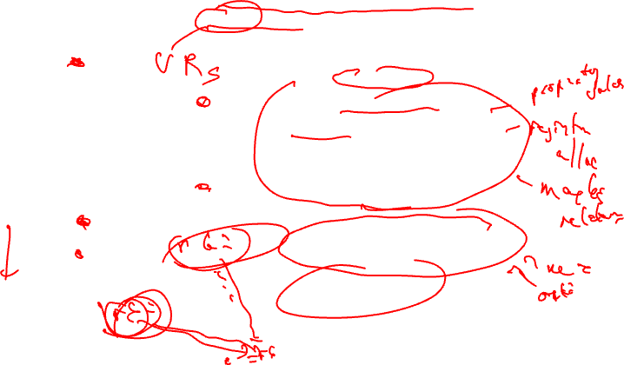
Dataflow Analysis Introduction
Dataflow analysis – Collection of information
that summarizes the creation/destruction of
values in a program. Used to identify legal
optimization opportunities.
r1 = r2 + r3
r6 = r4 – r5
Pick an arbitrary point in the program
r4 = 4
r6 = 8
Which VRs contain useful
data values? (liveness or upward
exposed uses)
Which definitions may reach
this point? (reaching defns)
Which definitions are guaranteed
to reach this point? (available defns)
Which uses below are exposed?
(downward exposed uses)
r6 = r2 + r3
r7 = r4 – r5

Slide 5
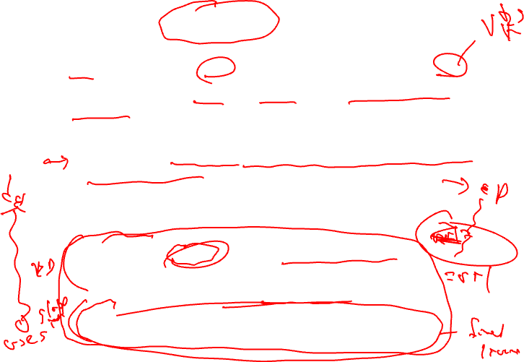
Live Variable (Liveness) Analysis
Defn: For each point p in a program and each variable y, determine whether y can be used before being redefined starting at p
Algorithm sketch
  For each BB, y is live if it is used before defined in the BB or it is live leaving the block
  Backward dataflow analysis as propagation occurs from uses upwards to defs
4 sets
  GEN = set of external variables consumed in the BB
  KILL = set of external variable uses killed by the BB
    equivalent to set of variables defined by the BB
  IN = set of variables that are live at the entry point of a BB
  OUT = set of variables that are live at the exit point of a BB

Slide 6
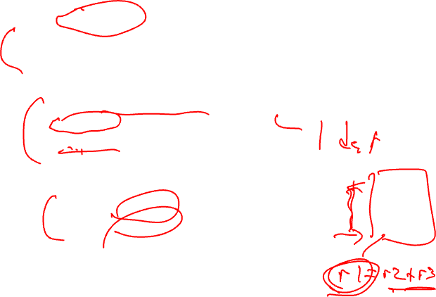
Computing GEN/KILL Sets For Each BB
for each basic block in the procedure, X, do
GEN(X) = 0
KILL(X) = 0
for each operation in reverse sequential order in X, op, do
for each destination operand of op, dest, do
GEN(X) -= dest
KILL(X) += dest
endfor
for each source operand of op, src, do
GEN(X) += src
KILL(X) -= src
endfor
endfor
endfor

Slide 7
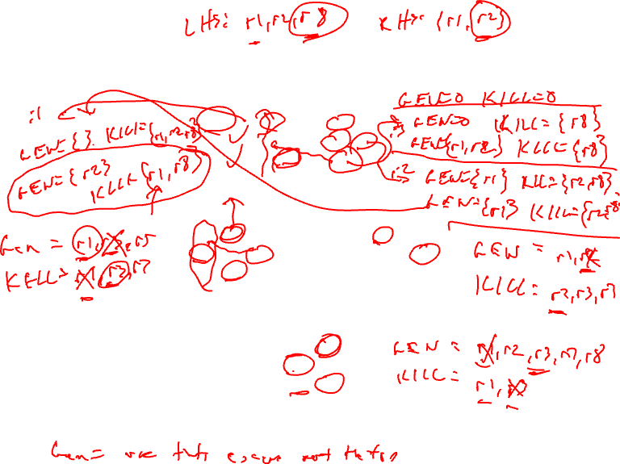
Example – GEN/KILL Liveness Computation
BB1
1. r1 = MEM[r2+0]
2. r2 = MEM[r1 + 1]
3. r8 = r1 * r2
BB2
4. r1 = r1 + 5
5. r3 = r5 – r1
6. r7 = r3 * 2
BB3
7. r2 = 0
8. r7 = r1 + r2
9: r3 = 4
BB4
10: r3 = r3 + r7
11: r1 = r2 – r8
12: r3 = r1 * 2

Slide 8
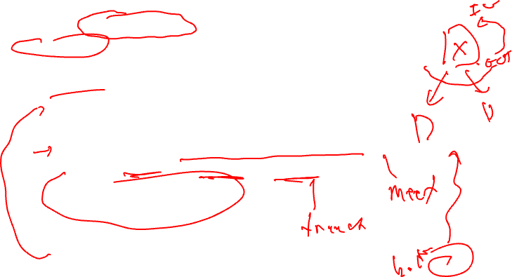
Compute IN/OUT Sets for all BBs
initialize IN(X) to 0 for all basic blocks X
change = 1
while (change) do
change = 0
for each basic block in procedure, X, do
old_IN = IN(X)
OUT(X) = Union(IN(Y)) for all successors Y of X
IN(X) = GEN(X) + (OUT(X) – KILL(X))
if (old_IN != IN(X)) then
change = 1
endif
endfor
endfor

Slide 9
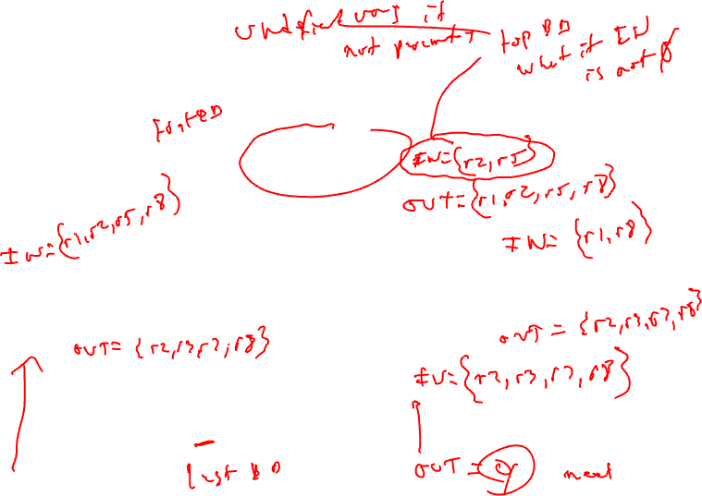
Example – Liveness Computation
OUT = Union(IN(succs))
IN = GEN + (OUT – KILL)
BB1
1. r1 = MEM[r2+0]
2. r2 = MEM[r1 + 1]
3. r8 = r1 * r2
GEN = r2
KILL = r1,r8
BB2
4. r1 = r1 + 5
5. r3 = r5 – r1
6. r7 = r3 * 2
BB3
7. r2 = 0
8. r7 = r1 + r2
9: r3 = 4
GEN = r1,r5
KILL = r3,r7
GEN = r1
KILL = r2,r3,r7
BB4
10: r3 = r3 + r7
11: r1 = r2 – r8
12: r3 = r1 * 2
GEN = r2,r3,r7,r8
KILL = r1

Slide 10
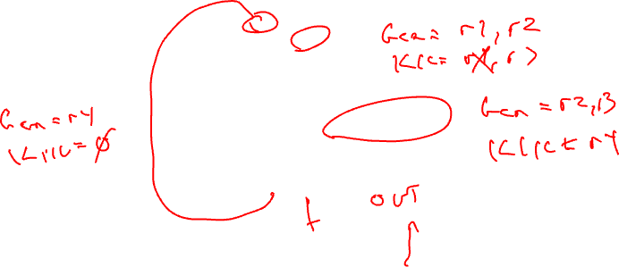
Liveness Class Problem
OUT = Union(IN(succs))
IN = GEN + (OUT – KILL)
1. r1 = 3
2. r2 = r3
3. r3 = r4
4. r1 = r1 + 1
5. r7 = r1 * r2
6. r4 = r4 + 1
7. r4 = r3 + r2
8. r8 = 8
9. r9 = r7 + r8

Slide 11
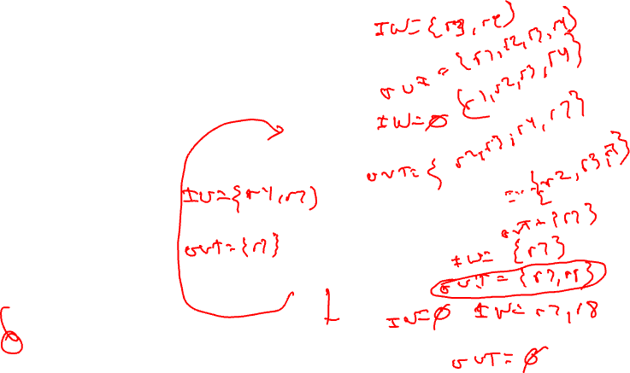
Liveness Class Problem - continued
OUT = Union(IN(succs))
IN = GEN + (OUT – KILL)
1. r1 = 3
2. r2 = r3
3. r3 = r4
GEN = r3, r4
KILL = r1, r2
4. r1 = r1 + 1
5. r7 = r1 * r2
GEN = r1, r2
KILL = r7
GEN = r4
KILL = NULL
6. r4 = r4 + 1
7. r4 = r3 + r2
GEN = r2, r3
KILL = r4
8. r8 = 8
GEN = NULL
KILL = r8
9. r9 = r7 + r8
GEN = r7, r8
KILL = r9

Slide 12

Liveness Class Problem Answer
OUT = Union(IN(succs))
IN = GEN + (OUT – KILL)
IN = r3, r4
1. r1 = 3
2. r2 = r3
3. r3 = r4
Blue sets are the first iteration IN/OUT,
Red sets are the second iteration IN/OUT
GEN = r3, r4
KILL = r1, r2
OUT = r1, r2, r3, r4
IN = r1, r2, r3, r4 → IN = r1, r2, r3, r4 (same!)
4. r1 = r1 + 1
5. r7 = r1 * r2
GEN = r1, r2
KILL = r7
OUT = r2, r3, r4, r7 → OUT = r1, r2, r3, r4, r7
IN = r4, r7 → IN = r1, r2, r3, r4, r7
IN = r2, r3, r7 → IN = r1, r2, r3, r7
GEN = r4
KILL = NULL
6. r4 = r4 + 1
7. r4 = r3 + r2
GEN = r2, r3
KILL = r4
OUT = r7 → OUT = r1, r2, r3, r4, r7
OUT = r7 → OUT = r1, r2, r3, r4, r7
IN = r7 → IN = r1, r2, r3, r4, r7
8. r8 = 8
GEN = NULL
KILL = r8
OUT = r7, r8 → OUT = r1, r2, r3, r4, r7, r8
IN = r7, r8
9. r9 = r7 + r8
GEN = r7, r8
KILL = r9
OUT = NULL

Slide 13
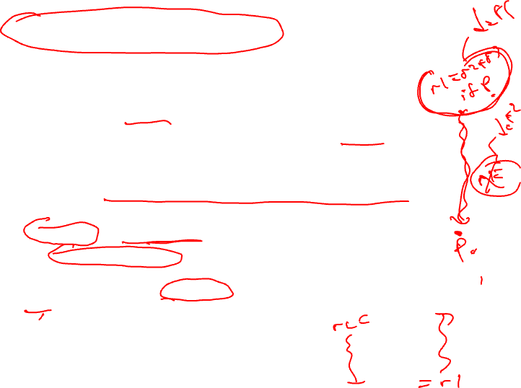
Reaching Definition Analysis (rdefs)
A definition of a variable x is an operation that assigns, or may assign, a value to x
A definition d reaches a point p if there is a path from the point immediately following d to p such that d is not “killed” along that path
A definition of a variable is killed between 2 points when there is another definition of that variable along the path
  r1 = r2 + r3 kills previous definitions of r1
Liveness vs Reaching defs
  Liveness → variables (e.g., virtual registers), don’t care about specific users
  Reaching defs → operations, each def is different
  Forward dataflow analysis as propagation occurs from defs downwards (liveness was backward analysis)

Slide 14
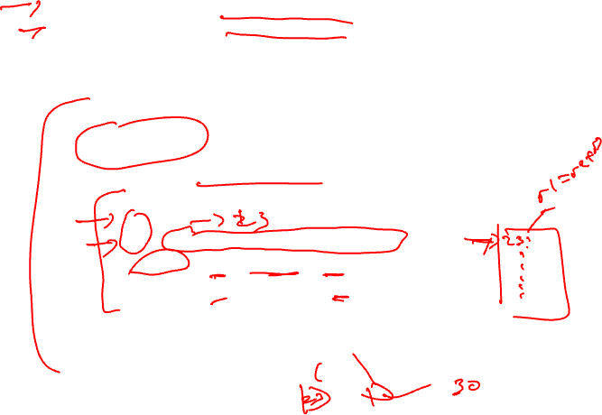
Compute Rdef GEN/KILL Sets for each BB
GEN = set of definitions created by an operation
KILL = set of definitions destroyed by an operation
- Assume each operation only has 1 destination for simplicity
so just keep track of “ops”..
for each basic block in the procedure, X, do
GEN(X) = 0
KILL(X) = 0
for each operation in sequential order in X, op, do
for each destination operand of op, dest, do
G = op
K = {all ops which define dest – op}
GEN(X) = G + (GEN(X) – K)
KILL(X) = K + (KILL(X) – G)
endfor
endfor
endwhile

Slide 15
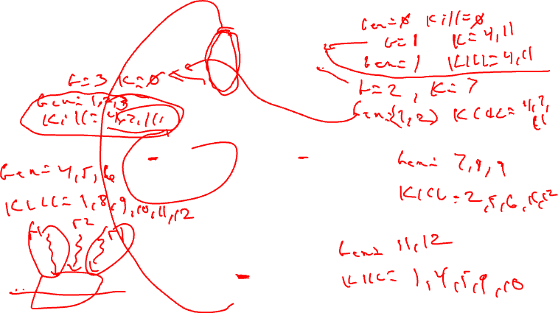
Example GEN/KILL Rdef Calculation
G = op
K = {all ops which define dest – op}
GEN(X) = G + (GEN(X) – K)
KILL(X) = K + (KILL(X) – G)
BB1
1. r1 = MEM[r2+0]
2. r2 = MEM[r1 + 1]
3. r8 = r1 * r2
BB2
4. r1 = r1 + 5
5. r3 = r5 – r1
6. r7 = r3 * 2
BB3
7. r2 = 0
8. r7 = r1 + r2
9. r3 = 4
BB4
10. r3 = r3 + r7
11. r1 = r2 – r8
12. r3 = r1 * 2

Slide 16
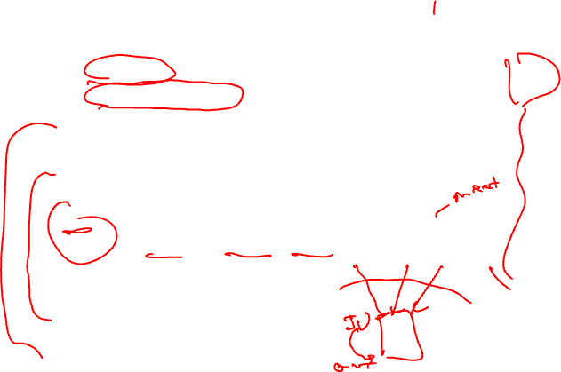
Compute Rdef IN/OUT Sets for all BBs
IN = set of definitions reaching the entry of BB
OUT = set of definitions leaving BB
initialize IN(X) = 0 for all basic blocks X
initialize OUT(X) = GEN(X) for all basic blocks X
change = 1
while (change) do
change = 0
for each basic block in procedure, X, do
old_OUT = OUT(X)
IN(X) = Union(OUT(Y)) for all predecessors Y of X
OUT(X) = GEN(X) + (IN(X) – KILL(X))
if (old_OUT != OUT(X)) then
change = 1
endif
endfor
endwhile

Slide 17
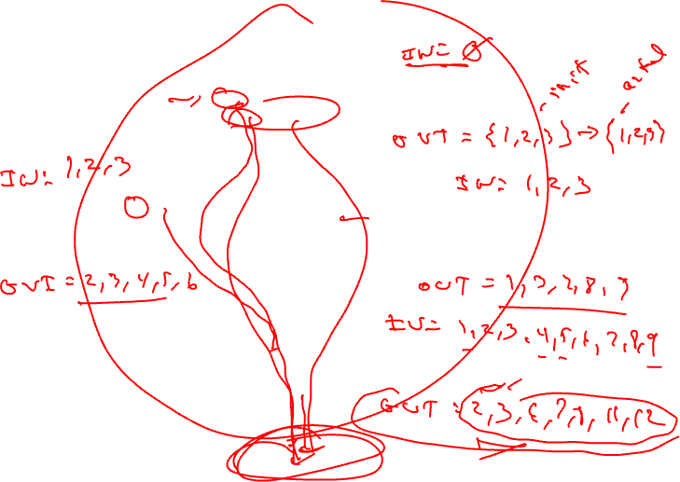
Example In/Out Rdef Calculation
IN = Union(OUT(preds))
OUT = GEN + (IN – KILL)
BB1
1. r1 = MEM[r2+0]
2. r2 = MEM[r1 + 1]
3. r8 = r1 * r2
GEN = 1,2,3
KILL = 4,7,11
BB2
4. r1 = r1 + 5
5. r3 = r5 – r1
6. r7 = r3 * 2
BB3
7. r2 = 0
8. r7 = r1 + r2
9. r3 = 4
GEN = 4,5,6
KILL = 1,8,9,10,11,12
GEN = 7,8,9
KILL = 2,5,6,10,12
BB4
10. r3 = r3 + r7
11. r1 = r2 – r8
12. r3 = r1 * 2
GEN = 11,12
KILL = 1,4,5,9,10

Slide 18
Rdefs Homework Problem
Compute reaching defs
Calculate GEN/KILL for each BB
Calculate IN/OUT for each BB
1. r1 = 3
2. r2 = r3
3. r3 = r4
4. r1 = r1 + 1
5. r7 = r1 * r2
6. r4 = r4 + 1
7. r4 = r3 + r2
8. r8 = 8
9. r9 = r7 + r8

Slide 19

Rdefs Homework Problem –Answer
IN = - → - → -
Compute reaching defs
Calculate GEN/KILL for each BB
Calculate IN/OUT for each BB
For solution IN/OUT sets specified as
A → B → C, A = initial state of sets,
B = after first iteration of analysis
C = after second iteration of analysis
- = empty set
1. r1 = 3
2. r2 = r3
3. r3 = r4
GEN = 1, 2, 3
KILL = 4
OUT = 1,2,3 → 1,2,3 → 1,2,3
4. r1 = r1 + 1
5. r7 = r1 * r2
IN = - → 1,2,3,8 → 1,2,3,4,5,6,7,8
GEN = 4,5
KILL = 1
OUT = 4,5 → 2,3,4,5,8 → 2,3,4,5,6,7,8
IN = - → 2,3,4,5,8 → 2,3,4,5,6,7,8
IN = - → 2,3,4,5,8 → 2,3,4,5,6,7,8
GEN = 6
KILL = 7
6. r4 = r4 + 1
7. r4 = r3 + r2
GEN = 7
KILL = 6
OUT = 6 → 2,3,4,5,6,8 → 2,3,4,5,6,8
OUT = 7 → 2,3,4,5,7,8 → 2,3,4,5,7,8
IN = - → 2,3,4,5,6,7,8 → 2,3,4,5,6,7,8
8. r8 = 8
GEN = 8
KILL = -
OUT = 8 → 2,3,4,5,6,7,8 → 2,3,4,5,6,7,8
IN = - → 2,3,4,5,6,7,8 → 2,3,4,5,6,7,8
9. r9 = r7 + r8
GEN = 9
KILL = -
OUT = 9 → 2,3,4,5,6,7,8,9 → 2,3,4,5,6,7,8,9

Slide 20
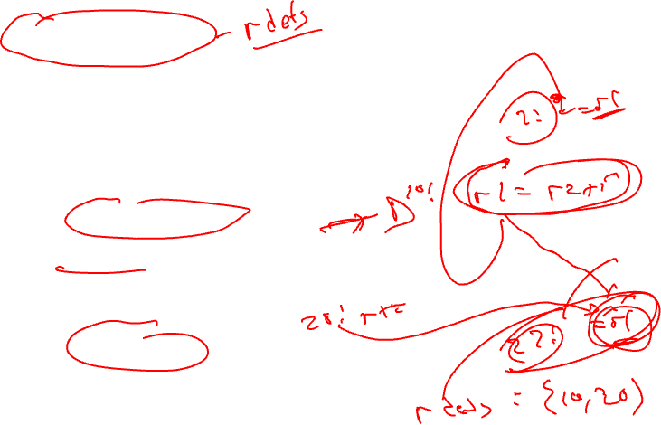
DU/UD Chains
Convenient way to access/use reaching defs info
Def-Use chains
  Given a def, what are all the possible consumers of the operand produced
  Maybe consumer
Use-Def chains
  Given a use, what are all the possible producers of the operand consumed
  Maybe producer

Slide 21
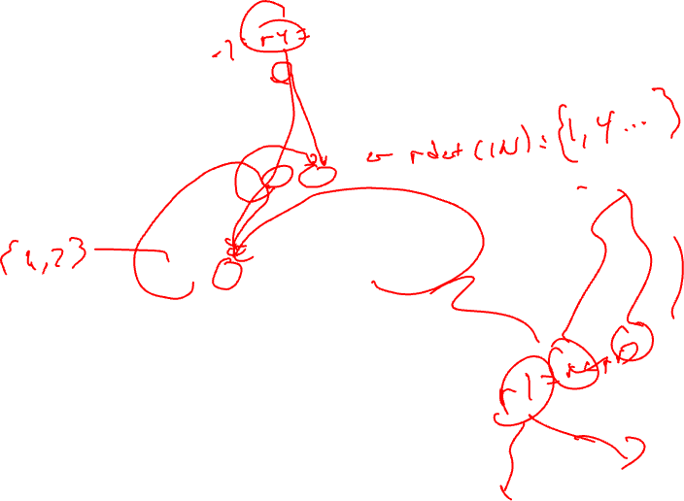
Example – DU/UD Chains
1. r1 = 3
2. r2 = r3
3. r3 = r4
4. r1 = r1 + 1
5. r7 = r1 * r2
6. r4 = r4 + 1
7. r4 = r3
8. r8 = 8
9. r9 = r7 + r8

Slide 22
Generalizing Dataflow Analysis
Transfer function
  How information is changed by “something” (BB)
  OUT = GEN + (IN – KILL) /* forward analysis */
  IN = GEN + (OUT – KILL) /* backward analysis */
Meet function
  How information from multiple paths is combined
  IN = Union(OUT(predecessors)) /* forward analysis */
  OUT = Union(IN(successors)) /* backward analysis */
Generalized dataflow algorithm
  while (change)
    change = false
    for each BB
      apply meet function
      apply transfer functions
      if any changes → change = true

Slide 23
What About All Path Problems?
Up to this point
  Any path problems (maybe relations)
    Definition reaches along some path
    Some sequence of branches in which def reaches
    Lots of defs of the same variable may reach a point
  Use of Union operator in meet function
All-path: Definition guaranteed to reach
  Regardless of sequence of branches taken, def reaches
  Can always count on this
  Only 1 def can be guaranteed to reach
  Availability (as opposed to reaching)
    Available definitions
    Available expressions (could also have reaching expressions, but not that useful)

Slide 24
Reaching vs Available Definitions
1:r1 = r2 + r3
2:r6 = r4 – r5
1,2 reach
1,2 available
3:r4 = 4
4:r6 = 8
1,2 reach
1,2 available
1,3,4 reach
1,3,4 available
5:r6 = r2 + r3
6:r7 = r4 – r5
1,2,3,4 reach
1 available

Slide 25
To Be Continued …

