Slide 1

EECS 583 – Class 4
If-conversion
University of Michigan
January 24, 2024

Slide 2

Announcements & Reading Material
HW 1 – Deadline Mon Jan 29, midnight
  Talk to Aditya/Yunjie this week if you are having troubles
  Refer to EECS 583 piazza group for tips and answers to questions
  All should have access to eecs583a/eecs583b servers
Today’s class
  “The Program Dependence Graph and Its Use in Optimization”,
  J. Ferrante, K. Ottenstein, and J. Warren, ACM TOPLAS, 1987
    This is a long paper – the part we care about is the control dependence stuff. The PDG is interesting and you should skim it over.
  “On Predicated Execution”, Park and Schlansker, HPL Technical Report, 1991.
Material for Wednesday
  Compilers: Principles, Techniques, and Tools,
  A. Aho, R. Sethi, and J. Ullman, Addison-Wesley, 1988.
  (Sections: 10.5, 10.6 Edition 1) (Sections 9.2 Edition 2)

Slide 3
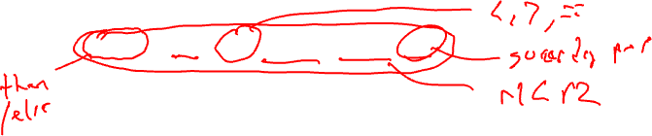
From Last Time: HPL-PD Compare-to-Predicate Operations (CMPPs)
How do we compute predicates
  Compare registers/literals like a branch would do
  Efficiency, code size, nested conditionals, etc
2 targets for computing taken/fall-through conditions with 1 operation
p1, p2 = CMPP.cond.D1a.D2a (r1, r2) if p3
p1 = first destination predicate
p2 = second destination predicate
cond = compare condition (ie EQ, LT, GE, …)
D1a = action specifier for first destination
D2a = action specifier for second destination
(r1,r2) = data inputs to be compared (ie r1 < r2)
p3 = guarding predicate

Slide 4
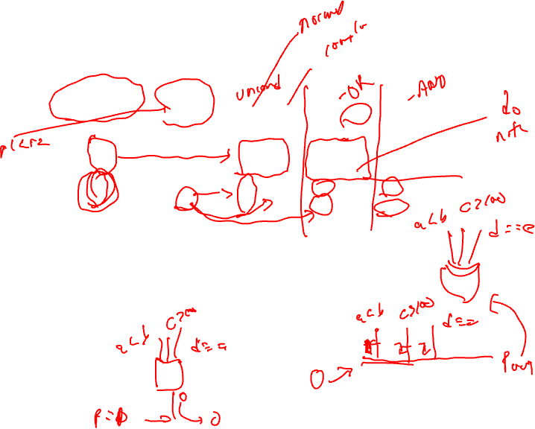
CMPP Action Specifiers
Guarding
predicate
0
0
1
1
Compare
Result
0
1
0
1
UN
0
0
0
1
UC
0
0
1
0
ON
-
-
-
1
OC
-
-
1
-
AN
-
-
0
-
AC
-
-
-
0
UN/UC = Unconditional normal/complement
This is what we used in the earlier examples
guard = 0, both outputs are 0
guard = 1, UN = Compare result, UC = opposite
ON/OC = OR-type normal/complement
AN/AC = AND-type normal/complement

Slide 5
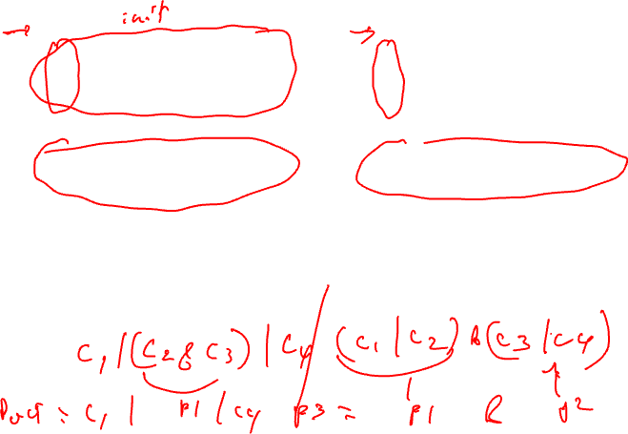
OR-type, AND-type Predicates
p1 = 0
p1 = cmpp_ON (r1 < r2) if T
p1 = cmpp_OC (r3 < r4) if T
p1 = cmpp_ON (r5 < r6) if T
p1 = (r1 < r2) | (!(r3 < r4)) |
(r5 < r6)
Wired-OR into p1
p1 = 1
p1 = cmpp_AN (r1 < r2) if T
p1 = cmpp_AC (r3 < r4) if T
p1 = cmpp_AN (r5 < r6) if T
p1 = (r1 < r2) & (!(r3 < r4)) &
(r5 < r6)
Wired-AND into p1
Generating predicated code
for some source code requires
OR-type predicates
Talk about these later – used
for control height reduction

Slide 6
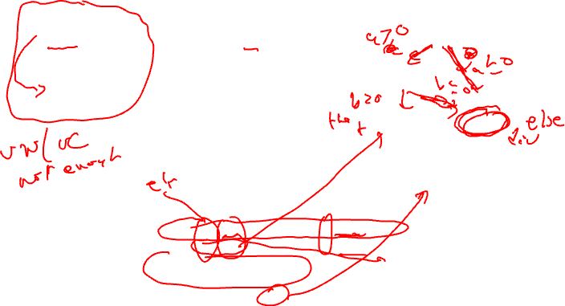
Use of OR-type Predicates
a = b + c
if (a > 0 && b > 0)
e = f + g
else
e = f / g
h = i - j
BB1
BB1
BB5
BB2
BB2
BB3
BB4
add a, b, c
ble a, 0, L1
ble b, 0, L1
add e, f, g
jump L2
L1: div e, f, g
L2: sub h, i, j
BB1
BB5
BB2
BB3
Traditional branching code
BB4
BB1
BB1
BB5
BB3
BB2
BB4
add a, b, c if T
p3, p5 = cmpp.ON.UC a <= 0 if T
p3, p2 = cmpp.ON.UC b <= 0 if p5
div e, f, g if p3
add e, f, g if p2
sub h, i, j if T
BB1
BB5
BB2
BB3
BB4
p2 → BB2
p3 → BB3
p5 → BB5
Predicated code

Slide 7
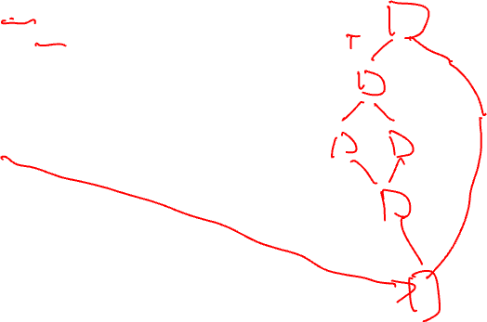
Homework Problem – Answer on next slide but don’t cheat!
if (a > 0) {
if (b > 0)
r = t + s
else
u = v + 1
y = x + 1
}
Draw the CFG
Predicate the code removing
all branches

Slide 8
Homework Problem Answer
if (a > 0) {
if (b > 0)
r = t + s
else
u = v + 1
y = x + 1
}
a > 0
p1 = cmpp.UN(a > 0) if T
p2, p3 = cmpp.UNUC(b > 0) if p1
r = t + s if p2
u = v + 1 if p3
y = x + 1 if p1
a <= 0
b > 0
b <= 0
r = t + s
u = v + 1
y = x + 1
Draw the CFG
Predicate the code removing
all branches

Slide 9

If-conversion
Algorithm for generating predicated code
  Automate what we’ve been doing by hand
  Handle arbitrary complex graphs
    But, acyclic subgraph only!!
    Need a branch to get you back to the top of a loop
  Efficient
Roots are from Vector computer days
  Vectorize a loop with an if-statement in the body
4 steps
  1. Loop backedge coalescing
  2. Control dependence analysis
  3. Control flow substitution
  4. CMPP compaction
My version of Park & Schlansker

Slide 10
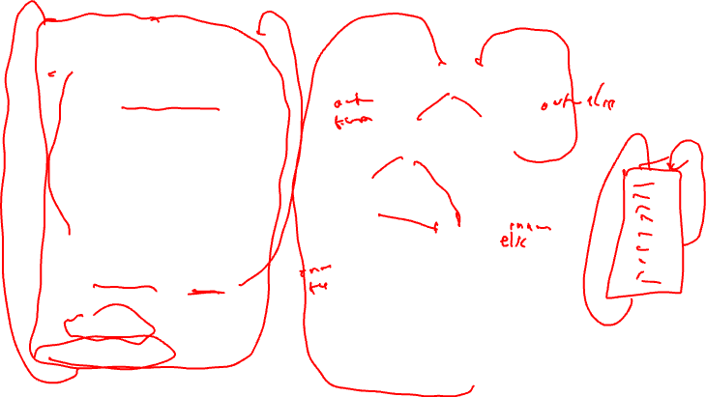
Running Example – Initial State
do {
b = load(a)
if (b < 0) {
if ((c > 0) && (b > 13))
b = b + 1
else
c = c + 1
d = d + 1
}
else {
e = e + 1
if (c > 25) continue
}
a = a + 1
} while (e < 34)
BB1
b < 0
b >= 0
BB2
BB3
e++
c > 0
c <= 0
c > 25
BB4
c <= 25
b > 13
b <= 13
b++
BB5
BB6
c++
BB7
d++
BB8
a++
e < 34
e >= 34

Slide 11
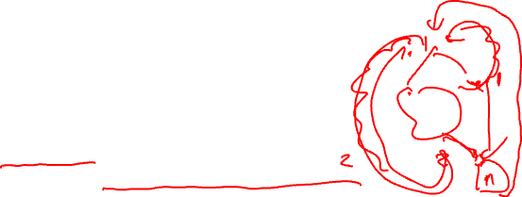
Step 1: Backedge Coalescing
Recall – Loop backedge is branch from inside the loop back to the loop header
This step only applicable for a loop body
  If not a loop body → skip this step
Process
  Create a new basic block
    New BB contains an unconditional branch to the loop header
  Adjust all other backedges to go to new BB rather than header
Why do this?
  Heuristic step – Not essential for correctness
    If-conversion cannot remove backedges (only forward edges)
    But this allows the control logic to figure out which backedge you take to be eliminated
  Generally this is a good thing to do

Slide 12
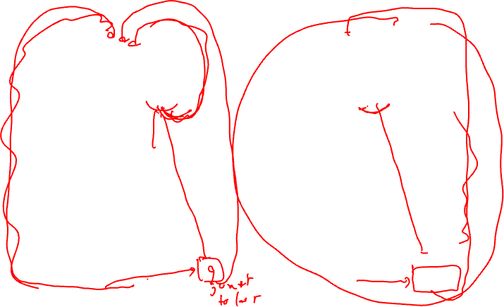
Running Example – Backedge Coalescing
BB1
BB1
b < 0
b >= 0
b < 0
b >= 0
BB2
BB3
BB2
BB3
e++
e++
c > 0
c > 0
c <= 0
c <= 0
c > 25
BB4
c <= 25
c > 25
BB4
c <= 25
b <= 13
b > 13
b <= 13
b > 13
BB5
BB6
b++
BB5
BB6
c++
b++
c++
BB7
BB7
d++
d++
BB8
a++
BB8
e < 34
a++
e < 34
BB9
e >= 34
e >= 34

Slide 13
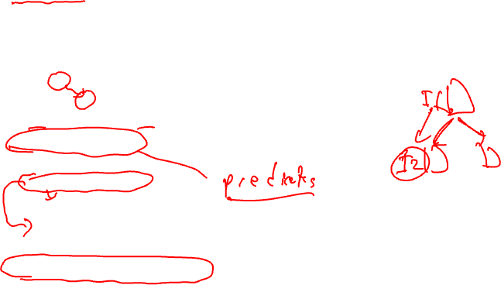
Step 2: Control Dependence Analysis (CD)
Control flow – Execution transfer from 1 BB to another via a taken branch or fallthrough path
Dependence – Ordering constraint between 2 operations
  Must execute in proper order to achieve the correct result
  O1: a = b + c
  O2: d = a – e
  O2 dependent on O1
Control dependence – One operation controls the execution of another
  O1: blt a, 0, SKIP
  O2: b = c + d
  SKIP:
  O2 control dependent on O1
Control dependence analysis derives these dependences

Slide 14
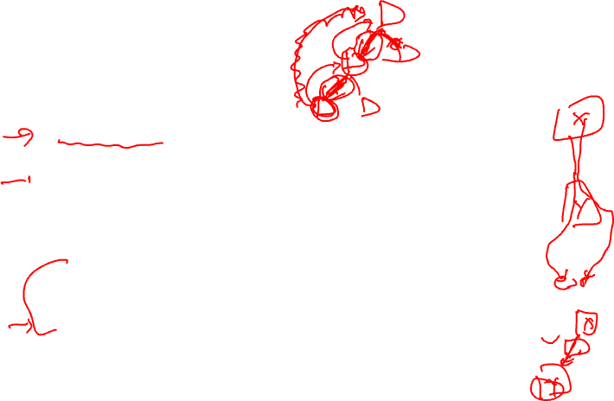
Control Dependences
Recall
  Post dominator – BBX is post dominated by BBY if every path from BBX to EXIT contains BBY
  Immediate post dominator – First breadth first successor of a block that is a post dominator
Control dependence – BBY is control dependent on BBX iff
  1. There exists a directed path P from BBX to BBY with any BBZ in P (excluding BBX and BBY) post dominated by BBY
  2. BBX is not post dominated by BBY
In English,
  A BB is control dependent on the closest BB(s) that determine(s) its execution
  Its actually not a BB, it’s a control flow edge coming out of a BB

Slide 15
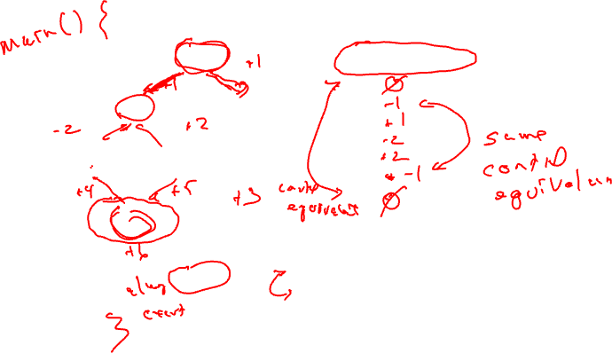
Control Dependence Example
BB1
Control dependences
BB1:
BB2:
BB3:
BB4:
BB5:
BB6:
BB7:
T
F
BB2
BB3
T
F
BB4
BB5
BB6
Notation
positive BB number = fallthru direction
negative BB number = taken direction
BB7

Slide 16
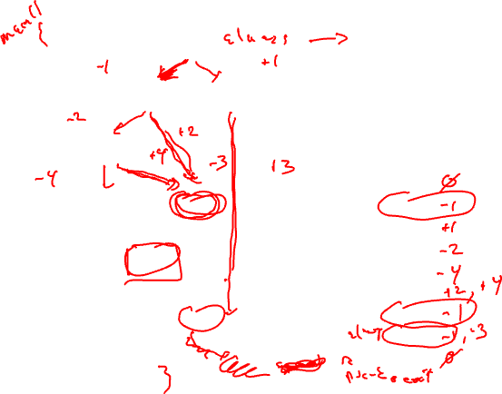
Running Example – CDs
Entry
BB1
First, nuke backedge(s)
Second, nuke exit edges
Then, Add pseudo entry/exit nodes
- Entry → nodes with no predecessors
- Exit → nodes with no successors
b < 0
b >= 0
BB2
BB3
e++
c > 0
c <= 0
BB4
c <= 25
c > 25
b <= 13
Control deps (left is taken)
BB1:
BB2:
BB3:
BB4:
BB5:
BB6:
BB7:
BB8:
BB9:
b > 13
b++
BB5
BB6
c++
BB7
d++
a++
BB8
e < 34
BB9
Exit

Slide 17
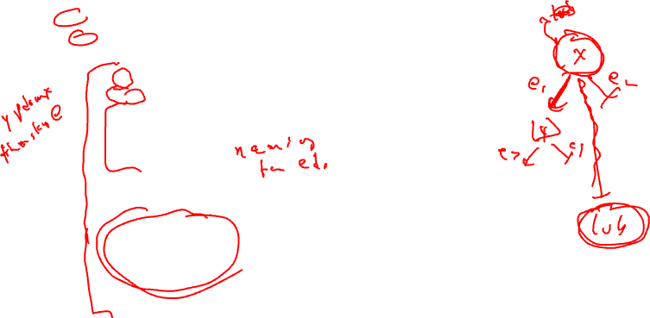
Algorithm for Control Dependence Analysis
for each basic block x in region
for each outgoing control flow edge e of x
y = destination basic block of e
if (y not in pdom(x)) then
lub = ipdom(x)
if (e corresponds to a taken branch) then
x_id = -x.id
else
x_id = x.id
endif
t = y
while (t != lub) do
cd(t) += x_id;
t = ipdom(t)
endwhile
endif
endfor
endfor
Notes
Compute cd(x) which contains those
BBs which x is control dependent on
Iterate on per edge basis, adding
edge to each cd set it is a member of

Slide 18

Running Example – Post Dominators
Entry
BB1
pdom ipdom
BB1: 1, 9, ex 9
BB2: 2, 7, 8, 9, ex 7
BB3: 3, 9, ex 9
BB4: 4, 7, 8, 9, ex 7
BB5: 5, 7, 8, 9, ex 7
BB6: 6, 7, 8, 9, ex 7
BB7: 7, 8, 9, ex 8
BB8: 8, 9, ex 9
BB9: 9, ex ex
b < 0
b >= 0
BB2
BB3
e++
c > 0
c <= 0
BB4
c <= 25
c > 25
b > 13
b <= 13
b++
BB5
BB6
c++
BB7
d++
a++
BB8
e < 34
BB9
Exit

Slide 19
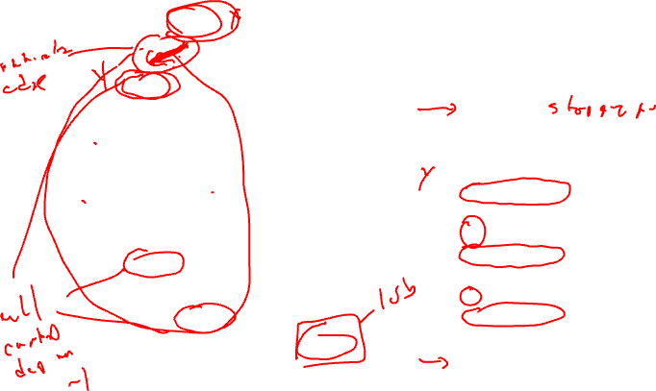
Running Example – CDs Via Algorithm
Entry
1 → 2 edge (aka –1)
BB1
x = 1
e = taken edge 1 → 2
y = 2
y not in pdom(x)
lub = 9
x_id = -1
t = 2
2 != 9
cd(2) += -1
t = 7
7 != 9
cd(7) += -1
t = 8
8 != 9
cd(8) += -1
t = 9
9 == 9
b < 0
b >= 0
BB2
BB3
e++
c > 0
c <= 0
BB4
c <= 25
c > 25
b > 13
b <= 13
b++
BB5
BB6
c++
BB7
d++
a++
BB8
e < 34
BB9
Exit

Slide 20
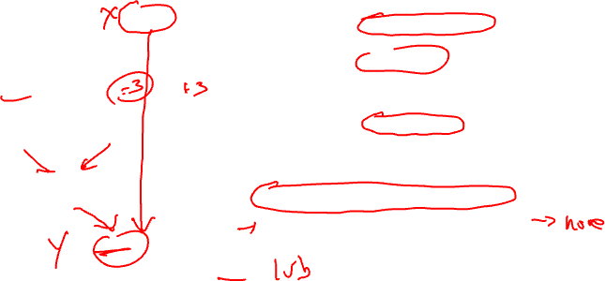
Running Example – CDs Via Algorithm (2)
Entry
3 → 8 edge (aka -3)
BB1
x = 3
e = taken edge 3 → 8
y = 8
y not in pdom(x)
lub = 9
x_id = -3
t = 8
8 != 9
cd(8) += -3
t = 9
9 == 9
b < 0
b >= 0
BB2
BB3
e++
c > 0
c <= 0
BB4
c <= 25
c > 25
b > 13
b <= 13
b++
BB5
BB6
c++
BB7
d++
Class ProblemA: 1 → 3 edge (aka 1)
Class ProblemB: 7 → 8 edge (aka -7)
a++
BB8
e < 34
BB9
Exit

Slide 21
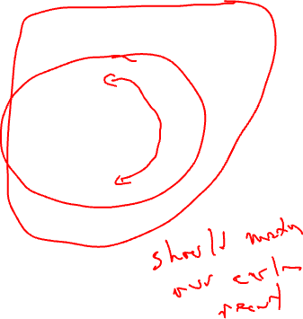
Running Example – CDs Via Algorithm (3)
Entry
BB1
b < 0
b >= 0
Control deps (left is taken)
BB1: none
BB2: -1
BB3: 1
BB4: -2
BB5: -4
BB6: 2, 4
BB7: -1
BB8: -1, -3
BB9: none
BB2
BB3
e++
c > 0
c <= 0
BB4
c <= 25
c > 25
b > 13
b <= 13
b++
BB5
BB6
c++
BB7
d++
a++
BB8
e < 34
BB9
Exit

Slide 22

Step 3: Control Flow Substitution
Go from branching code → sequential predicated code
5 baby steps
  1. Create predicates
  2. CMPP insertion
  3. Guard operations
  4. Remove branches
  5. Initialize predicates

Slide 23

Predicate Creation
R/K calculation – Mapping predicates to blocks
  Paper more complicated than it really is
  K = unique sets of control dependences
  Create a new predicate for each element of K
  R(bb) = predicate that represents CD set for bb, ie the bb’s assigned predicate (all ops in that bb guarded by R(bb))
K = {{-1}, {1}, {-2}, {-4}, {2,4}, {-1,-3}}
predicates = p1, p2, p3, p4, p5, p6
bb = 1, 2, 3, 4, 5, 6, 7, 8, 9
CD(bb) = {{none}, {-1}, {1}, {-2}, {-4}, {2,4}, {-1}, {-1,-3}, {none}
R(bb) = T p1 p2 p3 p4 p5 p1 p6 T

Slide 24
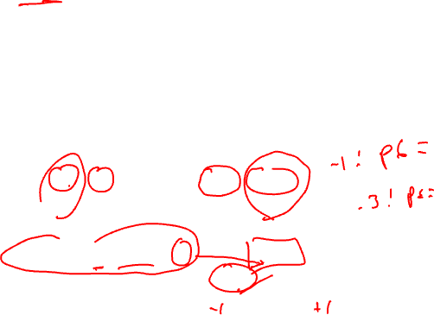
CMPP Creation/Insertion
For each control dependence set
  For each edge in the control dependence set
    Identify branch condition that causes edge to be traversed
    Create CMPP to compute corresponding branch condition
      OR-type – handles worst case
      guard = True
      destination = predicate assigned to that CD set
      Insert at end of BB that is the source of the edge
K = {{-1}, {1}, {-2}, {-4}, {2,4}, {-1,-3}}
predicates = p1, p2, p3, p4, p5, p6
Example: p1 = cmpp.ON (b < 0) if T
BB1
b < 0
b >= 0

Slide 25

Running Example – CMPP Creation
K = {{-1}, {1}, {-2}, {-4}, {2,4}, {-1,-3}}
p’s = p1, p2, p3, p4, p5, p6
p1 = cmpp.ON (b < 0) if T
p2 = cmpp.ON (b >= 0) if T
p6 = cmpp.ON (b < 0) if T
Entry
BB1
b < 0
b >= 0
p3 = cmpp.ON (c > 0) if T
p5 = cmpp.ON (c <= 0) if T
BB2
BB3
e++
p6 = cmpp.ON (c <= 25) if T
c > 0
c <= 0
p4 = cmpp.ON (b > 13) if T
p5 = cmpp.ON (b <= 13) if T
BB4
c <= 25
c > 25
b > 13
b <= 13
b++
BB5
BB6
c++
BB7
d++
a++
BB8
e < 34
BB9
Exit

Slide 26

Control Flow Substitution – The Rest
Guard all operations in each bb by R(bb)
  Including the newly inserted CMPPs
Nuke all the branches
  Except exit edges and backedges
Initialize each predicate to 0 in first BB
bb = 1, 2, 3, 4, 5, 6, 7, 8, 9
CD(bb) = {{none}, {-1}, {1}, {-2}, {-4}, {2,4}, {-1}, {-1,-3}, {none}
R(bb) = T p1 p2 p3 p4 p5 p1 p6 T

Slide 27
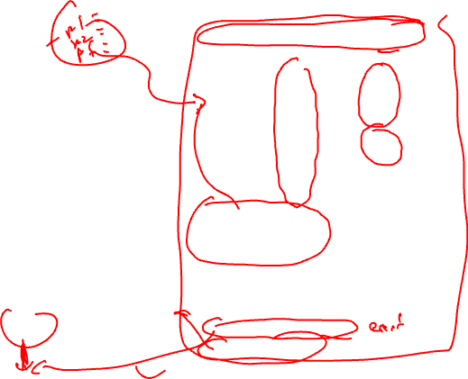
Running Example – Control Flow Substitution
Loop:
p1 = p2 = p3 = p4 = p5 = p6 = 0
b = load(a) if T
p1 = cmpp.ON (b < 0) if T
p2 = cmpp.ON (b >= 0) if T
p6 = cmpp.ON (b < 0) if T
p3 = cmpp.ON (c > 0) if p1
p5 = cmpp.ON (c <= 0) if p1
p4 = cmpp.ON (b > 13) if p3
p5 = cmpp.ON (b <= 13) if p3
b = b + 1 if p4
c = c + 1 if p5
d = d + 1 if p1
p6 = cmpp.ON (c <= 25) if p2
e = e + 1 if p2
a = a + 1 if p6
bge e, 34, Done if p6
jump Loop if T
Done:
BB1
b < 0
b >= 0
BB2
BB3
e++
c > 0
c <= 0
BB4
c <= 25
c > 25
b > 13
b <= 13
b++
BB5
BB6
c++
BB7
d++
a++
BB8
e < 34
BB9
e >= 34

Slide 28

Step 4: CMPP Compaction
Convert ON CMPPs to UN
  All singly defined predicates don’t need to be OR-type
  OR of 1 condition → Just compute it !!!
  Remove initialization (Unconditional don’t require init)
Reduce number of CMPPs
  Utilize 2nd destination slot
  Combine any 2 CMPPs with:
    Same source operands
    Same guarding predicate
    Same or opposite compare conditions

Slide 29
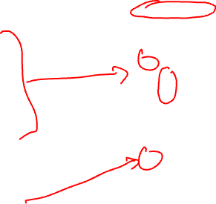
Running Example - CMPP Compaction
Loop:
p1 = p2 = p3 = p4 = p5 = p6 = 0
b = load(a) if T
p1 = cmpp.ON (b < 0) if T
p2 = cmpp.ON (b >= 0) if T
p6 = cmpp.ON (b < 0) if T
p3 = cmpp.ON (c > 0) if p1
p5 = cmpp.ON (c <= 0) if p1
p4 = cmpp.ON (b > 13) if p3
p5 = cmpp.ON (b <= 13) if p3
b = b + 1 if p4
c = c + 1 if p5
d = d + 1 if p1
p6 = cmpp.ON (c <= 25) if p2
e = e + 1 if p2
a = a + 1 if p6
bge e, 34, Done if p6
jump Loop if T
Done:
Loop:
p5 = p6 = 0
b = load(a) if T
p1,p2 = cmpp.UN.UC (b < 0) if T
p6 = cmpp.ON (b < 0) if T
p3,p5 = cmpp.UN.OC (c > 0) if p1
p4,p5 = cmpp.UN.OC (b > 13) if p3
b = b + 1 if p4
c = c + 1 if p5
d = d + 1 if p1
p6 = cmpp.ON (c <= 25) if p2
e = e + 1 if p2
a = a + 1 if p6
bge e, 34, Done if p6
jump Loop if T
Done:

Slide 30
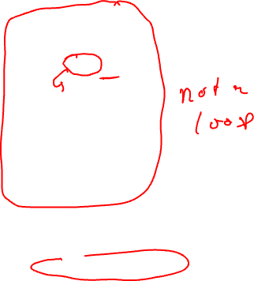
Homework Problem
if (a > 0) {
r = t + s
if (b > 0 || c > 0)
u = v + 1
else if (d > 0)
x = y + 1
else
z = z + 1
}
Draw the CFG
Compute CD
If-convert the code

Slide 31
Homework Problem Answer (1)
if (a > 0) {
r = t + s
if (b > 0 || c > 0)
u = v + 1
else if (d > 0)
x = y + 1
else
z = z + 1
}
BB1
a <= 0
a > 0
BB2
b <= 0
BB3
b > 0
c <= 0
c > 0
BB4
BB5
d <= 0
d > 0
BB6
BB7
Draw the CFG
Compute CD
If-convert the code
BB8

Slide 32
Homework Problem Answer (2)
BB CD
1 -
2 1
3 -2
4 -3
5 2,3
6 -4
7 4
8 -
BB Assigned Predicate
1 -
2 p1
3 p2
4 p4
5 p3
6 p5
7 p6
8 -
BB1
a <= 0
a > 0
BB2
b <= 0
BB3
b > 0
c <= 0
c > 0
BB4
BB5
p3 = 0
p1 = CMPP.UN (a > 0) if T
r = t + s if p1
p2,p3 = CMPP.UC.ON (b > 0) if p1
p4,p3 = CMPP.UC.ON (c > 0) if p2
u = v + 1 if p3
p5,p6 = CMPP.UC.UN (d > 0) if p4
x = y + 1 if p6
z = z + 1 if p5
d <= 0
d > 0
BB6
BB7
BB8

Slide 33
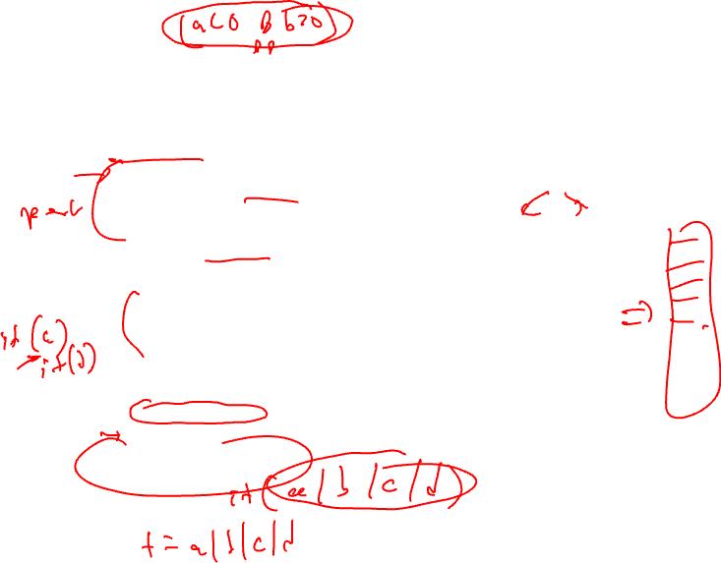
When to Apply If-conversion?
Positives
  Remove branch
    No disruption to sequential fetch
    No prediction or mispredict
    No draining of pipeline for mispredict
    No use of branch resource
  Increase potential for operation overlap
    Creates larger basic blocks
    Convert control dependences into data dependences
  Enable more aggressive compiler xforms
    Software pipelining
    Height reduction
What about the negatives?
10
BB1
90
80
20
BB2
BB3
80
20
BB4
10
BB5
90
10
BB6
10

Slide 34
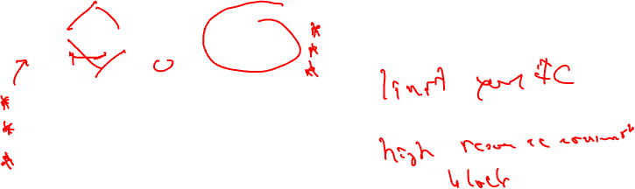
Negative 1: Resource Usage
Instruction execution is additive
for all BBs that are if-converted, thus
require more processor resources
Be careful applying if-conversion too liberally
when processor resources constrained OR
blocks have large numbers of instructions
100
BB1
BB1
60
40
BB2 if p1
BB2
BB3
BB3 if p2
60
40
BB4
BB4
100

Slide 35
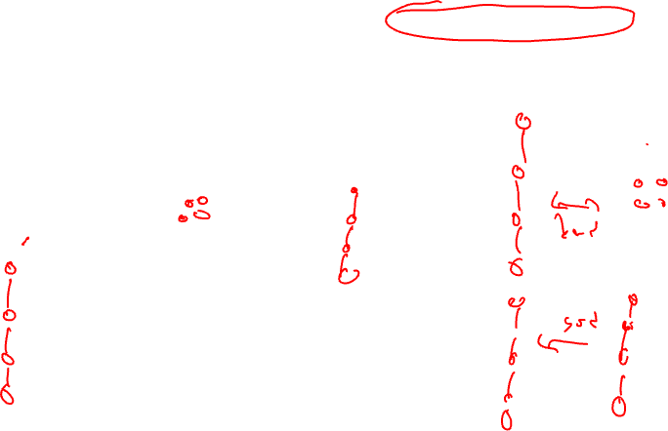
Negative 2: Dependence Height
Dependence height is max of
for all BBs that are if-converted
(dep height = schedule length
with infinite resources)
Be careful with if-converting blocks with
mismatched dependence heights
100
BB1
BB1
60
40
BB2 if p1
BB2
BB3
BB3 if p2
60
40
BB4
BB4
100

Slide 36
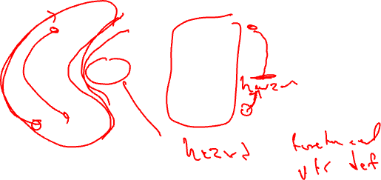
Negative 3: Hazard Presence
Hazard = operation that forces
the compiler to be conservative,
so limited reordering or optimization,
e.g., subroutine call, pointer store, …
Hazards should be avoided except
on the “main path”
100
BB1
BB1
60
40
BB2 if p1
BB2
BB3
BB3 if p2
60
40
BB4
BB4
100

Slide 37
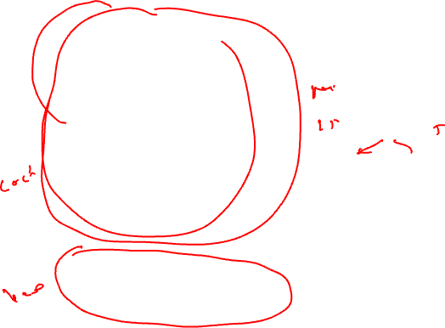
Deciding When/What To If-convert
Resources
  Small resource usage ideal for less important paths
Dependence height
  Matched heights are ideal
  Close to same heights is ok
Remember everything is relative for resources and dependence height !
Hazards
  Avoid hazards unless on most important path
Estimate of benefit
  Branches/Mispredicts removed
  Increased instruction overlap
100
BB1
BB1
60
40
BB2 if p1
BB2
BB3
BB3 if p2
60
40
BB4
BB4
100

Slide 38

For More on If-conversion/Predicated Execution
Selective if-conversion: "Effective Compiler Support for Predicated Execution using the Hyperblock", S. Mahlke et al., MICRO-25, 1992.
Use of AND-type predicates: "Control CPR: A Branch Height Reduction Optimization for EPIC Processors", M. Schlansker et al., PLDI-99, 1999.
Security: Data oblivious computing for making code side channel resistant

