Slide 1

EECS 583 – Class 2
Control Flow Analysis
University of Michigan
January 17, 2024
https://web.eecs.umich.edu/~mahlke/courses/583w24

Slide 2

Announcements & Reading Material
eecs583a,eecs583b.eecs.umich.edu
  Everyone has home directory and login
  Let us know if you can’t login (VPN required!)
HW 0 – Due today, but nothing to turn in (needed for HW1)
  Please get this done ASAP, talk to Aditya/Yunjie if you have problems
Reading
  Today’s class
    Ch 9.4, 10.4 (6.6, 9.6) from Compilers: Principles, Techniques Tools Ed 1 (Ed 2)
  Next class
    “Trace Selection for Compiling Large C Applications to Microcode”, Chang and Hwu, MICRO-21, 1988.
    “The Superblock: An Effective Technique for VLIW and Superscalar Compilation”, Hwu et al., Journal of Supercomputing, 1993

Slide 3

Homework 1 – Due Mon Jan 29
Get started ASAP. If you haven’t done HW0, you are behind!
Goals: Learn how to profile with LLVM, write stats collection pass
583_W24_HW1.tgz
  hw1pass.cpp: template for your pass
  583simple, 583anagram, 583compress: benchmark source code + inputs + expected outputs + run instructions
Easy to do, but hard to start because of newness
  Look for Aditya’s piazza post for help, more info in today’s discussion section
    Skeleton code
    How to run profiler
    Simple example with opcode stats
  Talk to the GSIs if you are stuck

Slide 4

From Last Time: Identifying BBs - Answer
L1: r7 = load(r8)
L2: r1 = r2 + r3
L3: beq r1, 0, L10
L4: r4 = r5 * r6
L5: r1 = r1 + 1
L6: beq r1 100 L3
L7: beq r2 100 L10
L8: r5 = r9 + 1
L9: jump L2
L10: r9 = load (r3)
L11: store(r9, r1)
L1: r7 = load(r8)
L2: r1 = r2 + r3
L3: beq r1, 0, L10
L4: r4 = r5 * r6
L5: r1 = r1 + 1
L6: beq r1 100 L3
L7: beq r2 100 L10
L8: r5 = r9 + 1
L9: jump L2
L10: r9 = load (r3)
L11: store(r9, r1)

Slide 5
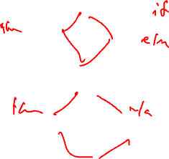
From Last Time: Control Flow Graph (CFG)
Defn Control Flow Graph – Directed graph, G = (V,E) where each vertex V is a basic block and there is an edge E, v1 (BB1) → v2 (BB2) if BB2 can immediately follow BB1 in some execution sequence
  A BB has an edge to all blocks it can branch to
  Standard representation used by many compilers
  Often have 2 pseudo vertices
    entry node
    exit node
Entry
BB1
BB2
BB3
BB4
BB5
BB6
BB7
Exit

Slide 6
From Last Time: Property of CFGs: Dominator (DOM)
Defn: Dominator – Given a CFG(V, E, Entry, Exit), a node x dominates a node y, if every path from the Entry block to y contains x
3 properties of dominators
  Each BB dominates itself
  If x dominates y, and y dominates z, then x dominates z
  If x dominates z and y dominates z, then either x dominates y or y dominates x
Intuition
  Given some BB, which blocks are guaranteed to have executed prior to executing the BB

Slide 7
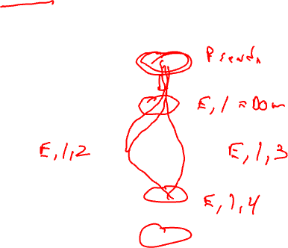
Dominator Example 1
Compute Dom(BBi) = set of blocks that dominate BBi
Entry
BB1
BB2
BB3
BB4
Exit

Slide 8
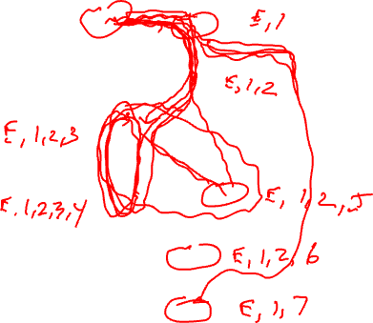
Dominator Example 2
Entry
BB1
BB2
BB3
BB4
BB5
BB6
BB7
Exit

Slide 9
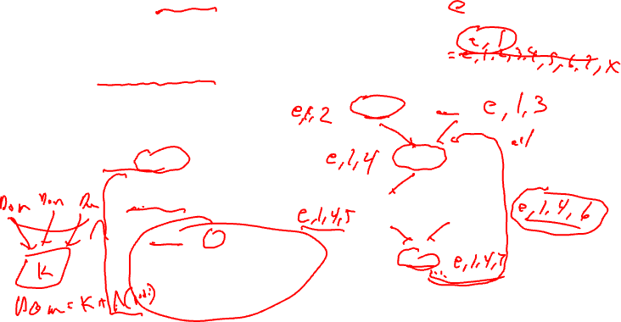
Dominator Analysis
Compute dom(BBi) = set of BBs that dominate BBi
Initialization
  Dom(entry) = entry
  Dom(everything else) = all nodes
Iterative computation
  while change, do
    change = false
    for each BB (except the entry BB)
      tmp(BB) = BB + {intersect of Dom of all predecessor BB’s}
      if (tmp(BB) != dom(BB))
        dom(BB) = tmp(BB)
        change = true
Entry
BB1
BB2
BB3
BB4
BB5
BB6
BB7
Exit

Slide 10
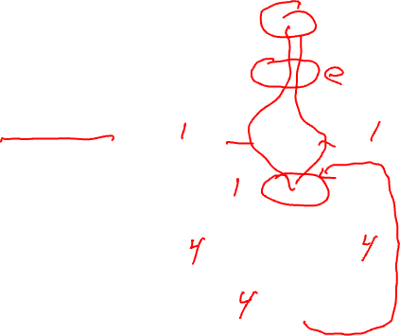
Immediate Dominator
Defn: Immediate dominator (idom) – Each node n has a unique immediate dominator m that is the last dominator of n on any path from the initial node to n
  Closest node that dominates
Entry
BB1
BB2
BB3
BB4
BB5
BB6
BB7
Exit

Slide 11
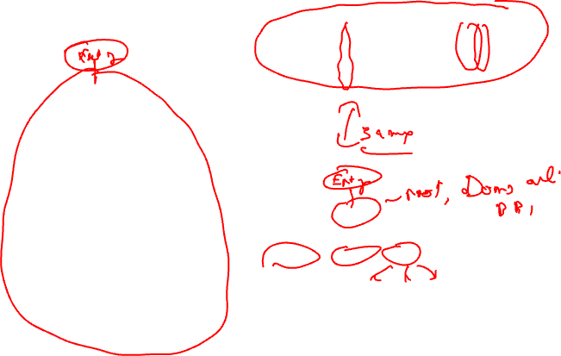
Dominator Tree
First BB is the root node, each node
dominates all of its descendants
BB DOM
1 1
2 1,2
3 1,3
4 1,4
BB DOM
5 1,4,5
6 1,4,6
7 1,4,7
BB1
BB2
BB3
BB4
BB1
BB5
BB6
BB2
BB3
BB4
BB5
BB6
BB7
BB7
Dom tree

Slide 12
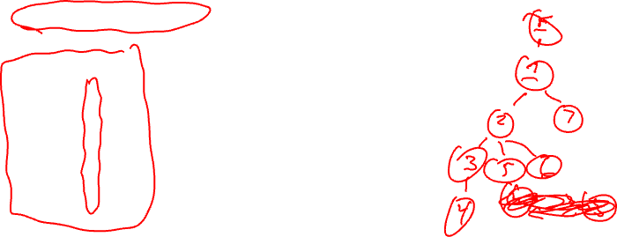
Dominator Tree Example
Draw the dominator tree
Entry
BB1
BB DOM
1 E,1
2 E,1,2
3 E,1,2,3
4 E,1,2,3,4
5 E,1,2,5
6 E,1,2,6
7 E,1,7
BB2
BB3
BB4
BB5
BB6
BB7
Exit

Slide 13
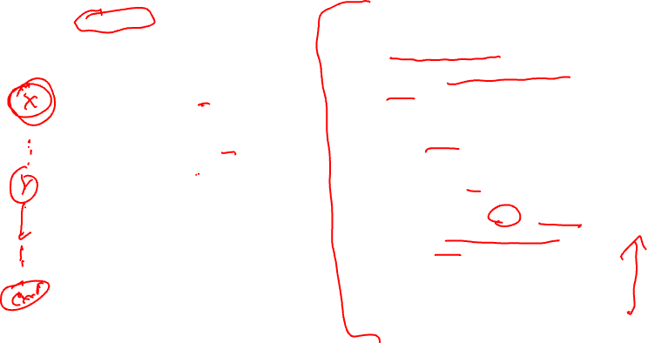
Post Dominator (PDOM)
Reverse of dominator
Defn: Post Dominator – Given a CFG(V, E, Entry, Exit), a node x post dominates a node y, if every path from y to the Exit contains x
Intuition
  Given some BB, which blocks are guaranteed to have executed after executing the BB
pdom(BBi) = set of BBs that post dominate BBi
Initialization
  Pdom(exit) = exit
  Pdom(everything else) = all nodes
Iterative computation
  while change, do
    change = false
    for each BB (except the exit BB)
      tmp(BB) = BB + {intersect of pdom of all successor BB’s}
      if (tmp(BB) != pdom(BB))
        pdom(BB) = tmp(BB)
        change = true

Slide 14
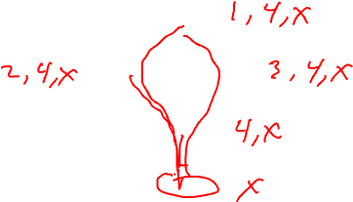
Post Dominator Example 1
Entry
BB1
BB2
BB3
BB4
Exit

Slide 15
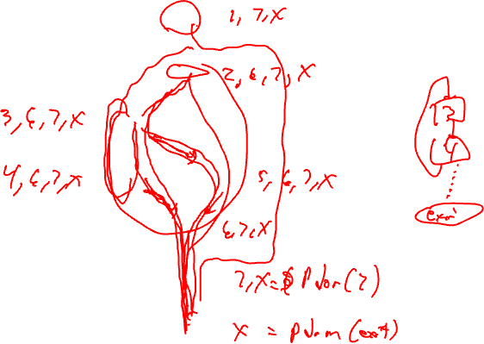
Post Dominator Example 2
Entry
BB1
BB2
BB3
BB4
BB5
BB6
BB7
Exit

Slide 16
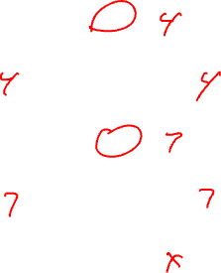
Immediate Post Dominator
Defn: Immediate post dominator (ipdom) – Each node n has a unique immediate post dominator m that is the first post dominator of n on any path from n to the Exit
  Closest node that post dominates
  First breadth-first successor that post dominates a node
Entry
BB1
BB2
BB3
BB4
BB5
BB6
BB7
Exit

Slide 17
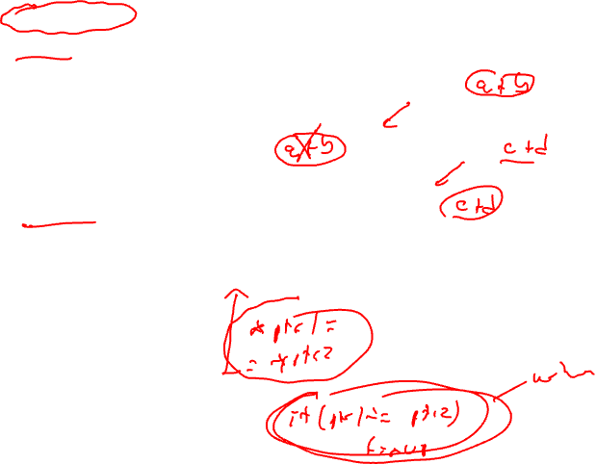
Why Do We Care About Dominators?
Loop detection – next subject
Dominator
  Guaranteed to execute before
  Redundant computation – an op is redundant if it is computed in a dominating BB
  Most global optimizations use dominance info
Post dominator
  Guaranteed to execute after
  Make a guess (ie 2 pointers do not point to the same locn)
  Check they really do not point to one another in the post dominating BB
Entry
BB1
BB2
BB3
BB4
BB5
BB6
BB7
Exit

Slide 18
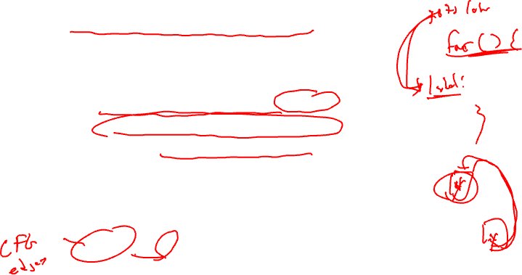
Natural Loops
Cycle suitable for optimization
  Discuss optimizations later
2 properties
  Single entry point called the header
    Header dominates all blocks in the loop
  Must be one way to iterate the loop (ie at least 1 path back to the header from within the loop) called a backedge
Backedge detection
  Edge, x→ y where the target (y) dominates the source (x)

Slide 19
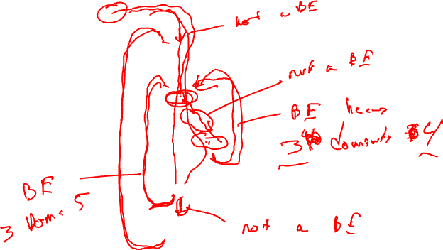
Backedge Example
Entry
BB1
BB2
BB3
BB4
BB5
BB6
Exit

Slide 20
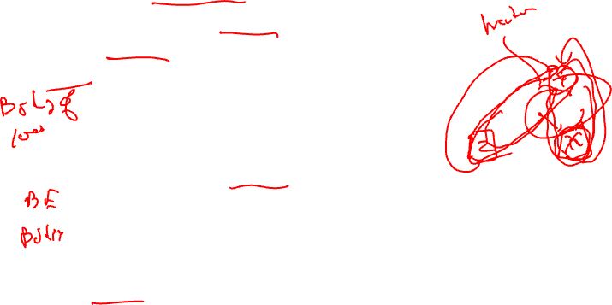
Loop Detection
Identify all backedges using Dom info
Each backedge (x → y) defines a loop
  Loop header is the backedge target (y)
  Loop BB – basic blocks that comprise the loop
    All predecessor blocks of x for which control can reach x without going through y are in the loop
Merge loops with the same header
  I.e., a loop with 2 continues
  LoopBackedge = LoopBackedge1 + LoopBackedge2
  LoopBB = LoopBB1 + LoopBB2
Important property
  Header dominates all LoopBB

Slide 21
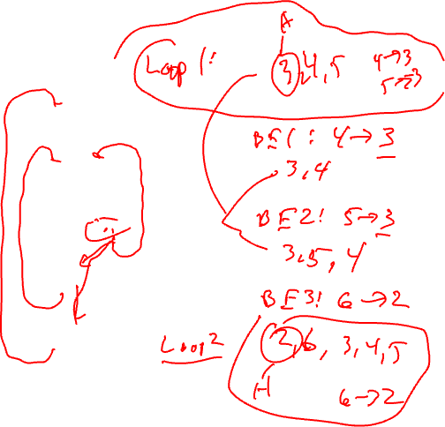
Loop Detection Example
Entry
BB1
BB2
BB3
BB4
BB5
BB6
Exit

Slide 22
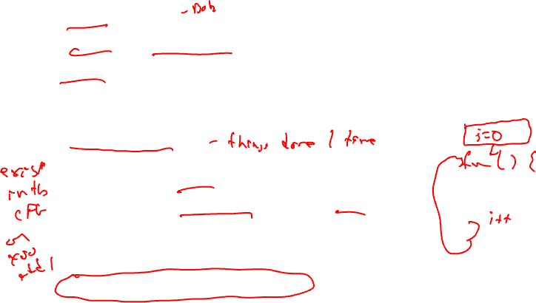
Important Parts of a Loop
Header, LoopBB
Backedges, BackedgeBB
Exitedges, ExitBB
  For each LoopBB, examine each outgoing edge
  If the edge is to a BB not in LoopBB, then its an exit
Preheader (Preloop)
  New block before the header (falls through to header)
  Whenever you invoke the loop, preheader executed
  Whenever you iterate the loop, preheader NOT executed
  All edges entering header
    Backedges – no change
    All others, retarget to preheader
Postheader (Postloop) - analogous

Slide 23
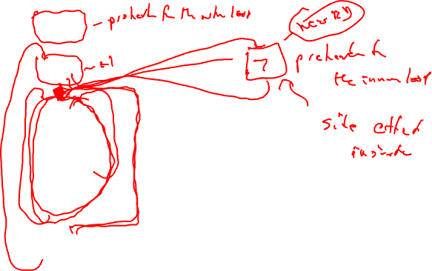
Find the Preheaders for each Loop
Entry
BB1
BB2
BB3
??
BB4
BB5
BB6
Exit

Slide 24

Characteristics of a Loop
Nesting (generally within a function scope)
  Inner loop – Loop with no loops contained within it
  Outer loop – Loop contained within no other loops
  Nesting depth
    depth(outer loop) = 1
    depth = depth(parent or containing loop) + 1
Trip count (average trip count)
  How many times (on average) does the loop iterate
  for (I=0; I<100; I++) → trip count = 100
  With profile info:
    Ave trip count = weight(header) / weight(preheader)

Slide 25
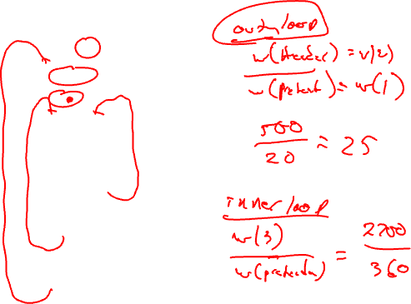
Trip Count Calculation Example
Entry
BB1
20
BB2
Calculate the trip
counts for all the loops
in the graph
360
BB3
2100
1000
480
600
BB4
140
1100
BB5
360
1340
BB6
20
Exit

Slide 26
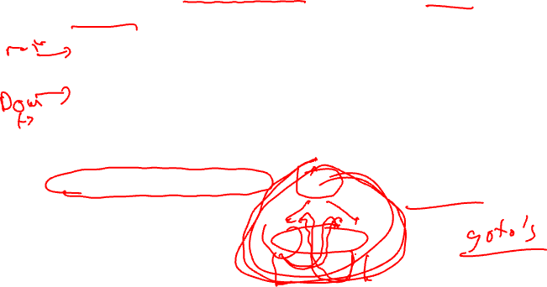
Reducible Flow Graphs
A flow graph is reducible if and only if we can partition the edges into 2 disjoint groups often called forward and back edges with the following properties
  The forward edges form an acyclic graph in which every node can be reached from the Entry
  The back edges consist only of edges whose destinations dominate their sources
More simply – Take a CFG, remove all the backedges (x→ y where y dominates x), you should have a connected, acyclic graph
bb1
Non-reducible!
bb2
bb3

