Slide 1

EECS 583 – Class 15
Exam Review
University of Michigan
March 18, 2024

Slide 2

Announcements
Project proposal deadline – Tonight (Monday) midnight
  Submit paragraph + reference on your project topic (Email to Aditya, Yunjie, and Scott)
Research paper presentations
  Each group sign up for 15 min (presentation) + 2 min (Q&A) slot on the EECS 583 calendar
  Mon Mar 25 (next Monday) – Wed Apr 17: presentations during class (4 slots per class), signup on eecs583 calendar
Midterm Exam
  Wednesday, Mar 20, Hybrid format
  In person – Send email to Aditya if you want to take the exam in class
    10:30am-11:50 (G906 Cooley)
    Questions answered in the hallway
  Virtual
    10:30am-11:50 + 15 mins extra time for logistics (printing, scanning, etc.)
    Questions about exam can be posted on piazza and will be answered ASAP
  Covers through register allocation (last lecture)

Slide 3

Research Paper Presentation Logistics
Monday Mar 25 – Wednesday Apr 17
  Signup for slot on Google calendar (just like project proposals)
  Sign up for earliest slot available on the day you want to present → no gaps
    Plan on attending the entire lecture on the day you present
  Not all days will be full (max of 4 slots per lecture)
  Will cancel class if no signups
Each group: 15 min slot + 2 mins Q&A
  You will be cut off if you go long!
  Tag-team presentation – Divide up as you like but everyone must talk
  Max of 20 slides (for the group), animations not included in count
  Record your paper on the group sign up sheet (so we can check for conflicts!)
  Submit paper (pdf) and slides (pptx or pdf) night before (by 9pm!)
    Call your files groupX_paper.pdf, groupX_slides.pdf/pptx
    Email to Aditya, Yunjie, and Scott

Slide 4

Research Paper Presentation Format
Make your own slides!!!
  Don’t just lift figures from the pdf (graphs/tables ok to lift)
  Don’t have too many all text slides
  No long sentences on slides, don’t just read the slides, look at audience
  Equations/proofs not very interesting to show, code examples are great
Points to discuss
  Intro/Motivation – area + problem + why is it important to solve this problem
  How the technique works, examples are super helpful
  Some results, but don’t show 10 graphs
  Group’s commentary (last slide or 2 of your presentation)
    What is best about the paper? Why is the idea so awesome? Don’t focus on results
    What are limitations/weaknesses of the approach (be critical!)

Slide 5

Research Paper Presentation – Audience Members
Research presentations != skip class
  You should attend or watch the Zoom video
Grading + give comments to your peers
  Class + Aditya, Yunjie, & I will evaluate each group’s presentation and provide feedback
  Each person will submit evaluation sheet for the day’s presentations
    Canvas quizzes
    3 days (72 hrs) to submit
  Aditya/Yunjie will anonymize comments and email to each group
  Be positive, every talk has some positives
    What did the group do well
  Be critical, but constructive with your criticisms
    What could be improved, comment on slides/speaking
  Don’t try to give separate comments for each group member, just evaluate the entire team

Slide 6
Exam Review

Slide 7

Virtual Exam Logistics (see piazza for more details)
Wednesday, Mar 20
10:30-11:50 + 15 minutes for logistics
Gradescope to distribute/collect exams, accessible via canvas
Steps
  Download, take exam, scan & submit
    Print out and write on exam sheets
    Just write answers on paper
    Use electronic method (ie tablet) to create electronic answers
  Exam itself should take ~ 65 mins
  Some slack time to deal with technical difficulties, but email course staff if you run into problems
Use piazza to ask questions and get answers during the exam
  We will answer ASAP. Be sure to read others questions before posting your own.

Slide 8

In-person Exam Logistics
Wednesday, Mar 20 – G906 Cooley
10:30-11:50
Printed exams available in classroom
Steps – Normal pre-COVID exam
  Exam itself should take ~65 mins
  Course staff will be outside lecture room to answer questions
Bring whatever you like (open book exam)
  Tablet/laptop
  Printed materials (old exams, lecture problems, etc.)
  Books, etc.

Slide 9

What to Expect
Exam format
  Open notes, open internet
  Apply techniques we discussed in class
  Reason about solving compiler problems – how/why things are done
  A couple of thinking problems
  No LLVM code
Honor code and cheating
  Must sign honor code acknowledging that you have neither given no received aid on the exam
  Please do not share answers or talk to other students during the exam
  Graduate class, so we don’t expect cheating to be an issue
    But we will investigate any anomalies that arise

Slide 10

Studying
9 exams + answer keys (F12, F13, F18, F19, F20, F21, F22, W23, F23) are posted on the course website
  Note – Past exams may not accurately predict future exams!!
  Fomat will be similar
  Work out the problems without looking at the answers!
  Exams vary in terms of time/length
Preparing yourself
  Yes, you should study even though its open notes
    Lots of material that you have likely forgotten from early this semester
    Refresh your memories, especially the old topics
    No memorization required, but you need to be familiar with the material to finish the exam
  Go through lecture notes, especially the examples!
  If you are confused on a topic, go through the reading
  Go through the practice exams (Don’t look at the answer) as the final step

Slide 11

Exam Topics
Control flow analysis
  Control flow graphs, Dom/pdom, Loop detection
  Trace selection, superblocks
Predicated execution
  Control dependence analysis, if-conversion
Dataflow analysis
  Liveness, reaching defs, DU/UD chains, available defs/exprs
  Static single assignment – Make sure you understand SSA!
Optimizations
  Classical: Dead code elim, constant/copy prop, CSE, LICM, induction variable strength reduction
  ILP optimizations - unrolling, tree height reduction, induction/accumulator expansion – Just understand the concepts
  Speculative optimization – like HW2

Slide 12

Exam Topics - Continued
Acyclic scheduling
  Dependence graphs, Estart/Lstart/Slack, list scheduling
  Code motion across branches, speculation, exceptions
Software pipelining
  DSA form, ResMII, RecMII, modulo scheduling
  Make sure you can modulo schedule a loop!
  Execution control with LC, ESC
Register allocation
  Interference graph, graph coloring

Slide 13
Some Sample Problems

Slide 14

Part I: Short Questions
Fast questions – a couple of minutes each
  Don’t waste too much time on any single question
  Come back later to questions you don’t know the answer
Basic facts/trends
Most should be obvious, but some a little thought

Slide 15
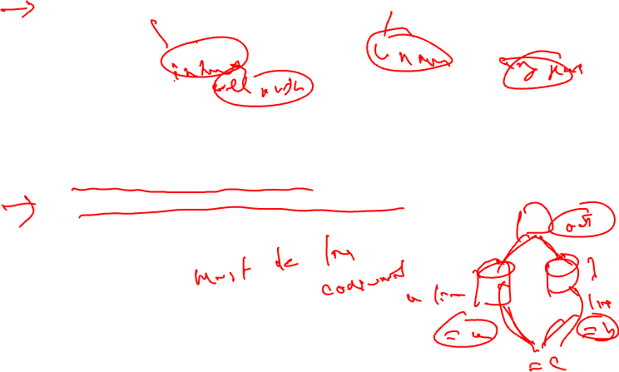
Question 1 – Fall 2021, Question 2 - Winter 2023
What is the main difference between reaching definitions and available definitions?
In liveness analysis, how would the analysis results be changed if the meet function was modified from using union of live variables (IN sets) of the successor blocks to intersection over the same sets of variables? Briefly explain your answer

Slide 16
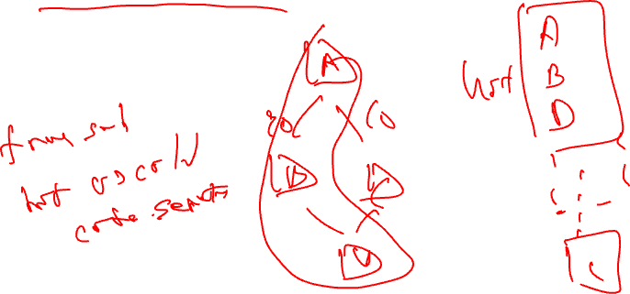
Question 2 – Fall 2023
Profile information can be used for a variety of purposes in a compiler. Name a way it can be used to optimize instruction cache performance. Briefly explain

Slide 17
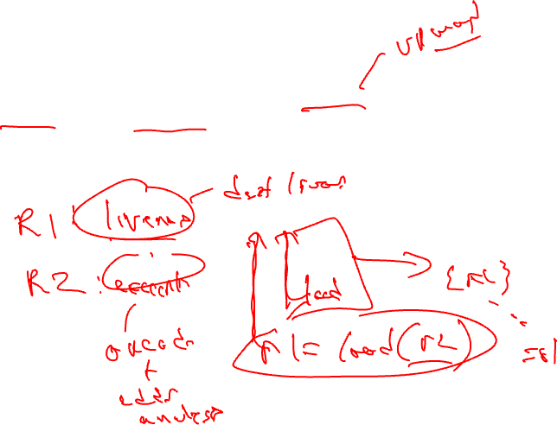
Question 3 – Fall 2018
When a compiler scheduler wants to speculate an instruction, name one issue that it must consider to preserve correctness of the resulting code.

Slide 18
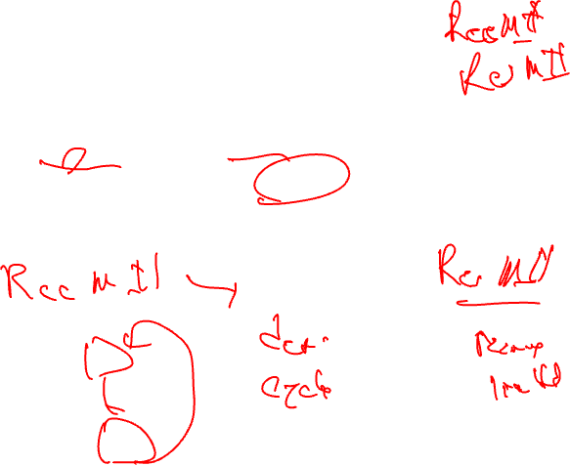
Question 2 – Fall 2020
It is often possible to improve the performance of a loop limited by RecMII by adding resources to the processor. Is the preceding statement True or False? Justify your answer

Slide 19
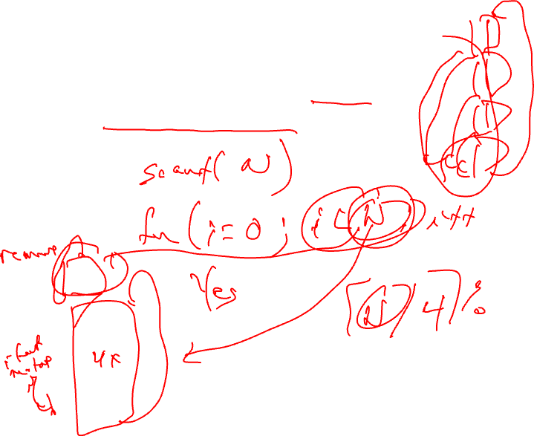
Question 3 – Fall 2021
Is it possible to unroll a loop with a statically (compile-time) unknown number of iterations? Yes/No and briefly explain.

Slide 20

Part II: Medium/Long Questions
Longer questions
  Problems that must be worked out: ~10 mins each
  Some questions like lecture examples
  But, some have a little twist
Practicing problems ahead of time will make you more comfortable and faster
  So, practicing is strongly recommended

Slide 21
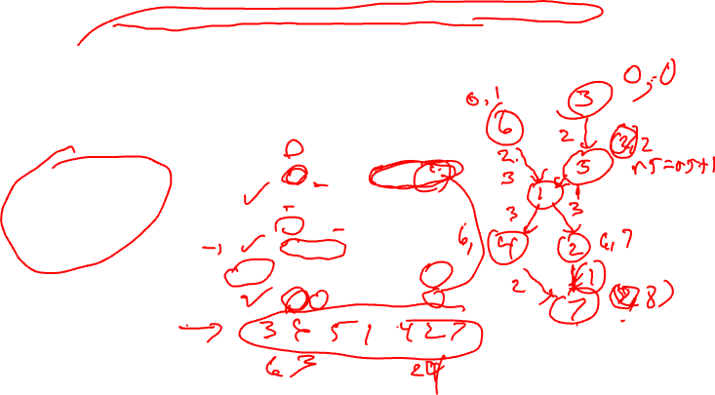
Question 9 – Fall 2022
Due to a corrupt disk, the original order of the instructions was lost and the
instructions got randomly ordered. The student reassigns the number of each
instruction and knows the corresponding partial Estart and Lstart values (see Table
below). It is also known that Instruction 7 (r2 = r6*2) is the last instruction of the BB
and has the largest Estart and Lstart values. Determine the original order of the
instructions using the partial Estart/Lstart values and complete the missing Estart/Lstart
values in the table below for the original ordering. Remember, the instruction numbers
do not represent the original order.

Slide 22
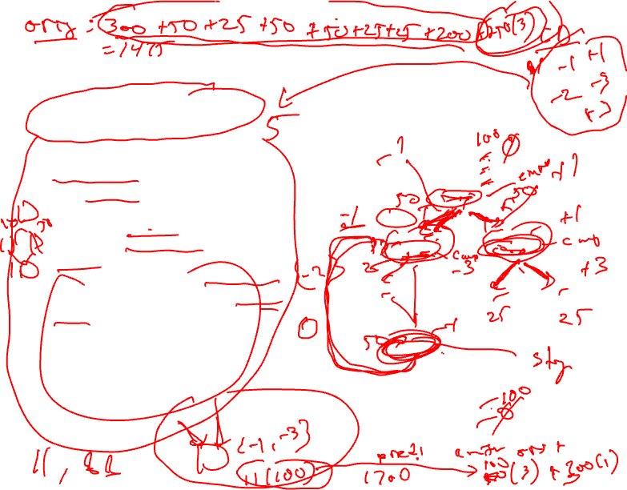
Question 8 – Fall 2023
a) Compute the number of predicates required to if-convert the code.
b) To profile the code, we ran this function 100 times, we found that:
i) The loop back-edge was never taken.
ii) All other conditional branches were taken exactly 50% of the time.
iii) All branch probabilities were independent.
iv) Each instruction takes 1 unit of time to execute, except branches which take 3
units each.
Based on this information, will if-conversion of all eligible branches to utilize predicated
execution (no other optimizations) make the code run faster on the same profile testcases?

Slide 23
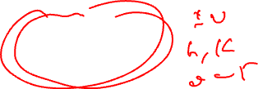
Question 7 – Fall 2020
Compute the Available Expression GEN/KILL/IN/OUT sets at BB4.
Assume r2, r3, r6 are defined before entering BB1
BB1:
1: r1 = mult r2, r3
2: r4 = add r2, 10
3: r5 = div r3, 2
BB2:
4: r4 = mult r2, r3
5: r2 = add r1, 10
BB3:
6: r3 = add r1, r4
7: r6 = add r6, r6
BB4:
8: r8 = div r5,3
9: r1 = mult r2, 3
10: r2 = add r2, 2

Slide 24
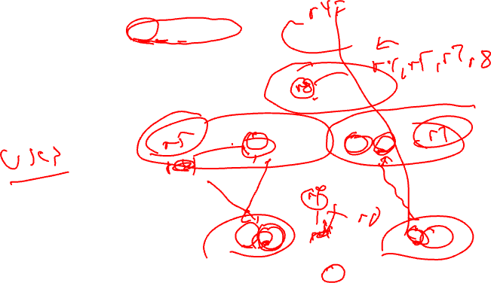
Question 8 – Fall 2023
Fill in the blanks using r4, r5, r7, and r8,
so that a maximum number of instructions
from BB2, BB3, BB4, and BB6 become
eligible for hoisting via LICM.

Slide 25
Question 9 – Fall 2020
a0 = 1
b0 = 2
Variable pool: a0, a2, a4, a5, a8; b3, b4, b5, b6, b7
(All variables can only be used once)
BB0
BB1
a1 = Phi(__, a8)
b1 = Phi(b0, b7)
a2 = a1 + b1
BB2
a3 = Phi(__, a6)
b2 = Phi(b1, b4)
__ = a3 * b2
BB3
__ = a3 + 1
__ = a3+ 2
BB4
__ = b1 + 2
BB6
BB5
a6 = Phi(a4, a5)
__ = b3 + 1
a7 = Phi(a6, a2)
__ = Phi(b4, b5)
__= a7+ 1
__ = a8 + b6
BB7

