Slide 1

EECS 583 – Class 11
Instruction Scheduling
University of Michigan
February 19, 2024

Slide 2

Announcements & Reading Material
HW 2 – Due Wed at midnight!
  See piazza for answered questions, Talk to Aditya/Yunjie for help
Project discussion meetings (Mar 11-15)
  Project proposal meeting signup next next week – Signup on Google Calendar
    Next week is spring break!
  Each group meets 10 mins with Aditya, Yunjie, and I
  Action items
    Need to identify group members
    Use piazza to recruit additional group members or express your availability
    Think about general project areas that you want to work on
Today’s class
  “The Importance of Prepass Code Scheduling for Superscalar and Superpipelined Processors,” P. Chang et al., IEEE Transactions on Computers, 1995, pp. 353-370.
Next class
  “Iterative Modulo Scheduling: An Algorithm for Software Pipelining Loops”, B. Rau, MICRO-27, 1994, pp. 63-74.

Slide 3

From Last Time: Code Generation
Map optimized “machine-independent” assembly to final assembly code
Input code
  Classical optimizations
  ILP optimizations
  Formed regions (sbs, hbs), applied if-conversion (if appropriate)
Virtual → physical binding
  2 big steps
  1. Scheduling
    Determine when every operation executions
    Create MultiOps (for VLIW) or reorder instructions (for superscalar)
  2. Register allocation
    Map virtual → physical registers
    Spill to memory if necessary

Slide 4
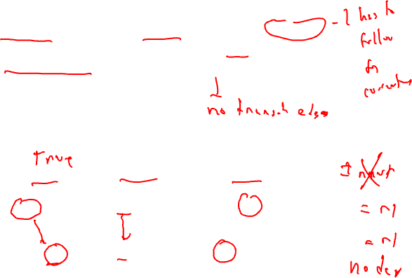
Data Dependences
Data dependences
  If 2 operations access the same register, they are dependent
  However, only keep dependences to most recent producer/consumer as other edges are transitively redundant
  Types of data dependences
Flow
Output
Anti
r1 = r2 + r3
r4 = r1 * 6
r1 = r2 + r3
r1 = r4 * 6
r1 = r2 + r3
r2 = r5 * 6

Slide 5
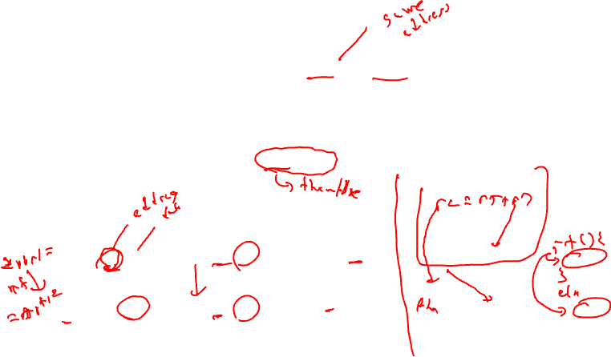
More Dependences
Memory dependences
  Similar as register, but through memory
  Memory dependences may be certain or maybe
Control dependences
  We discussed this earlier
  Branch determines whether an operation is executed or not
  Operation must execute after/before a branch
Mem-flow
Mem-output
Mem-anti
Control
store (r1, r2)
r3 = load(r1)
store (r1, r2)
store (r1, r3)
r2 = load(r1)
store (r1, r3)
if (r1 != 0)
r2 = load(r1)

Slide 6
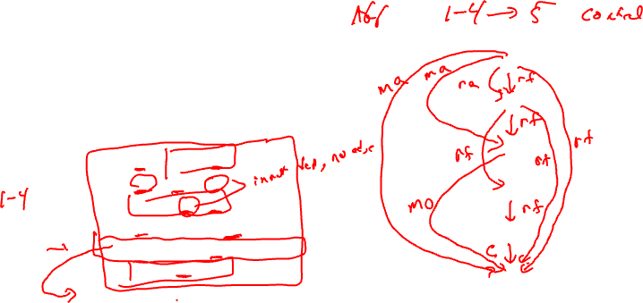
Dependence Graph
Represent dependences between operations in a block via a DAG
  Nodes = operations/instructions
  Edges = dependences
Single-pass traversal required to
insert dependences
Example
1
2
1: r1 = load(r2)
2: r2 = r1 + r4
3: store (r4, r2)
4: p1 = cmpp (r2 < 0)
5: branch if p1 to BB3
6: store (r1, r2)
3
4
5
6
BB3:

Slide 7

Dependence Graph - Solution
Example
Instructions 1-4 have
control dependence to instruction 5
5→6 control dependence
1: r1 = load(r2)
2: r2 = r1 + r4
3: store (r4, r2)
4: p1 = cmpp (r2 < 0)
5: branch if p1 to BB3
6: store (r1, r2)
1
rf
ra
BB3:
rf
2
ma
rf
3
rf
ma
4
rf
rf
5
mo
6

Slide 8
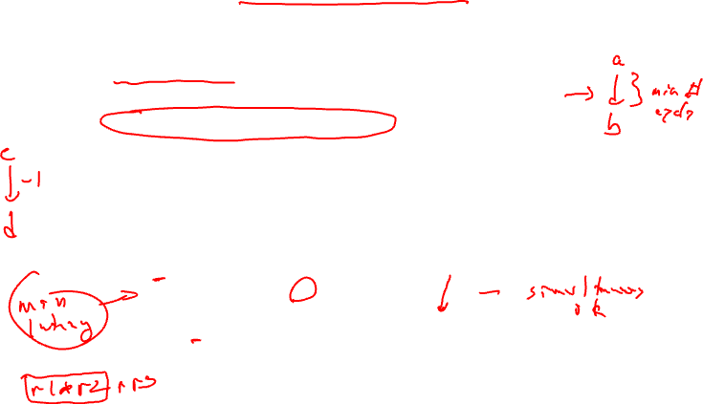
Dependence Edge Latencies
Edge latency = minimum number of cycles necessary between initiation of the predecessor and successor in order to satisfy the dependence
Is negative latency possible?
  Yes, means successor can start before predecessor
  We will only deal with latency >= 0
Flow
Output
Anti
r1 = r2 + r3
r4 = r1 * 6
r1 = r2 + r3
r1 = r4 * 6
r1 = r2 + r3
r2 = r5 * 6
Latency of
producer
1
0

Slide 9

Dependence Edge Latencies (2)
Memory dependences
  Ordering memory instructions to ensure correct memory state
Control dependences
  branch → b
    Instructions inside then/else paths dependent on branch
  a → branch
    Op a must be issued before the branch completes
Control
Mem-flow
Mem-output
Mem-anti
r3 = r4 + r5
if (r1 != 0)
r2 = load(r1)
0
store (r1, r2)
r3 = load(r1)
store (r1, r2)
store (r1, r3)
r2 = load(r1)
store (r1, r3)
1
1
1
1

Slide 10
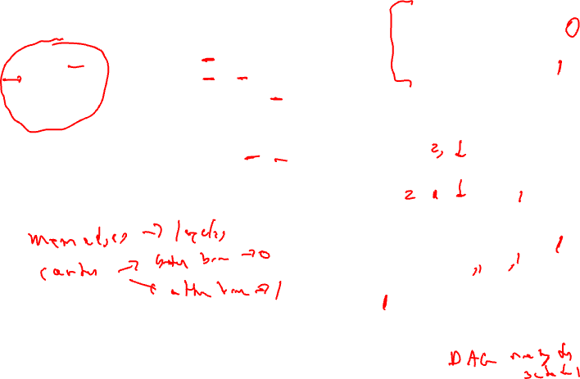
Class Problem – Add Latencies to Dependence Edges
latencies
add: 1
cmpp: 1
load: 2
store: 1
Example
Instructions 1-4 have control
dependence to instruction 5
5→6 control dependence
1: r1 = load(r2)
2: r2 = r1 + r4
3: store (r4, r2)
4: p1 = cmpp (r2 < 0)
5: branch if p1 to BB3
6: store (r1, r2)
1
rf
ra
BB3:
2
rf
ma
rf
3
rf
ma
4
rf
rf
5
mo
6

Slide 11
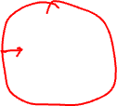
Homework Problem 1
1. Draw dependence graph
2. Label edges with type and
latencies
machine model
latencies
add: 1
mpy: 3
load: 2
store: 1
1
2
1. r1 = load(r2)
2. r2 = r2 + 1
3. store (r8, r2)
4. r3 = load(r2)
5. r4 = r1 * r3
6. r5 = r5 + r4
7. r2 = r6 + 4
8. store (r2, r5)
3
4
5
6
7
8

Slide 12
Homework Problem 1: Answer
1. Draw dependence graph
2. Label edges with type and
latencies
machine model
latencies
add: 1
mpy: 3
load: 2
store: 1
Store format (addr, data)
rf, 2
1
ra, 0
2
1. r1 = load(r2)
2. r2 = r2 + 1
3. store (r8, r2)
4. r3 = load(r2)
5. r4 = r1 * r3
6. r5 = r5 + r4
7. r2 = r6 + 4
8. store (r2, r5)
rf, 1
ro, 1
3
rf, 1
ra, 0
ra, 0
4
ra, 0
rf, 2
5
rf, 3
6
rf, 1
7
rf, 1
8
Memory deps all with latency =1: 1→3 (ma), 1→8 (ma),
3→4 (mf), 3→8 (mo), 4→8 (ma)
No control dependences

Slide 13
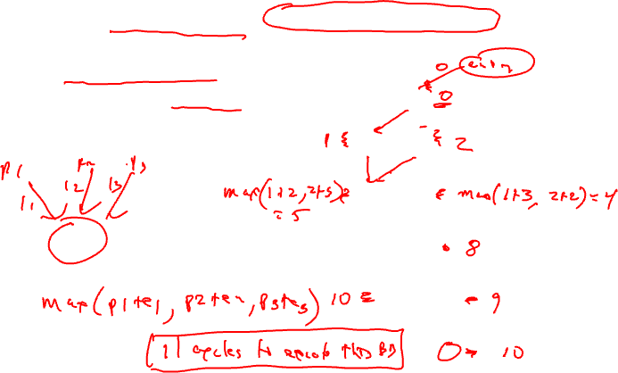
Dependence Graph Properties - Estart
Estart = earliest start time, (as soon as possible - ASAP)
  Schedule length with infinite resources (dependence height)
  Estart = 0 if node has no predecessors
  Estart = MAX(Estart(pred) + latency)
  for each predecessor node
  Example
0
1
1
2
1
2
3
2
3
3
2
2
5
4
5
4
3
1
6
8
2
1
10
7
8
9
0
0
Exit
10

Slide 14
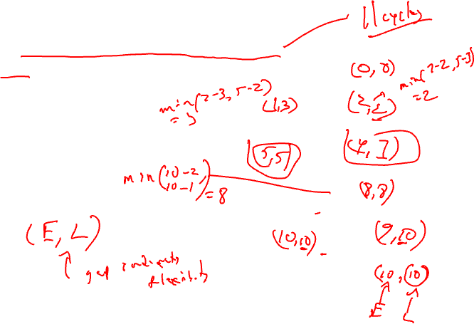
Lstart
Lstart = latest start time, ALAP
  Latest time a node can be scheduled s.t. sched length not increased beyond infinite resource schedule length
  Lstart = Estart if node has no successors
  Lstart = MIN(Lstart(succ) - latency)
  for each successor node
  Example
1
1
2
2
3
2
3
3
2
4
5
3
1
6
2
1
7
8
0
0
Exit

Slide 15
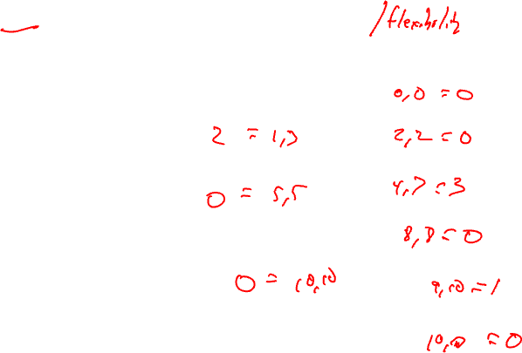
Slack
Slack = measure of the scheduling freedom
  Slack = Lstart – Estart for each node
  Larger slack means more mobility
  Example
1
1
2
2
3
2
3
3
2
4
5
3
1
6
2
1
7
8
0
0
Exit

Slide 16
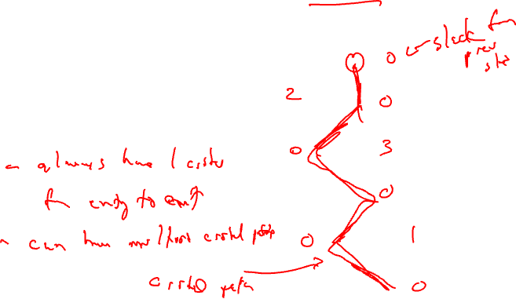
Critical Path
Critical operations = Operations with slack = 0
  No mobility, cannot be delayed without extending the schedule length of the block
  Critical path = sequence of critical
  operations from node with no
  predecessors to exit node, can
  be multiple crit paths
1
1
2
2
3
2
3
3
2
4
5
3
1
6
2
1
7
8
0
0
Exit

Slide 17
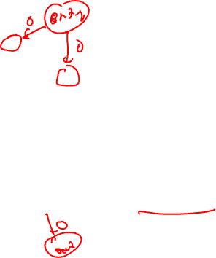
Homework Problem 2
Node Estart Lstart Slack
1
2
3
4
5
6
7
8
9
1
1
2
2
1
3
2
4
3
1
1
2
6
5
1
3
7
1
8
2
9
1
Critical path(s) =

Slide 18
Homework Problem 2 - Answer
Node Estart Lstart Slack
1 0 0 0
2 1 2 2
3 2 2 0
4 0 3 3
5 4 5 1
6 4 4 0
7 5 6 1
8 7 7 0
9 8 8 0
1
1
2
2
1
3
2
4
3
1
1
2
6
5
1
3
7
1
8
2
9
1
Critical path(s) = 1,3,6,8,9

Slide 19
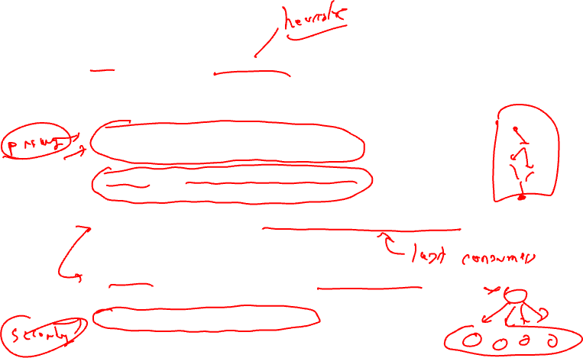
Operation Priority
Priority – Need a mechanism to decide which ops to schedule first (when you have multiple choices)
Common priority functions
  Height – Distance from exit node
    Give priority to amount of work left to do
  Slackness – inversely proportional to slack
    Give priority to ops on the critical path
  Register use – priority to nodes with more source operands and fewer destination operands
    Reduces number of live registers
  Uncover – high priority to nodes with many children
    Frees up more nodes
  Original order – when all else fails

Slide 20
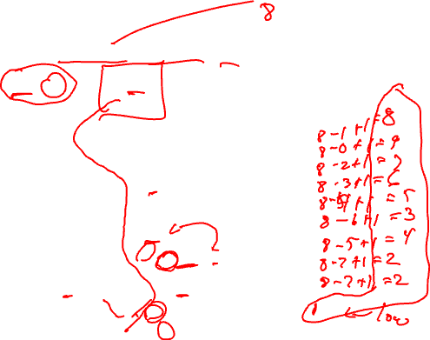
Height-Based Priority
Height-based is the most common
  priority(op) = MaxLstart – Lstart(op) + 1
0, 1
1
0, 0
1
2
2
2
op priority
1
2
3
4
5
6
7
8
9
10
2, 2
3
4
2, 3
2
1
5
4, 4
2
2
2
6
6, 6
1
2
7
0, 5
4, 7
8
9
7, 7
1
1
10
8, 8

Slide 21
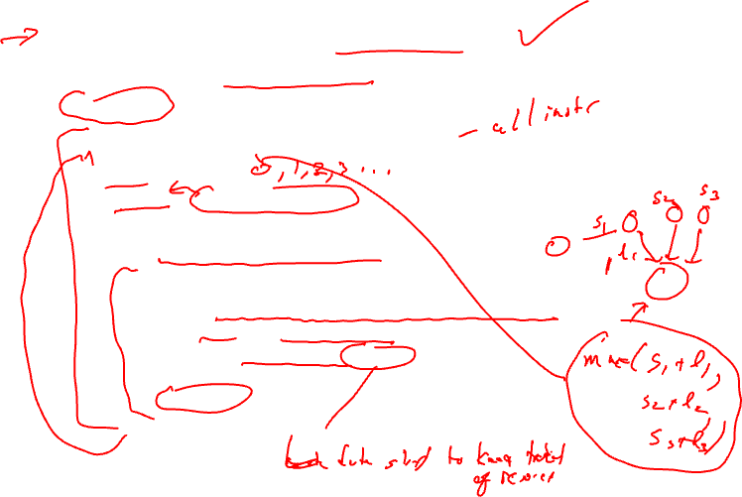
List Scheduling (aka Cycle Scheduler)
Build dependence graph, calculate priority
Add all ops to UNSCHEDULED set
time = -1
while (UNSCHEDULED is not empty)
  time++
  READY = UNSCHEDULED ops whose incoming dependences have been satisfied
  Sort READY using priority function
  For each op in READY (highest to lowest priority)
    op can be scheduled at current time? (are the resources free?)
      Yes, schedule it, op.issue_time = time
        Mark resources busy in RU_map relative to issue time
        Remove op from UNSCHEDULED/READY sets
      No, continue

Slide 22
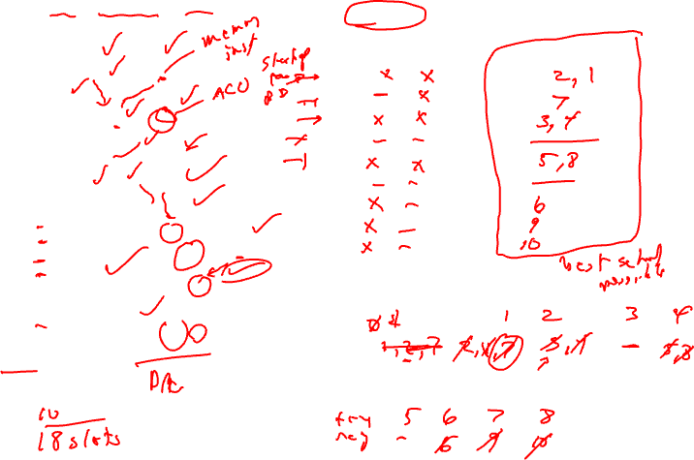
Cycle Scheduling Example
Processor: 2 issue, 1 memory port, 1 ALU
Memory port = 2 cycles, pipelined
ALU = 1 cycle
RU_map
Schedule
0, 1
1
0, 0
time ALU MEM
0
1
2
3
4
5
6
7
8
9
time Instructions
0
1
2
3
4
5
6
7
8
9
1
2
2m
2
2, 2
3m
4
2, 3
2
1
5m
4, 4
op priority
1 8
2 9
3 7
4 6
5 5
6 3
7 4
8 2
9 2
10 1
2
2
2
6
6, 6
1
2
7m
0, 5
4, 7
8
9
7, 7
1
1
10
8, 8
Time =
Ready =

Slide 23
Homework Problem 3
Processor: 2 issue, 1 memory port, 1 ALU
Memory port = 2 cycles, pipelined
ALU = 1 cycle
RU_map
Schedule
time ALU MEM
0
1
2
3
4
5
6
7
8
9
time Instructions
0
1
2
3
4
5
6
7
8
9
0,1
1m
2m
0,0
2
2
2,3
3
4m
2,2
1
1
2
3,5
5
6
3,4
7
4,4
1
1
1
5,5
8
9m
0,4
1
6,6
2
10
Time =
Ready =
Calculate height-based priorities
2. Schedule using cycle scheduler

Slide 24
Homework Problem 3 – Answer
Processor: 2 issue, 1 memory port, 1 ALU
Memory port = 2 cycles, pipelined
ALU = 1 cycle
Op priority
1 6
2 7
3 4
4 5
5 2
6 3
7 3
8 2
9 3
10 1
0,1
1m
2m
0,0
2
2
2,3
3
4m
2,2
RU_map
Schedule
1
1
2
time ALU MEM
0 X
1 X
2 X
3 X X
4 X
5 X
6 X
7 X
8 X
Time Instructions
0 2
1 1
2 4
3 3, 9
4 6
5 7
6 5
7 8
8 10
3,5
5
6
3,4
7
4,4
1
1
1
5,5
8
9m
0,4
1
6,6
2
10
Calculate height-based priorities
2. Schedule using Operation scheduler

Slide 25
Generalize Beyond a Basic Block
Superblock
  Single entry
  Multiple exits (side exits)
  No side entries
Schedule just like a BB
  Priority calculations needs change
  Dealing with control deps

Slide 26
Lstart in a Superblock
Not a single Lstart any more
  1 per exit branch (Lstart is a vector!)
  Exit branches have probabilities
1
1
2
3
1
1
op Estart Lstart0 Lstart1
1
2
3
4
5
6
3
4
1
1
5
Exit0 (25%)
2
6
Exit1 (75%)

Slide 27
Operation Priority in a Superblock
Priority – Dependence height and speculative yield
  Height from op to exit * probability of exit
  Sum up across all exits in the superblock
Priority(op) = SUM(Probi * (MAX_Lstart – Lstarti(op) + 1))
valid late times for op
1
1
2
3
op Lstart0 Lstart1 Priority
1
2
3
4
5
6
1
1
3
4
1
1
5
Exit0 (25%)
2
6
Exit1 (75%)

Slide 28
To Be Continued

