Slide 1
IntPatch:
Automatically Fix Integer-Overflow-to-Buffer-Overflow Vulnerability at Compile-Time
Group 4

Slide 2
Intro
What is it about
Why important
Previously Work and Disadvantages
IntPatch

Slide 3
What is it about?
IO2BO (Integer Overflow to Buffer Overflow) vulnerability:
“An integer overflow occurs when a program performs a calculation to determine how much memory to allocate, which causes less memory to be allocated than expected, leading to a buffer overflow.”

Slide 4
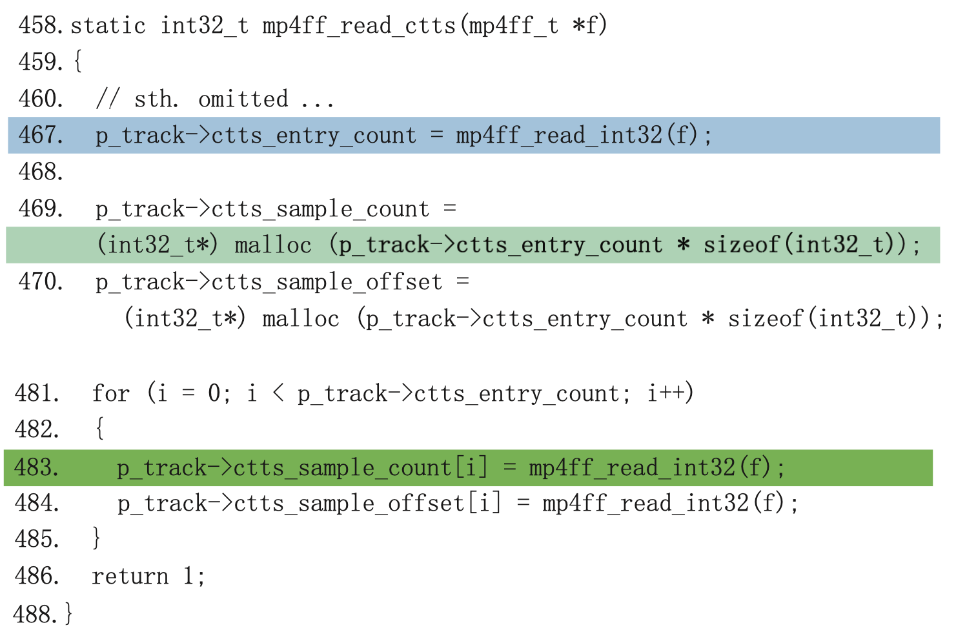
IO2BO example
Int32 max: 0x7FFFFFFF.
in line 467(IO): 0x80000001
In line 469: 0x80000001*4=4
A smaller memory will be allocated

Slide 5
Why Important?
IO2BO is an underestimated threat:
IO2BO is widely used by attackers: bypassing SSH, heap corruption attack
IO2BO: nearly ½ of integer overflow vulnerabilities, ⅓ of heap overflow vulnerabilities
Many programmers are not yet aware of the danger of IO2BO
Tedious and error-prone to fix
Notes:
CUPS first released a patch, but the initial patch failed to fix the vulnerability properly. The developers had to release another patch to completely fix this vulnerability. Moreover, the C99 standard specifies that signed overflow is considered as an undefined behavior, thus some patches that work properly in some compiler environments may fail in others.

Slide 6
Previous Work and Disadvantages
Some compilers/compilers extensions: insert extra code to capture integer overflows at runtime: false positives (benign integer overflow); non-trivial performance overhead
Static-analysis-based tools: Non-negligible false positives
Manually analyzing and patching: error-prone
Dynamic-analysis-based tools: False negatives or analysis results not sound
Notes:
RICH: runtime fix

Slide 7
IntPatch
Identify potential IO2BO vulnerabilities and fix automatically.
Type analysis to detect IO2BO: each variable’s taintedness and whether overflows
Another analysis to locate points to fix at (locating and patching):
Backward slicing to identify related arithmetic operations; insert check after to catch vulnerability at runtime.
On LLVM. Negligible runtime loss 1%. Caught all 46 known IO2BO and 21 zero-day bugs.

Slide 8
Input Validation
Postcondition testing
Efficient
Depends on a*b computation
Useless when aggressive optimization discard checks like (a * b) / b != a
Notes:
Before talking about the motivation behind IntPatch, we need to understand that fixing integer overflows is essentially an input validation problem. To check whether signed integer multiplication A * B overflows, one common check looks like this, and this is called postcondition test..This method is efficient, and it depends on the computation of a*b, but some aggressive compiler optimizations may discard checks like (a*b)/b != a. If that happens, this check will become useless.

Slide 9
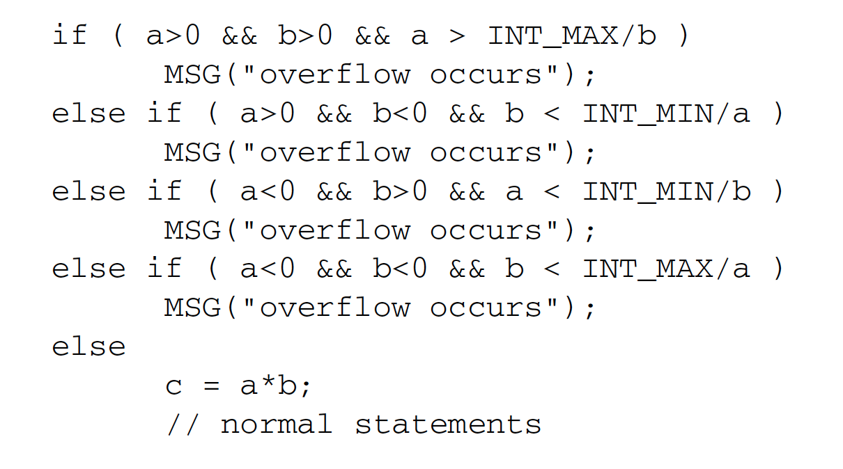
Input Validation
Precondition testing
Check prior to actual computation
Can circumvent compiler optimization
But overhead is non-trivial
Notes:
Another popular way to check overflow is the precondition test. It checks whether a times b may overflow before the actual multiplication, therefore, it can circumvent compiler optimization. However, in order to make a comprehensive check, at least four extra statements are inserted for each signed integer operation. And this introduces a non-trivial performance overhead.

Slide 10
Motivation
Fixing IO2BO is tedious and error-prone.
Some programmers might not be aware of integer overflow.
Even for programmers who are aware of integer overflow, fixing it manually can be error-prone and complicated.
Notes:
Now let’s talk about the motivation behind intpatch. The main motivation behind developing IntPatch is fixing IO2BO can be very tedious and error-prone. Some programmers might not even be aware of the integer overflow problem. Even for programmers who are aware of this problem, they need to be very careful to not make a mistake while fixing the issue.

Slide 11
Awareness of IO2BO
Many programmers are not aware of integer overflows and IO2BO.
Code from Dillo version 2.1
Notes:
So here are some examples. This code snippet in Dillo version 2.1 checks whether the value of picture width times the picture height becomes too large. However, the existence of integer overflows completely changes the program logic. If the result becomes too large, its value gets wrapped and usually becomes a very small value, then this check is not violated so it can’t handle overflow problems.

Slide 12
Fixing IO2BO can be error-prone
For programmers who are aware of integer overflows, fixing it is still error-prone.
Code from CUPS version 1.3.9
Notes:
For developers who are aware of integer overflows, fixing it is still error-prone. In this code snippet, the original vulnerability is that the expression in the blue box may overflow. And this if statement meant to fix the vulnerability. But, if img->ysize * 3 already overflows, then both bufsize and img->ysize times 3 use an overflowed value, and the result of bufsize divided by img->ysize*3 would still be equal to img->xsize. So this if check becomes useless.

Slide 13
Use compilers to help
Fixing IO2BO appears to be too bothersome for programmers.
Good idea: eliminate IO2BO vulnerabilities at compile time.
Programmers don’t need to know what IO2BO is and how to fix them anymore
Notes:
So, as we mentioned in previous slides, fixing integer overflow is not an easy task for programmers. On the other hand, we can utilize compilers to fix IO2BO at compile time and programmers don’t need to worry about IO2BO anymore.

Slide 14
Type System and Analysis

Slide 15
Definition of Types
Defs:
Tainted:
A value is tainted if it originates from some program inputs
May-overflow:
A value is may-overflowed if it comes from an arithmetic operation that may overflow at runtime.
Four types of variables:
Untainted and non-overflow b(00)
Tainted and non-overflow b(10)
Untainted and may-overflow b(01)
Tainted and may-overflow b(11)
T11
T10
T01
T00

Slide 16
Assignment and Branch

Slide 17
Compare ops
T10: tainted and non-overflowed
Notes:
The comparison operation produces a boolean. So, it cannot overflow. But it can be tainted because of the operands. The left hand side of the AND is easy to take the upper bound of the two types. The AND operation is to do two things. First, we want to preserve “taintedness” if the upper bound is tainted. Second, since the value of the if statement is boolean, it may not overflow.

Slide 18
Partial arithmetic ops
Notes:
It is listed partial because not all operations can cause overflow issues. For example: adding a negative value to a positive value does not cause overflow issue. The key here is to consider the sign of the operations.

Slide 19
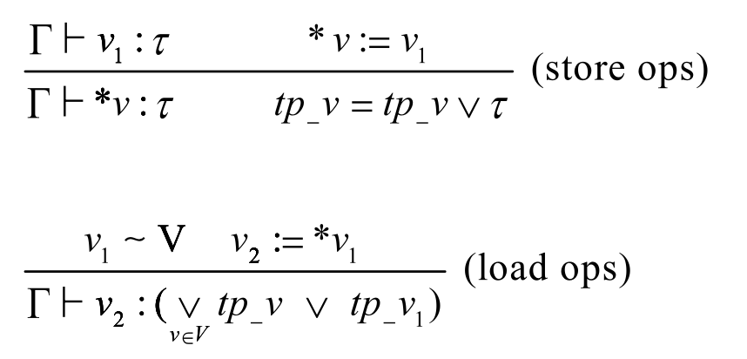
Load and store
1
M1
2
Notes:
Tp_v is the upper bound of the pointer v. It records all past types of the pointer’s content. The first equation states that the v1 with type tau is stored at location pointed by v*. After storing, we say that v* has type tau and OR tp_v, which is the possible type of the memory chunks pointed by v, with tau.
The second equation has two meanings. The first meaning is that if v2 loads the content pointed by v1, then v2 has the same type as v1 does. The second meaning is that if v1 is in a pointer set, ie one of the pointer points to the location, then v2 takes the upper bound of the types in the set.
One interesting thing about this is that v* was never used again in the type system. We are not entirely sure the reason of leaving it out.

Slide 20
Struct field access
Notes:
For instructions that access struct fields or array elements, the offset also have types. For example, when accessing an element of an array, the offset may be an expression related to program input, and thus it have the attribute taint.

Slide 21
Phi-node
Notes:
Phi-node is a control node. Since we don’t know which will be taken, we take the upper bound of all possible choices.

Slide 22
Methodology
Dataflow Analysis
Backward Slicing Analysis
Runtime check statements insertion
Notes:
The method can be divided into three steps, dataflow analysis, backward slicing analysis and runtime check statements insertion

Slide 23
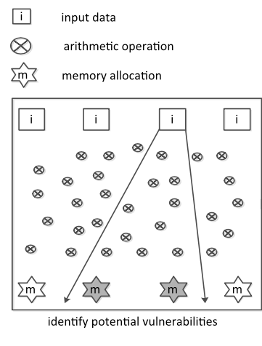
Dataflow Analysis
Tainted data comes from the input (source)
Arithmetic operation propagates the tainted data
Memory allocation (sink) consumes the tainted data and leads to the overflow vulnerabilities
Notes:
First, dataflow analysis. This is the most interesting part of the story. So the tainted data comes from the user input, typically a file. The arithmetic operation propagates the tainted data, because the results of arithmetic operations may be overflow. Memory allocation consumes the tainted data and leads to the overflow vulnerabilities, so that's where the integer overflow causes buffer overflow problem.

Slide 24
Dataflow Analysis
Similar to the reaching def analysis
Initialize the type of the input value to be "tainted"
Fixed point algorithm:
initialize to default
while there are still changes, iterate
infer the type for all operations
SSA makes it easy
Notes:
The algorithm of this dataflow analysis is quite similar to the reaching def analysis. We will assign each operation, or value, since its in SSA form, with a type. Then we apply the fixed point algorithm, where we iterates the inference process until we hit the stable state. The SSA makes the process easy since all values can only be defined once so its type is static throughout the whole analysis.

Slide 25
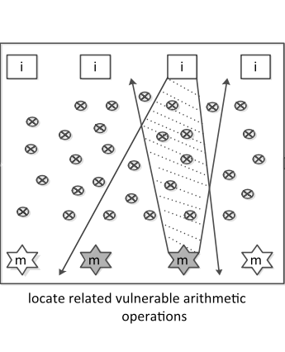
Backward Slicing
Only memory allocation can create vulnerability
Reduce false positive by excluding the arithmetic operations that never reach any memory allocation
Notes:
Since only memory allocation can create buffer overflow vulnerability, we can ignore the arithmetic operations that never reach any memory allocation. This way we can reduce the patch size.

Slide 26
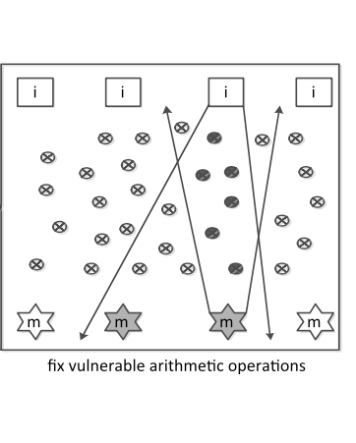
Runtime check statements Insertion
If runtime overflow occurs at checkpoints, redirect to error handler
Notes:
Finally, for all tainted arithmetic operations, we insert check statements that redirect to error handler if runtime overflow happens.

Slide 27
Evaluation
Overhead:
Bugs detected:

Slide 28
Thanks for listening

