Slide 1
Group 8
Optimal Partial Redundancy Elimination
Yinhua Yang, Yujie Liu, Shengrong Xu, Zhifan Xue
Briggs, Preston, and Keith D. Cooper. "Effective partial redundancy elimination." ACM SIGPLAN Notices 29.6 (1994): 159-170.

Slide 2
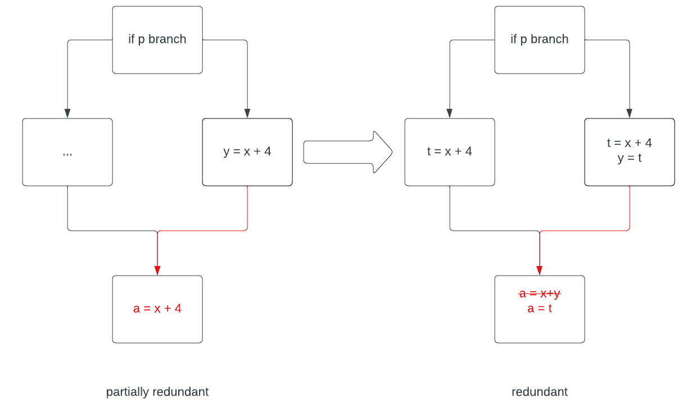
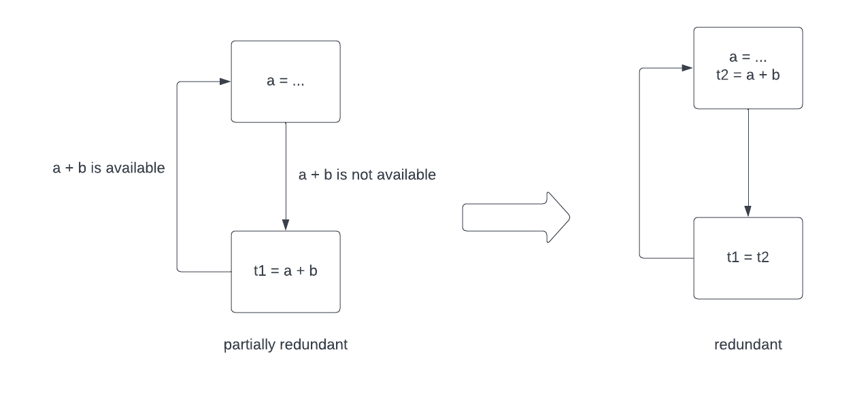
Basic PRE
Partial-redundant:
An expression is partially-redundant at point p if it is redundant along some paths that reaches p
Combination and extension of CSE and LICM
PRE converts partially-redundant expressions in to fully redundant expression, then CSE and LICM

Slide 3
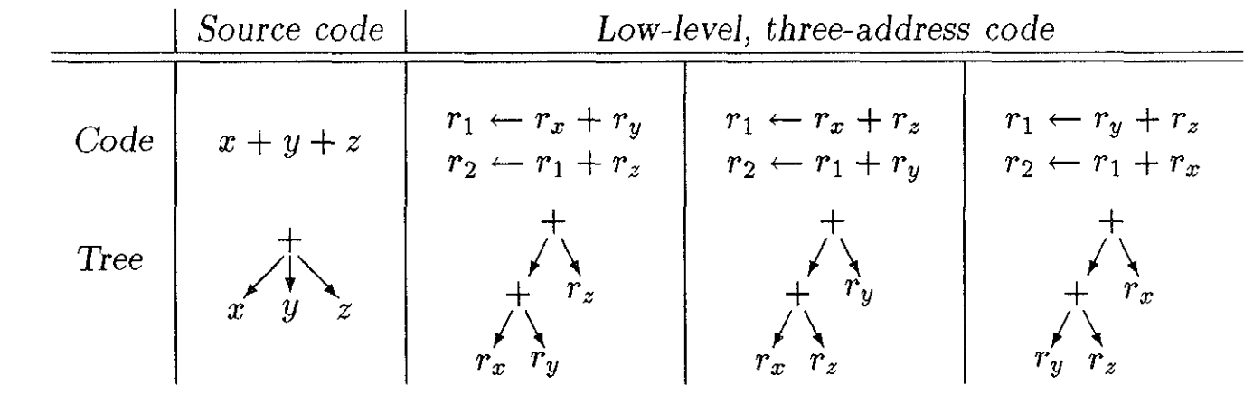
Limitations - code shape
Compiler optimizer uses low-level intermediate language.
Different code shapes limites PRE’s ability of hoisting.
Precision of floating-point arithmetic restrict possible ordering.
Larger number of possible variable ordering makes exhaustive search for optimal solution impractical.
1
2
3

Slide 4
Limitations - Naming
Variable name -> target of a copy instruction, corresponding to source level assignments
Expression name -> target of a computation, an instruction other than branch and copy
Lexically-identical expression always receive the same name
Uses hash table to record expression and its name
Can not eliminate different names with same value
r1 = ry +rz , ra = ry, r2 = ra+rz
Difficult to maintaining naming rules across other optimizations
Running PRE multiple times might introduce over-optimization and new errors
PRE must be run first and only once
x = y + z
a = y
b = a +z
r1 = ry + rz r1 -> name of expression
rx = r1 rx -> name of variable
ra = ry ra->name of variable
r2 = ra + rz r2 -> name of expression
rb = r2 rb -> name of variable

Slide 5
Improvements
Global Reassociation
Modify the code shape for optimal computation association
Make expressions fully redundant
Global Renaming
Fix the naming association modified by global reassociation

Slide 6
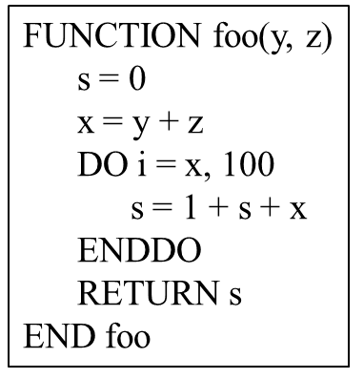
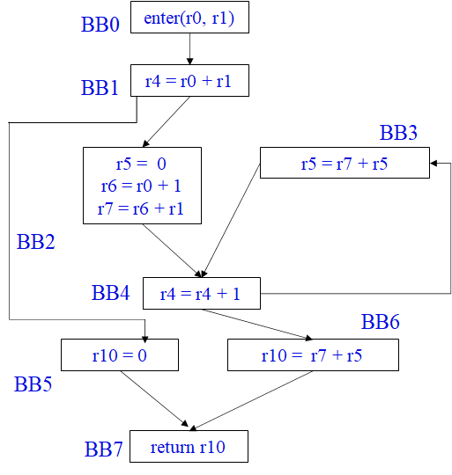
Global Reassociation
Steps:
Compute a rank for each expression
Propagate expressions forward to their uses
Reassociate expressions, sorting their operands by ranks

Slide 7
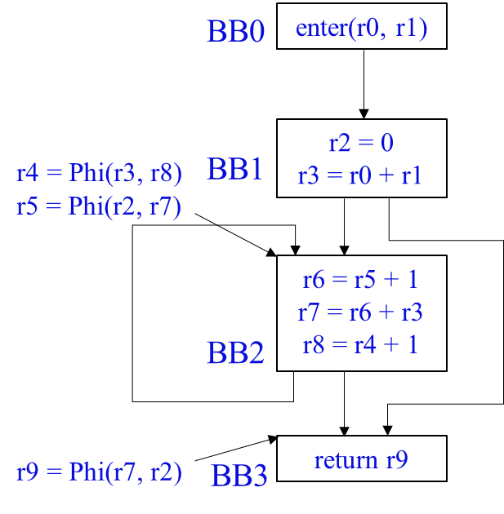
Global Reassociation
Steps:
Compute a rank for each expression
Propagate expressions forward to their uses
Reassociate expressions, sorting their operands by ranks

Slide 8
Global Reassociation
Compute a rank for each expression
Requirements:
Loop-invariant expressions have lower ranks than loop-variant ones
Nested loops: r (invariant inner two) < r (invariant only one innermost)
Steps:
Build the pruned SSA form and rename variables
Phi nodes are only needed for variables that are “live” after the Phi node
Assign ranks
Assign each block a rank as visited: r(1st block) = 1, r(2nd block) = 2…
Assign each expression:
r(constant) = 0
Phi-node/any variable modified by procedure (including load) receives the rank of the block
An expression receives a rank equal to its highest-ranked operand

Slide 9
Global Reassociation
expression | rank
r0 | 1
r1 | 1
r2 | 0
r3 | 1
r4 | 2
r5 | 2
r6 | 2
r7 | 2
r8 | 2
r9 | 3
Compute a rank for each expression

Slide 10
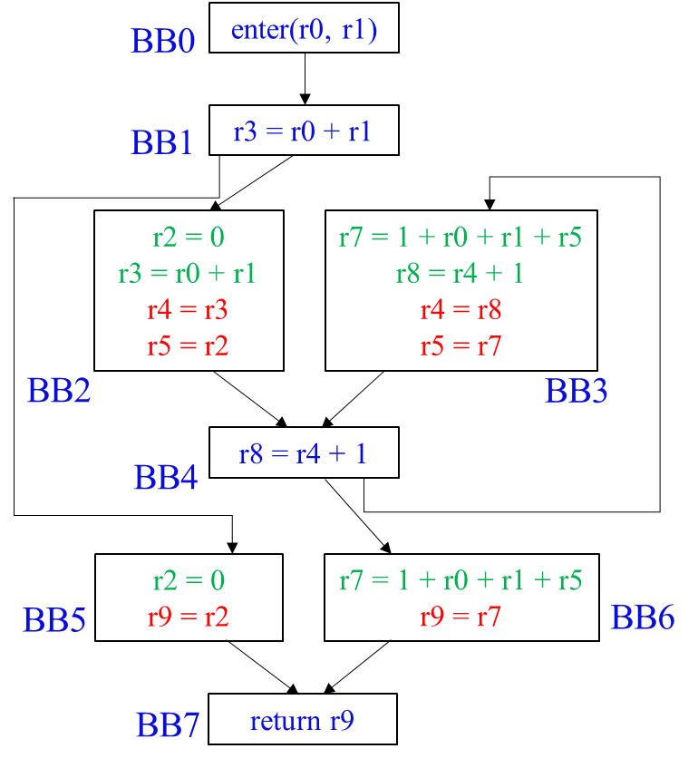
Global Reassociation
Steps:
Compute a rank for each expression
Propagate expressions forward to their uses
Reassociate expressions, sorting their operands by ranks

Slide 11
Global Reassociation
Propagate expressions forward to their uses
Remove Phi nodes by inserting copies at the end of appropriate predecessor blocks and propagate each expression and subexpression as far forward as possible
Steps
Remove each Phi node x = Phi(y, z) by inserting the copies x = y and x = z
Trace from each copy back along the SSA graph (new blocks required) to construct expression trees
Check the uses and push expressions
Importance
Build large expressions from small expressions → more scope for reassociation
Compilers have to cycle to ensure best results without forward propagation into loops
Avoid the distinction between variable names and expression names → correctness
Notes:
PRE will never place an expression on a path where it is partially dead, without forward propagation into loops, the compiler would have to cycle between reassociation and PRE to ensure best results with deeply-nested loops
trivially ensures that every expression is used on every path to an exit

Slide 12
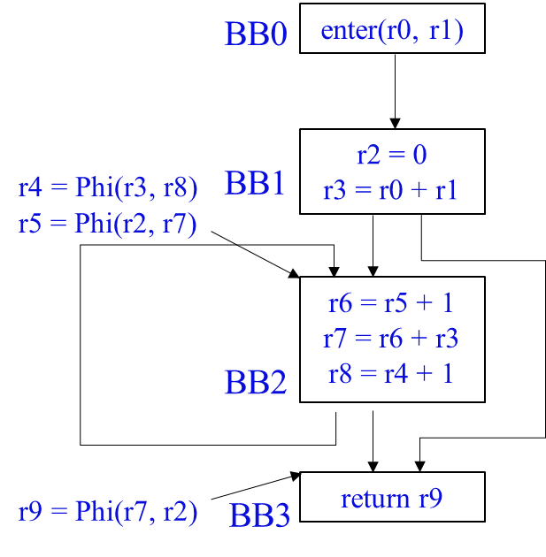
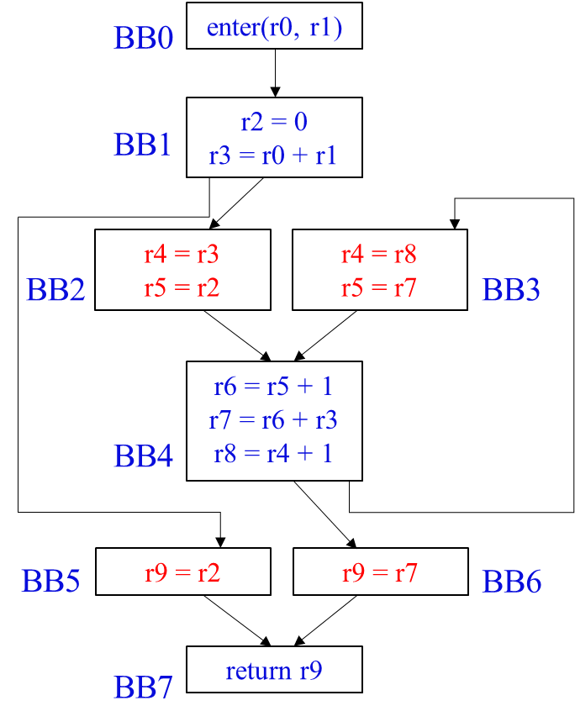
Global Reassociation
Propagate expressions forward to their uses — inserting

Slide 13
Global Reassociation
Propagate expressions forward to their uses — forward propagating
Notes:
Check uses

Slide 14
Global Reassociation
Steps:
Compute a rank for each expression
Propagate expressions forward to their uses
Reassociate expressions, sorting their operands by ranks

Slide 15
Global Reassociation
Sorting and reassociate expressions
Rewrite certain operations based on associativity
x - y + z x + (-y) + z
y/x y * (1/x)
Sort the operands of each associative operation by rank
1 + r0 + 3 1 + 3 + r0 4 + r0 (constant propagation)
Result
r7 = 1 + r0 + r1 + r5
r8 = r4 + 1
r4 = r8
r5 = r7
ra = r0 + 1
rb = ra + r1
r7 = rb + r5
r8 = r4 + 1
r4 = r8
r5 = r7
r7 = 1 + r0 + r1 + r5
r9 = r7
ra = r0 + 1
rb = ra + r1
rc = rb + r5
r9 = r7

Slide 16
Global Renaming
Uses technique based on Alpen, Wegman, and Zadeck’s “detecting equality of variables in programs^{[1]}.”
Each lexically-identical expression will have the same name
copies inserted during reassociation will only target the original variable names
Result
ra = r0 + 1
rb = ra + r1
r7 = rb + r5
r8 = r4 + 1
r4 = r8
r5 = r7
r6 = r0 + 1
r7 = r6 + r1
r8 = r7 + r5
r9 = r4 + 1
r4 = r9
r5 = r8
ra = r0 + 1
rb = ra + r1
r7 = rb + r5
r9 = r7
r6 = r0 + 1
r7 = r6 + r1
r8 = r7 + r5
r10 = r8
[1] Bowen Alpern, Mark N. Wegman, and F. Kenneth Zadeck. Detecting equality of variables in programs. In Conference Record of the Ftfteenth Annual ACM Synl-poswrn on Principles of Programming Languages, pages 1-11, San Diego, California, January 1988.

Slide 17
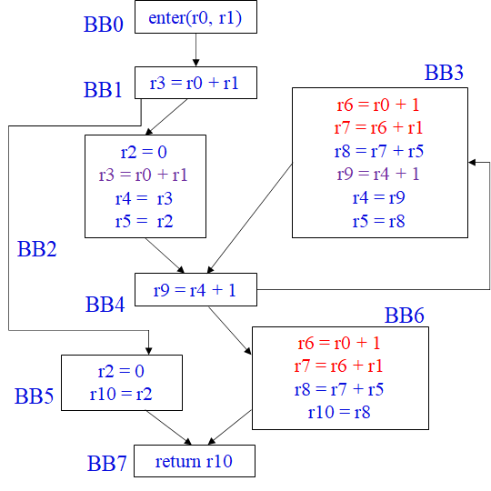
Global Renaming
Can be hoisted
redundant

Slide 18
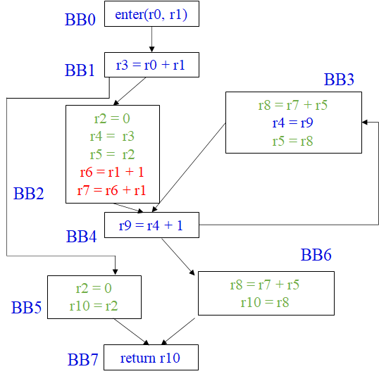
Applying PRE
Hoisted instruction
Unnecessary copies

Slide 19
Coalescing
Coalesce with Chaitin-style global register allocator method
Introduced in “Register allocation via coloring”^{[2]}
Removed all copies in this case (not always true!)
[2] Gregory J. Chaitin, Marc A. Auslander, Ashok K.Chandra, John Cocke, Martin E. Hopkins, and Pe-ter W. Markstein. Register allocation via coloring. Conlputer Languages, 6:47-57, January 1981.

Slide 20
Experimental Study and Results
An experimental FORTRAN compiler
FORTRAN —> ILOC —> ILOC —> C (dynamic counts)
baseline: after optimization passes
partial: after PRE followed by baseline
reassociation & distribution: after global reassociation and global value numbering before PRE
new: improvement over partial contributed by reassociation and distribution
total: improvement over the baseline by the entire set of optimization
Notes:
To test the effectiveness of these optimization techniques mentioned above, the authors implemented versions of global reassociation, global value numbering, and PRE in the context of an experimental FORTRAN compiler. The compiler is structured as a front end, an optimizer and a back end. The front end consumes the programming language FORTRAN and produces the intermediate language lLOC, the optimizer consumes and produces lLOC, and the back end consumes ILOC and produces C while C code is instrumented to accumulate dynamic counts of the ILOC operations. The authors ran several versions of the optimizer on 50 test routines. Each version adds new passes to the previous one. The first version is baseline which provides the dynamic operation count, including branches, for each routine optimized using a sequence of global constant propagation, global peephole optimization, global dead code elimination, coalescing, and a final pass to eliminate empty basic blocks. The second one is partial that provides the operation counts for routines optimized with PRE, followed by the sequence of optimizations used to establish the baseline. The third and last version reassociation and distribution both gives the operation counts for routines optimized using global reassociation and global value numbering before PRE and the other optimizations. But reassociation does not include distribution of multiplication over addition, while distribution does. And the percentage at the right in each version is the percentage improvements over the previous version. The total column gives the percentage improvements achieved over the baseline by the entire set of optimization, while the new column gives the improvement over partial contributed by the combination of reassociation and distribution with global value numbering. So the table here extract seven routines and their results, which we can see the optimization techniques successfully reduce the operation counts for most of the routines.

Slide 21
Code Degradation and Limitations
Three Sources of Difficulty
Reassociation – disguise common sub expressions.
Distribution – distribution of multiplication over addition cause problems in some cases.
Forward Propagation – code degradation if expressions are moved into loops – invariant but unable to be hoisted by PRE
Notes:
However, the results in this table also extracted from the 50 routines, reveal several cases where the “improvements” actually slowed down the code. Since we are using heuristic approaches to difficult problems, we should not be surprised by occasional losses, annoying as they are. After examination, these degraded code revealed three sources of difficulty. They are Reassociation, Distribution and Forward Propagation.
The optimizer is not complete. In particular, it is missing passes for strength reduction and hash-based value numbering, Nevertheless, the authors still believe their results are valid indications of the importance of reassociation. And it is not hard to see from the fact that this paper is top referenced in the study of PRE over the decades.

