Slide 1
EECS 583 – Automatic Parallelization Via
Decoupled Software Pipelining
University of Michigan
April 10, 2023

Slide 2
Parallelization: Scientific vs Non-Scientific Codes
Scientific Codes (FORTRAN-like)
General-purpose Codes (legacy C/C++)
for(i=1; i<=N; i++) // C
a[i] = a[i] + 1; // X
while(ptr = ptr->next) // LD
ptr->val = ptr->val + 1; // X
Core 1
Core 2
Core 1
Core 2
Independent
Multithreading
(IMT)
Example: DOALL
parallelization
Cyclic Multithreading
(CMT)
Example: DOACROSS
[Cytron, ICPP 86]
0
0
C:1
C:2
LD:1
1
1
X:1
X:2
X:1
LD:2
2
2
C:3
C:4
LD:3
X:2
3
3
X:3
X:4
X:3
LD:4
4
4
C:5
C:6
LD:5
X:4
5
5
X:5
X:6
X:5
LD:6
Notes:
1

Slide 3
Alternative Parallelization Approaches
while(ptr = ptr->next) // LD
ptr->val = ptr->val + 1; // X
Core 1
Core 2
Core 1
Core 2
Cyclic
Multithreading
(CMT)
Pipelined
Multithreading (PMT)
Example: DSWP
[PACT 2004]
0
0
LD:1
LD:1
1
1
X:1
LD:2
LD:2
X:1
2
2
LD:3
X:2
LD:3
X:2
3
3
X:3
LD:4
LD:4
X:3
4
4
LD:5
X:4
LD:5
X:4
5
5
X:5
LD:6
LD:6
X:5
Notes:
2

Slide 4
Comparison: IMT, PMT, CMT
IMT
PMT
CMT
Core 1
Core 2
Core 1
Core 2
Core 1
Core 2
0
0
0
C:1
C:2
LD:1
LD:1
1
1
1
X:1
X:2
LD:2
X:1
2
2
2
C:3
C:4
LD:3
X:1
LD:2
3
3
3
X:3
X:4
LD:4
X:2
X:2
4
4
4
C:5
C:6
LD:5
X:3
LD:3
5
5
5
X:5
X:6
LD:6
X:4
X:3
lat(comm) = 1:
1 iter/cycle
1 iter/cycle
1 iter/cycle
lat(comm) = 2:
1 iter/cycle
1 iter/cycle
0.5 iter/cycle
Notes:
3

Slide 5
Comparison: IMT, PMT, CMT
Thread-local Recurrences ➔ Fast Execution
IMT
PMT
CMT
Core 1
Core 2
Core 1
Core 2
Core 1
Core 2
0
0
0
C:1
C:2
LD:1
LD:1
1
1
1
X:1
X:2
LD:2
X:1
2
2
2
C:3
C:4
LD:3
X:1
LD:2
3
3
3
X:3
X:4
LD:4
X:2
X:2
4
4
4
C:5
C:6
LD:5
X:3
LD:3
5
5
5
X:5
X:6
LD:6
X:4
X:3
Cross-thread Dependences ➔ Wide Applicability
Notes:
4

Slide 6
Decoupled Software Pipelining

Slide 7
[MICRO 2005]
Decoupled Software Pipelining (DSWP)
A: while(node)
B: ncost = doit(node);
C: cost += ncost;
D: node = node->next;
Dependence
Graph
D
DAG_{SCC}
A D
Thread 1
Thread 2
A
A
B
B
D
B
C
C
C
register
control
intra-iteration
loop-carried
Inter-thread communication
latency is a one-time cost
communication queue
Notes:
6

Slide 8
Implementing DSWP
L1:
DFG
Aux:
register
control
memory
intra-iteration
loop-carried
Notes:
Choose a valid partitioning
Goals: balance load, reduce sync
Transform the code

Slide 9
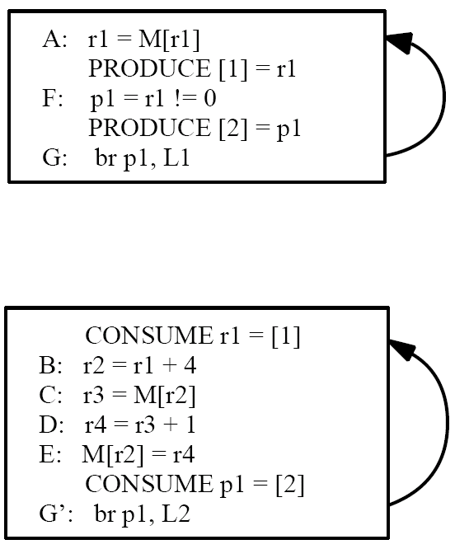
Optimization: Node Splitting
To Eliminate Cross Thread Control
L1
L2
register
control
memory
intra-iteration
loop-carried

Slide 10
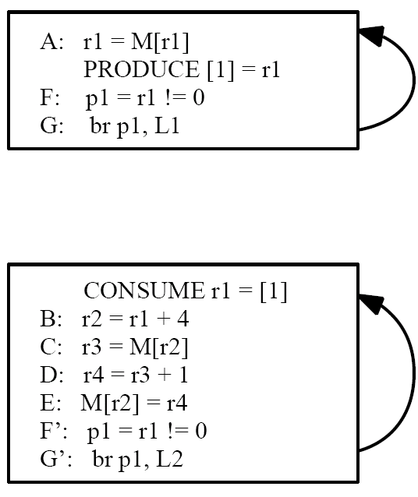
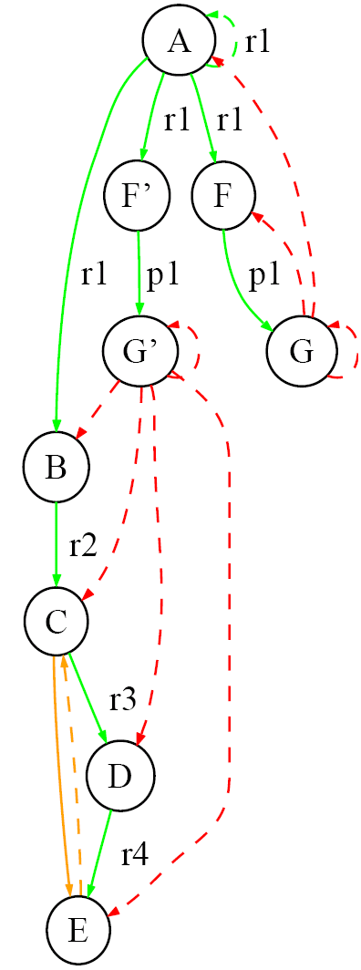
Optimization: Node Splitting To Reduce Communication
L1
L2
register
control
memory
intra-iteration
loop-carried

Slide 11
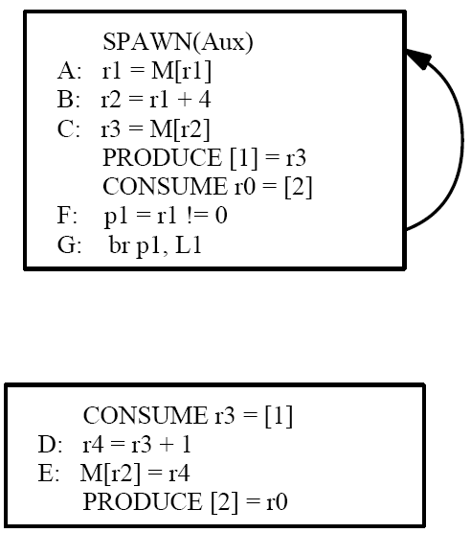
Constraint: Strongly Connected Components
Consider:
Solution: DAG_{SCC}
register
control
memory
Eliminates pipelined/decoupled property
intra-iteration
loop-carried
Notes:
Choose a valid partitioning
Goals: balance load, reduce sync
Transform the code

Slide 12
Speculation – Break Statistically Unlikely Dependences
A: while(node)
B: ncost = doit(node);
C: cost += ncost;
D: node = node->next;
Dependence
Graph
DAG_{SCC}
A D
D
A
B
B
register
C
C
control
intra-iteration
loop-carried
communication queue

Slide 13
Why Speculation?
A: while(cost < T && node)
B: ncost = doit(node);
C: cost += ncost;
D: node = node->next;
Dependence
Graph
DAG_{SCC}
A D
D
B
A
B
A B C D
register
C
C
control
intra-iteration
Predictable
Dependences
loop-carried
communication queue

Slide 14
Why Speculation?
A: while(cost < T && node)
B: ncost = doit(node);
C: cost += ncost;
D: node = node->next;
Dependence
Graph
DAG_{SCC}
D
D
B
A
B
C
register
C
control
intra-iteration
Predictable
Dependences
A
loop-carried
communication queue

Slide 15
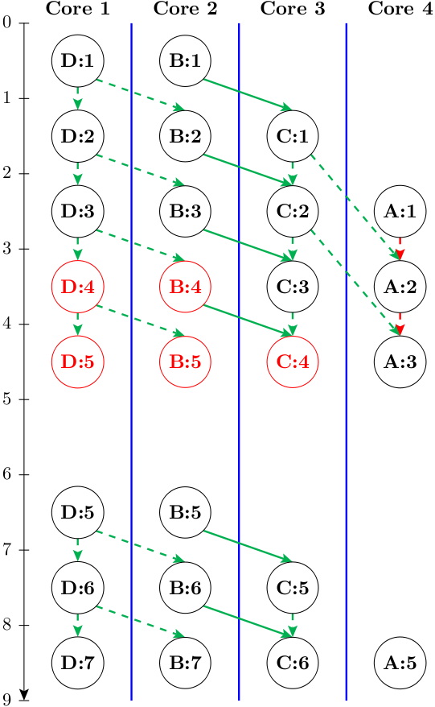
Execution Paradigm
DAG_{SCC}
D
B
Misspeculation
detected
C
Misspeculation Recovery
Rerun Iteration 4
A
register
control
intra-iteration
loop-carried
communication queue
Notes:
14

Slide 16
Evaluation: Dual Core vs Single Core
Notes:
- They selected important benchmark loops, corresponding from 16 to 98% of the total benchmark execution time, and here are the resulting loop speedups compared to the single-threaded baseline.
- DSWP obtained speedups of up to 45% on the selected loops, with a geometric mean of about 17%.
- For 2 benchmarks, the resulting code runs slower, probably because of the difficulty in statically estimating the resulting performance of different partitionings in the compiler.

Slide 17
References
“Automatic Thread Extraction with Decoupled Software Pipelining,” G. Ottoni, R. Rangan, A. Stoler, and D. I. August, Proceedings of the 38th IEEE/ACM International Symposium on Microarchitecture, Nov. 2005
“Revisiting the Sequential Programming Model for Multi-Core,” M. J. Bridges, N. Vachharajani, Y. Zhang, T. Jablin, and D. I. August, Proc 40th IEEE/ACM International Symposium on Microarchitecture, December 2007.

