Slide 1

EECS 583 – Class 3
Region Formation, Predicated Execution
University of Michigan
January 11, 2023

Slide 2

Announcements & Reading Material
HW0 due today – Remember nothing to turn in
HW1 is out – Due Monday Jan 23
  http://web.eecs.umich.edu/~mahlke/courses/583w23/homeworks
Today’s class
  “Trace Selection for Compiling Large C Applications to Microcode”, Chang and Hwu, MICRO-21, 1988.
  “The Superblock: An Effective Technique for VLIW and Superscalar Compilation”, Hwu et al., Journal of Supercomputing, 1993
Material for Monday
  “The Program Dependence Graph and Its Use in Optimization”,
  J. Ferrante, K. Ottenstein, and J. Warren, ACM TOPLAS, 1987
    This is a long paper – the part we care about is the control dependence stuff. The PDG is interesting and you should skim it
    “On Predicated Execution”, Park and Schlansker, HPL Technical Report, 1991.

Slide 3
Homework 1 – Due Mon Jan 23
Get started ASAP. If you haven’t done HW0, you are falling behind!
Goals: Learn how to profile with LLVM, write stats collection pass
583_W23_HW1.tgz
  hw1pass.cpp: template for your pass
  583simple, 583wc, 583compress: benchmark source code + inputs + expected outputs + run instructions
Easy to do, but hard to start because of newness
  Look for Aditya’s piazza post for help
    Skeleton code
    How to run profiler
    Simple example with opcode stats
  Talk to the GSI if you are stuck

Slide 4
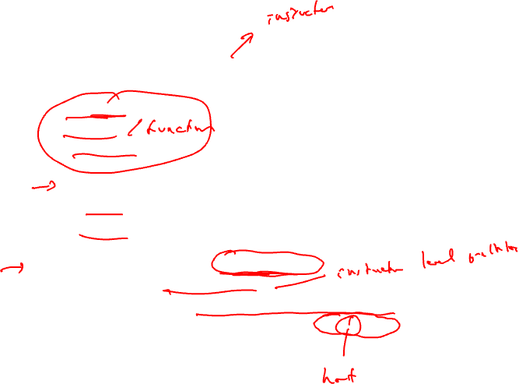
Regions
Region: A collection of operations that are treated as a single unit by the compiler
  Examples
    Basic block
    Procedure
    Body of a loop
  Properties
    Connected subgraph of operations
    Control flow is the key parameter that defines regions
    Hierarchically organized
Problem
  Basic blocks are too small (3-5 operations)
    Hard to extract sufficient parallelism
  Procedure control flow too complex for many compiler xforms
    Plus only parts of a procedure are important (90/10 rule)

Slide 5

Regions (2)
Want
  Intermediate sized regions with simple control flow
  Bigger basic blocks would be ideal !!
  Separate important code from less important
  Optimize frequently executed code at the expense of the rest
Solution
  Define new region types that consist of multiple BBs
  Profile information used in the identification
  Sequential control flow (sorta)
  Pretend the regions are basic blocks

Slide 6
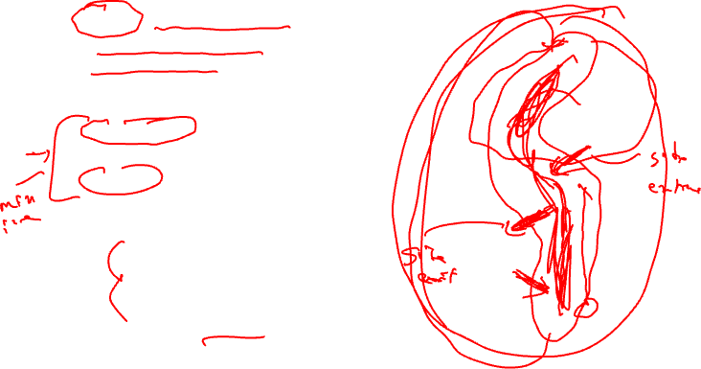
Region Type 1 - Trace
Trace - Linear collection of basic blocks that tend to execute in sequence
  “Likely control flow path”
  Acyclic (outer backedge ok)
Side entrance – branch into the middle of a trace
Side exit – branch out of the middle of a trace
Compilation strategy
  Compile assuming path occurs 100% of the time
  Patch up side entrances and exits afterwards
Motivated by scheduling (i.e., trace scheduling)
10
BB1
90
80
20
BB2
BB3
80
20
BB4
10
BB5
90
10
BB6
10

Slide 7
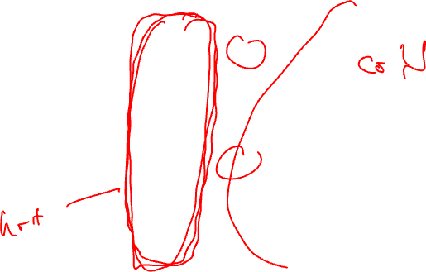
Linearizing a Trace
10 (entry count)
BB1
80
20 (side exit)
90 (entry/
exit count)
BB2
BB3
80
20 (side entrance)
BB4
10 (side exit)
90
BB5
10 (side entrance)
BB6
10 (exit count)

Slide 8
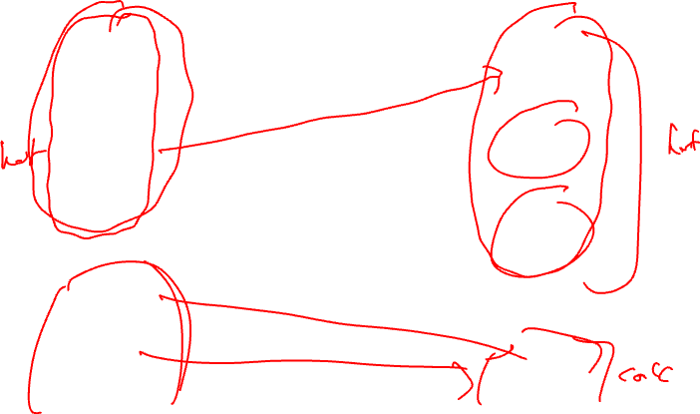
Intelligent Trace Layout for Icache Performance
BB1
Intraprocedural code placement
Procedure positioning
Procedure splitting
trace1
BB2
trace 2
BB4
BB6
trace 3
BB3
BB5
The rest
Trace view
Procedure view

Slide 9
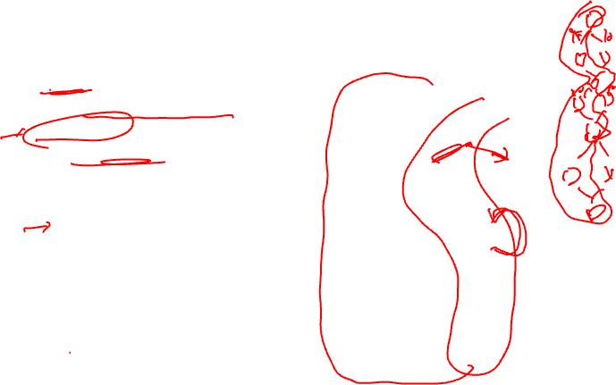
Issues With Selecting Traces
Acyclic
  Cannot go past a backedge
Trace length
  Longer = better ?
  Not always !
On-trace / off-trace transitions
  Maximize on-trace
  Minimize off-trace
  Compile assuming on-trace is 100% (ie single BB)
  Penalty for off-trace
Tradeoff (heuristic)
  Length
  Likelihood remain within the trace
10
BB1
90
80
20
BB2
BB3
80
20
BB4
10
BB5
90
10
BB6
10

Slide 10

Trace Selection Algorithm
i = 0;
mark all BBs unvisited
while (there are unvisited nodes) do
seed = unvisited BB with largest execution freq
trace[i] += seed
mark seed visited
current = seed
/* Grow trace forward */
while (1) do
next = best_successor_of(current)
if (next == 0) then break
trace[i] += next
mark next visited
current = next
endwhile
/* Grow trace backward analogously */
i++
endwhile

Slide 11
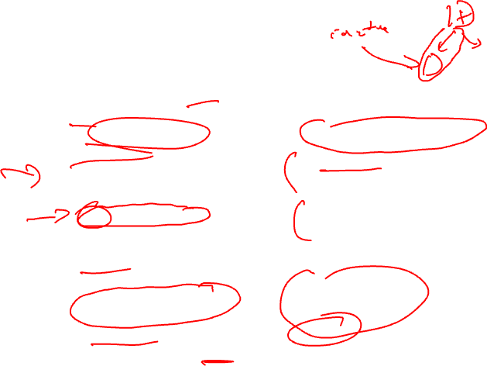
Best Successor/Predecessor
Node weight vs edge weight
  edge more accurate
THRESHOLD
  controls off-trace probability
  60-70% found best
Notes on this algorithm
  BB only allowed in 1 trace
  Cumulative probability ignored
  Min weight for seed to be chose (ie executed 100 times)
best_successor_of(BB)
e = control flow edge with highest
probability leaving BB
if (e is a backedge) then
return 0
endif
if (probability(e) <= THRESHOLD) then
return 0
endif
d = destination of e
if (d is visited) then
return 0
endif
return d
end procedure

Slide 12
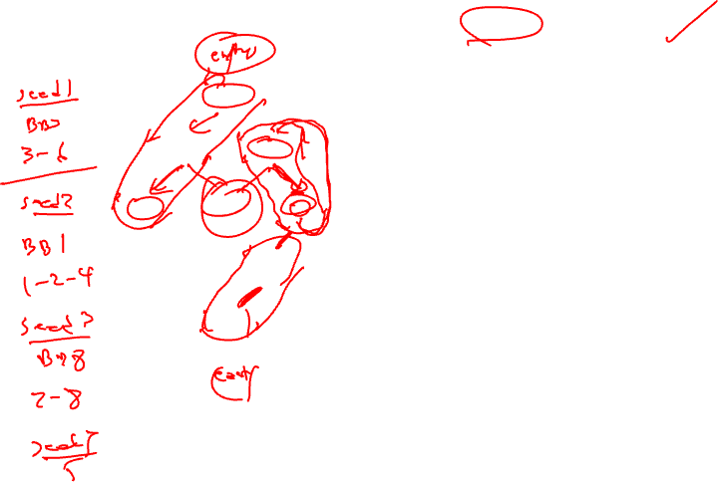
Example Problems
Find the traces. Assume a threshold probability of 60%.
100
100
BB1
BB1
20
60
40
80
BB2
BB3
BB2
BB3
50
10
5
135
100
20
80
BB4
BB5
BB6
BB4
25
51
49
15
35
BB7
BB5
BB6
25
10
75
41
BB8
BB7
BB8
49
450
100
41
10
BB9

Slide 13
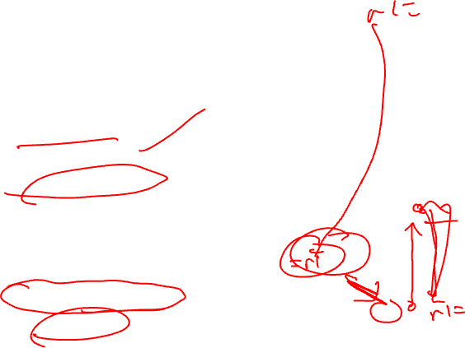
Traces are Nice, But …
Treat trace as a big BB
  Transform trace ignoring side entrance/exits
  Insert fixup code
    aka bookkeeping
  Side entrance fixup is more painful
  Sometimes not possible so transform not allowed
Solution
  Eliminate side entrances
  The superblock is born
10
BB1
90
80
20
BB2
BB3
80
20
BB4
10
BB5
90
10
BB6
10

Slide 14
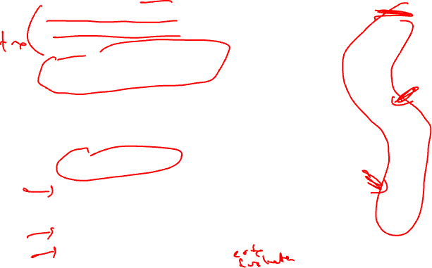
Region Type 2 - Superblock
Superblock - Linear collection of basic blocks that tend to execute in sequence in which control flow may only enter at the first BB
  “Likely control flow path”
  Acyclic (outer backedge ok)
  Trace with no side entrances
  Side exits still exist
Superblock formation
  1. Trace selection
  2. Eliminate side entrances
10
BB1
90
80
20
BB2
BB3
80
20
BB4
10
BB5
90
10
BB6
10

Slide 15
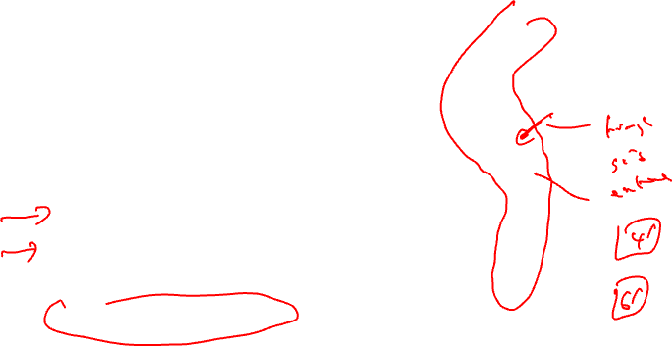
Tail Duplication
To eliminate all side entrances replicate the “tail” portion of the trace
  Identify first side entrance
  Replicate all BB from the target to the bottom
  Redirect all side entrances to the duplicated BBs
  Copy each BB only once
  Max code expansion = 2x-1 where x is the number of BB in the trace
  Adjust profile information
10
BB1
90
80
20
BB2
BB3
80
20
BB4
10
BB5
90
10
BB6
10

Slide 16
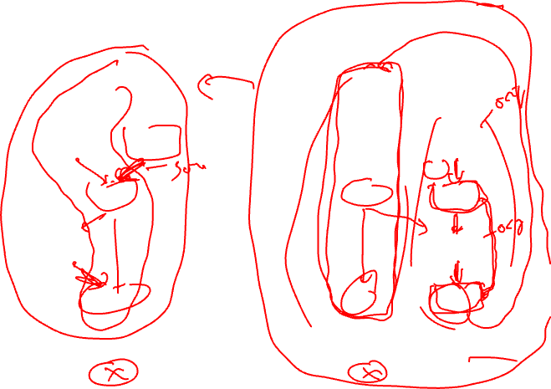
Superblock Formation
10
10
BB1
BB1
90
80
20
80
20
64.8
BB2
BB3
BB2
BB3
80
20
80
20
BB4
BB4
BB4’
18
10
8
Duplicate
BB4 and BB6
and adjust
control flow
72
2
BB5
90
BB5
10
10
BB6
BB6
BB6’
7.2
10
2.8
25.2

Slide 17
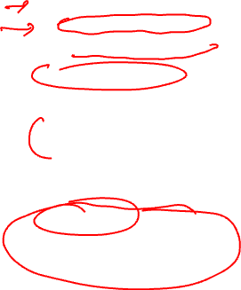
Issues with Superblocks
Central tradeoff
  Side entrance elimination
    Compiler complexity
    Compiler effectiveness
  Code size increase
Apply intelligently
  Most frequently executed BBs are converted to SBs
  Set upper limit on code expansion
  1.0 – 1.10x are typical code expansion ratios from SB formation
10
BB1
80
20
64.8
BB2
BB3
80
20
BB4
BB4’
18
8
72
2
BB5
10
BB6
BB6’
7.2
2.8
25.2

Slide 18
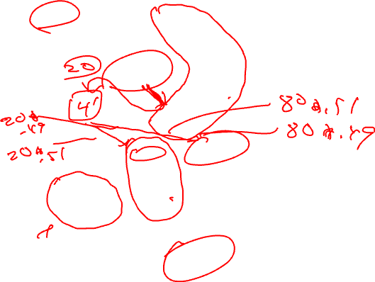
Class Problem
Create the superblocks, trace
threshold is 60%
100
BB1
20
80
BB2
BB3
20
80
BB4
51
49
BB5
BB6
10
41
BB7
BB8
49
450
41
10
BB9

Slide 19

Class Problem Solution – Superblock Formation
To convert trace 1-3-4
into a superblock, BB4
is duplicated and the
edge weights are adjusted
100
100
Each color represents
a trace.
BB1
BB1
20
80
20
80
BB2
BB3
BB2
BB3
20
80
20
80
BB4
BB4’
9.8
BB4
51
49
40.8
39.2
10.2
BB5
BB6
BB5
BB6
10
10
41
41
49
BB7
BB8
49
450
BB7
BB8
450
41
41
10
10
BB9
Create the superblocks, trace
threshold is 60%
BB9

Slide 20
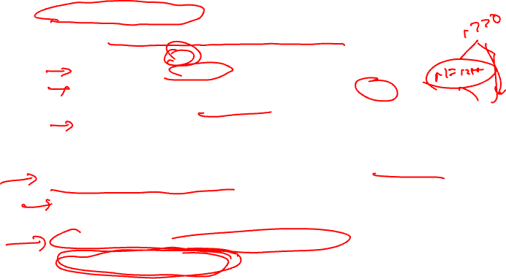
An Alternative to Branches: Predicated Execution
Hardware mechanism that allows operations to be conditionally executed
Add an additional boolean source operand (predicate)
  ADD r1, r2, r3 if p1
    if (p1 is True), r1 = r2 + r3
    else if (p1 is False), do nothing (Add treated like a NOP)
    p1 referred to as the guarding predicate
    Predicated on True means always executed
    Omitted predicated also means always executed
Provides compiler with an alternative to using branches to selectively execute operations
  If statements in the source
  Realize with branches in the assembly code
  Could also realize with conditional instructions
  Or use a combination of both

Slide 21
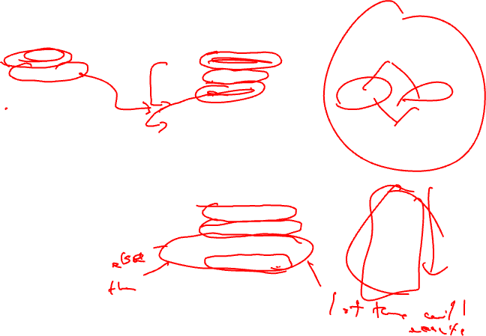
Predicated Execution Example
a = b + c
if (a > 0)
e = f + g
else
e = f / g
h = i - j
BB1
BB1
BB3
BB3
BB2
BB4
add a, b, c
bgt a, 0, L1
div e, f, g
jump L2
L1: add e, f, g
L2: sub h, i, j
BB1
BB2
BB3
BB4
Traditional branching code
BB1
BB1
BB1
BB3
BB2
BB4
add a, b, c if T
p2 = a > 0 if T
p3 = a <= 0 if T
div e, f, g if p3
add e, f, g if p2
sub h, i, j if T
BB1
BB2
BB3
BB4
p2 → BB2
p3 → BB3
Predicated code

Slide 22
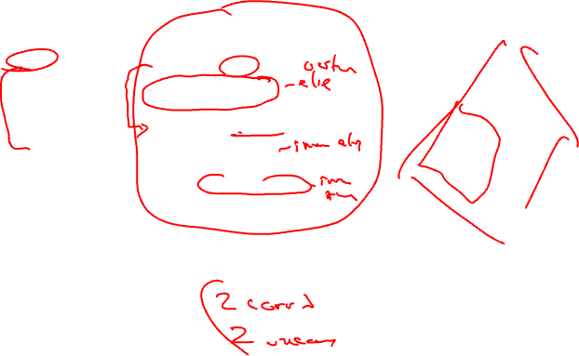
What About Nested If-then-else’s?
a = b + c
if (a > 0)
if (a > 25)
e = f + g
else
e = f * g
else
e = f / g
h = i - j
BB1
BB1
BB3
BB3
BB2
BB6
BB6
BB5
BB4
add a, b, c
bgt a, 0, L1
div e, f, g
jump L2
L1: bgt a, 25, L3
mpy e, f, g
jump L2
L3: add e, f, g
L2: sub h, i, j
BB1
BB2
BB3
BB5
BB6
BB4
Traditional branching code

Slide 23
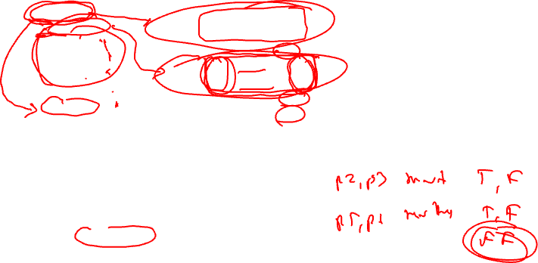
Nested If-then-else’s – No Problem
a = b + c
if (a > 0)
if (a > 25)
e = f + g
else
e = f * g
else
e = f / g
h = i - j
BB1
BB1
BB1
BB3
BB3
BB3
BB6
BB5
BB4
add a, b, c if T
p2 = a > 0 if T
p3 = a <= 0 if T
div e, f, g if p3
p5 = a > 25 if p2
p6 = a <= 25 if p2
mpy e, f, g if p6
add e, f, g if p5
sub h, i, j if T
BB1
BB2
BB3
BB4
BB5
BB6
Predicated code
What do we assume to make this work ??
if p2 is False, both p5 and p6 are False
So, predicate setting instruction should set result to False if guarding
predicate is false!!!

Slide 24
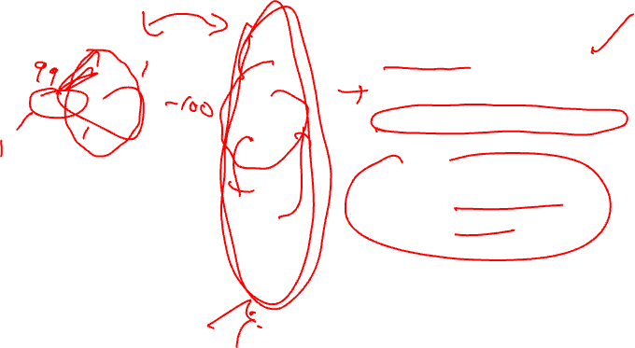
Benefits/Costs of Predicated Execution
BB1
BB1
BB2
BB3
BB4
BB5
BB6
BB7
Benefits:
- No branches, no mispredicts
- Can freely reorder independent
operations in the predicated block
- Overlap BB2 with BB5 and BB6
Costs (execute all paths)
worst case schedule length
worst case resources required
BB2
BB3
BB4
BB5
BB6
BB7

Slide 25
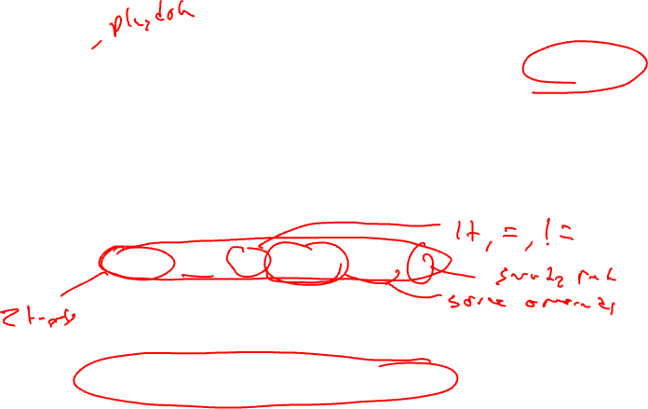
HPL-PD Compare-to-Predicate Operations (CMPPs)
How do we compute predicates
  Compare registers/literals like a branch would do
  Efficiency, code size, nested conditionals, etc
2 targets for computing taken/fall-through conditions with 1 operation
p1, p2 = CMPP.cond.D1a.D2a (r1, r2) if p3
p1 = first destination predicate
p2 = second destination predicate
cond = compare condition (ie EQ, LT, GE, …)
D1a = action specifier for first destination
D2a = action specifier for second destination
(r1,r2) = data inputs to be compared (ie r1 < r2)
p3 = guarding predicate

Slide 26
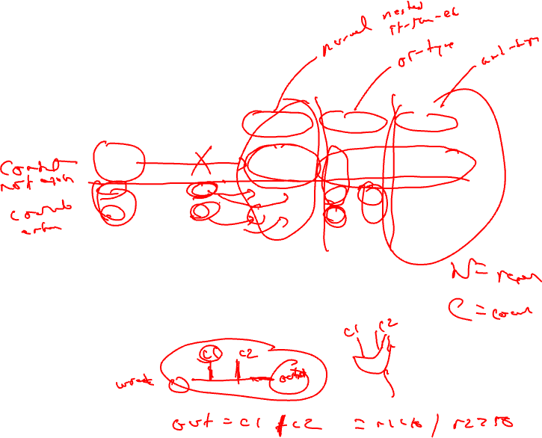
CMPP Action Specifiers
Guarding
predicate
0
0
1
1
Compare
Result
0
1
0
1
UN
0
0
0
1
UC
0
0
1
0
ON
-
-
-
1
OC
-
-
1
-
AN
-
-
0
-
AC
-
-
-
0
UN/UC = Unconditional normal/complement
This is what we used in the earlier examples
guard = 0, both outputs are 0
guard = 1, UN = Compare result, UC = opposite
ON/OC = OR-type normal/complement
AN/AC = AND-type normal/complement

Slide 27
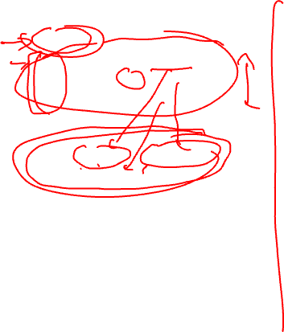
OR-type, AND-type Predicates
p1 = 0
p1 = cmpp_ON (r1 < r2) if T
p1 = cmpp_OC (r3 < r4) if T
p1 = cmpp_ON (r5 < r6) if T
p1 = (r1 < r2) | (!(r3 < r4)) |
(r5 < r6)
Wired-OR into p1
p1 = 1
p1 = cmpp_AN (r1 < r2) if T
p1 = cmpp_AC (r3 < r4) if T
p1 = cmpp_AN (r5 < r6) if T
p1 = (r1 < r2) & (!(r3 < r4)) &
(r5 < r6)
Wired-AND into p1
Generating predicated code
for some source code requires
OR-type predicates
Talk about these later – used
for control height reduction

Slide 28
Use of OR-type Predicates
a = b + c
if (a > 0 && b > 0)
e = f + g
else
e = f / g
h = i - j
BB1
BB1
BB5
BB2
BB2
BB3
BB4
add a, b, c
ble a, 0, L1
ble b, 0, L1
add e, f, g
jump L2
L1: div e, f, g
L2: sub h, i, j
BB1
BB5
BB2
BB3
Traditional branching code
BB4
BB1
BB1
BB5
BB3
BB2
BB4
add a, b, c if T
p3, p5 = cmpp.ON.UC a <= 0 if T
p3, p2 = cmpp.ON.UC b <= 0 if p5
div e, f, g if p3
add e, f, g if p2
sub h, i, j if T
BB1
BB5
BB2
BB3
BB4
p2 → BB2
p3 → BB3
p5 → BB5
Predicated code

Slide 29
Homework Problem – Answer on next slide but don’t cheat!
if (a > 0) {
if (b > 0)
r = t + s
else
u = v + 1
y = x + 1
}
Draw the CFG
Predicate the code removing
all branches

Slide 30
Homework Problem Answer
if (a > 0) {
if (b > 0)
r = t + s
else
u = v + 1
y = x + 1
}
a > 0
p1 = cmpp.UN(a > 0) if T
p2, p3 = cmpp.UNUC(b > 0) if p1
r = t + s if p2
u = v + 1 if p3
y = x + 1 if p1
a <= 0
b > 0
b <= 0
r = t + s
u = v + 1
y = x + 1
Draw the CFG
Predicate the code removing
all branches

