Slide 1

EECS 583 – Class 14
Finish Modulo Scheduling
Register Allocation
University of Michigan
February 22, 2023

Slide 2

Announcements
Project proposal meeting signups – this week
  10 minute Zoom meeting with Aditya and I
  Planned for Mar 6, Mar 8, Mar 9: 10am-noon
Midterm Exam – Wed Mar 15
  Exam review – Mon Mar 13
  Exam scope: Covers all lecture material through today’s class
  Exam format: Hybrid (Virtual or in-person)
    In-person: 10:30-11:50, walk outside to get questions answered
      Send Aditya and I email if you plan to take the exam in-person
    Virtual: 10:30-11:50 + 15 mins extra time (Extra time for printing, scanning, uploading), post private questions on piazza to get answers
    Piazza questions answered up to 12:00
Today’s class reading
  “Register Allocation and Spilling Via Graph Coloring,” G. Chaitin, Proc. 1982 SIGPLAN Symposium on Compiler Construction, 1982.

Slide 3
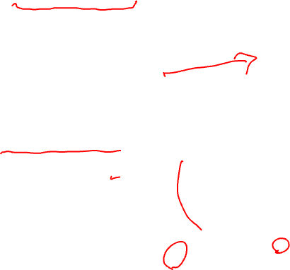
Homework Problem From Last Class
Latencies: ld = 2, st = 1, add = 1, cmpp = 1, br = 1
Resources: 1 ALU, 1 MEM, 1 BR
1
<1,1>
<1,0>
<2,2>
<2,3>
<0,0>
1: r1[-1] = load(r2[0])
2: r3[-1] = r1[1] – r1[2]
3: store (r3[-1], r2[0])
4: r2[-1] = r2[0] + 4
5: p1[-1] = cmpp (r2[-1] < 100)
remap r1, r2, r3
6: brct p1[-1] Loop
<1,1>
2
<1,0>
3
<0,0>
<1,1>
<1,1>
4
<1,0>
5
Calculate RecMII, ResMII, and MII
<1,0>
6
ResMII: ALU: 3 instrs / 1 unit = 3
MEM: 2 instrs / 1 unit = 2
BR: 1 instr / 1 unit = 1
MAX(3,2,1) = 3
RecMII: 4 → 4: 1/1 = 1
3 → 4 → 3: (0 + 1) / (0 +1) = 1
1 → 3 → 1: (1 + 1) / (0 + 1) = 2
1 → 2 → 3 → 1: (2+1+1) / (2+0+1) = 2
1 → 2 → 3 → 1: (2+1+1) / (3+0+1) = 1
MAX(1,1,2,2,1) = 2
MII = MAX(ResMII, RecMII) = MAX(3,2) = 3

Slide 4
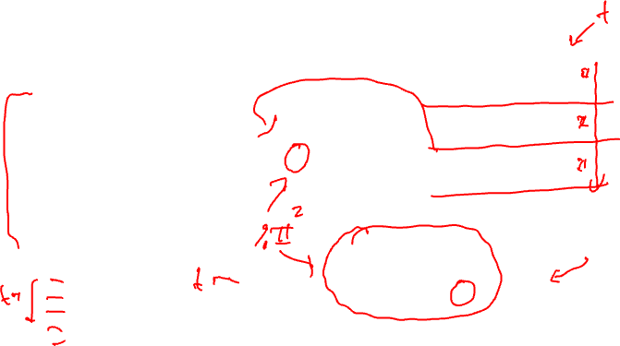
From Last Class: Example – Step 11
Step11: calculate ESC, SC = ceiling(max unrolled sched length / ii)
unrolled sched time of branch = rolled sched time of br + (ii*esc)
SC = 6 / 2 = 3, ESC = SC – 1
time of br = 1 + 2*2 = 5
Unrolled
Schedule
Rolled
Schedule
LC = 99
0
1
4
Loop:
1: r3[-1] = load(r1[0])
2: r4[-1] = r3[-1] * 26
3: store (r2[0], r4[-1])
4: r1[-1] = r1[0] + 4
5: r2[-1] = r2[0] + 4
remap r1, r2, r3, r4
7: brlc Loop
1
0
1
2
4
2
2
3
1
7
3
5
4
5
3
5
7
6
alu0
alu1
mem
br
0
X
X
X
MRT
1
X
X
X

Slide 5
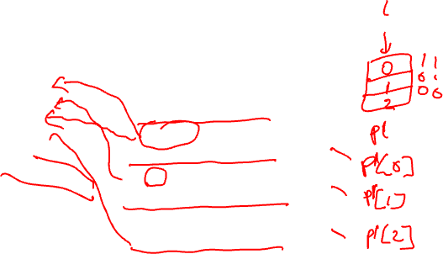
From Last Class: Example – Step 12
Finishing touches - Sort ops, initialize ESC, insert BRF and staging predicate,
initialize staging predicate outside loop
Staging predicate, each
successive stage increment
the index of the staging predicate
by 1, stage 1 gets px[0]
LC = 99
ESC = 2
p1[0] = 1
Loop:
1: r3[-1] = load(r1[0]) if p1[0]
2: r4[-1] = r3[-1] * 26 if p1[1]
4: r1[-1] = r1[0] + 4 if p1[0]
3: store (r2[0], r4[-1]) if p1[2]
5: r2[-1] = r2[0] + 4 if p1[2]
7: brlc Loop if p1[2]
Unrolled
Schedule
0
1
4
Stage 1
1
2
2
Stage 2
3
4
Stage 3
5
3
5
7
6

Slide 6
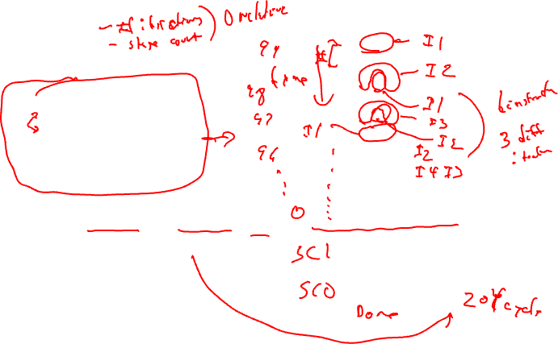
From Last Class: Example – Dynamic Execution of the Code
LC = 99
ESC = 2
p1[0] = 1
time: ops executed
0: 1, 4
1:
2: 1,2,4
3:
4: 1,2,4
5: 3,5,7
6: 1,2,4
7: 3,5,7
…
198: 1,2,4
199: 3,5,7
200: 2
201: 3,5,7
202: -
203 3,5,7
Loop:
1: r3[-1] = load(r1[0]) if p1[0]
2: r4[-1] = r3[-1] * 26 if p1[1]
4: r1[-1] = r1[0] + 4 if p1[0]
3: store (r2[0], r4[-1]) if p1[2]
5: r2[-1] = r2[0] + 4 if p1[2]
7: brlc Loop if p1[2]
Total time = II(num_iteration + num_stages – 1)
= 2(100 + 3 – 1) = 204 cycles

Slide 7
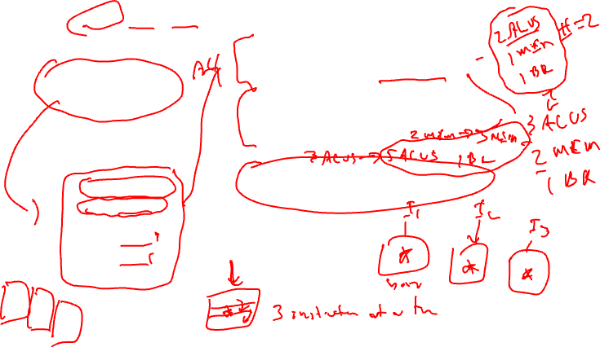
Class Problem
latencies: add=1, mpy=3, ld = 2, st = 1, br = 1
How many resources of each type are
required to achieve an II=1 schedule?
If the resources are non-pipelined,
how many resources of each type are
required to achieve II=1
Assuming pipelined resources, generate
the II=1 modulo schedule.
for (j=0; j<100; j++)
b[j] = a[j] * 26
LC = 99
Loop:
1: r3 = load(r1)
2: r4 = r3 * 26
3: store (r2, r4)
4: r1 = r1 + 4
5: r2 = r2 + 4
7: brlc Loop

Slide 8
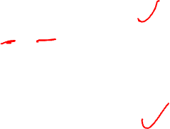
Class Problem – Answers in Red
latencies: add=1, mpy=3, ld = 2, st = 1, br = 1
How many resources of each type are
required to achieve an II=1 schedule?
For II=1, each operation needs a dedicated resource,
so: 3 ALU, 2 MEM, 1 BR
If the resources are non-pipelined,
how many resources of each type are
required to achieve II=1
Instead of 1 ALU to do the multiplies, 3 are needed,
and instead of 1 MEM to do the loads, 2 are needed.
Hence: 5 ALU, 3 MEM, 1 BR
Assuming pipelined resources, generate
the II=1 modulo schedule.
See next few slides
for (j=0; j<100; j++)
b[j] = a[j] * 26
LC = 99
Loop:
1: r3 = load(r1)
2: r4 = r3 * 26
3: store (r2, r4)
4: r1 = r1 + 4
5: r2 = r2 + 4
7: brlc Loop

Slide 9
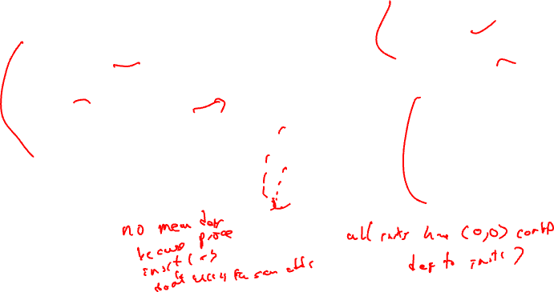
Problem continued
Assume II=1 so resources are: 3 ALU, 2 MEM, 1 BR
Dependence graph
DSA converted code below (same
as example in class)
1,1
1
RecMII = 1
RESMII = 1
MII = MAX(1,1) = 1
LC = 99
2,0
0,0
Loop:
1: r3[-1] = load(r1[0])
2: r4[-1] = r3[-1] * 26
3: store (r2[0], r4[-1])
4: r1[-1] = r1[0] + 4
5: r2[-1] = r2[0] + 4
remap r1, r2, r3, r4
7: brlc Loop
2
3,0
3
Priorities
1: H = 5
2: H = 3
3: H = 0
4: H = 4
5: H = 0
7: H = 0
1,1
1,1
0,0
4
5
1,1
1,1
7

Slide 10
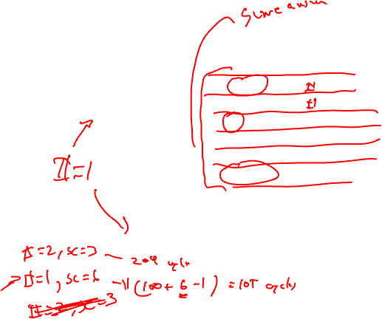
Problem continued
resources: 3 alu, 2 mem, 1 br
latencies: add=1, mpy=3, ld = 2, st = 1, br = 1
LC = 99
Unrolled
Schedule
Loop:
1: r3[-1] = load(r1[0])
2: r4[-1] = r3[-1] * 26
3: store (r2[0], r4[-1])
4: r1[-1] = r1[0] + 4
5: r2[-1] = r2[0] + 4
remap r1, r2, r3, r4
7: brlc Loop
Rolled
Schedule
0
1
4
stage 1
0
7
1
4
2
3
5
1
stage 2
2
2
stage 3
3
stage 4
4
stage 5
5
3
5
7
stage 6
Scheduling steps:
Schedule brlc at time II-1
Schedule op1 at time 0
Schedule op4 at time 0
Schedule op2 at time 2
Schedule op3 at time 5
Schedule op5 at time 5
Schedule op7 at time 5
6
alu0
alu1
alu2
m1
m2
br
0
X
X
X
X
X
X
MRT

Slide 11
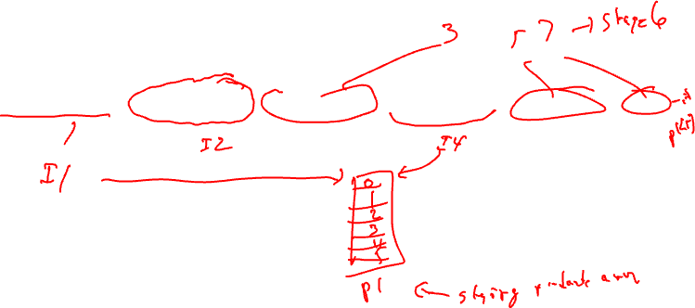
Problem continued
The final loop consists of a single MultiOp containing 6 operations,
each predicated on the appropriate staging predicate. Note register allocation
still needs to be performed.
LC = 99
Loop:
r3[-1] = load(r1[0]) if p1[0]; r4[-1] = r3[-1] * 26 if p1[2]; store (r2[0], r4[-1]) if p1[5]; r1[-1] = r1[0] + 4 if p1[0]; r2[-1] = r2[0] + 4 if p1[5]; brlc Loop

Slide 12
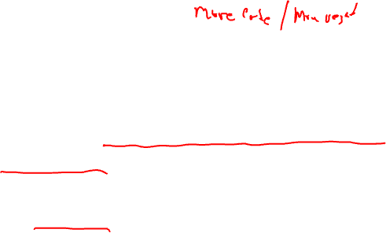
What if We Don’t Have Hardware Support for Modulo Scheduling?
No predicates
  Predicates enable kernel-only code by selectively enabling/disabling operations to create prolog/epilog
  Now must create explicit prolog/epilog code segments
No rotating registers
  Register names not automatically changed each iteration
  Must unroll the body of the software pipeline, explicitly rename
    Consider each register lifetime i in the loop
    Kmin = min unroll factor = MAXi (ceiling((Endi – Starti) / II))
    Create Kmin static names to handle maximum register lifetime
  Apply modulo variable expansion

Slide 13
Register Allocation

Slide 14
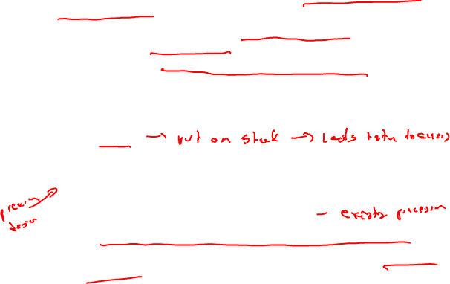
Register Allocation: Problem Definition
Through optimization, assume an infinite number of virtual registers
  Now, must allocate these infinite virtual registers to a limited supply of hardware registers
  Want most frequently accessed variables in registers
    Speed, registers much faster than memory
    Direct access as an operand
  Any VR that cannot be mapped into a physical register is said to be spilled
Questions to answer
  What is the minimum number of registers needed to avoid spilling?
  Given n registers, is spilling necessary
  Find an assignment of virtual registers to physical registers
  If there are not enough physical registers, which virtual registers get spilled?

Slide 15
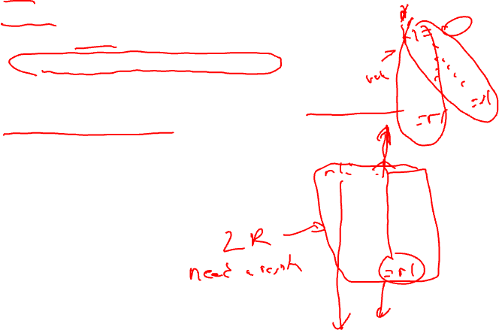
Live Range
Value = definition of a register
Live range = Set of operations
  1 more or values connected by common uses
  A single VR may have several live ranges
Live ranges are constructed by taking the intersection of reaching defs and liveness
  Initially, a live range consists of a single definition and all ops in a function in which that definition is live

Slide 16
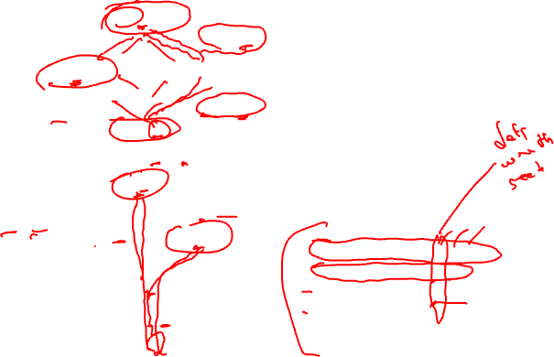
Example – Constructing Live Ranges
{liveness}, {rdefs}
1: x =
{}, {1}
{x}, {1}
2: x =
3:
{x}, {2}
{x}, {1}
4: = x
Each definition is the
seed of a live range.
Ops are added to the LR
where both the defn reaches
and the variable is live
{}, {1,2}
5: x =
{}, {5,6}
{}, {5}
{x}, {5}
6: x =
LR1 for def 1 = {1,3,4}
LR2 for def 2 = {2,4}
LR3 for def 5 = {5,7,8}
LR4 for def 6 = {6,7,8}
{x}, {6}
7: = x
{x}, {5,6}
8: = x

Slide 17
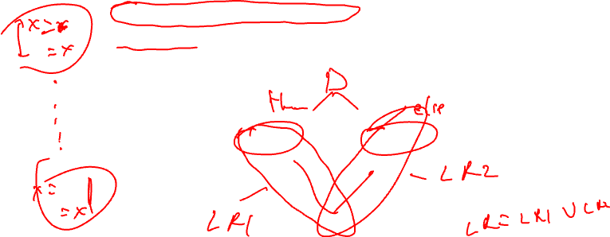
Merging Live Ranges
If 2 live ranges for the same VR overlap, they must be merged to ensure correctness
  LRs replaced by a new LR that is the union of the LRs
  Multiple defs reaching a common use
  Conservatively, all LRs for the same VR could be merged
    Makes LRs larger than need be, but done for simplicity
    We will not assume this
r1 =
r1 =
= r1

Slide 18
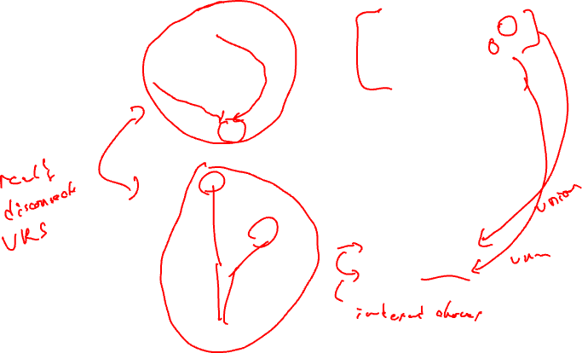
Example – Merging Live Ranges
{liveness}, {rdefs}
LR1 for def 1 = {1,3,4}
LR2 for def 2 = {2,4}
LR3 for def 5 = {5,7,8}
LR4 for def 6 = {6,7,8}
1: x =
{}, {1}
{x}, {1}
2: x =
3:
{x}, {2}
{x}, {1}
4: = x
{}, {1,2}
5: x =
Merge LR1 and LR2,
LR3 and LR4
LR5 = {1,2,3,4}
LR6 = {5,6,7,8}
{}, {5,6}
{}, {5}
{x}, {5}
6: x =
{x}, {6}
7: = x
{x}, {5,6}
8: = x

Slide 19
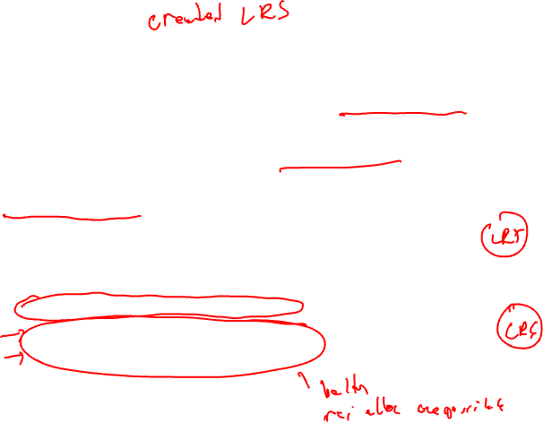
Interference
Two live ranges interfere if they share one or more ops in common
  Thus, they cannot occupy the same physical register
  Or a live value would be lost
Interference graph
  Undirected graph where
    Nodes are live ranges
    There is an edge between 2 nodes if the live ranges interfere
  What’s not represented by this graph
    Extent of interference between the LRs
    Where in the program is the interference

Slide 20
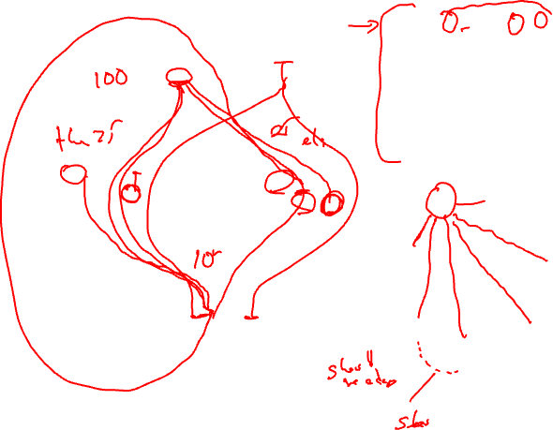
Example – Interference Graph
lr(a) = {1,2,3,4,5,6,7,8}
lr(b) = {2,3,4,6}
lr(c) = {1,2,3,4,5,6,7,8,9}
lr(d) = {4,5}
lr(e) = {5,7,8}
lr(f) = {6,7}
lr{g} = {8,9}
1: a = load()
2: b = load()
3: c = load()
4: d = b + c
5: e = d - 3
6: f = a * b
7: e = f + c
a
b
c
d
8: g = a + e
9: store(g)
e
f
g

Slide 21
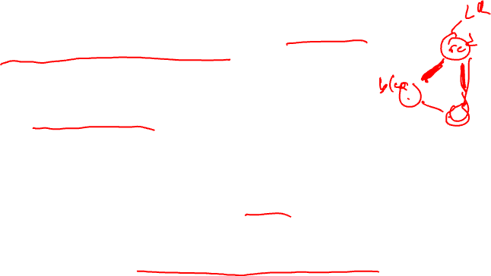
Graph Coloring
A graph is n-colorable if every node in the graph can be colored with one of the n colors such that 2 adjacent nodes do not have the same color
  Model register allocation as graph coloring
  Use the fewest colors (physical registers)
  Spilling is necessary if the graph is not n-colorable where n is the number of physical registers
Optimal graph coloring is NP-complete for n > 2
  Use heuristics proposed by compiler developers
    “Register Allocation Via Coloring”, G. Chaitin et al, 1981
    “Improvement to Graph Coloring Register Allocation”, P. Briggs et al, 1989
  Observation – a node with degree < n in the interference can always be successfully colored given its neighbors colors

Slide 22
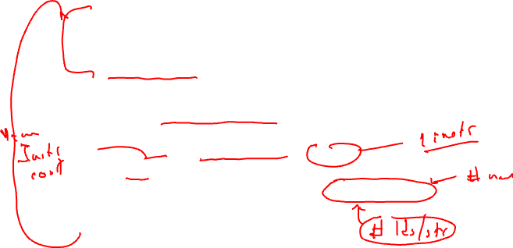
Coloring Algorithm
1. While any node, x, has < n neighbors
  Remove x and its edges from the graph
  Push x onto a stack
2. If the remaining graph is non-empty
  Compute cost of spilling each node (live range)
    For each reference to the register in the live range
      Cost += (execution frequency * spill cost)
  Let NB(x) = number of neighbors of x
  Remove node x that has the smallest cost(x) / NB(x)
    Push x onto a stack (mark as spilled)
  Go back to step 1
While stack is non-empty
  Pop x from the stack
  If x’s neighbors are assigned fewer than R colors, then assign x any unsigned color, else leave x uncolored

Slide 23
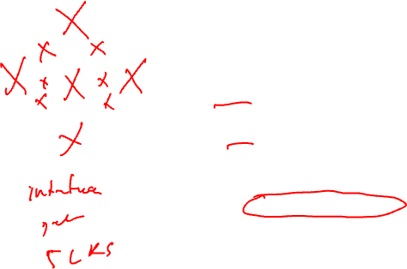
Example – Finding Number of Needed Colors
How many colors are needed to color this graph?
B
Try n=1, no, cannot remove any nodes
Try n=2, no again, cannot remove any nodes
Try n=3,
Remove B
Then can remove A, C
Then can remove D, E
Thus it is 3-colorable
A
E
C
D

Slide 24
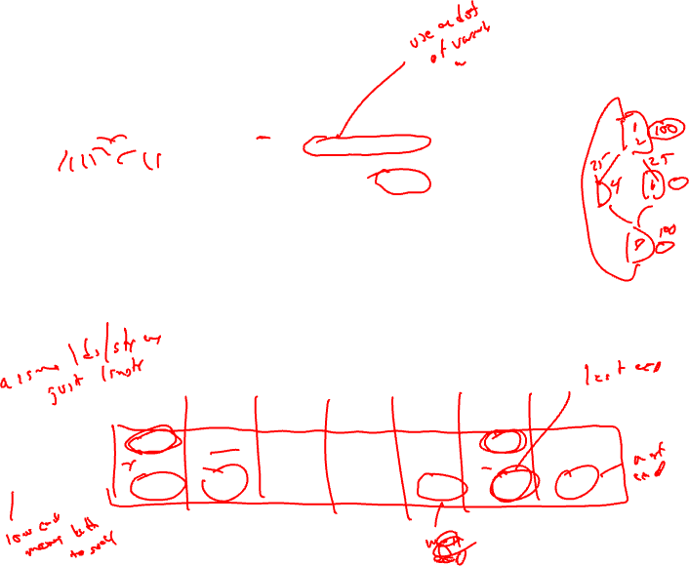
Example – Do a 3-Coloring
a
b
lr(a) = {1,2,3,4,5,6,7,8}
refs(a) = {1,6,8}
lr(b) = {2,3,4,6}
refs(b) = {2,4,6}
lr(c) = {1,2,3,4,5,6,7,8,9}
refs(c) = {3,4,7}
lr(d) = {4,5}
refs(d) = {4,5}
lr(e) = {5,7,8}
refs(e) = {5,7,8}
lr(f) = {6,7}
refs(f) = {6,7}
lr{g} = {8,9}
refs(g) = {8,9}
Profile freqs
1,2 = 100
3,4,5 = 75
6,7 = 25
8,9 = 100
Assume each
spill requires
1 operation
c
d
e
f
g
a b c d e f g
cost 225 200 175 150 200 50 200
neighbors 6 4 5 4 3 4 2
cost/n 37.5 50 35 37.5 66.7 12.5 100

Slide 25
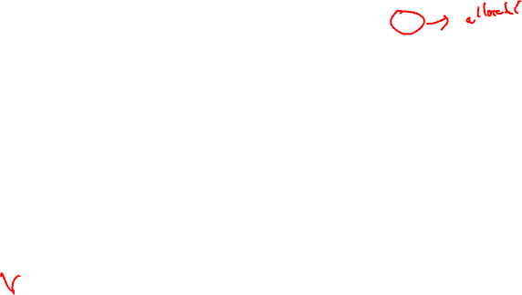
Example – Do a 3-Coloring (2)
Remove all nodes < 3 neighbors
So, g can be removed
Stack
g
a
b
a
b
c
d
c
d
e
e
f
f
g

Slide 26
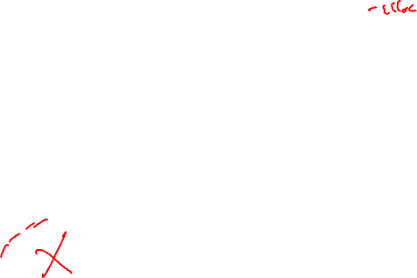
Example – Do a 3-Coloring (3)
Now must spill a node
Choose one with the smallest
cost/NB → f is chosen
Stack
f (spilled)
g
a
b
a
b
c
d
c
d
e
e
f

Slide 27
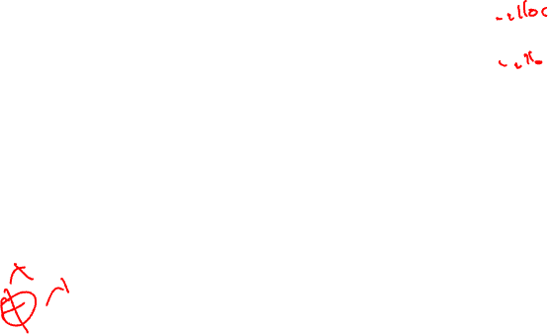
Example – Do a 3-Coloring (4)
Remove all nodes < 3 neighbors
So, e can be removed
Stack
e
f (spilled)
g
a
b
a
b
c
d
c
d
e

Slide 28
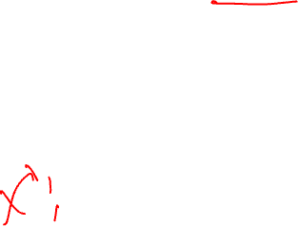
Example – Do a 3-Coloring (5)
Now must spill another node
Choose one with the smallest
cost/NB → c is chosen
Stack
c (spilled)
e
f (spilled)
g
a
b
a
b
c
d
d

Slide 29

Example – Do a 3-Coloring (6)
Remove all nodes < 3 neighbors
So, a, b, d can be removed
Stack
d
b
a
c (spilled)
e
f (spilled)
g
a
b
Null
d

Slide 30
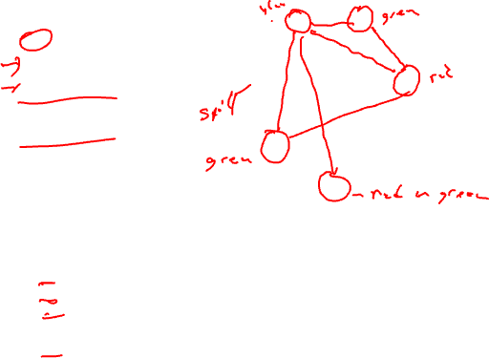
Example – Do a 3-Coloring (7)
Stack
d
b
a
c (spilled)
e
f (spilled)
g
a
b
c
d
e
f
g
Have 3 colors: red, green, blue, pop off the stack assigning colors
only consider conflicts with non-spilled nodes already popped off stack
d → red
b → green (cannot choose red)
a → blue (cannot choose red or green)
c → no color (spilled)
e → green (cannot choose red or blue)
f → no color (spilled)
g → red (cannot choose blue)

Slide 31
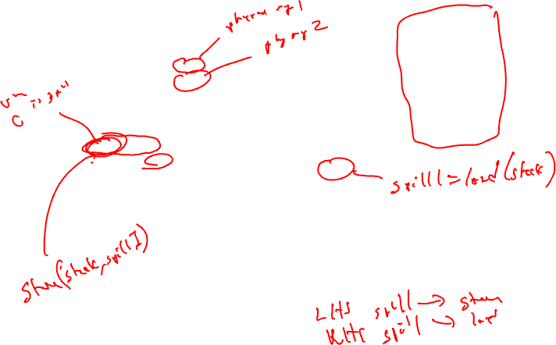
Example – Do a 3-Coloring (8)
d → red
b → green
a → blue
c → no color
e → green
f → no color
g → red
1: blue = load()
2: green = load()
3: spill1 = load()
4: red = green + spill1
5: green = red - 3
6: spill2 = blue * green
7: green = spill2 + spill1
Notes: no spills in the blocks
executed 100 times. Most spills
in the block executed 25 times.
Longest lifetime (c) also spilled
8: red = blue + green
9: store(red)

