Slide 1
Kernel instruction optimization based on the triton compiler
Group 21: Archit Kumar, Siddharth Chavan, Jack Gurecki, Batu Engin

Slide 2
Motivation
Larger deep learning models and increased complexity of training
Triton is one GPU compiler, used in the Torch Inductor
Problems with redundant operations post-loop unrolling
Suboptimal execution efficiency
Redundant Instruction Optimization
Algebraic Transformation Optimization
Notes:
We are looking for newer methods to achieve increased efficiency in gpu compilers
Triton is one GPU compiler that is adopted by the Torch Inductor, which is a part of the Pytorch compilation stack.
Nevertheless it has its flaws and therefore room for improvement. Some kernels post-compilation end up with redundant operations which lead to suboptimal execution efficiency.
This paper presents two techniques, redundant instruction optimization and algebraic computation transformation which make sense together as they fix problems that are often found in reduction kernels after loop unrolling
However, empirical analysis reveals that Triton still has blind spots when handling complex memory dependencies and sequential algebraic expressions

Slide 3
Key Definitions
Kernel
Triton
Torch Inductor
Reduction Kernel
TTGIR
Notes:
Kernel: A small function launched on an accelerator (GPU/CPU) that runs in parallel across many threads on different data elements.
Triton: An open-source, Python-like GPU programming language and compiler (originated at OpenAI) for writing custom, high-performance kernels.
TorchInductor: PyTorch’s default ahead-of-time/just-in-time compiler backend used by torch.compile. It fuses ops, plans memory, and generates optimized code. On GPUs it often emits Triton kernels; on CPUs it generates vectorized code (via LLVM/OpenMP).
Reduction kernel: A kernel whose primary job is to reduce many values to fewer values using an associative/commutative op (e.g., sum, max, mean).
TTGIR: “Triton GPU IR.” A lower-level, target-aware intermediate representation in Triton used after high-level Triton IR (TTIR) to model GPU execution details (threads/warps/blocks, shared memory, barriers) before lowering to LLVM IR and final device code.

Slide 4
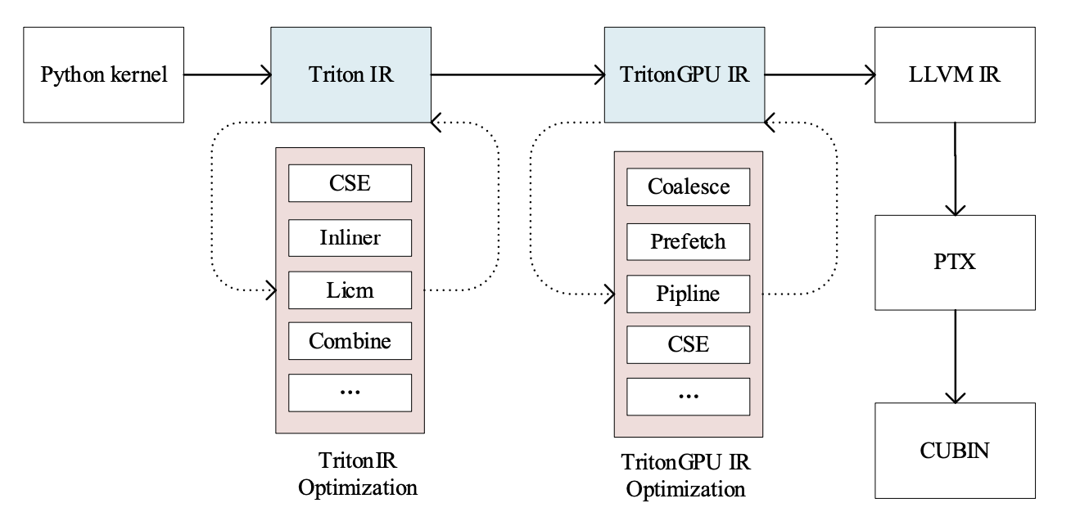
Triton

Slide 5
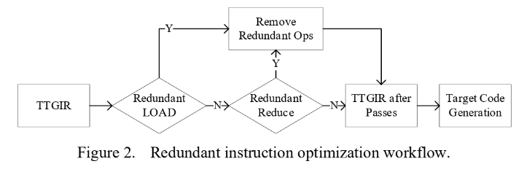
Redundant Instruction Optimization
Triton: CSE optimization using MLIR (LLVM)
This does not fully eliminate redundancies
Redundant memory ops due to differing properties
Some equivalent reduce ops not merged
Authors propose new method

Slide 6
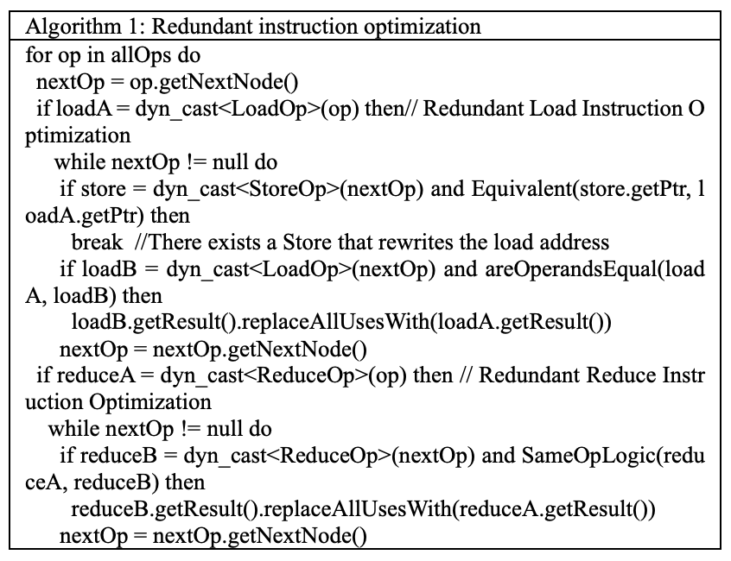
Redundant Instruction Optimization
Identify Redundant Loads
Replace loads with equal operands
Stop at store to same pointer
Identify Redundant Reduces
Replace redundant reduce operations

Slide 7
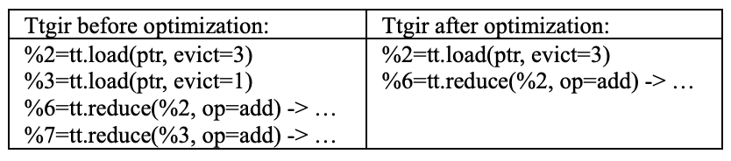
Redundant Instruction Example

Slide 8
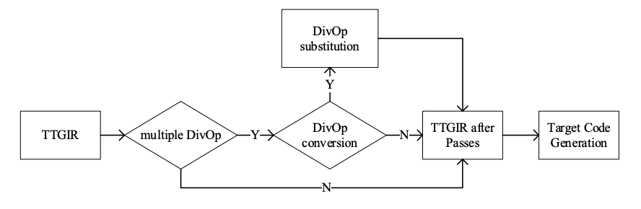
Algebraic Transformation Optimization
GPUs: Lack dedicated hardware support for division
Implemented with iterative algorithms
Strong dependency chains → efficiency bottleneck
Division-to-multiplication transformation
Analyze data dependencies; apply transformation if valid
Shortens critical path of reduction kernel

Slide 9
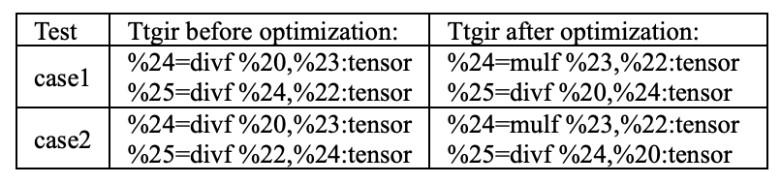
Algebraic Transformation Example
(a/b)/c
dependent on a/b
a/b is slow
a/(b*c)
dependent on b*c
b*c is fast

Slide 10
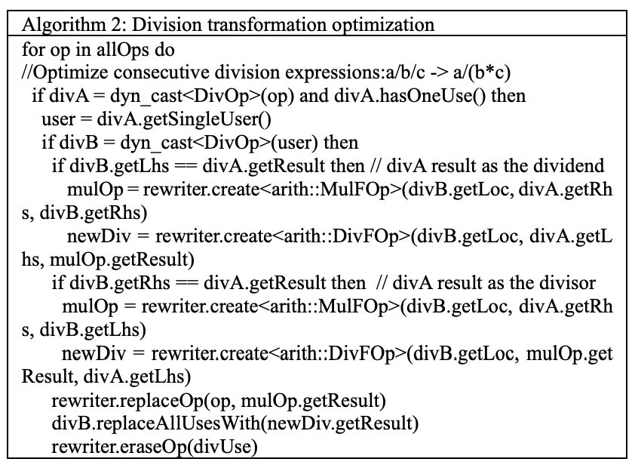

Slide 11
(a/b)/c ⇒ a/(b*c)
d/(a/b) ⇒ (d*b)/a

Slide 13
Experimental Evaluation
Two optimizations evaluated
Redundant Instruction Elimination
Algebraic (Division) Transformation
GPU platform using:
Triton 2.1
Pytorch 2.1.2
LLVM 17.0
Goal: Quantify execution time speedups without losing correctness

Slide 14
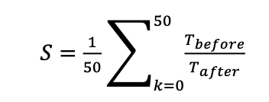
Setup and Performance Metric
Correctness verification
Main metric: Acceleration Ratio (s) = average of 50 runs comparing time before (T_{before}) / time after (T_{after})
Higher S → Faster kernel after optimization

Slide 15
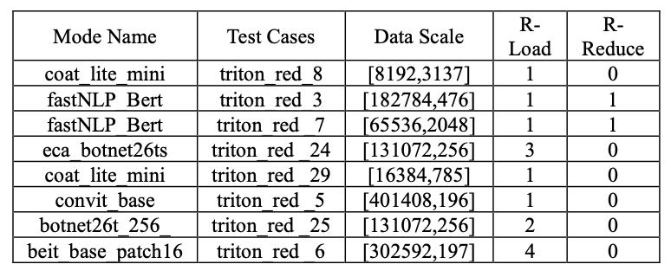
Redundant Instruction Test Set

Slide 16
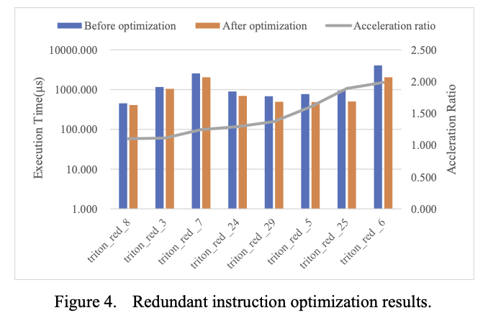
Redundant Instruction Results

Slide 17
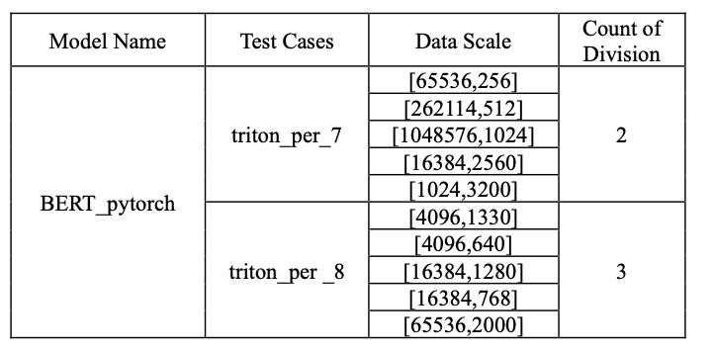
Division Transformation Test Set

Slide 18
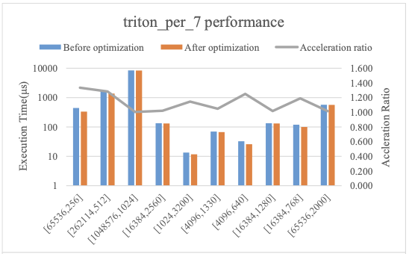
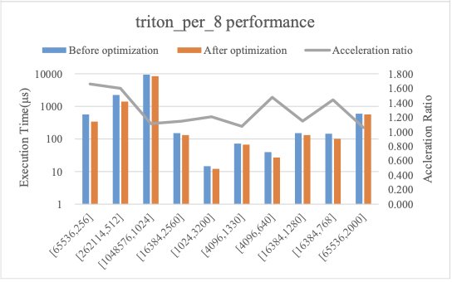
Division Transformation Results

Slide 19
Reference
Han, L., Du, Y., Li, J., & Gao, W. (2025). Kernel Instruction Optimization Based on the Triton Compiler. In Proc. 6th Int’l Conf. on Computer Engineering and Application (ICCEA), IEEE. [DOI: 10.1109/ICCEA65460.2025.11102282]

