Slide 1

Scalar Interpolation: A Better Balance Between Vector and Scalar Execution for SuperScalar Architectures
Group10: Jiarui Li, Yolanda Zhou, Zhiyi Hu
Notes:
Group 10

Slide 2
Agenda
Motivation and Background
Designs
Evaluation
Comments
Notes:
9-12 pages

Slide 3
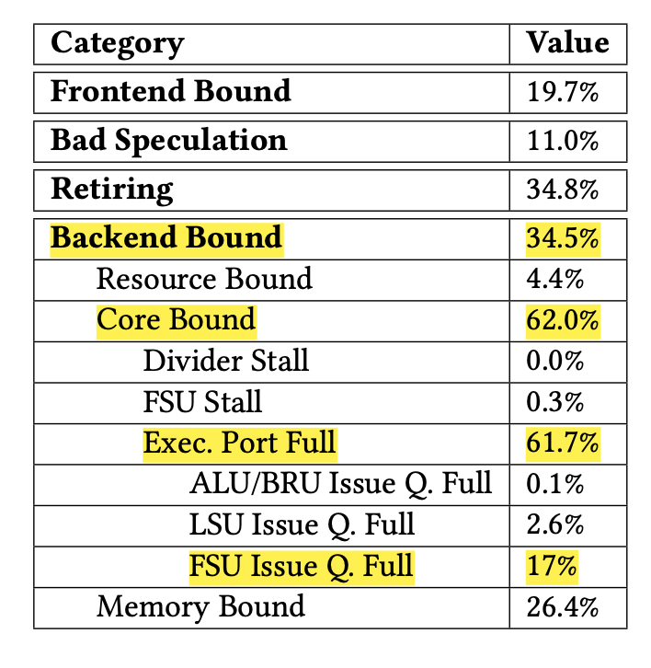
Motivation: Vectorization Bottleneck
Separate pipelines for modern compilers:
Scalar units: e.g., a+b
Vector units: e.g., [a1,a2,a3,a4]+[b1,b2,b3,b4]
Problem: “all or nothing”, convert all computations to vector
Vector units would become saturated
Scalar units would become idle
Notes:
Full vectorization? -> saturates vector units but leave scalar units unused.
Offload some loop computation to scalar units, reduce pressure on vector unit

Slide 4
Background: Existing and Proposed Solution
Partial Vectorization:
Splits a single iteration across both scalar and vector units
Requires data movements to get results back and forth
Proposed Method: Scalar Interpolation
Key idea: inserting a few full, original iterations on the scalar units
Before: [VEC ITER], [VEC ITER], [VEC ITER], [VEC ITER]...
After: [VEC ITER], [SCALAR ITER], [VEC ITER], [SCALAR ITER]..
Number of inserted scalar iterations: determined using two methods:
  Cost model
  Auto Tuner
Notes:
Full vectorization? -> saturates vector units but leave scalar units unused.
Offload some loop computation to scalar units, reduce pressure on vector unit

Slide 5
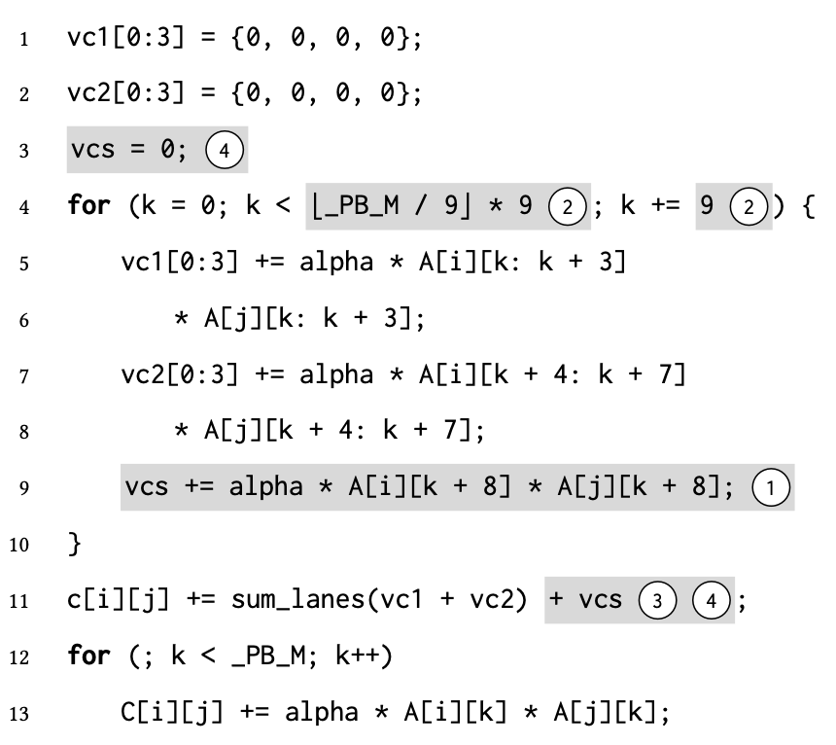
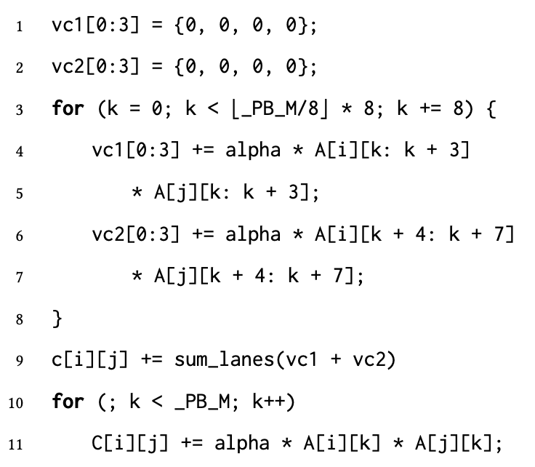
Full vectorization
With scalar interpolation
Notes:
Full vectorization? -> saturates vector units but leave scalar units unused.
Offload some loop computation to scalar units, reduce pressure on vector unit

Slide 6
Scalar Interpolation
Legality check:
No loop-carried dependencies
Prevent huge overhead from data transfers between scalar and vector registers.
Vectorization applies only if dependencies are absent or distance > vectorization factor.
No control flow in loops
Scalar interpolation algorithm does not support it -> if conversion
Integer-only operations
Vector and floating points often share the same ports, no performance gain

Slide 7
Scalar Interpolation
Goal:
Transform a vectorized loop to interleave selected scalar instructions for better ILP
Requirements:
Use scalar interpolation factor (SIF) determined by cost model
Adjust step and termination condition of the loop
Handle liveout values correctly
Manage reduction operations

Slide 8
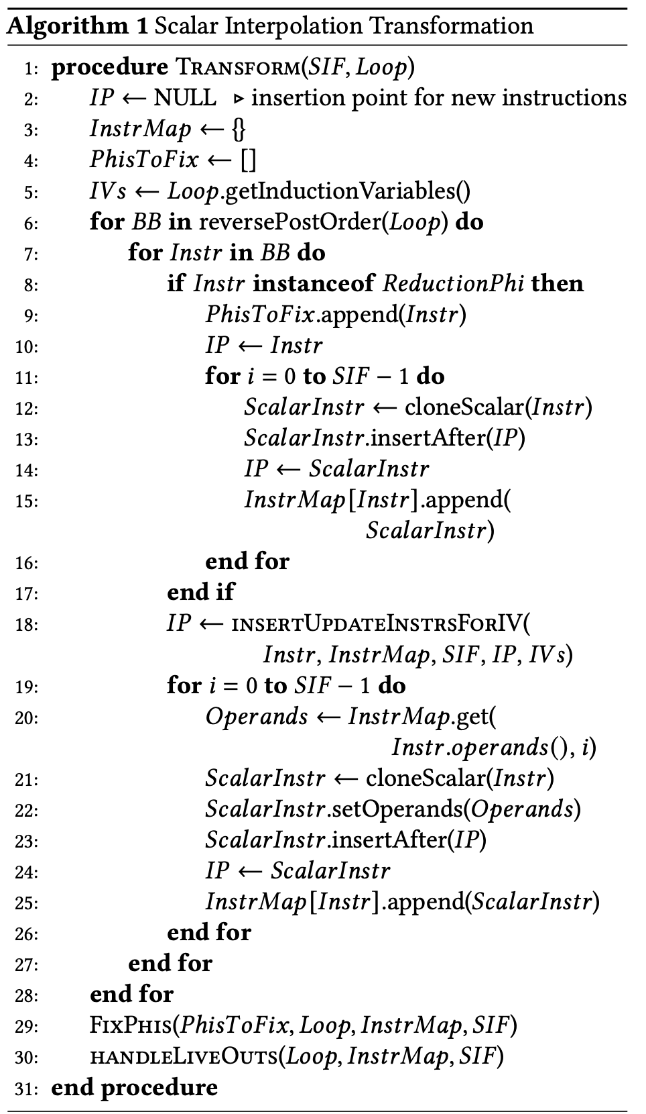
Transformation logic
1. Iterate through loop in reverse post-order -> bottom-up approach
2. Interpolation phase
For each vector instruction, clone and insert SIF scalar equivalents
InstrMap[vector]→[scalar_0 … scalar_{SIF-1}].
3. Preserve dependencies
InstrMap: vector -> interpolated scalar + operands
reverse post-order processing
4. Adjust induction variables
Insert SIF updates (each increments by 1) to reflect interpolated iterations.
New loop step = S × (UF × VF + SIF).
Notes:
→ Ensures all dependencies of an instruction are visited before interpolation.
SIF update instruc-
tions are required because, to preserve dependencies, each
interpolated iteration accesses its own update instruction.

Slide 9
Transformation logic
5. Liveouts :
Collect all def-use relations
Updates defs inside loop to the last scalar version via InstrMap.
last interpolated scalar instruction produce final liveout value
6. Phi Reductions :
Detect reduction Phi nodes.
Merges initialization and reinitialization values for scalar instructions
FixPhis() connects correct sources for each scalar iteration
Notes:
End of Transform:
All scalar reductions are aggregated with vector reductions in the loop-exit block → final reduction value.
Resulting loop preserves semantics, dependencies, and live-outs while exposing more ILP.

Slide 10
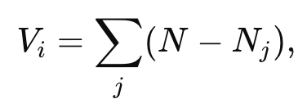
Cost Model
Balances scalar & vector workloads
Increases total unit utilization
Don’t increase loop latency
Goal: Find the optimal SIF!
Method:
Use a critical-path-first greedy list scheduler to estimate latency
Increment SIF from 1 up, stop when exceeding original 𝐿vec
Versatility scheduling
Notes:
aim to keep more versatile ports free for later scheduling. Thus, a port with lower 𝑉𝑖 has a higher priority for scheduling.
calculates 𝑉𝑖 by summing the number of ports that do not
support instruction types that are supported by port 𝑖.
For early trials, there is signifi-cant randomization in the priority of each port and, and stabilize around the value of 1/𝑉𝑖 . The scheduling algorithm selects the candidate port with higher 𝑅𝑖.

Slide 11
Auto-tuner
no control flow in loops → SIF is independent of input
-> We can determine SIF through auto-tuning
Method:
Choose candidate SIF values (e.g., 1, 2, 4, 8)
Interpolate program for each SIF
Execute multiple times, pick SIF yielding with fastest execution time.

Slide 12
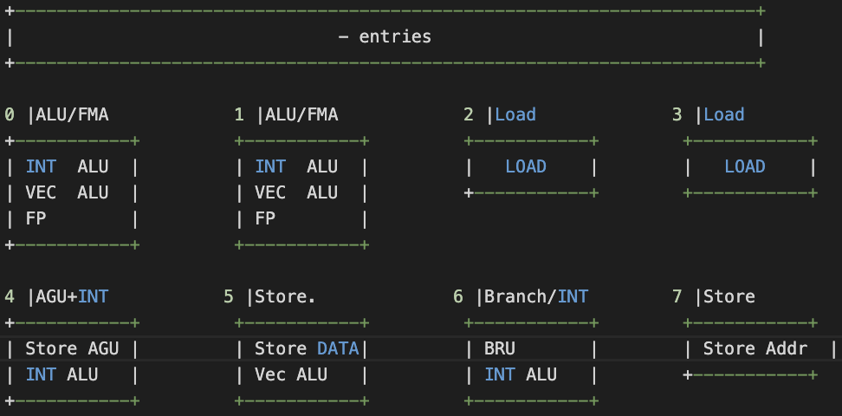
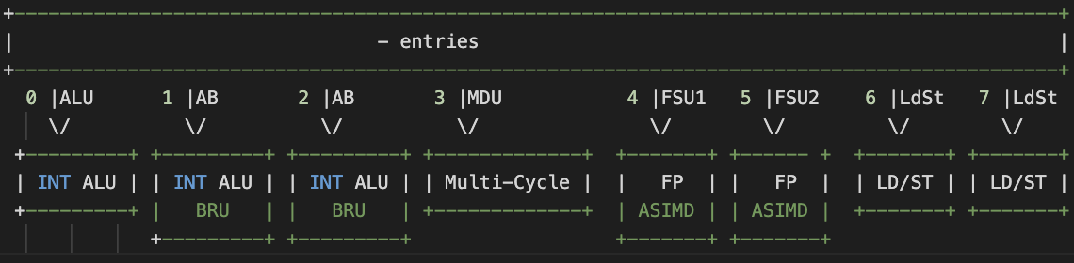
Evaluation: Settings
LLVM 17 mid-end implementation.
  R1: Original loop <-> Vectorized loop
  R2: target-agnostic transformation
PolyBench/C benchmark
  Linear algebra.
Two CPUs
  Intel Xeon E5-2698
  Huawei Kunpeng-920
http://uops.info/table.html
https://www.agner.org/optimize/#manual_microarch
https://www.intel.com/content/www/us/en/content-details/671488/intel-64-and-ia-32-architectures-optimization-reference-manual-volume-1.html
https://chipsandcheese.com/p/huaweis-kunpeng-920-and-taishan-v110
https://github.com/qcjiang/OSACA/blob/feature/tsv110/osaca/data/tsv110.yml
https://www-file.huawei.com/-/media/corp2020/pdf/publications/huawei-research/2022/huawei-research-issue1-en.pdf
Notes:
Loop-vectorization pass.
Support integer-only operations

Slide 13

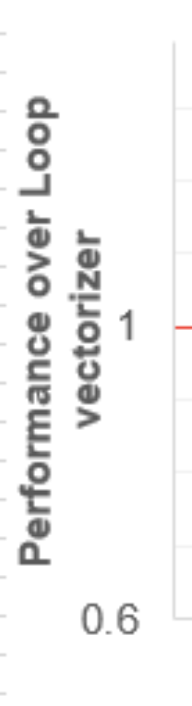
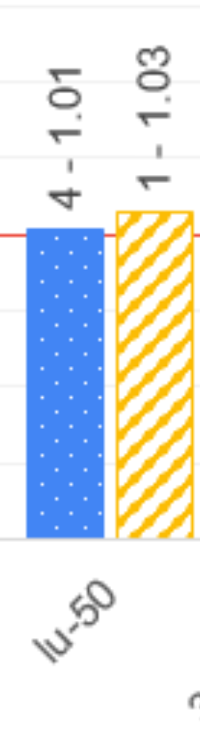


Evaluation: Cost Model v.s. Auto-Tuner
Cost Model Failure
  Case 1: Column-major loop. Load/Store bottleneck.
  Case 2: False scheduling cost estimation at the IR-level
  Case 3: Simple and conservative cost model
Auto-Tuner
  Empirical search
  Especially helpful when the mid-end cost estimation
implementation lack precise target information
Notes:
Went the access is column major, the vector access also needs to fetch from individual address and use vector pack. Loading 4 data at the same time from consecutive addresses is not possible. So load/store are already stressed.

Slide 14
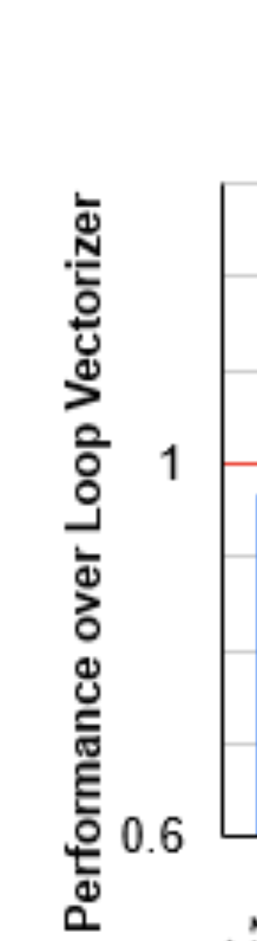
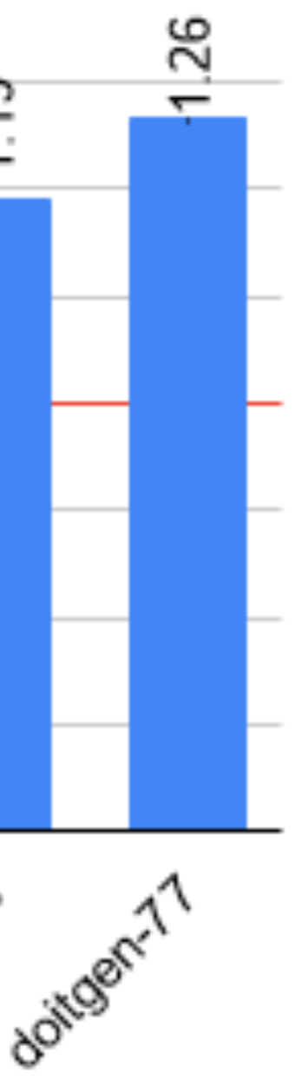
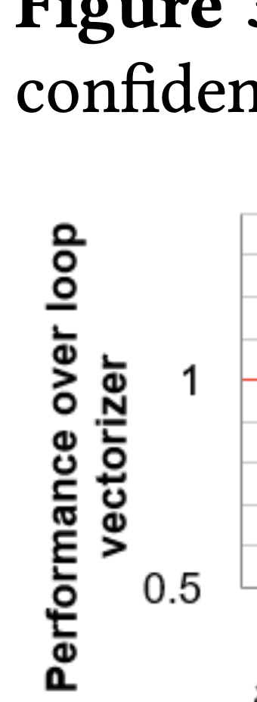
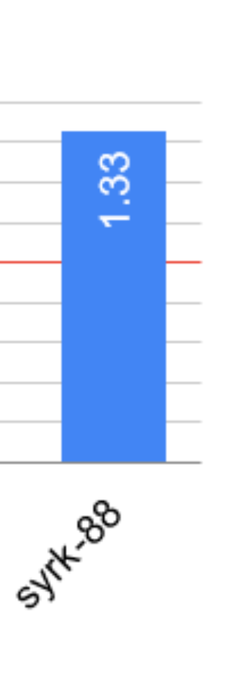
Evaluation: Performance Improvements
Low Memory Interaction Loops
  syrk-88
  Dot product: 4 loads, 4 multiplications, 2 additions, and no stores per iter.
Costly Vector Operations
  doitgen-77
  Cost: vector > scalar
    Division. Six time cost on Xeon.
    Column-major. Leading to vector packing overhead.
Xeon
Kunpeng
Notes:
syrk-88
These are arithmetic-intensive loops with many multiplications/additions but few loads/stores
Vector and scalar arithmetic use separate execution ports, so interpolation improves utilization
doitgen-77
Loops with operations that are much more expensive in vector form than scalar

Slide 15
Comments
Interesting points
  Insight of the imbalance between vector and scalar ports
  Interpolate individual complete iterations instead of partially
Limitations
  Application range: No loop carried dependency. No control flow in loop. INT only.
  Suboptimal/Empirical solution: The cost model is not reliable. Empirical search is costly.

Slide 16
Backups

Slide 17
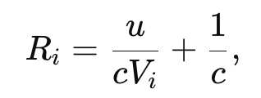
Cost Model
Balances scalar & vector workloads
Increases total unit utilization
Don’t increase loop latency
Goal: Find the optimal SIF!
Method:
Use a critical-path-first greedy list scheduler to estimate latency
Increment SIF from 1 up, stop when exceeding original 𝐿vec
Versatility scheduling VS randomized scheduling
Notes:
aim to keep more versatile ports free for later scheduling. Thus, a port with lower 𝑉𝑖 has a higher priority for scheduling.
calculates 𝑉𝑖 by summing the number of ports that do not
support instruction types that are supported by port 𝑖.
For early trials, there is signifi-cant randomization in the priority of each port and, and stabilize around the value of 1/𝑉𝑖 . The scheduling algorithm selects the candidate port with higher 𝑅𝑖.

Slide 18
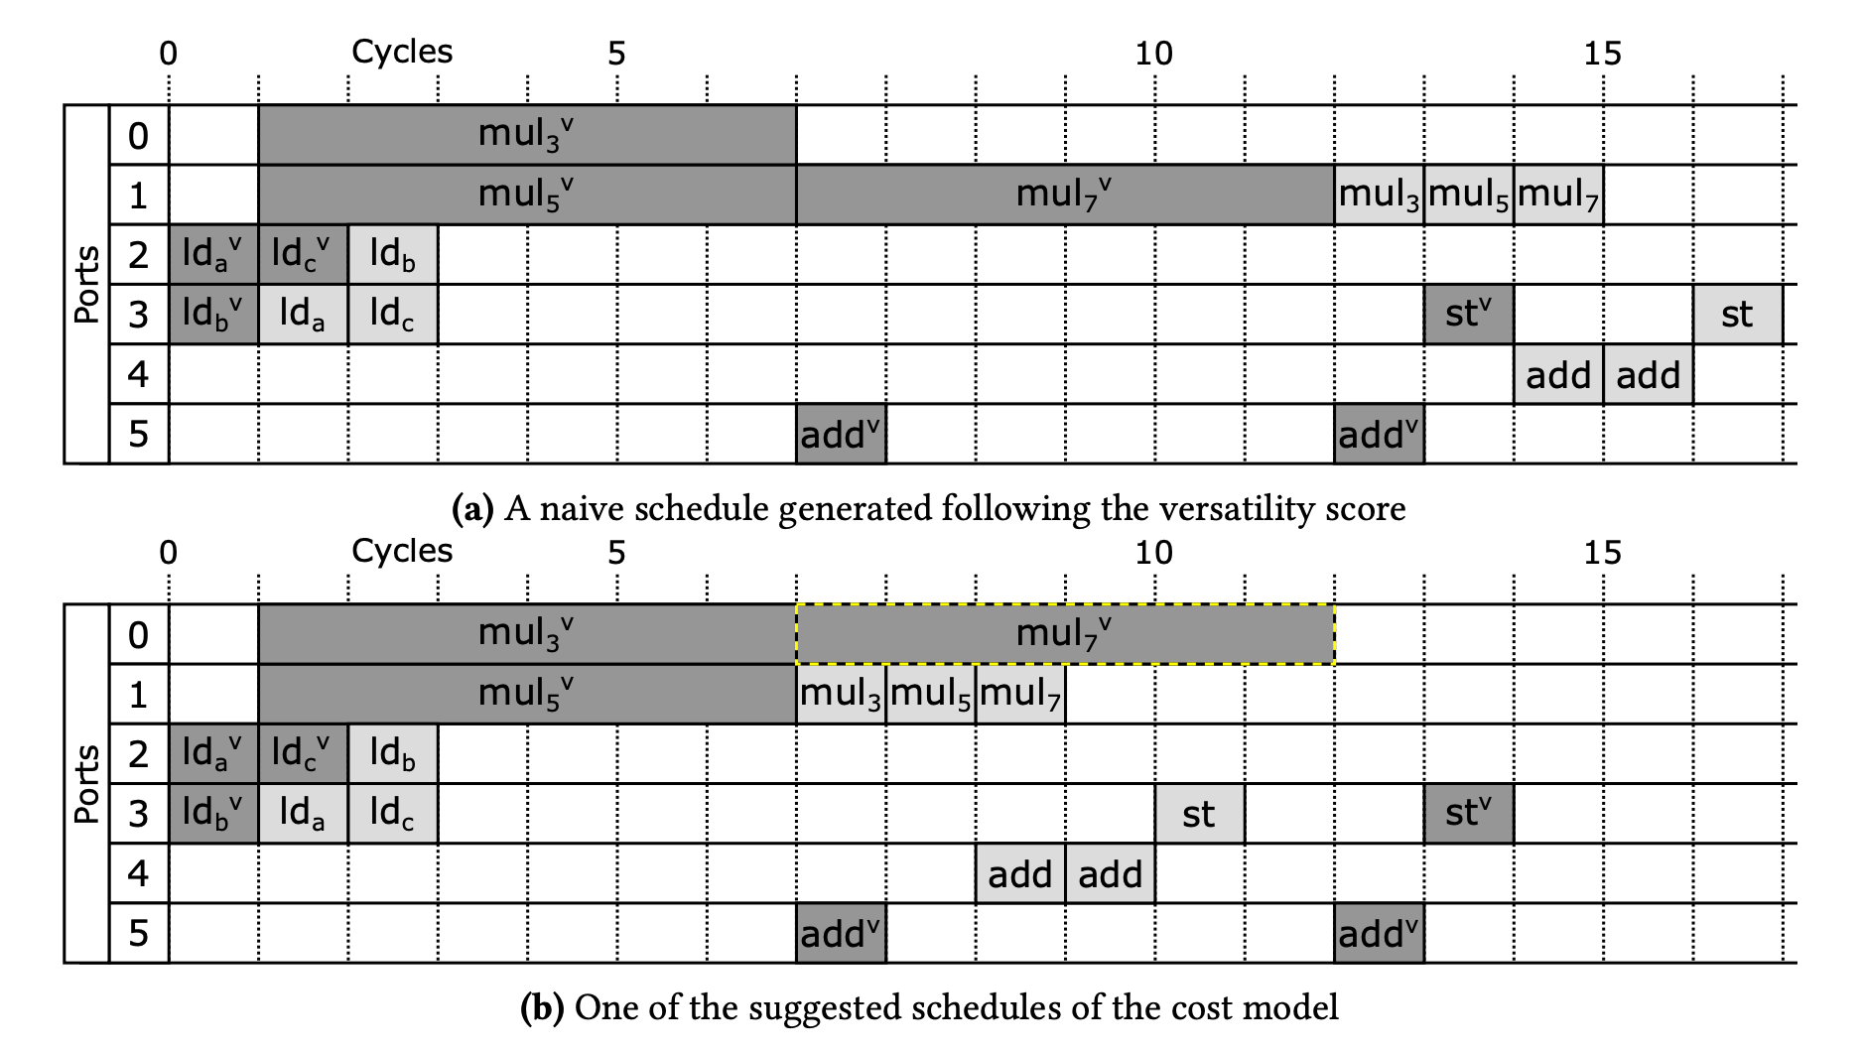

Slide 19
Agenda
Zhiyi: Motivation and Background # 3-4 pages. Sec 1&2&6.
Yolanda: Designs # 3-4 pages. Sec 3.
Jiarui:
Evaluation # 2 page. Sec 4&5
Comments # 1-2 pages. Limitations. Our plan.
Notes:
9-12 pages

