Slide 1
Automatic Parallelization Via Decoupled Software Pipelining
Presented by: Scott Mahlke
Paper by: G. Ottoni, R. Rangan, A. Stoler, and D. I. August
November 5, 2025

Slide 2
Parallelization: Scientific vs Non-Scientific Codes
Scientific Codes (FORTRAN-like)
General-purpose Codes (legacy C/C++)
for(i=1; i<=N; i++) // C
a[i] = a[i] + 1; // X
while(ptr = ptr->next) // LD
ptr->val = ptr->val + 1; // X
Core 1
Core 2
Core 1
Core 2
Independent
Multithreading
(IMT)
Example: DOALL
parallelization
Cyclic Multithreading
(CMT)
Example: DOACROSS
[Cytron, ICPP 86]
0
0
C:1
C:2
LD:1
1
1
X:1
X:2
X:1
LD:2
2
2
C:3
C:4
LD:3
X:2
3
3
X:3
X:4
X:3
LD:4
4
4
C:5
C:6
LD:5
X:4
5
5
X:5
X:6
X:5
LD:6
Notes:
1

Slide 3
DOALL Coverage – Provable and Profiled
Still not good enough!
Notes:
Pointer analysis is done in the provable… successful in many applications like specfp… but even a single dependence ruins everything
People have used profiling to find more parallel loops
This figure shows the coverage of doall loops using compiler analysis and profile information.
Y-axis shows..
Blue bar: time spent in loops can be proved to be doall by compiler
Red bar: doall loops identified by profiler
Compiler analysis limited for general applications. Profiled can identify more loops.
Good but still need to improve
Either remove or isolate dependeces

Slide 4
Alternative Parallelization Approaches
while(ptr = ptr->next) // LD
ptr->val = ptr->val + 1; // X
Core 1
Core 2
Core 1
Core 2
Cyclic
Multithreading
(CMT)
Pipelined
Multithreading (PMT)
Example: DSWP
[PACT 2004]
0
0
LD:1
LD:1
1
1
X:1
LD:2
LD:2
X:1
2
2
LD:3
X:2
LD:3
X:2
3
3
X:3
LD:4
LD:4
X:3
4
4
LD:5
X:4
LD:5
X:4
5
5
X:5
LD:6
LD:6
X:5
Notes:
3

Slide 5
Comparison: IMT, PMT, CMT
IMT
PMT
CMT
Core 1
Core 2
Core 1
Core 2
Core 1
Core 2
0
0
0
C:1
C:2
LD:1
LD:1
1
1
1
X:1
X:2
LD:2
X:1
2
2
2
C:3
C:4
LD:3
X:1
LD:2
3
3
3
X:3
X:4
LD:4
X:2
X:2
4
4
4
C:5
C:6
LD:5
X:3
LD:3
5
5
5
X:5
X:6
LD:6
X:4
X:3
lat(comm) = 1:
1 iter/cycle
1 iter/cycle
1 iter/cycle
lat(comm) = 2:
1 iter/cycle
1 iter/cycle
0.5 iter/cycle
Notes:
4

Slide 6
Comparison: IMT, PMT, CMT
Thread-local Recurrences ➔ Fast Execution
IMT
PMT
CMT
Core 1
Core 2
Core 1
Core 2
Core 1
Core 2
0
0
0
C:1
C:2
LD:1
LD:1
1
1
1
X:1
X:2
LD:2
X:1
2
2
2
C:3
C:4
LD:3
X:1
LD:2
3
3
3
X:3
X:4
LD:4
X:2
X:2
4
4
4
C:5
C:6
LD:5
X:3
LD:3
5
5
5
X:5
X:6
LD:6
X:4
X:3
Cross-thread Dependences ➔ Wide Applicability
Notes:
5

Slide 7
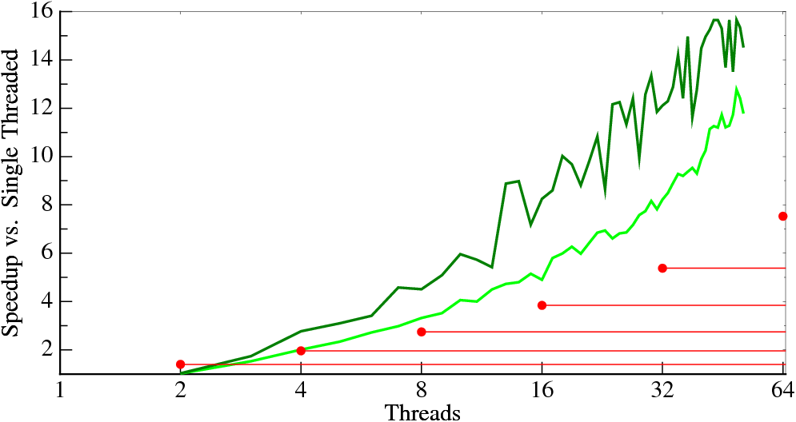
Our Objective: Automatic Extraction of Pipeline Parallelism using DSWP
197.parser
Find
English
Sentences
Parse
Sentences
(95%)
Emit
Results
Decoupled Software Pipelining
PS-DSWP (Spec DOALL Middle Stage)
Notes:
6
This is parser with two input sets shown in green. The red dots are the historic performance trend lines, our goal, shown the first slide. We can automatically parallelize parser in a scalable way - all we need is to have the programmer remove or mark the custom allocator. That is so much easier than rewriting parser in a new language.

Slide 8
Decoupled Software Pipelining

Slide 9
[MICRO 2005]
Decoupled Software Pipelining (DSWP)
A: while(node)
B: ncost = doit(node);
C: cost += ncost;
D: node = node->next;
Dependence
Graph
D
DAG_{SCC}
A D
Thread 1
Thread 2
A
A
B
B
D
B
C
C
C
register
control
intra-iteration
loop-carried
Inter-thread communication
latency is a one-time cost
communication queue
Notes:
8

Slide 10
Implementing DSWP
L1:
DFG
Aux:
register
control
memory
intra-iteration
loop-carried
Notes:
Choose a valid partitioning
Goals: balance load, reduce sync
Transform the code

Slide 11
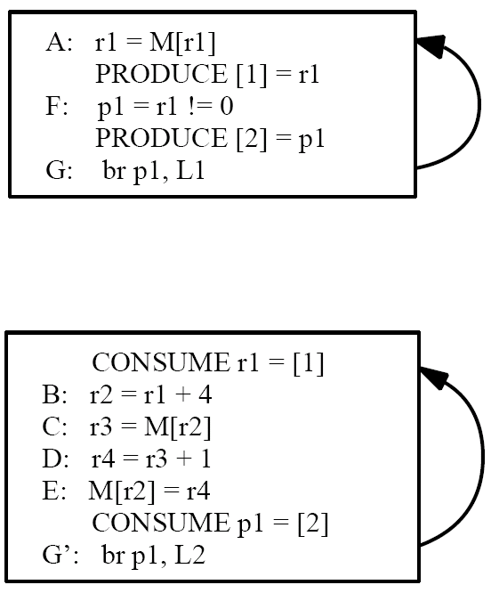
Optimization: Node Splitting To Eliminate Cross Thread Control
L1
L2
register
control
memory
intra-iteration
loop-carried

Slide 12
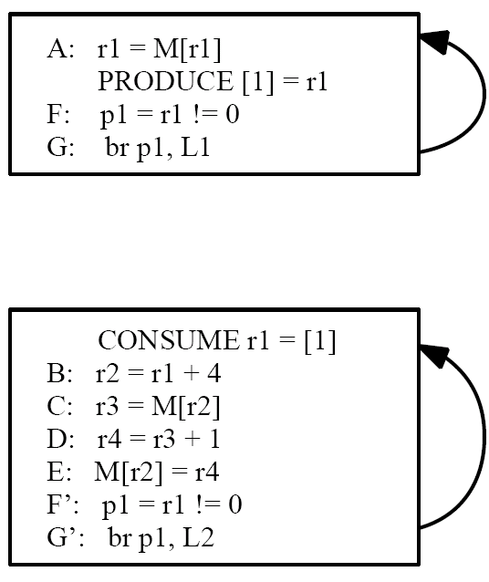
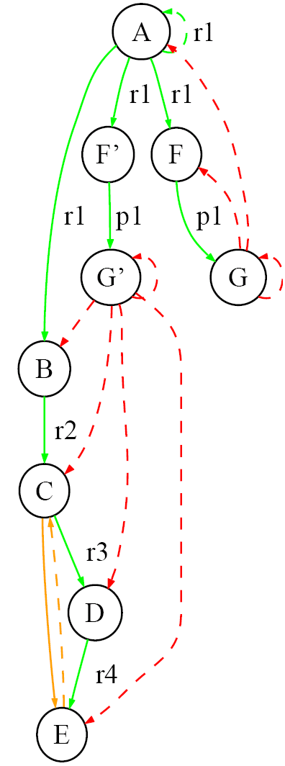
Optimization: Node Splitting To Reduce Communication
L1
L2
register
control
memory
intra-iteration
loop-carried

Slide 13
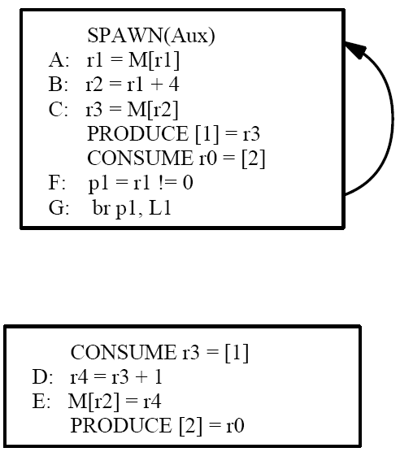
Constraint: Strongly Connected Components
Consider:
Solution: DAG_{SCC}
register
control
memory
Eliminates pipelined/decoupled property
intra-iteration
loop-carried
Notes:
Choose a valid partitioning
Goals: balance load, reduce sync
Transform the code

Slide 14
Speculation – Break Statistically Unlikely Dependences
A: while(node)
B: ncost = doit(node);
C: cost += ncost;
D: node = node->next;
Dependence
Graph
DAG_{SCC}
A D
D
A
B
B
register
C
C
control
intra-iteration
loop-carried
communication queue

Slide 15
Why Speculation?
A: while(cost < T && node)
B: ncost = doit(node);
C: cost += ncost;
D: node = node->next;
Dependence
Graph
DAG_{SCC}
A D
D
B
A
B
A B C D
register
C
C
control
intra-iteration
Predictable
Dependences
loop-carried
communication queue

Slide 16
Why Speculation?
A: while(cost < T && node)
B: ncost = doit(node);
C: cost += ncost;
D: node = node->next;
Dependence
Graph
DAG_{SCC}
D
D
B
A
B
C
register
C
control
intra-iteration
Predictable
Dependences
A
loop-carried
communication queue

Slide 17
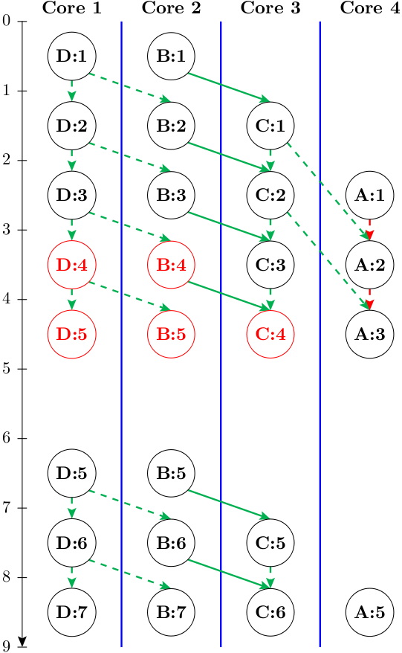
Execution Paradigm
DAG_{SCC}
D
B
Misspeculation
detected
C
Misspeculation Recovery
Rerun Iteration 4
A
register
control
intra-iteration
loop-carried
communication queue
Notes:
16

Slide 18
Evaluation: Dual Core vs Single Core
Notes:
- They selected important benchmark loops, corresponding from 16 to 98% of the total benchmark execution time, and here are the resulting loop speedups compared to the single-threaded baseline.
- DSWP obtained speedups of up to 45% on the selected loops, with a geometric mean of about 17%.
- For 2 benchmarks, the resulting code runs slower, probably because of the difficulty in statically estimating the resulting performance of different partitionings in the compiler.

Slide 19
Strengths/Weaknesses
Strengths
Pipeline is a great solution for loops with dependences
Highly practical solution, full prototype built and run
Made everyone rethink parallelization for SPEC applications
Changed views of what a compiler could do in parallelization
Weaknesses
Speculation not very well developed - How do you decide what dependences to speculate?
Speculation overheads - Undo speculation decisions at run-time
How many cores can DSWP realistically scale to?
Can a pipeline be adjusted when the number of available cores increases/decreases, or based on what else is running on the processor?

Slide 20
References
“Automatic Thread Extraction with Decoupled Software Pipelining,” G. Ottoni, R. Rangan, A. Stoler, and D. I. August, Proceedings of the 38th IEEE/ACM International Symposium on Microarchitecture, Nov. 2005
“Revisiting the Sequential Programming Model for Multi-Core,” M. J. Bridges, N. Vachharajani, Y. Zhang, T. Jablin, and D. I. August, Proc 40th IEEE/ACM International Symposium on Microarchitecture, December 2007.

