Slide 1
Compiler-Based Prefetching for Recursive Data Structures
Group 27
Qilong Wang, Kyungsup Song, Christopher Davis, Xiangyu Liu

Slide 2
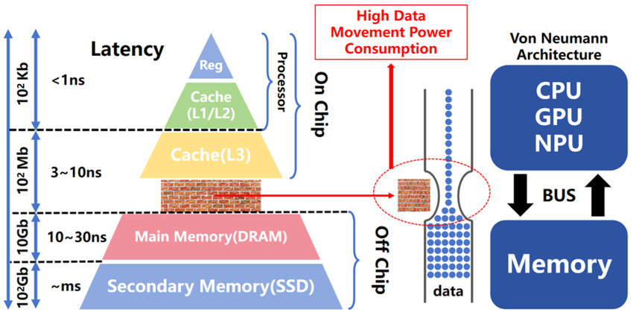
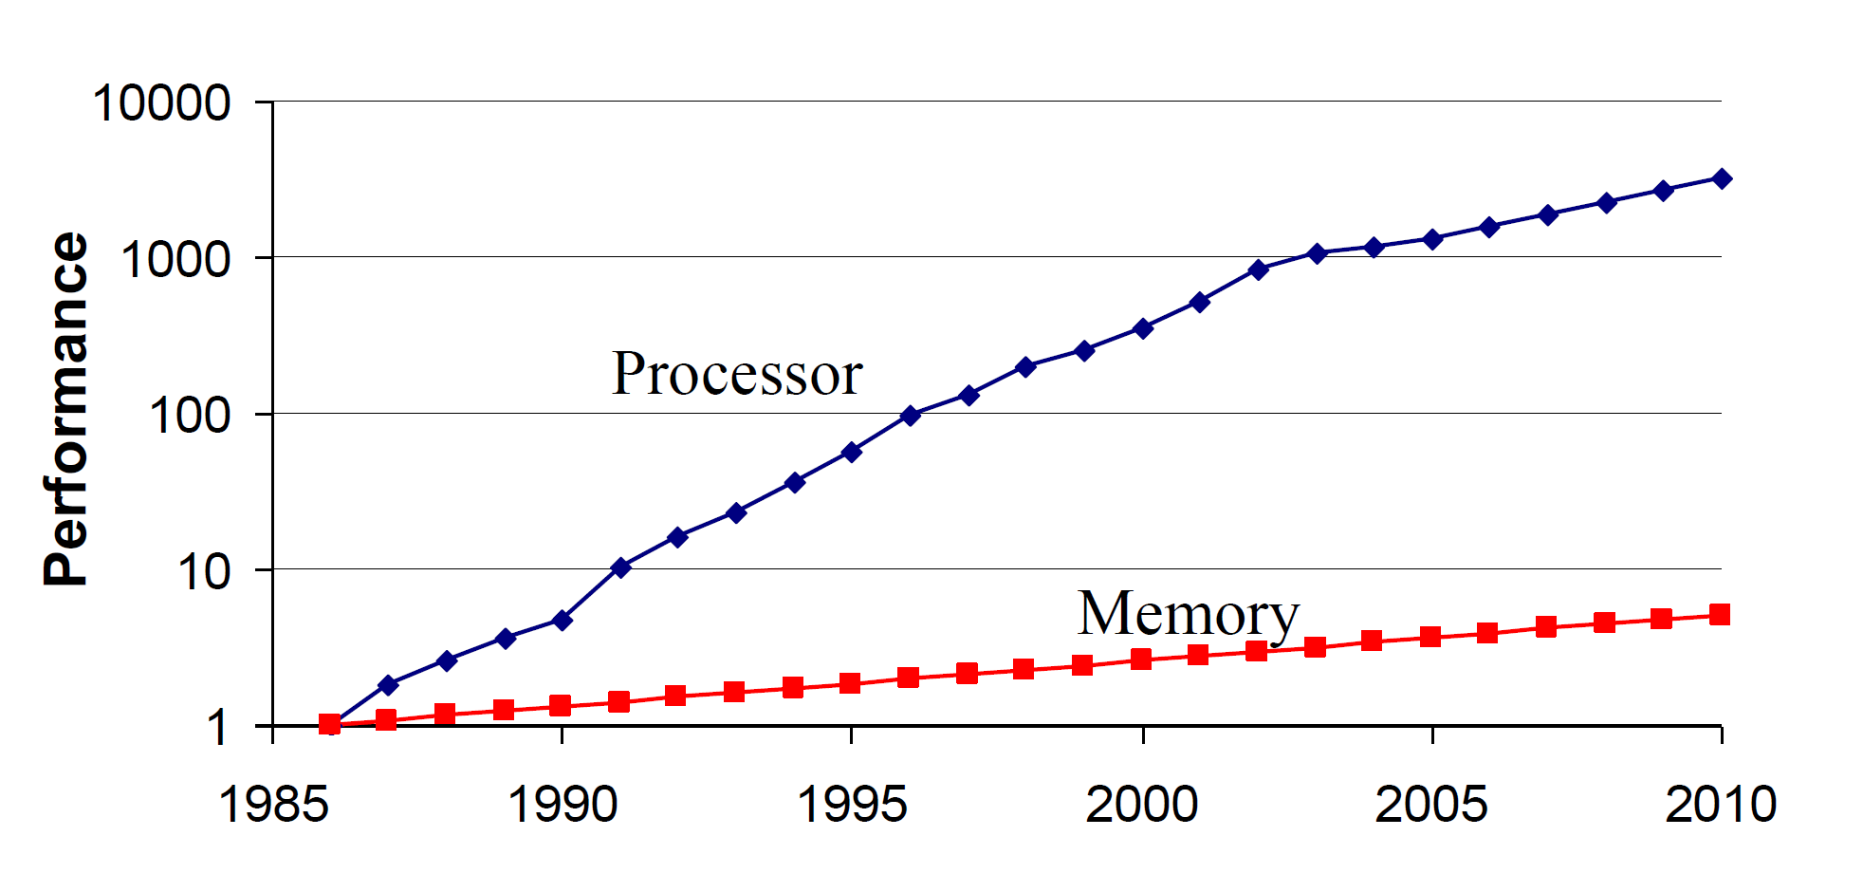
Motivation
Memory wall: Processor performance keeps increasing while memory latency has not caught up
  bottleneck in performance-intensive computing
Many techniques are aimed to hide memory latency
  OoO execution, hierarchical cache, prefetch
For instructions and data array, effective software prefetch solution exists
However recursive data structures(RDS) remain hard to tackle due to address dependence

Slide 3
Recursive Data Structures
int sum_array(int *A, int n) {
int sum = 0;
for (int i = 0; i < n; i++) {
sum += A[i];
}
return sum;
}
Pointer-based structures: linked lists, trees, graphs, etc
  individual nodes are dynamically allocated from the heap, nodes are linked together through pointers
Traversal is pointer-chasing, not predictable indexing
  Low spatial locality
  Next address unknown until current node is loaded
  Prefetch too early/late → ineffective or wasteful
Thus, conventional prefetch is insufficient
(a) Data array
struct Node {
int data;
struct Node *next;
};
int sum_list(struct Node *p) {
int sum = 0;
while (p != NULL) {
sum += p->data;
p = p->next;
}
return sum;
}
(b) RDSs

Slide 4
Data Arrays VS Recursive Data Structures
Data Arrays
Access pattern is index-driven and easily analyzable
Strong spatial locality, elements stored contiguously
Future addresses can be computed statically (A[i+1], A[i+2], …)
RDSs
Structures shape determined at runtime
Memory layout reflects allocation history, not index order
Address of a pointer dereference is unknown until value is loaded

Slide 5
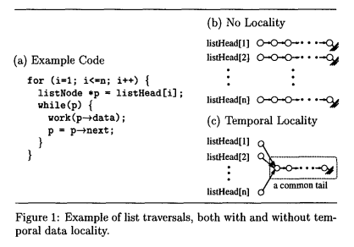
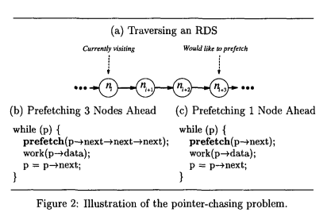
Challenges in RDSs
Analysis Challenges
Uncertain temporal locality, hard to identify which nodes will be reused
Heap-allocated nodes may be disjoint or partially shared
Difficult to predict memory access patterns
Scheduling Challenges
Goal is to prefetch far ahead to hide memory latency
Prefetch depth is limited by unknown future addresses
Intermediate nodes must be visited before computing future pointers-pointer-chasing, add extra instruction overhead

Slide 6
Limits of Hardware Prefetch & Multithreading
Hardware Prefetch
Adv: No extra instruction overhead
Cons:
Unable to recognize irregular memory access
  Relies on predictable patterns, assuming regular, strided or sequential access
RDSs exhibit chaotic, data dependent address sequence
Multithreading
Adv: Does not require predicting address ahead of time
Cons:
Needs multiple runnable threads exist, which may not exist or be supported by hardware
Cannot resolve serial pointer dependencies in RDS traversal
Often no parallel work exists during RDS traversal

Slide 7
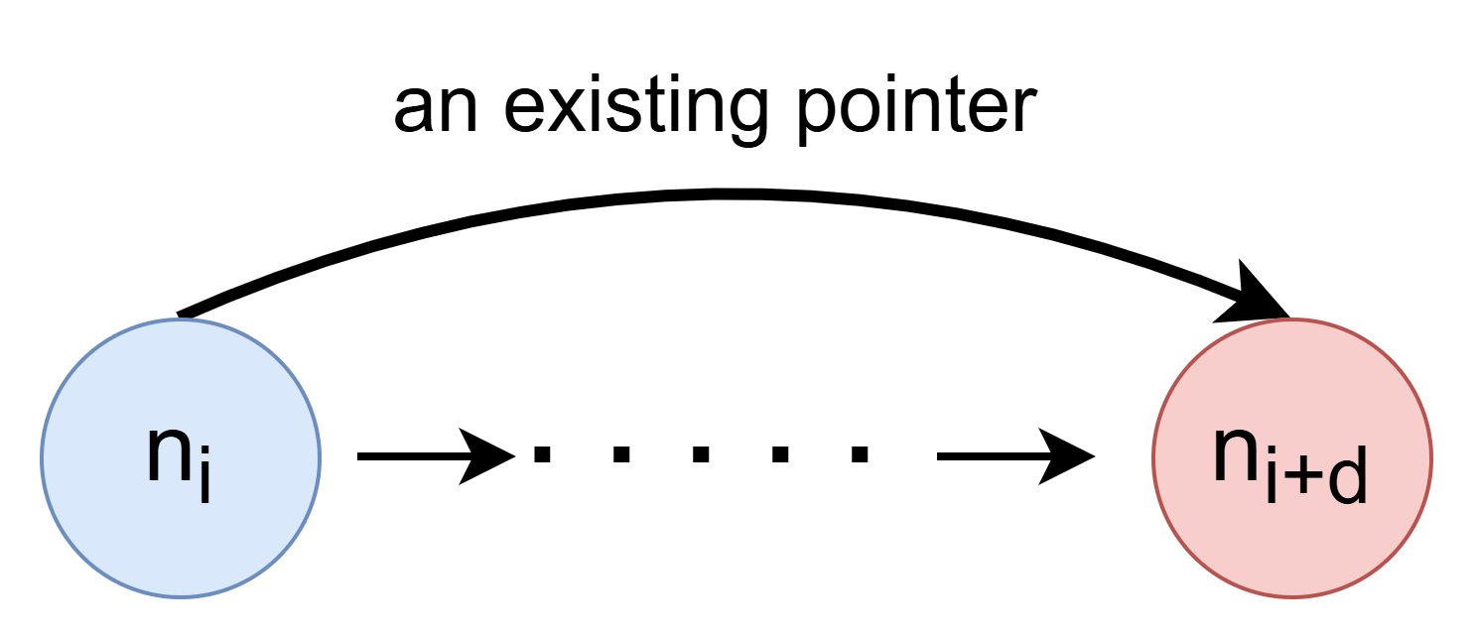
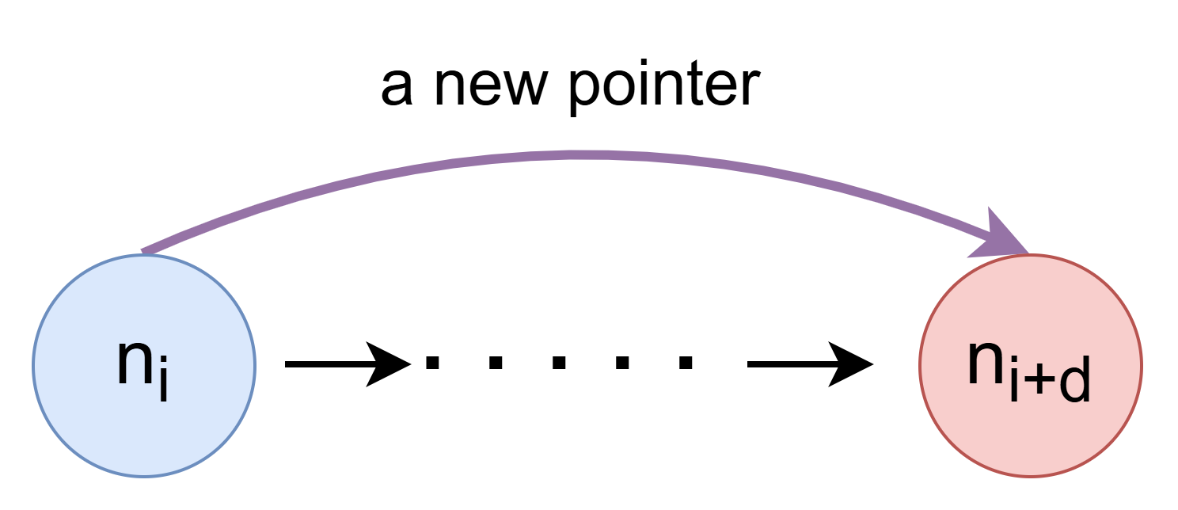
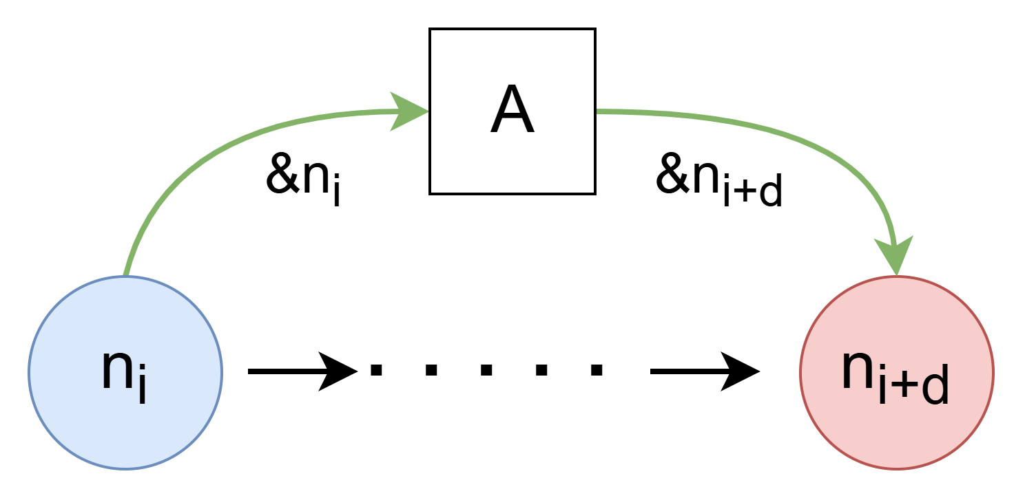
Proposed Software Prefetch
Greedy prefetch
  Prefetch the next node followed by the immediate control flow
History-pointer prefetch
  Add history pointers obtained from recent traversal
Data-Linearization prefetch
  Map nodes close in the traversal to contiguous memory

Slide 8




Software-Controlled Prefetching for RDSs

Slide 9
Prefetching in RDSs – Key Points
Challenge: RDSs make prefetch analysis and scheduling difficult
Focus: Schedule prefetches to maximize latency hiding
Core Problem: Pointer-Chasing
  Must dereference pointer chains to compute future addresses
  Cost = II𝓕ll (number of dereferences)
Prefetch Distance (d):
  Chosen to hide cache-miss latency
  At node n_{i} with address A_{i}, prefetch node n_{i+d}
Objective: Minimize II𝓕ll for timely, effective prefetching
Prefetch
1
2
3
4
Prefetch node 4 at node 1 requires 3 dereferences (*node1, *node2, *node3)
No Prefetching: II𝓕ll = 3

Slide 10
II𝓕ll := number of dereferences
At node n_{i} with address A_{i}, prefetch node n_{i+d}
Prefetching Schemes | No | Greedy | History-Pointer | Data-Linearization
II𝓕ll | d | 1 | 1 | 0
Structures | / | Nature jump pointers | Artificial jump pointers (= History–pointers) | Mapping the nodes at creation time
Strengths | / | ▪️low runtime overhead ▪️straightforward to implement in a compiler | ▪️hide nearly all of the latency for subsequent traversals of the RDS | ▪️Without requiring any pointer dereferences
Limitations | / | ▪️not offer precise control over the prefetching distance | ▪️execution overhead & space overhead ▪️RDS traversal patterns need to be stable | ▪️Only beneficial when RDS changes only slowly (or not at all)
Use Cases | / | Most widely applicable | Same RDS traversal patterns | RDS changes only slowly (or not at all)

Slide 11
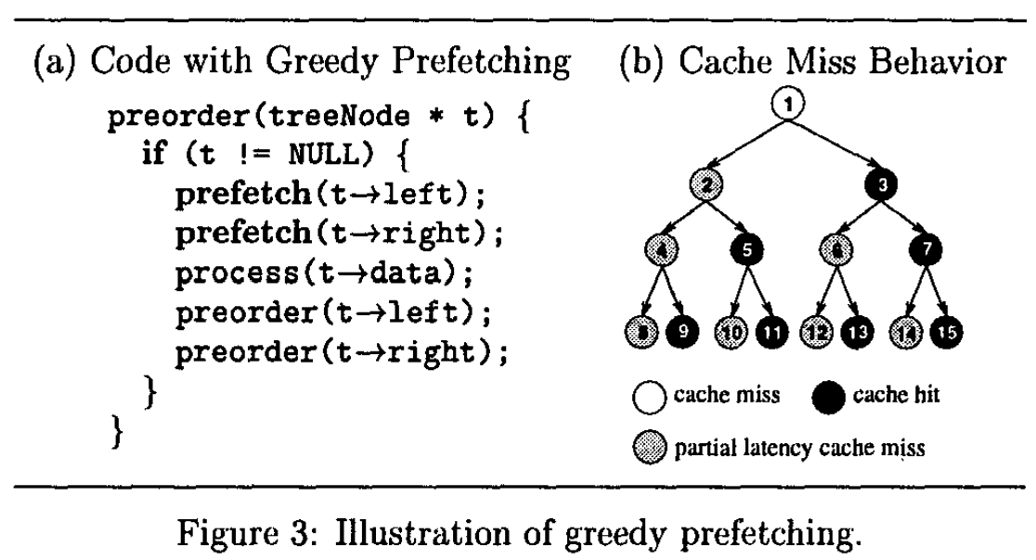
0. No Prefetching
process() latency: 1 cycle
cache miss latency: 2 cycles
#1
miss
process(node 1)
#1
#2
miss
#2
#4
miss
#4
#8
miss
#8
#9
miss
#9
#5
miss
#5
miss
#10
#10
Time
CPU Mem CPU Mem

Slide 12
Greedy Prefetching
process() latency: 1 cycle
cache miss latency: 2 cycles
⇒ Prefetching Distance: d = 2
#1
miss
#1
#1
#1
#2
#2
miss
#3
#2
#4
#2
#5
#4
miss
#4
#8
#9
#4
#8
#8
miss
#9
#8
#5
#10
miss
#11
#9
#10
#9
#11
miss
#3
#5
#5
miss
#10
#10
CPU Mem CPU Mem

Slide 13
Greedy Prefetching
Greedy Prefetching in k-ary RDS
Each node has k pointers to other nodes
Observation: Only one pointer is followed immediately during traversal
Greedy idea: Remaining k-1 pointers are natural jump-pointers
  Can be prefetched immediately upon visiting the node
Limitation: Prefetched nodes may be evicted before use
Generalization: For a k-ary tree, the fraction of nodes where latency is fully hidden is roughly (k-1)/k, assuming prefetched nodes are not displaced from cache

Slide 14
II𝓕ll := number of dereferences
At node n_{i} with address A_{i}, prefetch node n_{i+d}
Prefetching Schemes | Naive | Greedy | History-Pointer | Data-Linearization
II𝓕ll | d | 1 | 1 | 0
Structures | / | Nature jump pointers | Artificial jump pointers (= History–pointers) | Mapping the nodes at creation time
Strengths | / | ▪️Low runtime overhead ▪️Straightforward to implement in a compiler | ▪️hide nearly all of the latency for subsequent traversals of the RDS | ▪️Without requiring any pointer dereferences
Limitations | / | ▪️Not offer precise control over the prefetching distance | ▪️execution overhead & space overhead ▪️RDS traversal patterns need to be stable | ▪️Only beneficial when RDS changes only slowly (or not at all)
Use Cases | / | Most widely applicable | Same RDS traversal patterns | RDS changes only slowly (or not at all)

Slide 15
2. History Pointer Prefetching
History-Pointer Prefetching
Idea:
  Create history-pointers in node n_{i} to record A_{i+d} observed in recent traversal
  (Can store multiple pointers to handle different traversal orders)
Effective if traversal patterns do not change rapidly
Construction:
  Maintain a FIFO queue of length d with last d visited nodes
  After first complete traversal, all history-pointers are set
Performance:
  First traversal: no improvement (history-pointers not set yet)
  Subsequent traversals: hides nearly all latency
  (Greedy prefetching hides only a fraction)

Slide 16
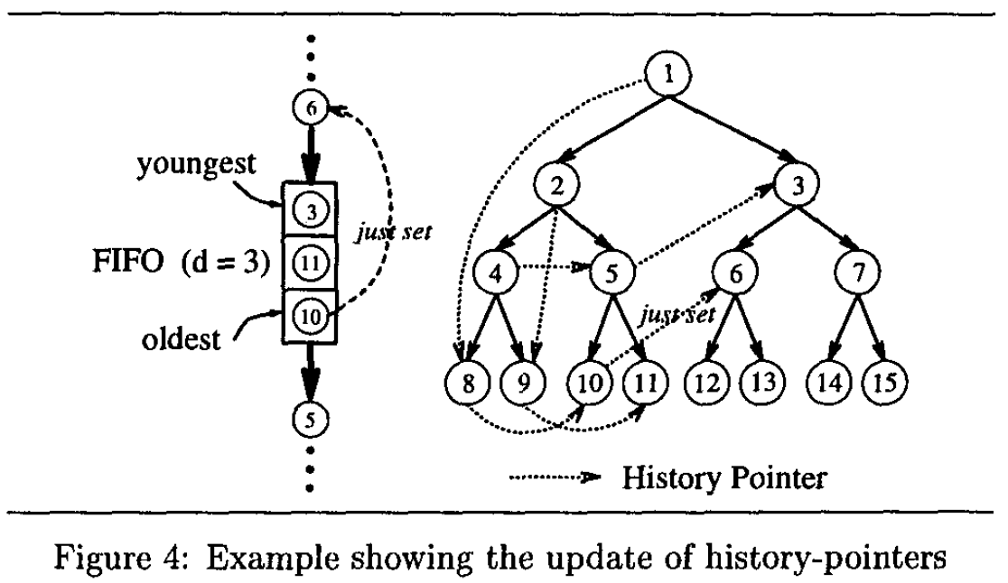
2. History Pointer Prefetching

Slide 17
II𝓕ll := number of dereferences
At node n_{i} with address A_{i}, prefetch node n_{i+d}
Prefetching Schemes | Naive | Greedy | History-Pointer | Data-Linearization
II𝓕ll | d | 1 | 1 | 0
Structures | / | Nature jump pointers | Artificial jump pointers (= History–pointers) | Mapping the nodes at creation time
Strengths | / | ▪️Low runtime overhead ▪️Straightforward to implement in a compiler | ▪️Hide nearly all of the latency for subsequent traversals of the RDS | ▪️Without requiring any pointer dereferences
Limitations | / | ▪️Not offer precise control over the prefetching distance | ▪️Execution overhead & space overhead ▪️RDS traversal patterns need to be stable | ▪️Only beneficial when RDS changes only slowly (or not at all)
Use Cases | / | Most widely applicable | Same RDS traversal patterns | RDS changes only slowly (or not at all)

Slide 18
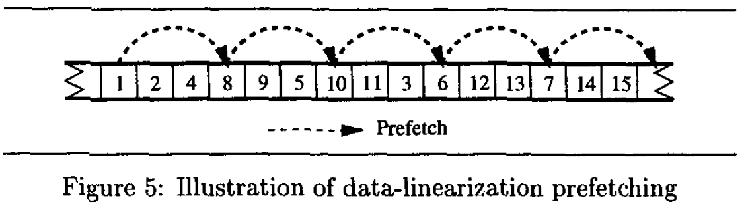
3. Data-Linearization Prefetching
Data-Linearization Prefetching
Goal: Predict A_{i+d} precisely without pointer dereferences (II𝓕ll = 0)
Key idea: Map heap-allocated nodes likely accessed together into contiguous memory
  Improves spatial locality
  Compute A_{i+d} via simple arithmetic: &x[i + d] = &x[i] + d * sizeof(x[0])
When to perform mapping:
  Best at node creation time
  Works well if creation order matches traversal or can be safely reordered
  Dynamic remapping is expensive or unsafe
Limitations:
  If RDS structure changes radically, program correctness is preserved, but prefetching benefit is lost

Slide 19
II𝓕ll := number of dereferences
At node n_{i} with address A_{i}, prefetch node n_{i+d}
Prefetching Schemes | Naive | Greedy | History-Pointer | Data-Linearization
II𝓕ll | d | 1 | 1 | 0
Structures | / | Nature jump pointers | Artificial jump pointers (= History–pointers) | Mapping the nodes at creation time
Strengths | / | ▪️Low runtime overhead ▪️Straightforward to implement in a compiler | ▪️Hide nearly all of the latency for subsequent traversals of the RDS | ▪️Without requiring any pointer dereferences
Limitations | / | ▪️Not offer precise control over the prefetching distance | ▪️Execution overhead & space overhead ▪️RDS traversal patterns need to be stable | ▪️Only beneficial when RDS changes only slowly (or not at all)
Use Cases | / | Most widely applicable | Same RDS traversal patterns | RDS changes only slowly (or not at all)

Slide 20
Implementation of Greedy Prefetching
Analysis
Scheduling Prefetches

Slide 21
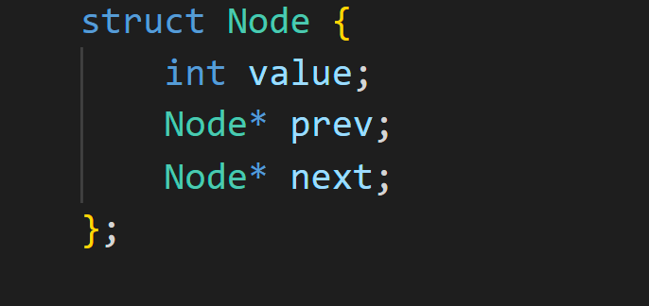
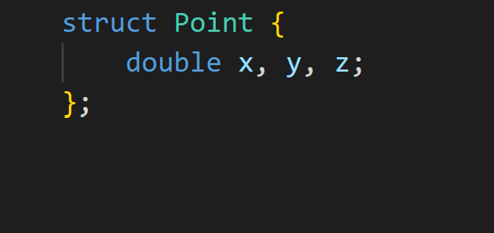
Analysis
Discover data structures with the appropriate types
Type declaration information
  Figure out which data objects are Recursive Data Structures
RDS type
Non RDS type

Slide 22
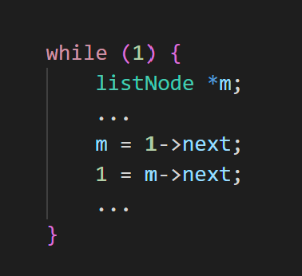
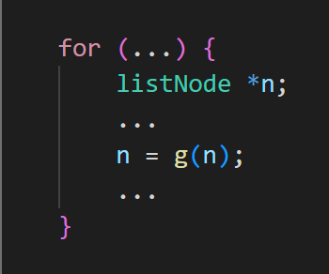
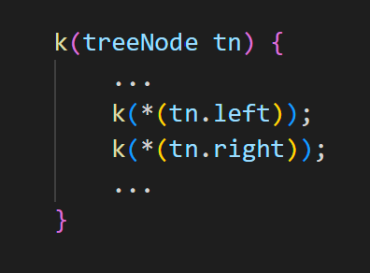
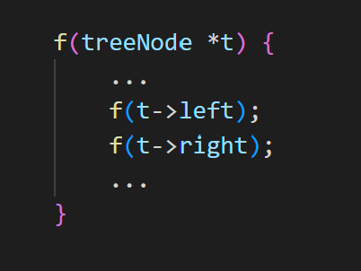
Analysis
Figure out which control structures are traversing the RDSs
Looks for loops or recursive procedure calls
  Compiler’s heuristic : Find recurrent pointer update
    A pointer keeps being updated from a field of itself
Propagates pointer values using a simplified but less precise pointer analysis
  Which pointer variables point to an RDS, how values change

Slide 23
Scheduling Prefetches
Compiler inserts greedy prefetches
At the point where the recurrent pointer update occurs
  Inserts prefetches of all pointers within this object that points to RDS-type objects
    Earliest points where addresses are available
Propagating the earliest generation points of pointer values with the values allows the computation of availability of prefetch addresses

Slide 24
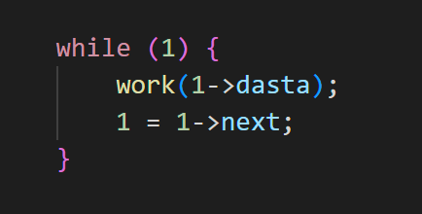
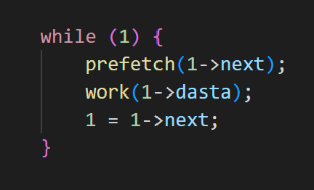
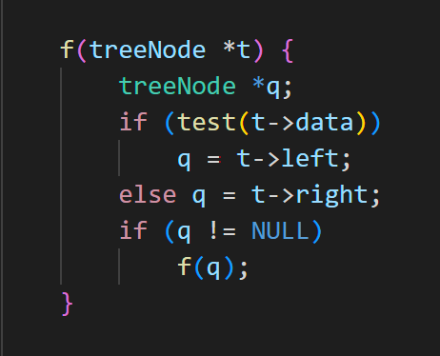
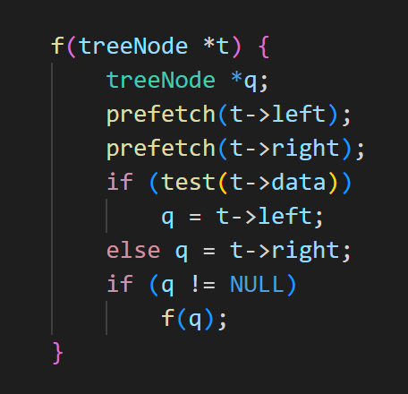
Scheduling Prefetches

Slide 25
Evaluation
Testing & Results

Slide 26
Experimental Framework
Goal: quantify how well compiler-inserted prefetches hide memory latency for recursive data structures
Metrics: speedup, stall cycles, prefetch coverage, and prefetch overhead
  Also explore robustness: unnecessary prefetches, sensitivity to prefetch distance and miss latency

Slide 27
Experimental Framework (Cont’d)
Benchmarks: 10 pointer-intensive Olden programs (lists, trees, graphs, etc.)
Experimented with detailed, cycle-accurate simulations
  Run on “dynamically-scheduled, super-scalar processor similar to the MIPS R10000”
Also use a custom allocator
  Minimize impact of store-stalls when initializing dynamic mem objects
  >2x speedup over malloc, especially for small, frequently created objects

Slide 28
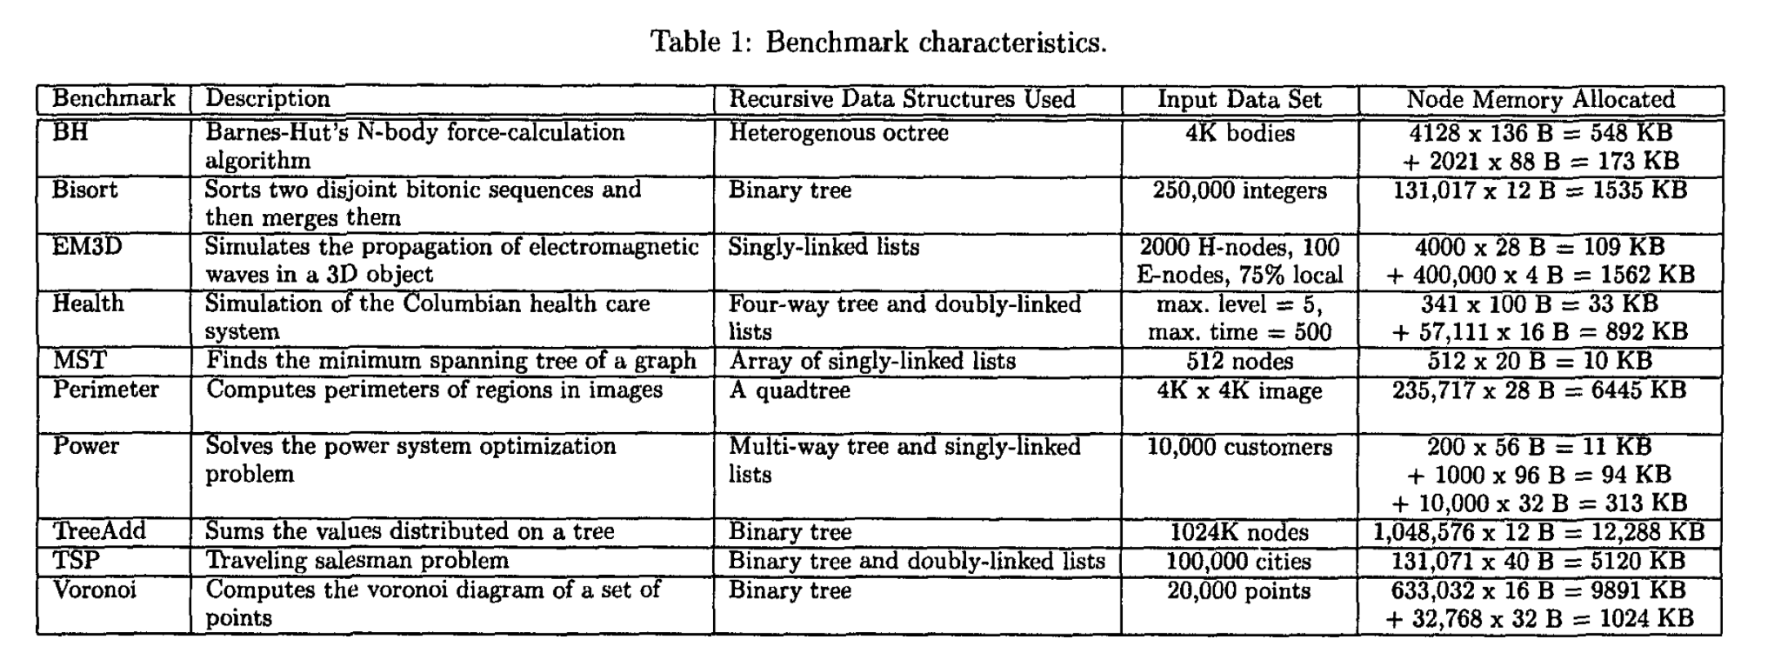

Slide 29

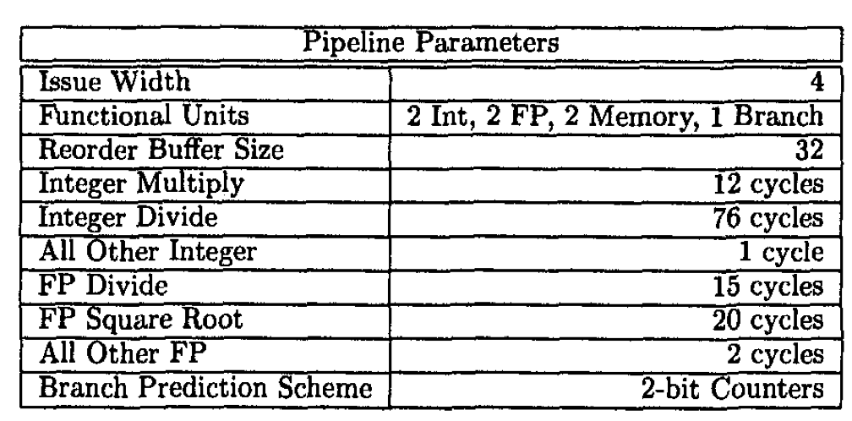
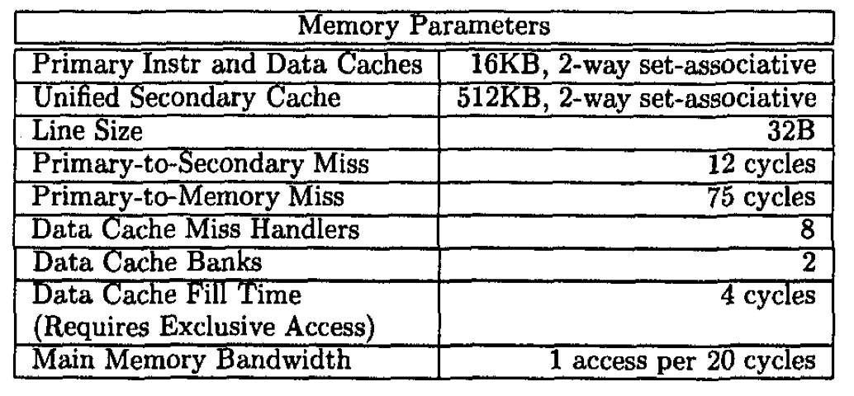

Slide 30
Results Overview
Compiler-Inserted Greedy Prefetching
Performance
  In roughly half of the Olden programs, compiler-inserted greedy prefetching yields noticeable speedups (up to ~45%) by shrinking load stall time.
Coverage
  Coverage factor (fraction of original D-cache misses that are either prefetched hits or misses) exceeds ~60% for 7/10 programs.
  Remaining misses often stem from scalar/array loads outside recognized RDS patterns.
Unnecessary Prefetches
  Some programs show >80% of dynamic prefetches bring already-cached data (i.e., high “unnecessary” rate).
  Despite this, overall execution time still improves because prefetch instructions are relatively cheap and scheduled early.

Slide 31
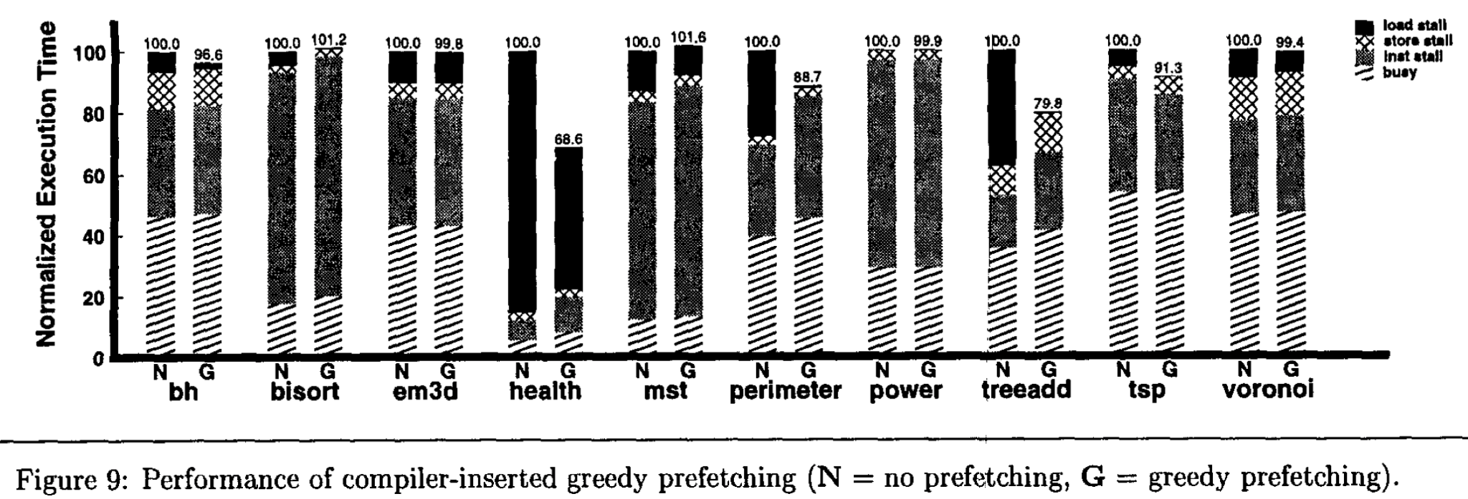
Results (Cont’d)

Slide 32
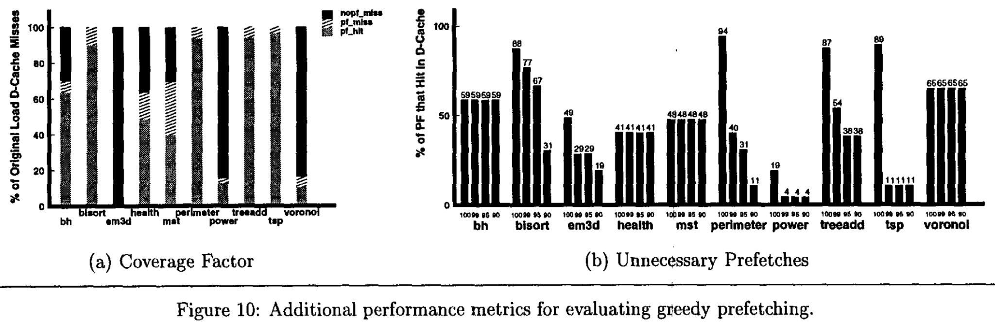
Results (Cont’d)

Slide 33
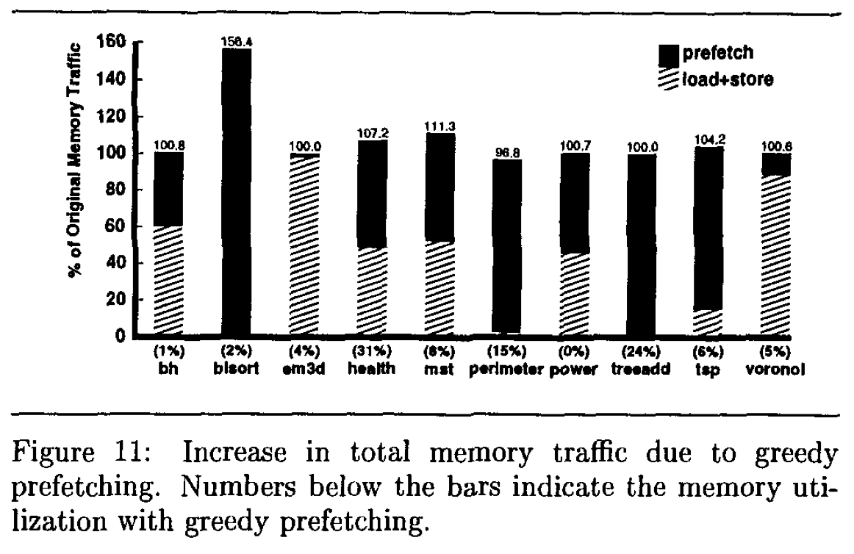
Results (Cont’d)

Slide 34
Results (Cont’d)
Compiler-Inserted Greedy Prefetching
Key Takeaways
  Even a simple, widely applicable greedy scheme can substantially reduce memory stalls
  But, still lots of room to remove useless and redundant prefetches

Slide 35
Remove Wasted Prefetches
Idea: Use memory feedback (e.g., profiling/simulator data) to measure the hit rate of each static prefetch site.
Heuristic: Eliminate prefetch instructions whose addresses almost always hit in the cache (i.e., very high prefetch hit rate), keeping only high-payoff prefetches.
Results
  Light pruning of high-hit prefetch sites yields small but consistent extra speedups (by cutting useless/redundant traffic) on several of the benchmarks.
  Too aggressive pruning reduces miss coverage and hurts performance; need to balance overhead vs coverage.
Takeaway: better locality analysis can make compiler prefetching cheaper without redesigning the core prefetch algorithm.

Slide 36
Other Approaches
History-Pointer Prefetching & Data Linearization Prefetching
History-pointer prefetching
  Adds “history pointers” to nodes to prefetch further ahead without pointer chasing.
  For health, improves speedup relative to greedy (~40% better) via:
    Higher miss coverage (e.g., ~64% → ~100%)
    Fewer unnecessary prefetches (e.g., ~41% → ~29%)
  Tradeoff: extra instructions & memory to maintain history pointers.
Data Linearization prefetching
  Relies on laying out nodes so traversal order has locality
  Achieves precise control of prefetch distance and good coverage, but only when a stable traversal order exists.
    E.g., for perimeter and treeadd

Slide 37
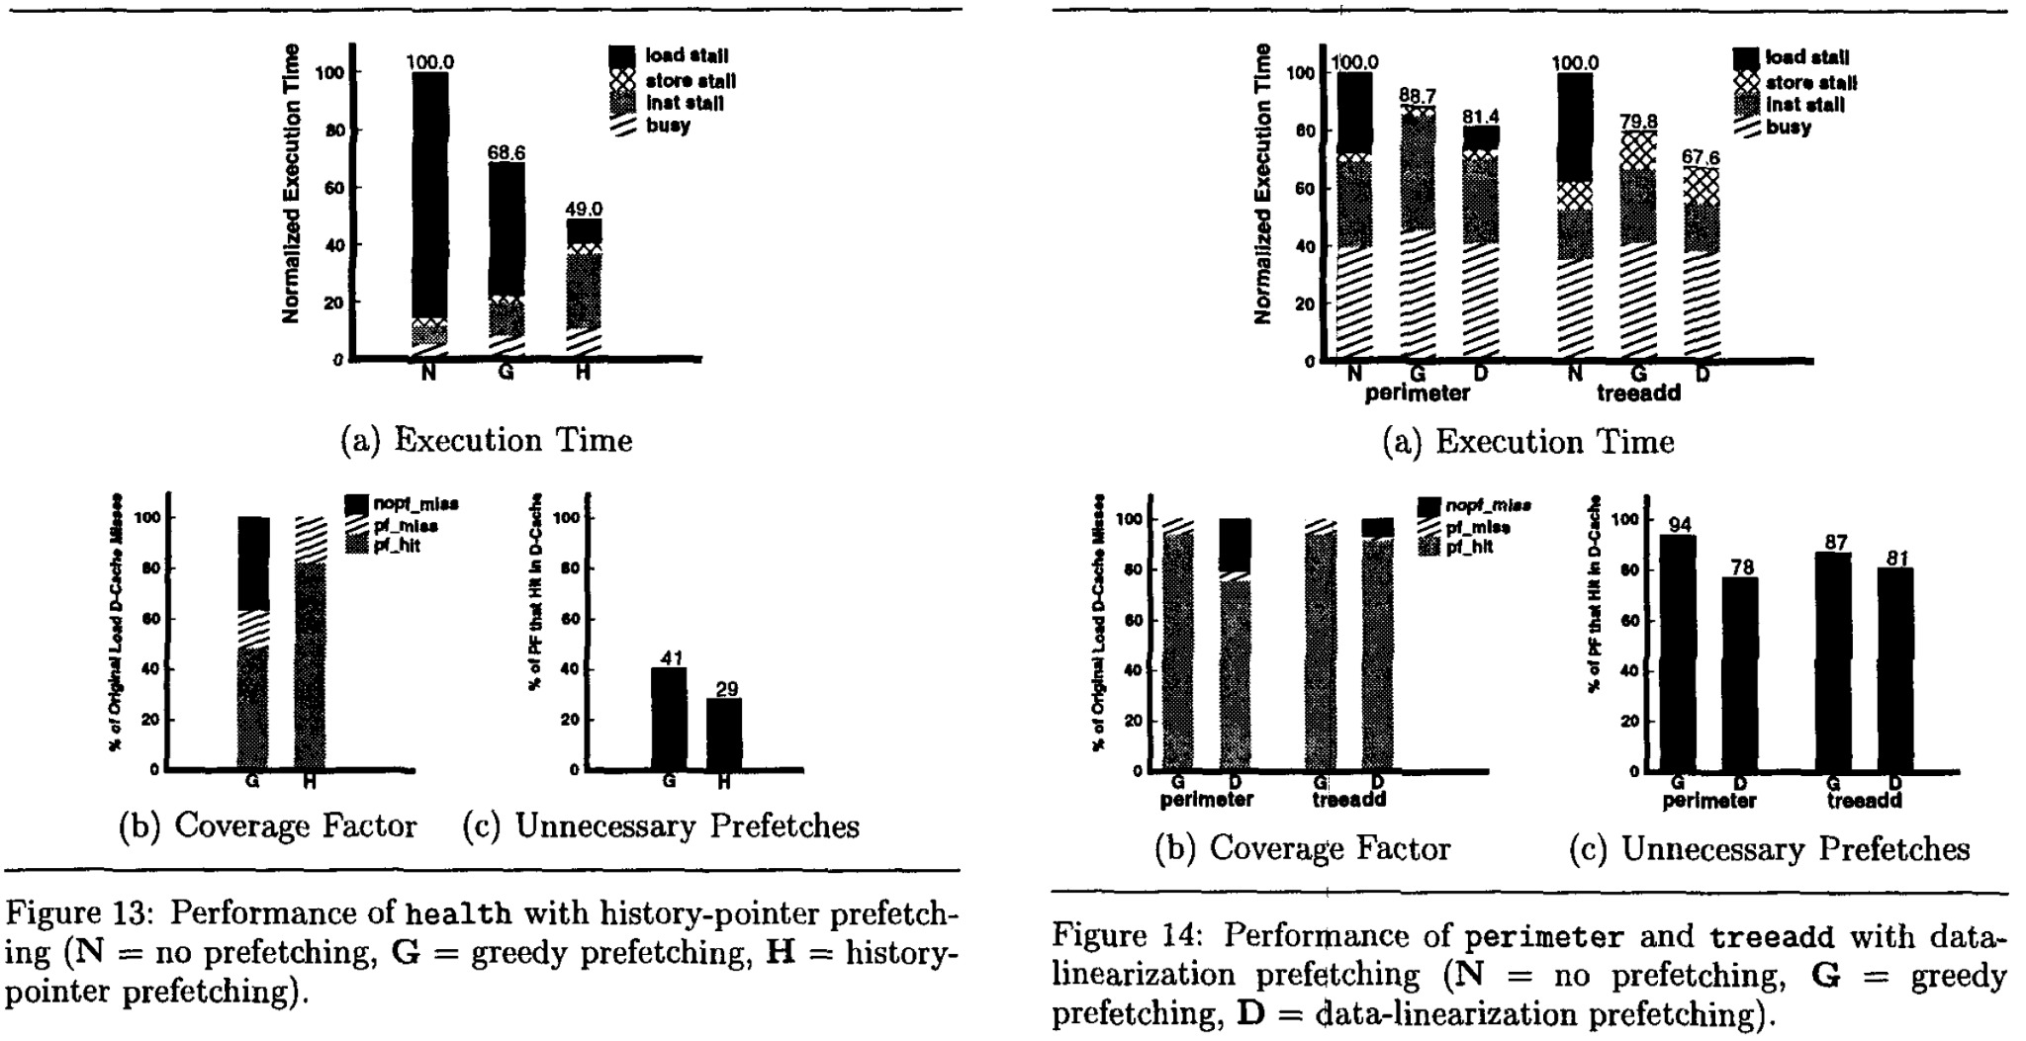

Slide 38
Architectural Support for Prefetch RDSs
Problem #1 — Memory Function Units
  Prefetching adds both prefetch instructions and extra loads (e.g., for jump-pointers), increasing pressure on memory units.
  Varying the number of memory units shows that two units capture most of the performance benefit; going beyond that yields diminishing returns.
Problem #2 — Non-Excepting Memory Operations
  RDS codes frequently generate invalid prefetch addresses (NULL / invalid pointers), unlike array codes where it mainly happens at array bounds.
  With excepting prefetches, the compiler must guard many prefetches with explicit NULL checks, and the out-of-order core cannot fully hide this overhead.
    Noticeable slowdowns in some benchmarks.
  With non-excepting prefetches, those guards are unnecessary, so we keep most of the coverage with much lower overhead.

Slide 39
Conclusion
Related Works

Slide 40
Related Works
Software Prefetching for Indirect Memory Accesses (CGO 2017)
  Develops a LLVM IR pass that inserts prefetches automatically for indirect memory accesses
  Use the compiler to generate prefetches that hardware can’t figure out easily, but implemented as an LLVM pass and targets modern CPUs
Coroutines for Prefetching Dynamic Data Structures (2024)
  Builds an LLVM compiler pass that transforms code to use coroutines that prefetches in dynamic data structures
  Reduce main-thread overhead and overlap memory latency better

Slide 41
Related Works
Techniques for Bandwidth-Efficient Prefetching of Linked Data Structures (2009)
  Hardware prefetcher specialized for linked data
Effective Jump-Pointer Prefetching for Linked Data Structures (1999)
  Introduces hardware/software jump-pointer prefetching for linked lists and trees

Slide 42
Thank you!
Questions?

