Slide 1
Serberus: Protecting Cryptographic Code from Spectres at Compile-Time
Group 11: Alex Georgiev, Max Christman, Brian McNulty

Slide 2
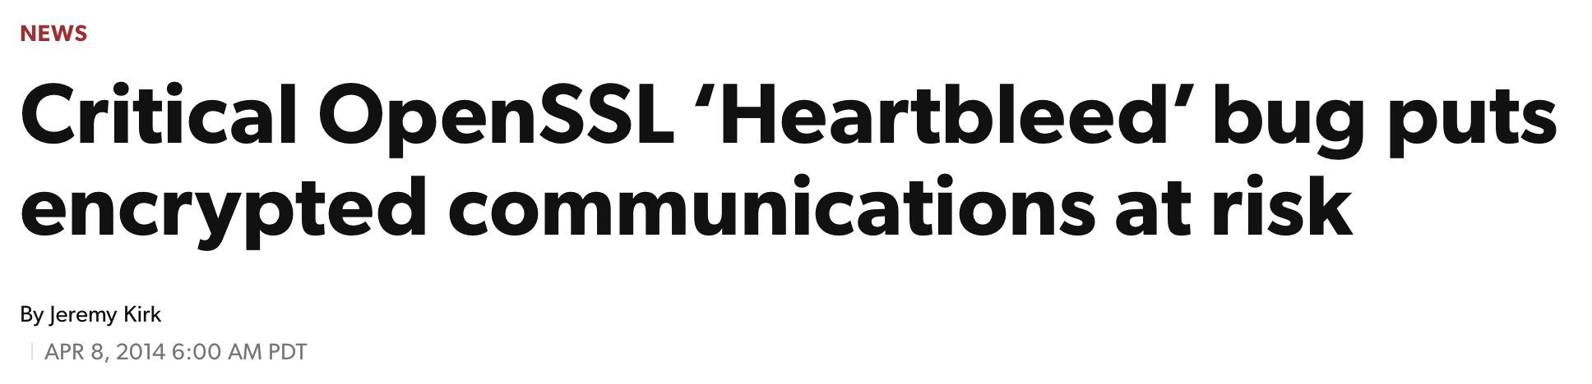


Motivation
Side-channel attacks exploit programs whose behavior depends on secret values
This can include timing, memory access patterns, resource usage, etc.
Any code which shares resources with an untrusted party is potentially vulnerable
Headline 1: PCWorld, Headline 2: NBC News, Headline 3: The Boston Globe
Notes:
Bugs involving cryptographic code are particularly harmful
In 2014, there was a widespread bug in OpenSSL, which is used for TLS (i.e. what lets you view websites over an encrypted connection)
This was called Heartbleed, and it affected hundreds of thousands or even millions of popular websites
Heartbleed had a huge impact, but it was a buffer over-read, and it was relatively simple to detect and fix
It involved a victim disclosing secrets directly
Even more insidious are side-channel attacks, which rely on inferring secrets through a program’s secret-dependent behavior
These are particularly dangerous in cryptographic code
If an attacker shares resources with the cryptographic code, they can measure its execution (time, memory access, etc.) and learn something about its secrets

Slide 3
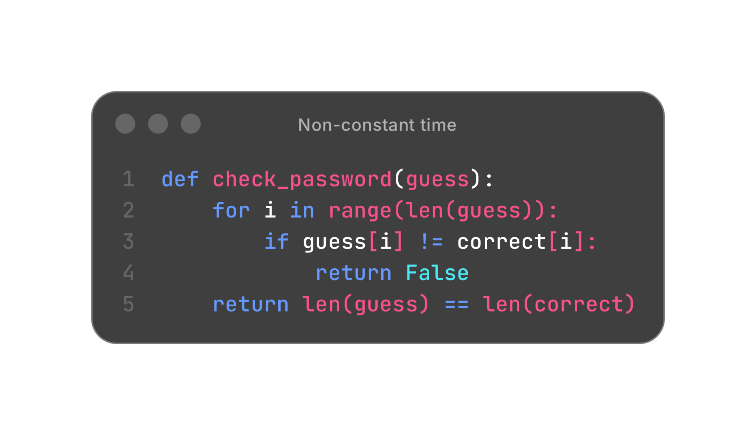
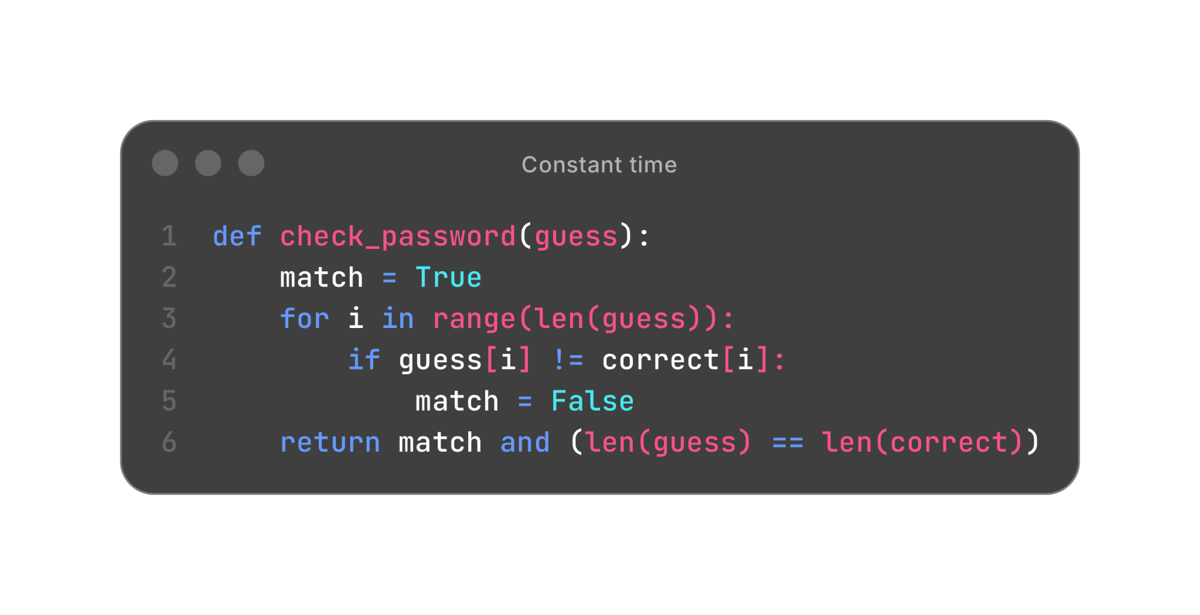
Constant-time code
Notes:
Constant-time code is code whose execution doesn’t depend on potentially secret information
Execution can refer to time, but also memory access patterns and other resource usage
Here’s an example of a program that’s not constant time
This function checks if a password guess was correct by looping through each character of the password
If a character doesn’t match, it immediately returns
The execution time of the program leaks how many characters of the guess match the correct password
An attacker can use this to cut down their number of guesses dramatically, as they can guess characters independently
Here, we have a constant-time version of the same program
This program loops through all characters of the guess, even after it sees a character that doesn’t match
This will take the same amount of time to run regardless of the guess
This is slower than the first example

Slide 4

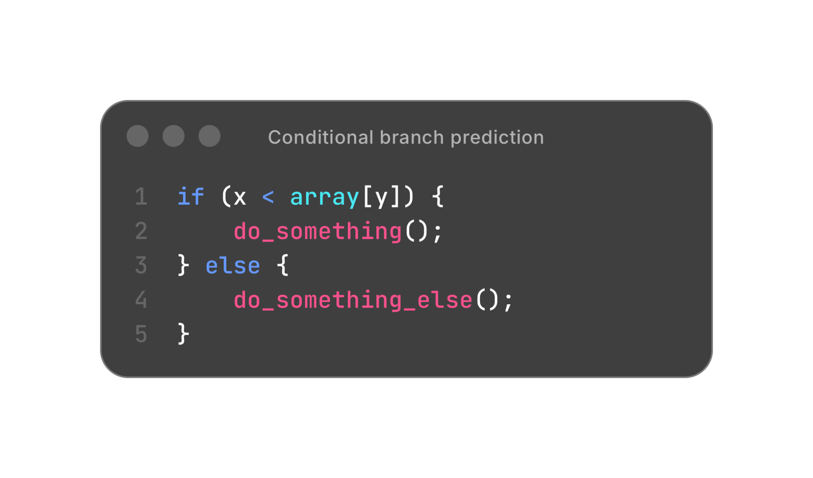
Speculative execution
Notes:
It turns out, this definition of constant time is incomplete due to how modern processors are implemented
When a processor encounters a branch, like on line 1, it may take hundreds of cycles to load from memory and determine if the branch should be taken
Instead, the processor will use a branch predictor to guess the direction of the branch and speculatively execute the instructions
Modern branch predictors are highly accurate, meaning it pays off to guess
And just undo its work when the branch resolves if the guess was wrong
It turns out that even if the registers and architectural state are restored, speculative execution has other side effects which aren’t restored
These side effects, most prominently the cache state, can have serious security consequences
This was first shown in Spectre in 2019

Slide 5
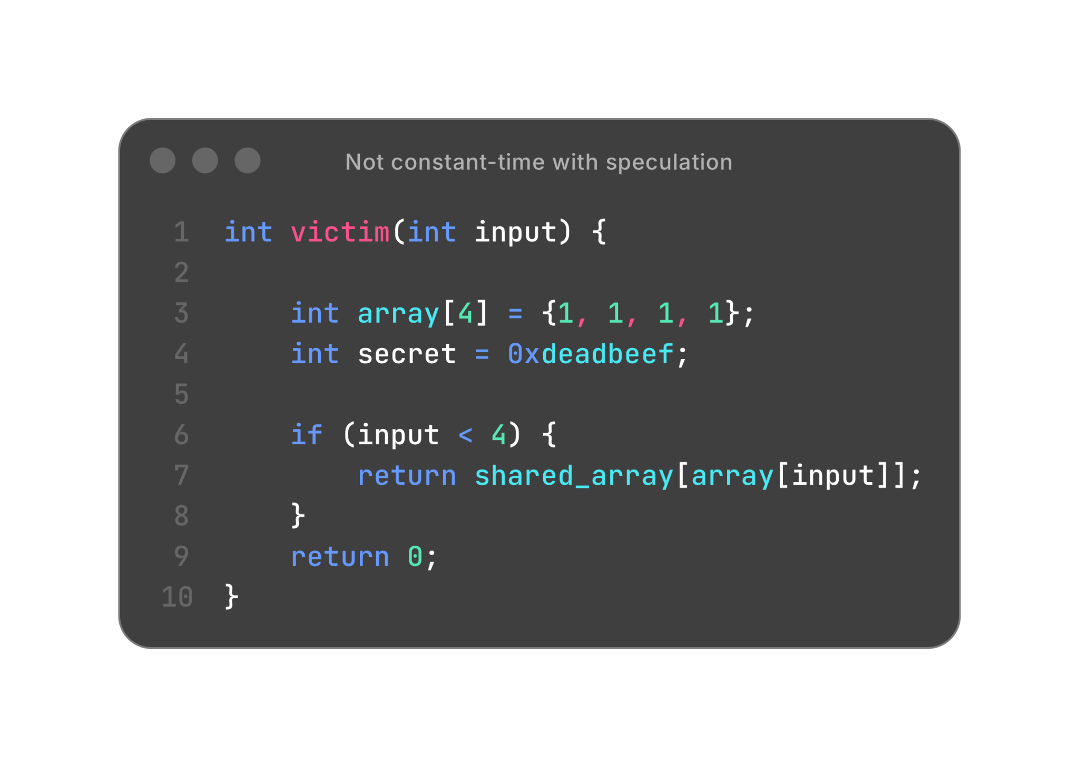
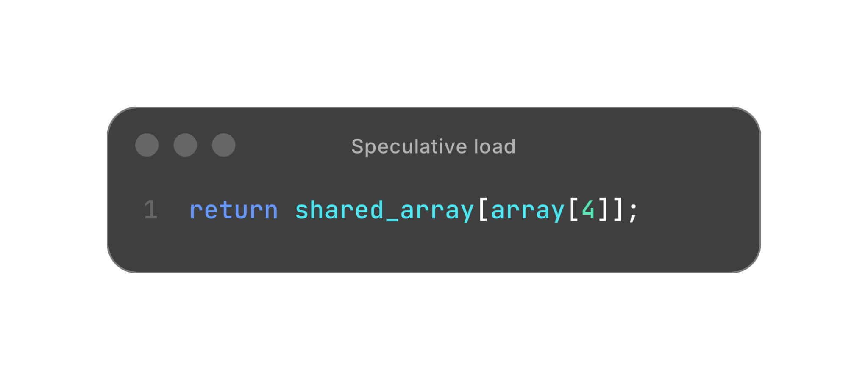
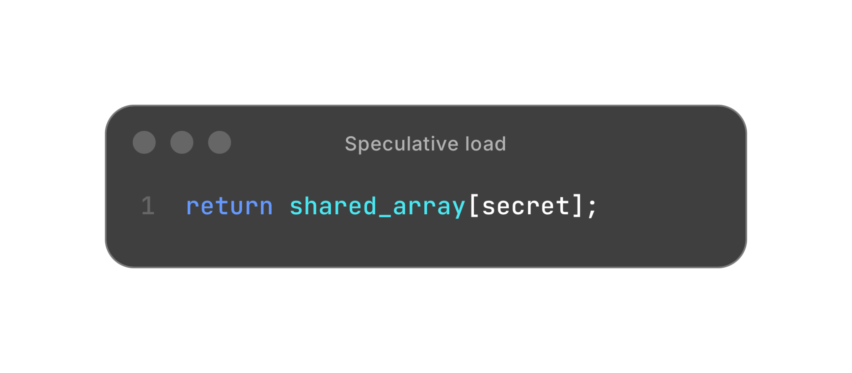
Speculative execution and constant-time
Notes:
Now, let’s go back to the idea of constant-time code
This time, we’ll look at what happens if we consider speculative execution
In array, we have four public values followed by a secret value on the stack
We check the bounds, and then use the value from the array to indexed into a shared array
This code is normally constant-time
It has constant execution time and even memory access patterns
We are only ever accessing shared_array[1]
However, due to branch misprediction, this example could speculatively take the input < 4 branch with input = 4
This would perform a secret-dependent memory access to public_array, which can leave side effects in the cache
If an attacker also has access to shared_array, they can access it and time how long it takes to see which values were brought into the cache
Whichever indices are cached likely correspond to the secret
This code can be rewritten to be constant time, even in the case of branch misprediction
However, this involves removing all branches
Here, we use bitwise operations to compute a mask that will result in the same value as before
However, we always access all elements of the public array
This can be very costly if we have a large array
Ideally, we would like a more efficient method for mitigating speculative attacks

Slide 6











Problem
How can we make constant-time code secure from the wide variety of Spectre-style attacks?
All logos are licensed under Creative Commons.
Notes:
Every since these speculative attacks were discovered in 2019, researchers have discovered numerous additional vulnerabilities
There are many variants of speculative attacks that work slightly differently
Outside of the original attacks, called Spectre and Meltdown, there were attacks exploiting
Internal CPU buffers (MDS and Load-value injection)
Web browsers (Spook.js and iLeakage)
Secure enclaves (Foreshadow and SGX.fail)
Load address and load value predictors (SLAP and FLOP)
Branch prediction history, both conditional and indirector (Pathfinder and Indirector)
How can we defend against all of these attacks?
They are widely present in code without architectural vulnerabilities

Slide 7
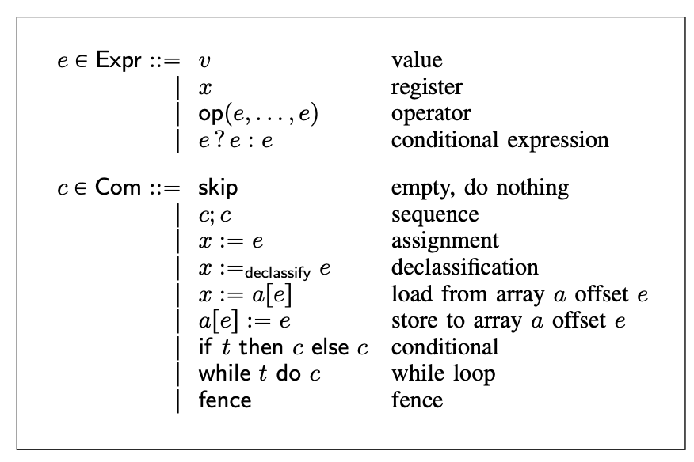

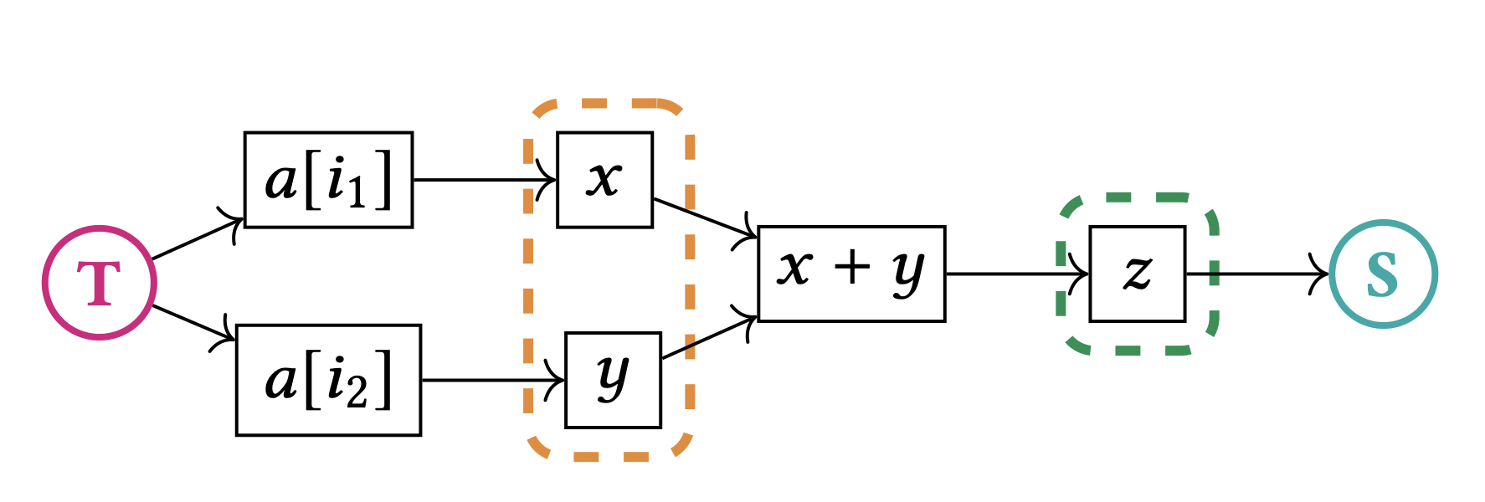
Limitations of previous work
Symbolic execution can detect Spectre vulnerabilities
Formal methods can also detect these
Compiler tools can mitigate vulnerabilities
Figure 1: Klee, Figure 2: https://eprint.iacr.org/2022/426.pdf, Figure 3: https://cseweb.ucsd.edu/~dstefan/pubs/vassena:2021:blade.pdf
Notes:
Symbolic execution has been used to detect speculative vulnerabilities, but it doesn’t scale well to large programs
And it completely misses some types of vulnerabilities
Formal methods have also been used to model and detect leaked information, but not to comprehensively mitigate the leaks
Finally, there have been compiler tools to mitigate Spectre vulnerabilities, but they aren’t formally proven and typically focus on just one type of vulnerability
We would like a solution which can detect and provably mitigate all types of speculative vulnerabilities, without sacrificing too much performance

Slide 8

Serberus
Problem: A leaky instruction can leak secret data when executed speculatively from an misprediction
→ Serberus secures constant-time code against speculative attacks
Input: constant-time program
Implemented as 3 LLVM passes
Written in 2023, published in 2024
Notes:
Talk about how misprediction is induced
Talk about types of vulnerable instructions
These attacks are only possible when branches are mispredicted, and certain vulnerable instructions are executed

Slide 9
Avenues of misprediction
Conditional branch prediction (beq, regA, regB, offset)
Indirect branch prediction (call regA)
Return address prediction (ret)
Store-to-load forwarding prediction
  A load may read from an older same-address (could be uncommitted) store
Predictive store forwarding
  A load may read from any older store (before their addresses have even resolved)
  Serberus simply disables via hardware because of performance
Notes:
Cond Branch - PHT; indirect - BTB
STL - a load may speculatively read from any same-addr uncommitted store or the most recent same-addr committed store

Slide 10
Leaky Instructions
Definition: instructions that put a secret value in a publicly-typed register
Loads/Stores with non-constant (runtime-dependent) addresses
  Could access or depend on secrets
Uninitialized stack loads
  Speculatively operate on values from a previous stack frame before stack initialization
  Enabled by store-to-load forwarding prediction
Unexpectedly secret arguments
  Secrets in registers used in speculatively executed functions
Notes:
NCAL - addr is computed at runtime

Slide 11
Non-constant-address stores
x = 0
*p = secret
temp = A[x]
Speculative non-constant-address store that precedes from a non-constant-address load

Slide 12
Defense: LFENCE insertion
LFENCE prevents instructions after it from being executed speculatively
sw r1 → addr in r4
Source
Intel
Serebus
LFENCE
r3 = r3 + 2
LFENCE
lw r4 ← from 0xbeef
Sink
r4 = r4 + r3
LFENCE
sw r4 → to 0xbeef
Notes:
LFENCE guarantees that younger instructions will not execute until older ones commit → 440% overhead when inserted after every cond branch

Slide 13
Uninitialized stack loads
Speculatively read stale data from stack
SP→
x_secret
process_secret():
x = secret
…
return
unrelated_func():
y = 0
z = array[y]
x_secret is speculatively read before y = 0 is written!
SP→
z = array[x_secret]

Slide 14
Defense: Function-private stacks
Each function gets its own stack on which only it can allocate (never reused)
load correct private stack pointer from memory
→ cannot read stale data from other stacks
PSP 1 →
PS 1
PS = private stack
PSP = private stack pointer
PSP 2 →
PS 2
PSP 3 →
PS 3
Notes:
If procedures share the same data stack, it is difficult to ensure that a publicly-typed stack access will not read a secret value transiently

Slide 15
Unexpectedly secret arguments
If a processor speculates execution of the wrong function, its arguments could refer to the same registers the calling function stores secrets in
Since the incorrect function is not expecting a secret argument, it could speculatively execute instructions that leak secrets through the unexpectedly secret arguments
void do_nothing() { }
void dangerous(int x) {
// This will leak the value in
// the register when speculated
int y = public_array[x];
}
void secret_func(int &secret) {
int temp = secret;
// Speculative execution can cause
// dangerous() to be speculated
// with unexpected secret register
do_nothing();
}
Notes:
-- brian start --

Slide 16
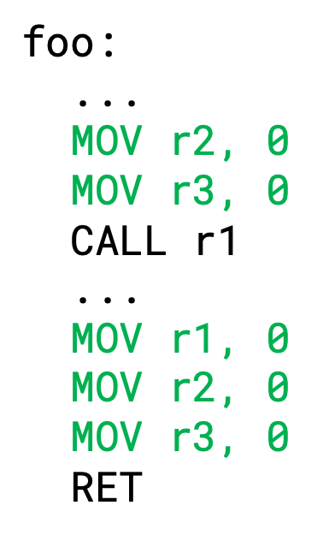
Defense: Register cleaning
Sets all non-argument registers to zero before calling any function within code handling secret arguments
“Argument registers” are determined based on the definition of the target function
Secret values cannot be used as parameters to public and secret functions, as both can cause a secret to be speculatively executed
Instead, all secret arguments must be passed by reference and not by value

Slide 17
Non-constant address loads
All three of these defenses work to mitigate non-constant address loads
  LFENCE insertion prevents some speculative loads that could expose secrets
  Function-private stacks prevents stale secrets from other functions resulting in data leaks
  Register cleaning prevents registers from being exposed through public function arguments
The paper provides in-depth proofs to demonstrate that all of these defenses together prevent non-constant address loads
Fence
Insertion
Private Stacks
Register Cleaning
Non-constant address stores
Uninitialized loads
Unexpectedly secret args
Non-constant address loads

Slide 18
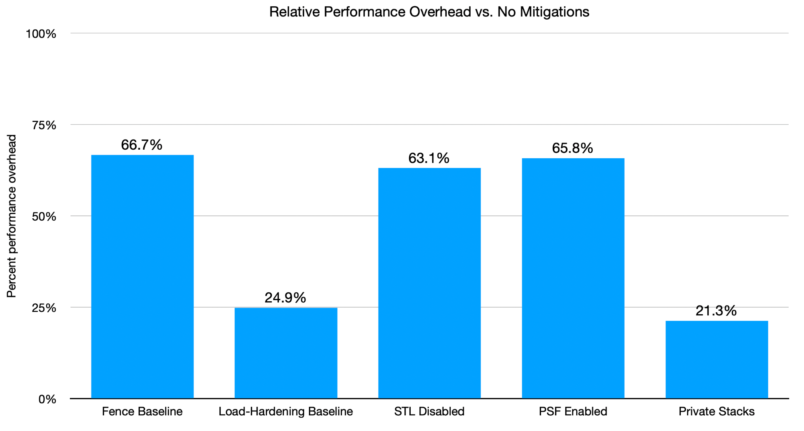
Notes:
Mitigation presented in the paper has less of an overhead than each of the baseline mitigations
LLSCT: 21.3%; Fence Baseline: 66.7%, Load-hardening Baseline: 24.9%
Private stacks cut down on the number of fences
STL (store-to-load) disabled: 63.1%, PSF (predictive store forwarding) enabled: 65.8%
Fence baseline inserts fences for every conditional branch so it has a higher overhead compared to only inserting fences to prevent transmitter functions
Overhead is based on no mitigation

Slide 19
Summary
Strengths:
First work to comprehensively defend constant-time code against Spectre attacks
Significantly less overhead than other mitigations
No annotations required (e.g., labeling secret values)
Only needed to rely on hardware to disable predictive store forwarding
Weaknesses:
Conservatively assumes any load/store with a runtime address may modify a secret
Requires program already be in constant-time format
Requires program pass secrets by reference
Relies on control-flow integrity hardware extensions (Intel CET)

Slide 20
Future Work
Improve performance to allow defenses to be more widely adopted
Support programmer-annotated secret values to avoid unnecessary LFENCE insertions, since fences dominate the overhead on Serberus
Support for hardening non-constant time code
Lower the overhead of predictive store forwarding so that it doesn’t have to be disabled
Notes:
Label secrets & use taint tracking so we don’t have to conservatively assume that any memory op with a runtime-calculated address could read/write a secret → cuts down on LFENCE insertions (the dominating overhead of Serberus)

