Slide 1
CIMA: Compiler-Enforced Resilience Against Memory Safety Attacks in Cyber-Physical Systems
Chekole et. al. Computers & Security 94 (2020)
Group 2: Ethan McKean, Andre Quimper Osores, Forest Zhang

Slide 2
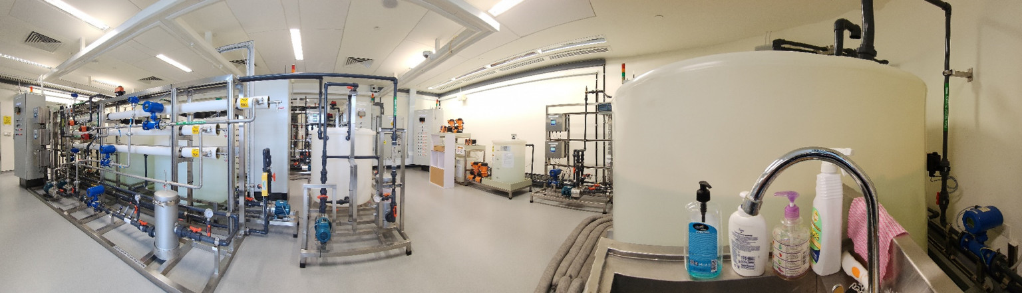
Motivation
Secure Water Treatment (SWaT)™ Testbed
Most Cyber-Physical Systems run Memory Unsafe C/C++
Memory safety vulnerabilities occur when a program incorrectly accesses memory locations it shouldn't, leading to security exploits.

Slide 3
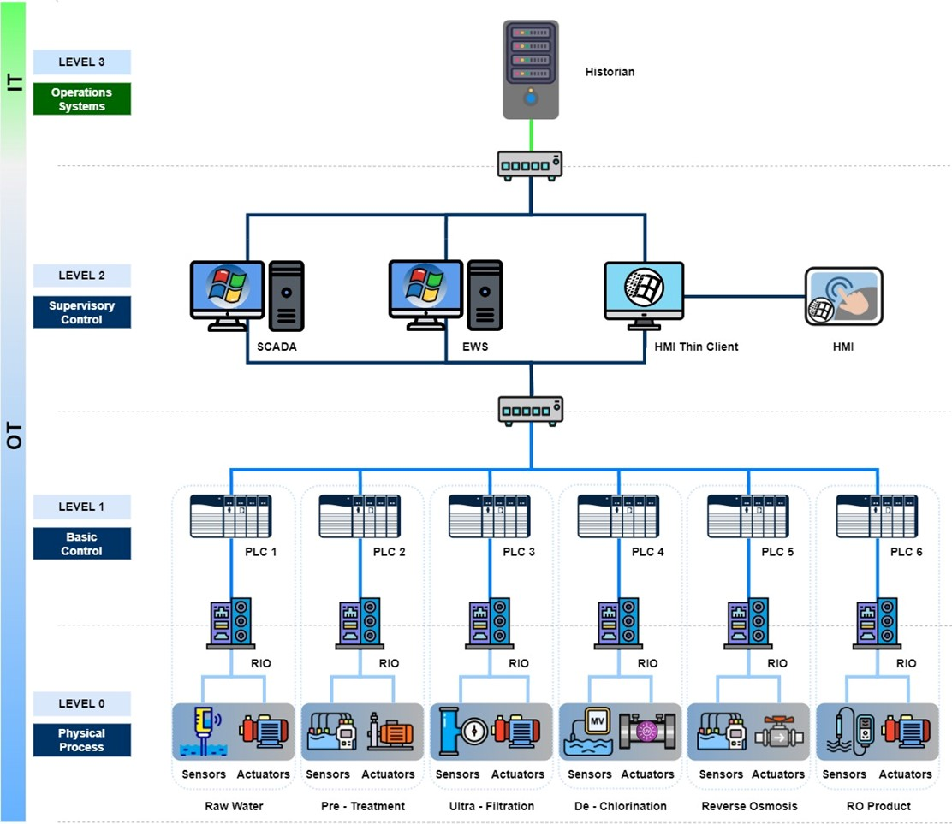
Potentially Untrusted Sources of Data for our PLCs
SWaT network diagram
Notes:
SCADA: Supervisory Control and Data Acquisition
EWS: Engineering Workstation

Slide 4
Other Defense Techniques
Static Program Analysis
  Unfeasible on real systems due to scalability issues
Self-healing or Live Patching
  Directly detect attacks and resume the corrupted system from a previous safe state
  Heavy overhead of maintaining system states for checkpoints.
AddressSanitizer (ASan)
  Abort the program upon detection of memory corruption
  Catastrophic on most Cyber-Physical Systems

Slide 5
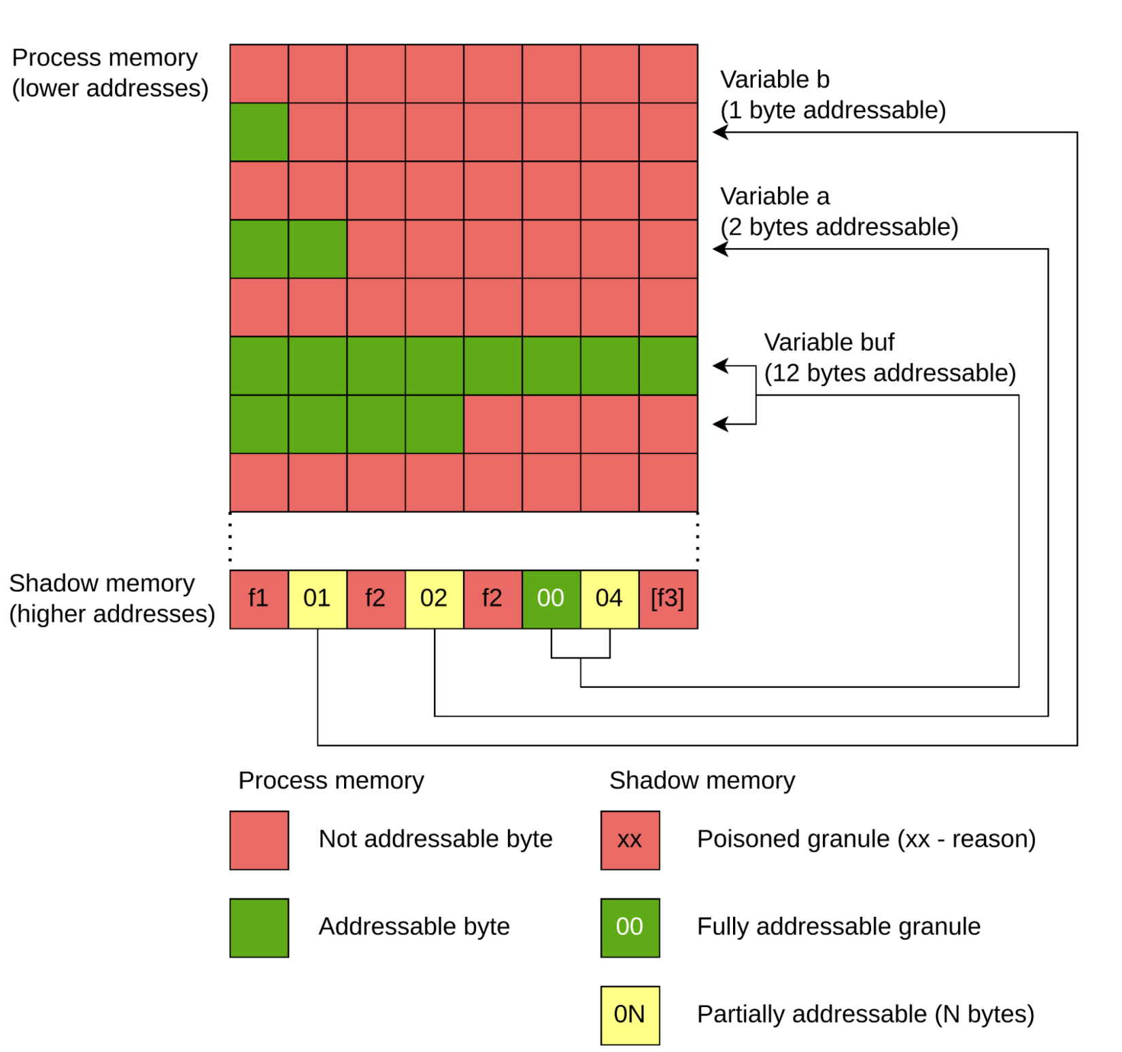
Technical Background: AddressSanitizer (ASan)
Notes:
Shadow Memory is a special region of memory that tracks metadata about process memory
Red zones are memory regions inserted between objects so that ASan can detect out of bounds accesses

Slide 6
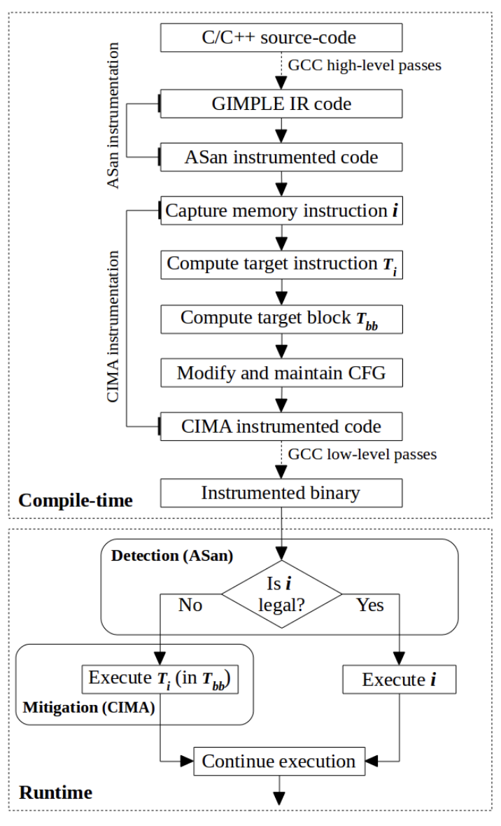
CIMA
Notes:
Note that CIMA implemented in GCC, we are going to target LLVM

Slide 7
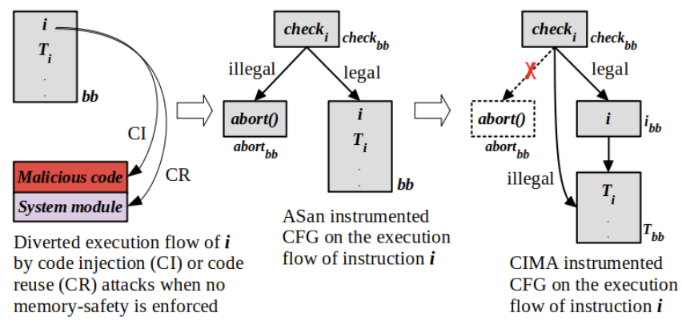
Scenario 1
Notes:
Figure 6: Illustrating the change of CFG in scenario 1 (i.e. i and Ti reside
in same basic block) involving three cases: attacker diverted CFG (without
memory-safety), ASan instrumented CFG (preventing exploitation but crashing
execution) and CIMA instrumented CFG (preventing exploitation and continu-
ing execution).

Slide 8
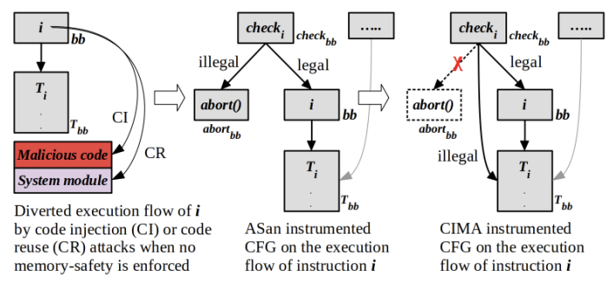
Scenario 2
Notes:
Figure 7: Illustrating the change of CFG in scenario 2 (i.e. i and Ti reside in
different basic blocks) involving three cases: attacker diverted CFG (without
memory-safety), ASan instrumented CFG (preventing exploitation but aborting
execution) and CIMA instrumented CFG (preventing exploitation and continu-
ing execution)

Slide 9


CPS Model
PLCs input scan, do logic, and output update
In the cyber physical model we care about
  Real-time (can we schedule in time)
  Physical state resiliency
Notes:
Note: define scan and cycle time

Slide 10
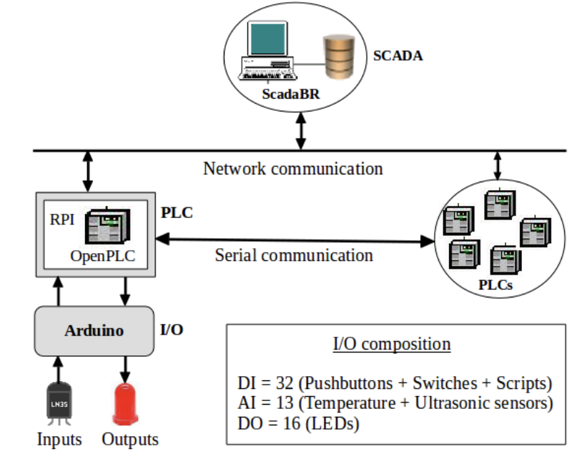
Evaluation Overview
2 OpenPLC test beds based on real world CPS:
Secure Water Treatment (SWaT)
Secure Urban Transportation System (SecUTS)
4 dimensions
Security
Efficiency
Resilience
Memory Overhead
Notes:
CIMA’s security evaluation used two real cyber-physical testbeds:
SWaT(secure water treatment) is a fully operational water purification testbed for research that produces five gallons/minute of doubly filtered water. Unfortunately, SWaT is designed using proprietary PLCs, so it was not possible for the researchers to directly modify the firmware of these PLCs. However, they have the specifications, so they replicated the system’s behavior that relate to the Scan time and Memory safety overhead of PLCs with an OpenPLC controller, which they called open-SWaT
An overview of the design is to the left but the exact details arent that important
SecUTS (secure urban transport system) was designed to research the security of a Metro SCADA system. . At a high level, it controls traffic lights and vehicle signals through distributed embedded controllers. Similarly, the PLCs are proprietary and needed to be replicated

Slide 11
Security
Detection and Mitigation accuracy
Tested on a wide range of safety attacks (buffer under/overflows, use-after-free, etc.)
Depends on ASan, works just as well with no false positives
Found vulnerability in the OpenPLC firmware that CIMA protected against
Notes:
Security- Defined as how accurately we mitigate memory safety violations
Tested a variety of vulnerabilities such as (stack, heap and global) buffer under/overflows, use-after-free errors (dangling pointers), use-after- return errors, initialization order bugs and memory leaks.
The nice thing about ASan is that it has no false positives on these errors and rarely has false negatives.
Cima correctly avoided any problems ASan detected
Discovered a global buffer overflow vulnerability in the OpenPLC firmware that CIMA protected against

Slide 12
Efficiency
Measure overhead
 | SWaT | SecUTS
ASan Overhead | 53.46% | 50.4%
CIMA Overhead | 8.06% | 6.53%
Total | 61.52% | 56.57%
 | SWaT | SecUTS
T_{c} | 10ms | 30ms
Mean T_{s} | 441.72μs | 398.39μs
Max T_{s} | 3167.15μs, | 2506.39 μs
Notes:
Go over
Seems sizeable, but
What we really care about is whether or not the overhead is tolerable for out real time constraints if we look at the cycle time and scan time, we are way underneath in both cases on average and even in the worse case.

Slide 13
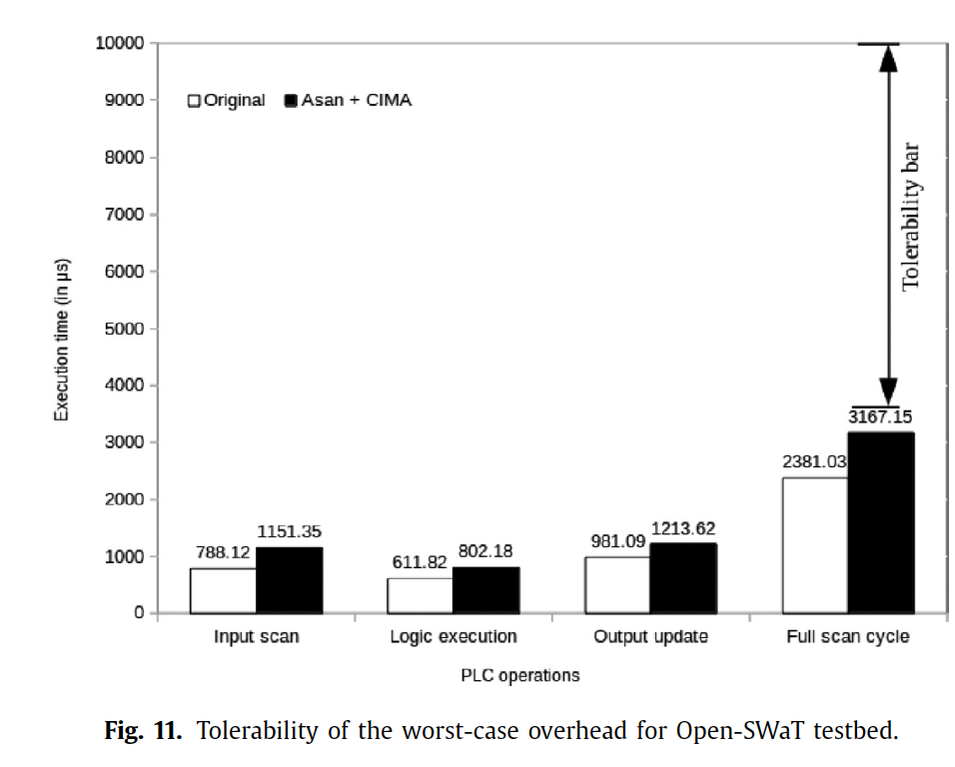
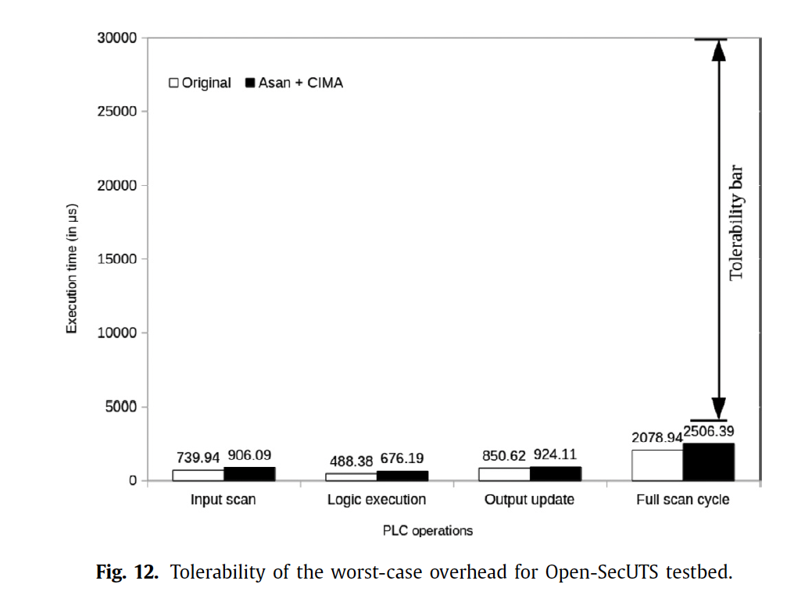
Resilience
Resilience follows from efficiency by construction because the system can only miss a cycle from overhead.
Notes:
Resiliency
The good thing about how we designed the system is that if the scan time is below the cycle time, we get resilience for free because the system basically never crashes. To emphasize how much we are under the threshold, we have these graphs that show the total scan time compared to the cycle time.

Slide 14
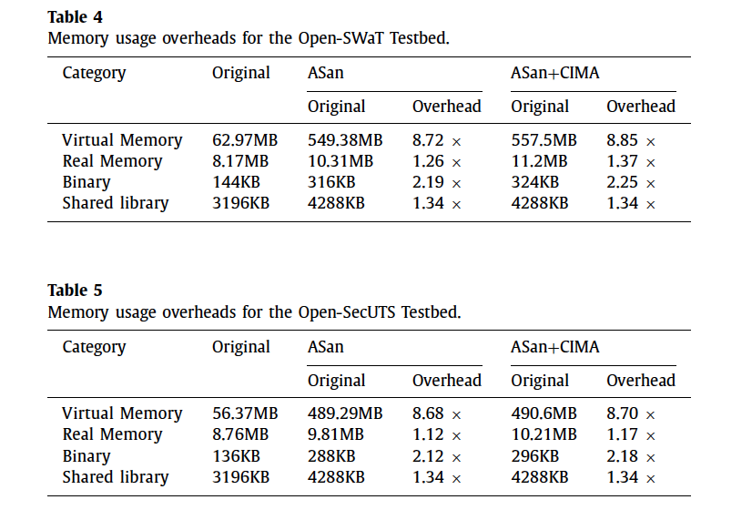
Memory Overhead
Majority of memory overhead came from Asan
Acceptable - PLCs have ≥1GB
Notes:
They measure the virtual memory usage, real memory usage, binary size and shared library usage.
They found a nearly 9x increase in virtual memory usage, primarily because of the allocation of large redzones with malloc
Real usage only increased by 1.1-1.37x
Deemed acceptable since most PLCs nowadays have >1GB of memory. If you look at the raw numbers, they all fall way under that.

Slide 15
Strengths and Weaknesses
Strengths
Relatively easy to implement
Works as well as ASan
Weaknesses
Reliant on ASan
Skipping instructions can be detrimental to the program/system
Evaluation does not compare to any other approaches to highlight advantages
Notes:
Strengths
Relatively easy to implement because it depends on ASan, and widely used tool
Works as well as ASan which is a well understood and dependable
Weaknesses
We also found that being reliant on ASancoudl be seens as a weakness, not as flexible and carries over the same edge case false negatives
Changing semantics can still be very bad– likely to be left in an undefined state–for example, invariants can be broken, variables could be uninitialized -. They even mentioned in the apper a pathological case where an attacker could cause an infinite loop – at most as bad as faulting, our project says focuses on doing bette by not just skipping - default values, getting closest valid memory- maybe running average of variable in loop
The evaluation did not compare against other solutions self healing and live patching, which they claimed were too slow to highlight the benefits of CIMA.

Slide 16


Q&A!

