Slide 1
CSE 583 HW2
Frequent Path LICM
Due On: Oct 08, 2025

Slide 2
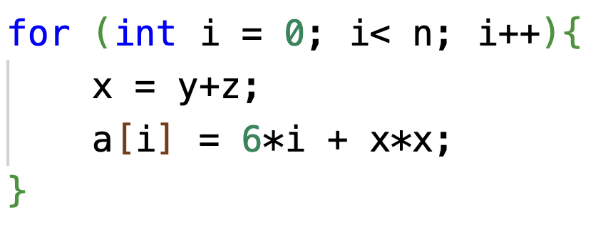

Loop Invariant Code Motion (LICM)
These values do not change within the body of the loop.

Slide 3
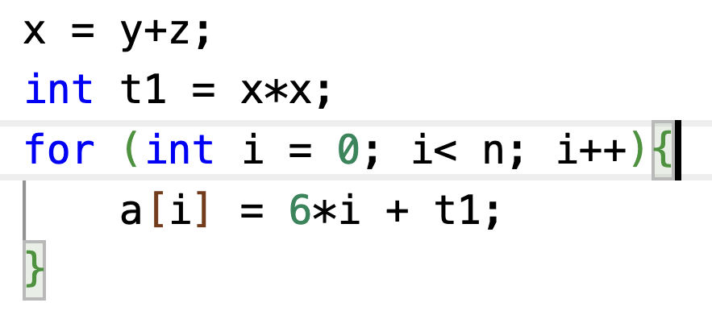
Loop Invariant Code Motion (LICM)
Move operations whose source operands do not change within the loop to the loop preheader.
Execute them only 1x per invocation of the loop.
LICM is already implemented in LLVM
/lib/Transforms/Scalar/LICM.cpp

Slide 4
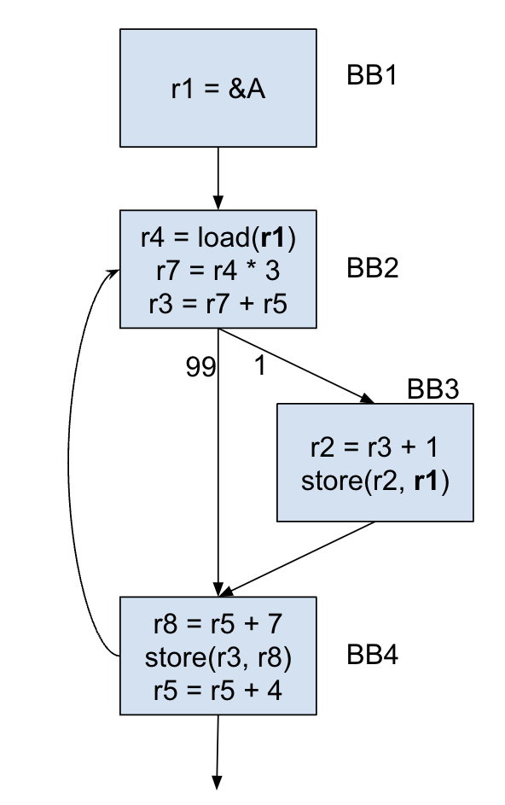

Frequent Path LICM
There is a store-load dependency.
The load cannot be hoisted up because it is not invariant in the loop.
But according to the profile data, it nearly never changes.

Slide 5
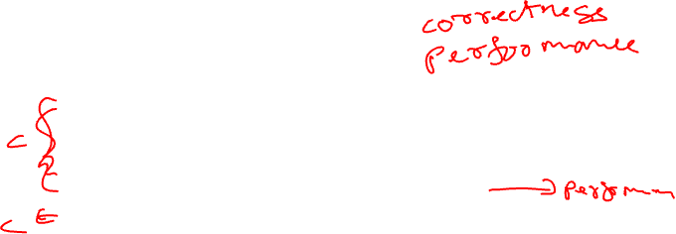
Implementation Steps
Identify the loops. Then for each loop:
Identify the frequent path (≥ 80%).
Identify loads that are invariant on the frequent path.
Perform LICM on those loads.
[Bonus] Perform LICM on other instructions.
Add fix-up code to ensure that the execution is correct.

Slide 6
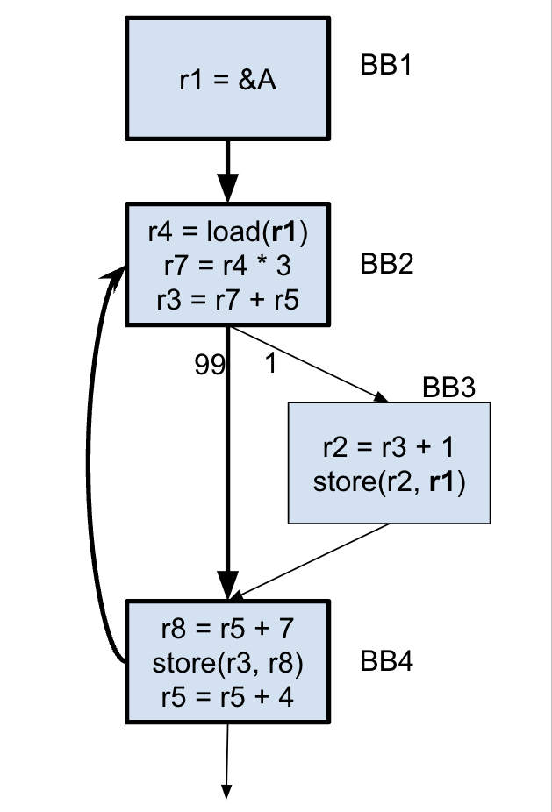

Identify the Frequent Path
Start at the loop header, keep choosing the branch that is taken at least 80% of the time, or until the loop is closed.
We do not consider the cumulative probabilities (they may drop lower).
Everything not on the frequent path is considered to be on the infrequent path.

Slide 7
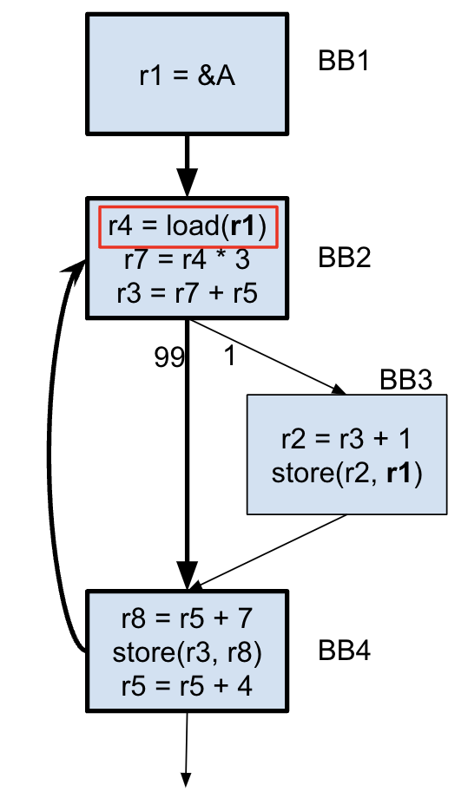
Identify the (Almost) Invariant Loads
Now that we consider only the frequent path, the load has become invariant.
For the correctness pass, you only need to consider the loads.

Slide 8
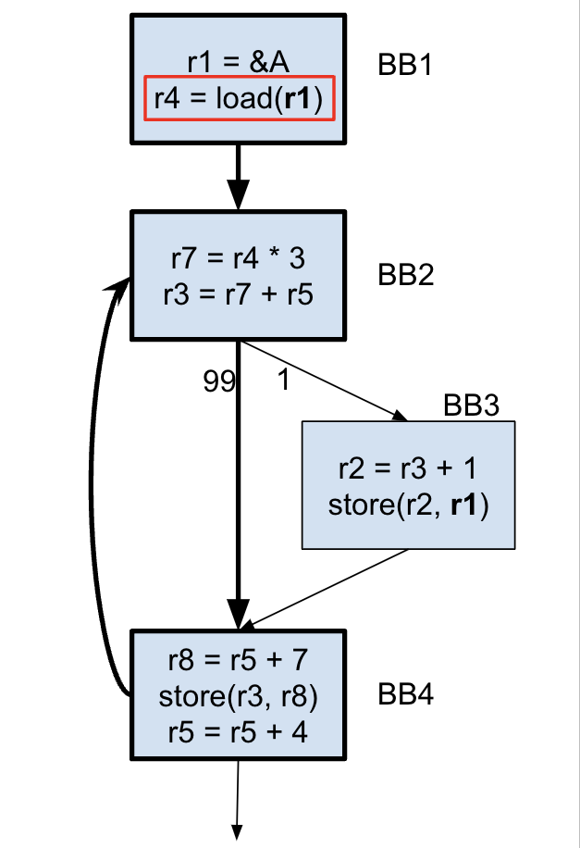
Move the Load
We can now move the load up to the pre-header.
This is the key optimization step as the load is now executed only once.
However it is important to note that the program in its current state will not be correct.

Slide 9
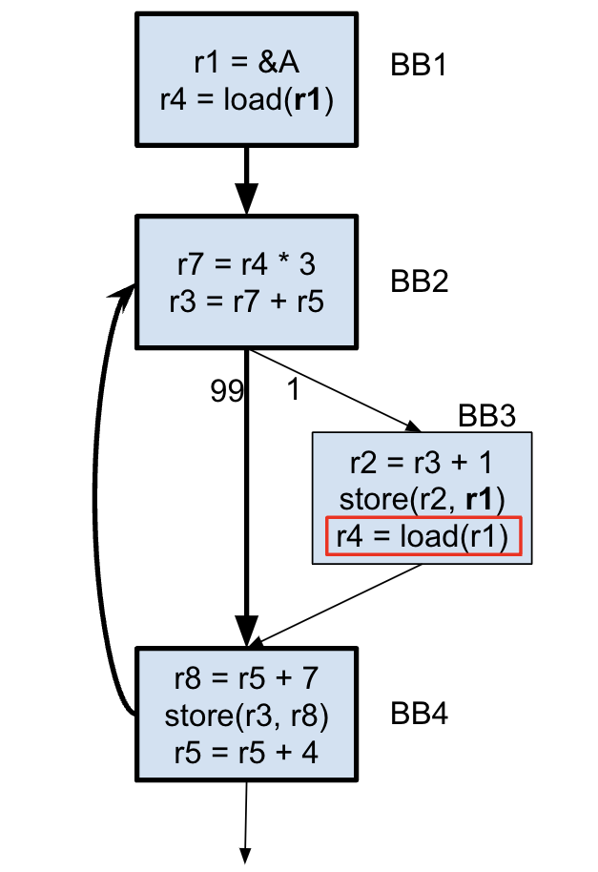
Fixing Up
Now that we have moved the load, we need to add code so that the program execution is correct.
Just copying the load instruction to the infrequent path will ensure that it works correctly.

Slide 10
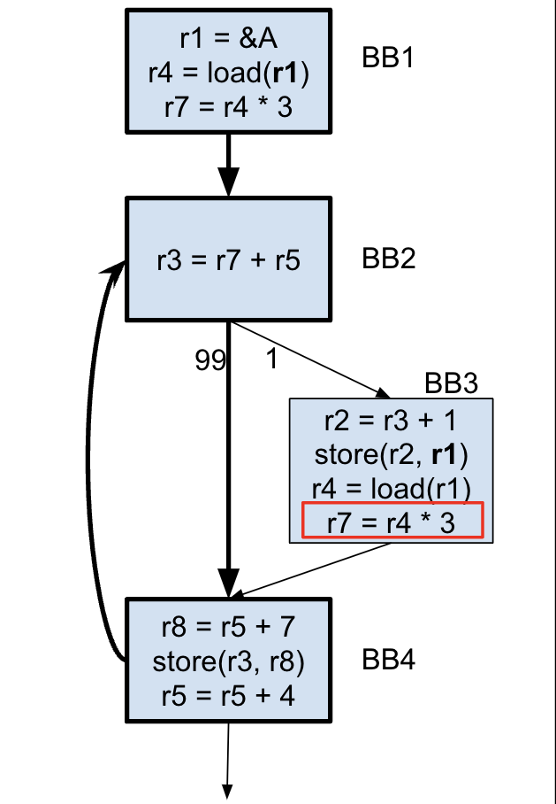
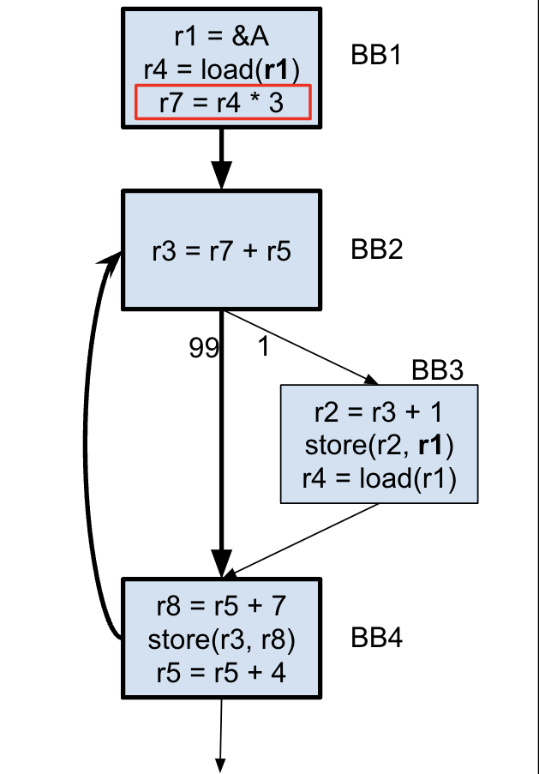
[BONUS] Move more instructions
Since we moved the load, the following instruction has also become invariant in the loop.
So we can move it up to the pre-header as well, adding to our gains.
And we need to add the fix up code too.

Slide 11
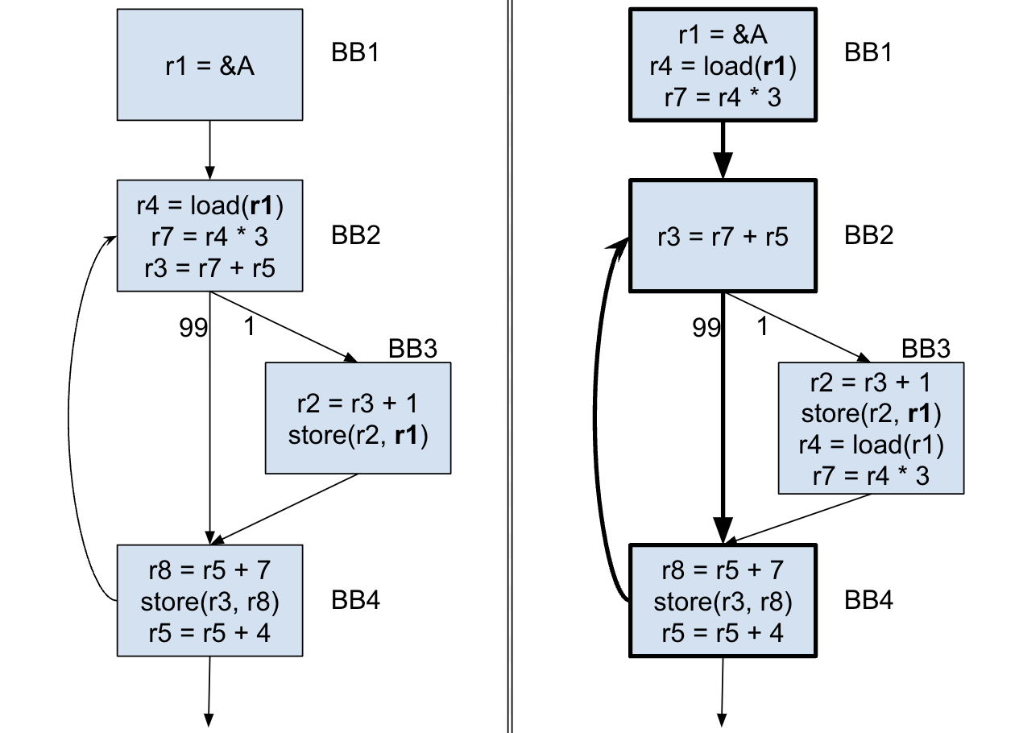
FPLICM
Before
After

Slide 12
HW2 Overview
Implement FPLICM.
Two passes:
Correctness (Mandatory):
Perform FPLICM on almost-invariant loads.
Performance (Bonus):
Perform FPLICM on any instruction.
Adjust heuristics (threshold for hot-path detection).
Any other optimization you want to do.

Slide 13
What you have been given
A run script
Includes option to visualize the CFG
Benchmarks
6 correctness (Mandatory)
Simple cases exploring different scenarios that your code should be able to handle.
4 performance (Optional)
Cases with high trip counts and more opportunities for hoisting.
Basic template to write code in.

Slide 14
Some LLVM Resources
Disclaimer: These are only recommendations, you do not have to use these.
Always a useful resource: https://llvm.org/docs/ProgrammersManual.html

Slide 15
Manipulating Basic Blocks
SplitBlock()
Splits the BB at the specified instruction.
SplitEdge()
Insert a BB on the edge connecting two specified BBs

Slide 16
Instructions and Variables
Most Instructions have a constructor (look at the documentation)
It allows you to specify operands
It also allows you to specify where you want to insert this instruction.
Many instructions also have a clone() function
Functions that are useful across all Instructions are in llvm/IR/Instructions.h
These include functions that can be used to insert/move instructions
Use AllocaInst to allocate memory space on the stack.

Slide 17
An important note on SSA
LLVM is in SSA form.
This means that when you clone an instruction, the LHS will be different.
You need to ensure that the correct values are used in the correct places.
One solution is to store the value onto the stack (in the pre-header) and retrieve it before any use.
A better solution is to use PHI nodes to merge the values of the copy and the moved instruction.

Slide 18
Final Notes
Read the spec and the Piazza post carefully and thoroughly.
Start early.
Make sure you do not break the program.
Use the -v option on the run script to visualize the CFG and debug.
Start with the given script and template.
If you finish early, attempt the bonus part.
Check Piazza frequently, someone may have encountered the same issues as you.
For performance, your code needs to be correct, not just fast.

