Slide 1


Energy-Conscious Compilation Based on Voltage Scaling
Shreya Nadiger, Ryan Kendra, Vanshika Singla, Hanning Li

Slide 2
Motivation
Growing Importance of Energy Efficiency
Embedded and portable devices are now everywhere
Energy consumption has become a major constraint in system design
Systems must meet performance while minimizing power usage
Software Matters More
Software now represents a large share of total system execution
Traditional low-power circuit and hardware optimizations alone are insufficient
Software + hardware co-optimization is required for energy reduction

Slide 3
Motivation
Need for Energy-Aware Compilers
Compiler optimizations usually focus on performance only
Question remains:
  Can compiler transformations also reduce energy?
  How should standard optimizations change to be power-efficient?
Introduces two compiler-directed techniques that use voltage scaling to reduce energy

Slide 4
What is Voltage Scaling?
Technique to reduce processor supply voltage
Lower voltage → lower energy consumption
Energy ∝ K × C × V²
K = switching rate
C = capacitance
V = supply voltage
Reducing voltage decreases dynamic energy quadratically

Slide 5
How Compiler-Based Voltage Scaling Differs
Traditional Hardware DVFS
Adjusts voltage based on electrical behavior (temperature, switching rate, etc.)
Very fast but blind to application semantics
Purely reactive
OS-Based DVFS
Uses CPU utilization, scheduling data, runtime measurements
Adjusts every few milliseconds
Still reactive – predicts based only on recent behavior
OS cannot know:
  Which functions are critical
  What the program will do next

Slide 6
How Compiler-Based Voltage Scaling Differs
Compiler-Based DVFS (This Paper)
Compiler knows program structure ahead of time
  Loop bounds
  Data reuse
  Execution order
Makes proactive decisions before execution
Converts optimization performance slack into energy savings

Slide 7
What is Voltage Scaling?
Lowering voltage also increases execution time.
Therefore, voltage scaling introduces an energy vs. performance trade-off
Goal: lower V without violating execution-time constraints
Introduces two compiler-directed techniques that use voltage scaling to reduce energy:
Static Voltage Scaling
Dynamic Voltage Scaling

Slide 8
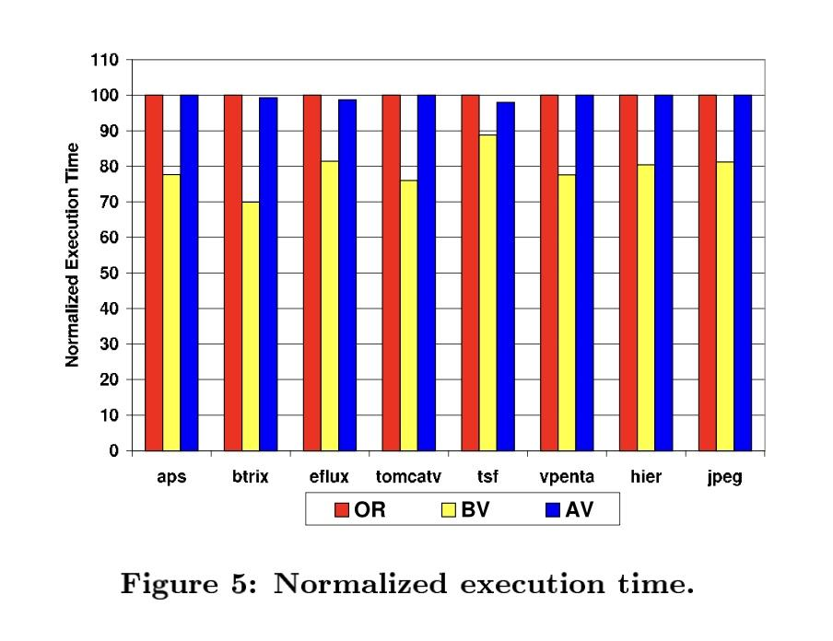
Key Idea
Use optimization performance slack as energy savings.
Instead of making optimized code run faster,
→ run it at lower voltage
→ same/better speed
→ dramatically lower energy consumption
Code after Voltage Scaling(AV), improves energy consumption of code by 31.8 % on average

Slide 9
Static and Dynamic Voltage Scaling
Static Voltage Scaling
Compiler optimizes code to make it run faster (loop permutation, loop fusion, loop tiling, loop distribution)
Instead of taking the performance gain, compiler reduces supply voltage
Final execution time ≈ original execution time
Result: the same performance but lower energy usage
Dynamic Voltage Scaling
Different parts of the program may require different voltages
Compiler selects voltage per region using Integer Linear Programming
Can meet multiple constraints (energy AND performance)
Works well in real-time systems with deadline constraints

Slide 10
Loop Optimizations
Loop Permutation (Interchange):
Reorder nested loops to improve memory locality:
// Before (poor locality on row-major)
for (j) for (i) A[i][j] = ...;
// After (better locality)
for (i) for (j) A[i][j] = ...;
Makes memory access sequential

Slide 11
Loop Optimizations
Loop Fusion:
Combine two loops with the same iteration space
// Before
for (i) A[i] = f(i);
for (i) B[i] = g(A[i]);
// After (fused)
for (i) {
A[i] = f(i);
B[i] = g(A[i]);
}
A[i] stays in registers/cache → avoids extra memory reloads.

Slide 12
Loop Optimizations
Loop Tiling :
Break large loops into smaller tiles that fit in cache
for (ii=0; ii<N; ii+=T)
for (i=ii; i<ii+T; i++)
…
Data in a tile is reused many times before eviction → fewer DRAM accesses.

Slide 13
Loop Optimizations
Loop Distribution (Fission)
Split a loop into multiple loops
// Before
for (i) { A[i]=f(i); B[i]=g(i); }
// After
for (i) A[i]=f(i);
for (i) B[i]=g(i);
Enables parallelization/vectorization and simplifies optimization.

Slide 14
Static Voltage Scaling - Core Idea
Use compiler optimizations to make code faster, but don’t use the speedup for performance.
Instead, lower CPU supply voltage (Vr < Vo) until the optimized program’s runtime = original runtime.
Since dynamic energy ∝ V², lowering voltage ⇒ large energy savings.

Slide 15
How It Works
Original code runs at Vo with time Xo.
Apply loop optimizations → fewer cycles → time Xi < Xo → execution faster .
Lower the CPU voltage so the slower clock brings the runtime back up to the original value.
Memory voltage stays unchanged.
Result: Same runtime, much lower energy.

Slide 16
Why Only Scale CPU Voltage?
Memory already uses reduced voltage swing; cannot be slowed safely.
Voltage scaling affects CPU delay only, not DRAM.

Slide 17
Results
Benchmarks: scientific + image/video codes.
Energy reduction:
  13.9% (compiler optimizations alone)
  31.8% (with static voltage scaling)
Performance stays equal to original.

Slide 18


Dynamic Voltage Scaling
Static approaches assume that the same voltage is being supplied throughout execution of the entire program
Better idea: Optimize loop nests based on available voltage at a given time, good for multiple voltage sources, and can give multiple parameters
Experimented with before at the OS and hardware levels, new approach at compiler level
?

Slide 19
Dynamic Voltage Scaling - Approach
Analysis Passes
Idea: precompute estimated energy consumption/runtime of each loop nest, and store the results in a table
Use different tables for each nest, with a table for energy and a table for runtime
Selection algorithm uses Integer Level Programming (ILP), a form of optimization (specifically linear programming) that treats all values as integers
Tables
ILP

Slide 20
Dynamic Voltage Scaling - Approach
Analysis Passes
Once tables are generated, figure out optimal voltage for each nest using ILP with defined constraints
Need to take into account overhead for switching voltages (~100ms per switch)
Performance measured using nested sums, depending on selected voltages
Tables
ILP

Slide 21
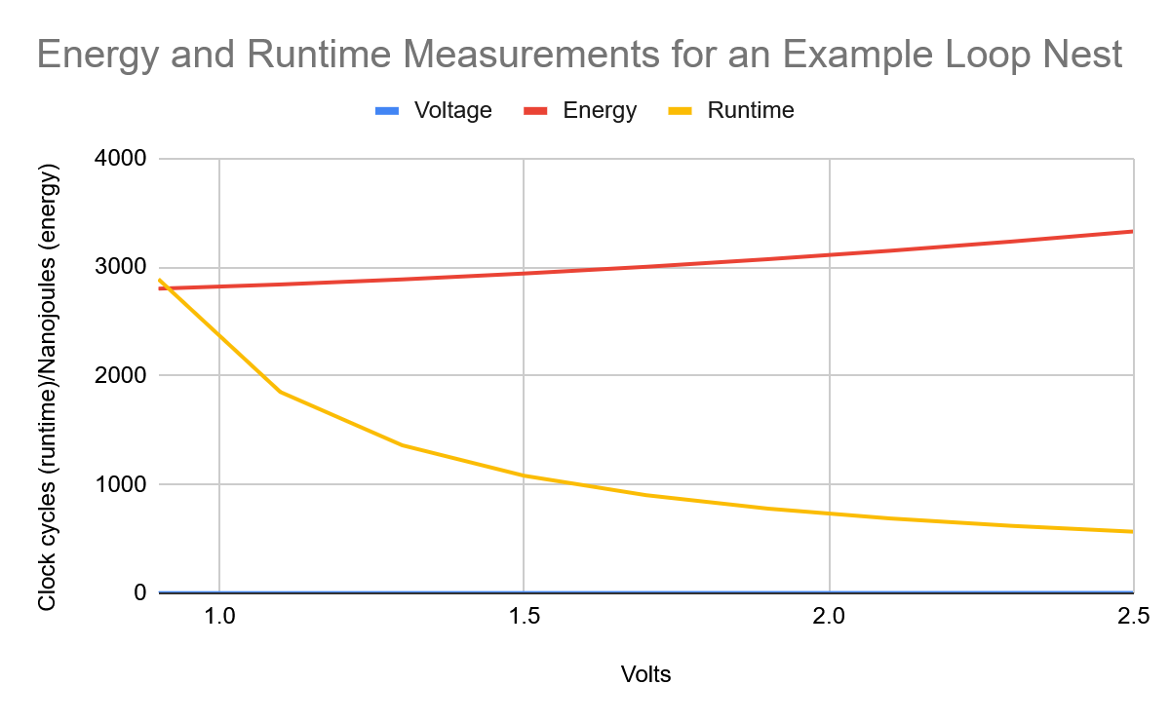
Dynamic Voltage Scaling - Evaluation
Generally, optimizing for a lower voltage increases execution time, but lowers energy consumption, and vice versa
Optimizing either aspect without constraint drastically changes results. Between max performance and max efficiency, max performance was 82.5% faster, and max efficiency used 25.6% less energy
Algorithm becomes more conservative when constraints are added

Slide 22
Dynamic Voltage Scaling - Evaluation with Overhead
When overhead is taken into account, the ILP algorithm attempts to minimize the amount of time voltage is switched.
Drastic changes still observed when compiling for energy vs performance
Selected voltages when Optimizing for Energy (with Time Constraints)
 | n1 | n2 | n3 | n4 | n5 | n6 | n7 | n8 | n9
No Overhead | 1.9V | 1.5V | 1.7V | 1.9V | 1.5V | 1.9V | 1.3V | 1.9V | 1.9V
100ms Overhead | 1.9V | 1.9V | 1.9V | 1.5V | 1.5V | 1.7V | 1.7V | 1.7V | 1.7V

Slide 23
Evaluation
Purpose of Evaluation
• Check if compiler-based static voltage scaling actually reduces energy
• Ensure programs don’t become slower than the original
• Understand how loop optimizations + voltage scaling interact in real workloads
Benchmarks Used
• 8 programs total
– 6 scientific array-dominated codes (aps, btrix, eflux, tomcatv, tsf, vpenta)
– 2 image/video apps (hier, jpeg)
Why these benchmarks?
• They heavily stress both CPU and memory, making them ideal to see whether voltage scaling still works under real conditions.
• Very common patterns in embedded + DSP + multimedia workloads.

Slide 24
Evaluation
Experimental Setup
• Used SimplePower, a cycle-accurate energy simulator
• Models power in: CPU, cache, off-chip memory, clock circuitry
• 5-stage pipeline, 200 MHz
• Voltage scaling applied to CPU only, not memory (for safety + accuracy)
Three Program Versions Compared
OR : Original
BV : Before Voltage Scaling (only loop optimizations)
AV : After Voltage Scaling (optimized + lowered voltage)
What They Measured
• Total energy consumption
• Execution time
• Normalized results (everything compared to original = 1)

Slide 25
Evaluation
Energy Savings
• BV (optimized): 13.9% less energy
• AV (volt-scaled optimized): 31.8% less energy → best result
Performance Impact
• BV runs 20.8% faster than original
• AV is slowed down intentionally to match original runtime
• Some small mismatches due to discrete voltage levels (2.5 → 2.3 → 2.1…)
Why It Works
• Loop optimizations reduce memory stalls → faster code
• Compiler uses this “extra speed” as performance slack
• Voltage is lowered until runtime = original → huge energy reduction
Takeaway
• Static voltage scaling consistently reduces energy across ALL benchmarks
• Meets performance constraints → no slowdown for the user

Slide 26
Related Work
Hardware / OS DVFS (1990s–2000s)
• Early CPUs: Intel XScale, AMD K6-IIIE+, Crusoe
• OS algorithms (Weiser ’94, Govil ’95): utilization-based DVFS
• Reactive → respond to load, not program structure
Compiler-Based Approaches
• Hsu & Kremer (2001–02): region-based DVFS
• Used analytical models
• Focused on superscalar, out-of-order CPUs
Loop & Memory Energy Studies
• Kandemir et al.: loop tiling reduces memory energy
• Memory banks → sleep modes via compiler guidance
What This Paper Adds
• Uses loop optimizations for energy, not speed
• Defines Static + Dynamic Voltage Scaling
• Introduces ILP-based per-loop voltage selection
• Proactive compiler decisions > OS reactive DVFS

Slide 27
Modern Context
DVFS is now standard everywhere
• Modern CPUs/GPUs adjust voltage & frequency thousands of times per second
• Runs on phones, laptops, servers, cloud GPUs
• Energy saving is a first-class design goal in all processors
Examples in real hardware (2025)
• ARM big.LITTLE : mixes high-power and low-power cores
• Intel SpeedShift / AMD Precision Boost : per-core voltage tuning
• NVIDIA GPU Power States : lowers voltage aggressively during light workloads
What’s changed since 2002
• Hardware DVFS is much faster and highly automated
• OS power governors use machine learning and predictive models
• Energy efficiency is now critical due to mobile + AI workloads

Slide 28
Strengths & Weaknesses
Strengths
• Big energy savings (up to 31.8% with static, +15% more with dynamic)
• Uses compiler knowledge → proactive voltage decisions
• Works well on scientific + multimedia workloads
• ILP-based dynamic scaling = flexible under different constraints
• Converts performance slack → energy savings without hurting speed
• Fully compatible with real-time / embedded systems
Weaknesses
• Voltage levels are discrete, so runtime matching isn’t perfect
• Only CPU voltage scaled so memory stays fixed
• ILP overhead grows with program size (loop-heavy programs)
• Needs accurate energy models → simulator dependency
• Works best on array/loop-heavy codes; less effective for irregular patterns

Slide 29
Conclusion
Main Idea
• Use compiler optimizations to create performance slack
• Convert that slack into energy savings through voltage scaling
Key Contributions
• Static Voltage Scaling
– Optimizes code → slows it down via lower voltage → same speed, much lower energy
• Dynamic Voltage Scaling (ILP)
– Assigns voltages per loop → handles multiple constraints → better energy results
Results
• Static: 31.8% energy reduction without performance loss
• Dynamic: 15% more savings compared to static under same constraints
Impact
• Shows compiler-level decisions can outperform OS-only DVFS
• Foundation for modern energy-aware compilation and hardware–software co-design
Final Takeaway: “Optimizing for energy doesn’t have to sacrifice speed as with the right compiler strategies, you get both.”

