Slide 1

EECS 583 – Class 9
Classic + ILP Optimization
University of Michigan
September 24, 2025

Slide 2

Announcements & Reading Material
Hopefully everyone is making some progress on HW 2
  Due Oct 8
Today’s class
  “Compiler Code Transformations for Superscalar-Based High-Performance Systems,” S. Mahlke, W. Chen, J. Gyllenhaal, W. Hwu, P, Chang, and T. Kiyohara, Proceedings of Supercomputing '92, Nov. 1992, pp. 808-817
Next class (code generation)
  “Machine Description Driven Compilers for EPIC Processors”, B. Rau, V. Kathail, and S. Aditya, HP Technical Report, HPL-98-40, 1998. (long paper but informative)

Slide 3

Course Project – Time to Start Thinking About This
Mission statement: Design and implement something “interesting” in a compiler
  LLVM preferred, but other compilers are fine
  Groups of 3-5 people (other group sizes are possible in some cases)
  Extend existing research paper or go out on your own
Group size
  Higher expectations for larger groups, but not strictly proportional to group size
    3-4 seems like a sweet spot
  Everyone needs to have done something (rough work distribution)

Slide 4
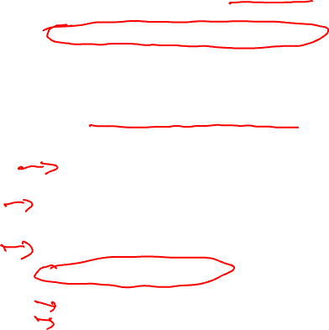
Course Projects – Timetable
Now - Start thinking about potential topics, identify group members
  Use piazza to recruit group members
Oct 20-24: Project proposal discussions, No class Oct 20/22, Regular class resumes Mon Oct 27
  Naveen, Rishika, and I will meet with each group virtually for 5-10 mins, slot signups the week before, Oct 13-17
  Ideas/proposal discussed at meeting – don’t come into the meeting with too many ideas (1-2 only)
  Short written proposal (a paragraph plus 1-2 references) due Mon, Oct 27 from each group, submit via email
Nov 3 – End of semester: Research presentations (details later)
  Each group presents a research paper related to their project (15 mins)
Mid Nov - Optional quick discussion with groups on progress
Dec 5 - 12: Project demos
  Each group, 15 min slot - Presentation/Demo/whatever you like
  Turn in short report on your project

Slide 5
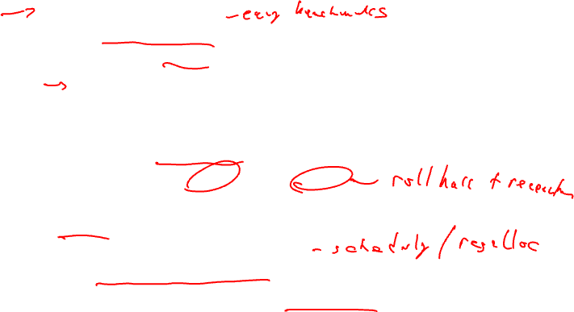
Sample Project Ideas (Traditional)
Memory system
  Cache profiler for LLVM IR – miss rates, stride determination
  Data cache prefetching, cache bypassing, scratch pad memories
  Data layout for improved cache behavior
  Advanced loads – move up to hide latency
Reliability
  Selective code duplication for soft error protection
  Low-cost fault detection and/or recovery
  Efficient soft error protection on GPUs/SIMD
Energy
  Minimizing instruction bit flips
  Deactivate parts of processor (FUs, registers, cache)
  Use different processors (e.g., big.LITTLE)

Slide 6
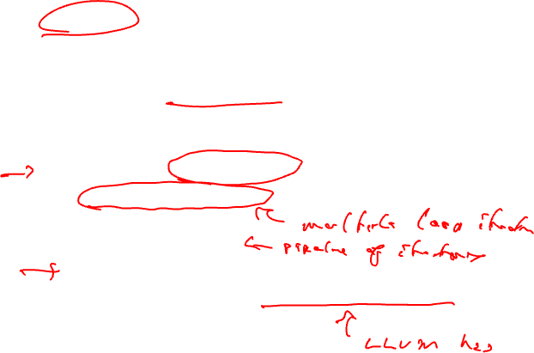
Sample Project Ideas (Traditional cont)
Security/Safety
  Efficient taint/information flow tracking
  Automatic mitigation methods – obfuscation for side channels
  Preventing control flow exploits
  Rule compliance checking (driving rules for AV software)
  Run-time safety verification
Parallelization/SIMDization
  DOALL loop parallelization, dependence breaking transformations
  DSWP parallelization
  Access-execute program decomposition
  Automatic SIMDization, Superword level parallelism

Slide 7
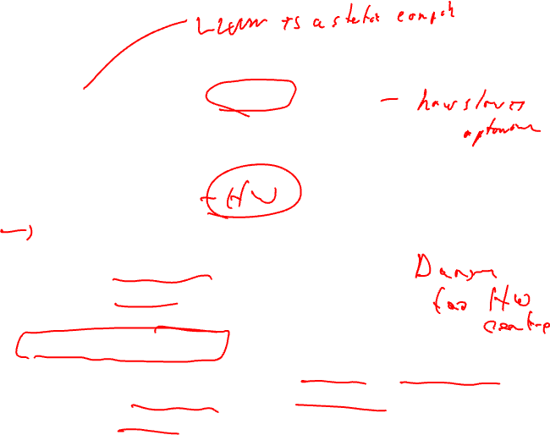
More Project Ideas
Dynamic optimization (Dynamo, LLVM)
  Run-time optimization of frequent paths
  Run-time program analysis for reliability/security
  Run-time memory optimization (cache, memory dependence, etc.)
High level synthesis
  Custom instructions - finding most common instruction patterns, constrained by inputs/outputs
  Int/FP precision analysis, Float to fixed point
  Custom data path synthesis
  Customized memory systems (e.g., sparse data structs)
Approximate computing
  New approximation optimizations (lookup tables, loop perforation)
  Impact of local approximation on global program outcome
  Program distillation - create a subset program with equivalent behavior

Slide 8
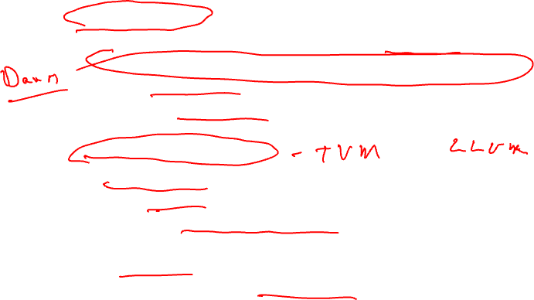
Sample Project Ideas (ML)
ML for compilers
  Using ML/search to guide optimizations (no unroll factors!!)
  Using ML/search to guide optimization choices (which optis/order)
  ML to infer profile data
  ML to guide loop restructuring.
  Be careful of low compiler content!!
Compilers for ML/GPUs
  Kernel fusion/restructuring
  Kernel optimization (unrolling, tiling, etc.)
  Reducing uncoalesced memory accesses – measurement of uncoalesced accesses, code restructuring to reduce these
  Data restructuring
Remember, this isn’t a restaurant menu, don’t just pick one of my suggestions, you can pick other topics!

Slide 9
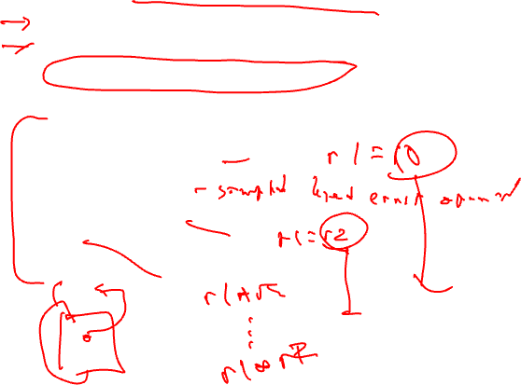
Back to Code Optimization
Classical (machine independent, done at IR level)
  Reducing operation count (redundancy elimination)
  Simplifying operations
  Generally good for any kind of machine
We went through
  Dead code elimination
  Constant propagation
  Constant folding
  Copy propagation
  CSE
  LICM

Slide 10
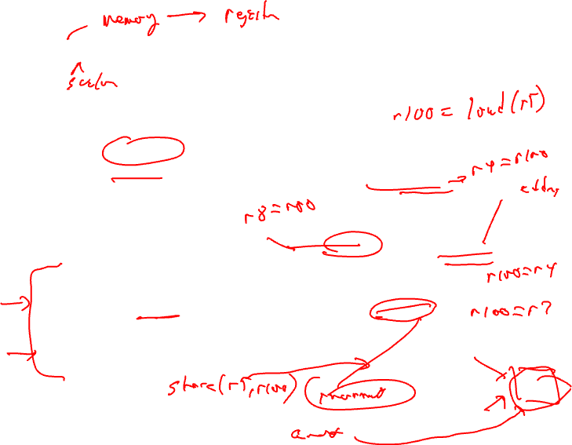
Global Variable Migration
Assign a global variable temporarily to a register for the duration of the loop
  Load in preheader
  Store at exit points
Rules
  X is a load or store
  address(X) not modified in the loop
  if X not executed on every iteration, then X must provably not cause an exception
  All memory ops in loop whose address can equal address(X) must always have the same address as X
BB1
BB2
1. r4 = load(r5)
2. r4 = r4 + 1
BB3
BB4
3. r8 = load(r5)
4. r7 = r8 * r4
5. store(r5, r4)
BB5
6. store(r5,r7)
BB6

Slide 11
Global Variable Migration Example
BB1
BB2
1. r4 = load(r5)
2. r4 = r4 + 1
BB3
BB4
3. r8 = load(r5)
4. r7 = r8 * r4
5. store(r5, r4)
BB5
6. store(r5,r7)
BB6

Slide 12
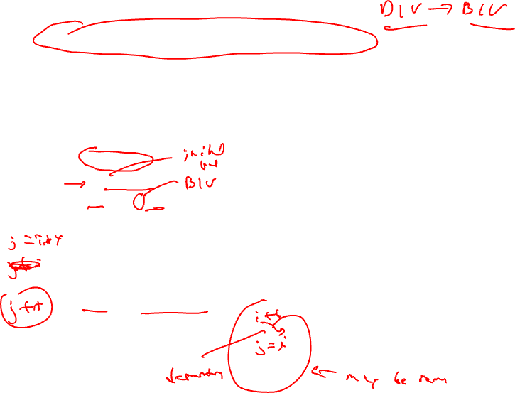
Induction Variable Strength Reduction
Create basic induction variables from derived induction variables
Induction variable
  BIV (i++)
    0,1,2,3,4,...
  DIV (j = i * 4)
    0, 4, 8, 12, 16, ...
  DIV can be converted into a BIV that is incremented by 4
Issues
  Initial and increment vals
  Where to place increments
BB1
BB2
1. r5 = r4 - 3
2. r4 = r4 + 1
BB3
BB4
3. r7 = r4 * r9
BB5
4. r6 = r4 << 2
BB6

Slide 13
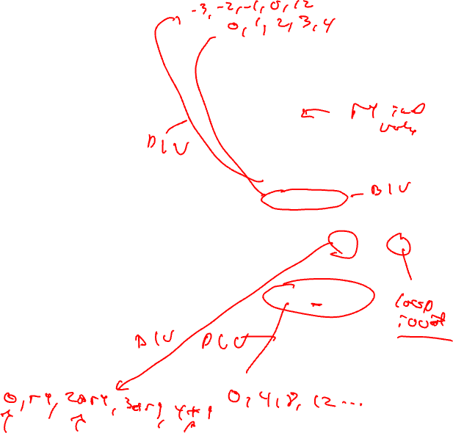
Induction Variable Strength Reduction (2)
Rules
  X is a *, <<, + or – operation
  src1(X) is a basic ind var
  src2(X) is invariant
  No other ops modify dest(X)
  dest(X) != src(X) for all srcs
  dest(X) is a register
Transformation
  Insert the following into the preheader
    new_reg = RHS(X)
  If opcode(X) is not add/sub, insert to the bottom of the preheader
    new_inc = inc(src1(X)) opcode(X) src2(X)
  else
    new_inc = inc(src1(X))
  Insert the following at each update of src1(X)
    new_reg += new_inc
  Change X → dest(X) = new_reg
BB1
BB2
1. r5 = r4 - 3
2. r4 = r4 + 1
BB3
BB4
3. r7 = r4 * r9
BB5
4. r6 = r4 << 2
BB6

Slide 14
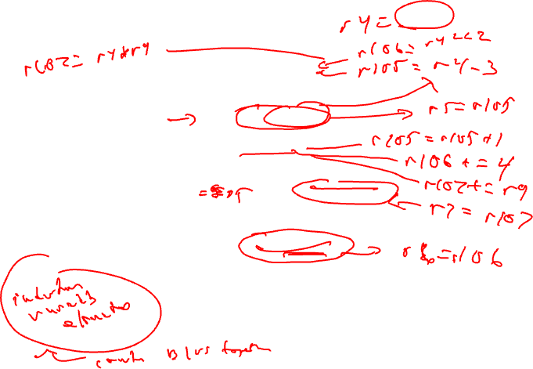
Induction Variable Strength Reduction - Example
BB1
BB2
1. r5 = r4 - 3
2. r4 = r4 + 1
BB3
BB4
3. r7 = r4 * r9
BB5
4. r6 = r4 << 2
BB6

Slide 15

Class Problem
Optimize this applying
induction var str
reduction
BB1
1. r1 = 0
2. r2 = 0
BB2
3. r5 = r5 + 1
4. r11 = r5 * 2
5. r10 = r11 + 2
6. r12 = load (r10+0)
7. r9 = r1 << 1
8. r4 = r9 - 10
9. r3 = load(r4+4)
10. r3 = r3 + 1
11. store(r4+0, r3)
12. r7 = r3 << 2
13. r6 = load(r7+0)
14. r13 = r2 - 1
15. r1 = r1 + 1
16. r2 = r2 + 1
BB3
r13, r12, r6, r10
liveout

Slide 16
Class Problem Solution
r1 = 0
r2 = 0
r111 = r5 * 2
r109 = r1 << 1
r113 = r2 -1
Optimize this applying
induction var str reduction
r1 = 0
r2 = 0
r5 = r5 + 1
r11 = r5 * 2
r10 = r11 + 2
r12 = load (r10+0)
r9 = r1 << 1
r4 = r9 - 10
r3 = load(r4+4)
r3 = r3 + 1
store(r4+0, r3)
r7 = r3 << 2
r6 = load(r7+0)
r13 = r2 - 1
r1 = r1 + 1
r2 = r2 + 1
r5 = r5 + 1
r111 = r111 + 2
r11 = r111
r10 = r11 + 2
r12 = load (r10+0)
r9 = r109
r4 = r9 - 10
r3 = load(r4+4)
r3 = r3 + 1
store(r4+0, r3)
r7 = r3 << 2
r6 = load(r7+0)
r13 = r113
r1 = r1 + 1
r109 = r109 + 2
r2 = r2 + 1
r113 = r113 + 1
Note, after copy
propagation, r10
and r4 can be
strength reduced
as well.
r13, r12, r6, r10
liveout
r13, r12, r6, r10
liveout

Slide 17
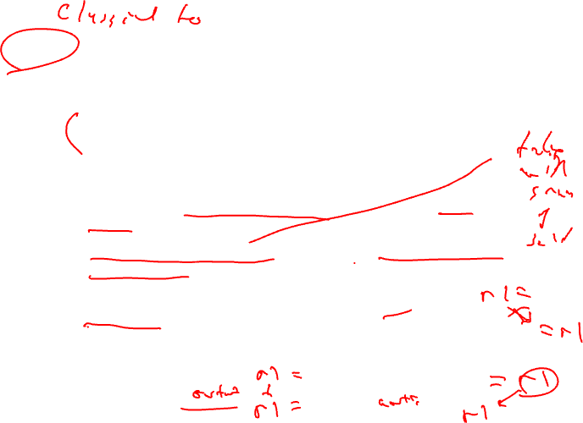
ILP Optimization
Traditional optimizations
  Redundancy elimination
  Reducing operation count
ILP (instruction-level parallelism) optimizations
  Increase the amount of parallelism and the ability to overlap operations
  Operation count is secondary, often trade parallelism for extra instructions (avoid code explosion)
ILP increased by breaking dependences
  True or flow = read after write dependence
  False or (anti/output) = write after read, write after write

Slide 18
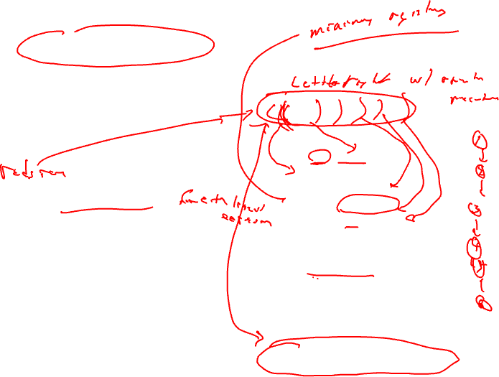
Back Substitution
Generation of expressions by compiler frontends is very sequential
  Account for operator precedence
  Apply left-to-right within same precedence
Back substitution
  Create larger expressions
    Iteratively substitute RHS expression for LHS variable
  Note – may correspond to multiple source statements
  Enable subsequent optis
Optimization
  Re-compute expression in a more favorable manner
y = a + b + c – d + e – f;
1. r9 = r1 + r2
2. r10 = r9 + r3
3. r11 = r10 - r4
4. r12 = r11 + r5
5. r13 = r12 – r6
Subs r12:
r13 = r11 + r5 – r6
Subs r11:
r13 = r10 – r4 + r5 – r6
Subs r10
r13 = r9 + r3 – r4 + r5 – r6
Subs r9
r13 = r1 + r2 + r3 – r4 + r5 – r6

Slide 19
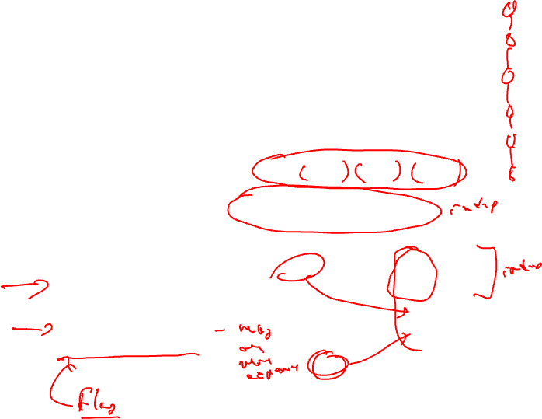
Tree Height Reduction
Re-compute expression as a balanced binary tree
  Obey precedence rules
  Essentially re-parenthesize
  Combine literals if possible
Effects
  Height reduced (n terms)
    n-1 (assuming unit latency)
    ceil(log2(n))
  Number of operations remains constant
  Cost
    Temporary registers “live” longer
  Watch out for
    Always ok for integer arithmetic
    Floating-point – may not be!!
original:
r9 = r1 + r2
r10 = r9 + r3
r11 = r10 - r4
r12 = r11 + r5
r13 = r12 – r6
after back subs:
r13 = r1 + r2 + r3 – r4 + r5 – r6
r1 + r2
r3 – r4
r5 – r6
final code:
+
t1 = r1 + r2
t2 = r3 – r4
t3 = r5 – r6
t4 = t1 + t2
r13 = t4 + t3
+
r13

Slide 20
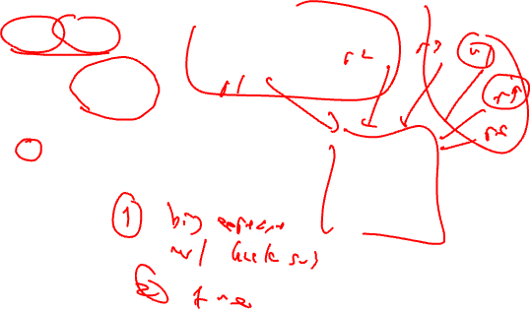
Class Problem
Assume: + = 1, * = 3
operand
arrival times
0
r1
0
r2
0
r3
1
r4
2
r5
0
r6
1. r10 = r1 * r2
2. r11 = r10 + r3
3. r12 = r11 + r4
4. r13 = r12 – r5
5. r14 = r13 + r6
Back susbstitute
Re-express in tree-height reduced form
Account for latency and arrival times

Slide 21

Class Problem Solution
Assume: + = 1, * = 3
Expression after back substitution
r14 = r1 * r2 + r3 + r4 - r5 + r6
Want to perform operations on r1,r2,r3,r6 first
due to operand arrival times
t1 = r1 * r2
t2 = r3 + r6
The multiply will take 3 cycles, so combine t2
with r4 and then r5, and then finally t1
t3 = t2 + r4
t4 = t3 – r5
r14 = t1 + t4
Equivalently, the fully parenthesized expression
r14 = ((r1 * r2) + (((r3 + r6) + r4) - r5))
operand
arrival times
0
r1
0
r2
0
r3
1
r4
2
r5
0
r6
1. r10 = r1 * r2
2. r11 = r10 + r3
3. r12 = r11 + r4
4. r13 = r12 – r5
5. r14 = r13 + r6
Back susbstitute
Re-express in tree-height reduced form
Account for latency and arrival times

Slide 22
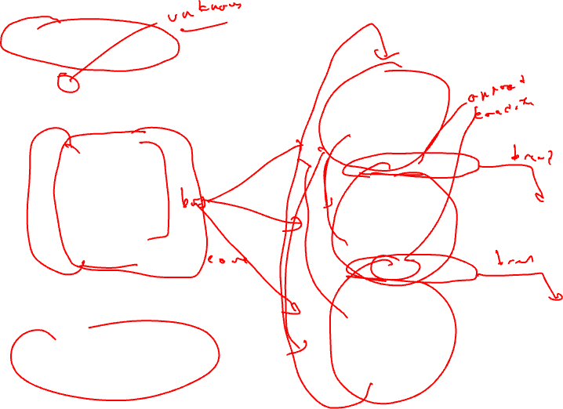
Loop Unrolling
for (i=x; i< 100; i++) {
sum += a[i]*b[i];
}
loop:
r1 = load(r2)
r3 = load(r4)
r5 = r1 * r3
r6 = r6 + r5
r2 = r2 + 4
r4 = r4 + 4
if (r4 >= 400) goto exit
unroll 3 times
iter1
loop:
r1 = load(r2)
r3 = load(r4)
r5 = r1 * r3
r6 = r6 + r5
r2 = r2 + 4
r4 = r4 + 4
if (r4 < 400) goto loop
r1 = load(r2)
r3 = load(r4)
r5 = r1 * r3
r6 = r6 + r5
r2 = r2 + 4
r4 = r4 + 4
if (r4 >= 400) goto exit
iter2
r1 = load(r2)
r3 = load(r4)
r5 = r1 * r3
r6 = r6 + r5
r2 = r2 + 4
r4 = r4 + 4
if (r4 < 400) goto loop
Unroll = replicate loop body
n-1 times.
Hope to enable overlap of
operation execution from
different iterations
iter3
exit:

Slide 23
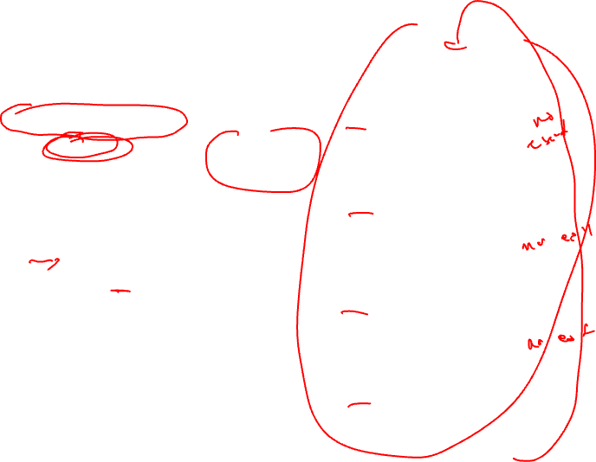
Smarter Loop Unrolling with Known Trip Count
loop:
r1 = load(r2)
r3 = load(r4)
r5 = r1 * r3
r6 = r6 + r5
r2 = r2 + 4
r4 = r4 + 4
Want to remove early exit branches
iter1
Trip count = 400/4 = 100
r4 = 0
r1 = load(r2)
r3 = load(r4)
r5 = r1 * r3
r6 = r6 + r5
r2 = r2 + 4
r4 = r4 + 4
if (r4 < 400) goto loop
unroll multiple
of trip count
r1 = load(r2)
r3 = load(r4)
r5 = r1 * r3
r6 = r6 + r5
r2 = r2 + 4
r4 = r4 + 4
loop:
iter2
r1 = load(r2)
r3 = load(r4)
r5 = r1 * r3
r6 = r6 + r5
r2 = r2 + 4
r4 = r4 + 4
iter3
r1 = load(r2)
r3 = load(r4)
r5 = r1 * r3
r6 = r6 + r5
r2 = r2 + 4
r4 = r4 + 4
if (r4 < 400) goto loop
iter4
exit:

Slide 24
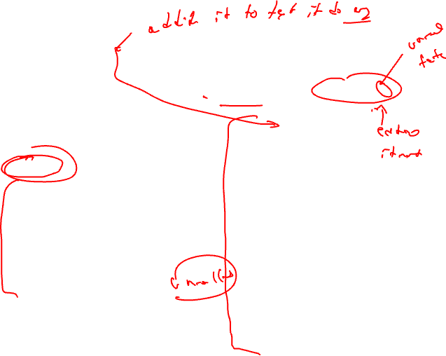
What if the Trip Count is not Statically Known?
preloop
for (i=0; i< ((400-r4)/4)%3; i++) {
sum += a[i]*b[i];
}
loop:
r1 = load(r2)
r3 = load(r4)
r5 = r1 * r3
r6 = r6 + r5
r2 = r2 + 4
r4 = r4 + 4
Create a preloop to
ensure trip count of
unrolled loop is a multiple
of the unroll factor
iter1
r4 = ??
r1 = load(r2)
r3 = load(r4)
r5 = r1 * r3
r6 = r6 + r5
r2 = r2 + 4
r4 = r4 + 4
if (r4 < 400) goto loop
loop:
r1 = load(r2)
r3 = load(r4)
r5 = r1 * r3
r6 = r6 + r5
r2 = r2 + 4
r4 = r4 + 4
iter2
r1 = load(r2)
r3 = load(r4)
r5 = r1 * r3
r6 = r6 + r5
r2 = r2 + 4
r4 = r4 + 4
if (r4 < 400) goto loop
iter3
exit:

Slide 25
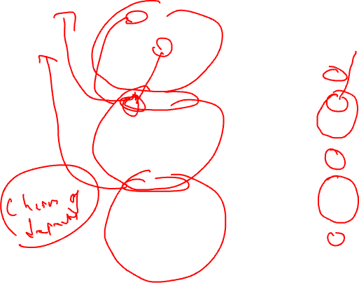
Unrolling Not Enough for Overlapping Iterations: Register Renaming
loop:
r1 = load(r2)
r3 = load(r4)
r5 = r1 * r3
r6 = r6 + r5
r2 = r2 + 4
r4 = r4 + 4
loop:
r1 = load(r2)
r3 = load(r4)
r5 = r1 * r3
r6 = r6 + r5
r2 = r2 + 4
r4 = r4 + 4
iter1
iter1
r1 = load(r2)
r3 = load(r4)
r5 = r1 * r3
r6 = r6 + r5
r2 = r2 + 4
r4 = r4 + 4
r11 = load(r2)
r13 = load(r4)
r15 = r11 * r13
r6 = r6 + r15
r2 = r2 + 4
r4 = r4 + 4
iter2
iter2
r1 = load(r2)
r3 = load(r4)
r5 = r1 * r3
r6 = r6 + r5
r2 = r2 + 4
r4 = r4 + 4
if (r4 < 400) goto loop
r21 = load(r2)
r23 = load(r4)
r25 = r21 * r23
r6 = r6 + r25
r2 = r2 + 4
r4 = r4 + 4
if (r4 < 400) goto loop
iter3
iter3

Slide 26
Register Renaming is Not Enough!
loop:
r1 = load(r2)
r3 = load(r4)
r5 = r1 * r3
r6 = r6 + r5
r2 = r2 + 4
r4 = r4 + 4
Still not much overlap possible
Problems
  r2, r4, r6 sequentialize the iterations
  Need to rename these
2 specialized renaming optis
  Accumulator variable expansion (r6)
  Induction variable expansion (r2, r4)
iter1
r11 = load(r2)
r13 = load(r4)
r15 = r11 * r13
r6 = r6 + r15
r2 = r2 + 4
r4 = r4 + 4
iter2
r21 = load(r2)
r23 = load(r4)
r25 = r21 * r23
r6 = r6 + r25
r2 = r2 + 4
r4 = r4 + 4
if (r4 < 400) goto loop
iter3

Slide 27
Accumulator Variable Expansion
r16 = r26 = 0
loop:
r1 = load(r2)
r3 = load(r4)
r5 = r1 * r3
r6 = r6 + r5
r2 = r2 + 4
r4 = r4 + 4
Accumulator variable
  x = x + y or x = x – y
  where y is loop variant!!
Create n-1 temporary accumulators
Each iteration targets a different accumulator
Sum up the accumulator variables at the end
May not be safe for floating-point values
iter1
r11 = load(r2)
r13 = load(r4)
r15 = r11 * r13
r16 = r16 + r15
r2 = r2 + 4
r4 = r4 + 4
iter2
r21 = load(r2)
r23 = load(r4)
r25 = r21 * r23
r26 = r26 + r25
r2 = r2 + 4
r4 = r4 + 4
if (r4 < 400) goto loop
iter3
exit:
r6 = r6 + r16 + r26

Slide 28
Induction Variable Expansion
r12 = r2 + 4, r22 = r2 + 8
r14 = r4 + 4, r24 = r4 + 8
Induction variable
  x = x + y or x = x – y
  where y is loop invariant!!
Create n-1 additional induction variables
Each iteration uses and modifies a different induction variable
Initialize induction variables to init, init+step, init+2*step, etc.
Step increased to n*original step
Now iterations are completely independent !!
r16 = r26 = 0
loop:
r1 = load(r2)
r3 = load(r4)
r5 = r1 * r3
r6 = r6 + r5
r2 = r2 + 12
r4 = r4 + 12
iter1
r11 = load(r12)
r13 = load(r14)
r15 = r11 * r13
r16 = r16 + r15
r12 = r12 + 12
r14 = r14 + 12
iter2
r21 = load(r22)
r23 = load(r24)
r25 = r21 * r23
r26 = r26 + r25
r22 = r22 + 12
r24 = r24 + 12
if (r4 < 400) goto loop
iter3
exit:
r6 = r6 + r16 + r26

Slide 29
Better Induction Variable Expansion
r16 = r26 = 0
loop:
r1 = load(r2)
r3 = load(r4)
r5 = r1 * r3
r6 = r6 + r5
With base+displacement addressing, often don’t need additional induction variables
  Just change offsets in each iterations to reflect step
  Change final increments to n * original step
iter1
r11 = load(r2+4)
r13 = load(r4+4)
r15 = r11 * r13
r16 = r16 + r15
iter2
r21 = load(r2+8)
r23 = load(r4+8)
r25 = r21 * r23
r26 = r26 + r25
r2 = r2 + 12
r4 = r4 + 12
if (r4 < 400) goto loop
iter3
exit:
r6 = r6 + r16 + r26

Slide 30
Homework Problem
loop:
loop:
r1 = load(r2)
r5 = r6 + 3
r6 = r5 + r1
r2 = r2 + 4
if (r2 < 400) goto loop
r1 = load(r2)
r5 = r6 + 3
r6 = r5 + r1
r2 = r2 + 4
r1 = load(r2)
r5 = r6 + 3
r6 = r5 + r1
r2 = r2 + 4
r1 = load(r2)
r5 = r6 + 3
r6 = r5 + r1
r2 = r2 + 4
if (r2 < 400) goto loop
Optimize the unrolled
loop
Renaming
Tree height reduction
Ind/Acc expansion

Slide 31
Homework Problem - Answer
loop:
loop:
r16 = r26 = 0
loop:
r1 = load(r2)
r5 = r6 + 3
r6 = r5 + r1
r2 = r2 + 4
if (r2 < 400) goto loop
r1 = load(r2)
r5 = r6 + 3
r6 = r5 + r1
r2 = r2 + 4
loop:
r1 = load(r2)
r5 = r1 + 3
r6 = r6 + r5
r2 = r2 + 4
r11 = load(r2)
r15 = r11 + 3
r6 = r6 + r15
r2 = r2 + 4
r21 = load(r2)
r25 = r21 + 3
r6 = r6 + r25
r2 = r2 + 4
if (r2 < 400)
goto loop
r1 = load(r2)
r5 = r1 + 3
r6 = r6 + r5
r11 = load(r2+4)
r15 = r11 + 3
r16 = r16 + r15
r21 = load(r2+8)
r25 = r21 + 3
r26 = r26 + r25
r2 = r2 + 12
if (r2 < 400)
goto loop
r6 = r6 + r16
r6 = r6 + r26
r1 = load(r2)
r5 = r6 + 3
r6 = r5 + r1
r2 = r2 + 4
r1 = load(r2)
r5 = r6 + 3
r6 = r5 + r1
r2 = r2 + 4
if (r2 < 400)
goto loop
Optimize the unrolled
loop
Renaming
Tree height reduction
Ind/Acc expansion
after renaming and
tree height reduction
after acc and
ind expansion

