Slide 1

EECS 583 – Class 8
Classic Optimization
University of Michigan
September 22, 2025

Slide 2
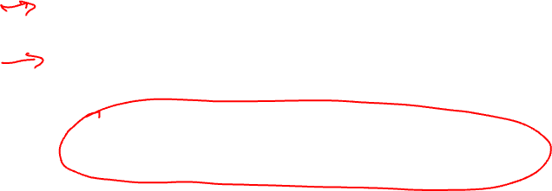
Announcements & Reading Material
HW2 – Get busy on it ASAP!
Talk about course projects next class – Start thinking about forming/joining a group (3-5 students)
Today’s class
  Compilers: Principles, Techniques, and Tools,
  A. Aho, R. Sethi, and J. Ullman, Addison-Wesley, 1988,
  9.9, 10.2, 10.3, 10.7 Edition 1; 8.5, 8.7, 9.1, 9.4, 9.5 Edition 2
Material for next Monday
  “Compiler Code Transformations for Superscalar-Based High-Performance Systems,” S. Mahlke, W. Chen, J. Gyllenhaal, W. Hwu, P. Chang, and T. Kiyohara, Proceedings of Supercomputing '92, Nov. 1992, pp. 808-817
  And if you want more on ILP optimizations: D. J. Kuck, The Structure of Computers and Computations. New York, NY: John Wiley and Sons, 1978. (optional!)

Slide 3
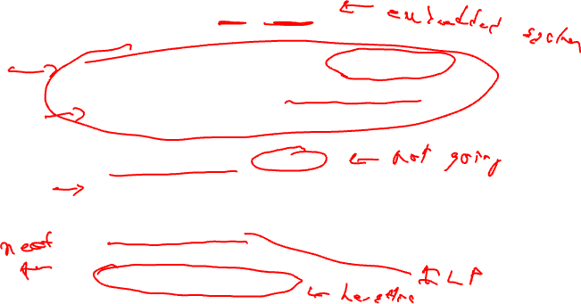
Code Optimization
Make the code run faster on the target processor
  My (Scott’s) favorite topic !!
  Other objectives: Power, code size
Classes of optimization
  1. Classical (machine independent, done at IR level)
    Reducing operation count (redundancy elimination)
    Simplifying operations
    Generally good for any kind of machine
  2. Machine specific (done in llc)
    Peephole optimizations
    Take advantage of specialized hardware features
  3. Parallelism enhancing (IR level often, but sometimes llc)
    Increasing parallelism (ILP or TLP)
    Possibly increase instructions

Slide 4
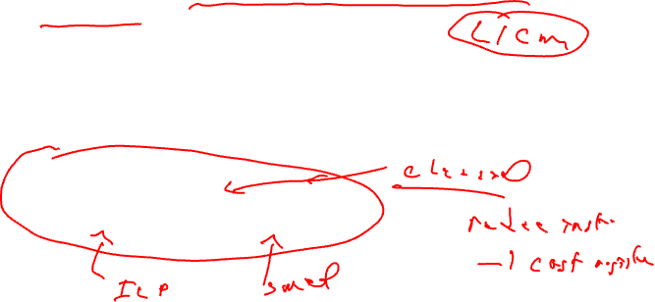
A Tour Through the Classical Optimizations
For this class – Go over concepts of a small subset of the optimizations
  What it is, why its useful
  When can it be applied (set of conditions that must be satisfied)
  How it works
  Give you the flavor but don’t want to beat you over the head
Challenges
  Register pressure?
  Parallelism verses operation count

Slide 5
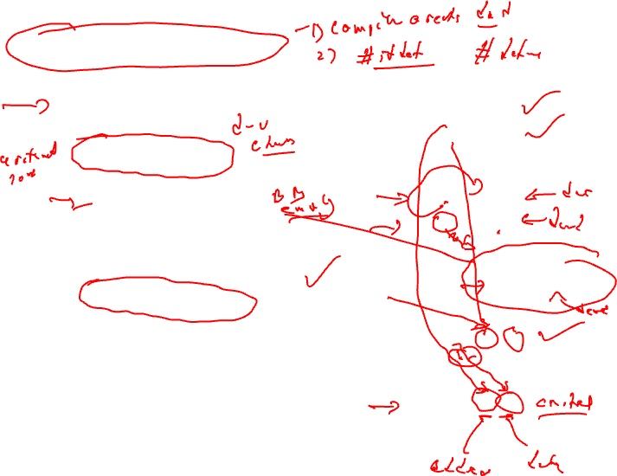
Dead Code Elimination
Remove any operation who’s result is never consumed
Rules
  X can be deleted
    no stores or branches
  DU chain empty or dest register not live
This misses some dead code!!
  Especially in loops
Better Algorithm
  Critical operation
    store or branch operation
  Any operation that does not directly or indirectly feed a critical operation is dead
  Trace UD chains backwards from critical operations
  Any op not visited is dead
1. r1 = 3
2. r2 = 10
BB1
3. r4 = r4 + 1
4. r7 = r1 * r4
BB2
BB3
BB4
5. r2 = 0
6. r3 = r3 + 1
BB5
7. r3 = r2 + r1
BB6
8. store (r1, r3)

Slide 6
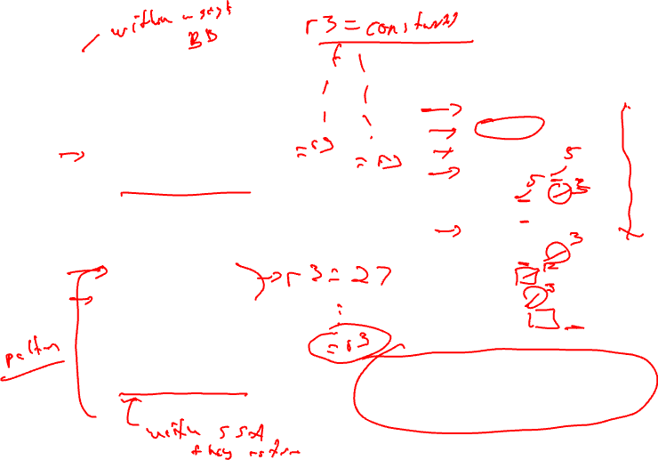
Local Constant Propagation
Forward propagation of moves of the form
  rx = L (where L is a literal)
  Maximally propagate
Consider 2 ops, X and Y in a BB, X is before Y
  1. X is a move
  2. src1(X) is a literal
  3. Y consumes dest(X)
  4. There is no definition of dest(X) between X and Y (local available defs)
BB1
1. r1 = 5
2. r2 = 3
3. r3 = 7
4. r4 = r4 + r1
5. r1 = r1 + r2
6. r1 = r1 + 1
7. r3 = 12
8. r8 = r1 - r2
9. r9 = r3 + r5
10. r3 = r2 + 1
11. r10 = r3 – r1
Note, ignore operation format issues, so
all operations can have literals in either
operand position

Slide 7
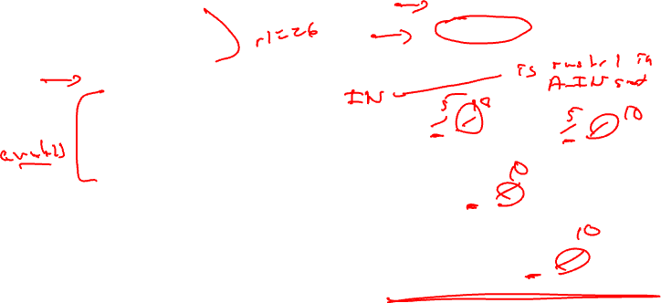
Global Constant Propagation
Consider 2 ops, X and Y in different BBs
  1. X is a move
  2. src1(X) is a literal
  3. Y consumes dest(X)
  4. X is in a_in(BB(Y)) (global available defs)
  5. Dest(x) is not modified between the top of BB(Y) and Y (local available defs)
BB1
1. r1 = 5
2. r2 = 10
BB2
BB3
3. r1 = r1 + r2
4. r7 = r1 – r2
BB4
5. r8 = r1 * r2
BB5
6. r9 = r1 + r2

Slide 8
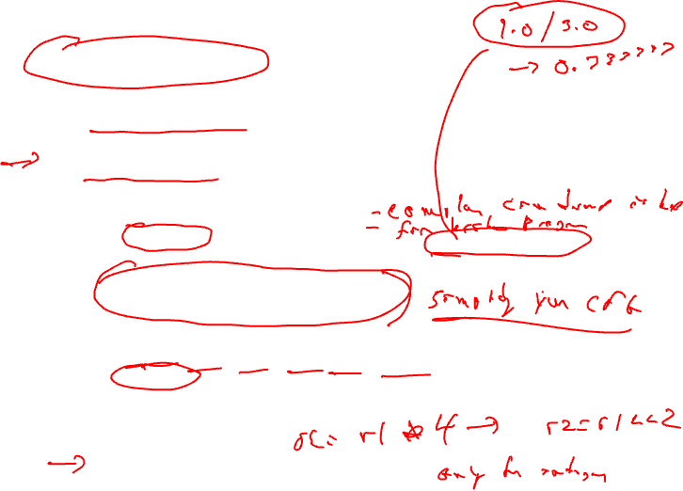
Constant Folding
Simplify 1 operation based on values of src operands
  Constant propagation creates opportunities for this
All constant operands
  Evaluate the op, replace with a move
    r1 = 3 * 4 → r1 = 12
    r1 = 3 / 0 → ??? Don’t evaluate excepting ops !, what about floating-point?
  Evaluate conditional branch, replace with BRU or noop
    if (1 < 2) goto BB2 → BRU BB2
    if (1 > 2) goto BB2 → convert to a noop
Algebraic identities
  r1 = r2 + 0, r2 – 0, r2 | 0, r2 ^ 0, r2 << 0, r2 >> 0
    r1 = r2
  r1 = 0 * r2, 0 / r2, 0 & r2
    r1 = 0
  r1 = r2 * 1, r2 / 1
    r1 = r2

Slide 9

Class Problem
Optimize this applying
1. constant propagation
2. constant folding
1. r1 = 0
2. r2 = 10
3. r3 = 0
BB1
BB2
4. r4 = 1
5. r7 = r1 * 4
6. r6 = 8
7. if (r3 > 0)
BB3
BB4
8. r2 = 0
9. r6 = r6 * r7
10. r3 = r2 / r6
11. r3 = r4
12. r3 = r3 + r2
13. r1 = r6
BB5
14. r2 = r2 + 1
15. r1 = r1 + 1
16. if (r1 < 100)
BB6
17. store (r1, r3)

Slide 10
Class Problem - Solution
Optimize this applying
1. constant propagation
2. constant folding
1. r1 = 0
2. r2 = 10
3. r3 = 0
1. r1 = 0
2. r2 = 10
3. r3 = 0
BB1
BB1
BB2
4. r4 = 1
5. r7 = r1 * 4
6. r6 = 8
7. if (r3 > 0)
BB2
4. r4 = 1
5. r7 = r1 * 4
6. r6 = 8
7. if (r3 > 0)
BB3
BB4
BB3
BB4
8. r2 = 0
9. r6 = r6 * r7
10. r3 = r2 / r6
11. r3 = r4
12. r3 = r3 + r2
13. r1 = r6
8. r2 = 0
9. r6 = r7 << 3
10. r3 = 0
11. r3 = 1
12. r3 = 1 + r2
13. r1 = 8
BB5
14. r2 = r2 + 1
15. r1 = r1 + 1
16. if (r1 < 100)
BB5
14. r2 = r2 + 1
15. r1 = r1 + 1
16. if (r1 < 100)
BB6
17. store (r1, r3)
BB6
17. store (r1, r3)
Red instructions can be deleted by
subsequent dead code elimination

Slide 11
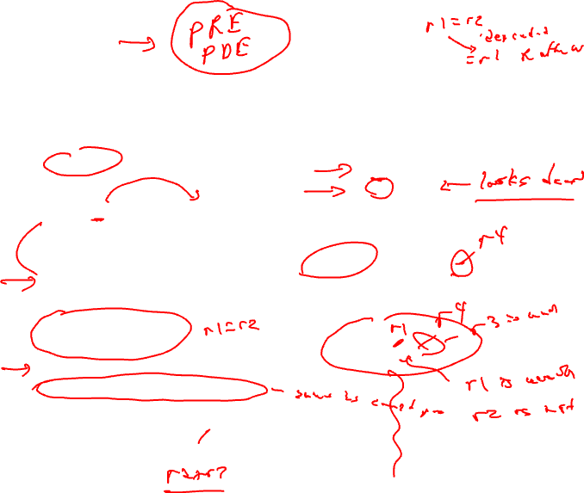
Forward Copy Propagation
Forward propagation of the RHS of moves
  r1 = r2
  …
  r4 = r1 + 1 → r4 = r2 + 1
Benefits
  Reduce chain of dependences
  Eliminate the move
Rules (ops X and Y)
  X is a move
  src1(X) is a register
  Y consumes dest(X)
  X.dest is an available def at Y
  X.src1 is an available expr at Y
BB1
1. r1 = r2
2. r3 = r4
BB2
BB3
3. r2 = 0
4. r6 = r3 + 1
BB4
5. r5 = r2 + r3

Slide 12
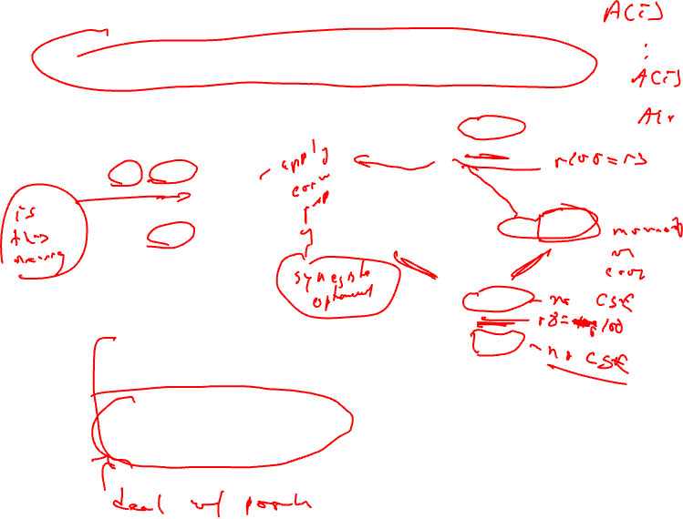
CSE – Common Subexpression Elimination
Eliminate recomputation of an expression by reusing the previous result
  r1 = r2 * r3
  → r100 = r1
  …
  r4 = r2 * r3 → r4 = r100
Benefits
  Reduce work
  Moves can get copy propagated
Rules (ops X and Y)
  X and Y have the same opcode
  src(X) = src(Y), for all srcs
  expr(X) is available at Y
  if X is a load, then there is no store that may write to address(X) along any path between X and Y
BB1
1. r1 = r2 * r6
2. r3 = r4 / r7
BB2
BB3
3. r2 = r2 + 1
4. r6 = r3 * 7
BB4
5. r5 = r2 * r6
6. r8 = r4 / r7
7. r9 = r3 * 7
if op is a load, call it redundant
load elimination rather than CSE,
Redundant store elimination also possible,
but applied a bit differently – think about it!

Slide 13

Class Problem
Optimize this applying
1. dead code elimination
2. forward copy propagation
3. CSE
BB1
1. r4 = r1
2. r6 = r15
3. r2 = r3 * r4
4. r8 = r2 + r5
5. r9 = r3
6. r7 = load(r2)
7. if (r2 > r8)
BB2
BB3
8. r5 = r9 * r4
9. r11 = r2
10. r12 = load(r11)
11. if (r12 != 0)
12. r3 = load(r2)
13. r10 = r3 / r6
14. r11 = r8
15. store (r11, r7)
BB4
16. store (r12, r3)

Slide 14
Class Problem Solution
Optimize this applying
1. dead code elimination
2. forward copy propagation
3. CSE
r4 = r1
r6 = r15
r2 = r3 * r4
r8 = r2 + r5
r9 = r3
r7 = load(r2)
if (r2 > r8)
r2 = r3 * r1
r8 = r2 + r5
r7 = load(r2)
if (r2 > r8)
r5 = r9 * r4
r11 = r2
r12 = load(r11)
if (r12 != 0)
r3 = load(r2)
r10 = r3 / r6
r11 = r8
store (r11, r7)
if (r7 != 0)
r3 = r7
store (r8, r7)
store (r12, r3)
store (r12, r3)

Slide 15
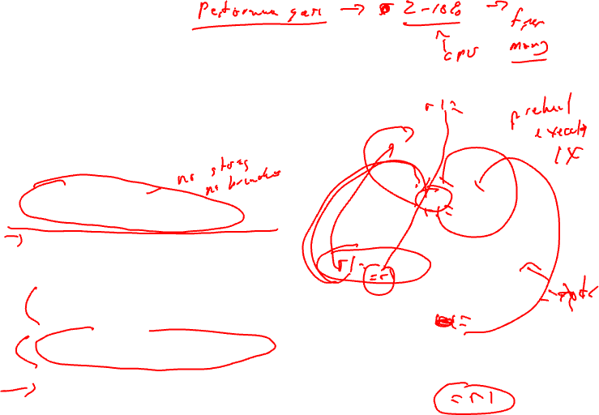
Loop Invariant Code Motion (LICM)
Move operations whose source operands do not change within the loop to the loop preheader
  Execute them only 1x per invocation of the loop
Rules
  X can be moved
  src(X) not modified in loop body
  X is the only op to modify dest(X)
  for all uses of dest(X), X is in the available defs set
  for all exit BB, if dest(X) is live on the exit edge, X is in the available defs set on the edge
  if X not executed on every iteration, then X must provably not cause exceptions
  if X is a load or store, then there are no writes to address(X) in loop
BB1
BB2
BB3
BB4
BB5
BB6

Slide 16
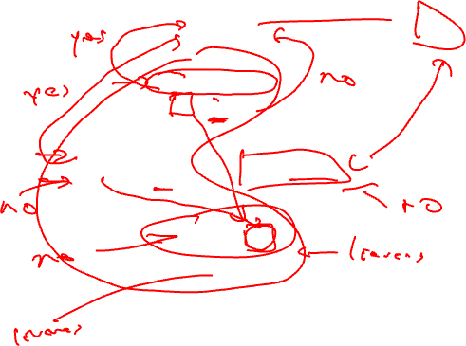
LICM Example
BB1
1. r1 = 3
2. r5 = &A
BB2
3. r4 = load(r5)
4. r7 = r4 * 3
BB3
BB4
5. r8 = r2 + 1
6. r7 = r8 * r4
7. r3 = r2 + 1
BB5
8. r1 = r1 + r7
BB6
9. store (r1, r3)

Slide 17
Global Variable Migration
Assign a global variable temporarily to a register for the duration of the loop
  Load in preheader
  Store at exit points
Rules
  X is a load or store
  address(X) not modified in the loop
  if X not executed on every iteration, then X must provably not cause an exception
  All memory ops in loop whose address can equal address(X) must always have the same address as X
BB1
BB2
1. r4 = load(r5)
2. r4 = r4 + 1
BB3
BB4
3. r8 = load(r5)
4. r7 = r8 * r4
5. store(r5, r4)
BB5
6. store(r5,r7)
BB6

Slide 18
Global Variable Migration Example
BB1
BB2
1. r4 = load(r5)
2. r4 = r4 + 1
BB3
BB4
3. r8 = load(r5)
4. r7 = r8 * r4
5. store(r5, r4)
BB5
6. store(r5,r7)
BB6

Slide 19
Induction Variable Strength Reduction
Create basic induction variables from derived induction variables
Induction variable
  BIV (i++)
    0,1,2,3,4,...
  DIV (j = i * 4)
    0, 4, 8, 12, 16, ...
  DIV can be converted into a BIV that is incremented by 4
Issues
  Initial and increment vals
  Where to place increments
BB1
BB2
1. r5 = r4 - 3
2. r4 = r4 + 1
BB3
BB4
3. r7 = r4 * r9
BB5
4. r6 = r4 << 2
BB6

Slide 20
Induction Variable Strength Reduction (2)
Rules
  X is a *, <<, + or – operation
  src1(X) is a basic ind var
  src2(X) is invariant
  No other ops modify dest(X)
  dest(X) != src(X) for all srcs
  dest(X) is a register
Transformation
  Insert the following into the preheader
    new_reg = RHS(X)
  If opcode(X) is not add/sub, insert to the bottom of the preheader
    new_inc = inc(src1(X)) opcode(X) src2(X)
  else
    new_inc = inc(src1(X))
  Insert the following at each update of src1(X)
    new_reg += new_inc
  Change X → dest(X) = new_reg
BB1
BB2
1. r5 = r4 - 3
2. r4 = r4 + 1
BB3
BB4
3. r7 = r4 * r9
BB5
4. r6 = r4 << 2
BB6

Slide 21
Induction Variable Strength Reduction - Example
BB1
BB2
1. r5 = r4 - 3
2. r4 = r4 + 1
BB3
BB4
3. r7 = r4 * r9
BB5
4. r6 = r4 << 2
BB6

Slide 22
Class Problem
Optimize this applying
induction var str
reduction
BB1
1. r1 = 0
2. r2 = 0
BB2
3. r5 = r5 + 1
4. r11 = r5 * 2
5. r10 = r11 + 2
6. r12 = load (r10+0)
7. r9 = r1 << 1
8. r4 = r9 - 10
9. r3 = load(r4+4)
10. r3 = r3 + 1
11. store(r4+0, r3)
12. r7 = r3 << 2
13. r6 = load(r7+0)
14. r13 = r2 - 1
15. r1 = r1 + 1
16. r2 = r2 + 1
BB3
r13, r12, r6, r10
liveout

Slide 23
Class Problem Solution
r1 = 0
r2 = 0
r111 = r5 * 2
r109 = r1 << 1
r113 = r2 -1
Optimize this applying
induction var str reduction
r1 = 0
r2 = 0
r5 = r5 + 1
r11 = r5 * 2
r10 = r11 + 2
r12 = load (r10+0)
r9 = r1 << 1
r4 = r9 - 10
r3 = load(r4+4)
r3 = r3 + 1
store(r4+0, r3)
r7 = r3 << 2
r6 = load(r7+0)
r13 = r2 - 1
r1 = r1 + 1
r2 = r2 + 1
r5 = r5 + 1
r111 = r111 + 2
r11 = r111
r10 = r11 + 2
r12 = load (r10+0)
r9 = r109
r4 = r9 - 10
r3 = load(r4+4)
r3 = r3 + 1
store(r4+0, r3)
r7 = r3 << 2
r6 = load(r7+0)
r13 = r113
r1 = r1 + 1
r109 = r109 + 2
r2 = r2 + 1
r113 = r113 + 1
Note, after copy
propagation, r10
and r4 can be
strength reduced
as well.
r13, r12, r6, r10
liveout
r13, r12, r6, r10
liveout

