Slide 1

EECS 583 – Class 6 Dataflow Analysis II
University of Michigan
September 15, 2025

Slide 2
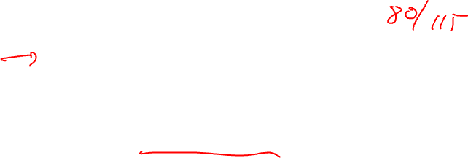
Announcements & Reading Material
HW 1 – Due tonight at midnight
See piazza/GSIs if you are stuck
Can use up to 2 late days (10% penalty per day)
HW 2 coming out Wednesday
Today’s class
Compilers: Principles, Techniques, and Tools, A. Aho, R. Sethi, and J. Ullman, Addison-Wesley, 1988. (Sections: 10.5, 10.6, 10.9, 10.10 Edition 1; 9.2, 9.3 Edition 2)
Next class
“Practical Improvements to the Construction and Destruction of Static Single Assignment Form,” P. Briggs, K. Cooper, T. Harvey, and L. Simpson, Software--Practice and Experience, 28(8), July 1998, pp. 859-891.

Slide 3
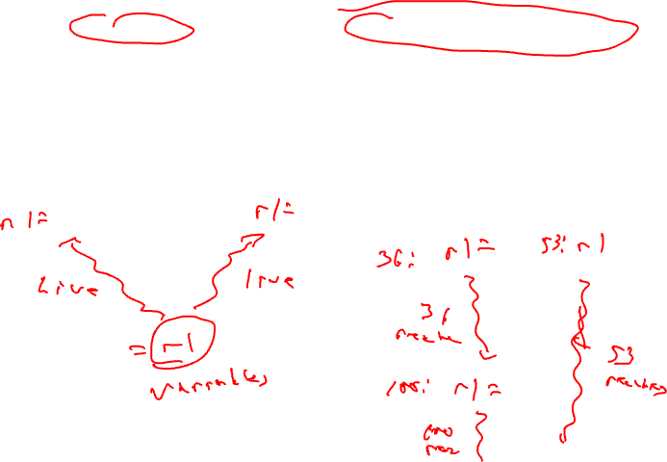
Recap: Liveness vs Reaching Defs
Liveness
Reaching Definitions/DU/UD
OUT = Union(IN(succs))
IN = GEN + (OUT – KILL)
IN = Union(OUT(preds))
OUT = GEN + (IN – KILL)
Bottom-up dataflow
Any path
Keep track of variables/registers
Uses of variables → GEN
Defs of variables → KILL
Top-down dataflow
Any path
Keep track of instruction IDs
Defs of variables → GEN
Defs of variables → KILL

Slide 4
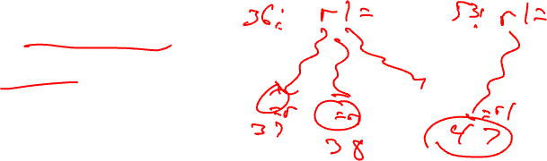
From Last Time: DU/UD Chains
Convenient way to access/use reaching defs info
Def-Use chains
Given a def, what are all the possible consumers of the operand produced
Maybe consumer
Use-Def chains
Given a use, what are all the possible producers of the operand consumed
Maybe producer

Slide 5
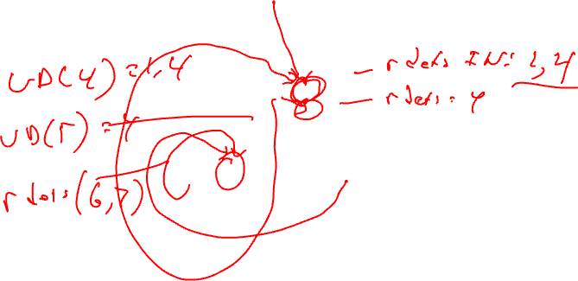
Example – DU/UD Chains
1. r1 = 3
2. r2 = r3
3. r3 = r4
4. r1 = r1 + 1
5. r7 = r1 * r2
6. r4 = r4 + 1
7. r4 = r3
8. r8 = 8
9. r9 = r7 + r8

Slide 6
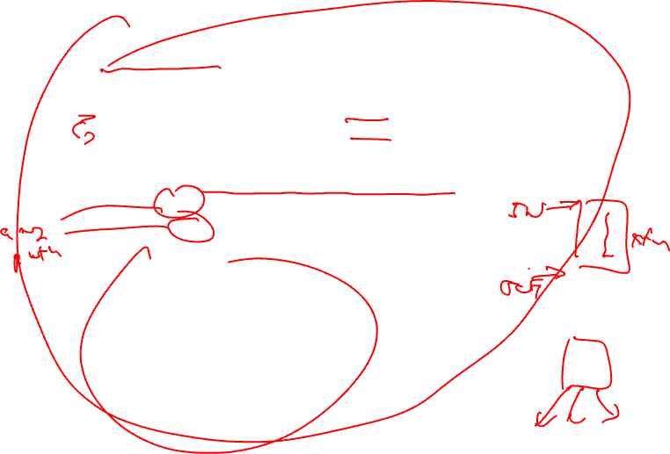
Generalizing Dataflow Analysis
Transfer function
How information is changed by “something” (BB)
OUT = GEN + (IN – KILL) /* forward analysis, e.g., rdefs */
IN = GEN + (OUT – KILL) /* backward analysis, e.g., liveness */
Meet function
How information from multiple paths is combined
IN = Union(OUT(predecessors)) /* forward analysis */
OUT = Union(IN(successors)) /* backward analysis */
Generalized dataflow algorithm
while (change)
change = false
for each BB
apply meet function
apply transfer functions
if any changes → change = true

Slide 7
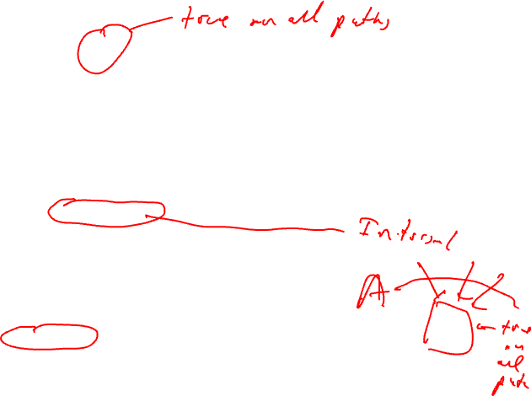
What About All Path Problems?
Up to this point
Any path problems (maybe relations)
Definition reaches along some path
Some sequence of branches in which def reaches
Lots of defs of the same variable may reach a point
Use of Union operator in meet function
All-path: Definition guaranteed to reach
Regardless of sequence of branches taken, def reaches
Can always count on this
Only 1 def can be guaranteed to reach
Availability (as opposed to reaching)
Available definitions
Available expressions (could also have reaching expressions, but not that useful)

Slide 8

Reaching vs Available Definitions
1:r1 = r2 + r3
2:r6 = r4 – r5
1,2 reach
1,2 available
3:r4 = 4
4:r6 = 8
1,2 reach
1,2 available
1,3,4 reach
1,3,4 available
5:r6 = r2 + r3
6:r7 = r4 – r5
1,2,3,4 reach
1 available

Slide 9
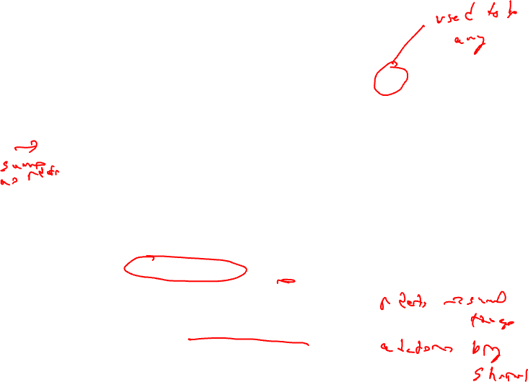
Available Definition Analysis (Adefs)
A definition d is available at a point p if along all paths from d to p, d is not killed
Remember, a definition of a variable is killed between 2 points when there is another definition of that variable along the path
r1 = r2 + r3 kills previous definitions of r1
Algorithm
Forward dataflow analysis as propagation occurs from defs downwards
Use the Intersect function as the meet operator to guarantee the all-path requirement
GEN/KILL/IN/OUT similar to reaching defs
Initialization of IN/OUT is the tricky part

Slide 10
Compute GEN/KILL Sets for each BB (Adefs)
Exactly the same as reaching defs !!!
for each basic block in the procedure, X, do
GEN(X) = 0
KILL(X) = 0
for each operation in sequential order in X, op, do
for each destination operand of op, dest, do
G = op
K = {all ops which define dest – op}
GEN(X) = G + (GEN(X) – K)
KILL(X) = K + (KILL(X) – G)
endfor
endfor
endwhile

Slide 11
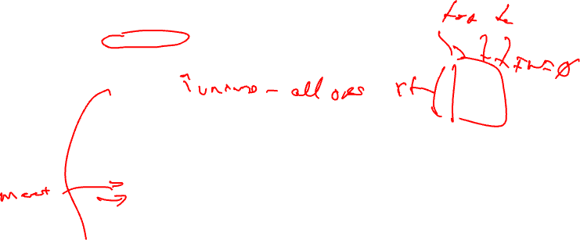
Compute IN/OUT Sets for all BBs (Adefs)
U = universal set of all operations in the Procedure
IN(0) = 0
OUT(0) = GEN(0)
for each basic block in procedure, W, (W != 0), do
IN(W) = 0
OUT(W) = U – KILL(W)
change = 1
while (change) do
change = 0
for each basic block in procedure, X, do
old_OUT = OUT(X)
IN(X) = Intersect(OUT(Y)) for all predecessors Y of X
OUT(X) = GEN(X) + (IN(X) – KILL(X))
if (old_OUT != OUT(X)) then
change = 1
endif
endfor
endwhile

Slide 12
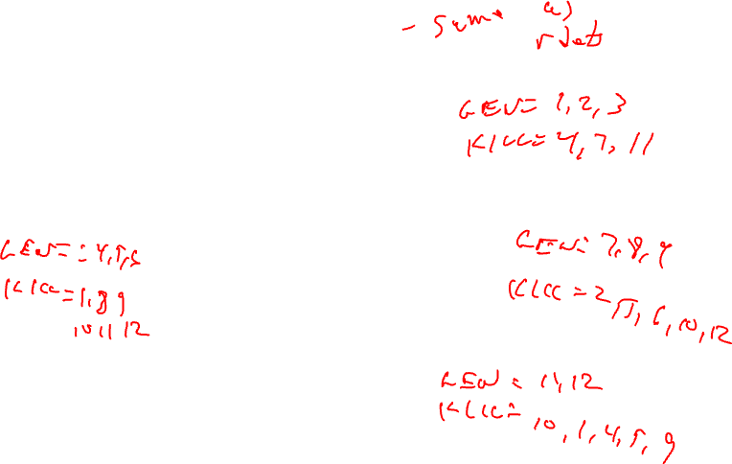
Example Adef Calculation
G = op
K = {all ops which define dest – op}
GEN(X) = G + (GEN(X) – K)
KILL(X) = K + (KILL(X) – G)
BB1
1. r1 = MEM[r2+0]
2. r2 = MEM[r1 + 1]
3. r8 = r1 * r2
BB2
4. r1 = r1 + 5
5. r3 = r5 – r1
6. r7 = r3 * 2
BB3
7. r2 = 0
8. r7 = r1 + r2
9. r3 = 4
BB4
10. r3 = r3 + r7
11. r1 = r2 – r8
12. r3 = r1 * 2

Slide 13
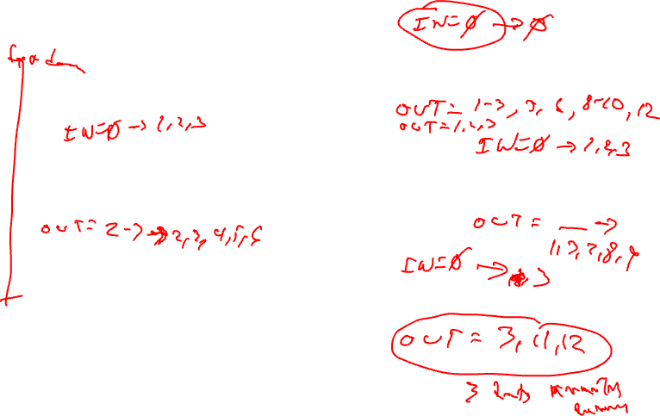
Example Adef Calculation - Continued
IN = Intersect(OUT(preds))
OUT = GEN + (IN – KILL)
BB1
1. r1 = MEM[r2+0]
2. r2 = MEM[r1 + 1]
3. r8 = r1 * r2
GEN = 1, 2, 3
KILL = 4, 7, 11
BB2
4. r1 = r1 + 5
5. r3 = r5 – r1
6. r7 = r3 * 2
BB3
7. r2 = 0
8. r7 = r1 + r2
9. r3 = 4
GEN = 4, 5, 6
KILL = 1, 8, 9, 10, 11, 12
GEN = 7, 8, 9
KILL = 2, 5, 6, 10, 12
BB4
10. r3 = r3 + r7
11. r1 = r2 – r8
12. r3 = r1 * 2
GEN = 11, 12
KILL = 1,4,5,9,10

Slide 14
Example Adef Calculation - Answer
IN = Intersect(OUT(preds))
OUT = GEN + (IN – KILL)
BB1
1. r1 = MEM[r2+0]
2. r2 = MEM[r1 + 1]
3. r8 = r1 * r2
IN = 0 → 0
GEN = 1, 2, 3
KILL = 4, 7, 11
OUT = 1,2,3 → 1,2,3
IN = 0 → 1,2,3
BB2
4. r1 = r1 + 5
5. r3 = r5 – r1
6. r7 = r3 * 2
BB3
7. r2 = 0
8. r7 = r1 + r2
9. r3 = 4
IN = 0 → 1,2,3
GEN = 4, 5, 6
KILL = 1, 8, 9, 10, 11, 12
GEN = 7, 8, 9
KILL = 2, 5, 6, 10, 12
OUT = 2,3,4,5,6,7 → 2,3,4,5,6
OUT = 1,3,4,7,8,9,11 → 1,3,7,8,9
BB4
10. r3 = r3 + r7
11. r1 = r2 – r8
12. r3 = r1 * 2
IN = 0 → 3
GEN = 11, 12
KILL = 1,4,5,9,10
OUT = 2,3,6,7,8,11,12 → 3,11,12

Slide 15
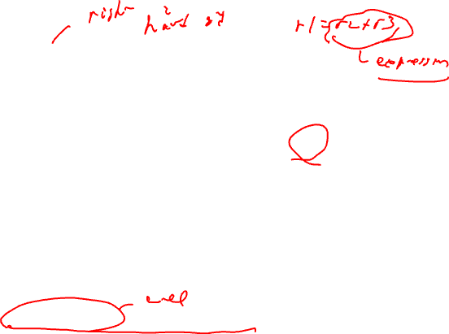
Available Expression Analysis (Aexprs)
An expression is a RHS of an operation
r2 = r3 + r4, r3+r4 is an expression
An expression e is available at a point p if along all paths from e to p, e is not killed
An expression is killed between 2 points when one of its source operands are redefined
r1 = r2 + r3 kills all expressions involving r1
Algorithm
Forward dataflow analysis as propagation occurs from defs downwards
Use the Intersect function as the meet operator to guarantee the all-path requirement
Looks exactly like adefs, except GEN/KILL/IN/OUT are the RHS’s of operations rather than the LHS’s

Slide 16
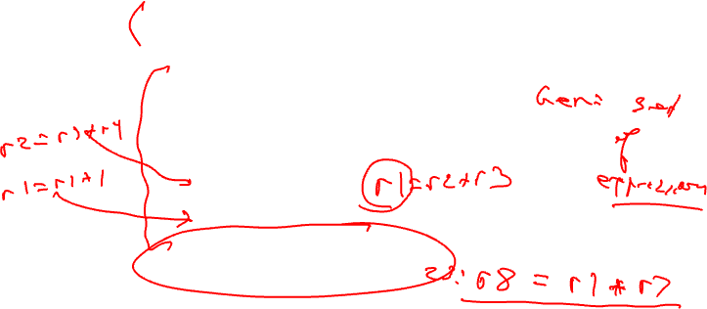
Computation of Aexpr GEN/KILL Sets
We can also formulate the GEN/KILL slightly differently so you do not
need to break up instructions like “r2 = r2 + 1”.
for each basic block in the procedure, X, do
GEN(X) = 0
KILL(X) = 0
for each operation in sequential order in X, op, do
K = 0
for each destination operand of op, dest, do
K += {all ops which use dest}
endfor
if (op not in K)
G = op
else
G = 0
GEN(X) = G + (GEN(X) – K)
KILL(X) = K + (KILL(X) – G)
endfor
endfor

Slide 17
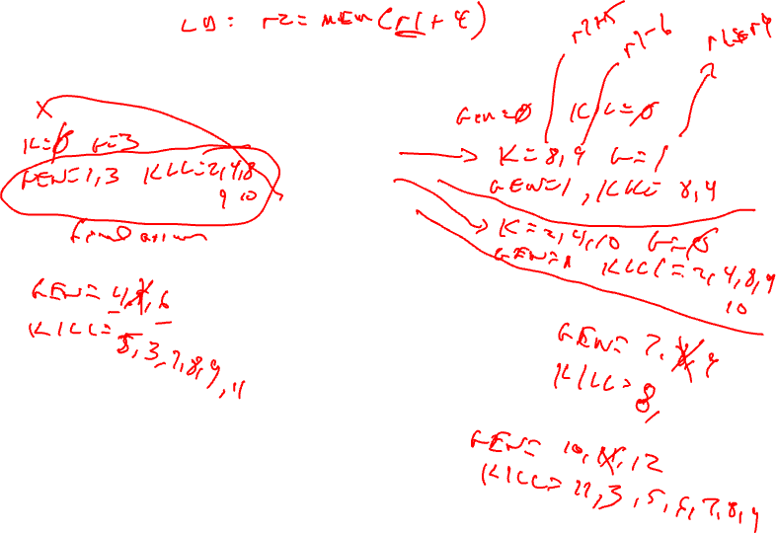
Example Aexpr Calculation
1: r1 = r6 * r9
2: r2 = r2 + 1
3: r5 = r3 * r4
4: r1 = r2 + 1
5: r3 = r3 * r4
6: r8 = r3 * 2
7: r7 = r3 * r4
8: r1 = r1 + 5
9: r7 = r1 - 6
10: r8 = r2 + 1
11: r1 = r3 * r4
12: r3 = r6 * r9

Slide 18
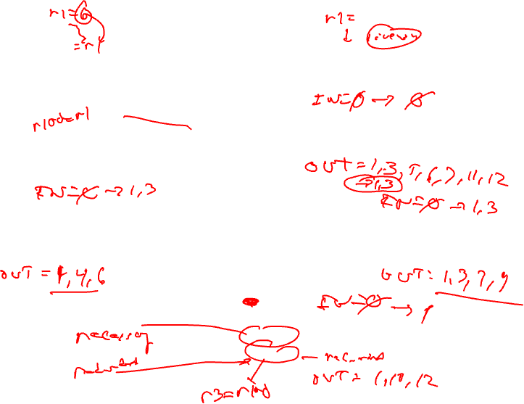
Example Aexpr Calculation - Continued
1: r1 = r6 * r9
2: r2 = r2 + 1
3: r5 = r3 * r4
GEN = 1,3 (remember {1, 3} means {“r6*r9”, “r3*r4”})
KILL = 2, 4, 8, 9, 10
4: r1 = r2 + 1
5: r3 = r3 * r4
6: r8 = r3 * 2
7: r7 = r3 * r4
8: r1 = r1 + 5
9: r7 = r1 - 6
GEN = 4, 6
KILL = 3, 5, 7, 8, 9, 11
GEN = 7, 9
KILL = 8
10: r8 = r2 + 1
11: r1 = r3 * r4
12: r3 = r6 * r9
GEN = 10, 12
KILL = 3, 5, 6, 7, 8, 9, 11

Slide 19
Example Aexpr Calculation - Answer
IN/OUT sets
A → B
A = initial state
B = after first iteration
IN = - → -
1: r1 = r6 * r9
2: r2 = r2 + 1
3: r5 = r3 * r4
GEN = 1,3 (remember {1, 3} means {“r6*r9”, “r3*r4”})
KILL = 2, 4, 8, 9, 10
OUT = 1,3,5,6,7,11,12 → 1,3
IN = - → 1,3
4: r1 = r2 + 1
5: r3 = r3 * r4
6: r8 = r3 * 2
7: r7 = r3 * r4
8: r1 = r1 + 5
9: r7 = r1 - 6
IN = - → 1,3
GEN = 4, 6
KILL = 3, 5, 7, 8, 9, 11
GEN = 7, 9
KILL = 8
OUT = 1,2,4,6,10,12 → 1,4,6
OUT = 1,2,3,4,5,6,7,9,10,11,12 → 1,3,7,9
10: r8 = r2 + 1
11: r1 = r3 * r4
12: r3 = r6 * r9
IN = - → 1
GEN = 10, 12
KILL = 3, 5, 6, 7, 8, 9, 11
OUT = 1,2,4,10,12 → 1,10,12

Slide 20
Dataflow Summary
Liveness
Reaching Definitions/DU/UD
OUT = Union(IN(succs))
IN = GEN + (OUT – KILL)
IN = Union(OUT(preds))
OUT = GEN + (IN – KILL)
Bottom-up dataflow
Any path
Keep track of variables/registers
Uses of variables → GEN
Defs of variables → KILL
Top-down dataflow
Any path
Keep track of instruction IDs
Defs of variables → GEN
Defs of variables → KILL
Available Expressions
Available Definitions
IN = Intersect(OUT(preds))
OUT = GEN + (IN – KILL)
IN = Intersect(OUT(preds))
OUT = GEN + (IN – KILL)
Top-down dataflow
All path
Keep track of instruction IDs
Expressions of variables → GEN
Defs of variables → KILL
Top-down dataflow
All path
Keep track of instruction IDs
Defs of variables → GEN
Defs of variables → KILL

Slide 21
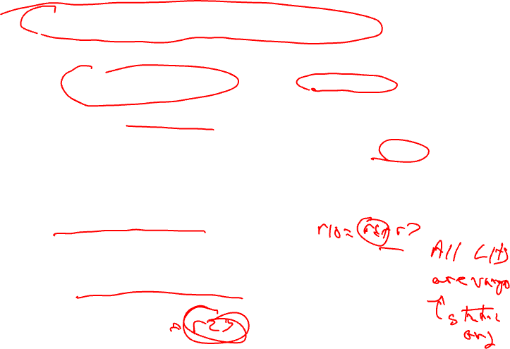
Static Single Assignment (SSA) Form
Difficulty with optimization
Multiple definitions of the same register
Which definition reaches
Is expression available?
Static single assignment
Each assignment to a variable is given a unique name
All of the uses reached by that assignment are renamed
DU chains become obvious based on the register name!
r1 = r2 + r3
r6 = r4 – r5
r4 = r6
r6 = 8
r7 = r4 – r5
r8 = r2 + r3

Slide 22
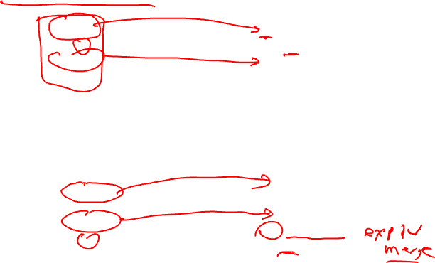
Converting to SSA Form
Trivial for straight line code
More complex with control flow – Must use Phi nodes
x = -1
y = x
x = 5
z = x
x0 = -1
y = x0
x1 = 5
z = x1
if ( ... )
x = -1
else
x = 5
y = x
if ( ... )
x0 = -1
else
x1 = 5
x2 = Phi(x0,x1)
y = x2

Slide 23
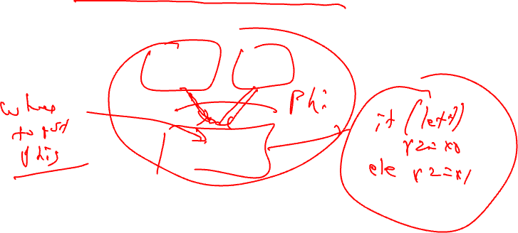
Phi Nodes (aka Phi Functions)
Special kind of copy that selects one of its inputs
Choice of input is governed by the CFG edge along which control flow reached the Phi node
Phi nodes are required when 2 non-null paths X→Z and Y→Z converge at node Z, and nodes X and Y contain assignments to V
x0 =
x1 =
x2 = Phi(x0,x1)

Slide 24
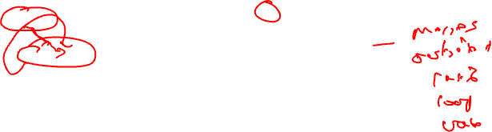
Converting to SSA Form (2)
What about loops?
No problem!, use Phi nodes again
i = 0 do {
i = i + 1
}
while (i < 50)
i0 = 0 do {
i1 = Phi(i0, i2)
i2 = i1 + 1
}
while (i2 < 50)

Slide 25
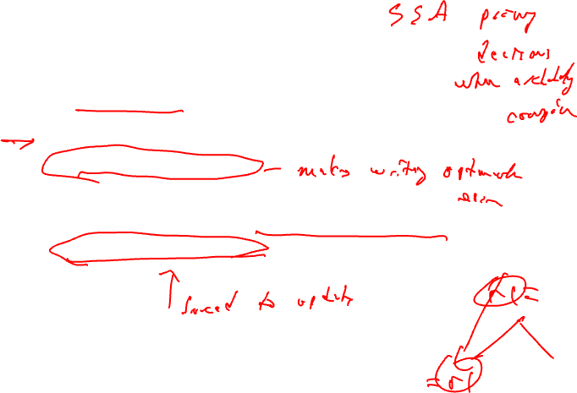
SSA Plusses and Minuses
Advantages of SSA
Explicit DU chains – Trivial to figure out what defs reach a use
Each use has exactly 1 definition!!!
Explicit merging of values
Makes optimizations easier
Disadvantages
When transform the code, must either recompute (slow) or incrementally update (tedious)

Slide 26
Generation of SSA Form
2 big parts
Determine where Phi nodes for each variable need to go
Rename the variables
Algorithm next time!!

