Slide 1

EECS 583 – Class 5 Dataflow Analysis
University of Michigan
September 10, 2025

Slide 2

Reading Material + Announcements
Reminder – HW 1 due Monday Sept 15, midnight
Use eecs583a, eecs583b servers
Before asking questions: 1) Read all threads on piazza, 2) Think a bit
Then, post question or talk to Naveen/Rishika if you are stuck
Today’s class
Compilers: Principles, Techniques, and Tools, A. Aho, R. Sethi, and J. Ullman, Addison-Wesley, 1988. (Chapters: 10.5, 10.6 Edition 1; Chapters 9.2 Edition 2)
Material for next Monday
Compilers: Principles, Techniques, and Tools, A. Aho, R. Sethi, and J. Ullman, Addison-Wesley, 1988. (Chapters: 10.5, 10.6, 10.9, 10.10 Edition 1; Chapters 9.2, 9.3 Edition 2)

Slide 3
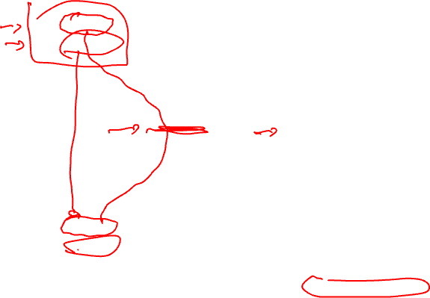
Looking Inside the Basic Blocks: Dataflow Analysis + Optimization
r1 = r2 + r3
r6 = r4 – r5
Control flow analysis
Treat BB as black box
Just care about branches
Now
Start looking at ops in BBs
What’s computed and where
Classical optimizations
Want to make the computation more efficient
Ex: Common Subexpression Elimination (CSE)
Is r2 + r3 redundant?
Is r4 – r5 redundant?
What if there were 1000 BB’s
Dataflow analysis !!
r4 = r4 + 1
What if r6 is modified?
r7 = r2 + r3
r8 = r4 – r5

Slide 4
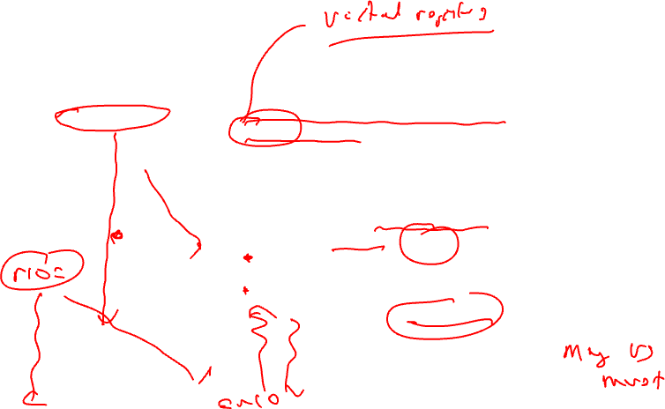
Dataflow Analysis Introduction
Dataflow analysis – Collection of information
that summarizes the creation/destruction of
values in a program. Used to identify legal
optimization opportunities.
r1 = r2 + r3
r6 = r4 – r5
Pick an arbitrary point in the program
r4 = r4 + 1
r6 = 8
Which VRs contain useful
data values? (liveness or upward
exposed uses)
Which definitions may reach
this point? (reaching defns)
Which definitions are guaranteed
to reach this point? (available defns)
Which uses below are exposed?
(downward exposed uses)
r7 = r2 + r3
r8 = r4 – r5

Slide 5
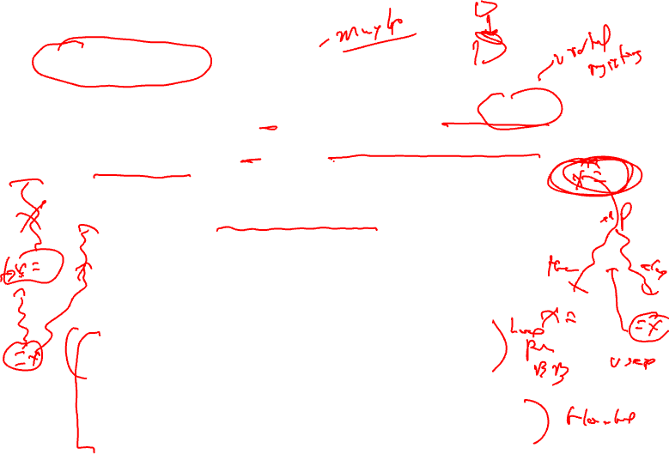
Live Variable (Liveness) Analysis
Defn: For each point p in a program and each variable y, determine whether y can be used before being redefined starting at p
Algorithm sketch
For each BB, y is live if it is used before defined in the BB or it is live leaving the block
Backward dataflow analysis as propagation occurs from uses upwards to defs
4 sets
GEN = set of external variables consumed in the BB
KILL = set of external variable uses killed by the BB
equivalent to set of variables defined by the BB
IN = set of variables that are live at the entry point of a BB
OUT = set of variables that are live at the exit point of a BB

Slide 6
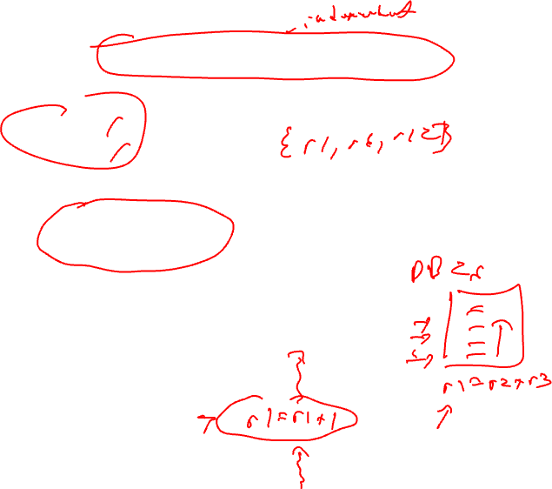
Computing GEN/KILL Sets For Each BB
for each basic block in the procedure, X, do
GEN(X) = 0
KILL(X) = 0
for each operation in reverse sequential order in X, op, do
for each destination operand of op, dest, do
GEN(X) -= dest
KILL(X) += dest
endfor
for each source operand of op, src, do
GEN(X) += src
KILL(X) -= src
endfor
endfor
endfor

Slide 7
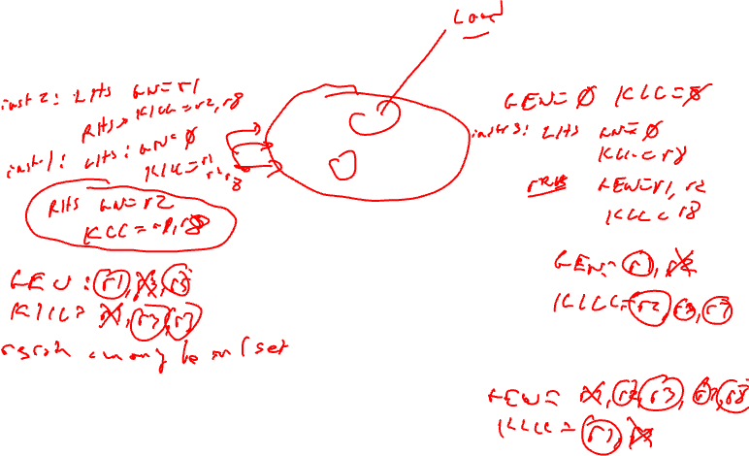
Example – GEN/KILL Liveness Computation
BB1
1. r1 = MEM[r2+0]
2. r2 = MEM[r1 + 1]
3. r8 = r1 * r2
BB2
4. r1 = r1 + 5
5. r3 = r5 – r1
6. r7 = r3 * 2
BB3
7. r2 = 0
8. r7 = r1 + r2
9: r3 = 4
BB4
10: r3 = r3 + r7
11: r1 = r2 – r8
12: r3 = r1 * 2

Slide 8
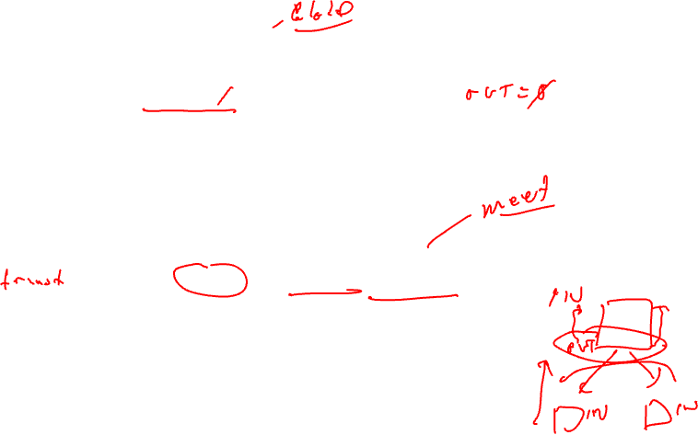
Compute IN/OUT Sets for all BBs
initialize IN(X) to 0 for all basic blocks X
change = 1
while (change) do
change = 0
for each basic block in procedure, X, do
old_IN = IN(X)
OUT(X) = Union(IN(Y)) for all successors Y of X
IN(X) = GEN(X) + (OUT(X) – KILL(X))
if (old_IN != IN(X)) then
change = 1
endif
endfor
endfor

Slide 9
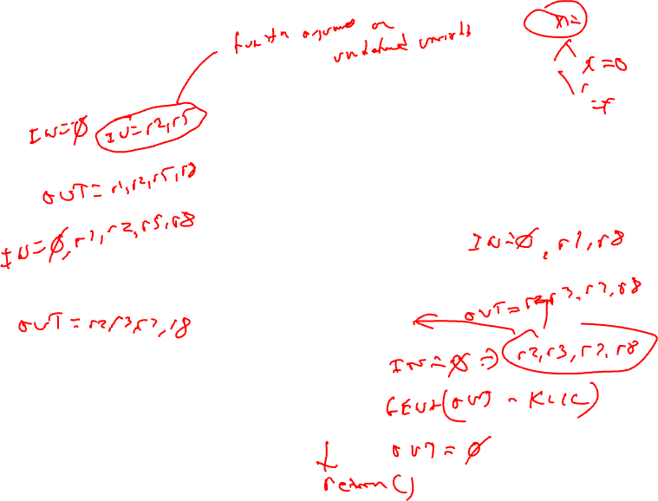
Example – Liveness Computation
OUT = Union(IN(succs))
IN = GEN + (OUT – KILL)
BB1
1. r1 = MEM[r2+0]
2. r2 = MEM[r1 + 1]
3. r8 = r1 * r2
GEN = r2
KILL = r1,r8
BB2
4. r1 = r1 + 5
5. r3 = r5 – r1
6. r7 = r3 * 2
BB3
7. r2 = 0
8. r7 = r1 + r2
9: r3 = 4
GEN = r1,r5
KILL = r3,r7
GEN = r1
KILL = r2,r3,r7
BB4
10: r3 = r3 + r7
11: r1 = r2 – r8
12: r3 = r1 * 2
GEN = r2,r3,r7,r8
KILL = r1

Slide 10
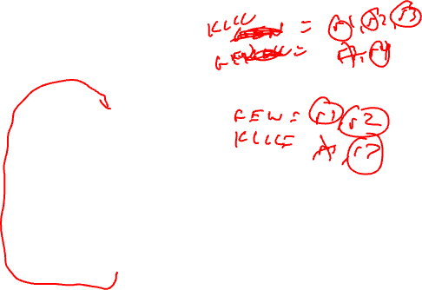
Liveness Class Problem
OUT = Union(IN(succs))
IN = GEN + (OUT – KILL)
1. r1 = 3
2. r2 = r3
3. r3 = r4
4. r1 = r1 + 1
5. r7 = r1 * r2
6. r4 = r4 + 1
7. r4 = r3 + r2
8. r8 = 8
9. r9 = r7 + r8

Slide 11
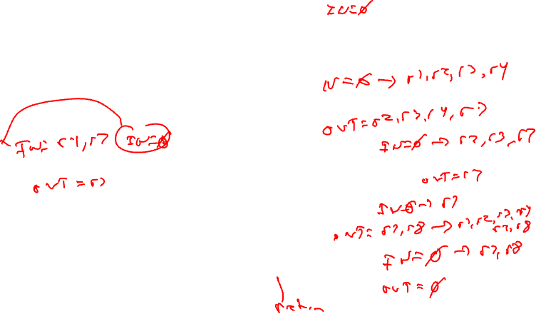
Liveness Class Problem - continued
OUT = Union(IN(succs))
IN = GEN + (OUT – KILL)
1. r1 = 3
2. r2 = r3
3. r3 = r4
GEN = r3, r4
KILL = r1, r2
4. r1 = r1 + 1
5. r7 = r1 * r2
GEN = r1, r2
KILL = r7
GEN = r4
KILL = NULL
6. r4 = r4 + 1
7. r4 = r3 + r2
GEN = r2, r3
KILL = r4
8. r8 = 8
GEN = NULL
KILL = r8
9. r9 = r7 + r8
GEN = r7, r8
KILL = r9

Slide 12
Liveness Class Problem Answer
OUT = Union(IN(succs))
IN = GEN + (OUT – KILL)
IN = r3, r4
1. r1 = 3
2. r2 = r3
3. r3 = r4
Blue sets are the first iteration IN/OUT,
Red sets are the second iteration IN/OUT
GEN = r3, r4
KILL = r1, r2
OUT = r1, r2, r3, r4
IN = r1, r2, r3, r4 → IN = r1, r2, r3, r4 (same!)
4. r1 = r1 + 1
5. r7 = r1 * r2
GEN = r1, r2
KILL = r7
OUT = r2, r3, r4, r7 → OUT = r1, r2, r3, r4, r7
IN = r4, r7 → IN = r1, r2, r3, r4, r7
IN = r2, r3, r7 → IN = r1, r2, r3, r7
GEN = r4
KILL = NULL
6. r4 = r4 + 1
7. r4 = r3 + r2
GEN = r2, r3
KILL = r4
OUT = r7 → OUT = r1, r2, r3, r4, r7
OUT = r7 → OUT = r1, r2, r3, r4, r7
IN = r7 → IN = r1, r2, r3, r4, r7
8. r8 = 8
GEN = NULL
KILL = r8
OUT = r7, r8 → OUT = r1, r2, r3, r4, r7, r8
IN = r7, r8
9. r9 = r7 + r8
GEN = r7, r8
KILL = r9
OUT = NULL

Slide 13
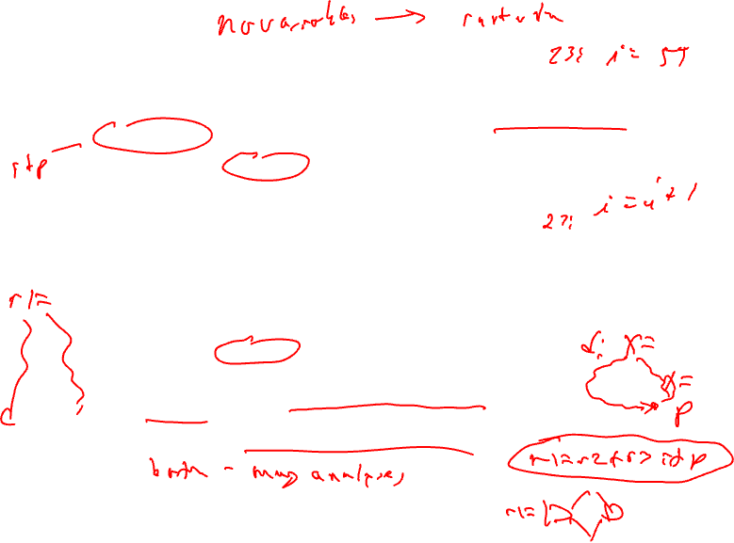
Reaching Definition Analysis (rdefs)
A definition of a variable x is an operation that assigns, or may assign, a value to x
A definition d reaches a point p if there is a path from the point immediately following d to p such that d is not “killed” along that path
A definition of a variable is killed between 2 points when there is another definition of that variable along the path
r1 = r2 + r3 kills previous definitions of r1
Liveness vs Reaching defs
Liveness → variables (e.g., virtual registers), don’t care about specific users
Reaching defs → operations, each def is different
Forward dataflow analysis as propagation occurs from defs downwards (liveness was backward analysis)

Slide 14
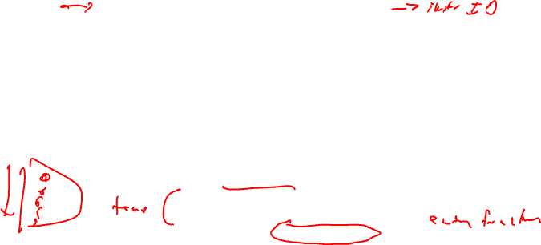
Compute Rdef GEN/KILL Sets for each BB
GEN = set of definitions created by an operation
KILL = set of definitions destroyed by an operation
- Assume each operation only has 1 destination for simplicity
so just keep track of “ops”..
for each basic block in the procedure, X, do
GEN(X) = 0
KILL(X) = 0
for each operation in sequential order in X, op, do
for each destination operand of op, dest, do
G = op
K = {all ops which define dest – op}
GEN(X) = G + (GEN(X) – K)
KILL(X) = K + (KILL(X) – G)
endfor
endfor
endwhile

Slide 15
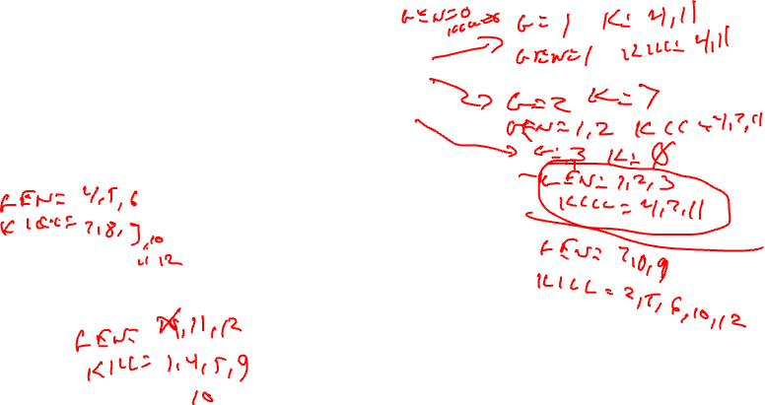
Example GEN/KILL Rdef Calculation
G = op
K = {all ops which define dest – op}
GEN(X) = G + (GEN(X) – K)
KILL(X) = K + (KILL(X) – G)
BB1
1. r1 = MEM[r2+0]
2. r2 = MEM[r1 + 1]
3. r8 = r1 * r2
BB2
4. r1 = r1 + 5
5. r3 = r5 – r1
6. r7 = r3 * 2
BB3
7. r2 = 0
8. r7 = r1 + r2
9. r3 = 4
BB4
10. r3 = r3 + r7
11. r1 = r2 – r8
12. r3 = r1 * 2

Slide 16
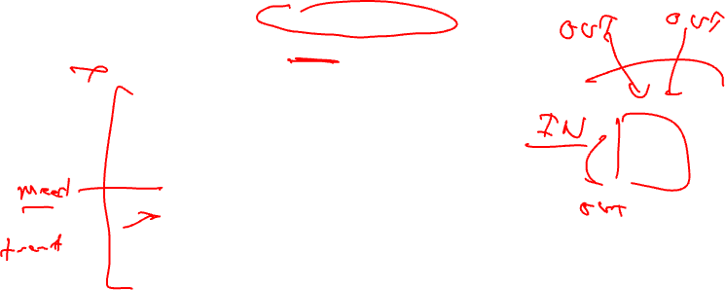
Compute Rdef IN/OUT Sets for all BBs
IN = set of definitions reaching the entry of BB
OUT = set of definitions leaving BB
initialize IN(X) = 0 for all basic blocks X
initialize OUT(X) = GEN(X) for all basic blocks X
change = 1
while (change) do
change = 0
for each basic block in procedure, X, do
old_OUT = OUT(X)
IN(X) = Union(OUT(Y)) for all predecessors Y of X
OUT(X) = GEN(X) + (IN(X) – KILL(X))
if (old_OUT != OUT(X)) then
change = 1
endif
endfor
endwhile

Slide 17
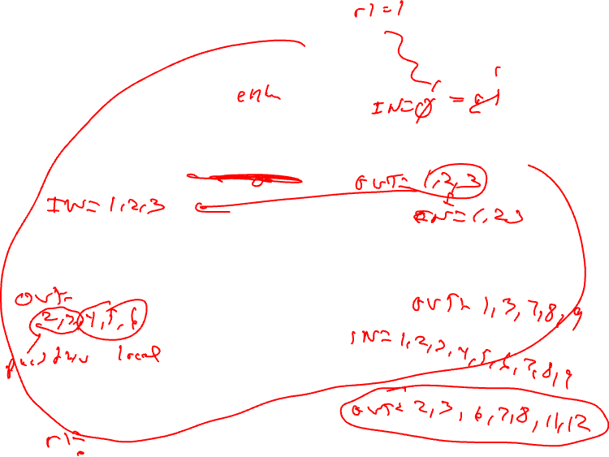
Example In/Out Rdef Calculation
IN = Union(OUT(preds))
OUT = GEN + (IN – KILL)
BB1
1. r1 = MEM[r2+0]
2. r2 = MEM[r1 + 1]
3. r8 = r1 * r2
GEN = 1,2,3
KILL = 4,7,11
BB2
4. r1 = r1 + 5
5. r3 = r5 – r1
6. r7 = r3 * 2
BB3
7. r2 = 0
8. r7 = r1 + r2
9. r3 = 4
GEN = 4,5,6
KILL = 1,8,9,10,11,12
GEN = 7,8,9
KILL = 2,5,6,10,12
BB4
10. r3 = r3 + r7
11. r1 = r2 – r8
12. r3 = r1 * 2
GEN = 11,12
KILL = 1,4,5,9,10

Slide 18
Rdefs Homework Problem
Compute reaching defs
Calculate GEN/KILL for each BB
Calculate IN/OUT for each BB
1. r1 = 3
2. r2 = r3
3. r3 = r4
4. r1 = r1 + 1
5. r7 = r1 * r2
6. r4 = r4 + 1
7. r4 = r3 + r2
8. r8 = 8
9. r9 = r7 + r8

Slide 19
Rdefs Homework Problem –Answer
IN = - → - → -
Compute reaching defs
Calculate GEN/KILL for each BB
Calculate IN/OUT for each BB
For solution IN/OUT sets specified as
A → B → C, A = initial state of sets,
B = after first iteration of analysis
C = after second iteration of analysis
- = empty set
1. r1 = 3
2. r2 = r3
3. r3 = r4
GEN = 1, 2, 3
KILL = 4
OUT = 1,2,3 → 1,2,3 → 1,2,3
4. r1 = r1 + 1
5. r7 = r1 * r2
IN = - → 1,2,3,8 → 1,2,3,4,5,6,7,8
GEN = 4,5
KILL = 1
OUT = 4,5 → 2,3,4,5,8 → 2,3,4,5,6,7,8
IN = - → 2,3,4,5,8 → 2,3,4,5,6,7,8
IN = - → 2,3,4,5,8 → 2,3,4,5,6,7,8
GEN = 6
KILL = 7
6. r4 = r4 + 1
7. r4 = r3 + r2
GEN = 7
KILL = 6
OUT = 6 → 2,3,4,5,6,8 → 2,3,4,5,6,8
OUT = 7 → 2,3,4,5,7,8 → 2,3,4,5,7,8
IN = - → 2,3,4,5,6,7,8 → 2,3,4,5,6,7,8
8. r8 = 8
GEN = 8
KILL = -
OUT = 8 → 2,3,4,5,6,7,8 → 2,3,4,5,6,7,8
IN = - → 2,3,4,5,6,7,8 → 2,3,4,5,6,7,8
9. r9 = r7 + r8
GEN = 9
KILL = -
OUT = 9 → 2,3,4,5,6,7,8,9 → 2,3,4,5,6,7,8,9

Slide 20
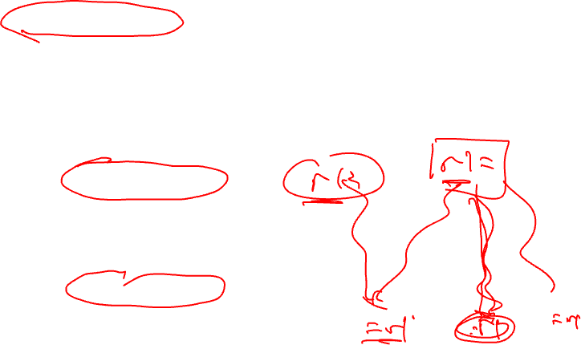
DU/UD Chains
Convenient way to access/use reaching defs info
Def-Use chains
Given a def, what are all the possible consumers of the operand produced
Maybe consumer
Use-Def chains
Given a use, what are all the possible producers of the operand consumed
Maybe producer

Slide 21
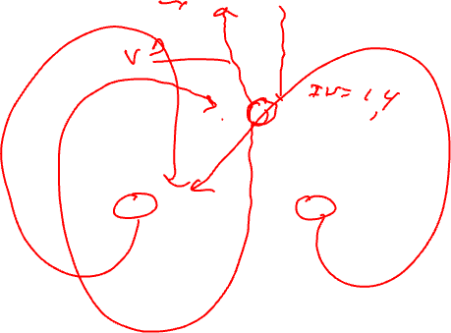
Example – DU/UD Chains
1. r1 = 3
2. r2 = r3
3. r3 = r4
4. r1 = r1 + 1
5. r7 = r1 * r2
6. r4 = r4 + 1
7. r4 = r3
8. r8 = 8
9. r9 = r7 + r8

Slide 22
Generalizing Dataflow Analysis
Transfer function
How information is changed by “something” (BB)
OUT = GEN + (IN – KILL) /* forward analysis */
IN = GEN + (OUT – KILL) /* backward analysis */
Meet function
How information from multiple paths is combined
IN = Union(OUT(predecessors)) /* forward analysis */
OUT = Union(IN(successors)) /* backward analysis */
Generalized dataflow algorithm
while (change)
change = false
for each BB
apply meet function
apply transfer functions
if any changes → change = true

Slide 23
What About All Path Problems?
Up to this point
Any path problems (maybe relations)
Definition reaches along some path
Some sequence of branches in which def reaches
Lots of defs of the same variable may reach a point
Use of Union operator in meet function
All-path: Definition guaranteed to reach
Regardless of sequence of branches taken, def reaches
Can always count on this
Only 1 def can be guaranteed to reach
Availability (as opposed to reaching)
Available definitions
Available expressions (could also have reaching expressions, but not that useful)

Slide 24
Reaching vs Available Definitions
1:r1 = r2 + r3
2:r6 = r4 – r5
1,2 reach
1,2 available
3:r4 = 4
4:r6 = 8
1,2 reach
1,2 available
1,3,4 reach
1,3,4 available
5:r6 = r2 + r3
6:r7 = r4 – r5
1,2,3,4 reach
1 available

Slide 25
To Be Continued …

