Slide 1

EECS 583 – Class 2 Control Flow Analysis
University of Michigan
August 27, 2025
https://web.eecs.umich.edu/~mahlke/courses/583f25

Slide 2

Announcements & Reading Material
eecs583a,eecs583b.eecs.umich.edu servers are ready
Everyone has home directory and login, need VPN to login
HW 0 – Due Next Wednesday (9/3), but nothing to turn in
Please get this done ASAP, talk to Naveen/Rishika if you have problems
Needed for HW 1 which goes out next Wednes
Go to http://llvm.org, go through writing a pass tutorial
Detailed LLVM installation instructions on piazza, see GSI post
On eecs583a/b, you link to a central install, just build your part
Private server, need to download/build entire LLVM
Reading
Today’s class
Ch 9.4, 10.4 (6.6, 9.6) from Compilers: Principles, Techniques Tools Ed 1 (Ed 2)
Next class
“Trace Selection for Compiling Large C Applications to Microcode”, Chang and Hwu, MICRO-21, 1988.
“The Superblock: An Effective Technique for VLIW and Superscalar Compilation”, Hwu et al., Journal of Supercomputing, 1993

Slide 3
From Last Time: Identifying BBs - Answer
L1: r7 = load(r8)
L2: r1 = r2 + r3
L3: beq r1, 0, L10
L4: r4 = r5 * r6
L5: r1 = r1 + 1
L6: beq r1 100 L3
L7: beq r2 100 L10
L8: r5 = r9 + 1
L9: jump L2
L10: r9 = load (r3)
L11: store(r9, r1)
L1: r7 = load(r8)
L2: r1 = r2 + r3
L3: beq r1, 0, L10
L4: r4 = r5 * r6
L5: r1 = r1 + 1
L6: beq r1 100 L3
L7: beq r2 100 L10
L8: r5 = r9 + 1
L9: jump L2
L10: r9 = load (r3)
L11: store(r9, r1)

Slide 4
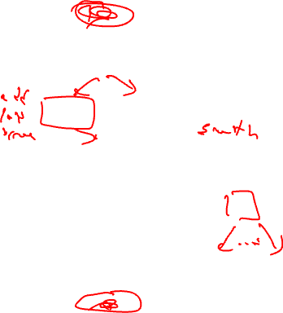
From Last Time: Control Flow Graph (CFG)
Defn Control Flow Graph – Directed graph, G = (V,E) where each vertex V is a basic block and there is an edge E, v1 (BB1) → v2 (BB2) if BB2 can immediately follow BB1 in some execution sequence
A BB has an edge to all blocks it can branch to
Standard representation used by many compilers
Often have 2 pseudo vertices
entry node
exit node
Entry
BB1
BB2
BB3
BB4
BB5
BB6
BB7
Exit

Slide 5

Property of CFGs: Dominator (DOM)
Defn: Dominator – Given a CFG(V, E, Entry, Exit), a node x dominates a node y, if every path from the Entry block to y contains x
3 properties of dominators
Each BB dominates itself
If x dominates y, and y dominates z, then x dominates z
If x dominates z and y dominates z, then either x dominates y or y dominates x
Intuition
Given some BB, which blocks are guaranteed to have executed prior to executing the BB

Slide 6
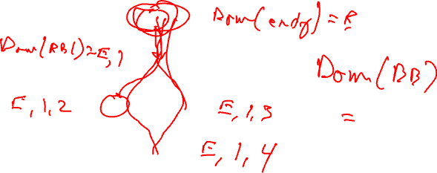
Dominator Example 1
Compute Dom(BBi) = set of blocks that dominate BBi
Entry
BB1
BB2
BB3
BB4
Exit

Slide 7
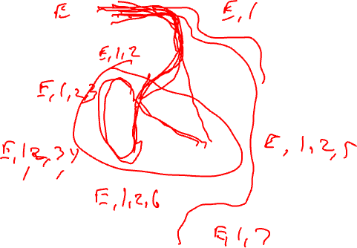
Dominator Example 2
Entry
BB1
BB2
BB3
BB4
BB5
BB6
BB7
Exit

Slide 8
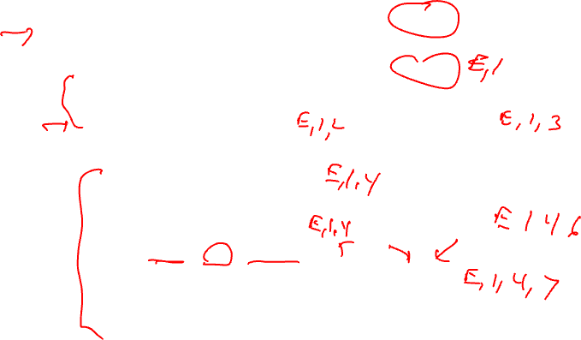
Dominator Analysis
Compute dom(BBi) = set of BBs that dominate BBi
Initialization
Dom(entry) = entry
Dom(everything else) = all nodes
Iterative computation
while change, do
change = false
for each BB (except the entry BB)
tmp(BB) = BB + {intersect of Dom of all predecessor BB’s}
if (tmp(BB) != dom(BB))
dom(BB) = tmp(BB)
change = true
Entry
BB1
BB2
BB3
BB4
BB5
BB6
BB7
Exit

Slide 9
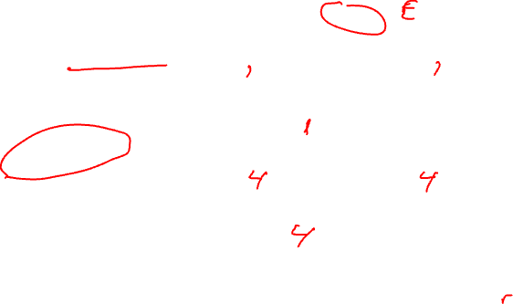
Immediate Dominator
Defn: Immediate dominator (idom) – Each node n has a unique immediate dominator m that is the last dominator of n on any path from the initial node to n
Closest node that dominates
Entry
BB1
BB2
BB3
BB4
BB5
BB6
BB7
Exit

Slide 10

Dominator Tree
First BB is the root node, each node
dominates all of its descendants
BB DOM
1 1
2 1,2
3 1,3
4 1,4
BB DOM
5 1,4,5
6 1,4,6
7 1,4,7
BB1
BB2
BB3
BB4
BB1
BB5
BB6
BB2
BB3
BB4
BB5
BB6
BB7
BB7
Dom tree

Slide 11
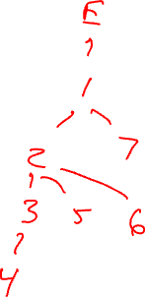
Dominator Tree Example
Draw the dominator tree
Entry
BB1
BB DOM
1 E,1
2 E,1,2
3 E,1,2,3
4 E,1,2,3,4
5 E,1,2,5
6 E,1,2,6
7 E,1,7
BB2
BB3
BB4
BB5
BB6
BB7
Exit

Slide 12
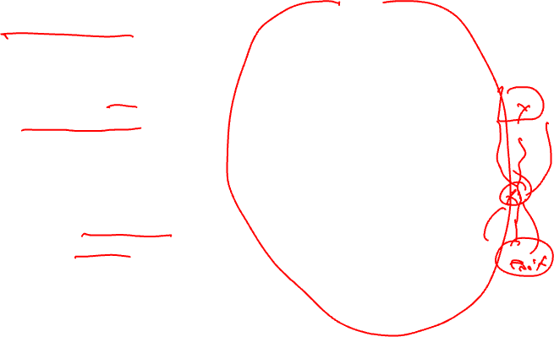
Post Dominator (PDOM)
Reverse of dominator
Defn: Post Dominator – Given a CFG(V, E, Entry, Exit), a node x post dominates a node y, if every path from y to the Exit contains x
Intuition
Given some BB, which blocks are guaranteed to have executed after executing the BB
pdom(BBi) = set of BBs that post dominate BBi
Initialization
Pdom(exit) = exit
Pdom(everything else) = all nodes
Iterative computation
while change, do
change = false
for each BB (except the exit BB)
tmp(BB) = BB + {intersect of pdom of all successor BB’s}
if (tmp(BB) != pdom(BB))
pdom(BB) = tmp(BB)
change = true

Slide 13
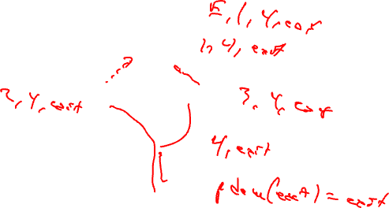
Post Dominator Example 1
Entry
BB1
BB2
BB3
BB4
Exit

Slide 14
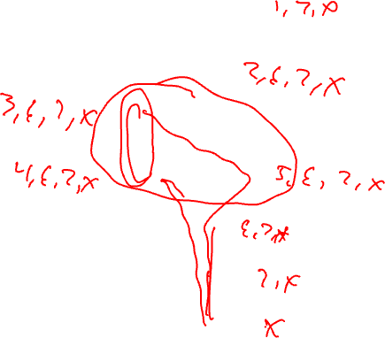
Post Dominator Example 2
Entry
BB1
BB2
BB3
BB4
BB5
BB6
BB7
Exit

Slide 15
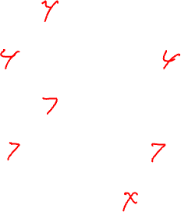
Immediate Post Dominator
Defn: Immediate post dominator (ipdom) – Each node n has a unique immediate post dominator m that is the first post dominator of n on any path from n to the Exit
Closest node that post dominates
First breadth-first successor that post dominates a node
Entry
BB1
BB2
BB3
BB4
BB5
BB6
BB7
Exit

Slide 16
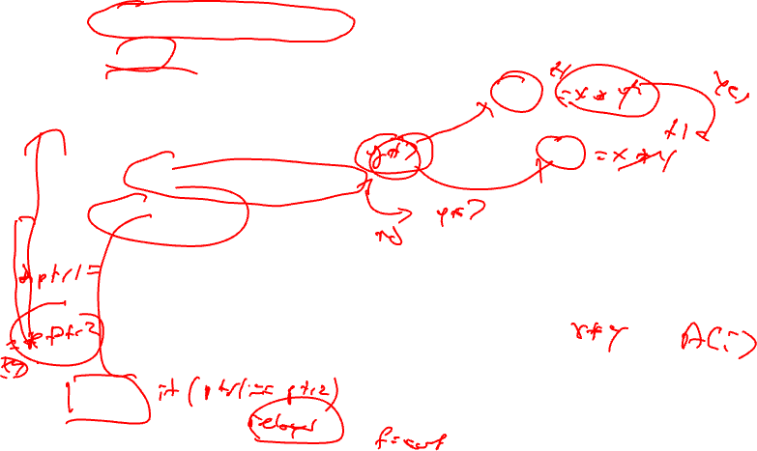
Why Do We Care About Dominators?
Loop detection – next subject
Dominator
Guaranteed to execute before
Redundant computation – an op is redundant if it is computed in a dominating BB
Most global optimizations use dominance info
Post dominator
Guaranteed to execute after
Make a guess (ie 2 pointers do not point to the same locn)
Check they really do not point to one another in the post dominating BB
Entry
BB1
BB2
BB3
BB4
BB5
BB6
BB7
Exit

Slide 17
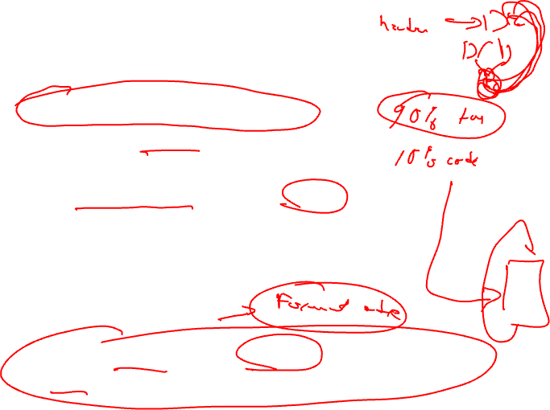
Natural Loops
Cycle suitable for optimization
Discuss optimizations later
2 properties
Single entry point called the header
Header dominates all blocks in the loop
Must be one way to iterate the loop (ie at least 1 path back to the header from within the loop) called a backedge
Backedge detection
Edge, x→ y where the target (y) dominates the source (x)

Slide 18
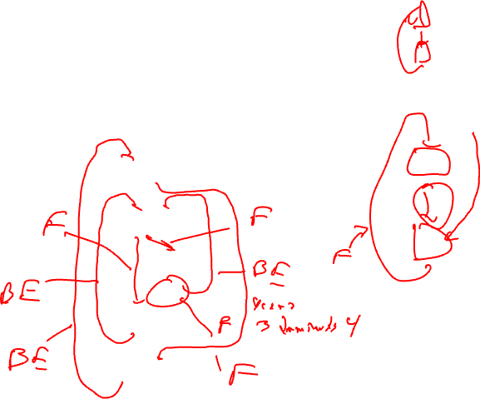
Backedge Example
Entry
BB1
BB2
BB3
BB4
BB5
BB6
Exit

Slide 19
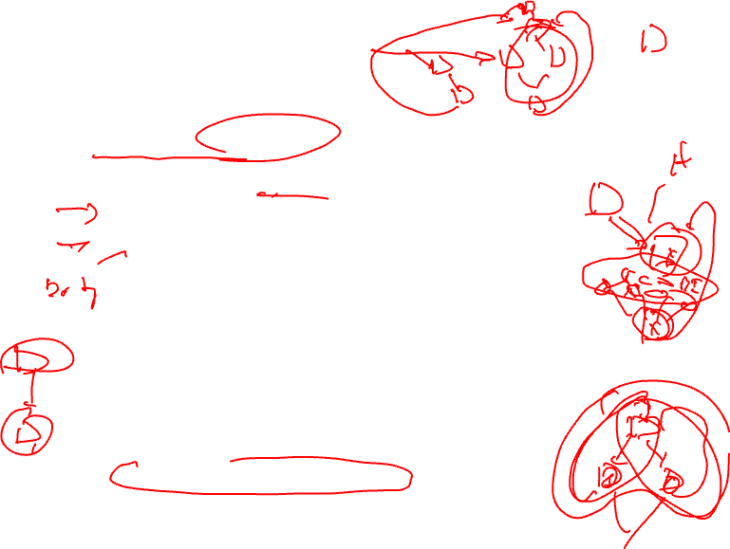
Loop Detection
Identify all backedges using Dom info
Each backedge (x → y) defines a loop
Loop header is the backedge target (y)
Loop BB – basic blocks that comprise the loop
All predecessor blocks of x for which control can reach x without going through y are in the loop
Merge loops with the same header
I.e., a loop with 2 continues
LoopBackedge = LoopBackedge1 + LoopBackedge2
LoopBB = LoopBB1 + LoopBB2
Important property
Header dominates all LoopBB

Slide 20
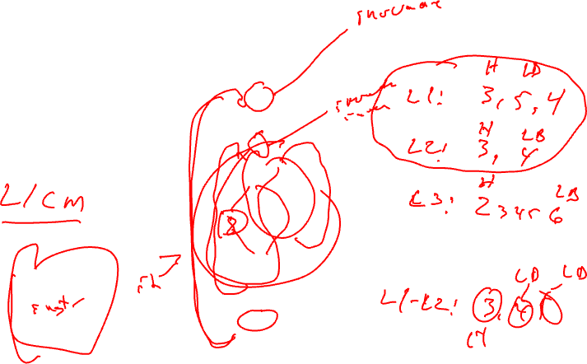
Loop Detection Example
Entry
BB1
BB2
BB3
BB4
BB5
BB6
Exit

Slide 21
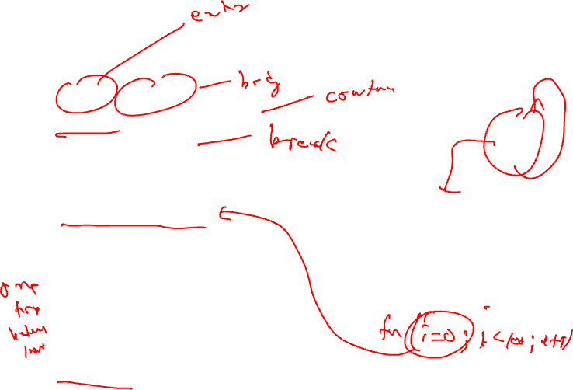
Important Parts of a Loop
Header, LoopBB
Backedges, BackedgeBB
Exitedges, ExitBB
For each LoopBB, examine each outgoing edge
If the edge is to a BB not in LoopBB, then its an exit
Preheader (Preloop)
New block before the header (falls through to header)
Whenever you invoke the loop, preheader executed
Whenever you iterate the loop, preheader NOT executed
All edges entering header
Backedges – no change
All others, retarget to preheader
Postheader (Postloop) - analogous

Slide 22
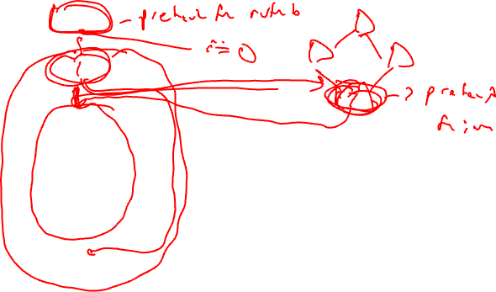
Find the Preheaders for each Loop
Entry
BB1
BB2
BB3
??
BB4
BB5
BB6
Exit

Slide 23
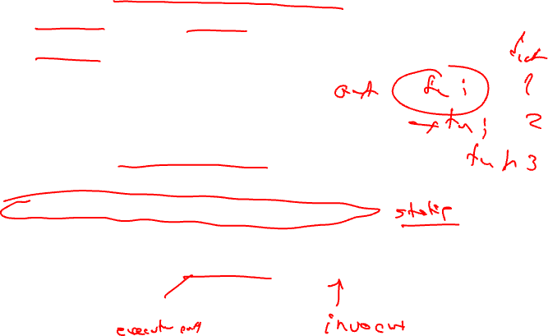
Characteristics of a Loop
Nesting (generally within a function scope)
Inner loop – Loop with no loops contained within it
Outer loop – Loop contained within no other loops
Nesting depth
depth(outer loop) = 1
depth = depth(parent or containing loop) + 1
Trip count (average trip count)
How many times (on average) does the loop iterate
for (I=0; I<100; I++) → trip count = 100
With profile info:
Ave trip count = weight(header) / weight(preheader)

Slide 24
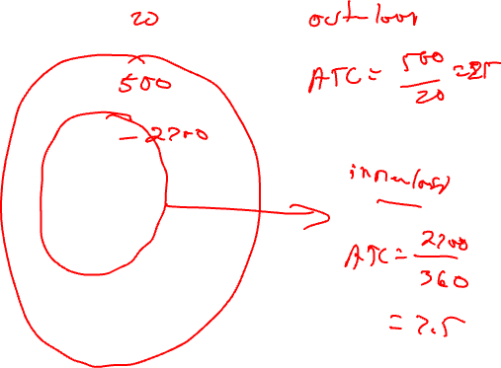
Trip Count Calculation Example
Entry
BB1
20
BB2
Calculate the trip
counts for all the loops
in the graph
360
BB3
2100
1000
480
600
BB4
140
1100
BB5
360
1340
BB6
20
Exit

Slide 25
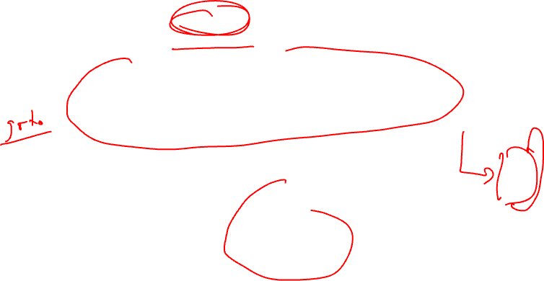
Reducible Flow Graphs
A flow graph is reducible if and only if we can partition the edges into 2 disjoint groups often called forward and back edges with the following properties
The forward edges form an acyclic graph in which every node can be reached from the Entry
The back edges consist only of edges whose destinations dominate their sources
More simply – Take a CFG, remove all the backedges (x→ y where y dominates x), you should have a connected, acyclic graph
bb1
Non-reducible!
bb2
bb3

